Slide 1
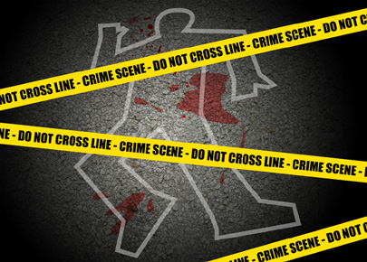
CRIME SCENE INVESTIGATION
- Dr. Kalpesh Zanzrukiya

Slide 2
CRIME SCENE
The Place or places where a particular crime is committed or where from any physical evidence related to crime is detected.
It Can be
Indoor place – area covered by roof e.g. house, building , godown, railway compartment, bus, aeroplane etc.
Outdoor place – area which is open to sky e.g. playground, farm, garden, road, forest, terrace etc.

Slide 3
Protect the crime scene as earliest as possible.
Specially entry & exit points
Visit CS as soon as possible
Autopsy doctor can demand to the I.O. for visit the CS before or after autopsy

Slide 4
OBJECTIVES
To establish that a crime has actually committed.
To search all relevant(positive & negative) findings/evidence, analyze & preserve for further investigations
To establish correlations between the suspects, victim and the place of crime.
To establish the identity of unknown victims & offenders.
To exonerate the innocent.
To verify the statements given by the victim & the offenders/suspects.
To reveal the ‘modus operandi’ of the offender in commission of crime.
Search answer for 6W(what, who, when, where, (w)how, why)

Slide 5
TEAM
Police :
Specialized personnel :
1. Fingerprint Expert
2. Forensic Photo-video grapher
3. Forensic medicine expert
4. Forensic science expert
5. Firearm/Explosive Expert

Slide 6
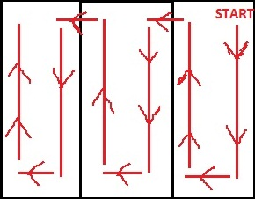
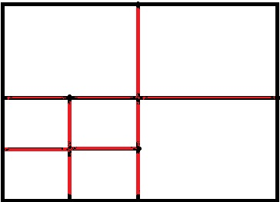
METHODS
For rectangular area
Strip method : Zone method :

Slide 7
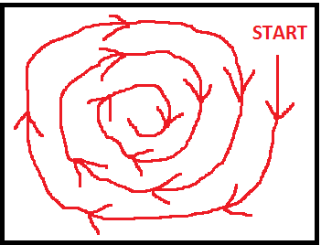
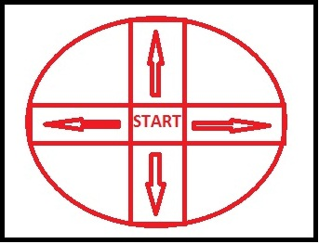
For circular area
Spiral method : Wheel method :

Slide 8
CRIME SCENE KIT
Consists of..
Fingerprint/Footprint kit
Photography/ videography kit
Blood/biological stain examination kit
Sketching/documentation kit
Packaging kit

Slide 9
GENERAL PERTICULARS
Date & time of F.I.R.
Date & time of CSI
Nature of crime
Facts of the case
Name of members of investigating team members and witnesses.
Crime scene location with brief description of area
Complete description of interior & exterior of the crime scene.
Condition of weather and lighting condition.

Slide 10
EVIDENCES TO SEARCH FOR
Condition of the place – lightings, ventilation, doors & windows- open/closed, keys, curtains, grills, size & measurements, electricity & telephone connectivity wires, instruments etc.
Any unusual odour – perfume, food, drink, blood, explosive /inflammable gases, smoke of cigarette, alcohol, drugs, poison.
The corps – position, condition, coverings, clothing & ornaments, stains, injuries, blood stains, identification marks, contents of cloth pockets, trace evidences.

Slide 11
EVIDENCES TO SEARCH FOR
Articles around – furniture, bed sheets, decorative articles, house hold appliances, hooks and hanging stuffs on ceiling, computers, cell phone, sim card, memory discs, cd-dvds, bags, briefcases, pen, pencils, position & condition of articles.
Any documents – id cards, work documents, suicide note, audio-video tapes, cc tv camera footages, mobile phone details etc.
Mortal objects – weapon, firearm, ligature material, poison, food, empty containers, bottles, utensils, dustbin thrash, inflammable items, drugs , tablets, syringes, gas cylinders, stove etc.

Slide 12
EVIDENCES TO SEARCH FOR
Trace evidences –
Fingerprints, footprints, lip prints, footwear prints, vehicle wheel marks
Stains – blood, semen, saliva, other fluid, dust, gunpowder, oil, grease, mud
Hairs, nails, teeth
Broken Buttons, clips, decorative objects of clothings, torn pieces of cloths, fibers.
Broken pieces of ornaments, hairclips, glass etc.

Slide 13
COLLECTION OF EVIDENCES
Take permission in written from I.O. for moving/collect anything in advance
Each & every evidences should be collected separately in clean container, labeled & sealed.
Avoid contamination by using gloves, masks, proper instruments, expert techniques.
Identity, security & confidentiality of all evidences should be maintained along with chain of custody.

Slide 14
DOCUMENTATION
Drawings & sketches:
Location of scene with surrounding structures
Interior of place with measurements in detail
Position of corps at place & other important objects in relation to it
Photography & videography :
Start from outside location & surroundings
All possible angles.
Series of photographs representing each & every objects & evidences – first as & where the objects are at scene and than with measuring scale by side for reference.
Prepare ‘Crime scene visit report’ in duplicate.

Slide 15
THANK YOU

