Slide 1
NEUROENDOSCOPY
AVINASH K S

Slide 2
HISTORY
First endoscopic neurosurgery was performed by L’Espinasse (a urologist) ,introduced a cystoscope into the ventricle to fulgurate choroid plexus in 1910
Walter Dandy in 1918 reported a technique to treat communicating hydrocephalus by extirpating the choroid plexus of both lateral ventricle through bilateral circular parietal bone flap
Dandy coined the term “ventriculoscopy”

Slide 3
Fay and Grant were the first to perform endoscopic intraventricular photography in 1923
W Janson Mixter in 1923 performed the first ETV in a child with congenital hydrocephalus . The floor of the third ventricle was perforated using a urethroscope and probe
Mixter proposed ETV as a treatment of obstructive
hydrocephalus
Popularity waned because of high mortality, large
cumbersome instruments, preference for choroid fulgration

Slide 4
Putnam and Scarf developed a coagulation
endoscope in 1934
Scarf published that out of 20 children, 3 died
immediately, 7 survived without decreased ICP
and 10 had permanent improvement in ICP
The successful implantation of valved shunt in 1949 by Nulsen and Spitz , revolutioned the management of hcp
Mid 1980’s minimally invasive neurosurgery became popular leading to a renewed interest in ETV and neuroendoscopy

Slide 5
It is important to realize that endoscopic neurosurgery is a technique , not a solution and is also not a “ subspecialty” but is rather an instrument analogous to the operating microscope ,the ultrasonic aspirator and neuronavigation devices

Slide 6
There are two different concepts regarding use of neuroendoscopy
1) endoscopic neurosurgery
2) endoscopy assisted microsurgery
Notes:
In the first sgis performed in cavity through the channels of endoscope inserted in ventricles or cavities
In 2nd endoscope is used to guide microsurgical instuments

Slide 7
Indications

Slide 8
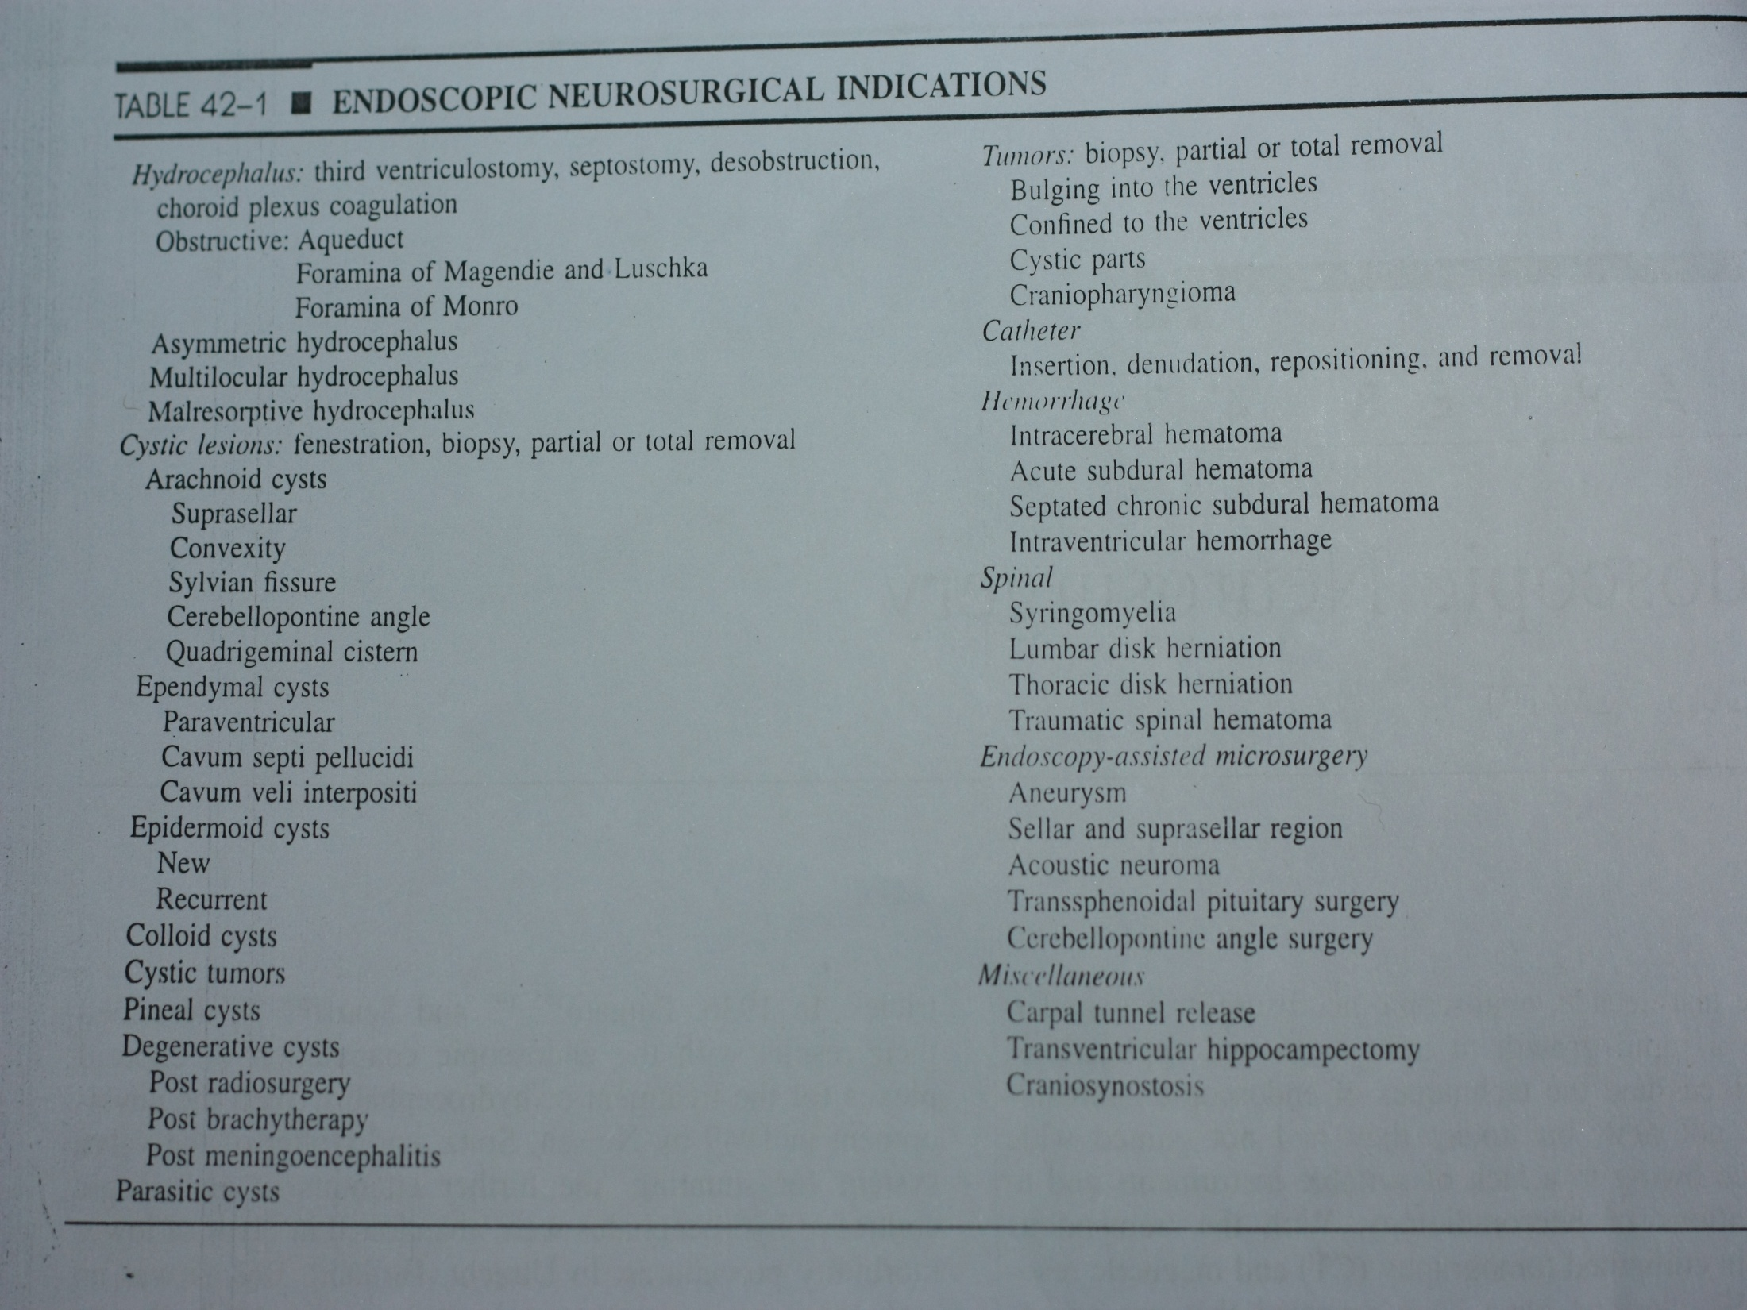

Slide 9
Instruments
ENDOSCOPE
Rigid endoscope
Flexible endoscope
Fundamental requirements of NES are
color balanced cold light of high intensity
Irrigation inflow system
Irrigation out flow system
large channel for passage of working instruments
small channel for laser fiber to allow simultaneous hemostasis

Slide 10
Rigid endoscopes
Flexible endoscopes
Brilliant optical quality , wide angle view and ease of orientation and guidance
In case of minor bleeding which might blur the view , surgeon can stay oriented
More operating channels and instruments available for RES
In RES one can be sure that shaft is straight behind the shaft
Image quality is for below that of RES
Which is difficult in flexible endoscopes because of small diameter of irrigation channels
Less for FES
Flexible shaft may move unseen and cause damage

Slide 11
Introduction of scope
Free hand technique
simplest and most versatile approach to the enlarged ventricles. It is done through a burr hole or in infants a suture or fontanella
Conventional stereotaxy
used when the ventricles are small or the target is cyst or other lesion in cerebral substance
Neuronavigation systems
provide the ideal combination of secure guidance, support , controlled mobility and real time monitoring of position of scope

Slide 12
Irrigation
irrigation is done with ringer lactate at 36’ c to 37’ c , because abundant irrigation with saline causes increase in body temperature .
It is utmost important to make sure that the outflow channel is open to prevent dangerous increase in icp

Slide 13
hemostasis
Difficulties of hemostasis have been a chief reason for slow acceptance neuroendoscopy
It can be done by
jet of warm irrigation at bleeding site
Nd: YAG laser
unipolar or bipolar diathermy
microclips
biological hemostatic glue

Slide 14
Endoscopic Third
Ventriculostomy
ETV is the treatment of choice for
aqueductal stenosis caused by anatomic,
inflammatory, and some neoplastic etiologies.
Preferred treatment for congenital AS, less
successful in patients with acquired AS

Slide 15
Indications for E TV
Aqueductal Stenosis
Most common indication, congenital, heriditory or idiopathic
Isolated Lateral Ventricle with hydrocephalus
ETV in combination with septal fenestration
Idiopathic Stenosis of foramen of Magendie and Luschka
Shunt failure in patients with a prior peritonial or cardiac shunt

Slide 16
Isolated 4th Ventricle
4th ventricular obstruction combined with functional occlusion of the aqueduct
Intraventricular Hematoma
Used in patients with supratentorial IVH as a method to aspirate clot
Intraventricular Tumors
Used to relieve HCP and perform tumor biopsy
McArthur et al., reported long term control of HCP and
tissue diagnosis in 55/66 (83%) of patients.

Slide 17
Pineal and Tectal Tumors with HCP
One step procedure to include ETV and biopsy
Risk: Case reports of germinoma recurring along
ventriculoscope tract
Posterior Fossa Tumors
Saint Rose et al., performed ETV prior to posterior fossa surgery. They found that this significantly reduced risk of postoperative hcp
Postinfectious and post hemorrhagic
less successful
Newborn infants with myelomenigocele and associated blockage at aqueduct level or the level of exits of 4th ventricles are not suitable

Slide 18
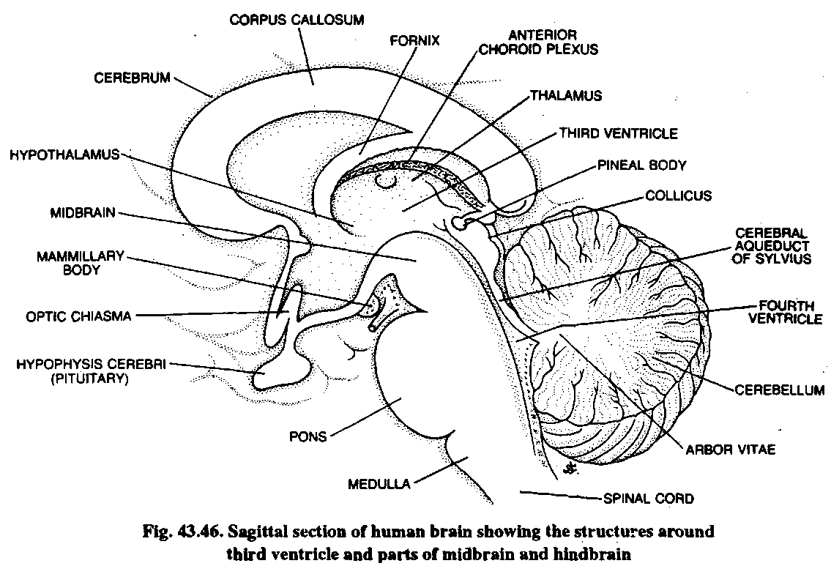
Anatomy of third ventricle

Slide 19
Anatomy of the 3rd ventricle
Lateral Walls: anterior 2/3 of the thalamus and hypothlamus. These are joined together by the massa intermedia.
Posterior anatomy: pineal body, habenular commisure, posterior commisure, and the cerebralaqueduct
Anterior anotomy in ap direction– Optic Recess
– Optic Chiasm
– Infundibulum
– Infundibular recess
– Tuber Cinereum
– Mamillary Bodies

Slide 20
Anatomical considerations during ETV
Lateral ventricles should be of adequate size for access
Side chosen should be that of the larger of the lateral ventricles or the side of non dominant hemisphere
The foramen of monro and 3rd ventricle should be of adequate size to permit safe passage for scope
The floor of ventricle should be attenuated and bulging downwards

Slide 21
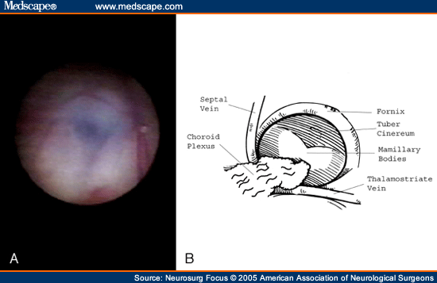

Slide 22
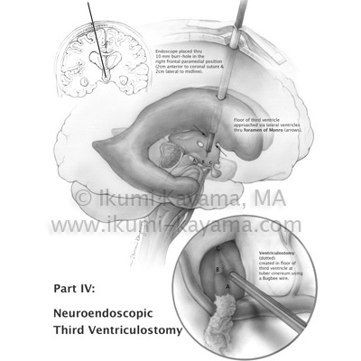

Slide 23
Technique: Targeting
Preoperative MRI evaluation of neurovascular structures below floor
Burr hole at coronal suture and mid-pupillary
line, approx 2-3 cm lateral to midline
Aim endoscope medially toward medial canthus of ipsilateral eye and toward the contralateral EAM in the ap plane

Slide 24
Create burr hole and pass a 14 French peel
away sheath into lateral ventricle
Introduce endoscope through the sheath and
navigate through the Foramen of Monro
Identify structures on floor of 3rd ventricle
The exact site for perforation lies between the infudibular recess anteriorly and mamillary body posteriorly

Slide 25
Multiple methods exist for perforating the floor including:
Blunt probe
Laser probe
Ultrasonic contact probe
Electro-coagulation and cutting probes
Dilation of the fenestration is achieved using a Fogarty balloon catheter
Must explore the pre-pontine space and open membrane of Liliequist for a successful ETV. When etv is completed basilar artery and clivus can be seen
.
Liliequist extends from the upper border of dorsum sellae to the anterior edge of mamillarybody

Slide 26
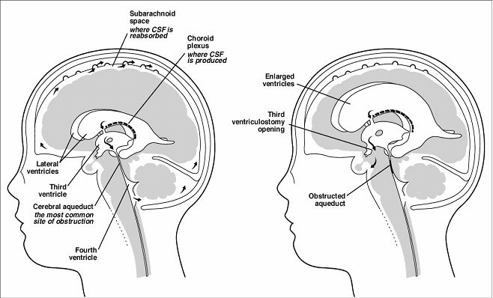

Slide 27
complications
Vascular Injury: basilar artery injury
Bradycardia
Incidence as high as 41%
Memory deficit
Respiratory Arrest
Diabetes Insipidus
Pneumocephalus
Subdural hygromas, hematomas
Death: subarachnoid hemorrhage,
late failure of ETV (from post-op to 7 years later

Slide 28
results
Normal intracranial pressure is the aim of treatment not the normal ventricular size
Reliability of ETV was stratified according to age.
– 0-1 month: 31 % success
– 1-6 months: 50% success
– 6-24 months: 71% success
– Greater than 24 months: 84%

Slide 29
Endoscopic pituitory tumor excision
History
The earliest transsphenoidal surgeries was done(1907–1909) by Schloffer, von Eiselsberg, and Kocher taking external rhinotomy incisions.
Endonasal and sublabial approaches were introduced in 1910 by Hirsch and Halstead respectively.

Slide 30
By 1914, , Cushing reported a less traumatic
transsphenoidal technique using a sublabial transseptalapproach.
the pure endoscopic transsphenoidal approach was introduced and popularized in the late 1990s by Jho and Carrau from the University of Pittsburgh Medical Center.

Slide 31
indications
Hormonally inactive tumors
Symptomatic compression of the optic nerves
Hypopituitarism
Pituitary apoplexy
Severe frontotemporal headaches
Hormonally active tumors
Acromegaly, hyperthyroidism, Cushing’ s Disease
Prolactinomas (Non-responders to
dopaminergic medications

Slide 32
This route is not used when there is
doubt over pathology
significant suprasellar component
an eccentric supra sellar component
when carotid arteries are at significant risk
of injury
active infection in sphenoid sinus

Slide 33
Phases of the Operation
Nasal phase-
Minimize mucosal bleeding
Lateral luxation of the middle turbinate
Identification of the sphenoid ostium
Sphenoid phase
Coagulation of the Sphenoethmoid recess
Enlargement of the anterior sphenoidotomy
Removal of the sphenoid septum
Sellar phase
Opening of the sella
Removal of the lesion
Sellar reconstruction

Slide 35
Advantages of Endoscopic
Pituitary Surgery
Improved visualization of surrounding optic bulbs, brainstem, and carotid prominences.
Improved ability to differentiate tumor from normal pituitary tissue
Completely transnasal approach avoids the risk of naso-oral fistulae, and lip numbness seen with the transseptal approach.
Less packing required post operatively
Reoperation can be done as many times
as needed

Slide 36
Disadvantages of Endoscopic
Pituitary Surgery
Need for proper endoscopic equipment
and specially designed surgical tools
One handed surgical skills required
Steep learning curve

Slide 37
complications
Visual loss
Orbital hematoma
Diplopia
Subcutaneous orbital emphysema
Csf leak

Slide 38
Thank you

