Slide 1
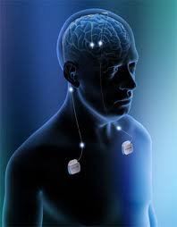
NEUROMODULATION
DR BHAGWATI SALGOTRA

Slide 2
DEFINITION
neuromodulation :electrical stimulation of a peripheral nerve, the spinal cord, or the brain for relief of pain; it may be done transcutaneously or with an implanted stimulator.
neuromodulation - the alteration of nerve activity through the delivery of electrical stimulation or chemical agents.

Slide 3
NEUROMODULATION FOR PAIN
Neuromodulation can be used for treating various chronic pain disorders
Chronic pain:low back pain,FBSS,chronic pain of malignancy
Chronic headache: migraine
Neuralgias: trigeminal neuralgia
phantom limb pain
anaesthesia dolorosa
peripheral neuropathy
Postherpatic neuralgia
brachial plexus avulsion pain
post cordotomy dyesthesia
Lower limb chronic ischemic pain

Slide 4
Epilepsy
parkinsonism
Pschychiatric disorders:
tourette syndrome
obsessive compulsive disorder
depression
Sacral neuromodulations can be used for
Bladder incontinence
Fecal incontinence
Erectile dysfunction

Slide 5
HISTORY
1809: WALKER et al : suggested that anterior and posterior spinal roots serve distinct motor and sensory function
1822: MAGENDIE : provided evidence that posterior spinal roots play role in transmission of pain.
1889:EDINGER:described spinothalamic tract
1922: SPILLER AND SCHULLER: described the pain conduction pathway.
1965: MALZACK and WALL: described the gate theory of pain. And proposed the possibility of pain management by neuromodulation.

Slide 6
1965:SWEET: performed the first neuromodulation procedure by doing peripheral nerve stimulation for pain relief.
1967: SHEALY and coworkers: performed the first trial of spinal dorsal column stimulation.
Same year MAZARS and associates showed that,ventral posterolateral, thalamic nuclei stimulation can relieve pain.
1970: opiate delivery from implantable pumps was introduced for chronic pain relief

Slide 7
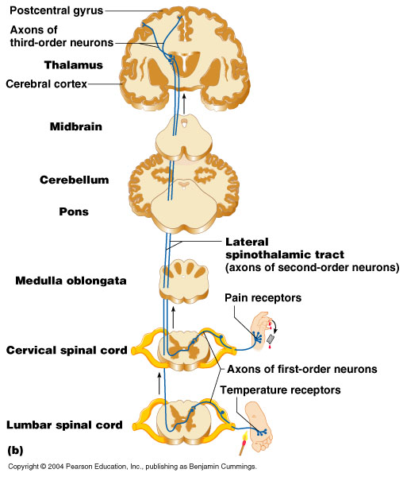
PATHWAY

Slide 8
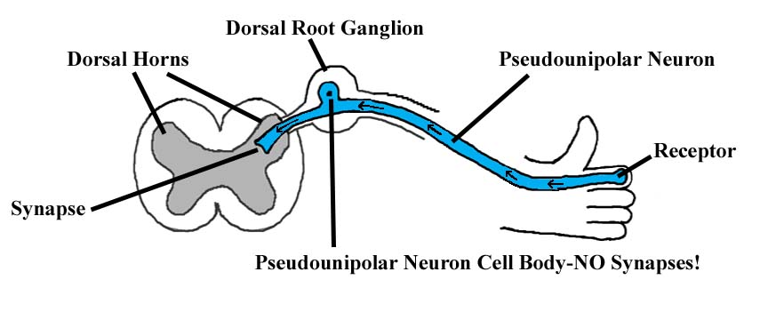
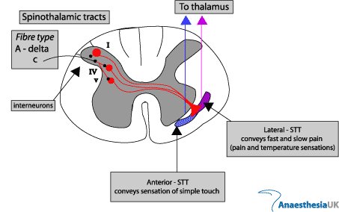

Slide 9
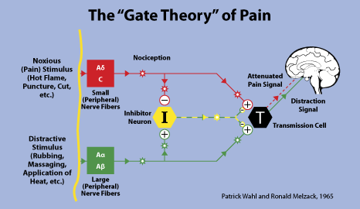

Slide 10
GATE THEORY
Ronald Melzack and Patrick Wall introduced their "gate control" theory of pain in the 1965 They proposed that thin (pain) and large diameter (touch, pressure, vibration) nerve fibers carry information from the site of injury to two destinations in the dorsal horn of the spinal cord: the "inhibitory" cells and the "transmission" cells.
Signals from both thin and large diameter fibers excite the transmission cells, and when the output of the transmission cells exceeds a critical level, pain begins.
inhibitory cells inhibit activation of the transmission cells. The transmission cells are the gate on pain, and inhibitory cells can shut the gate. When thin (pain) and large (touch, etc.) fibers, activated by a noxious event, excite a spinal cord transmission cell, they also act on its inhibitory cells.
The thin fibers impede the inhibitory cells (tending to leave the gate open) while the large diameter fibers excite the inhibitory cells (tending to close the gate).
the more large fiber activity relative to thin fiber activity coming from the inhibitory cell's , the less pain is felt.

Slide 11
In 1968 Ronald Melzack and Kenneth Casey described pain in terms of its three dimensions:
1. "Sensory-discriminative" (sense of the intensity, location, quality and duration of the pain),
2."Affective-motivational" (unpleasantness and urge to escape the unpleasantness), and
3."Cognitive-evaluative" (cognitions such as appraisal, cultural values, distraction and hypnotic suggestion).
pain intensity (the sensory discriminative dimension) and unpleasantness (the affective-motivational dimension) are not simply determined by the magnitude of the painful stimulus, but “higher” cognitive activities (the cognitive-evaluative dimension) can influence perceived intensity and unpleasantness. Cognitive activities "may affect both sensory and affective experience or they may modify primarily the affective-motivational dimension.
e.g excitement in games or war appears to block both dimensions of pain, while suggestion and placebos drugs may modulate the affective-motivational dimension and leave the sensory-discriminative dimension relatively undisturbed."

Slide 12
Neuromodulation methods
1. electrical stimulation
Peripheral nerve
Spinal cord
Thalamus
Basal ganglia
cortex
2.Neuraxial drug infusion
intrathecal
epidural
intraventricular

Slide 13
NEUROMODULATION
TENS:transcuteneous electric nerve stimulation
Spinal cord stimulation
Deep brain stimulation

Slide 14
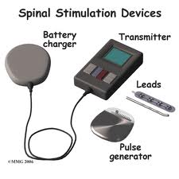
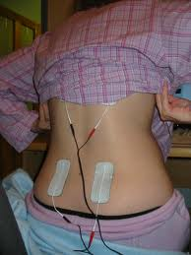
Neuromodulation
TENS:transcuteneous electric nerve stimulation

Slide 15
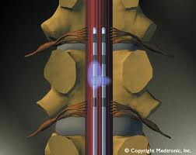
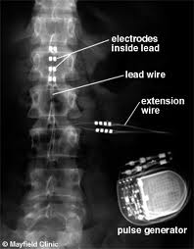
Spinal cord stimulation

Slide 16
SPINAL CHORD STIMULATION
Electrode’s longitudinal position is most important in achieving the desired result.
Dual electrode array created by inserting to electrodes in parallel is more effective than one electrode.
Electrodes can be placed percutaneously with tuohy’s needle.in some cases laminectomy is needed.
First temporary electrodes are placed then after a trial of 3 days if there is more than 50% pain relief is felt by the patient then he is subjected for permanent electrode placement with impulse generator.

Slide 17
complications
Spinal cord or nerve injury
CSF leakage
Infection
Epidural hematoma formation
Hardware failure
Electode migration

Slide 18
Neuromodulation –deep brain stimulation
Indications:
Chronic pain
movement disorders: parkinson’s disease
dystonia
tremor
Epilespy
Psychiatric disorders:Tourette syndrome
obsessive compulsive disorder
depression

Slide 19
Neuromodulation –deep brain stimulation for pain
Some e.g phantom limb pain
anaesthesia dolorosa
peripheral neuropathy
Postherpatic neuralgia
brachial plexus avulsion pain
post cordotomy dyesthesia
Target area: thalamic nuclei or
periventricular gray matter
periaqueductal gray matter.

Slide 20
Fucntional neuroimaging.
Local anaesthesia
Stereotactic Head framing
Position : dental chair position
14mm burr hole place just anterior to coronal suture 1.5 -2 cm lateral to midline
Sterotactic arc applied to frame
Physiological target localisation is done
Electrode implantation
Stimulation trial period : 3-7 days
unipolar ,bipolar,frequency,
pulse width in microseconds,
voltage intensity
Successful trial = reduction is atleast 33% of pain
Final placement of pulse generator

Slide 21
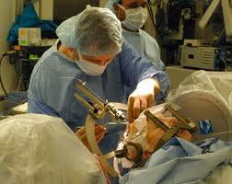
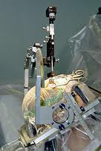
Insertion of electrode

Slide 22
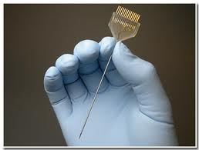
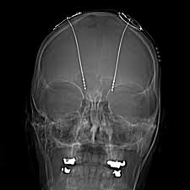
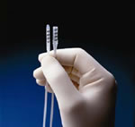
electrodes

Slide 23
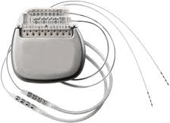
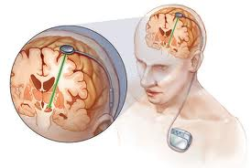

Slide 24
complications
Hemorrhage,death
Transient confusion
seizures
Infection
Hardware failure
Skin erosion
foreign body reaction
Headache
Local pain

Slide 25
Chemical modulation
.Neuraxial drug infusion
intrathecal
epidural
intraventricular

Slide 26
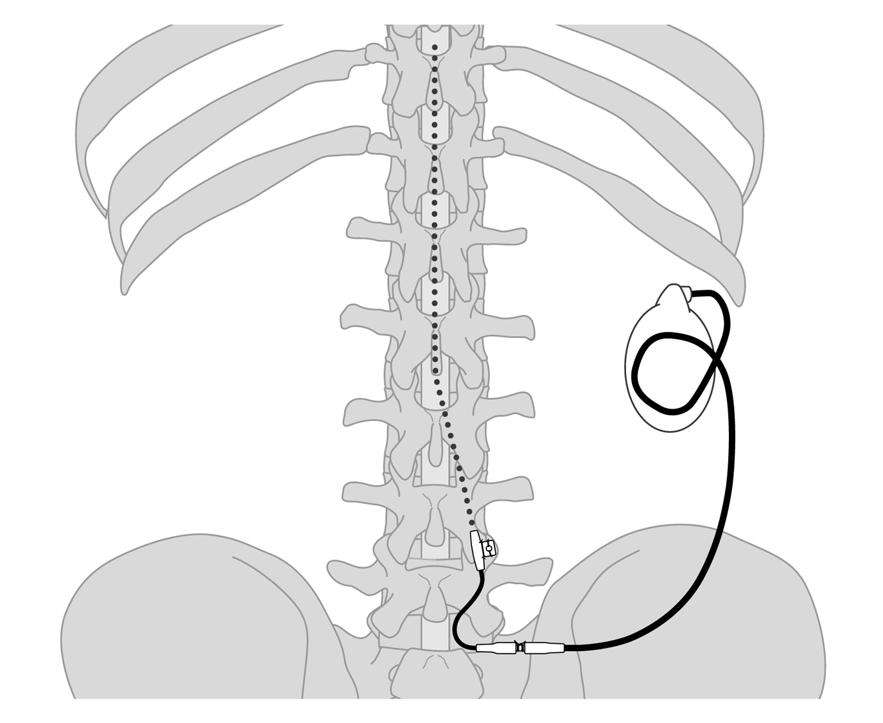
Intrathecal and epidural drug

Slide 27
Other uses of neuromodulation techniques
Dystonia: globus pallidus internus stimulation for primary dystonia
Epilepsy: vagal nerve stimulation
Parkinsonism :sub-thalamic nucleus stimulation and globus pallidus internus .
Pschychiatric disorders:
Tourette syndrome: thalamic and pallidal stimulation
Obsessive compulsive disorder:sub thalamic nuclei
Depression: subgenual cingulate gyrus stimulation

Slide 28
FUTURE RESEARCH
BRAINGATE NEURAL INTERFACE SYSTEM:
Currently the subject of a pilot clinical trial, the BrainGate Neural Interface System is designed to restore functionality for severely motor-impaired individuals. A sensor is implanted on the motor cortex of the brain, and the interpreted signals are transmitted directly to a computer, enabling the user to control various objects in their environment, such as lights and television, or possibly a BrainGate-compatible motorized wheelchair. It Is hoped that one day the BrainGate program will expand to allow individuals to once again use their limbs.

Slide 29
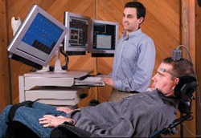

Slide 30
Traumatic Brain Injury
There is a great potential for using deep brain stimulation as a treatment for traumatic brain injury.
IN 2007,The operation was performed at the Cleveland Clinic by neurosurgeons. The patient was a 38-year-old severely brain-injured man who had been unable to communicate or eat by mouth for six years.
After a six-month, double-blinded on/off "crossover" trial, with periods of thalamic DBS alternating with periods where he did not receive the therapy, the patient now has oral feeding and verbal communication abilities.

Slide 31
Blindness
Neuromodulation devices are also under development that may restore vision to individuals who were blinded by diseases such as macular degeneration or retinitis pigmentosa..
Second Sight Medical Products (Sylmar, CA) is developing Argus II, a device that consists of a tiny camera and transmitter mounted in eyeglasses, an implanted receiver, and an electrode-studded array that is secured to the retina with a microtack.
A belt-mounted wireless microprocessor and battery pack power the entire device. The camera on the glasses captures an image and sends the information to the video processor, which converts the image to an electronic signal and sends it to the transmitter on the glasses. The implanted receiver wirelessly receives this data and sends the signals through a tiny cable to the electrode array, stimulating electrical pulses that induce responses in the retina that travel through the optic nerve to the brain.
The brain then perceives patterns of light and dark spots corresponding to the electrodes stimulated. Patients learn to interpret the visual patterns produced into meaningful images.

Slide 32
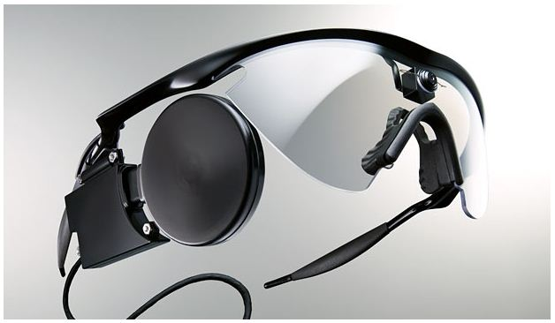
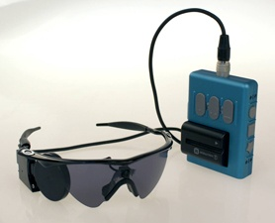

Slide 33
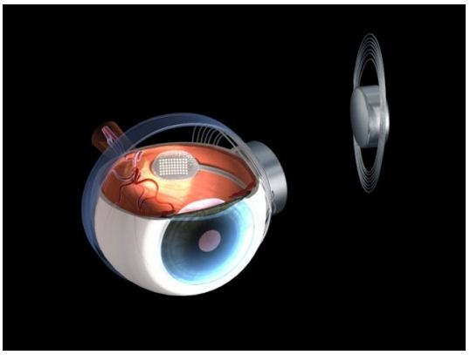
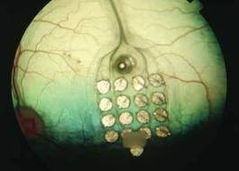

Slide 34
THANK YOU

