Slide 1
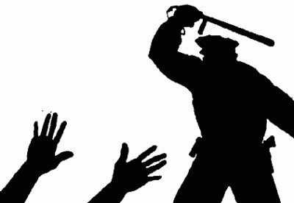
Custodial Death
Dr. Kalpesh Zanzrukiya

Slide 2
Introduction
In case of deaths in police action while conducting post-mortem examination of the deceased photographs of the deceased should be taken and the post mortem examination of the deceased should be video filmed.
The video film and photograph should be sent to the Commission.

Slide 3
The aim of video-filming and photography of post-mortem examination should be:
To record the detailed findings of the post mortem examination, especially marks of injury and violence which may suggest custodial torture.
To supplement the findings of post mortem examination (recorded in the post-mortem report) by video graphic evidence so as to rule out any undue influence or suppression of material information.
To facilitate an independent review of the post-mortem examination report at a later stage of required.

Slide 4
Precautions to be taken before conducting post mortem examination
Both hands of the deceased need to be wrapped in white paper bags before transportation. The dead body afterwards should be covered in special body bags having zip pouches for proper transportation.
Clothing on the body should not be removed by police or any other person. It should be collected, examined as well as preserved and sealed by doctor conducting autopsy and should be sent for further examination at the concerned forensic science laboratory. A detailed note regarding examination of the clothing should be incorporated in the post-mortem examination report by the doctor conducting autopsy.
In case of alleged firearms deaths, the dead body should be subjected radiological examination (X ray/ CT scan) prior to autopsy.

Slide 5
Video-filming and photography of post-mortem examination should be done in the following manner:
At the time of video-filming of the post-mortem examination the voice of the doctor conducting the post-mortem should be recorded. The doctor should narrate his prima facie observations while conducting the post-mortem examination.
A total of 20-25 coloured photographs covering the whole body should be taken. Some photographs of the body should be taken without removing the clothes. The photographs should include the following:
(a) Profile photo face (Front, Right lateral and Left
lateral views), Back of head.
(b) Front of body (up to torso-chest and abdomen)
and back.
(c) Upper extremity – Front and Back.

Slide 6
(d) Lower extremity – Front and Back.
(e) Focusing on each injury lesion – zoomed in after
properly numbering the injuries.
(f) Internal examination findings (2 photos of soles and
palms each, after making incision to show
absence/evidence of any old/deep seated injury).
→ In firearm injuries, while describing the distance from heel as well as midline must be taken in respect of each injury which will help later in reconstruction of events.

Slide 7
III. Photographs should be taken after incorporating post-mortem number, date of examination and a scale for dimensions in the frame of photographs itself.
IV. While taking photographs the camera should be held at right angle to the object being photographed.
V. Video-filming and photography of the post mortem examination should done by a person trained in forensic photography and videography. A good quality digital camera with 10X optical zoom and minimum 10 mega pixels should be used.

Slide 8
Thank you…..

