Slide 1
DROWNING
- Dr Sunil Doshi

Slide 2
CRITERIA | FRESH WATER DROWNING | SEA WATER DROWNING
Lung size & weight | Ballooned but light | Ballooned,very distended, heavier
Color | Pale pink | Purplish/bluish
Consistancy | Emphysematous | Soft, jelly like
Pleural effusion | Absent | Present
Shape on removal | Retained ,not collapsed | Collapse, flatten out on surface
On cut section | Frothy, bloody fluid, crapitus | Abundant frothy fluid, No crapitus
Pulmonary surfactant | more reduced | Less reduced
General injuries to lungs | Less | More

Slide 3
CRITERIA | FRESH WATER DROWNING | SEA WATER DROWNING
Na, Ca, Mg, Cl in left heart blood | No increase | Increased ++++
General circulation | Hemodilution | Hemoconcentration
Cause of death | Ventricular fibrilation, hypoxia to heart & brain | Pulmonary edema, electrolyte imbalance

Slide 4
FEATURES IN DIFFERENT TYPES OF DROWNING
FEATURE | ACCIDENTAL DROWNING | SUICIDAL DROWNING | HOMICIDAL DROWNING | POSTMORTEM DROWNING
Froth, Cadavaric spasm, Mud & algae in bronchioles, Water in lungs & stomach | Present | Present | Present | Absent
Hands & legs tied on back | No | No | Present | No/yes
Heavy weight tied to body | No | Rarely | Common | Common
Intoxicating drugs | May be | Rare | Common | Common

Slide 5
FEATURE | ACCIDENTAL DROWNING | SUICIDAL DROWNING | HOMICIDAL DROWNING | POSTMORTEM DROWNING
Gettler test | Positive | Positive | Positive | Negative
Diatom test | Positive | Positive | Positive | Negative
Injuries | Accidental/ fall type | No / hasitational type | Homicidal type | Homicidal type
Water depth | Usually more than body height | Usually more than body height | Any | Any
Circumstantial evidence over scene | Accidental – vehicular marks, fall etc | Suicide note, personal belongings & cloths | Signs of struggle – blood, weapon | Signs suggesting body was dragged / brought from somewhare else
Footware | In feet of person / in water sourse | Out of water source | In feet of person/ in water sourse | In feet of person / in water sourse

Slide 6
Duration of submersion
Body Temp.
  Body temp falls twice as rapidly in water than air.
Putrefaction – twice as slow in water than air
If body is exposed to air after drowning – putrefaction rate is twice as fast as in air
  2 hrs – wrinkling of skin starts
  12 hrs – bleaching of cuticle
  24 hrs – pronounced bleaching, corrugation, soddening
  48 hrs – cuticle begin to separate over palms & soles
  3 to 4 days - degloving of skin of hands & feet

Slide 7
Time of floatation
Mechanism – due to putrefaction gases
Time of floatation depends upon -
  Salinity of water – in salt water – earlier
  Body structure – infants & obese persons – earlier
  Position – obese person & females – face up, Thin persons & Males – spine up
Place of floatation – usually same as the place of drowning unless there is strong current of flow e.g. river
Time period in India – 12 to 18 hrs in summer, 18 to 36 hrs in winter.
Mg conc. In vitreous – 100 to 120 mg% in sea water drowning – rises in linear fashion – time of submersion can be calculated

Slide 8
DIATOMS
Microscopic, unicellular radially or axially symmetrical algae having a unique cell wall made of silica(frustule).
Found in all types of water
Shape – boat shaped, circular, crescentric, linear, oval, triangular, rectangular
Acid & heat resistance according to silica wall

Slide 9
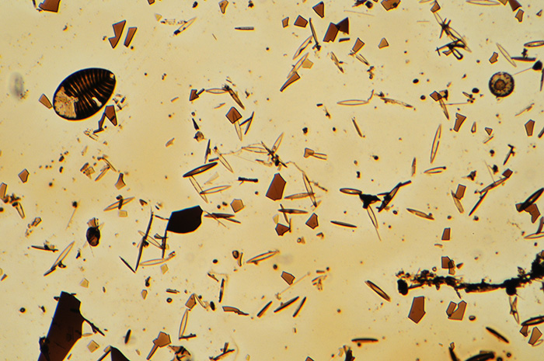
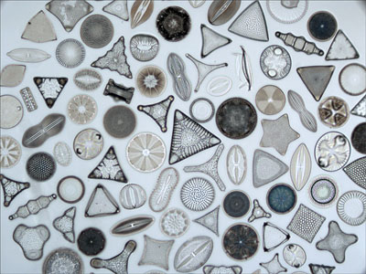

Slide 10
Diatom test for drowning
Principle:
Antemortem Drowning ->> respiratory efforts by person ->> water with diatoms enters lungs & stomach ->> diatoms <40u size pass to pulmonary blood via alveolar capillaries ->> left side of heart ->> systemic circulation ->> bone marrow, brain, liver, kidney, spleen, skeletal muscles ->> can be demonstrated by microscopic analysis

Slide 11
Postmortem Drowning ->> no respiratory efforts by person ->> very little water with diatoms enters lungs ->> no alveolar rupture ->> no diatoms to pulmonary blood ->> no diatoms in systemic circulation & body organs ->> diatoms can be found in lungs but not in body organs & bone marrow.

Slide 12
Samples to preserve
Any intact bone containing active bone marrow(femur & sternum most useful).
Part of internal organs - Lung, Liver, Brain, Spleen, kidney
Sample of water from where dead body found for comperision

Slide 13
Methods for demonstration
Direct digestion:
  Corrosives – HNO3,H2SO4
  Enzymetic digestion
  Overnight boiling
  Strong detergents
Indirect digestion – incineration of suspected tissue & than ashes dissolved in corrosives
Ultrasonic radiation
Direct microscopic examination- contrast microsope/ dark ground illumination

Slide 14
Medicolegal importance
To confirm cause of death i.e. drowning. It is important even if only a body part/limb is found.
To differentiate antemortem drowning/PM drowning
To know place of drowning – diatoms species from different water source are different
To know time of drowning – there is seasonal variation in diatoms in one water space

