Slide 1
Acute inflammatory conditions of the larynx
Dr. Ajay George

Slide 2
Search Mode
Medline search via Ovid
Search limited to English language only.
Key words:
laryngitis
epiglottitis
croup
laryngotracheobronchitis
pertussis
whooping cough
diphtheria
laryngocoel
laryngopyocoel

Slide 3
Levels of Evidence
Grade A – Systemic reviews, Meta analyses, RCT
Grade B – Non-randomised studies
Grade C – Observational studies
Grade D – Case Series, Expert opinion

Slide 4
Levels of Evidence
**** ~ Systematic reviews, meta analysis of randomized control studies
*** ~ Non randomized studies
** ~ Observational or non experimental studies
* ~ Expert opinion

Slide 5
General Symptoms of acute laryngitis
Change of voice
Difficulty in breathing
Throat pain
Odynophagia

Slide 6
Different Conditions
Acute laryngitis
Acute epiglottits
Acute laryngotracheobronhitis
Pertussis
Diphtheria
Infectious mononucleosis
Mycotoc laryngitis
Laryngopyocoel

Slide 7
ACUTE LARYNGITIS

Slide 8
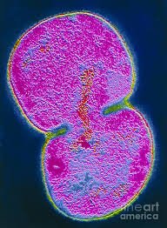
Moraxella catarrhalis
Commonest involved organism in descending acute laryngitis
(Grade A)

Slide 9
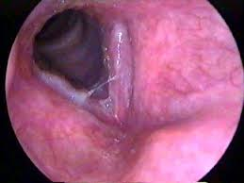

Slide 10
Acute laryngitis - Treatment
Voice rest
Avoidance of irritants
Steam inhalation
Antibiotic rarely indicated.
Speech therapy in persistent symptoms (Grade A)
Antivirals not indicated (Grade D)

Slide 11



Slide 12
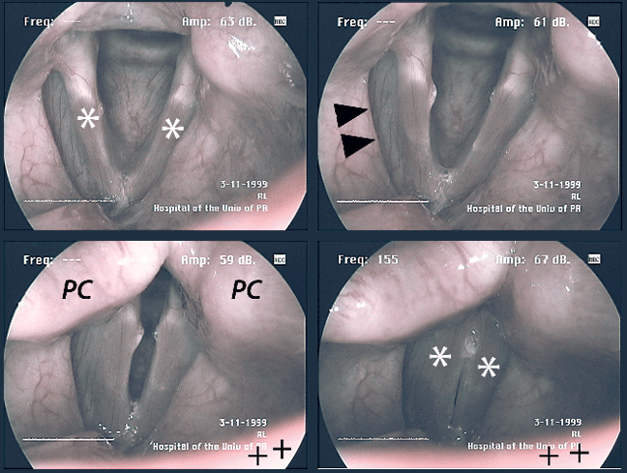

Slide 13
ACUTE EPIGLOTTITIS

Slide 14
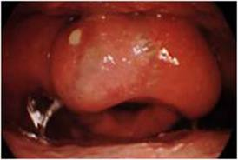

Slide 15
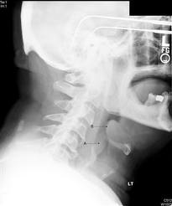

Slide 16
Acute epiglottitis - treatment
Airway management
Intravenous antibiotics – Ampicillin (Grade C)
100% humidified oxygen

Slide 17
ALTB – causative organisms
Children
  Paramyxovirus
  Parainfluenza vrus type I
  Parainfluenza virus type II
  Adult
    Herpes simplex
    CMV
    Influenza virus

Slide 18
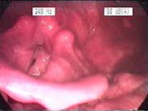

Slide 19
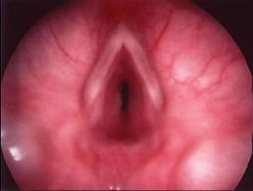
Subglottic edema in ALTB – Grade A

Slide 20
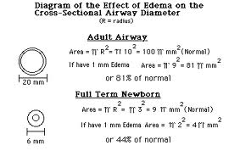

Slide 21
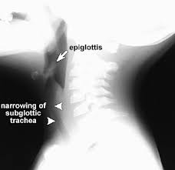

Slide 22
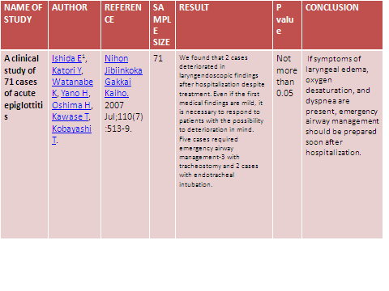

Slide 23
ALTB - Treatment
Airway management
Oxygen
Steroids
Nebulized adrenaline
Antibiotics
Prevention of molecular cascade (Grade A – D)

Slide 24
PERTUSSIS

Slide 25
DIPHTHERIA

Slide 26


Slide 27
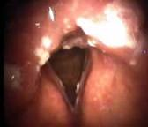

Slide 28
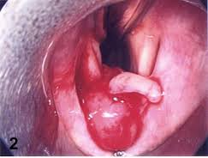

Slide 29
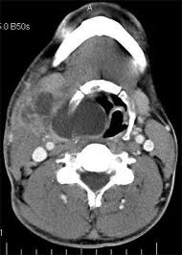

Slide 30
Q-1 most common organism involved in acute laryngitis is:
a. Moraxella catarrhalis
b. Staphlococcus aureus
c. Streptococcus pneumoni
d. Niesseria

Slide 31
Q-2 acute epi-glossitis on x-ray neck lateral view shows which sign:
Thumb sign
Delta sign
Sigma sign
None of above

Slide 32
Q-3 Acute laryngo-tracheo-bronchitis on x-ray AP view shows which sign:
Steeple sign
Thumb sign
Delta sign
Sigma sign

Slide 33
Q-4 CROUP is caused by
Viral infection
Bacterial infection
Allergies
All of the above

Slide 34
Q-5 Treatment for acute laryngitis does not include:
Antivirals
Speech therapy
Voice rest
antibiotics

