Slide 1

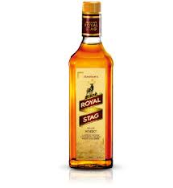
Drunkenness
Dr. Kalpesh Zanzrukiya

Slide 2
Definition
It is a condition which results from excessive intake of alcohol.
SHOWS
Loss of control over his mental faculties.
Inability to perform the duties.
Dangerous to himself or others.

Slide 3
Consent for Examination
The detained person should not be examined without his written consent.
If the person becomes unconscious or incapable of giving consent, examination and treatment can be carried out, but the doctor should not disclose any information and wait for his consent, till he regains consciousness.
Under Sec. 53 (1) CrPC, examination of an accused can be carried out by a doctor at the request of police, even without his consent and by use of force if necessary.

Slide 4
A Case of Drunkenness
Preliminary data:- name, age, sex, address, time of examination, two identification marks and person escorting the patient.
History:- Past illness and drug treatment.
If he admits having taken alcohol- nature, quantity and time of consumption.

Slide 5
Exclusion of Injuries and Pathological Conditions
Head injury
Metabolic disorders:- Hypoglycemia, Diabetic pre-coma, uremia, hyperthyroidism.
Neurological conditions:- Intracranial tumors, epilepsy, parkinsonism, disseminated sclerosis.
Drug overdose:- Insulin, barbiturates, antihistamines, morphine, atropine, hyoscine.
Psychological disorders.
Exposure to CO.

Slide 6
Examination of a case of Drunkenness
Clinical Examination
General appearance
General Examination
Specific physical examination

Slide 7
General appearance
Manner of dressing
Posture
General behavior and attitude

Slide 8
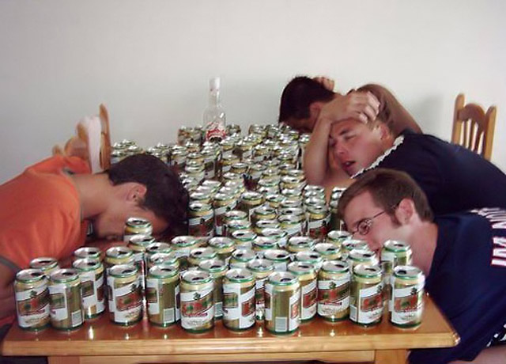

Slide 9
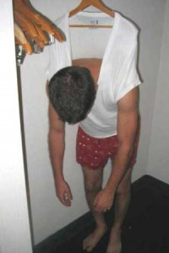

Slide 10
General Examination
For “head injury” – Scalp injury

Slide 11
Specific physical examination
Gait - staggering or normal
Stance – whether he can stand easily with eyes closed and feet close together.
Smell – Breath may confirmed that alcohol has been taken.
Handwriting – The examinee should be asked to copy a few lines from a newspaper or book and compare his sign with driving license.

Slide 12
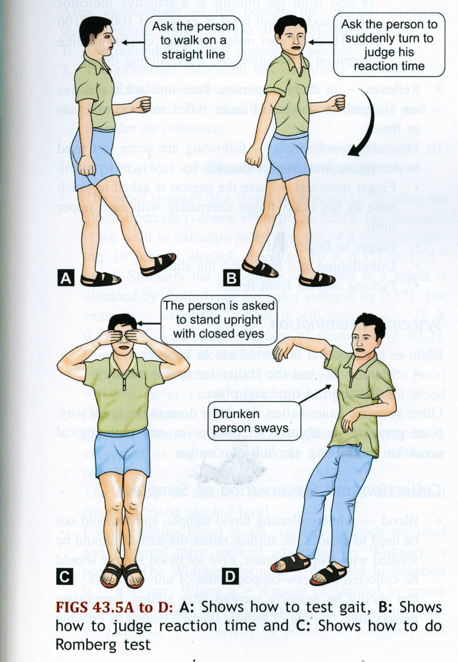

Slide 13
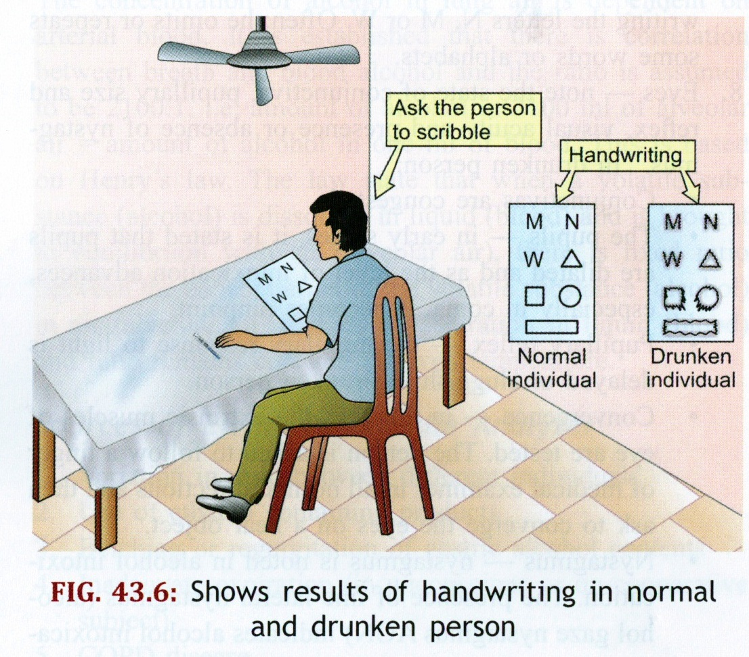

Slide 14
Cont…..
Speech – Slurred, thick or over precise. Content, articulation and clarity is noted.
Memory – Recent and past events.
Muscle coordination –
1) Finger nose test.
2) Finger finger test
3) Test of dexterity
4) When undressing for examination, the ability to undo buttons or any fumbling with zips should be noted.,

Slide 15
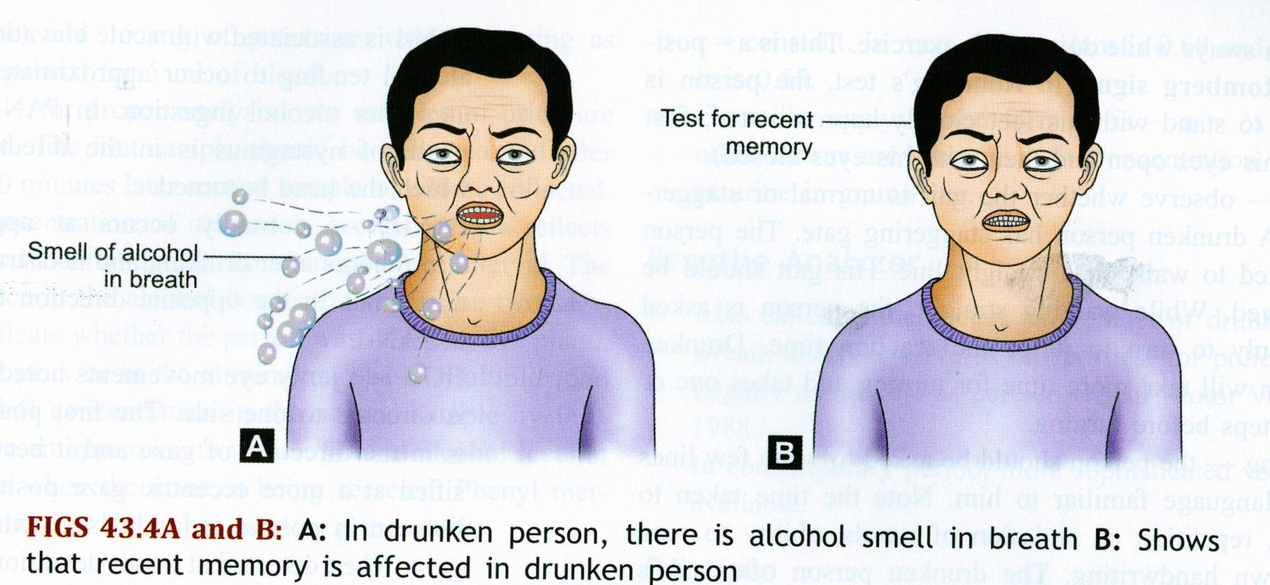

Slide 16
Eyes:-
1) Drooping and swollen eyelids and congestion of conjunctiva.
2) Visual acuity
3) Pupils
4) Convergence test
5) reaction to light
6) Strabismus and Nystagmus

Slide 17
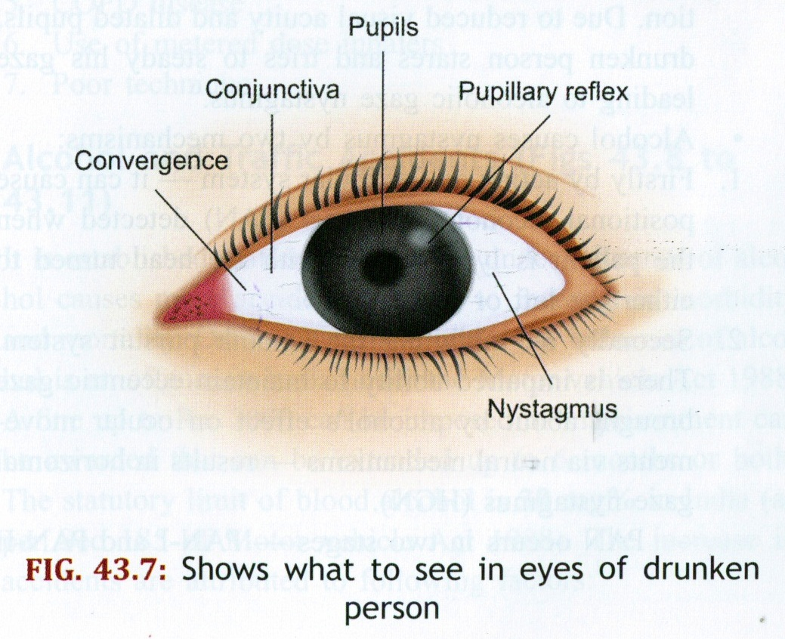

Slide 18
Ears:- Gross impairment and abnormality of ear drums.
Skin:- Dry, warm and flushed
Mouth:- General state of mouth, teeth, tongue.
Pulse:- rapid, full and bounding
Blood Pressure:- Slight rise in systolic B.P.
Respiration:- Hurried, shallow, stertorous.

Slide 19
Reflex:- Knee and Ankle reflex sluggish and delayed, plantar extensor/ flexor.
Systemic:- Liver cirrhosis , ascites edema.

Slide 20
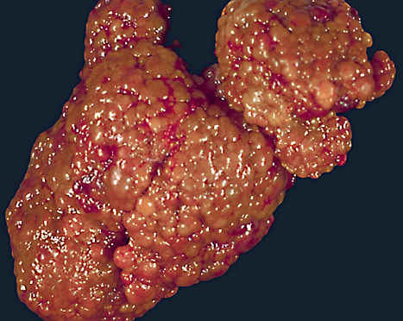
Alcohol & the Liver
Cirrhosis
Micronodular cirrhosis, solid, scarred, yellow

Slide 21
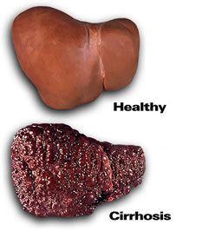
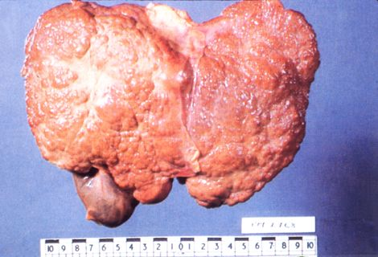
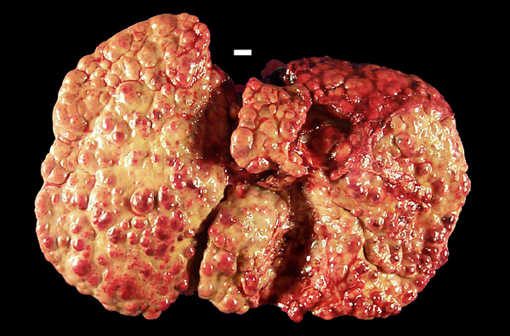
Effects on Liver

Slide 22
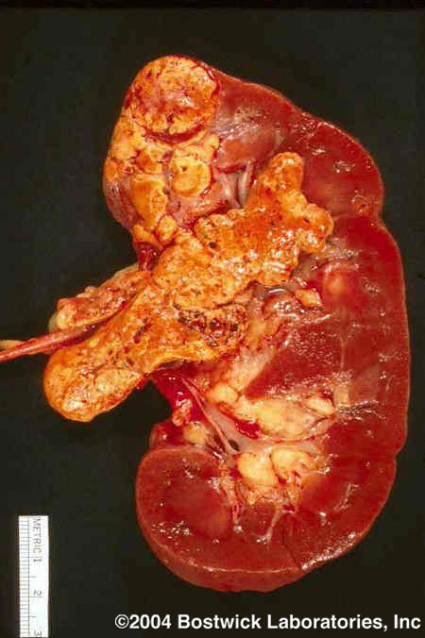
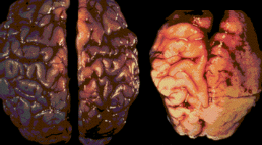
Effects on Kidneys and Brain
No exposure to alcohol
Heavy prenatal exposure to alcohol
Photo courtesy of Sterling Clarren, MD

Slide 23
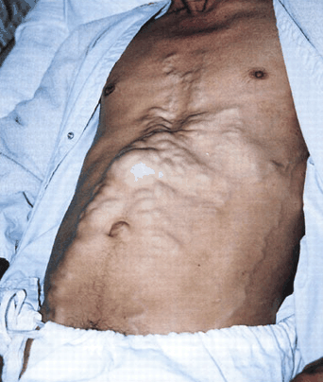
Alcohol & the Liver
Portal Hypertension
“Caput Medusa”

Slide 24
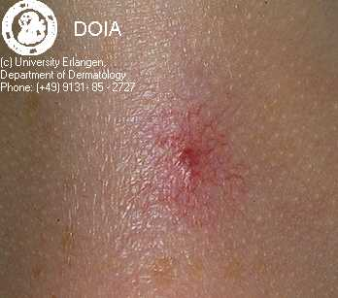
Alcohol & the Skin
“Spider Angiomas”

Slide 25
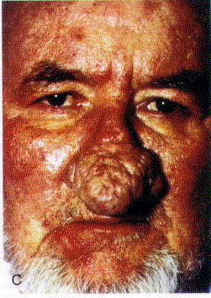
Alcohol & the Skin
Rhynophyma
(Acne rosacea variant)
Seen with EtOH & other vasodilatory substances

Slide 26
Opinion
The report should be written at that time with following statements.
1- He/ She has not consumed alcohol.
2- He/ She has consumed alcohol, but is not under the influence of it.
3- He/ She has consumed alcohol, and is under the influence of it.

Slide 27
Sample collection
In Living
Blood
Urine
Postmortem samples
Blood/ Vitreous/ Muscle
Breath

Slide 28
Erroneous BAC results can be obtained due to:
P.M. diffusion from other body fluids and tissues.
Sample stored at room temperature for more than a week.
Improperly preserved sample.
Hemolysis
Clot formation
Putrefaction

Slide 29
Laboratory Investigations
Estimation of alcohol from,
1) Blood
2) Urine
3) Breath
4) Vitreous fluid, bile and other tissue.

Slide 30
Measurement of Blood Alcohol
The BAC is the most useful measure, as there is rapid equilibration across the blood- brain barrier, therefore BAC reflects the concentration of alcohol currently affecting the brain.

Slide 31
Permissible BAC (mg/dl) | Countries
0 | Hungry, Pakistan, Saudi Arabia, UAE
20 | Norway, Poland, Sweden
30 | India, China, Japan
50 | Australia, France, Germany, Italy, Spain, Netherlands, Russia, Denmark
80 | Canada, UK, US (100 mg/dl in some states)

Slide 32
Urine
The Urine alcohol is more concentrated than blood level, due to tubular resorption of water in the ratio of 1.3:1.
But it is less useful, as the ureteric urine conc. varies with rising or falling BAC and as all the urine from the kidney is pooled in the bladder, that obtained from later micturation can only give a mean value over the period of excretion.

Slide 33
Breath alcohol
It is in equilibrium with blood, even through in a very small conc. of about 1:2300. ( based on Henry’s law )
At 37’ C , a level of 1 mg/dl in blood will be equivalent to 0.43 microgram/dl in breath.
The ratio is temperature dependant and varies slightly with depth of respiration and concentration of alcohol.

Slide 34
Methods to determine Ethanol
1) Macro ( require 1-2 ml)
2) Micro ( require 0.1 to 0.2 ml)
Specimen
Chemical
Widmark
Cavett
Biochemical
ADH method
Physical
GLC

Slide 35
Methods for estimation of alcohol
1) Widmark’s formula:- for blood alcohol level
a = pcr
where a – total amount of alcohol (in grams) absorbed in the body
p – weight of person (in kg)
c – conc of alcohol in blood( gm/kg)
r – constant ( M- 0.68, F- 0.5)

Slide 36
Alcohol level from urine by,,, a = ¾ pqr
where q – conc of alcohol in urine ( gm/ l)
and a, p, r are same as above.

Slide 37
Kozelka and Hine method or Cavett method
It involves distillation or diffusion under low pressure.
It’s principle that alcohol oxidized to acetic acid by oxidizing agent, potassium dichromate and sulphuric acid.
Nickolls method:- macro method, similar to cavett.
Southgate and carter mathod:- :- macro method.
Other methods:-
1) Gas liquid chromatography:- most reliable and most sensitive method produce accurate quantitative results.

Slide 38
Breath analyzer is a device for estimating BAC from breath sample. In 1954, Dr. Robert Borkenstein invented it.
As per sec. 185 of Motor Vehicle Act, 1988 traffic police used to measure BAC from breath sample.
It is used for chemical oxidation and photometry to determine alcohol conc.
It is a non invasive test with Immediate result.

Slide 39
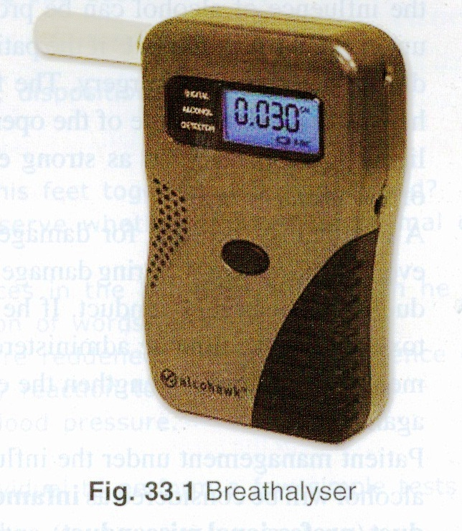

Slide 40
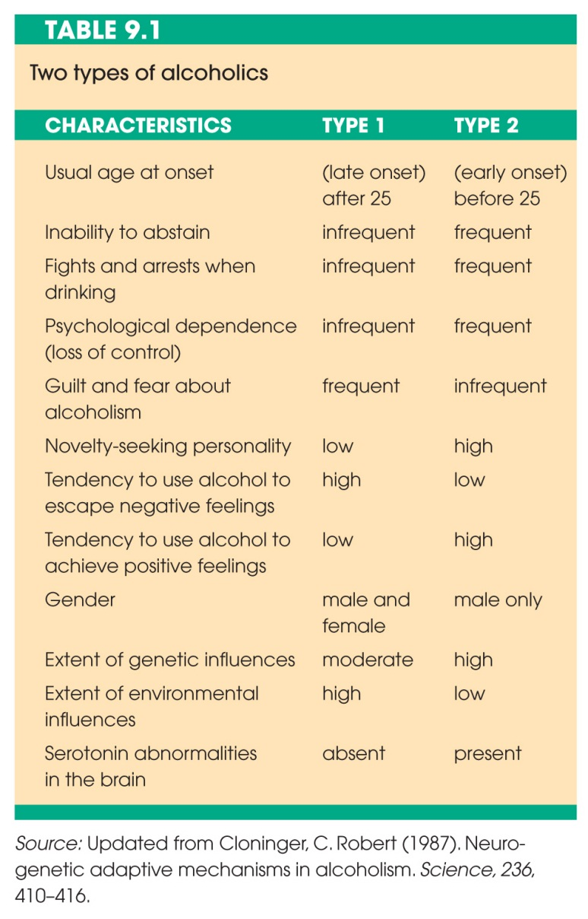

Slide 41
Alcohol and Pregnancy
A particular concern is the development of fetal alcohol syndrome (FAS) in the offspring of alcoholic mothers.
There is no amount of alcohol that is known to be safe
Total abstinence during pregnancy is ideal, and FAS is 100% preventable.

Slide 42
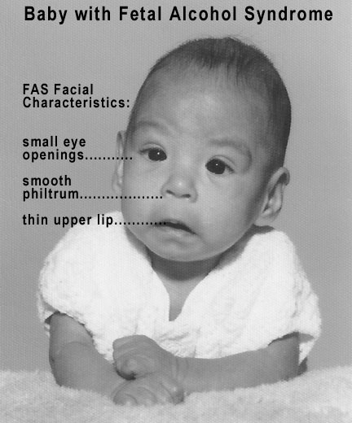
Fetal Alcohol Syndrome
Facial features are a good diagnostic for underlying brain damage.
The greater the facial abnormalities, the greater the underlying damage.
The exact degree and nature of deficits depends on timing, length and severity of exposure, in addition to individual differences in fetal sensitivity to alcohol.

Slide 43
Shorter-than-average height
Low body weight
Poor coordination
Small head size
Hyperactive behavior
Difficulty paying attention
Poor memory
Difficulty in school (especially with math)
Learning disabilities
Speech and language delays
Intellectual disability or low IQ
Poor reasoning and judgment skills
Sleep and sucking problems as a baby
Vision or hearing problems
Problems with the heart, kidney, or bones.

Slide 44
Anatomical Changes in the Brain
reduction in gross brain size
especially frontal and parietal lobes
agenesis of the corpus callosum
abnormal cerebellar development
reduced size of the caudate nucleus
Functionally
lower cerebral blood flow
reduced glucose utilization
reduced caudate and frontal lobe activation on
spatial memory tasks

Slide 45
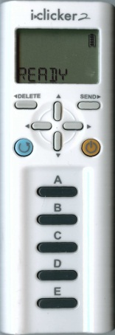
Fetal alcohol syndrome
A. is not a concern unless the mother is an alcoholic
B. is unavoidable because it results from abnormal metabolic activity of the fetus
C. can be avoided by drinking only beer and wine during pregnancy
D. can be a product of changes in sperm of an alcoholic father
E. can only be avoided with certainty if the mother abstains from alcohol completely

Slide 46
Long term effects of alcohol
After prolong intake of large quantity of alcohol it causes,
Alcoholic hallucination
Wernicke’s encephalopathy
Korsakoff’s psychosis

Slide 47
Alcoholic hallucination
Its mainly auditory with systematized delusions of persecution lasting from weeks to months.
It is psychiatry emergency needs of hospitalization, sedation and close monitoring.
Recovery occurs in a month.
Patient may become suicidal or homicidal in response to hallucination.
Treamant – Diazapam 40 – 80 mg/day.
Oral multi – B vitamins, thiamine 50- 100 mg daily for week.
Haloperidol 20 mg or more per day.
Adequate I.V. fluids.
Symptomatic treatment

Slide 48
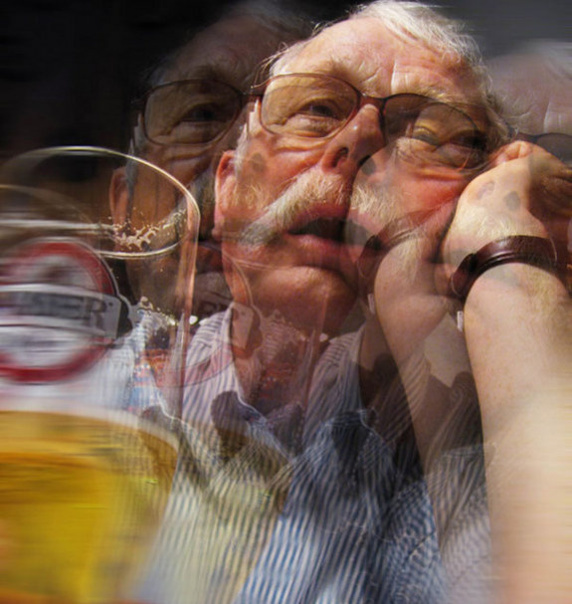

Slide 49
Wernicke’s encephalopathy
Due to severe thiamine deficiency ,, characteristically the onset occurs after period persisting of vomiting.
Signs and symptoms-
Ocular: coarse nystagmus, opthalmoparesis by 6th cranial nerve involvement, retinal hemorrhage, papilloedema.
CNS: Disorientation, confusion, recent memory disturbance. Apathy and ataxia early symptom.
Pathologically neuronal degeneration and hemorrhage is seen in thalamus, hypothalamus and mid brain.

Slide 50
Korsakoff’s psychosis
Korsakoff first identified this condition in 1887. it often follows Wernicke’s encephalopathy, so they are referred to as Wernicke-Korsakoff syndrome.
Cause – severe untreated thiamine deficiency, secondary to chronic alcohol abuse.
Signs and symptoms – “organic amnestic syndrome” characterized by inability to learn new information, impairment of short term memory, impaired insight.

Slide 51
Pathological lesion seen in bilateral dorsomedial nuclei of thalamus and mamillary bodies, periventricular and periaqueductal grey matter, cerebellum.
Treatment:
1) I.V. thiamine ( pabrinex), 2 vials 8 hrly for 48 hr, followed by oral 100 mg 8 hrly.
2) supplementation of electrolyte( Mg, K)

Slide 52
Alcoholic peripheral neuropathy:- weakness, pain in extremities, wrist and foot drop, unsteady gait, loss of deep reflex seen.
Alcoholic paranoia:- fixed delusion, but no hallucination. Pt becomes suspicious of the motives and actions of those he meets and of his family members.

Slide 53
Alcohol & The Nervous System
≈Alcoholic Peripheral Neuropathy
Associated Myopathy
Myelin degeneration of nerve sheaths.

Slide 54
Alcoholic seizures:- ( rum fits):- Generalised tonic clonic convulsion may occur after 12-48 h of heavy bout of drinking alcohol.
Multiple seizure are more common then single.

Slide 55
Marchiafava – Bignami syndrome
Rare disorder.
Disorientation, epilepsy, ataxia, dysarthria, hallucination, spastic limb paralysis,.
Demyelination of corpus callosum, optic tracts, cerebellar peduncles. And the cause may be alcohol related nutrition deficiency.

Slide 56
Alcohol Dependence
According to the DSM-IV criteria for alcohol dependence, at least 3 out of 7 of the following criteria must be manifest during a 12 month period:
Tolerance
Withdrawal symptoms or clinically defined Alcohol Withdrawal Syndrome
Use in larger amounts or for longer periods than intended
Persistent desire or unsuccessful efforts to cut down on alcohol use
Time is spent obtaining alcohol or recovering from effects
Social, occupational and recreational pursuits are given up or reduced because of alcohol use
Use is continued despite knowledge of alcohol-related harm (physical or psychological)

Slide 57
Screening Tools
The Alcohol Use Disorders Identification Test (AUDIT) is considered the most accurate alcohol screening tool for identifying potential alcohol misuse, including dependence. It was developed by the World Health Organisation, designed initially for use in primary healthcare settings with supporting guidance.
The Severity of Alcohol Dependence Questionnaire (SAD-Q) is a more specific twenty item inventory for assessing the presence and severity of alcohol dependence.

Slide 58
Medico legal aspects
Voluntary drunkenness is not an excuse for commission of crime.
Sec. 510 IPC: misconduct by a drunken person in public is punishable with imprisonment upto 24 h.
Motor Vehicles act 1988:- under this act, there can be arrest without warrant. And a breath test and lab test can also be carried out.

Slide 59
The age for possession and consumption of alcoholic beverages is 18-25 yrs in India ( varies between states)
First offence | 6 months imprisonment and/or 2000 rs.
Second offence within 3 years of 1st offence | 2 yrs and/or 3000 rs.

Slide 60
The Government has cleared a proposal to amend the Act. Drunk driving will be graded acco to BAC level.
BAC Level (mg/dl) | Punishment
Up to 60 | Same as previous slide
60-150 | 1 yr and/or 4000 rs
Repeated offence within 3 yr, of 60-150 level | 3yrs and/or 8000 rs
> 150 | 2 yrs and/or 5000 rs
Repeated offence within 3 yr, of >150 level | 4yrs and 10,000 rs with cancellation of license

Slide 61
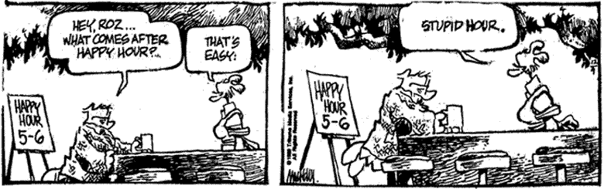
Then comes…. hospital hours

Slide 62
References
Review of Forensic Medicine & Toxicology – Dr Gautam Biswas , 2nd edition.
The Essentials of Forensic Medicine & Toxicology – Dr. K. S. Narayan Reddy , 32nd edition.
Principles of of Forensic Medicine & Toxicology – Dr Rajesh Bardale, 1st edition
Photographs from internet.

Slide 63
Thank you

