Slide 1
EXTERNAL NASAL VAULT & choanal atresia

Slide 2
Levels of Evidence
Grade A – Systemic reviews, Meta analyses, RCT
Grade B – Non-randomised studies
Grade C – Observational studies
Grade D – Case Series, Expert opinion

Slide 3
Levels of Evidence
**** ~ Systematic reviews, meta analysis of randomized control studies
*** ~ Non randomised studies
** ~ Observational or non experimental studies
* ~ Expert opinion

Slide 4
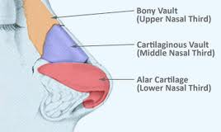
Shape : Pyramid
Osteocartilaginous framework covered by muscle and skin

Slide 5
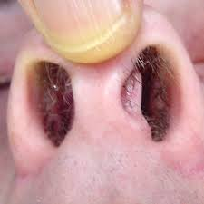
Vestibule and skin
Sebaceous and sweat glands
Hair follicles (vibrissae)
Limen nasi

Slide 6
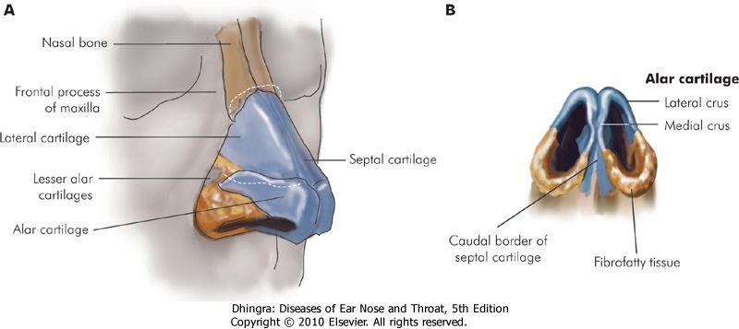
Osteocartilaginous framework

Slide 7
Bony part
Two nasal bones
Nasal process of frontal bone
Frontal processes of maxillae

Slide 8
Cartilaginous part
Upper lateral
Lower lateral (alar)
Lesser alar (sesamoid)
Septal

Slide 9
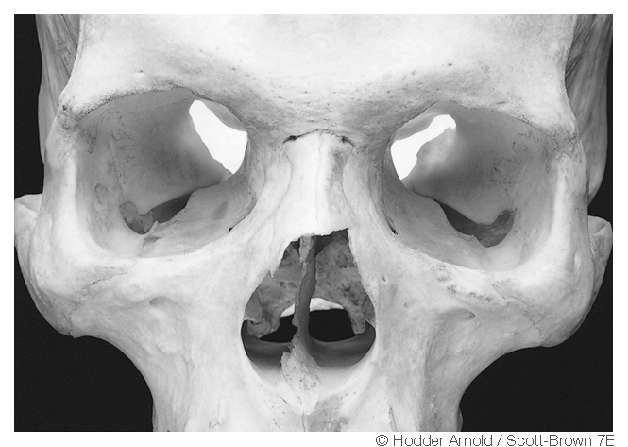
Pyriform Aperture

Slide 10
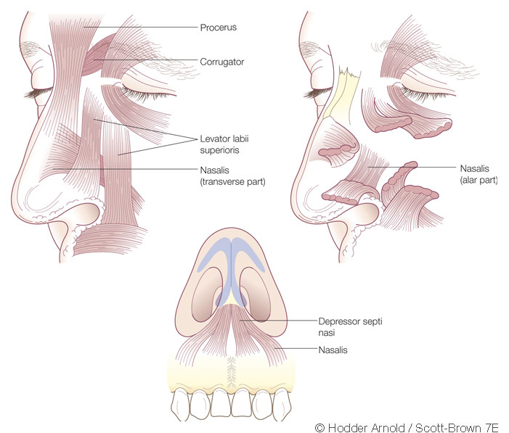
Nasal musculature

Slide 11
MUSCLES
Depressor septi nasi
Nasalis
Alar
Transverse
Procerus
Levator labii superioris alaquae nasi

Slide 12
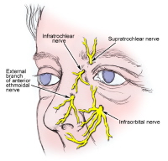
Nerve supply

Slide 13
Diseases of external nose

Slide 14
Cellulitis
Nasal deformities
Tumours

Slide 15
NASAL DEFORMITIES

Slide 16
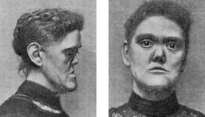
Saddle nose

Slide 17
ETIOLOGY:
Trauma
Itrogenic
Syphillis/TB/laprosy
Septal abscess/ hematoma
TREATMENT:
Augmentation rhinoplasty

Slide 18
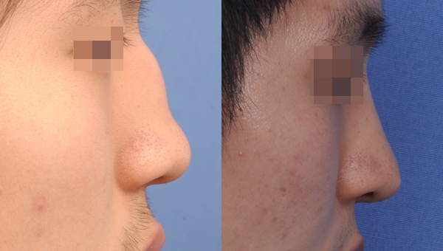
Humped nose

Slide 19
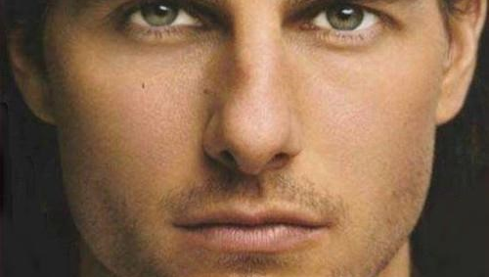
Crooked nose/ Deviated nose

Slide 20
Tumour

Slide 21
Tumours
Congenital
Benign
Malignant

Slide 22
Congenital tumour
Dermoid cyst
-simple
Associted with sinus
Encephlocele or meningoencephelocele
-nasofrontal
-nasoethmoid
-naso-orbital
Glioma

Slide 23
Benign tumour
Papilloma
Haemangioma
Neurofibroma
Pigmented naevus
Seborrhoeic keratosis
Rhinophyma

Slide 24
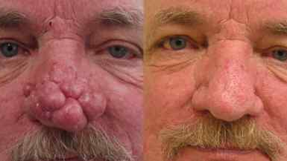
Rhinophyma

Slide 25
Malignant tumour
Basal cell carcinoma
Squamous cell carcinoma
Malenoma

Slide 26
NAME OF STUDY | AUTHOR | REFERENCE | SAMPLE SIZE | RESULT | P value | CONCLUSION
Anatomy of the nasal profile | K J Anderson, M Henneberg, and R M Norris | J Anat. Aug 2008; 213(2): 210–216. | 30 | In all subjects the angle of the septum differed from the external nasal dorsum angle. The superior border of the septal cartilage did not form a linear extension of the profile contour of the nasal bones but angled downwards. The superficial profile contour of the dorsum did not follow the profile of the nasal bones or the septal cartilage. | Not more than 0.05 | Within the limited range of body weight for our sample there was no relationship found between the weight of the individual and the amount of subcutaneous fat present on the nose There was also no sexual dimorphism found.

Slide 27
Choanal atresia

Slide 28
Persistance of bucconasal membrane
Uni/ bilateral
Complete/incomplete
Bony/ mambranous

Slide 29
MCQ

Slide 30
What is the shape of the External nasal vault:
Conical
Triangular
Pyramidal
None of the above

Slide 31
2. How many nasal bones are there:
3
2
4
1

Slide 32
3. Which of the following does not supply nasal vault:
Supratrochlear nerve
Infratochlear nerve
Intraorbital nerve
Trigeminal nerve

Slide 33
4. Which of the following is not an external nasal deformity:
Saddle nose
Hump nose
Crooked nose
Vestibulitis

Slide 34
5. which are the following are true for choanal atresia except ?
Unilateral/ bilateral
Complete/incomplete
Bony/ cartilagenous
Bony/ mambranous

Slide 35
Thank you

Slide 37
\456
1---c
2---b
3---d
4---d
5---c

