Slide 1
ANATOMY OF MIDDLE EAR

Slide 2
Levels of Evidence
Grade A – Systemic reviews, Meta analyses, RCT
Grade B – Non-randomised studies
Grade C – Observational studies
Grade D – Case Series, Expert opinion

Slide 3
Levels of Evidence
**** ~ Systematic reviews, meta analysis of randomized control studies
*** ~ Non randomised studies
** ~ Observational or non experimental studies
* ~ Expert opinion

Slide 4
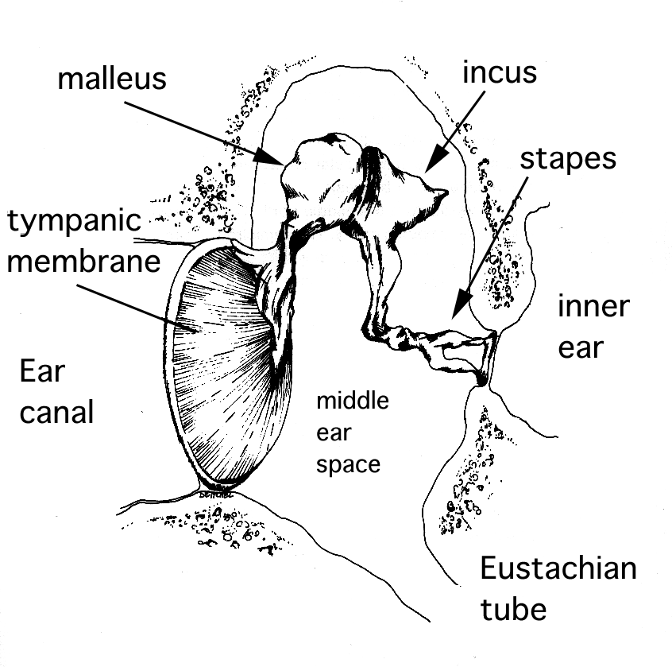
ANATOMY OF MIDDLE EAR
BY Dr.Saurabh Choubey

Slide 5
The Middle Ear
Middle ear cleft consists of mainly 3 parts
Tympanic cavity
The Eustachian tube
The Mastoid air cell system

Slide 6
The Tympanic Cavity
The Tympanic cavity is divided into three compartments
The Epitympanum
The Mesotympanum
The Hypotympanum
Notes:
Epitypanum lies above the level of malleolar folds and is separated from mesotpanum and hypo tympanum by series of mucosal membranes
Hypotympanum lies below the level of inferior part of the tympanic sulcus

Slide 7
The Lateral Wall
It is formed by
The bony lateral wall of epitympanum superiorly
The tympanic membrane centrally
The bony lateral wall of hypotympanum inferiorly

Slide 8
The ROOF
The roof is formed by the thin bony plate
The petrous and squamous portion of the temporal bone forms this thin bony plate
Notes:
1 This plate separates the middle ear from the middle cranial fossa
22 There exisits petrosqamous sutureline which does not closes till adult life
So route of if to extradural space

Slide 9
The Floor
It consisits of pneumatized bone
This bone seprates the hypotympanum from the dome of the jugular bulb
Notes:
At the junction of floor and medial wall is a small opening that has entry of tympanic branch of glossopharyngeal nerve into middle ear

Slide 10
The Anterior Wall
The upper 1/3 is usually pneumatized
Middle 1/3 comprises the tympanic orifice of the Eustachian tube
Lower 1/3 consists of the thin plate of bone covering the carotid artery as it enters the skull
Notes:
1 And may house the anterior epitympanic sinus which can hide residual cholesteatoma in canal wall up surgery
2v Which is oval and about 5x2 mm just above this is a canal containing the tensor tympani muscle

Slide 11
The Medial Wall
The medial wall separates the tympanic cavity from the internal ear
Oval window
Footplate of the stapes
Round window
Facial nerve canal
Notes:
1 kidney shaped opening that connects the tympanic cavity with the vestibule
lies behind the promontry
*Promontry is a round elevation occupying most of the central portion of the medial wall covering basal coil of cochlea
2 it along with its ligamentas closes the oval window (3.25mm long and 1.75mm wide)
3 it is triangular in shape
Lies below and little behind the oval window
4 runs above promontry marked by processus cochlearformis( a curved projection of bone)

Slide 12
The Posterior Wall
Aditus
Fossa incudis.
The pyramid.
Notes:
This aditus helps the middle ear communicate with the mastoid air cell system
2 Below the aditus is a small depression known as the
Fossa incudis houses the short process of the incus
3 small conical projection which is hollow and its apex pointing anteriorly. It contains the stapedius muscle, the tendon of which passes forwards to insert into the neck of the stapes.

Slide 13
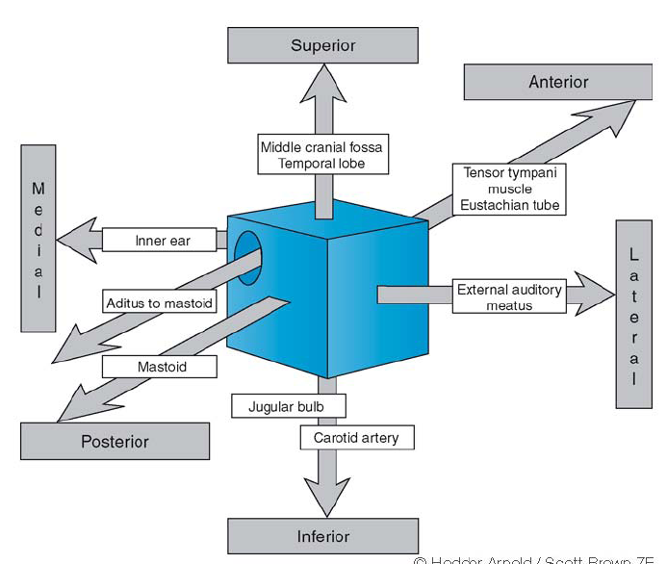
The Middle Ear

Slide 14
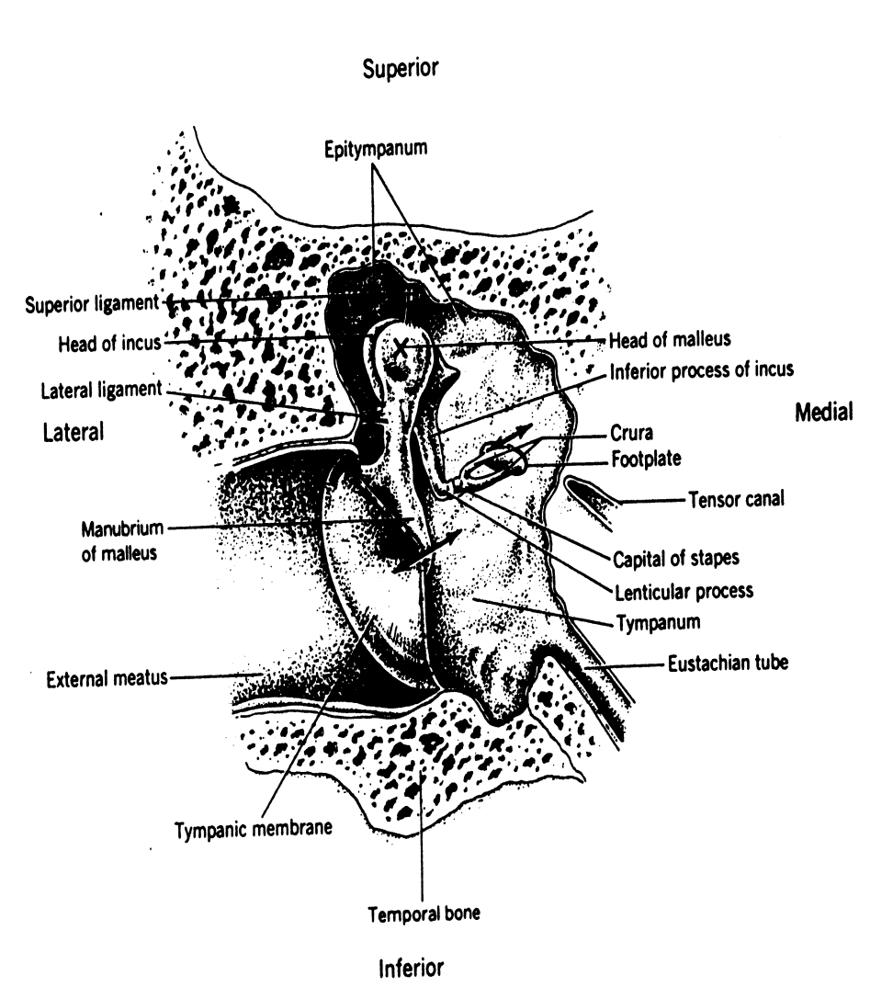
General Structures of the Middle Ear
Eardrum
Ossicular chain
Middle ear muscles

Slide 15
The Ossicles
Malleus (hammer)
Incus (anvil)
Stapes (stirrup)

Slide 16
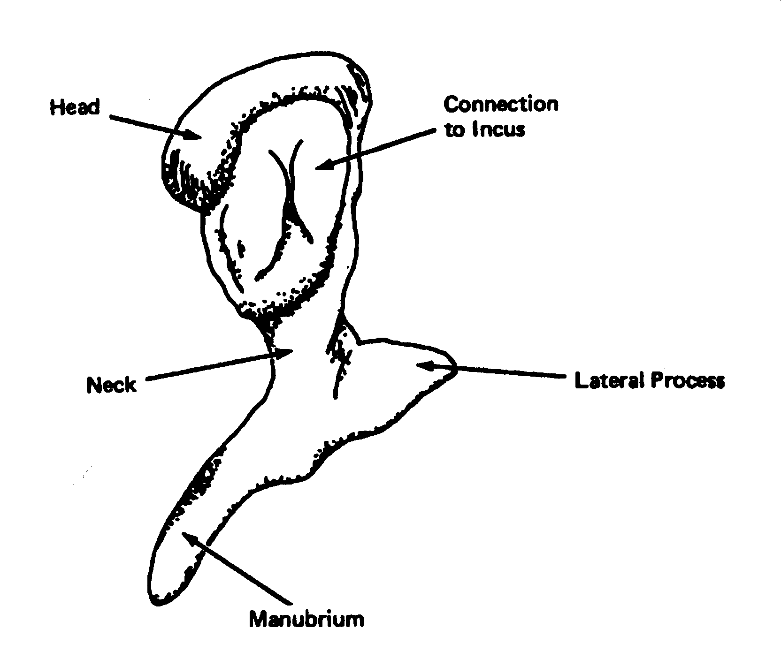
The Malleus
Manubrium
Neck
Head
Lateral process
Notes:
This bone is shaped like a hammer hence the name. This is the largest of the three ossicles of the middle ear cavity
overall length of the malleus ranges between 7.5 - 9 mm
posteriomedial surface has an elongated saddle shaped cartilage covered facet for articulation with the incus

Slide 17
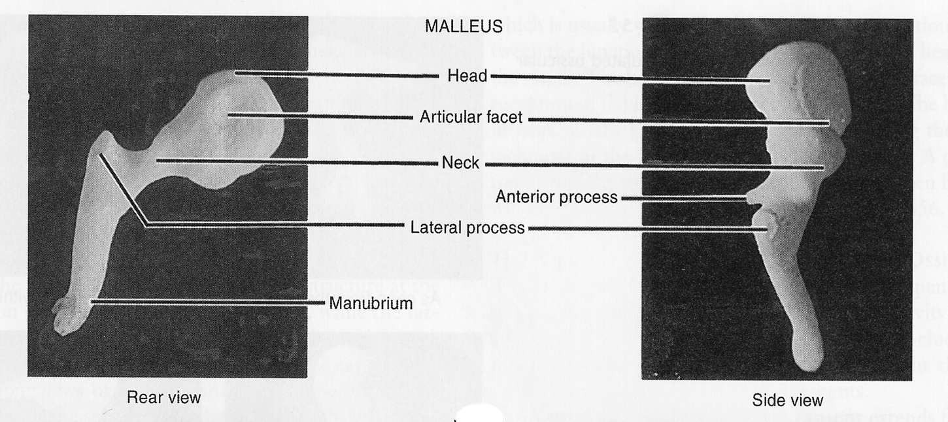
The Malleus

Slide 18
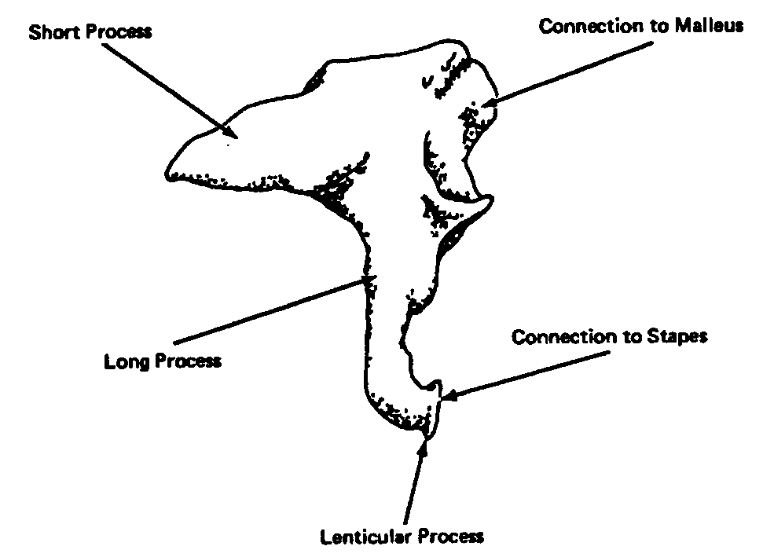
INCUS
Short process
Long process
Lenticular process
Notes:
It articulates with the malleus and has a body and two processes. The body lies in the attic and has a cartilage covered articular facet corresponding to that of the malleus.
The long process of the incus descends into the mesotympanum behind and medial to the handle of the malleus
At its tip there is a small medially directed lenticular process which articulates with the stapes

Slide 19
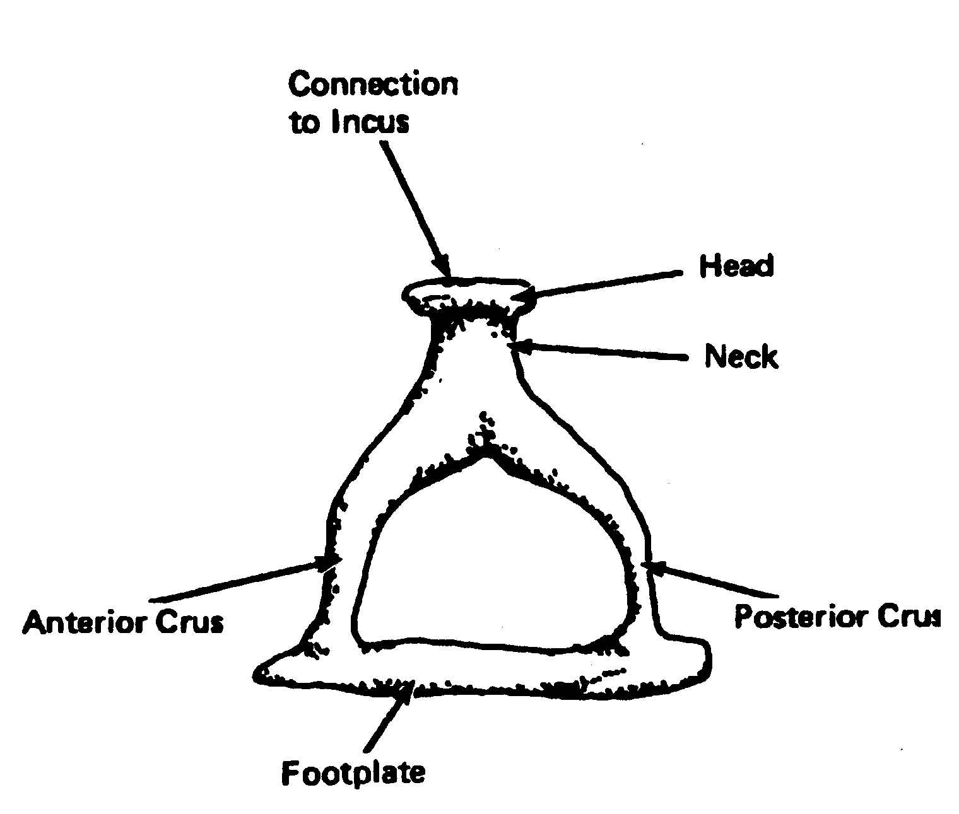
The Stapes
Head
Neck
Anterior crus
Posterior crus
Footplate
Notes:
The head of the stapes points laterally and has a small cartilage covered depression for articulation with the lenticular process of the incus
The tendon of the stapedius muscle attaches to the posterior part of the neck and the upper part of the posterior crura
The two crura join the foot plate which closes the oval window during life

Slide 20
Ligaments of the Ossicular Chain
Superior malleal ligament
Anterior malleal ligament
Lateral malleal ligament
Posterior incudal ligament

Slide 21
Muscles of the Middle Ear
Stapedius Muscle originating from the concial cavity within the pyramid
inserts into the stapes
Tensor tympani Muscle arises from the cartilagenous portion of the eustachian tube and the greater wing of sphenoid
Inserts into handle of malleus
Notes:
Origin :walls of the concial cavity within the pyramid
A slender tendon inserts into the stapes
This muscle is supplied by a small branch from the facial nerve
This muscle has a protective role to play. It protects the inner ear from insults caused by loud noise. Patients with facial nerve palsy have hyperacusis because of lack of action of this muscle.
2 arise from the cartilagenous portion of the eustachean tube and the greater wing of sphenoid
Inserts into medial aspect of the upper end of the handle of the malleus.
This muscle is supplied by the mandibular nerve by way of a branch from the medial pterygoid nerve
This muscle tenses the tympanic membrane by holding the handle of the malleus thus helping the middle ear in better sound perception.

Slide 22
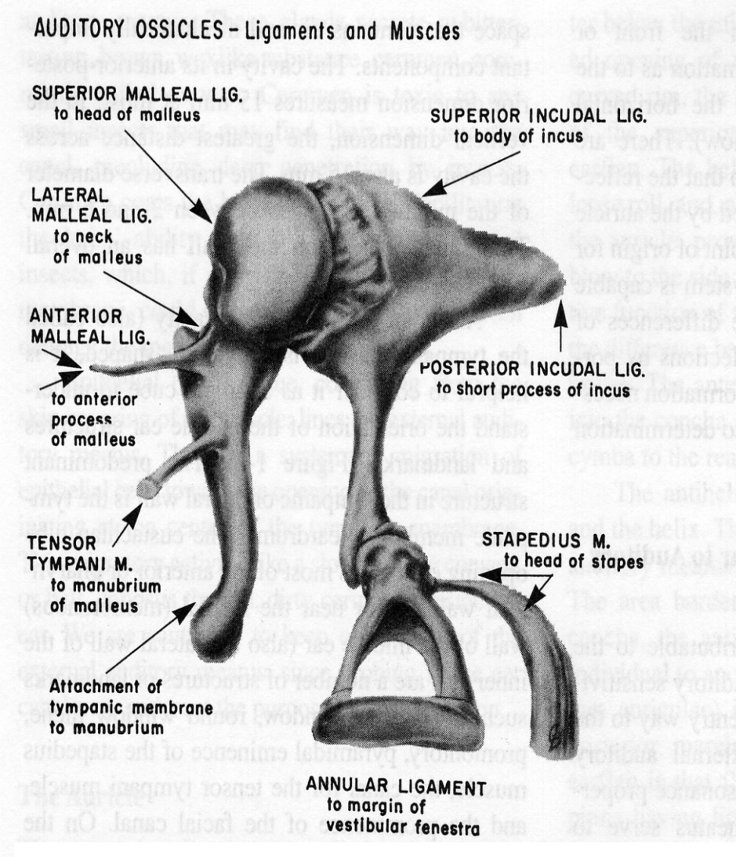

Slide 23
Name of study | Auther | Refrence Page No. | Sample Size | Result | conclusion
Arterial Anatomy of the ear | Imanishi N, Nakajima H,Aiso S | Okajimas Folia Anatomica Japonica 1997;73: 313-323 | 7 | 100% | The posterior auricular artery found to be the dominant blood supply for the ear.

Slide 24
THANK YOU

Slide 25
MCQ

Slide 26
Middle ear cleft consists of how many parts:
A.2
B.3
C.4
D. 5

Slide 27
2. Which of the following is a part of The Tympanic cavity:
A.The Epitympanum
B.The Mesotympanum
C.The Hypotympanum
D. All of the above

Slide 28
3. In Anterior Wall which part is usually Pneumatiezed
A.Upper 1/3
B. Middle 1/3
C. Lower 1/3
D. A &B

Slide 29
4. The medial wall separates the tympanic cavity from :
A.The internal ear
B.Oval window
C.Round window
D.Facial nerve canal

Slide 30
5. Which of the following can be seen with Tympanic membrane
on regular examination:
Malleus
Incus
Stapes
All of the above

