Slide 1
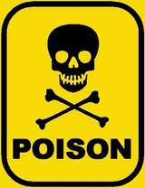
LEGAL TOXICOLOGY
- Dr. Sunil Doshi

Slide 2
Introduction
Poison :-
Scientific def. – a substance (solid/liquid/gas), which if introduced in the living body, or brought into contact with any part thereof, will produce ill-health or death, by its constitutional or local effects or both.
Inaccurate for law and justice
The intention is very important in law ( mens rea – actus reus )
i.e. administration of any substance, in any formation or any quantity, with intention of causing injury or death, and which causes injury or death as a result, is a crime and liable for punishment; whether the substance is called poison or not.
=> administrating poison to a person with criminal intention is by itself a criminal offence, whether actual hurt caused or not.
=>No difference b/w murder by poison and murder by any other means.

Slide 3
Various I.P.C.s related to poisoning
IPC 176 – omission to give notice or information regarding any subject/substance to a public servant by a person legally bound to give it.[punishment – simple imprison upto 1mth/Rs.500/both ]
IPC 193 – intentionally giving/fabricate false evidence. .[punishment – imprison upto 7yrs and fine]
IPC 201 – causing disappearance of evidence of offence, or giving false info to screen offender.[punishment – acco. to the crime, imprison up to 7yrs and fine]
IPC 202 – intentional omission to give information of offence by person legally bound to give.[punishment – imprison up to 6mth/fine/both]

Slide 4
IPC 299 – culpable homicide(by any means including poisoning)
IPC 300 – murder when culpable homicide not murder(by any means including poisoning)
IPC 302 – punishment for murder – death/imprison for life and fine
IPC 304A – causing death by negligence not amounting to culpable homicide(by any means including poisoning) [punishment – imprison 2yrs/fine/both]
IPC 309 – attempt to commit suicide[punishment- simple imprison 1yr/fine/both]
IPC 319 - hurt
IPC 320 – grievous hurt
IPC 324 – voluntarily causing hurt by dangerous weapons/poisons/any means[punishment – imprison 3yrs/fine/both]

Slide 5
IPC 326 - voluntarily causing grievous hurt by dangerous weapons/poisons/any means[punishment – imprison life or imprison upto 10yrs with fine]
IPC 328 – whoever administers to or causes to be taken by any person any poison or any stupefying, intoxicating or unwholesome drug, or other thing with intent to cause hurt to such person, or with intent to commit or to facilitate the commission of an offence, shall be punished with imprisonment upto 10 yrs and fine.
IPC 274 – adulteration of drugs.[punishment – imprison upto 6mth/Rs.1000/both ]
IPC 284 – negligent conduct with respect to poisonous substances as to endanger human life or to be likely to cause hurt or injury .[punishment – imprison upto 6mth/Rs.1000/both ]

Slide 6
Various Acts and Rules
The Poison Act, 1919:
  Regulates import, manufacture, distribution & sale of poisonous substances.
The Drugs And Cosmetics Act, 1940:
  Regulates import, manufacture, distribution & sale of all kinds of drugs.
  Control of quality, purity and strength of drugs.
  containers/packets containing drugs should have label mentioning formula or list of ingredients in it.
  Drugs technical advisory board and central drug laboratory.

Slide 7
The Drugs And Cosmetics Rules, 1945:
  Classification of drugs into schedules
  C : biological products
  E : list of poisons
  F : vaccines and sera
  G : Hormonal preparations
  H : drugs with special restrictions. To be sold only on prescription
  J : list of diseases, the drugs for which should not be advertised
  L : antibiotics, antihistamines and chemotherapeutic agents. To be sold only on prescription
The Pharmacy Act, 1948 :
  Regulation of profession of Pharmacy.
  Constitution of Central and State councils of Pharmacy
  Only registered pharmacists can compound, prepare, mix or dispense any medicine on prescription of RMP.
  Not apply to a doctor dispensing drugs for his own patients.

Slide 8
The Drugs Control Act, 1950 :
  Control of sale, supply and distribution of drugs
  Cash memo, marking of MRP must
  Power to fix MRP of any drugs
  The Drugs And Magic Remedies Act, 1954 :
  To ban advertisements which offend decency or morality
  Prohibition of advertisements of magic remedies for procuring abortion or contraception, correction of menstrual disorders, increase of sexual potency and treatment of venereal diseases.

Slide 9
Narcotic Drugs And Psychotropic substances(NDPS) Act, 1985 :
  Repeals and renders obsolete three precious acts
    The opium act, 1857
    The opium act, 1878
    The dangerous drugs act, 1930
  Narcotic drug = opium, cannabis, cocaine
  Psychotropic drug = drugs that alters mental function( LSD, phencyclidine, amphetamines, barbiturates, methaqualone, benzodiazepines, mescaline, psilocybine, designer drugs etc. total more than 100 drugs)
  Except for medical use and scientific research, complete prohibition on the cultivation of coca, poppy & cannabis plants and Manufacture, sale, purchase, use or transport of any narcotic drug or psychotropic substances
  Min. punishment – 10 yrs rig. imprison and fine Rs. 1 lakh
  Max. punishment – 20 yrs rig. imprison and fine Rs. 2 lakh

Slide 10
Minimum quantity 1st time arround should be equal to or over – opium 5gm, heroin 250 mg, hashish/charas 5 gm, ganja 500 gm, cocaine 125 mg
Punishment can be enhanced for repeat offenders upto death penalty if min quantity of drugs seized as per following
Opium - 10 kg.
Morphine – 1 kg.
Heroin – 1 kg.
Codeine – 1 kg.
Thebaine – 1 kg.
Cocaine – 0.5 kg.
Hashish – 20 kg.
Any mixture of above – 1.5 kg.
LSD – 0.5 kg.
THC – 0.5 kg.
Amphetamines – 1.5 kg.
Methaqualone – 1.5 kg.
Any salts and preparation of 9 to 12 – 1.5 kg.

Slide 11
Drug Small quantity Commercial quantity
Amphetamine 2 grams 50 grams
Buprenorphine 1gram 20 grams
Charas/Hashish 100 grams 1 kg
Cocaine 2 grams 100 grams
Codeine 10 grams 1 kg
Diazepam 20 grams 500 grams
Ganja 1 kg 20 kg
Heroin 5 grams 250 grams
MDMA (Ecstasy) 0.5 gram 10 grams
Methamphetamine 2 grams 50 grams
Methaqualone 20 grams 500grams
(mandrax)
Morphine 5 grams 250 grams
Popy Straw 1 kg 50 kg
* The same quantities apply to preparations of these drugs also.

Slide 12
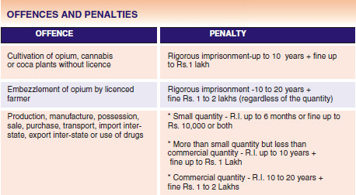

Slide 13
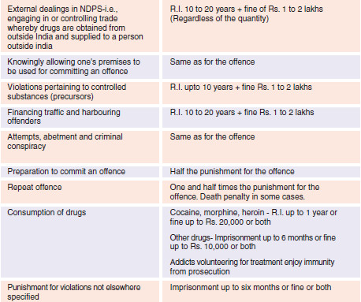

Slide 14
Constitution of Narcotics Control Bureau(1986) – head quarters at New Delhi; zonal offices at Mumbai, Kolkata, Chennai, Varanasi.
Constitution of Central Narcotic Drugs & Psychotropic Substances Consultative Committee - a chairman and 18 other members from diverse fields – periodic review of the NDPS act.
Restricted cultivation of narcotics(poppy, cocoa,cannabis) is allowed under strict control for medical or scientific use.
Prior liscence from the Central Government is must.
Poppy is cultivated in Rajasthan, UP and MP during specific time period of year.

Slide 15
The Insecticide Act(1968):
Regulation of import, manufacture, sale, distribution and use of insecticides with a view to prevent /minimize risks to humans and animals.
Insecticide = a substance which is used for destroying any kind of pest in the agricultural, industrial or domestic places.
Formation of Central Insecticides Board and a Registration Committee for registration of all insecticides after scrutinizing their formulae and verifying claims of the manufacturers.
Licensing officers in each state to give license the verified manufacturer.
Insecticide inspectors at central and state levels
A central insecticide laboratory to analyze and verify samples.

Slide 16
The Insecticide Rules(1971):
No person can manufacture, store or expose for sale any insecticide in the same building where any consumable articles for humans/animals are manufactured, stored or exposed for sale.
Proper packaging and labeling
Label must mention following details in indelible ink.
  Name of insecticide
  Name of manufacturer
  Registration no. of insecticide
  Name of active ingredient
  Net content
  Batch no.
  Exp. Date
  Antidote if any

Slide 17
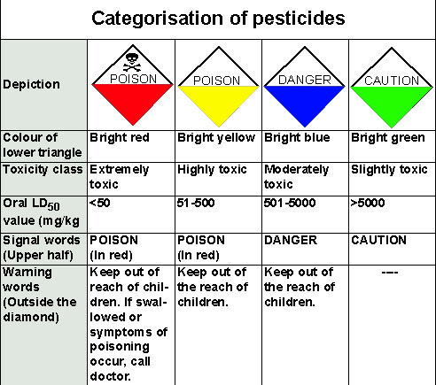
Label should also contain, in a prominent place, a diamond shaped square , the upper half triangle must contain following info.
(In Black)
(In Black)
Keep out of the reach of children

Slide 18
A separate leaflet containing following details is must
  Exact indication and mode of use.
  Nature of harm by active ingredient to humans and animals with symptoms and treatment(first aid measures and antidote if any)
  Warning relating to explosive/inflammable/irritating nature
  Instruction for safe disposal of used containers/unused stock.

Slide 19
Prevention of offences (by Acids) Act 2008
Act applies to victims of acid attacks
“Acid” = any substance which has the character of acidic or corrosive or burning nature that is capable of causing bodily injuries leading to scars or disfigurement or temporary or permanent disability.
“Acid attack” = any act of throwing acid or using acid in any form on the victim with the intention of or with knowledge that such person is likely to cause to the other person Permanent or partial damage or deformity or disfiguration to any part of the body of such person.
the National Acid Attack Victim’s Assistance Board
A victim, or her dependents or immediate family member may apply to the Board for financial and other relief.

Slide 20
Board or the monitoring authority shall satisfy itself about the claim & make a preliminary assessment of it.
Whithin 30 days, board shall order an interim financial relief of upto Rs.5, 00,000/- directly to the hospital for the treatment.
further sum of money(maximum of Rs 30 lakhs) as approved by the Board, from time to time, shall be ordered for the same.
In case of death of the victim, acc. to circumstances of the case, The Board will pay a lump sum not exceeding Rs. 2,00,000/- to the legal heir or the victim.
No medical hospital or speciality ,government/private shall deny any form of treatment to any such victim and will inform the national Board and the police of the same.
If any hospital refuses for the same – show cause notice + fine up to Rs. 5 lakh.

Slide 21
INSERTION OF NEW SECTION IPC 326 A - Whoever does any act of throwing acid or using acid in any form on the other person with the intention of or with knowledge that he is likely to cause such person Permanent or partial damage or deformity or disfiguration or disability to any part of the body of such person shall be punished with imprisonment of either description for a term which shall not be less than 10 years but which may extend to Life and shall also be liable to fine which shall be a min. of Rs. 2 Lakhs to max. Rs 5 lakhs
INSERTION OF NEW Section IPC 326 B - Attempt to throw or use acid in any form on the other person - with such intention or knowledge and under such circumstances that, if he by that act caused Permanent or partial damage or deformity disfiguration or disability to any part of the body of such person , shall be punished with imprisonment of either description for a term which shall not be less than 7 years and shall also be liable to fine to a minimum of Rs 1 lakh.

Slide 22
Duties of A Doctor in case of Poisoning
CLINICAL :
  Emergency ABCDE
  Proper history
  Interrogate pt,family,friends,neighbours
    What poison
    How much
    When
    How
    Primary symptoms
    Any allergy
    Associated illness
  Estimate toxicity
  Samples to lab.– blood, urine, vomitus, gastric lavage, feces.
  Ix – blood CBC, ABG, s. electrolytes, renal profile, liver profile, ECG, EEG, chest & abd. X-ray.
  Assessment & monitoring of neuro, cardio, liver, kidney function.

Slide 23
LEGAL :
  Private doctor/hospital – Accidental and suicidal cases should inform police, suspected/definite homicidal cases must inform police(sec. 39 Cr.PC, Sec. 176 IPC)
  Government doctor/hospital – all cases must inform police
  No scope of professional secrecy if police needs information(Sec. 175 Cr.PC)
  If information not given/ given wrong – culpable under IPC 193,202
  Every effort should done to collect & preserve evidence – deliberate omission to do so – culpable under IPC 201
  If patient conscious but about to die – make arrangement to record dying declaration.
  If patient dies – not to issue death certificate, send body for PM examination.
  Maintain detailed written records.

Slide 24
☺ THANK YOU ☺

