Slide 1
ANATOMY OF THE ORBIT
Dr Nirali Chauhan

Slide 2
Levels of Evidence
Grade A – Systemic reviews, Meta analyses, RCT
Grade B – Non-randomised studies
Grade C – Observational studies
Grade D – Case Series, Expert opinion

Slide 3
Levels of Evidence
**** ~ Systematic reviews, meta analysis of randomized control studies
*** ~ Non randomised studies
** ~ Observational or non experimental studies
* ~ Expert opinion

Slide 4
INTRODUCTION
Quadrilateral pyramid
Volume – 30 ml, eye -6.5ml
40 mm horizontally, 35 mm vertically
Made up of 7 bones

Slide 5
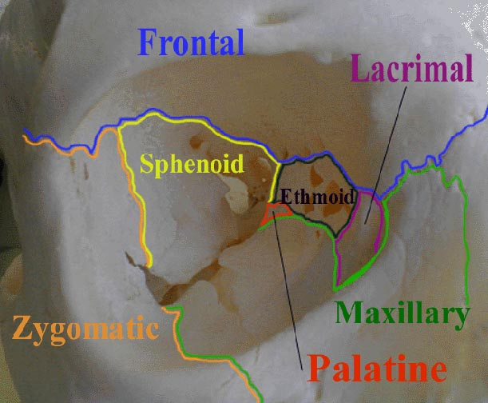

Slide 6
EMBRYOLOGY
Bones making up the orbit are derived from the neural crest
Ossification complete at birth

Slide 7
MEDIAL WALL
Frontal process of maxilla
Lacrimal bone
Lamina papyracea of ethmoid
Body of sphenoid

Slide 8
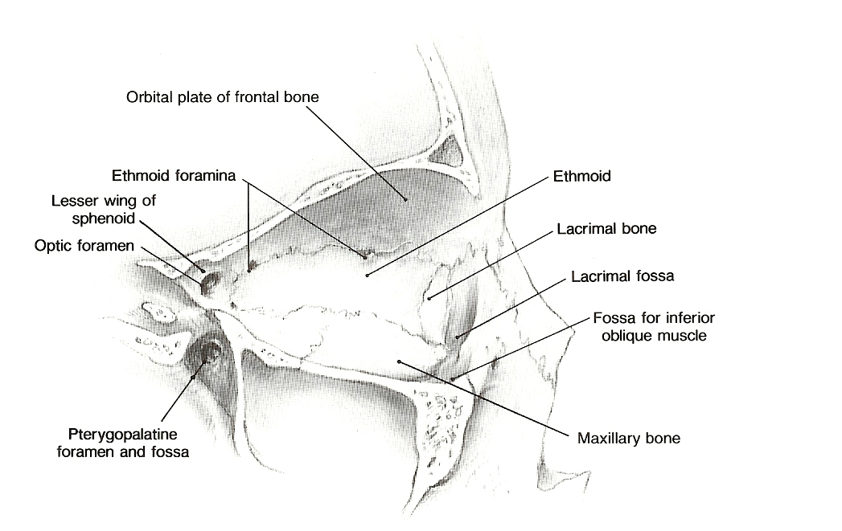

Slide 9
APPLIED ANATOMY
Lamina papyracea extremely thin; infections of ethmoid sinus spread to orbit
Tumours of nasal cavity
Lacrimal bone in region of lacrimal fossa penetrated in endoscopic DCR
Frontoethmiod suture line
Anterior and posterior ethmoidal foramina
24 – 12 – 6 rule

Slide 10
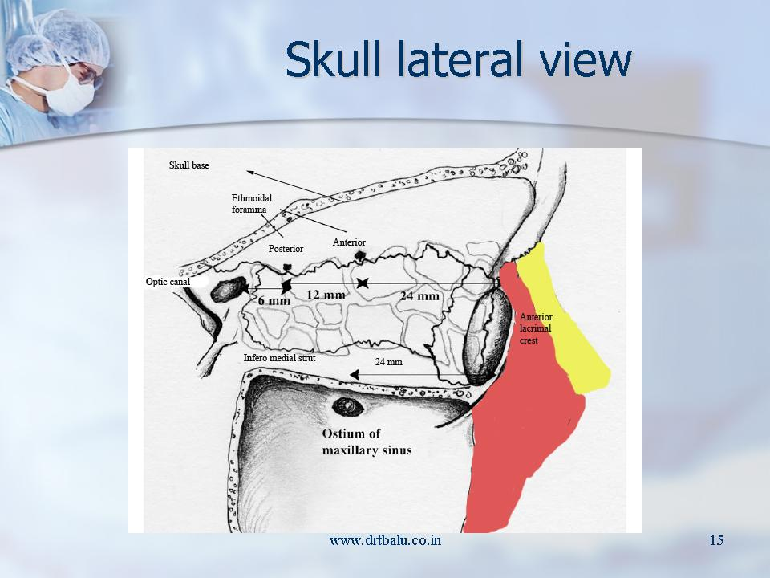

Slide 11
INFERIOR WALL
Orbital plate of maxilla
Zygomatic orbital plate
Orbital process of palatine bone

Slide 12
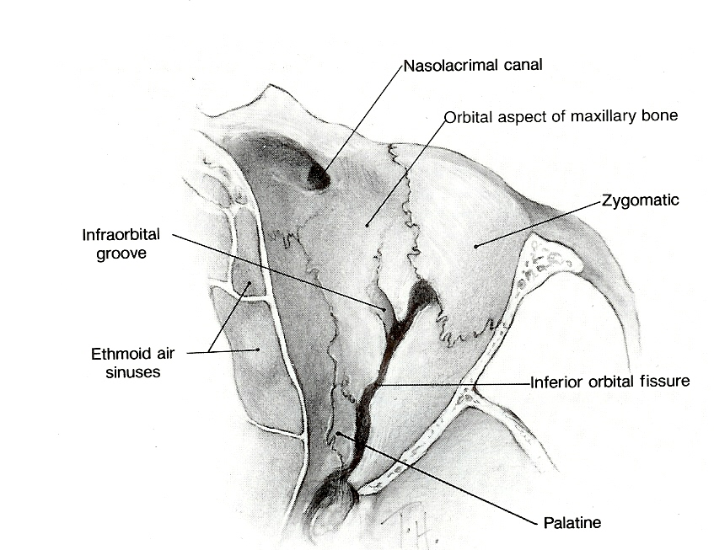

Slide 13
APPLIED ANATOMY
Origin of inferior oblique
Involved in blow-out fractures of the orbit

Slide 14
SUPERIOR WALL
Triangular
Orbital plate of frontal bone
Lesser wing of sphenoid

Slide 15
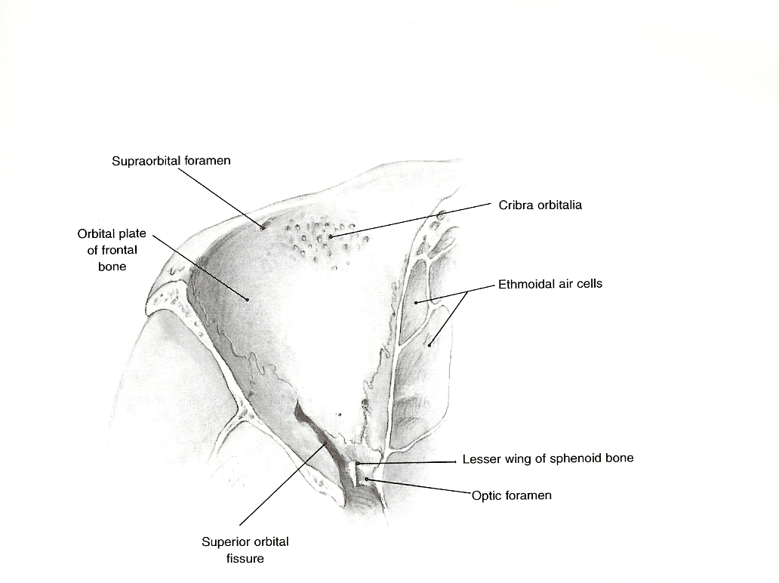

Slide 16
APPLIED ANATOMY
Supraorbital foramen
Trochlea

Slide 17
LATERAL WALL
Greater wing of sphenoid
Orbital surface of zygoma
Zygomatic process of frontal bone
Superior orbital fissure
Inferior orbital fissure

Slide 18
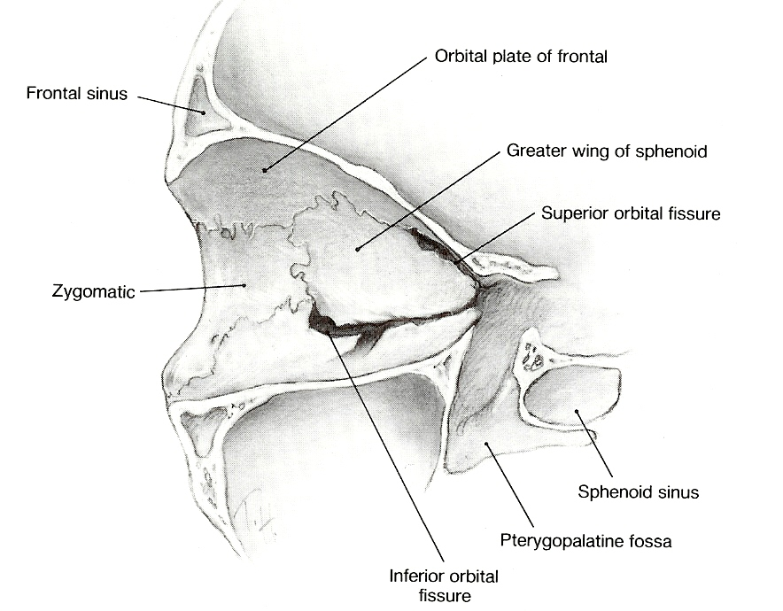

Slide 19
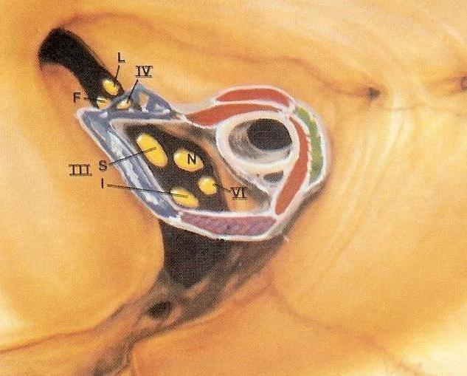
Superior orbital fissure

Slide 20
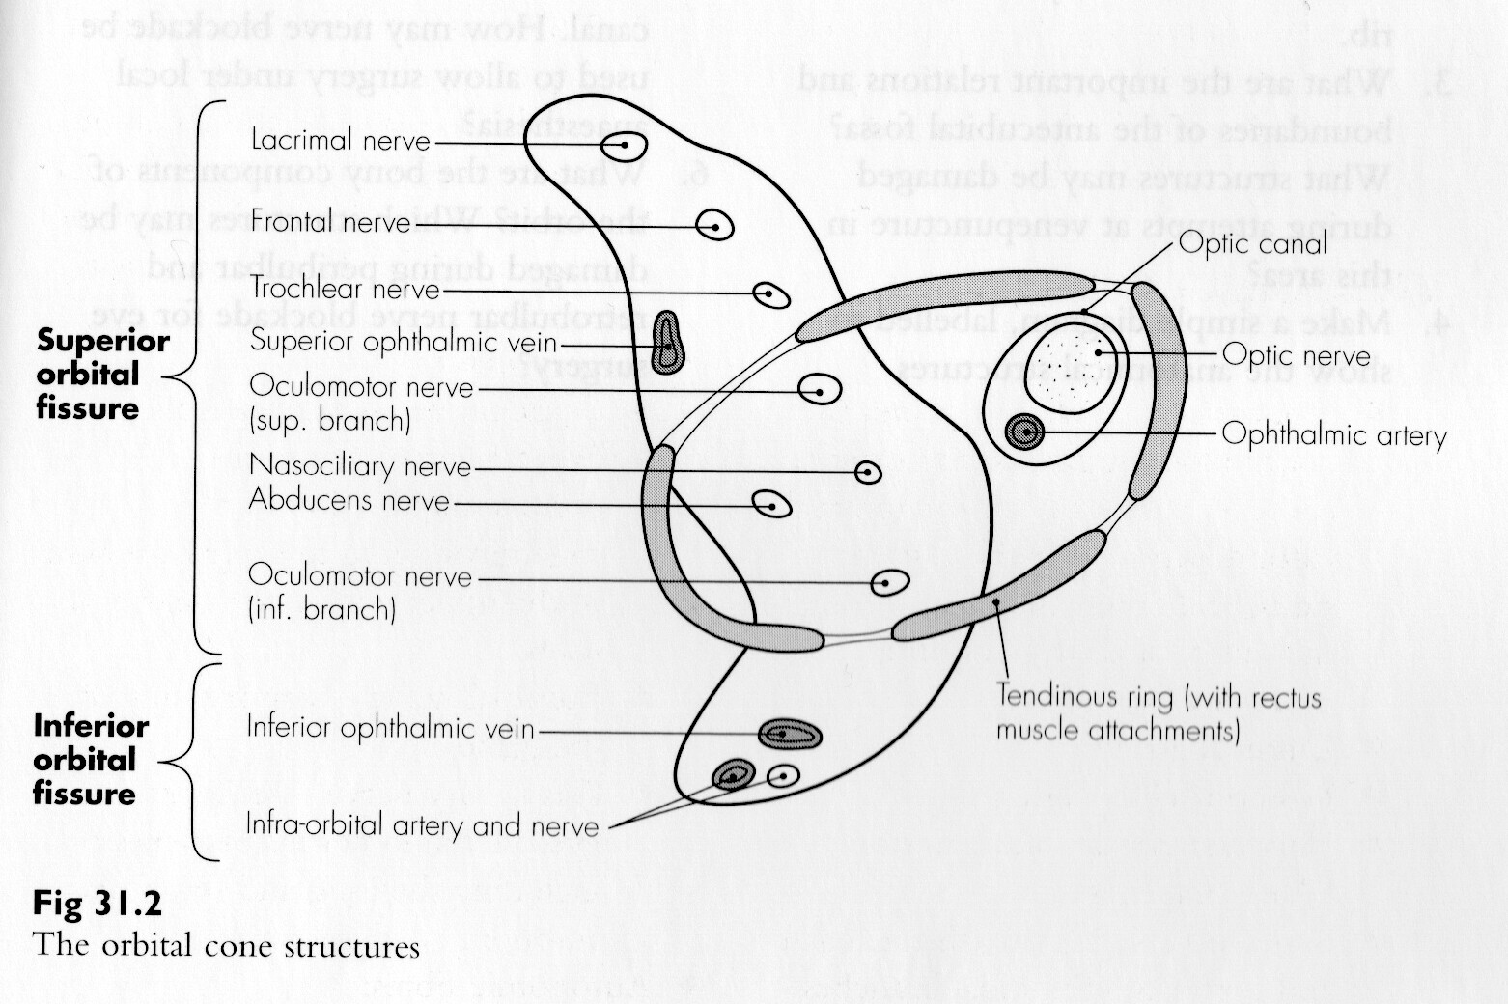
Inferior orbital fissure

Slide 21
Openings
Optic canal- optic nerve with meninges and ophthalmic artery
Foramen rotandum - maxillary nerve
Superior orbital notch- supraorbital nerve and vessels
Infra orbital foramen- infraorbital nerve and artery
Inferior orbital fissure- inferior ophthalmic vein & infra orbital artery & artery.

Slide 22
Opening
Superior orbital fissure-
Outside tendinous ring – structures passing outside are:
Lacrimal nerve –V1
Frontal nerve -V2
Trochlear nerve
Superior and inferior veins
Inside tendinous ring- structures passing inside the ring are -
Oculomotor (3rd cranial nerve) upper division
Nasociliary nerve
Abducent nerve (6th cranial nerve)
Oculomotor lower division (3rd cranial nerve)

Slide 23
SOFT TISSUES OF THE ORBIT
Orbital septum
Periorbita
Orbital fat
Extraocular muscles
Lacrimal system

Slide 24
ORBITAL DECOMPRESSION

Slide 25
INDICATIONS
Thyroid eye disease
Vasculitis
Sphenoid wing meningiomas with compressive optic neuropathy
Large myopic globes
Medial decompression
3 wall decompression

Slide 26
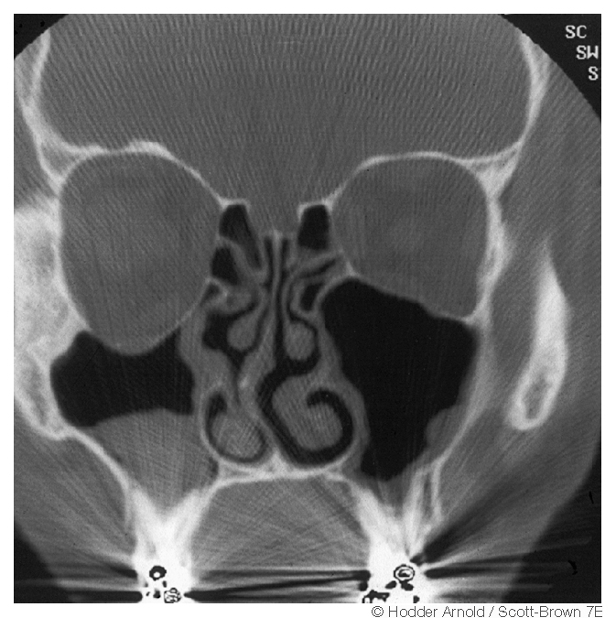

Slide 27
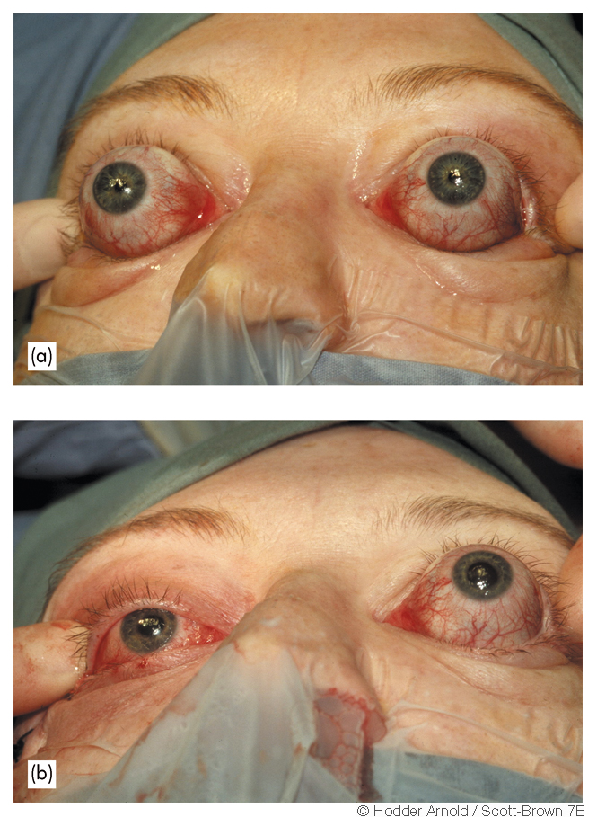

Slide 28
DECOMPRESSION OF THE OPTIC NERVE

Slide 29
Indications
-Trauma
-Thyroid eye disease
-Neoplastic decompression
-Fibrosis due to chronic inflammation
Approaches
Extracranial transcanal endoscopic
Craniofacial

Slide 30
Orbital complications of CRS [**]

Slide 31
ORBITAL CELLULITIS AND INTRAORBITAL ABSCESS
Etiology
Causative organisms
Stages
Management

Slide 32
Staphylococcus aureus
Streptococcus pnemoniae
Haemophilus influenzae
Moraxella catarrhalis
Anaerobes: Bacteroides
Aspergillus
Rhizopus

Slide 33
    1. Pre-septal cellulitis
    2. Orbital cellulitis without abscess
    3. Orbital cellulitis with extra-periosteal abscess
    4. Orbital cellulitis with intra-periosteal abscess
    5. Cavernous sinus thrombosis ?: intracranial
    6. Orbital apex syndrome

Slide 34
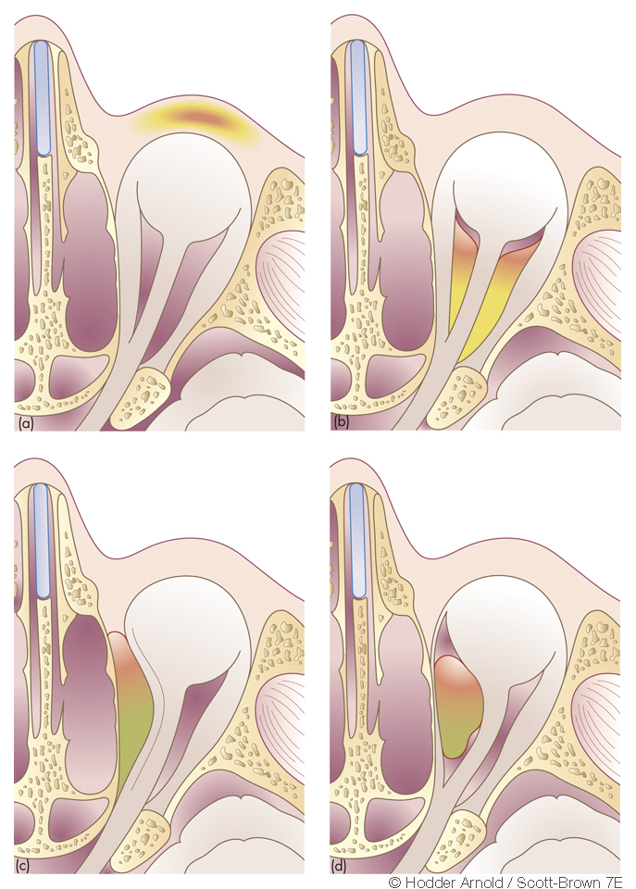
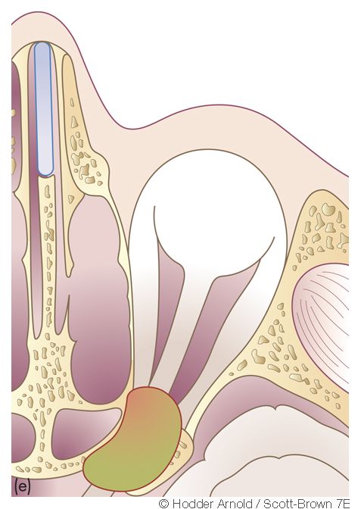
Stages:

Slide 35
C.S.T. | Orbital abscess
Bilateral | Unilateral
Rapidly progressive | Slowly progressive
Hectic fever | Low grade fever
Severe chemosis | Mild chemosis
Paraesthesia of V1, V2 | No paraesthesia
Sequential ophthalmoplegia | Concurrent pan-ophthalmoplegia
Symmetric axial proptosis | Asymmetric quadrantic proptosis

Slide 36
Orbital apex syndrome
Frontal headache + deep orbital pain
Optic nerve involvement (vision loss)
Paralysis of abducens nerve
Paralysis of oculomotor nerve
Paralysis of trochlear nerve
Painful paraesthesia of V1, V2

Slide 37
Management:
Investigation-
CT Scan
MRI
Treatment-
Medical
Surgical

Slide 38
Medical management
    1. Broad spectrum, high dose IV antibiotics
    (Ceftriaxone + Metronidazole)
    2. NSAIDs
    3. Topical / oral decongestants
    4. Mucolytics: Bromhexine, Ambroxol
    5. Nasal saline irrigation

Slide 39
Surgical management
For sinusitis:
1. Frontal trephination
2. External fronto-ethmoidectomy (Lynch Howarth)
3. Functional Endoscopic Sinus Surgery
For orbital complication:
1. Sub-periosteal abscess drainage
2. Orbital decompression

Slide 40
THE ‘IMPLODING’ ANTRUM
Increasing enophthalmos associated with contracture of the ipsilateral maxillary antrum
Spontaneous or idiopathic
After orbital decompression
Endoscopic middle meatus antrostomy
COMPLICATIONS

Slide 41
NAME OF STUDY | NAME OF AUTHOR | REFERENCE DETAILS | SAMPLE SIZE | RESULT | P VALUE | CONCLUSION
Ocular complications of functional endoscopic sinus surgery | Rakhshandeh Alipanahi | Journal of pakistan medical association,june 2011 | 53 | Among the 53 cases, there were 7 (13.1%) with ocular complications following functional endoscopic sinus surgery; one case (1.9%) of cellulitis, 6 cases (11.3%) of lids swelling and conjunctival injection | 0.001 | Functional endoscopic sinus surgery is an effective treatment modality against medical therapy for chronic sinus diseases

Slide 42
NAME OF STUDY | NAME OF AUTHOR | REFERENCE DETAILS | SAMPLE SIZE | RESULT | P VALUE | CONCLUSION
Clinical outcomes of chronic rhinosinusitis in response to medical therapy: results of a prospective study. | Hessler JL, Piccirillo JF, Fang D, Vlahiotis A, Banerji A, Levitt RG, Kramper MA, Thawley SE, Hamilos DL. | Am J Rhinol. 2007 Jan-Feb;21(1):10-8. | 84 | Baseline facial pain or facial pressure was negatively associated with outcome and did not correlate with extent of disease by sinus CT scoring | 0.048 and 0.029 respectively | These findings highlight the limitations of current medical treatment for CRS and the need for novel treatment strategies.

Slide 43
references
Report of the rhinosinusitis task force committee meeting. Otolaryngology and head and neck surgery.1997;117: 51-68.
Lidhodt T et al.Glucocorticoid treatment for nasal polyps: the use of topical Budesonide powder , intramuscular betamethasone and surgical treatment. Archives of otolaryngology head and neck surgery.1997;123:595-600.
Drettner B et al.prophylactic treatment with flunisolide after polypectomy. Rhinology 1982;20:149-58.
Singh B. The management of sinogenic orbital complications. Journal of laryngology and otology. 1995; 109:300-3.
Hawkins DB, Clark RW. Orbital involvement in acute rhinosinusitis. Lessons from 24 childhood patients. Clinical pediatrics. 1977; 16:464-71.
No authors given. Steroid therapy of acute ent infections: Rarely indicated. Prescrire international. 2001; 10:185-7.

Slide 44
MCQ

Slide 45
Q -1 Bony orbit is made up of how many bones?
6
7
8
9

Slide 46
Q-2 Rule for position of anterior and posterior ethmoidal foramina is
24-12-6
24-12-12
36-24-12
12-24-12

Slide 47
Q-3Nasolacrimal duct drais into which meatus?
Inferior meatus
Middle meatus
Superior meatus
Spheno-ethmoidal recess

Slide 48
Q-4 All are supplied by occulomotor nerve except
Superior rectus
Lateral rectus
Inferior rectus
Medial rectus

Slide 49
Q.5 what is orbital apex syndrome?
Involvement of III, IV,VI
Involvement of III, IV,VI, V1
Involvement of III, IV,VI, V1, V2
Involvement of II, III, IV,VI, V1, V2,

Slide 50
THANK YOU

Slide 51
1-b
2-a
3-a
4-b
5 -D

