Slide 1
ANATOMY OF TRIANGLES OF NECK
DR.JINESH SHAH

Slide 2
Levels of Evidence
Grade A – Systemic reviews, Meta analyses, RCT
Grade B – Non-randomised studies
Grade C – Observational studies
Grade D – Case Series, Expert opinion

Slide 3
Levels of Evidence
**** ~ Systematic reviews, meta analysis of randomized control studies
*** ~ Non randomised studies
** ~ Observational or non experimental studies
* ~ Expert opinion

Slide 4
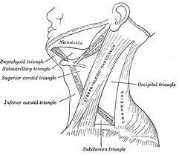
INTRODUCTION

Slide 5
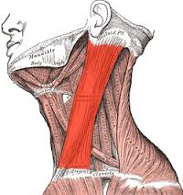
Sternocleidomastoid muscle deviding neck into:
Anterior triangle
Posterior triangle

Slide 6
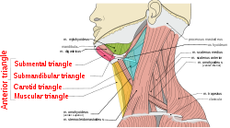
SUBDIVISIONS OF ANTERIOR TRIANGLE

Slide 7
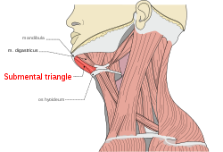
SUBMENTAL TRIANGLE
Contents :
2-4 submental lymph nodes
Submental salivary gland
Submental veins

Slide 8
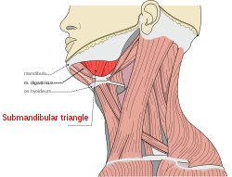
Submandibular triangle
Submandibular salivary gland
Deep fascia
Facial artery
Anterior facial vein
Marginal mandibular nerve
Lymphnodes

Slide 9
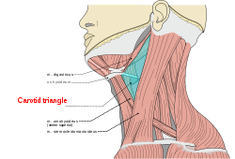
Carotid triangle
Arteries : CCA,ECA,ICA
Veins : IJV, common facial, pharyngeal, lingual
Nerves :vagus, superior laryngeal, spinal accessory, hypoglossal, sympathetic chain
Carotid sheath
Lymph nodes

Slide 10
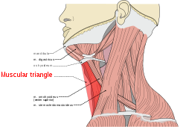
Muscular triangle
Contents :
Infrahyoid muscles

Slide 11
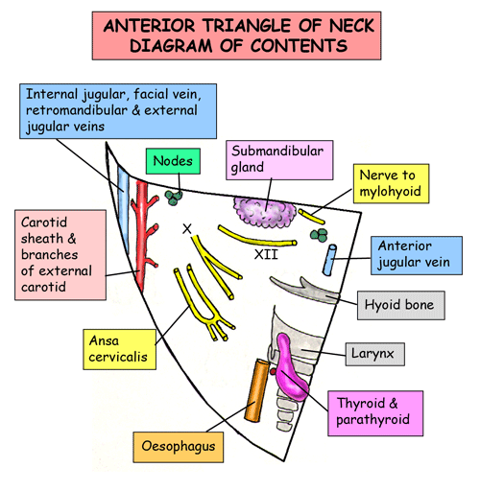

Slide 12
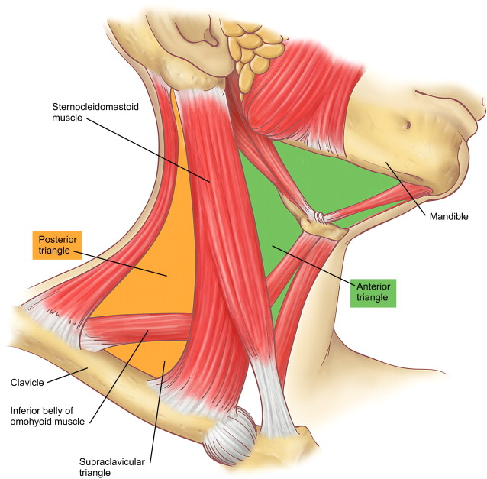
Posterior triangle

Slide 13
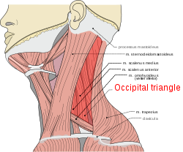
Lateral neck triangle

Slide 14
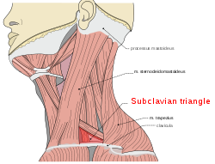
Subclavian triangle

Slide 15
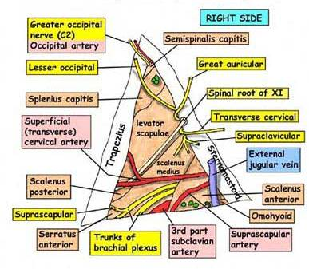
Contents of posterior triangle

Slide 16
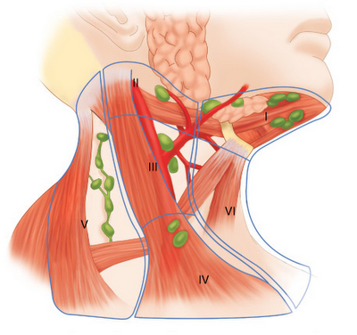
Lymph nodes in neck

Slide 17
NAME OF STUDY | NAME OF AUTHOR | REFERENCE DETAILS | SAMPLE SIZE | RESULT | P VALUE | CONCLUSION
Complications from planned, posttreatment neck dissections. | Davidson BJ, Newkirk KA, Harter KW, Picken CA, Cullen KJ, Sessions RB. | Arch Otolaryngol Head Neck Surg. 1999 Apr;125(4):401-5. | 34 | Complications were seen in 13 (38%) of 34 patients and 15 (37%) of 41 neck dissections. Wound complications occurred in 9 (22%) of 41 dissections | 0.005 | The complication rate associated with planned post treatment neck dissection is similar to that previously reported for neck dissection. Wound complications are more common when higher preoperative radiotherapy doses are used.

Slide 18
Q-1 Submandibular triangle is bounded by all except
Body of mandible
Anterior belly of digastric
Posterior belly of digastric
Sternocleidomastoid

Slide 19
Q-2 Level 6 lymphnodes lie in
Submandibular region
Pretracheal and Paratracheal region
Occipital region
Submental region

Slide 20
Q-3 Contents of carotid sheath
Internal jugular vein
Common carotid artery
Vagus nerve
All of the above

Slide 21
Q-4 Branches of internal carotid artery in neck
0
1
2
3

Slide 22
Q-5 Nasopharynx drains into
Level 1 LN
Level 3 LN
Level 4 LN
Level 5 LN

Slide 23
Thank you

