Slide 1
EXTRA CRANIAL COMPLICATIONS OF CHRONIC SUPPURATIVE
OTITIS MEDIA
Dr Nirali Chauhan

Slide 2
Levels of Evidence
Grade A – Systemic reviews, Meta analyses, RCT
Grade B – Non-randomized studies
Grade C – Observational studies
Grade D – Case Series, Expert opinion

Slide 3
Levels of Evidence
**** ~ Systematic reviews, meta analysis of randomized control studies
*** ~ Non randomised studies
** ~ Observational or non experimental studies
* ~ Expert opinion

Slide 4
Chronic otitis media
Non-suppurative (most common in children).
Suppurative (most common in adults):
1- Tubotympanic (safe).
2- Atticoantral (unsafe, associated with a lot of complications).

Slide 5
We have to treat OM aggressively, to avoid complications.
Ear is at base of skull, so any infection can go into the brain.
Only 2 mm separates the middle ear from the brain.

Slide 6
Classification:
Intra-cranial complications
Cranial(intra temporal) complications
Extra-cranial complications

Slide 7
Predisposing factors:
• Virulent organisms.
• Cholesteatoma and bone erosion.
• Presence of a congenital dehiscence (e.g.
dehiscent facial canal or jugular bulb) or a preformed pathway (e.g. skull base fracture).
• Obstruction of drainage e.g. by a polyp.
• Low resistance of the patient.

Slide 8
Pathways
Bone erosion
Blood vessels
Pre formed pathways
Labyrinth
IAC/CA

Slide 9
Routes of Spread
Direct erosion.
Venous thrombosis.
Surgical defects.
Accidental defects.
Normal anatomical openings.
Peri arteriolar space.

Slide 10
ROUTES OF SPREAD
Direct extension (natural):
Middle ear to inner ear through the round (easier, because oval is covered by the stapes bone), and oval windows.
Middle to outer ear by rupture of tympanic membrane.
Eustachian tube to nasopharynx.

Slide 11
ROUTES OF SPREAD
Bone extension (direct spread through ordinary boundaries, by destroying the bones):
Roof to brain.
Through the medial wall to the inner ear.
Sigmoid sinus

Slide 12
ROUTES OF SPREAD
Blood or lymph:
a. Veins (blood)

Slide 13
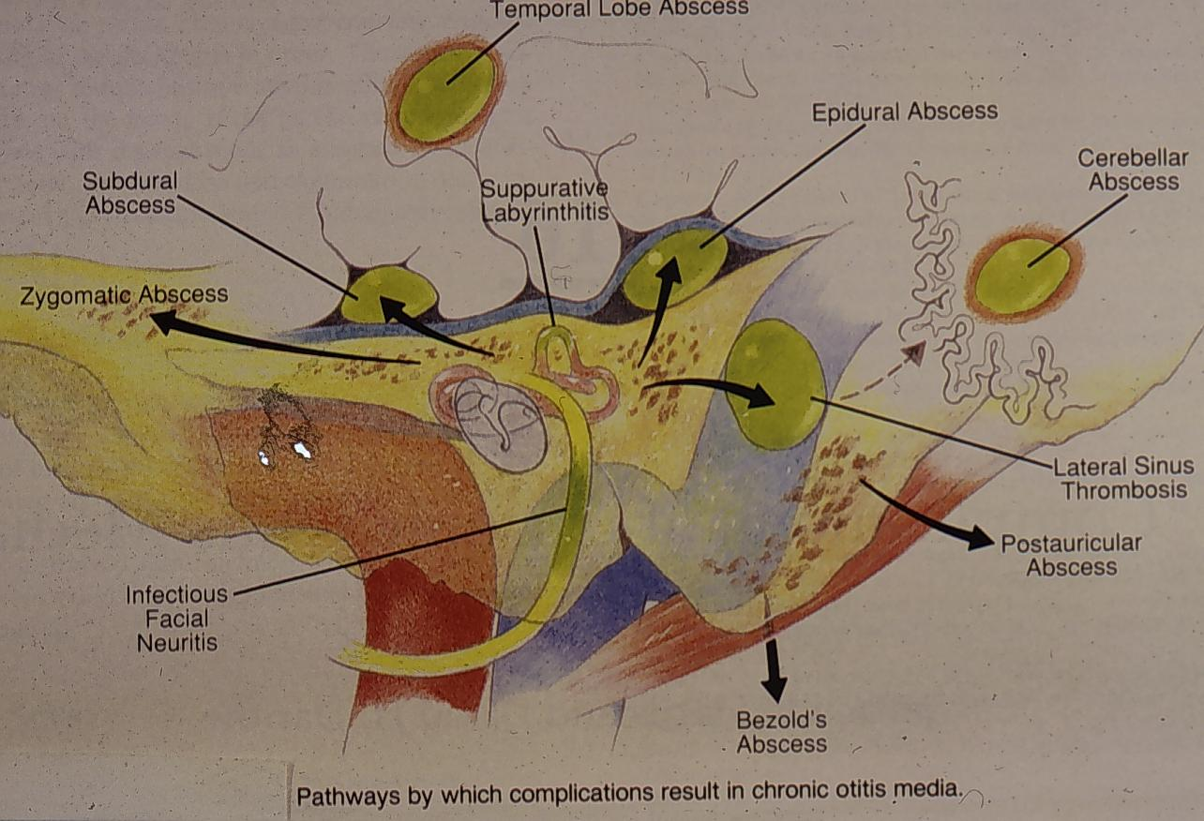

Slide 14
Factors influencing development of complications
Age
Poor socioeconomic status
Virulence of organisms
Strepto. Pneumone- autolysin, pneumolysin
H.influenza- resistance to Blactamase AB & chloramphenicol
Ps. aeruginosa, MRSA
Immune-compromised host
Preformed pathways
cholesteatomas

Slide 15
Preformed pathways
Congenital dehiscence(FC/JB)
Patent suture: petrosquamous suture
Previous skull fractures
Surgical defects; stapedectomy, fenestration & mastoidectomy with exposed dura
Oval & round window
From labyrinth: ICA, aqueducts of vestibule & cochlea to meninges

Slide 16
Extra Cranial Complications

Slide 17
Intra temporal cx
Mastoiditis and mastoid abscesses (most common complication).
Subperiosteal abscesses:
Post auricular, Zygomatic, Von Bezold’s, citteli’s, luc’s, para/retro pharyngeal .
• Petrositis.
• Labyrinthitis.
• Facial paralysis.
• Osteomyelitis of the temporal bone
.

Slide 18
EXTRACRANIAL COMPLICATIONS
Retropharyngeal and Parapharyngeal abscesses
Septicemia – pyemia
External otitis.
Cervical lymphadenitis

Slide 19
Otitis externa
Infection will spread from middle ear to outer ear through the TM, which is usually perforated.

Slide 20
Retropharyngeal abscess
Go to the pharynx and form an abscess,
Through the blood.

Slide 21
CRANIAL (INTRATEMPORAL) COMPLICATIONS
Mastoiditis
Petrositis
Facial nerve paralysis
Labyrinthine fistula and suppurative labyrinthitis

Slide 22
MASTOIDITIS
(a) acute mastoiditis
(b) masked mastoiditis

Slide 23
Acute mastoiditis
Pathology:
(1) Involvement of the bone of the mastoid air cells by acute suppurative inflammation.
(2) hyperaemic decalcification & osteoclastic resorption of bony walls.

Slide 24
Clinical features:
Ear discharge, pain behind ear, fever
Mastoid tenderness, sagging of PS meatal wall, perforated TM, swelling over mastoid region, hearing loss
Reservoir’ sign
Light house sign
Subperiosteal abscesses:
Post auricular, Zygomtic, Von Bezold’s, citteli’s, luc’s, para/ retro pharyngeal .

Slide 25
DIAGNOSIS OF ACUTE MASTOIDITIS
General constitutional manifestations.
Tympanic membrane changes: either bulging congested, or perforated with a lot of mucopurulent discharge.
On ototscopy, pus is seen in middle ear, or EAC if TM is perforated.
Sagging of posterosuperior meatal wall (wall between mastoid and EAC): due to destruction, inflammation of mastoid, sagging of wall occurs, narrowing the EAC.

Slide 26
Otorrhoea (and Reservoir sign: when you drain the discharge, it re accumulates again, because it’s found in mastoid, which resembles a pocket, this pocket or air cells are full of pus, once drained, pus re accumulates.)
Retro auricular tender red swelling.
Subperiosteal and bezold’s abscesses if infection persists. If infection persists, or in a poor health care center, abscess may rupture into the skin forming a fistula or sinus.
Imaging.

Slide 27
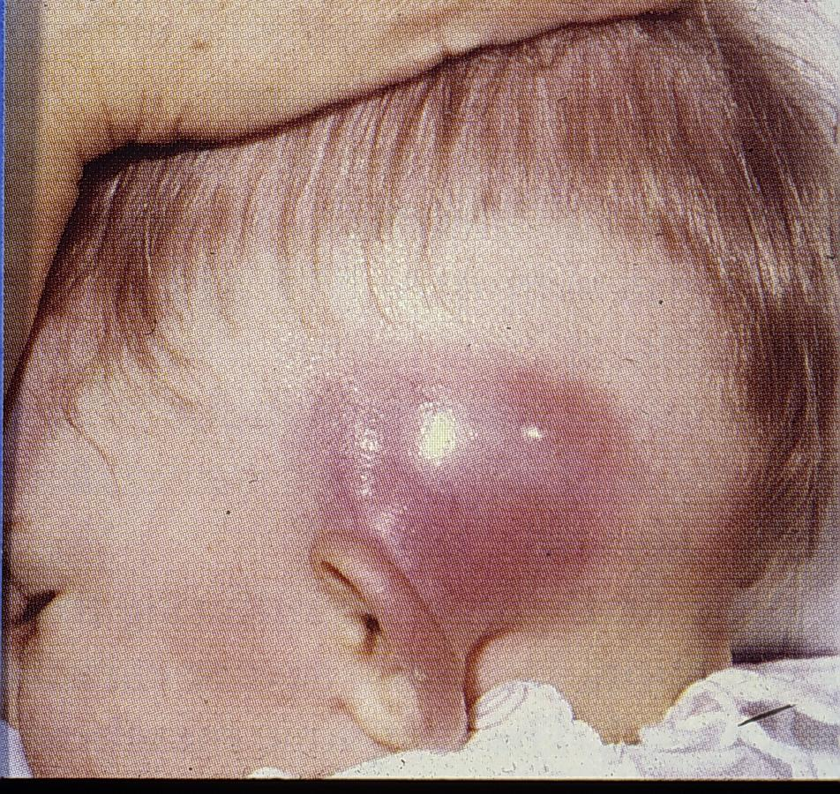
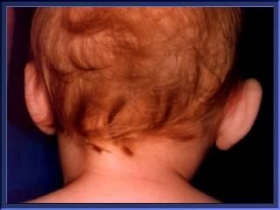

Slide 28
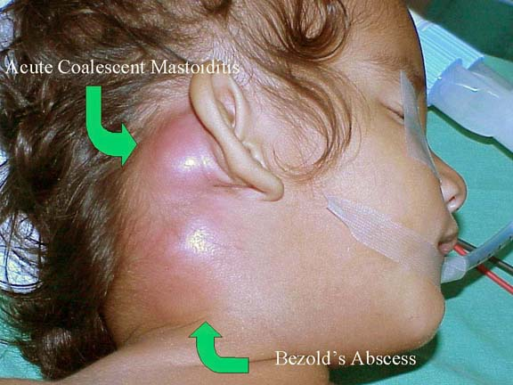

Slide 29
Imaging
X ray mastoid( schuller’s view): coalescent mastoiditis
CT scan: visualize the air cells, which are opaque, and that the ME cavity is filled with infection.

Slide 30
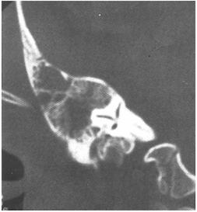
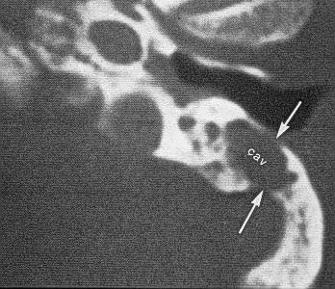

Slide 31
TREATMENT OF ACUTE MASTOIDITIS
Systemic IV antibiotics (of choice).
Myringotomy
Cortical mastoidectomy if there is sign of abscess formation, or medical treatment fails after 3 days.
Mastoidectomy is preferred over drainage, because a simple incision and drainage is not enough and abscess will recur.
Observe for other complication: examine the whole patient; e.g. headache, neck rigidity, vision problem, unsteadiness, facial palsy.

Slide 32
Antibiotics
Acute suppurative OM: streptococcus pneumoniae, streptococcus pyogenes, staphylococcus aureus, branamella catarhalis.
Treatment: penicillins (best), amoxicillin with clavulenic acid, cephalosporines.
Chronic suppurative OM : pseudomonas auriginosa (most commonly), and staphelococcus aureaus.
Treatment: cephalosporine or 2nd generation (cepheroxime or ceprophloxacine)

Slide 33
Incision & Drainage

Slide 34
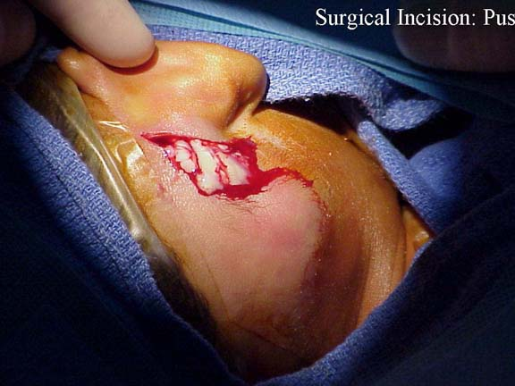
Postauricular incision, then pus starts to come out, because the infection destroyed the bone. Which means it may have destroyed the roof bone, reaching the brain.

Slide 35
Myringotomy

Slide 36
MASTOIDECTOMY
Types:
Cortical.
Modified radical:
infection is extensive and reached the middle ear, remove the wall between the middle ear and mastoid, making the mastid and EAC one cavity.
On otoscopy, you see a room, not the normal view.
Radical.

Slide 37
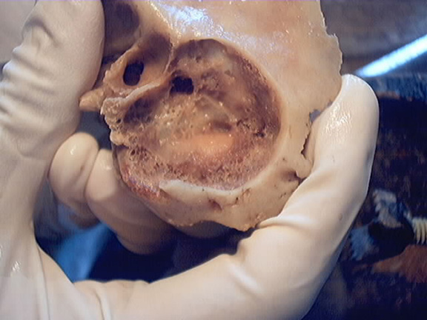
CORTICAL “SIMPLE” MASTOIDECTOMY
An operation in which the mastoid antrum and air cells are converted into one cavity, without disturbing the middle or external ears. It may be combined with myringotomy.

Slide 38
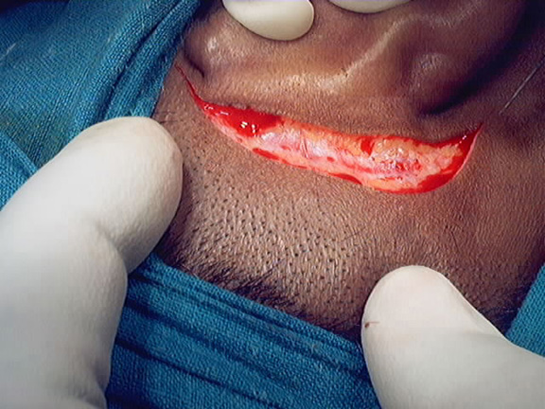

Slide 39
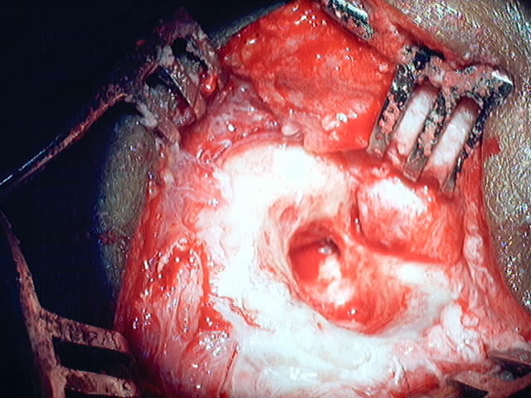

Slide 40
CHOLESTEATOMA
It is like keratin.
Chlesteatoma behaves like malignancy by destroying all structures in front of it (bones, nerves, veins); it’s very dangerous.
Cholesteatoma’s only way of treatment is emergency surgery, never wait or give medication! modified radical mastoidectomy, depending on its location.

Slide 41
Masked mastoiditis

Slide 42
Masked mastoiditis
Also k/a latent mastoiditis.
Slow destruction of mastoid air cells without acute s/s.

Slide 43
Aetiology :
Inadequate Rx
C/F:
Pain behind ear, thick TM, CHL
X ray s/o coalescent mastoiditis
Treatment:
Cortical mastoidectomy + inj. AB

Slide 44
Petrositis (apical apicitis)

Slide 45
Petrous temporal bone
Strongest bone in the skull.
Bone harboring the inner ear.
Petrous apex is the most anterior part of the petrous.

Slide 46
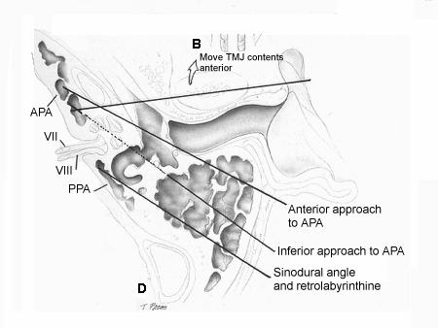

Slide 47
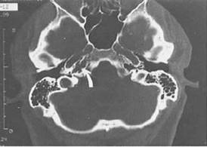
PETROSITIS (PETROUS APICITIS)
An extension of infection from the middle ear into a pneumatized petrous apex.
Rare complication.

Slide 48
DIAGNOSIS OF PETROSITIS
Gradenigo’s syndrome
  Retro-orbital pain, due to trigeminal nerve involvement.
  Lateral rectus palsy (squint), due to Abducens nerve palsy.
  Discharge. Otitis media (persistent otorrhea).
Imaging

Slide 49
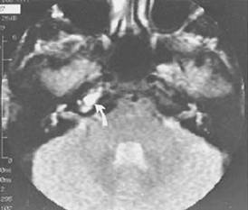
MRI showing opacity by T2 image.

Slide 50
TREATMENT OF PETROSITIS
Broad spectrum antibiotics which covers staphelococus areaus.
Myringotomy if tympanic membrane was not perforated, evacuate all the discharge.
Surgical drainage if antibiotics failed, mastoidectomy must be done to remove the infection from the ME and petrous temporal bone.

Slide 51
Facial nerve paralysis

Slide 52
FACIAL PARALYSIS IN AOM
Of the worst complications.
Facial nerve is normally dehiscent in 20% of the population.
Mostly due to pressure on a dehiscent nerve by inflammatory products, or spread of infection to the nerve, by destructing the bone, leading to paralysis.

Slide 53
It is usually partial and sudden in onset, so patient seeks help immediately.
On the same side of the affected ear.
Treatment:
Systemic antibiotics, myringotomy to drain the pus, and steroids to relieve the edema.

Slide 54
FACIAL PARALYSIS IN CSOM
Usually is due to pressure by cholesteatoma or granulation tissue.
Cholesteatoma forms a mass, destroying the bone.
Exerts pressure on the nerve, causing facial palsy.
Insidious in onset but gradual in progression.
May be partial or complete.
Treatment is by immediate surgical exploration decompression and inspection, keeping in mind not opening the nerve sheath, and “proceed”.

Slide 55
Labyrinthine fistula and labyrinthitis

Slide 56
PATHOLOGY OF LABYRINTHITIS
Labyrinthine fistula (Circumscribed labyrinthitis)
Acute diffuse serous labyrinthitis
Acute diffuse suppurative labyrinthitis
First three are acute.
Chronic labyrinthitis

Slide 57
DEFINITION OF LABYRINTHINE FISTULA
Fistula: opening between 2 cavities.
Loss of the bony labyrinthine wall, exposing the endosteum.
Infection in the mastoid bone will destroy the bone covering of the lateral semicircular canal.

Slide 58
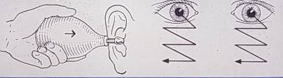
DIAGNOSIS OF LABYRITHINE FISTULA
Asymptomatic, discovered during surgery or on imaging.
Vertigo induced by pressure on the tragus, cleaning the ear, or after valsalva.
History of chronic intermittent ear discharge, then develops vertigo.
SNHL because the labyrinth is connected to the cochlea.
Nystagmus

Slide 59
Investigations of labyrinthine fistula
Fistula test: sudden inward pressure on the tragus.
The air will press on the destroyed semicircular canal, so any pressure, strong or not, induces vertigo with nystagmus towards the affected ear.
The labyrinth is a very sensitive organ.
Caloric test: water in the EAC that is 7 degrees more or less than the normal body temperature (37.2 C), leading to nystagmus, which is normal.
Absent reactive eye movement suggests vestibular weakness of the horizontal semicircular canal of the side being stimulated.
CT scan: to visualize the bone.

Slide 60
TREATMENT OF LABRYNTHINE FISTULA
Systemic antibiotics and canal wall down (CWD) mastoid operation to eliminate the causes.

Slide 61
NAME OF STUDY | NAME OF AUTHOR | REFERENCE DETAILS | SAMPLE SIZE | RESULT | P VALUE | CONCLUSION
Clinical Profile of Tubotympanic CSOM and Its Management With Special Reference to Site and Size of Tympanic Membrane Perforation, Eustachian Tube Function and Three Flap Tympanoplasty | Nishant Kumar,¹ Devashri Chilke,² and M. P. Puttewar³ | Indian J Otolaryngol Head Neck Surg. Mar 2012; 64(1): 5–12. Published online Jul 6, 2011. doi: 10.1007/s12070-010-0114-5 | 90 | . Otitis media is an important and a highly prevalent disease of the middle ear and poses serious health problem world wide especially in developing countries where large percentage of the population lack specialized medical care, suffer from malnutrition and live in poor hygienic environmental conditions. It has been a general view that the hearing loss increases with the size of the perforation, more so if it is in the posterio inferior quadrant. It was found that the maximum average loss occurred at 250 Hz. The hearing loss is less in small perforations (less than 2 mm diameter) then in larger ones; less in perforations touching the manubrium than in those away from it, and also less in perforations of the anterioinferior quadrant than in those on posterio-inferior quadrant. A normally functioning eustachian tube is also an essential physiologic requirement for a healthy middle ear and normal hearing. |  | . Young and middle aged population of low socio-economic class are the most common suffers of suppurative otitis media. Tympanic membrane perforations are long standing and they are poorly treated (usually with ear drops only) by general practitioners in this group. Unilateral ear involvement (that too on left side in majority of cases) in CSOM has been found more commonly than bilateral ear involvement. Hearing losses as on PTA in dry TM perforations range from 16 to 46 dB (conductive) and roughly 2/3rd of the cases have mild conductive hearing loss. Average hearing loss has been observed to be greater at lower frequencies than at higher frequencies. Malleolar perforations reveal greater hearing loss a compared to non-malleolar ones (even if both are of identical size). Hearing loss increases with the increase in the size of tympanic membrane perforation. Site of perforation is also an important factor as posterior quadrant pars tensa perforations have greater hearing loss than anterior quadrant perforations. Roughly 1/3rd cases of safe CSOM with dry TM perforation have normally functioning Eustachian tube and slightly less than 50% have only mild dysfunction as noted by Eustachian tube opening pressure. It is concluded that a good correlation exists between the functional status of eustachian tube and success of myringoplasty operation. The success rates of myringoplasty in normal ET function (81.8%) an in mild ET hypofunction (72.7%) are significant as compared to failures in the presence of moderate and severe ET hypofunction, whatever may be the technique.

Slide 62
MCQ

Slide 63
1. Which are the following are pathologies for acute mastoiditis?
Acute suppurative inflammation.
Hyperaemic decalcification
Chronic suppurative inflammation.
Virulence of organism

Slide 64
2. What are the following are intra temporal complications of COM?
Mastoiditis
Petrositis
Facial nerve paralysis
Labyrinthine fistula and suppurative labyrinthitis
All of the above

Slide 65
3. What is gradenigo syndrom?
  Retro-orbital pain
  Lateral rectus palsy
  Persistent otorrhea
  Earache

Slide 66
4.Which are the following are types of subperiosteal abscess?
Cetelli’s abscess
Bezold abscess
Peritonsillar abscess
Luc’s absess

Slide 67
5. Which is the following condition in which fistula test is positive?
Circumscribed Labyrinthitis
Acute mastoiditis
Meningitis
Petrositis

Slide 68
Thank you

Slide 69
A,b
E
Abc
Abd
A

