Slide 1
Medicolegal Examination of accused of sexual offence
- Dr. Kalpesh Zanzrukiya

Slide 2
Medicolegal examination of accused should be done after examination of victim.

Slide 3
Preliminaries
Name, age, sex, address, religion, marital status, occupation
Requisition done by
Accused brought by whom
MLC No. , date
Consent :
  Informed written witnessed consent.
  He should be explained that he has right to refuse for consent but refusal of consent/ the report of examination for examination may be go against him in the court.

Slide 4
Accused should be identified by escorting police person whose name, buckle number, police station noted.
Any 2 identification marks noted.
Time, date, place of examination commencement & completion.

Slide 5
Brief history
History of the incident (in verbatim, in detail, with date, time and place):
  As given to the police
As given by himself now..
Whether admits or denies the alleged incidence.
Whether he know the victim before the incidence.
Details of incidence in his verbatim.

Slide 6
Whether changed the clothes after the incident.
Whether passed urine/stool/took bath/shaved pubic hairs since the alleged assault
Sexual orientation : heterosexual/homosexual/bisexual
Any addiction/ consumption of alcohol
Any past/ present physical/psychological illness/surgical operations/accidents.
History of any past/present STD.
On any medication

Slide 7
General examination
Age should be determined
Height, weight
Built, nourishment
Dental status charting
Temp, Pulse, R/R, BP
Mental status & behavior
Speech
Gait
Co-ordination
  Finger-finger test, finger-nose test etc
Handwriting

Slide 8
Make him stand on a clean white paper sheet
Request him to undress himself
Look closure to all cloths for
  Stains – semen, blood, saliva, cosmetic material, any other suspected stain
  Unusual smell like alcohol
  Foreign hairs, fibers, buttons, earth, gravel, weeds(hair in zip, mud-earth grass on knees)
  Earth, mud, grass, fiber over shoe soles
  Signs of struggle – tears, cuts, broken buttons, pins
  UV light scan for seminal stain detection

Slide 9
Secondary sexual characteristics development–
  mustache & beard
  axillary hairs
  pubic hairs
  Adam's apple
  hoarseness of voice
Unusual smell from mouth like alcohol/intoxicating substances

Slide 10
Injuries/Marks of violence – abrasions, bruises, scratches over
  Around mouth, face, neck
  Wrists, arms, shoulders
  thighs
  Bite marks
  Broken/pulled hair, nail, tooth
Whether correlate to the history given by victim

Slide 11
Local examination
Pubic hair - present/absent
  Length
  Matted – cut the matted hair
  Comb rest hair – for any foreign hair
  Sample – cut /pluck min 20 hairs

Slide 12
Penis:
  Length- when flaccid, When erect
  Girth - when flaccid, When erect
  Any deformity – hypo/epispadiasis etc.
  Smegma - present/absent
  Prepuce - circumcised/retractile/non retractile
  Frenulum - intact/torn, bruising
  Any Discharge from the urethra
  Any evidence of STD
  Any injury: bruising, abrasions over glans
Penis washed with saline - collect & send
Swab penis & glans with swabstick, 2 slides – for identification of barr bodies, vaginal & cervical epithelial cells (Papanicolaou’s stain, lugol’s iodine test, microscopy)

Slide 13
Scrotum
  Size & development
  Testis & epididymis
  Any deformity
  Any evidence of STD
  Any injury: bruising, abrasions
Any stains over penis, scrotum, thighs – blood, semen, saliva, vaginal discharge
DNA analysis of all swabs

Slide 14
Clinical tests for potency
Sensations over perineum
Cremastric reflex
Nocturnal penile tumescence(NPT)
Hormone levels
FBS, PP2BS
Doppler USG for penile vessels

Slide 15
Samples
Clothes – each cloth separately
Matted hair
Combing of hair
Cut hair in live, pooled in dead
Fingernail scrapings/ nail clippings
Swab of saliva with slide

Slide 16
Blood
  EDTA bulb – for grouping- matching & DNA
  Plain bulb – for HIV, HbsAg, VDRL, hormone levels
  Fluoride bulb – for alcohol
Swabs from any discharge/stain, suspected regions
Swabs from penis glans with slide – for vaginal epithelial cells
Penile wash - for vaginal epithelial cells
Semen

Slide 17
PROVISIONAL OPINION
POTENCY | OPINION
No signs of impotency | There is nothing to suggest that the person is incapable for sexual performance. Opinion for recent sexual intercourse kept pending for FSL & other lab reports.
Definitive signs of impotency | The examinee person is incapable for sexual performance due to ___________________.
Need for further evaluation for potency | Opinion for potency & recent sexual intercourse kept pending for FSL & other lab reports.

Slide 18
FINAL OPINION
PENILE WASH FOR VAGINAL EPITHELIAL CELLS | POTENCY | OPINION
Negative | No signs of impotency | There are no signs s/o any recent sexual intercourse. There is nothing to suggest that the person is incapable for sexual performance.
Positive | No signs of impotency | There is evidence of recent sexual intercourse. There is nothing to suggest that the person is incapable for sexual performance.
Negative | Definitive signs of impotency | No signs s/o any recent sexual intercourse. The examinee person is incapable for sexual performance due to ___________________.

Slide 19
There are signs/no signs of recent physical injuries.
There are signs suggestive that examinee is under influence of intoxicating substance.

Slide 20
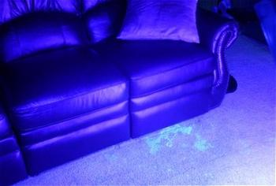
Suspected stains under UV light

Slide 21
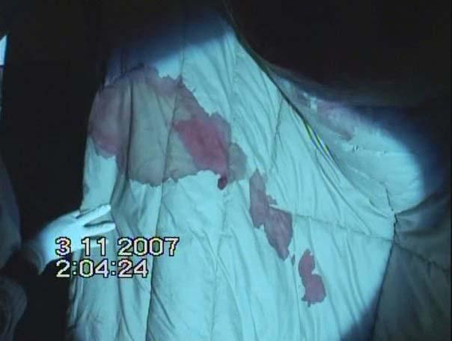
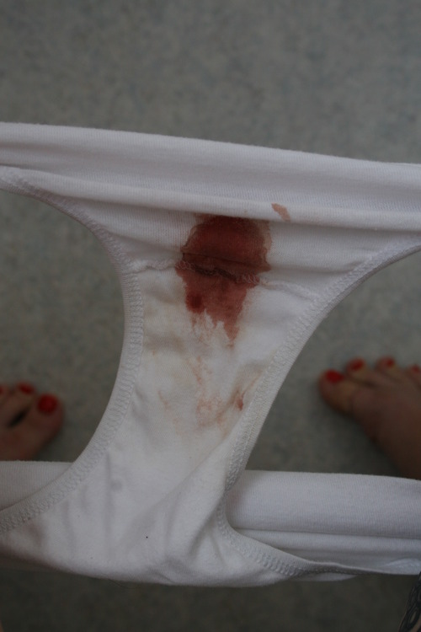
Blood stains

Slide 22
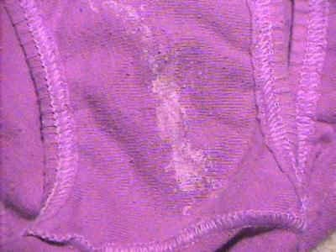
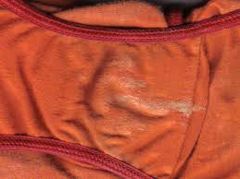
Seminal stains

Slide 23
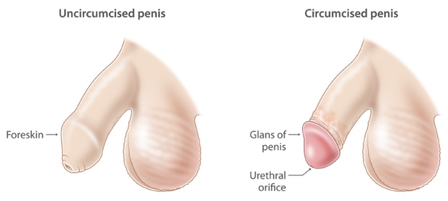
Anatomy of penis

Slide 24
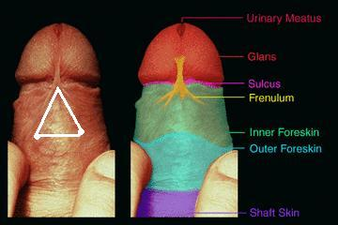
Anatomy of penis

Slide 25
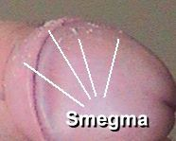
Smegma

Slide 26
Queries any
?

