Slide 1
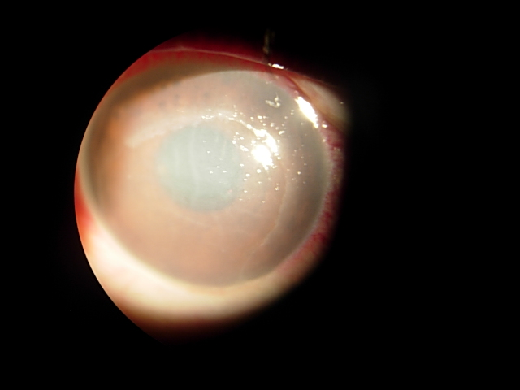
Chemical burn
BY DR RAJNI SETHIA

Slide 2
DEFINATION
Chemical injuries of the eye may produce extensive damage to the ocular surface epithelium,cornea & anterior segment,resulting in permanent unilateral or bilateral visual impairment

Slide 3
INCIDENCE
80% of ocular chemical burns were due to industrial and/or occupational exposure
Ocular burns are more common in males than in females
Lime burn(chunna) very common in India

Slide 4
ETIOLOGY- ALKALI
Ammonia---Fertilizers,Refrigerants,cleaning agents
Lye(NaOH)- Drain cleaners
Potassium hydroxide- Caustic potash
Magnesium Hydoxide –Sparklers
Lime-(Ca(OH)2- Plaster,whitewash,cement
AMMONIA,LYE & LIME IS MOST SERIOUS BURNS

Slide 5
ETIOLOGY-ACID
Sulfuric acid- Industrial cleaners,Battery acid
Sulfurous acid-Bleach,Refigerants
Hydrofluoric acids-Glass polishing
Acetic acids-Vinegars
MOST SERIOUS IS HYDROFLUORIC ACID(Low molecular wt.)

Slide 6
BIO CHEMICAL CHANGES-Alkali
Alkali substances are lipophilic and penetrate more rapidly than acids.
Saponification of cell membrane fatty acids causes cell disruption and death. In addition, the hydroxyl ion hydrolyzes intracellular glycosaminoglycans and denatures collagen.
Liquefactive necrosis, The damaged tissues stimulate an inflammatory response, which damages the tissue further by the release of proteolytic enzymes .

Slide 7
                Alkali substances can pass into the anterior chamber rapidly (approximately 5-15 min) exposing the iris, ciliary body, lens, and trabecular network to further damage. Irreversible damage occurs at a pH value above 11.5.
Liquefactive necrosis, The damaged tissues stimulate an inflammatory response, which damages the tissue further by the release of proteolytic enzymes

Slide 8
.
Alkali substances can pass into the anterior chamber rapidly (approximately 5-15 min) exposing the iris, ciliary body, lens, and trabecular network to further damage. Irreversible damage occurs at a pH value above 11.5.

Slide 9
BIO CHEMICAL CHANGES - Acid burns
Acid burns cause protein coagulation in the corneal epithelium, which limits further penetration.
Thus, these burns usually are nonprogressive and superficial.
Hydrofluoric acid is an exception.

Slide 10
PATHOPHYSILOGY
LEUCOCYTIC WAVE CHEMICAL BURN PED
12-24hrs(PMN+MONONUCLEAR LEUCOCYTES) KERATOCYTE DAMAGE Extensive LSC damage
PHAGOCYTIC DEG. STROMAL THINNING
TYPE I COLLAGENES mmp-8
Plasminogen activities STERILE CORNEAL ULCER
7 days inflam.cells
Vit A
Na hyalurnote
Vit C
Heparin
steroids
Tetracyclin,collagenase inhibitor,oral antioxidents
prostaglandins
steroids

Slide 11
Signs & Symptoms
Pain
Redness
Irritation
Tearing
Inability to keep the eye open
Sensation of something in the eye
Swelling of the eyelids
Blurred vision

Slide 12
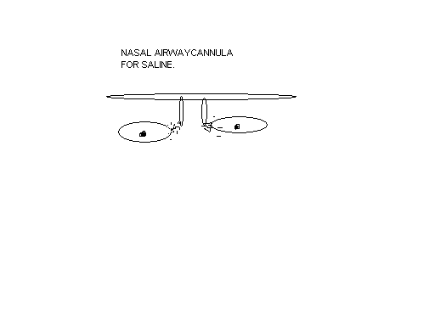
EQUIPMENTS IN EMERGENCY ROOM
Saline bottle
Drip set & Nasal Cannula
pH strip or urine dip strips
Fluroscein stain
Edta
Retractors
Scleral conformer( sterilised)/Prokara rings
Glass rods not used

Slide 13
Classification of severity of ocular surface
Burns by Roper-Hall
Grade Prognosis Cornea Epith. Conjunctiva/limbus
I Good Yes No limbal ischaemia
2 Good Yes <1/3/ <1/3
Corneal haze, iris details visible
3 Good Yes >1/3
Iris details obscured
4 Guarded Yes >1⁄2 limbal ischaemia
Cornea opaque, iris and pupil obscured
corneal haze as an important
prognostic variable.
Rapid changes

Slide 14
New classification of ocular surface burns. DUA et al
Grade Prognosis Clinical findings Conj.invol. Analogue scale
I Very good 0 clock hours of limbal invol. 0% 0/0%
II Good <3 clock hours of limbal invol. <30% 0.1–3/1–29.9%
III Good >3–6 clock hours of limbal invol. >30–50% 3.1–6/31–50%
IV Good-Guard.>6–9 clock hours of limbal invol. >50–75% 6.1–9/51–75%
V Guard-poor >9–<12 clock hours of limbal invol.>75–<100% 9.1–11.9/75.1– 99.9%
VI Very poor Total limbus (12 clock hours) involved Total conjunctiva (100%)
involved 12/100%
*The Analogue scale records accurately the
limbal involvement in clock hours of affected limbus/% of conjunctival involvement.
Only bulbar & fornices conjunctiva is considered

Slide 15
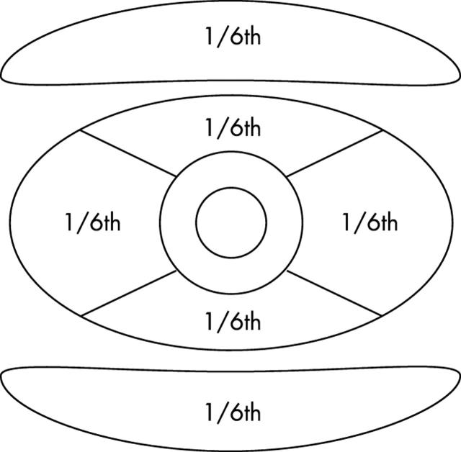
Estimation of conjunctival injury. For example, 1/6th+1/6th = 1/3rd.
BULBAR2/3 & TARSAL 1/3

Slide 16
PROGNOSIS
ALKALI
pH > 11
More then 2quadrent ischemia
Corneal anesthesia
ACID
pH < 2.5
Corneal anesthesia
Ischemia
Severe iritis
Lens opacification

Slide 17
Mc. CULLEY CLINICAL COURSE OF CHEMICAL INJURY
Acute up to 1 week
Early Repair 1-3weeks
Late repair >3wks
(Balance between collagen synthesis & collagen degradation)

Slide 18
Acute 1week | GRADE1 Heal with no damage | GRADE2 Early re-epithelization With slow recovery of stromal clarity | GRADE3 No epithelization no new vessels | GRADE4 No epithelization no new vessels
Early Repair 1-3wks | Uneventful | Slow recovery of stroma | No epithelization (2nd wave of inflammation) | No epithelization Neurotropic ulcer Anterior seg.necrosis
Late Repair >3wks | Mild corneal epitheliopathy (goblet cell damage) | Persistent epith.defect.Superficial vascular pannus in area of stemcell loss | Conjunctivzation of cornea.Symbepheron,entropion,trichiasis,scaring of cornea | Corneal melt,retrocorneal memb.hypotony &phthisis bulbi
Treatment | AT,steroids e/d | AT,steroids e/d,MPS | AT,steroids e/d,MPS LSCT & AMT | AT,steroids e/d,MPS Tenoplasty ,PK, Keratoprosthosis

Slide 19
TREATMENT
IMMEDIATE
Eye Wash for 45min
EDTA sol-0.01-0.05 molar sol
Na.EDTA mechanical removal of calcium
REDUCE INFLAMMATION
Pred.acetate intensive x10days
MPS E/d 1% qid & depo 10mgs weekly after 10days
Citrate Topical10 mgs 2hourly
Tab.Vit C 2gms QID
Cycloplegic
PROMOTE RE-EPITHELIZATION
& TRANSDIFFERATION
AT
Retinoic acid 0.01%
Sodium Hyaluronate(healon)
REPAIR & MINIMIZE ULCERATION
Ascorbate Tab & drops
Tetracycline
Collagenase inhibitors(Acetylcystine 10-20% & Na edta)
Oral antioxidents
Use of an amphoteric lavage solution for emergency treatment of eye burns. First animal type experimental clinical considerations.
Schrage NF¹, Kompa S, Haller W, Langefeld S. Burns. 2002 Dec;28(8):782-6.
PMID:

Slide 20
TREATMENT
LIMBAL ISCHEMIA(Revascularization)
Heparin e/d
Heparin injection(750units)
OTHERS
Anti-glaucoma e/d
Scleral conformer(G3&G4)
AVOID
PHENYLEPHRINE
PATCHING
Steroids after 10days
Autologous limbal grafting combined with deep lamellar keratoplasty in unilateral eye
with severe chemical or thermal burn at late stage
http://www.ncbi.nlm.nih.gov/pubmed/12414407
Ophthalmology. 2002 Nov;109(11):2011-7.

Slide 21
Pseudopterygium | Mechanical scraping with 15# BP blade,brush back to 5-7mm from the limbus 2-3 times
Extensive limbal damage.Proximal conjunctival damage(4) | Conj.tenons advancement(tenoplasty) reestablish limbal vascularity & facilitate re-epithelialization | Equatorial Region
LSC damage (PED) | Autograft,allograft,stem cell transplant
PK/LK | opaque
Keratoprosthosis | Bilateral opaque with severe dry eye

Slide 22
Citation | Objective | Method | Result | Conclusion
Schrage NF¹, Kompa S, Haller W, Langefeld S. Burns. 2002 Dec;28(8):782-6. PMID: 12464478 [PubMed - indexed for MEDLINE] | Use of an amphoteric lavage solution for emergency treatment of eye burns. First animal type experimental clinical considerations. | In a double-masked experiment 16 rabbits underwent a severe eye burn of one cornea followed by immediate rinsing with 0.9% sodium-chlorine solution (n=8) or Diphoterine (n=8). | During rinsing no fibrin precipitates occurred in the Diphoterine rinsed group whereas this was detectable in all eyes rinsed with saline solution. Diphoterine group showing efficacy of the buffering capacity of Diphoterine | The anterior chamber pH could be lowered by 5min of rinsing. No harmful effects of Diphoterine could be observed compared to rinsing with saline solution in the course of an severe alkali burn of the cornea.

Slide 23
Citation | Objective | Method | Result | Conclusion
http://www.ncbi.nlm.nih.gov/pubmed/12414407 Ophthalmology. 2002 Nov;109(11):2011-7. | Autologous limbal grafting combined with deep lamellar keratoplasty in unilateral eye with severe chemical or thermal burn at late stage. | Surgical procedures included excising epibulbar fibrous tissue, clearing the fibrovascular membrane over the cornea, deep removal of corneal stroma 7.5 to 8.0 mm in diameter, exposing Descemet's membrane in the pupillary area, grafting a corneal button, transplanting autologous limbal and conjunctival epithelial grafts, and making a temporary tarsorrhaphy. | hirty-four of 39 eyes that received ALT combined with DLK met the criteria of the study.Delayed epithelial healing occurred in two eyes (5.9%). The reconstructed corneal surface remained stable, and the renewed epithelium was characterized cytologically by nonkeratinized squamous cells without goblet cells. | Autologous limbal grafting combined with DLK simultaneously can restore a normal and stable ocular surface, create clear central cornea, and remarkably enhance visual acuity after severe chemical or thermal burns..

Slide 24
1.the moa for injury due to alkali burn Is
A. saponification
B. liqueficative necrosis
C. both a & b
D. non of above

Slide 25
2.acid burns fllowing is true
A. they are usually nonprogressive and superficial
B. protein coagulation in corneal epethilum limits further penetration
C. both a & b
D. non of the above

Slide 26
3. which of the following acid causes maximum damage ?
A. sulfuric acid
B. sulfurous acid
C.hydrofloric acid
D.acetic acid

Slide 27
4.the prognosis Is guarded in chemical injury when
A. cornea opaque iris & pupil obscured
B.>1/2 limbal ischemia
C. both a & b
D. non of the above

Slide 28
5. most distressing sequele of chemical burn is
A. trichiasis
B. ectropion
C. symblepharon
D. all of the above

