Slide 1
National Leprosy Eradication Programme in Gujarat Districts
Dr.Niraj PANDIT
Professsor and Head
Department of Community medicine
SBKS MI RC SUMANDEEP VIDYAPEETH

Slide 2
Strategy
Early detection through active surveillance by the trained health workers.
Regular treatment of cases by providing Multi Drug Therapy(MDT) to endemic areas.
Health education and public awareness campaigns.
Appropriate medical rehabilitation.

Slide 3
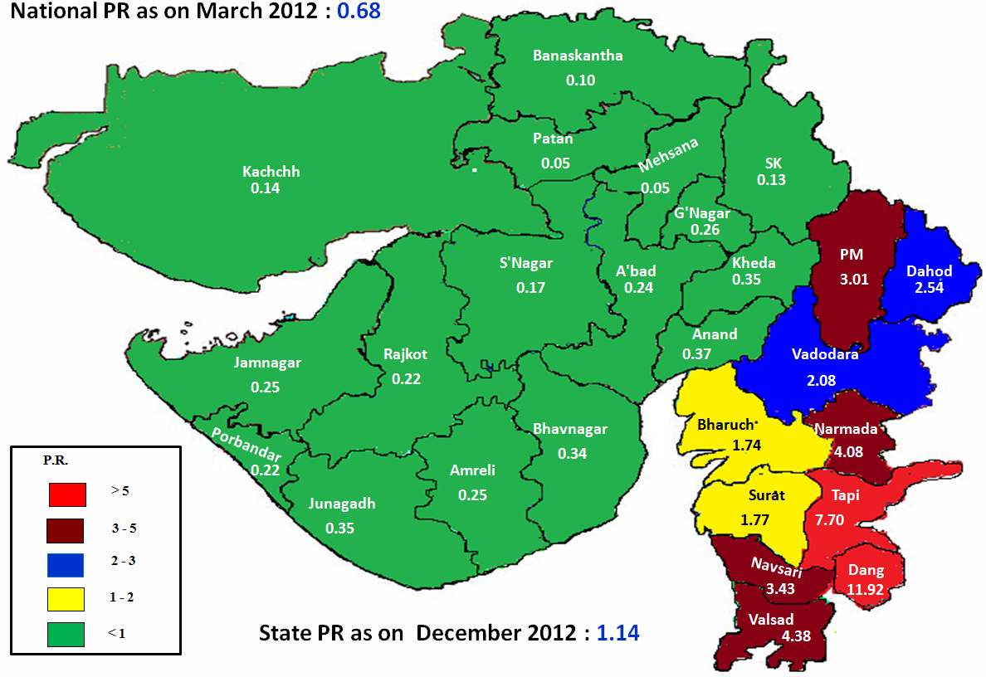
Prevalence Rate
(As on December 2012)
0.07
National PR as on Sept.12 : 0.77

Slide 4
Gujarat Towards Elimination of Leprosy

Slide 5
Status of NLEP
 | Particular | Apr. to Dec.08 | Apr. to Dec.09 | Apr. to Dec.10 | Apr. to Dec.11 | Apr. to Dec.12
1 | New Case Detection | 6040 | 4981 | 5380 | 5248 | 7717
 | PB | 3290 | 2428 | 2736 | 2769 | 4377
 | MB | 2750 | 2553 | 2644 | 2479 | 3340
2 | Pts. on Treatment | 5060 | 4495 | 5000 | 4584 | 6997
3 | Prevalence Rate | 0.87 | 0.76 | 0.82 | 0.74 | 1.14

Slide 6
Special Activities planned in Action Plan 2012-13 for Districts with ANCDR >10/100,00 population:
S. No | No. of Districts with ANCDR > 10/100,000 pops. As on Dec. 12 | Proposed activities for Action Plan 2012-13
1 | Bharuch (31.10) | Leprosy awareness drive in Identified 66 blocks in High Endemic Districts. ASHA involvement Reorientation training for all health facilitators 50 houses survey surrounding new MB cases. IEC activity particular at Haat Bazar. IEC activity carried out in fair and festivals. Supervision and Monitoring
2 | Dahod (39.28)
3 | Dangs (166.82)
4 | Narmada (56.26)
5 | Navsari (59.22)
6 | Panchmahal (41.39)
7 | Surat (25.41)
8 | Tapi (107.22)
9 | Vadodara (28.22)
10 | Valsad (67.33)

Slide 7
Monitorable target as per administrative
Approval of state PIP
Sr.No. | Activity/Measurable INDICATORS | Target 2012-13 | Achievement
1 | No .of Reconstructive surgeries performed under NLEP | 175 | 198 (137 Major + 61 Minor) (Apr. 12 to Jan.13)
2 | Annual New Cases Detection Rate for Leprosy | 12.20 | 16.50 (As on Dec.12)

Slide 8
NLEP Indicators MB Ratio

Slide 9
NLEP Indicators Female Ratio

Slide 10
Achievements
The prevalence rate of leprosy has declined from 21.1 per 10000 population in 1984 to 1.14 per 10000 in december 2012.

Slide 11
Key areas needing strengthening
Co ordination between WHO, central leprosy unit and state leprosy unit.
IEC at all level and in all states. The message should be in local language.
Disability prevention and ulcer care including supply of foot wear and other rehabilitative services.

Slide 12
Central Leprosy Division Directorate General of Health Services, Ministry of Health & Family Welfare, Government of India Nirman Bhavan, New Delhi | Highest level of evidence. | Doubtfull leprosy: Clinical examination Elicit cardinal signs of leprosy Skin smears If patch - skin biopsy from the patch Nerve conduction velocity If nerve thickening - nerve biopsy from the radial cutaneous or sural nerve and ask for nerve staining result, electron microscopy and PCR Aspiration cytology of nodules and lymph glands if any | Treatment The standard adult treatment regimen for MB leprosy is: Rifampicin..................600 mg once a month Clofazimine................300 mg once a month, and 50 mg daily Dapsone.....................100 mg daily Duration : 12 months (12 blister packs) The standard adult treatment regimen for PB leprosy is: Rifampicin..................600 mg once a month Dapsone.....................100 mg daily Duration : 6 months (6 blister packs) The standard child (ages 10 - 14) treatment regimen for MB leprosy is: Rifampicin..................450 mg once a month Clofazimine................150 mg once a month, and 50 mg every other day Dapsone.....................50 mg daily Duration : 12 months (12 blister packs) The standard child (ages 10 - 14) treatment regimen for PB leprosy is: Rifampicin..................450 mg once a month Dapsone.....................50 mg daily Duration : six months (six blister packs)

Slide 13
Questions
Q 1: Leprosy is caused by __________________

Slide 14
Questions
Q 2: Route of transmission for leprosy.

Slide 15
Questions
Q 3: Main objective for leprosy eradication programme.

Slide 16
Questions
Q 4: Gujarat is ______________ area according to prevalence of leprosy. (High/Moderate/Low endemic)

Slide 17
Questions
Q 5: National leprosy eradication programme was started in ____________.

Slide 18
Thanks...

