Slide 1
NO SCALPEL VASECTOMY(NSV)
DR.MANISH KATHAD
COMMUNITY MEDICINE DEPARTMENT

Slide 2
WHAT IS NSV?
Vasectomy is intended as a permanent method of contraception for men. It is suitable for those who are sure they never want children or do not want more children.
Non-scalpel vasectomy uses a unique method of incision. Compared to more conventional methods, patient can benefit from a shorter operating time, less pain and swelling, and faster recovery.

Slide 3
DEFINATION
The No-Scalpel technique is one of two main methods surgeons use to perform a vasectomy. Many doctors favour the No-Scalpel method because - unlike the traditional vasectomy approach - a scalpel is not required and there are no incisions (only one or two small punctures in the skin). In addition, the NSV often results in less discomfort after the procedure with a reduced risk of bleeding or infection. Also, there is no perceptible scaring.

Slide 4
How does it work?
During sexual intercourse sperm will travel from the testes through two tubes (vas deferens) and mix with semen before coming out of the penis.
During a non-scalpel vasectomy, the tubes are sealed so that sperm cannot reach the semen.

Slide 5
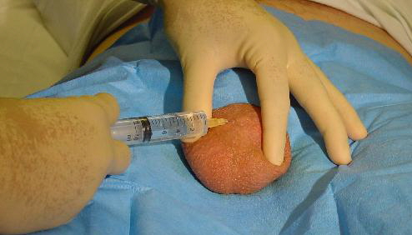
injection of Local Anaesthetic to 'numb' the skin area Superficially.

Slide 6
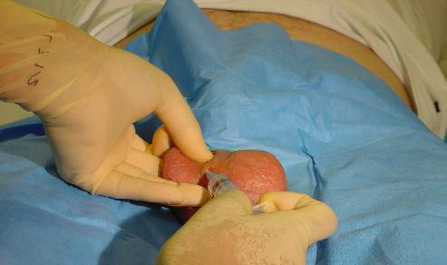
A slightly deeper injection around the Vas. The needle does not penetrate any structure and is not very painful.

Slide 7
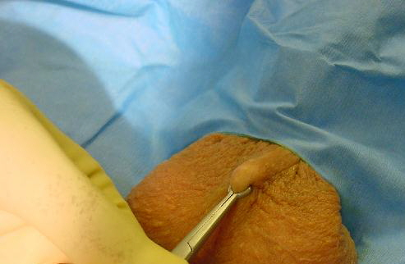
Vas is lifted up by a special vasectomy 'ring' thus separating from other structures.

Slide 8
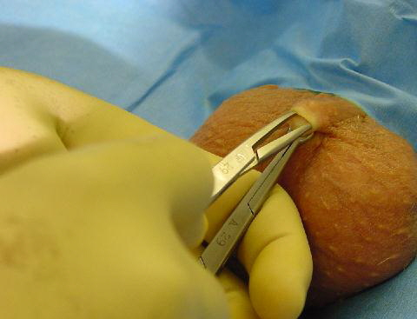
Small opening made in the skin. This is now done by an electric cautery.

Slide 9
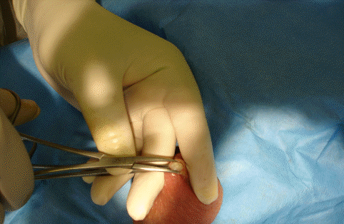
Vas showing through the skin aperture

Slide 10
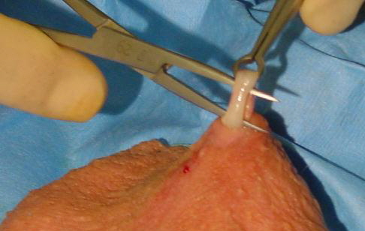
Vas lifted out of the scrotum

Slide 11
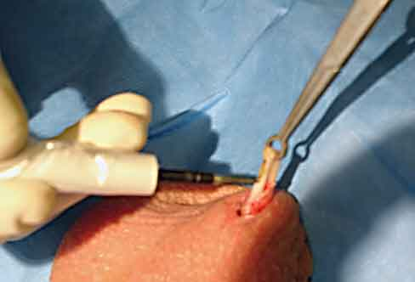
The exposed loop of vas being cauterised

Slide 12
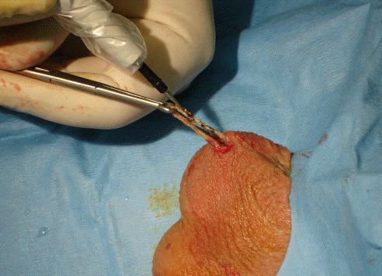
Cauterizing extended further to a larger portion of vas

Slide 13
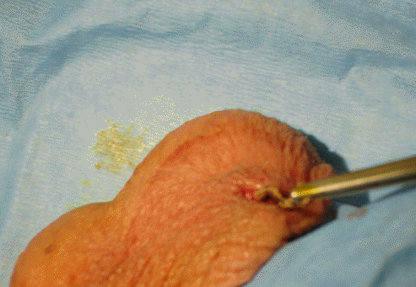
Cauterized loop is cut and returned to the scrotum.
The procedure then repeated on other sided vas also through same skin opening.

Slide 14
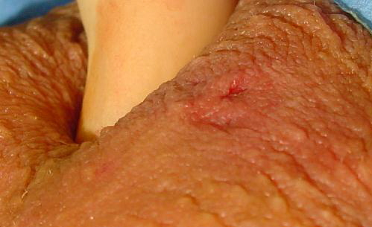
After both vasa are completed and returned to scrotum only a small skin wound is left, which does not require any sutures.

Slide 15
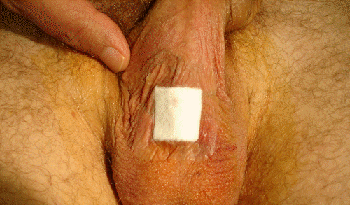
Wound covered by a small dressing which may be removed after 48 hours.

Slide 16
ADVANTAGES OF NSV
Ten times fewer complications
Less bleeding and pain
Faster recovery
Enhanced the popularity
NSV does not involve cutting the skin of the scrotum .
scrotal opening made during NSV does not need suturing due to its small size.

Slide 17
DISADVANTAGE
sperm are present in the posterior end of the vas following surgery and hence patients have to use alternative methods of contraception for a waiting period of 12 weeks to 15 weeks before relying on a vasectomy for contraception.
does not protect against sexually transmitted diseases (STDs), including infection with the human immunodeficiency virus (HIV).

Slide 18
1) Chen-Mok M, Bangdiwala SI, Dominik R, Hays M, Irsula B, Sokal D. Termination of a randomized controlled trial of two vasectomy techniques. Control Clin Trials 2003; 24: 78-84. | randomized controlled trial | compared the advantages of fascial interposition to ligation and excision alone. About 1 cm of each vas was removed at the time of vasectomy. Two definitions of vasectomy success are: (1) two consecutive azoospermic sperm samples, or (2) two severely oligospermic samples, with <100,000 sperm/mL. We also used a definition for early failure of >5 million motile sperm/mL at 14 weeks or later. An interim analysis was conducted after the first 414 participants had had time to complete 10 weeks of follow-up. The interim analysis results used only the time to azoospermia endpoint criteria and were complicated by differences between age groups. Recruitment was halted after 841 men had been enrolled because the interim analysis showed an advantage for fascial interposition [8]. The success rate with the use of fascial interposition was significantly higher at 22 weeks after vasectomy than ligation and excision alone (P<0.01). | some age-related effects with younger men achieving azoospermia earlier, the numbers of vasectomy failures were similar across age groups. The overall failure rate based on semen analysis was 5.7 % in the fascial interposition group and 12.5 % in the non-fascial interposition group

Slide 19
2) Sokal D, McMullen S, Gates D, Dominik R. A comparative study of the no scalpel and standard incision approaches to vasectomy in 5 countries. The Male Sterilization Investigator Team. J Urol.1999;162:1621–5. | multicenter, randomized, partially masked controlled trial. | Study conducted at 8 sites in Brazil, Guatemala, Indonesia, Sri Lanka and Thailand. Semen samples were collected 10 weeks postoperatively and tested to ascertain sterility using verification of no living spermatozoa. | The study included 1,429 men seeking vasectomy. The efficacy of the 2 approaches was virtually identical. In the no scalpel group operating time was significantly shorter, and complications and pain were less frequent than in the standard incision group. The no scalpel group resumed intercourse sooner, probably as a result of less pain following the procedure.

Slide 20
3) Cook LA, Pun A, van Vliet H, Gallo MF, Lopez LM. Scalpel versus no-scalpel incision for vasectomy.Cochrane Database Syst Rev. 2007;18:CD004112. | Randomized controlled trials and controlled clinical trials . | measures included safety, acceptability, operating time, contraceptive efficacy, and discontinuation. | Two randomized controlled trials evaluated the no-scalpel technique and differed in their findings. The larger trial demonstrated less perioperative bleeding (Odds ratio (OR) 0.49; 95% Confidence Interval (CI) 0.27 to 0.89) and pain during surgery (OR 0.75; 95% CI 0.61 to 0.93), scrotal pain (OR 0.63; 95% 0.50 to 0.80), and incisional infection (OR 0.21; 95% CI 0.06 to 0.78) during follow up than the standard incisional group. Both studies found less hematoma with the no-scalpel technique (OR 0.23; 95% CI 0.15 to 0.36). Operations using the no-scalpel approach were faster and had a quicker resumption of sexual activity.

Slide 21
CONCLUSION
The no-scalpel approach to the vas resulted in less bleeding, hematoma, infection, and pain as well as a shorter operation time than the traditional incision technique.
No difference in effectiveness was found between the two approaches.

Slide 22
Questions
Q 1: Vasectomy is __________ type of contraception.

Slide 23
Questions
Q 2: Write advantages of vasectomy

Slide 24
Questions
Q 3: Write dis advantages of vasectomy

Slide 25
Questions
Q 4: Failure rate of contraception is measured by:
  Half time
  Pearl index
  Number of accidental pregnancy
  Total gestational period

Slide 26
Questions
Q 5: Name few complications of Vasectomy.

Slide 27
THANK YOU

