Slide 1

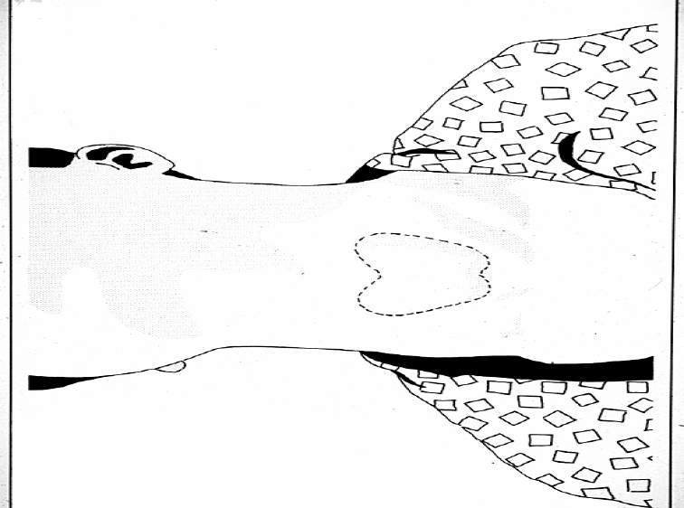
IODINE DEFICIENCY DISORDER
Dr.Grishma Chauhan Associate Professor
DEPARTMENT OF
COMMUNITY MEDICINE

Slide 2

IODINE
Iodine is an essential micronutrient.
It is present in the body in a minute amount
(normally 20-30mg)
80% of the iodine in the body is present in the thyroid gland where it is used in synthesis of several thyroid hormones (like thyroxine T4 & triiodothyronine T3)
The remainder is distributed throughout other tissues,particularly in the mammary, salivary,gastric glands and in the kidneys.

Slide 3
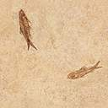
SOURCES
Sea foods (sea fish, sea salt)
Cod liver oil
Milk, meat, vegetables, cereals also contain smaller amount of iodine.
Sea foods & sea water fish are rich sources (30-300mg/100gm meal)

Slide 4
RECOMMENDED INTAKE
Adult (male &female) : 150microgram/day
Children : 40microgram/day

Slide 5
FUNCTION OF IODINE
It is an integral part of thyroid hormones that play a major role in regulating growth and development
They also have important role in regulation of metabolic rate
It is required for early development of nervous system during fetal life
It is needed for normal reproductive function

Slide 6
IODINE DEFECIENCY
It is the leading cause of preventable intellectual impairment. It is associated with a variety of clinical disorders called “iodine deficiency disorder”
IDD is known to be significant health problem in 118 countries, IDD affects 740 million of people,30% of remainder at risk

Slide 7
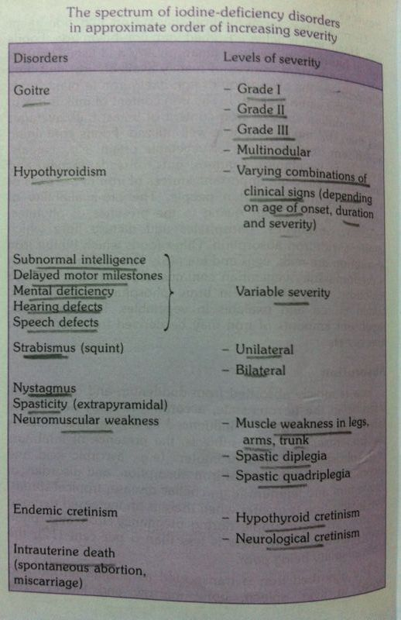

Slide 8
IDD affect poor pregnant woman, preschool children causing serious health problems that includes :
Endemic cretinism
Hypothyroidism
Mental retardation
Reproductive failure,abortion, stillbirth
Endemic goiter
Childhood mortality
Socio-economic retardation

Slide 9
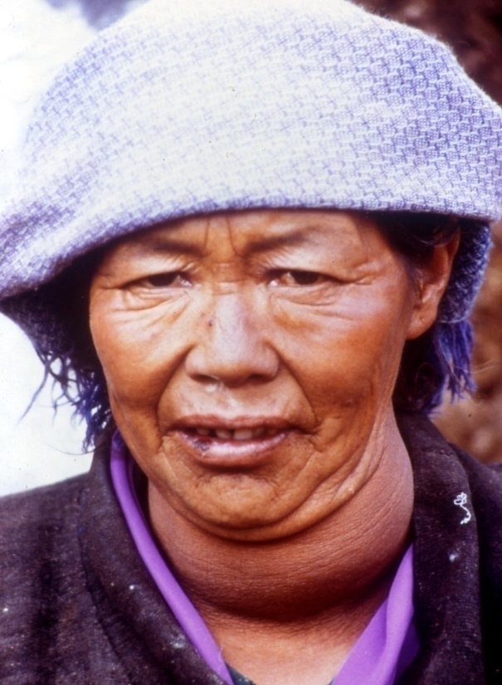
ENDEMIC GOITER
Enlargement of thyroid gland, most obvious clinical manifestation of iodine deficiency caused by dietary deficiency of iodine
The minimum amount of iodine required to cover the turnover of the thyroid gland is 50 microgram/day. Below this the thyroid gland will begin to enlarge markedly at puberty particularly in girls.
This enlargement is considered as a compensatory mechanism to trap more iodine. In some patients large goiter may cause pressure on trachea &esophagus which cause difficulty in breathing, irritative cough,voice changes &some time may affect swallowing.

Slide 10
HYPOTHYROIDISM
Some patients develop hypothyroidism, which could be mild (low thyroid level, low BMR, low productivity, slower mental function, low physical growth) or severe (classical myxoedema)

Slide 11

ENDEMIC CRETINISM
Iodine deficiency during pregnancy can lead to birth of cretinous child. The infant may appear normal at birth but slow to grow & development, small in size, mentally dull, retarded in reaching normal development milestones.
Cretinism may be 2types:
  Nervous cretinism : mental deficiency ,deaf mute, spasticity ataxia, iodine deficiency occur early in fetal life.
  Myxoedematous cretinism: dwarfism, signs of myxoedema, marked delay in growth & sexual development, mental retardation, neurological examinations
  are normal, deaf mutism is absent, iodine deficiency occur late in fetal life& post natal life.
In both types neurological damage, mental retardation, dwarfism are not reversible by treatment.

Slide 12
MENTAL RETARDATION
In endemic area, large number of person fails to grow optimally either physically or mentally even though they don’t have classical features of cretinism. IDD affected people may loss 15% IQ points.

Slide 13
REPRODUCTIVE FAILURE
Women with severe Iodine deficiency have miscarriage, still birth, LBW and other problem of pregnancy.
Iodine deficiency is considered as one of the causes of decreased fertility of women & secondary sterility.

Slide 14
CHILDHOOD MORTALITY
Mortality rate in iodine deficient children is founded to be higher.
Supplementation program of iodine increase in survival rate of those children.

Slide 15
SOCIO-ECONOMIC RETARDATION
Iodine deficiency affects socioeconomic development of the community in many ways:
People who are mentally slower are harder to educate, lower in productivity, increased in the rate handicapped & mentally retarded children.
Domestic animals in iodine deficient areas also suffer from iodine deficiency &produce less meat, egg &have also more abortion.

Slide 16
ETIOLOGY OF IODINE DEFICIENCY
Deficient intake (diet &water) :in mountain areas, isolated localities depending on well or spring in which iodine content is low.
Increased requirement: developing fetus, newborn, young child, adolescents especially in female, pregnant &lactating woman.
Intake goitrogens: substances occur naturally in food, that act by blocking absorption, utilization of iodine. they are found in cabbage, cassava, peanut & soyabeans. These substances are inactivated by cooking.
Deficiency of enzymes needed in the metabolism of iodine

Slide 17
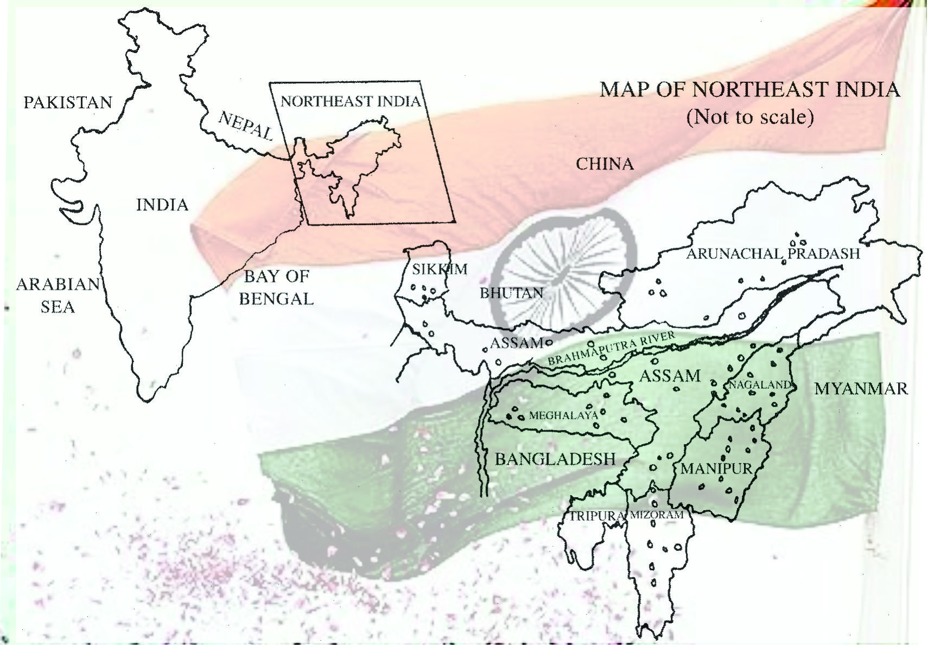

Slide 18
ASSESSING THE SEVERITY OF IODINE DEFICIENCY IN THE COMMUNITY:
The prevalence of goiter:
WHO classification of goiter size:
GRADE DESCRIPTION
0 No goiter
1A Thyroid lobes more than end
of the thumb
1B Thyroid enlarge, visible when
the head tilted back
2 Thyroid enlarged, visible when
neck in normal position
3 Thyroid greatly enlarged, visible
from about
meters 10

Slide 19
2. Urinary iodine :
Examination of iodine concentration in urine could be done on24-hours urine sample or on casual urine sample
Median urinary iodine concentration of >100 microgram/l define population which has no iodine deficiency.
Urinary iodine concentration is currently the most practical biochemical marker for iodine nutrition.
3. Laboratory tests related to thyroid hormones:
levels of thyroid stimulating hormones (TSH),
thymoglobulin(TG) can serve as surveillance
indicators.

Slide 20
4. Determining thyroid size by ultrasonography:
safe, non invasive technique, provide more precise measurement of thyroid volume compared with palpation.
need ultrasound equipment, electricity & specially trained personnel.

Slide 21

PREVENTION & CONTROL OF IDD

Slide 22
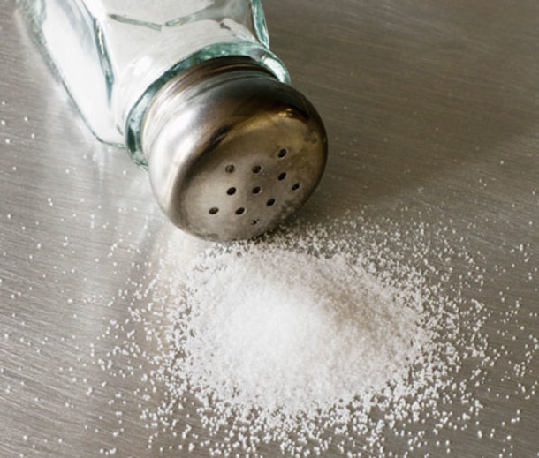
Universal salt iodization:
This greatly decreases the goiter in many countries, the amount added should be related to the usual consumption in the community (5-10 g/person/day).
It is recommended that iodine concentration in the salt at site of production should be within the range of 20-40 mg of iodine/kg of salt (20-40ppm of iodine) in order to provide 150microgram of iodine/person/day.
Administration of iodized oil either in form of injection or capsule:
alternative mean where the use of iodized salt is not possible & when endemic goiter is more severe and accompanied by endemic cretinism.
Single injection (1ml im) will provide protection for more than 1year (2-4y)
We give iodized oil capsules every
6-18 months.

Slide 23
3. Iodization of water supply:
In remote village where distribution of iodized salt or injection of iodized oil is impractical.
It reduced the prevalence of goiter in some area by about 30-61%
4. Dietary modification :
To include more food known to be good source of iodine (sea food, sea & fresh water fish).
5. Good medical service & health care:
For early diagnosis & treatment of goiter
and hypothyroidism.

Slide 24
6. Direct administration of iodine solution:
such as lugol’s iodine at regular interval (once a month).

Slide 25
NEUROLOGICAL DAMAGE TO THE FETUS RESULTING FROM SEVERE IODINE DEFICIENCY DURING PREGNANCY P.O.D. Pharoah, I.H. Buttfield, B.S. Hetzel | Randomise controlled triad(high level evidence) | follow-up over four years revealed 26 endemic cretins out of a total of 534 children born to mothers who had not received iodised oil; the mothers of 5 of these cretins were pregnant at the start of the trial. In comparison, 7 cases of endemic cretinism occurred among 498 children born to mothers who had been treated with iodised oil; in 6 of these 7 cases, the mother was pregnant when the trial commenced. | concluded that intramuscular iodised oil is effective in the prevention of endemic cretinism and that, for it to be effective, it should be given prior to conception. This suggests that severe iodine deficiency in the mother produces neurological damage during fetal development.

Slide 26
REFERENCES:
Internet
Book of Psm (K. Park)
Book of Medicine(Davidson)

Slide 27
Questions
Q 1: What is normal amount of Iodine found in human body? _______

Slide 28
Questions
Q 2: What is Source of Iodine?

Slide 29
Questions
Q 3: What are major functions of Iodine?

Slide 30
Questions
Q 4: Name few sign and symptoms of iodine deficiency.

Slide 31
Questions
Q 5: How can Iodine deficiency disorder be prevented.

Slide 32

THANK
YOU

