Slide 1
Epidemiology of Tuberculosis & Its Prevention & Control
Dr. Divyang N Patel
Associate Professor
S.B.K.S Medical Institute & Research Centre

Slide 2
Why TB?
It is one of the most important, readily preventable infectious disease in the world, yet it still kills and sickens millions each year.

Slide 3
About TB
  One of the oldest diseases known.
  Usually a respiratory disease due to infection by Mycobacterium tuberculosis³.
Notes:
(1) In March 1882, Dr. Robert Koch discovered Mycobacterium Bacillus, in Germany. At that time TB was very prevalent.
(2) This is the most frequent presentation. Extra-pulmonary TB (e.g. miliary, skeletal, meningeal, gastro-intestinal) also occur, particularly in children, immigrants from countries where TB is more common and in people with impaired immunity.
(3) Tubercle bacilli are acid alcohol-fast bacilli (AAFB), that means they strongly resist decolourisation with acid or alcohol.

Slide 4
Global burden of TB
2 billion infected, i.e. 1 in 3 of global population
9.4 million (139/lakh) new cases in 2008, (80% in 22 high-burden countries)
4 m new sm+ve PTB (61/lakh) cases in 2008
1.77m deaths in 2007, 98% in low-income countries
MDR-TB -prevalence in new cases around 3.6%.
Ref: WHO Global Report, 2006
Notes:
3
Source of information (2006 report)

Slide 5
How global is TB?
Someone is infected with TB every second;
33% of the world population is already infected;
25% of all avoidable deaths in economically productive age groups are due to TB.
Global incidence of TB has peaked in 2004 and is declining.
Notes:
Follow the link to find more about TB, and a map with mortality data.

Slide 6
Estimated TB incidence rate, 2007
:Source: WHO Geneva; WHO Report 2009: Global Tuberculosis Control; Surveillance, Planning and Financing

Slide 7
Incidence and prevalence of infection
Tuberculin survey: imperfect measuring tool?
Low-income countries: 50% or more of productive population infected.
Industrialized countries: 10% or less of productive population infected

Slide 8
Problem of TB in India
Estimated incidence
  1.96 million new cases annually
  0.8 million new smear positive cases annually
  75 new smear positive PTB cases/1lakh population per year
Estimated prevalence of TB disease
  3.8 million bacillary cases in 2000
  1.7 million new smear positive cases in 2000
Estimated mortality
  330,000 deaths due to TB each year
  Over 1000 deaths a day
  2 deaths every 3 minutes
Gopi P et al (TRC), IJMR, Sep 2005
Notes:
Divide into two slides

Slide 9
Problem of TB in India (contd)
Prevalence of TB infection
  40% (~400m) infected with M. tuberculosis (with a 10% lifetime risk of TB disease in the absence of HIV)
Estimated Multi-drug resistant TB
  < 3% in new cases
  12% in re-treatment cases
TB-HIV
  ~2.31 million people living with HIV (PLWHA)
  10-15% annual risk (60% lifetime risk) of developing active TB disease in PLWHA
  Estimated ~ 5% of TB patients are HIV infected

Slide 10
India is the highest TB burden country accounting for more than one-fifth of the global incidence
Global annual incidence = 9.4 million
India annual incidence = 1.96 million
India is 17th among 22 High Burden Countries (in terms of TB incidence rate)
Notes:
However, in terms of absolute numbers, India accounts for one fifth of the global Tuberculosis burden. Every year 1.9 million people in India develop tuberculosis (TB), of which 0.8 million are sputum positive cases that are infectious. Tuberculosis is unique among the main disease killers of the developing world in that it afflicts nearly all age groups. Tuberculosis has devastating social costs as well. This continued burden of disease is particularly tragic because TB is nearly 100% curable. Untreated patients can infect 10-15 persons each year; poorly treated patients develop drug resistant and potentially incurable TB.

Slide 11
Social and Economic Burden of TB in India
Estimated burden per year
Indirect costs to society $3 billion
Direct costs to society $300 million
Productive work days lost due to TB illness 100 million
Productive work days lost due to TB deaths 1.3 billion
School drop-outs due to parental TB 300,000
Women rejected by families due to TB 100,000
Notes:
Estimates made in 1998-99.

Slide 12
Infection with tubercle bacilli
Transmitted by airborne route
(M.Bovis: contaminated milk)

Slide 14
Risk factors for exposure
o | Incidence of infectious tuberculosis
o | Duration of infectiousness
o | Number of cases/contacts interactions per unit of time of infectiousness -population density -family size -climatic conditions -age of sources of infection -gender

Slide 15
Risk of Infection ?
No. of infectious droplets produced
Volume of shared air space
Length of exposure
Ventilation
Climatic conditions

Slide 16
Characteristics of an infectious patient
Sputum smear positive patients are the major source of infection in the community
Sputum smear negative patients are responsible for 15-20% of transmission

Slide 18
Risk of Infection Given Exposure:
Largely Exogenous Factors
Particles
Volume
x
Exposure time
Particles:
Volume:
Exposure time:
Production of infectious droplet nuclei
Volume of air and ventilation
Time of inhaling air with droplet nuclei

Slide 19
Each case leads to two cases
-_-_-
1 Infectious case
20 contacts
2 cases
of TB
1 Non-infectious

Slide 23
Major risk factors:
Time since infection
HIV infection
Untreated/poorly treated previous TB
Other factors:
-age
-gender
-malnutrition
-diabetes
-silicosis
-genetic factors

Slide 24
Who are most at risk?
Malnourished, elderly, poor.
Migrants, refugees, travelers.
Smokers, chronic alcoholics.
Those with co-morbidity: diabetes, HIV/AIDS, silicosis.
Notes:
Historically, children under 5 years old were also at risk of TB. However, their risk has been markedly reduced since the introduction of BCG vaccination.

Slide 25
Other High Risk Groups
Populations in war / civil unrest
Refugees and migrants
Slum dwellers
Homeless people/Foot path dwellers
Smoking
Prisoners

Slide 26
Risk factors for disease given that infection has occurred ?
[Relative Risk of remotely acquired infection = 1] (0.2% per year)

Slide 27
Extent of Contact
o Proximity
o Length of contact

Slide 28
Changing TB mortality
In the West, decline in TB mortality due to
  elimination of poverty
  improved nutrition
  medical care (streptomycin reduced deaths in UK by 51% 1948-1971).
Notes:
However, it is not all good news. TB is on the increase among the growing numbers of homeless peoples in Europe and America, among the poorest living in economies under transition, such as in E. Europe. Also, those countries experiencing war or other politically-determined privations where disease surveillance and treatment have been disrupted, such as, currently, Afghanistan and Iraq, are probably seeing an increase in TB infections and deaths.

Slide 29
Risk Factors for Death from Tuberculosis
o
o | Patient’s and doctor’s delay

Slide 30
Determinants of death?
Site and form of tuberculosis
Severity of illness
Smear positivity
delay in diagnosis
quality of treatment
drug susceptibility pattern

Slide 32
Interpreting trends 1: real trends
Environmental: (nutrition, wealth housing, hygiene, sociopolitical).
Host changes: susceptibility (e.g. HIV/AIDS infection), travel, migration, sociodemographics.
Agent changes: Development of drug resistant strains of TB.
Notes:
A real change in disease incidence or mortality can occur due to changes in the environment, in the host or in the agent.

Slide 33
Interpreting trends 2: apparent trends
Changed social attitudes towards TB;
Improved diagnostic techniques, recognition and awareness;
Improved notification procedures
Availability of health statistics.
Notes:
Apparent changes in incidence or mortality can occur over time (apparent trend) without real changes in actual rates. It is very important to consider these influences when analyzing trends.
(1) In 19th C. Europe TB was common and “consumption” a trendy, though tragic cause of death. In the operas La Boheme and La Traviata, both heroines die from TB, while the Romantic poet Shelley also succumbed. In the Oslo Art Gallery, a 19th C. painting “The Sick Child” depicts a young girl clearly dying from TB.

Slide 34
Epidemiology of HIV - TB Co-infection

Slide 35
Evidence of association between
HIV and TB
Increase in TB in areas worst affected by HIV
Higher increase in age group affected by HIV.
50 to 70% AIDS cases develop TB in SEAR.
HIV positivity higher among TB cases than general population.
-Northern Thailand: HIV positivity in TB cases : 40%
: Malawi : 75%

Slide 36
Impact of HIV on the Epidemiology of Tuberculosis
Direct: | o | Reactivation of tuberculous infection acquired before HIV infection
 | o | Progression of tuberculous infection acquired after HIV infection
Indirect: | o | Transmission to the population not infected with HIV
Sutherland I. Br Comm Dis Rep 1990:10

Slide 37
HIV infection and tuberculosis disease
Higher rate of progression from latent infection to disease (5-10% per year compared to 10% per year among HIV negative)
HIV infected persons when exposed to TB rapidly develop the disease.
Excess cases due to the above lead to increased transmission of infection
Higher case fatality due to HIV infection

Slide 38
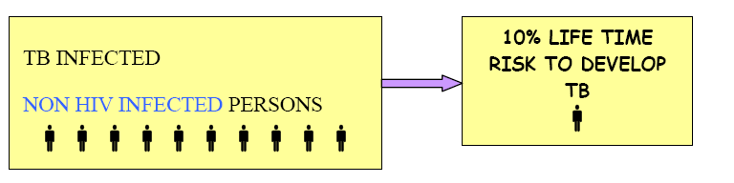
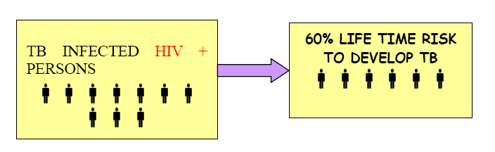
TB infected/HIV-: 5-10% life time risk to progress to TB disease
TB infected/HIV+: 5-10% annual risk to progress to TB disease

Slide 41
Indian Scenario
TB Situation
Estimated 400 million infected with TB
1.8 million new TB cases annually
Incidence of TB is higher in north
HIV Situation
Estimated 2.4 million with HIV ( National Adult HIV Prevalence 0.34%)
Prevalence of HIV higher in south
TB/HIV Co-infection
Estimated 1 million co-infected with TB and HIV
Estimated ~5% of TB patients are HIV positive nationwide ( WHO Global TB Report-2005)

Slide 42
PREVALENCE OF HIV INFECTION AMONG TUBERCULOSIS PATIENTS IN DELHI - A SENTINEL SURVEILLANCE STUDY | Research Design:- Cross sectional Study Level -3 Evidence | Methodology:- The population of Delhi is served by 14 TB clinics/hospitals. It was decided to limit the study to six tuberculosis clinics. 400 patients from Each sentinel clinic were to be inducted during 2 months. Every day, two Technicians visited two chest clinic to collect specimens and connected relevant information. Patients newly diagnosed on that day and fulfilling criteria For inclusion in the study were listed without further selection. The basic socio- demograplnc and laboratory data (namely sex, age, etc.) were recorded on a pretested form (Performa). At the New Delhi Tuberculosis Centre, serum was separated out and forwarded to the National AIDS Reference Centre at National Institute of Communicable Diseases for ELISA testing without any other information or identification provided to them | Result:- Seroprevalance of HIV infection among newly diagnosed untrated Tuberculosis patients of Delhi was 0.68%(95% CI = 0.35%-1.01%). The age distribution suggest an increase in seroprevalence of HIV with rising age: Prevalence was 0.51 % in 15-24 years group, 1.55% in 25-34 years group and 1.66% in the 35 years and more group.

Slide 43
Common Opportunistic Infections in INDIA
Opportunistic Infection | Prevalence
Pulmonary TB | 49%
Pneumocystis Carinii Pneumonia | 6%
Cryptococcal Meningitis | 5%
Cerebral Toxoplasmosis | 3%

Slide 44
Impact of TB on HIV programme
Increased caseload of active TB among PLWHA
Increased morbidity and mortality from TB among PLWHA
Difficulties with diagnosing TB among PLWHA due to different clinical presentation... (Extra Pulmonary TB)
Increased burden on HIV services

Slide 45
Impact of HIV on TB programme
Increased caseload of active TB attributable to HIV
Higher default rates, lower cure rates
More adverse drug reactions
Increased burden on TB services

Slide 46
Combat tuberculosis:
Indicators for goal 6
Indicators
  Prevalence and death rate associated with tuberculosis
  Proportion of tuberculosis cases detected and cured under DOTS
Additional core intermediate indicators
  Percentage of estimated new smear-positive tuberculosis cases registered under the DOTS approach
Indicators

Slide 47
Prevention & TB control
Decrease transmission of infection by:-
- Rapidly identifying cases
- Adequate treatment
Decrease deaths due to TB.
Cure of maximum number of cases.
To prevent relapse.
To prevent emergence of drug resistance.
To reduce TB in children by preventive treatment.
IEC - Purpose

Slide 48
INTENSIFIED TB CASE FINDING AT ICTCS
All ICTC clients should be screened by the ICTC Counsellor for the presence of the symptoms of TB disease.
  10 point counseling tool on TB in place
  At pre, post, and follow-up Counselling
  All TB suspects, irrespective of their HIV status, should be referred to nearest facility providing RNTCP services.

Slide 49
Each case leads to two cases
-_-_-
1 Infectious case
20 contacts
2 cases
of TB
1 Non-infectious

Slide 50
Priority to smear positive cases
To reduce transmission of infection. A good DOTS programme would reduce transmission of infections by about 73%
Cost per DALY highest for treating smear positive cases.

Slide 51
epidemiological indicators of TB

Slide 52
Epidemiological indicators of tuberculosis ?
Prevalence of infection
Incidence (average annual risk) of infection (ARI)
Prevalence of disease
Incidence of disease
Tuberculosis mortality rates

Slide 53
Other Epidemiological indicators of Tuberculosis
Ratio of prevalence and incidence
Age distribution of cases
Case fatality rates
Force of MDR cases
TBM notification rates
Disability adjusted life years (DALY)

Slide 54
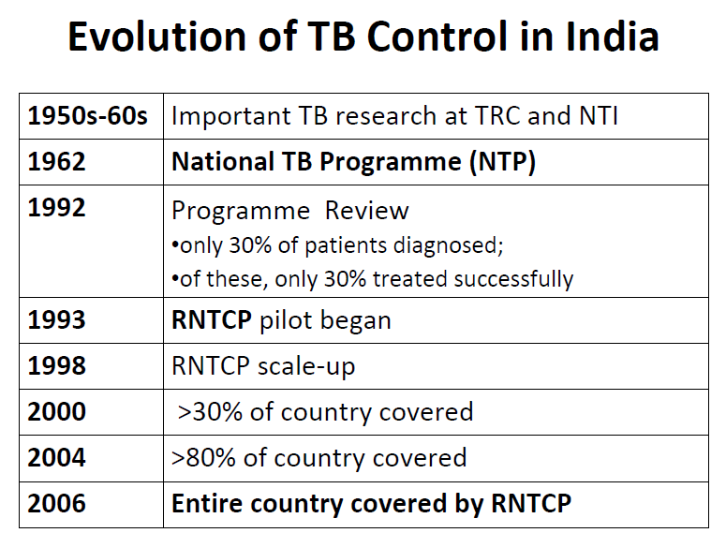

Slide 55
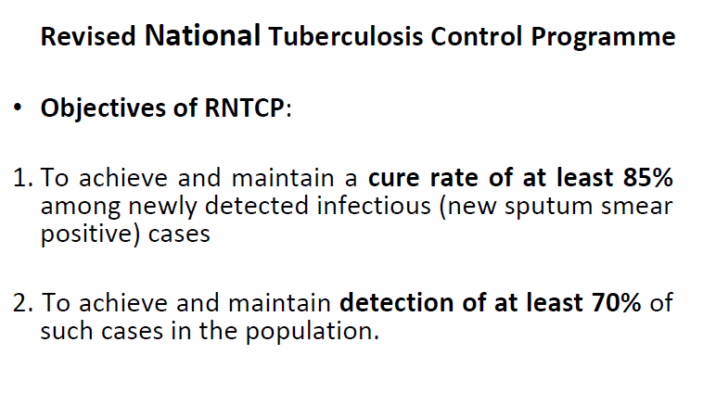

Slide 56
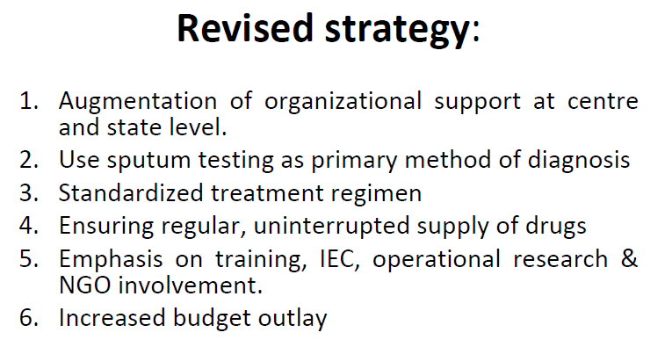

Slide 57
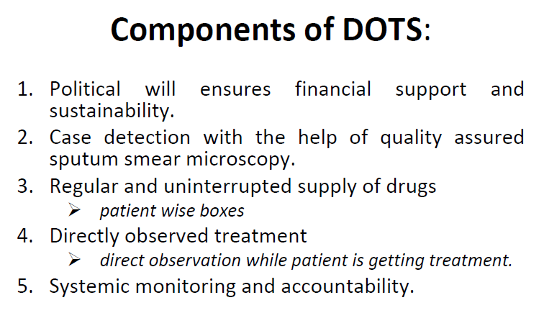

Slide 58
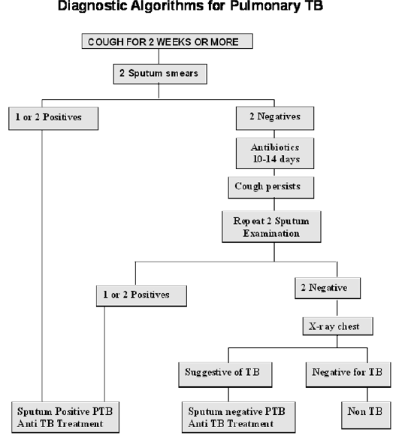

Slide 59
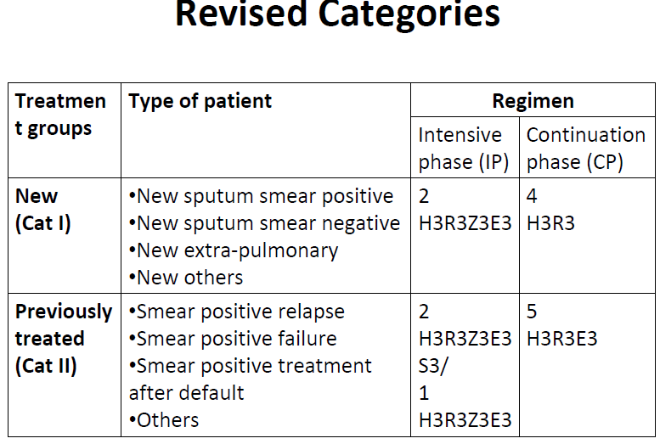

Slide 60
Thank You

Slide 61
MCQ-1
BCG vaccine Prevent
Prevention from infection
Prevention from development of disease
Prevention of Drug resistance

Slide 62
MCQ-2
Which is the objective of RNTCP
Cure rate 85%
Cure rate 80%
Cure rate 75%

Slide 63
MCQ-3
Which case is more infectious?
Smear positive pulmonary TB
Smear Negative pulmonary TB
Extra pulmonary TB

Slide 64
MCQ-4
Which Regimen used for Extra pulmonary TB
DOTS cat-1
Dots cat-2

Slide 65
MCQ-5
What is the most common symptoms of TB
Cough
Fever
Breathlessness
Sneezing

