Slide 1
Thyroid Gland- Anatomy and Physiology.

Slide 2
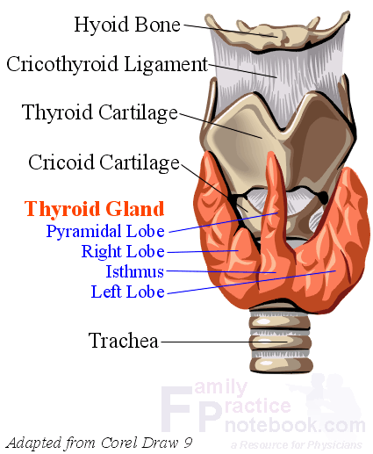
Anatomy
Location: lower part of the front and side of the neck opposite to the C5, C6, C7 and T1 vertebrae.
Each lateral lobe extends upwards to oblique line of thyroid cartilage and below up to the 5th or 6th tracheal ring.
The isthmus extends across the midline in front of the 2nd ,3rd and 4th tracheal ring.

Slide 3
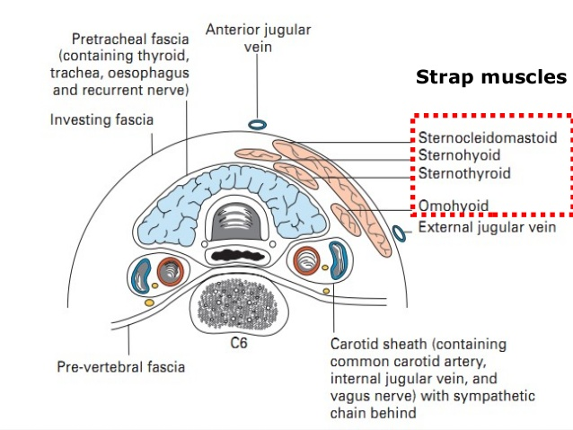
Transverse section of the anterior part of the neck at the level of isthmus, showing relations of thyroid gland.

Slide 4
Blood supply:
Arterial supply:
Superior thyroid artery: branch of external carotid artery; upper 1/3rd of the lobe & upper half of the isthmus.
Inferior thyroid artery: branch of thyrocervical trunk from the first part of the subclavian artery; lower 2/3rd of the lobe & lower half of the isthmus.
Thyroidea ima artery (in 30% cases).
Accessory thyroid arteries.
Venous Drainage:
Superior thyroid vein: drains into the internal jugular vein.
Middle thyroid vein: drains into internal jugular vein.
Inferior thyroid vein: drains into left brachiocephalic vein.

Slide 5
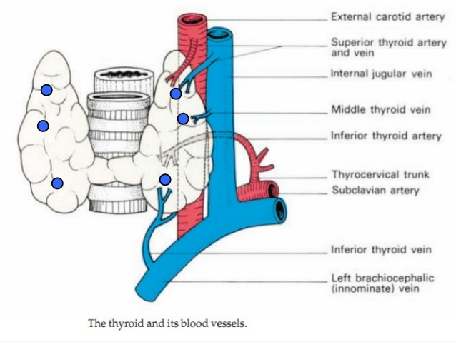

Slide 6
Lymphatic Drainage:
Upper group: into prelaryngeal and upper deep cervical (jugulodigastric) lymph nodes.
Lower group: into pretracheal and
lower deep cervical lymph nodes
Nerve Supply:
Parasympathetic: derived from vagus and recurrent laryngeal nerves.
Sympathetic: derived from superior, middle, and inferior cervical sympathetic ganglia (mainly from the middle one).

Slide 7
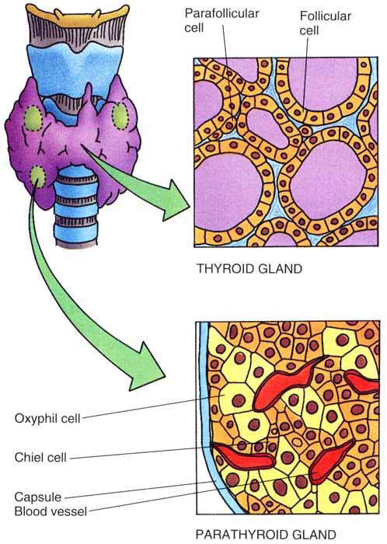
Histology
The thyroid gland consists of two types of secretory cells-follicular and parafollicular.
The follicular cells are cuboidal epithelial cells forming the wall of spherical thyroid follicles. They secrete two hormones: thyroxine and triiodothyronine.
The parafollicular cells or C-cells lie between the basement membrane and the follicular cells. They secrete a hormone called thyrocalcitonin (or calcitonin).

Slide 8
Physiology of the thyroid gland.
2 important thyroid hormones:
Thyroxine(T₄) or tetraiodothyronine
Triiodothyronine (T₃)
-Secreted by Follicular cells.
- Having significant effect on the metabolic rate of the body.
Calcitonin
- Secreted by Parafollicular cells.
- Important hormone for Ca2+ metabolism & homeostasis

Slide 9
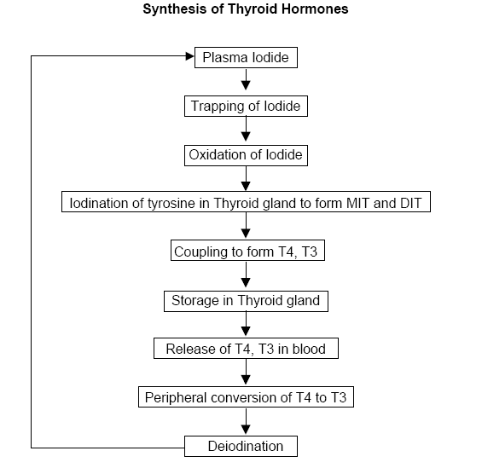

Slide 10
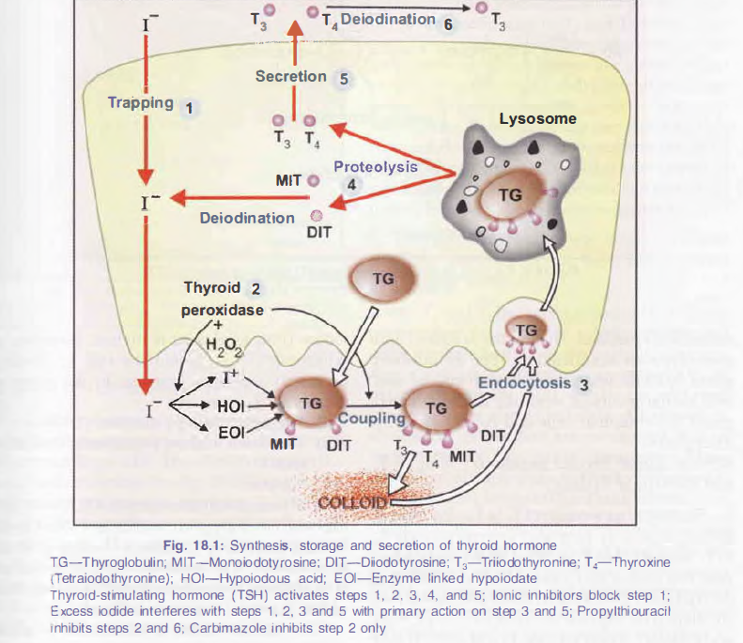

Slide 11
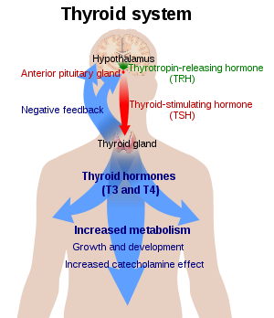
Actions of Thyroid
Hormones
Calorigenic (heat production) action: Thyroid hormone thermogenesis.
On CVS: increase in pulse rate, increase in force of contraction and decrease in circulation time.

Slide 12
On protein metabolism: Anabolic, i.e. increases protein synthesis resulting in positive nitrogen balance.
On carbohydrate metabolism: produces two opposite effects that balance each other-
-insulin-like action-increases peripheral utilisation of glucose causing hypoglycaemia.
-hyperglycemia
On lipid metabolism:
-cholesterol: decreases serum levels.
-lipids: T₄ decreases the fat storage from adipose tissue.

Slide 13
Also required for-
-Proper growth
-Bodyweight
-Increase blood level
-Respiration
-CNS development in fetus.
-Skeletal muscles

Slide 14
Clinical features
HYPERTHYROIDISM
# increased secretion of thyroid hormones
# caused by graves’ disease(autoimmune antibodies) and thyroid adenoma(tumour development)
# signs and symptoms
-intolerence to heat
-increased sweating
-decreased body weight
-diarrhea
-exophthalmos
-muscular wekness and tachycardia

Slide 15
HYPOSECRETION
#decreased secretion of thyroid hormones
#leads to:-
Myxedema in adults
-swollen face
-puffed eyes
-non-pitting type of edema
-artherosclerosis

Slide 16
2. Cretinism
-stunted growth
-dripping saliva
-hanging tongue
-difficulty in breathing and swallowing

Slide 17
3.GOITRE
-basically it is the enlargement of thyroid gland
Hyperthyroidism-toxic goitre
Hypothyroidism-non toxic goitre

Slide 18
reference
"goitre - definition of goitre in English". Oxford Dictionaries | English. Retrieved 18 September 2016.
Jump up^ Davidson's 2010, p. 750.
Jump up^ Treatment for Thyroid disease Retrieved on 2010-02-07
Jump up^ "Thyroiditis." www.thyroid.org. 2005. American Thyroid Association. 13 Mar. 2008. 15 Oct. 2010 <http://www.thyroid.org/patients/brochures/Thyroiditis.pdf>.
Jump up^ Madill, EM; Cooray, SD; Bach, LA (2016). "Palpation thyroiditis following subtotal parathyroidectomy for hyperparathyroidism.". Endocrinology, diabetes & metabolism case reports. 2016. doi:10.1530/EDM-16-0049. PMC 4967109. PMID 27482385

Slide 19
THANK YOU

