Slide 1
TREATMENT OF ALLERGIC RHINITIS

Slide 2
Levels of Evidence
Grade A – Systemic reviews, Meta analyses, RCT
Grade B – Non-randomised studies
Grade C – Observational studies
Grade D – Case Series, Expert opinion

Slide 3
Levels of Evidence
**** ~ Systematic reviews, meta analysis of randomized control studies
*** ~ Non randomised studies
** ~ Observational or non experimental studies
* ~ Expert opinion

Slide 4
TREATMENT
Managment includes-
Allergen avoidance
Pharmacotherapy
Education
Immunotherapy
Surgery

Slide 5
EDUCATION/ALLERGEN AVOIDANCE
Explanation of disease, progress and treatment.
Breastfeeding
Parental smoking
Allergen avoidance

Slide 6
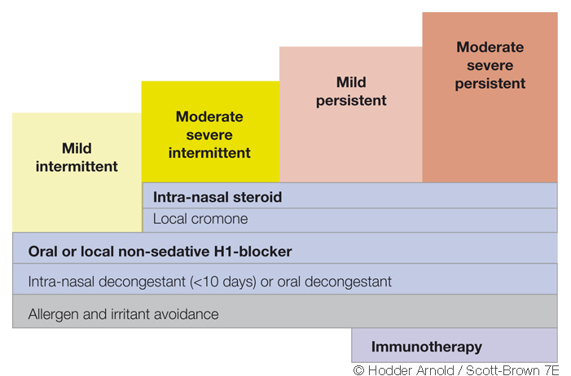

Slide 7
PHARMACOTHERAPY
Topical Nasal Treatments
Oral Treatments
Corticosteroids
Antihistamines
Chromones
Anticholinergics
Decongestants
Antihistamines
Corticosteroids
Antileukotrienes
Decongestants

Slide 8
PHARMACOTHERAPY
 | Itch/Sneezing | Discharge | Blockage | Impaired Smell
Sodium cromoglycate | + | + | +/- | -
Oral Antihistamines | +++ | ++ | +/- | -
Ipratropium bromide | - | +++ | - | -
Topical Decongestants | - | - | +++ | -
Topical Corticosteroids | +++ | +++ | ++ | +
Oral Corticosteroids | +++ | +++ | +++ | ++
Antileukotrienes | - | ++ | + | +/-

Slide 9
IMMUNOTHERAPY
Involves repeated administration of an allergen extract to induce a state of immunological tolerance
More effective in limited spectrum of allergies in particular seasonal pollen allergy
Severe symptoms failing to respond to usual treatment.
Subcutaneous injection/sublingual route.

Slide 10
Other method
Nasal douches
- adjuvant to other treatments
- useful in children with
seasonal rhinitis
- pregnancy
Notes:
30 gm sodium bicarbonate,30 gm of sodium biborate ,60 gmsodium chloride

Slide 11
ARIA RECOMMENDATIONS
Topical corticosteroids and oral antihistamines (non-sedating) form the mainstay of treatment
The newer topical steroids e.g. Mometasone furoate and Fluticasone propionate were highest recommended
Other drugs should only be considered as second-line treatment
Immunotherapy in selected patients can be highly effective.

Slide 12
PAEDIATRIC ALLERGIC RHINITIS
4 years and older should be treated as for adults
Children (>4) with AR and Asthma can be treated with combination of newer generation topical and inhaled corticosteroids with low risk of complications
Diagnosis in smaller children is difficult as can have up to 6 to 8 colds per year
Small children – oral antihistamines, saline sprays and corticosteroids if symptoms severe.

Slide 13
NAME OF STUDY | NAME OF AUTHOR | REFERENCE DETAILS | SAMPLE SIZE | RESULT | P VALUE | CONCLUSION
Correlation between allergic rhinitis, asthma,& atopic dermatitis in children | Milica Sofranac | Pediatrics 2008;121;s91 | 142 | a.complete recovery 50% b.Partial recovery 40% c.No recovery 10% |  | In 30.3 % of the cases the children with allergic rhinitis also had atopic dermatitis in 99.3%of cases the children with allergic rhinitis also had asthma

Slide 14
WHAT IS THE MANAGEMENT OF ALLERGIC RHINITIS?
A.Allergen avoidance\
B. Pharmacotherapy
C. Education
D. All of the above

Slide 15
2. TOPICAL NASAL TREATMENT OF AR INCLUDES?
A.Corticosteroids
B. Antihistamines
C.Chromones
D. All of the above

Slide 16
3.ORAL TREATMENT INCLUDES?
A. Antihistamines
B.Corticosteroids
C.Antileukotrienes
D. All of the above

Slide 17
4.WHAT IS IMMUNOTHERAPY?
Involves repeated administration of an allergen extract to induce a state of immunological tolerance
Involves repeated treatment with a fixed set of medications
All of the above
None of the above

Slide 18
QUESTIONS
5.WHAT ARE THE NEWER TOPICAL STEROIDS?
Mometasone furoate
Fluticasone propionate
A and B both
None of the above

Slide 19
Thank you

