Slide 1
SEVERE ACUTE RESPIRATORY SYNDROME (SARS)
Dr Jatin Chhaya
Department of Community Medicine
SBKS MI & RC

Slide 2
Learning objectives..
Background situations
Problem statement
Epidemiological concerns: IP & MOT
Case definition
Diagnostic confirmations
Complications of SARS
Treatment, Prevention & Prognostic factors of SARS.

Slide 3

Introduction..
Caused by Coronavirus
The most common symptoms: fever, malaise, chills, headache myalgia, dizziness, cough, sore throat and running nose.
In some cases there is rapid deterioration with low oxygen saturation and acute respiratory distress requiring ventilatory support.
CFR 10%
Chest X-ray findings typically begin with a small, unilateral patchy shadowing, and progress over 1-2 days to become bilateral and generalized, with interstitial infiltration.

Slide 4
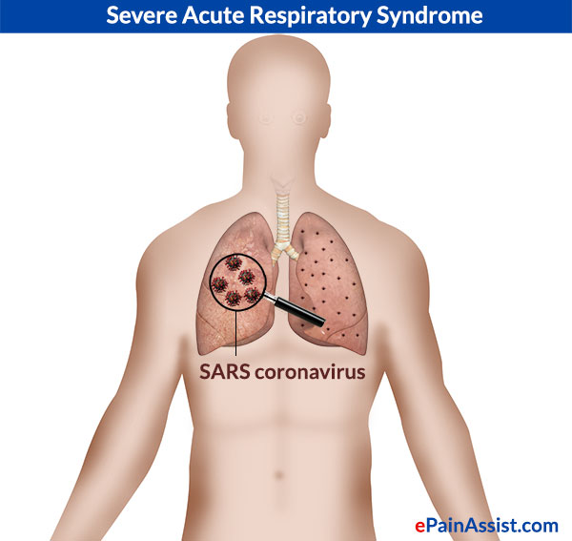
Problem statement..
The earliest case was traced to a health care worker in China, in late 2002, with rapid spread to Hong Kong, Singapore, Vietnam, Taiwan and Toranto.
As of early August 2003, about 8,422 cases were reported to the WHO from 30 countries with 916 fatalities.

Slide 5
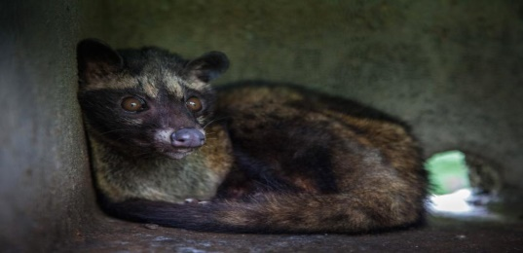
Incubation period & Mode of transmission
IP: 2 to 7 days, commonly 3 to 5 days
The primary mode of transmission appears to be through direct or indirect contact with respiratory droplets or fomites.
The use of aerosol-generating procedures (endotracheal intubation, bronchoscopy, nebulization treatments) in hospitals may amplify the transmission of the SARS coronavirus.
The natural reservoir appears is bat. It is the disease of Civet.
The SARS virus can survive for hours on common surfaces outside the human body, and up to four days in human waste.
The virus can survive at least for 24 hours on a plastic surface at room temperature, and can live for extended periods in the cold.

Slide 6
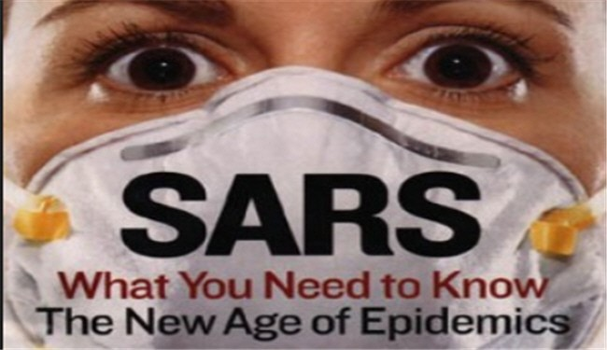
Case definition..
Case definition for notification of SARS under the International Health Regulation (2005)
  In the period following an outbreak of SARS, a notifiable case of SARS is defined as
    an individual with laboratory confirmation of infection with SARS coronavirus (SARSCoV) who either fulfils the clinical case definition of SARS or has worked in a laboratory handling live SARS-CoV or storing clinical specimens infected with SARS-CoV.

Slide 7
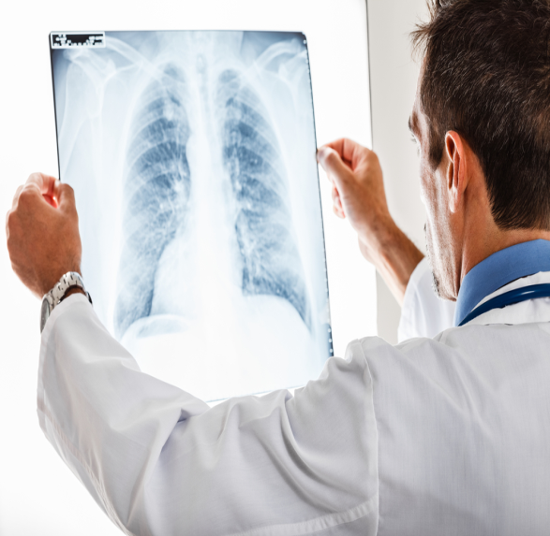
Clinical case definition of SARS..
1. A history of fever, or documented fever
AND
2. One or more symptoms of lower respiratory tract illness (cough, difficulty in breathing, shortness of breath)
AND
3. Radiographic evidence of lung infiltrates consistent with pneumonia or acute respiratory distress syndrome (ARDS) or autopsy findings consistent with the pathology of pneumonia or ARDS without an identifiable cause
AND
4. No alternative diagnosis fully explaining the illness.

Slide 8
Diagnostic tests required for laboratory confirmation of SARS .
(a) Conventional reverse transcriptase PCR (RT-PCR) and real-time reverse transcriptase PCR (real-time RT-PCR) assay detecting viral RNA present in: ·
  1. At least 2 different clinical specimens (e.g. nasopharyngeal and stool specimens)
  OR
  2. The same clinical specimen collected on 2 or more occasions during the course of the illness (e.g. sequential nasopharyngeal aspirates)
  OR
  3. Virus culture from any clinical specimen.

Slide 9
(b) Enzyme-linked immunosorbent assay (ELISA) and immunofluorescent assay (IFA)
  1. Negative antibody test on serum collected during the acute phase of illness, followed by positive antibody test on convalescent-phase serum, tested simultaneously
  OR
  2. A 4-fold or greater rise in antibody titre against SARS-CoV between an acute-phase serum specimen and a convalescent-phase serum specimen (paired sera), tested simultaneously.
The positive predictive value of a SARS-CoV diagnostic test is extremely low; So, In the absence of known SARS-CoV transmission to humans, the diagnosis should be independently verified in one or more WHO international SARS reference and verification network laboratories.
Every single case of SARS must be reported to WHO

Slide 10
Epidemiological aspect
Health care workers, especially those involved in procedures generating aerosols, accounted for 21 per cent of all cases.
Maximum virus excretion from the respiratory tract occurs on about day 10 of illness and then declines.
The efficiency of transmission appears to be greatest following exposure to severely ill patients or those experiencing rapid clinical deterioration, usually during the second week of illness.
There was no evidence that patient transmits infection 10 days after fever has resolved.
Children are rarely affected by SARS. To date, there have been two reported cases of transmission from children to adults and no report of transmission from child to child.
Furthermore, no evidence of SARS has been found in infants of mothers who were infected during pregnancy.

Slide 11
Epidemiological aspect.. Cont..
International flights have been associated with the transmission of SARS from symptomatic probable cases to passengers or crew.
WHO recommends exit screening and other measures to reduce opportunities for further international spread associated with air travel during the epidemic period.

Slide 12
Complications
As with any viral pneumonia, pulmonary decompensation is the most feared problem.
ARDS occurs in about 16% patients, and about 20-30% of patients require intubation and mechanical ventilation.
Squeal of intensive care include infection with nosocomial pathogens, tension pneumothorax from ventilation at high peak pressures, and non-cardiogenic pulmonary edema.

Slide 13
Treatment
Severe cases require intensive support.
Although a number of different agents including ribavirin (400-600 mg/d and4 g/d), lopinavir/ritonavir (400 mg/100 mg), interferon type 1, intravenous immunoglobulin, and systemic corticosteroids were used to treat SARS patients during the 2003 epidemic
The treatment efficacy of these therapeutic agents remains inconclusive and further research is needed.

Slide 14
Prognosis
The overall mortality rate of identified cases is about 10% to 14%.
Mortality is age-related, ranging from less than 1 % in persons under 24 years of age to greater than 50% in persons over 65 years of age.
Poor prognostic factors include advanced age, chronic hepatitis B infection treated with lamivudine, high initial or high peak lactate dehydrogenase concentration, high neutrophil count on presentation, diabetes mellitus, acute kidney disease, and low counts of CD4 and CD8 on presentation.

Slide 15
Prevention
As there is no vaccine against SARS, the preventive measures for SARS control are appropriate detection and protective measures which include :
  1. Prompt identification of persons with SARS, their movements and contacts;
  2. Effective isolation of SARS patients in hospitals;
  3. Appropriate protection of medical staff treating these patients;
  4. Comprehensive identification and isolation of suspected SARS cases;
  5. Simple hygienic measures such as hand-washing after touching patients, use of appropriate and well-fitted masks, and introduction of infection control measures;
  6. Exit screening of international travellers;
  7. Timely and accurate reporting and sharing of information with other authorities and/or governments.

Slide 16
Identification of Severe Acute Respiratory Syndrome in Canada
Author: Susan M. Poutanen, M.D., M.P.H., Donald E. Low, M.D., Bonnie Henry, M.D., Sandy Finkelstein, M.D., David Rose
Result: The patients ranged from 24 to 78 years old; 60 percent were men. Transmission occurred only after close contact. The most common presenting symptoms were fever (in 100 percent of cases) and malaise (in 70 percent), followed by nonproductive cough (in 100 percent) and dyspnea (in 80 percent) associated with infiltrates on chest radiography (in 100 percent). Lymphopenia (in 89 percent of those for whom data were available), elevated lactate dehydrogenase levels (in 80 percent), elevated aspartate aminotransferase levels (in 78 percent), and elevated creatinine kinase levels (in 56 percent) were common. Empirical therapy most commonly included antibiotics, oseltamivir, and intravenous ribavirin. Mechanical ventilation was required in five patients. Three patients died, and five have had clinical improvement. The results of laboratory investigations were negative or not clinically significant except for the amplification of human metapneumovirus from respiratory specimens from five of nine patients and the isolation and amplification of a novel coronavirus from five of nine patients. In four cases both pathogens were isolated.
Background
Severe acute respiratory syndrome (SARS) is a condition of unknown cause that has recently been recognized in patients in Asia, North America, and Europe. This report summarizes the initial epidemiologic findings, clinical description, and diagnostic findings that followed the identification of SARS in Canada.
Methods
SARS was first identified in Canada in early March 2003. We collected epidemiologic, clinical, and diagnostic data from each of the first 10 cases prospectively as they were identified. Specimens from all cases were sent to local, provincial, national, and international laboratories for studies to identify an etiologic agent.
Conclusions
SARS is a condition associated with substantial morbidity and mortality. It appears to be of viral origin, with patterns suggesting droplet or contact transmission. The role of human metapneumovirus, a novel coronavirus, or both requires further investigation.

Slide 17
Thank you..

Slide 18
Which of the following group of virus responsible for SARS?
Adenovirus
Coronavirus
Rhinovirus
Para influenza virus

Slide 19
The initial outbreak of SARS originated in China in..
1997
1999
2001
2003

Slide 20
Incubation period of SARS?
2 to 7 days
8 to 11 days
10 to14 days
16 to 18 days

Slide 21
False regarding SARS?
Transmitted by aerosol generating procedure
Case fatality rate is up to 100%
Fever is most common symptom
Spread by Coronavirus

Slide 22
All the disease are notifiable under International Health Regulation except?
Malaria
Typhoid fever
SARS
Diabetes

