Slide 1
KERATOCONUS
BY DR. DIPAK PATEL

Slide 2
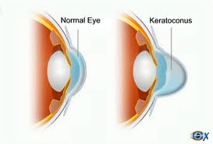
DEFINITION
Keratoconus is a bilateral, ectatic condition in which the cornea assumes a conical shape due to its congenital weakness, though it only manifests itself after puberty.

Slide 3
EPIDEMIOLOGY
1 IN 2000
ALL ETHNIC GROUPS
NO SEX PREPONDERANCE
SPORADIC – IF GENETIC THEN AD TRANSMISSION – CONTROVERSIAL

Slide 4
ETIOPATHOGENESIS
NOT KNOWN
ENZYME THEORY
INCRESED EPITHELIAL LYSOSOMAL ENZYMES
DECREASED ALPHA-1 PROTEASE INHIBITOR
DECREASED GLUCOSE – 6 PHOSPHATE DEHYDROGENASE LEVELS
CONNECTIVE TISSUE ABNORMALITY
GENETIC THEORY – ASSOC WITH TRISOMY 21
HORMONAL THEORY – ADOLESCENCE
EYE RUBBING

Slide 5
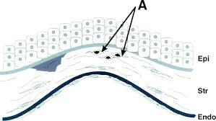
HISTOPATHOLOGY
THINNING OF CORNEAL STROMA
BREAKS IN BOWMAN’S LAYER
DEPOSITION OF IRON IN BASAL LAYERS OF EPITHELIUM

Slide 6
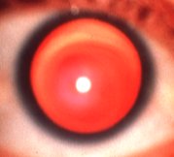
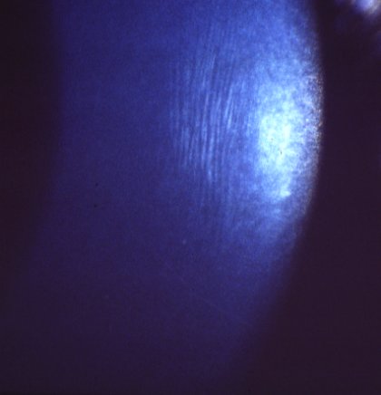
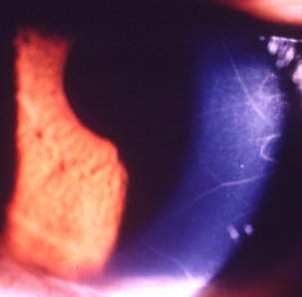
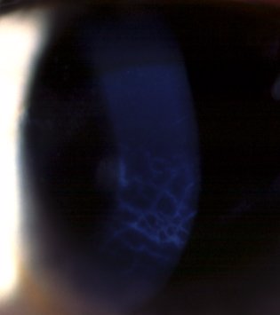
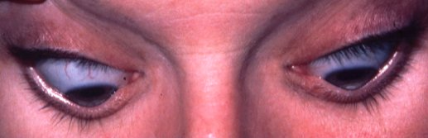
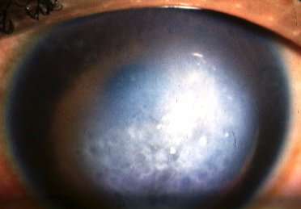
Signs of keratoconus
Bilateral in 85% but asymmetrical
Oil droplet reflex
Vogt striae
Prominent corneal nerves
Bulging of lower lids
on downgaze
Fleischer ring & scarring
Munson sign
Acute hydrops

Slide 7



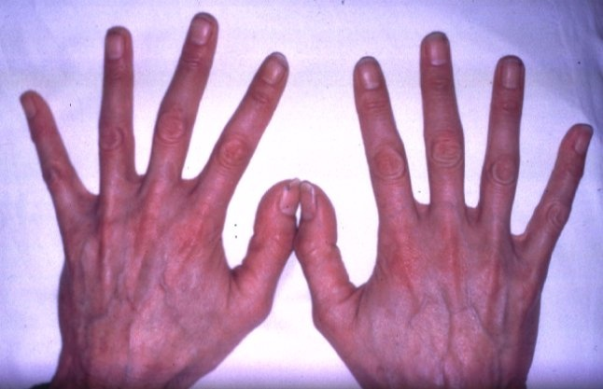
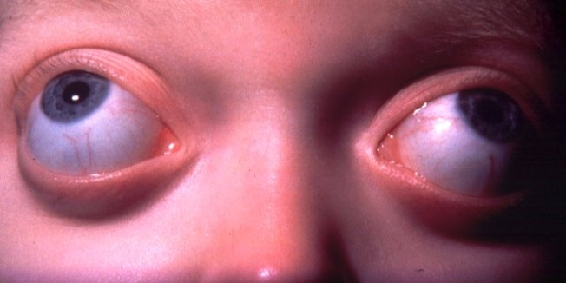
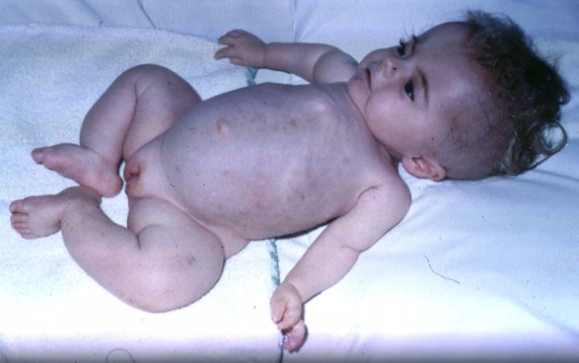
Systemic associations of keratoconus
Atopic dermatitis
Down syndrome
Ehlers-Danlos
syndrome
Marfan syndrome
Crouzon syndrome
Osteogenesis imperfecta

Slide 8
STAGING
STAGE I
MYOPIA/ASTIGMATISM - <5D
CORNEAL RADIUS <= 48D
VOGT STRAIE
STAGE II
MYOPIA/ ASTIGMATISM 5-8 D
CORNEAL RADIUS <=53D
CORNEAL THICKNESS >=400 MICRONS
STAGE III
MYOPIA/ASTIGMATISM 8-10D
CORNEAL RADIUS >53D
CORNEAL THICKNESS 200-400MICRONS
STAGE IV
REFRACTIVE ERROR NOT MEASURABLE
CORNEAL RADIUS >55D
CORNEAL SCAR/PERFORATION
CORNEAL THICKNESS 200MICRONS

Slide 9
INVESTIGATIONS
DIRECT OPHTHALMOSCOPY : OIL DROPLET SIGN NOTED IN BOTH EYES
THIS IS DUE TO THE PHENOMENON OF TOTAL INTERNAL REFLECTION OF THE LIGHT SURROUNDING THE CENTRAL BRIGHT RED FUNDUS REFLEX AND SEPERATING IT FROM THE NORMAL PERIPHERAL REFLEX.

Slide 10
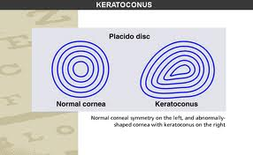
KERATOSCOPY : USING HANDHELD PLACIDO’S DISC

Slide 11
ORBSCAN : OPTICAL BEAM SCANNING SLIT TOPOGRAPHY, MEASURES THE POSTERIOR SURFACE OF CORNEA
PENTACAM : IMAGES THE ANTERIOR SEGMENT OF THE EYE USING A ROTATING SCHEIMPFLUG CAMERA
DIGITAL RASTERSTEREOGRAPHY BASED TOPOGRAPHY : WHOLE CORNEA AND PARTS OF SCLERA
LASER HALOGRAPHIC INTERFEROMETRY : 3 D IMAGES

Slide 12
MANAGEMENT
CONSERVATIVE :
1) SPECTACLES CORRECTION TILL TOLERATED

Slide 13
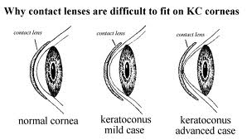
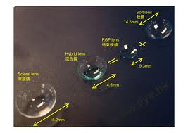
2) CONTACT LENSES : SOFT → HARD → PIGGYBACK CONTACT LENSES→ SCLERAL FIXATOR CONTACT LENSES
3- POINT TOUCH TECHNIQUE : LIGHT CENTRAL TOUCH 2-3MM AT THE APEX , ANOTHER TOUCH AT 3-9 ‘O CLOCK POSITION

Slide 14
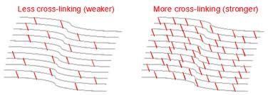
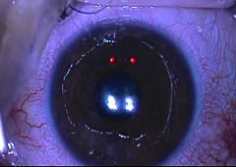
CORNEAL COLLAGEN CROSS LINKING/C3R/CCR/KXL/CXL
EPITHELIUM REMOVED →ONE TIME APPLICATION OF RIBOFLAVIN 0.1% → ACTIVATED BY UV RAYS OF 370 NMFOR 30 MINUTES → NEW BONDS ARE FORMED IN STROMA → STABILITY

Slide 15
Citation | Objectives | Method | Results | Conclusion
Can J Ophthalmol. 2014 Feb;49(1):54-9. doi: 10.1016/j.jcjo.2013.09.002. | To assess the long-term effects of treatment of progressive keratoconus with ultraviolet A-riboflavin collagencross-linking (CXL). | prospective clinical study | UCVA and BCVA were unchanged. Steepest meridian keratometry (D) and mean cylinder (D) did not show significant change compared with pretreatment values but showed a slight increase as compared with the 24-month time point. No significant change was observed in ECD, corneal hysteresis and corneal resistance factor, MCT, or foveal thickness. | 3-year results after CXL show stable visual acuity, corneal thickness, and corneal biomechanical parameters. The decreasing trend in keratometry values that was observed during the first 2 years after CXL was no longer evident. Longer follow-up is needed to decide whether it is a first sign of loss of achieved stability and resumption of keratoconus progression.

Slide 16
SURGICAL MANAGEMENT :
SUPERFISCIAL KERATECTOMY WITH BLADE OR EXCIMER LASER PHOTOTHERAPEUTIC KERATECTOMY FOR CENTRAL NODULAR SCARS
INTRASOMAL CORNEAL RINGS ( INTACS) FOR MODERATE CASES
LAMELLAR KERATOPLASTY – DEEP ANTERIOR LAMELLAR KERATOPLASTY – BIG BUBBLE TECHNIQUE
PENETRATING KERATOPLASTY – ADVANCED CASES – GOOD VISUAL RESULTS
PHAKIC IOL - HIGH MYOPIA

Slide 17
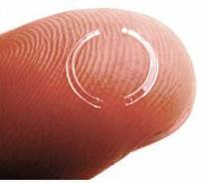
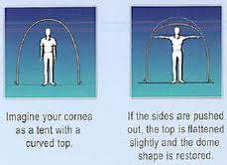
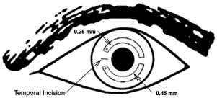
INTACS : INTRASOMAL CORNEAL RINGS
PRINCIPLE
PROCEDURE

Slide 18
Citation | Objectives | Method | Results | Conclusion
Am J Ophthalmol. 2013 Mar;155(3):575-584.e1. doi: 10.1016/j.ajo.2012.08.020. Epub 2012 Dec 4. | To analyze the outcomes of intracorneal ring segment (ICRS) implantation for the treatment of keratoconus based on preoperative visual impairment. | Multicenter, retrospective, nonrandomized study. | Significant improvement after the procedure in UCVA(P < .05). CDVA significantly decreased in grade I (P < .01) but significantly increased in all other grades (P < .05). Spherical equivalent and keratometry readings showed a significant reduction in all grades (P ≤ .02). Corneal higher-order aberrations did not change after the procedure (P ≥ .05). | Based on preoperative visual impairment, ICRS implantation provides significantly better results in patients with a severe form of the disease. A notable loss of CDVA lines can be expected in patients with a milder form of keratoconus.

Slide 19
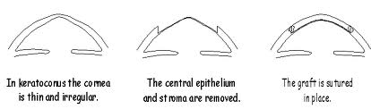
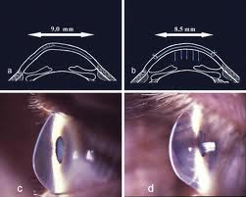
DALK

Slide 20
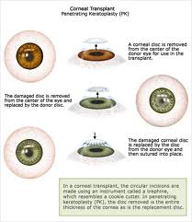
PENETRATING KERATOPLASTY

Slide 21
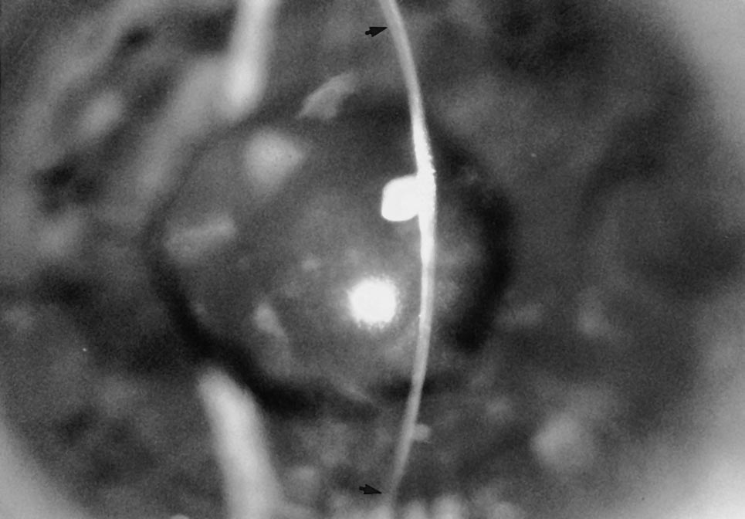
DIFFERENTIAL DIAGNOSIS
KERATOGLOBUS – THINNING OF THE WHOLE CORNEA FROM LIMBUS TO LIMBUS
DEVELOPMENTAL ANOMALY
PRESENTS SOON AFTER BIRTH

Slide 22
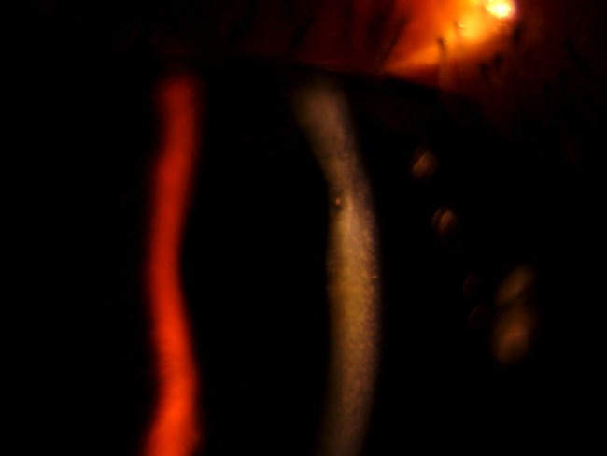
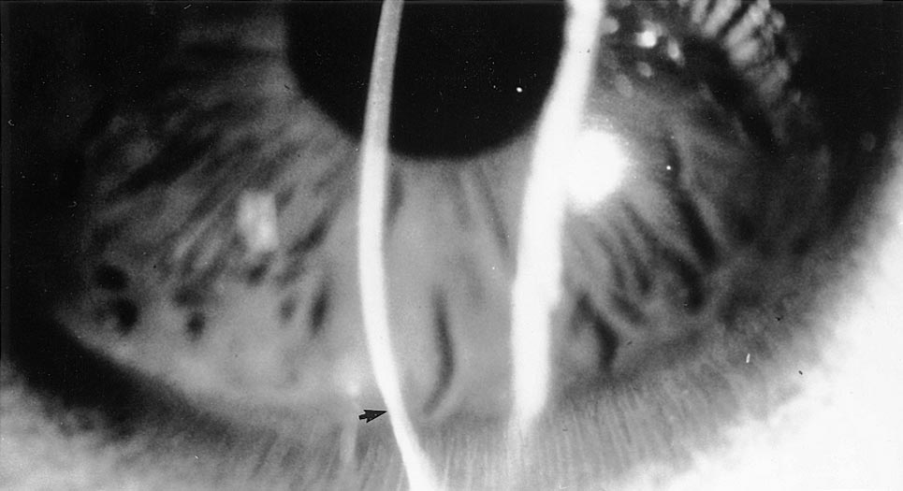
2) POSTERIOR KERATOCONUS -
NON- PROGRESSIVE DOME SHAPED POSTERIOR EXCAVATION OF CORNEA, MAY BE SMALL, CIRCUMSCRIBED
USUALLY FOLLOWING TRAUMA
3) PELLUCID MARGINAL DEGENERATION
THINNING IN THE INFERIOR PART ONLY
OCCURS IN 2ND TO 5TH DECADE
4) CONTACT LENS WARPAGE
5) POST LASIK ECTASIA

Slide 23
Keratoconus is?
Thinning in axial part
Thinning in horizontal part
Both
None of above

Slide 24
2) Features of keratoconus?
Munsons sign
Irregular mires
Irregular circles
All of above

Slide 25
3) Treament for keratoconus?
Intacs
Laser
Both
None of above

Slide 26
4) Complication of keratocnus?
Acute hydrops
Cataract
Papillitis
conjunctivitis

Slide 27
5) Keratoconus is ?
-unilateral
Bilateral
Both
None of above

