Slide 1
SUBTROCHANTERIC FEMUR FRACTURES
Dr. Sudhir Rawat
Associate Professor
SBKS MIRC

Slide 2

Classification of subtrochanteric femoral fractures
C.L. Loizou *, I. McNamara, K. Ahmed, G.A. Pryor, M.J. Parker
Injury, Int. J. Care Injured 41 (2010) 739–745.
Subtrochanteric fractures involve an area between the lesser trochanter and the isthmus of the diaphysis of the femoral shaft

Slide 3
Epidemiology
10-34% of all hip fractures
Velasco and Comfort
63% of subtrochanteric fractures in 51 - 70 year olds
Only 24% in those 17 - 50 years old
Michelson et al
14% of hip fractures in patients older than 50 are subtrochanteric fractures

Slide 4
Mechanism of Injury
young and healthy individuals- high-energy trauma
elderly population - osteoporotic fall
pathological fractures
periprosthetic fractures

Slide 5
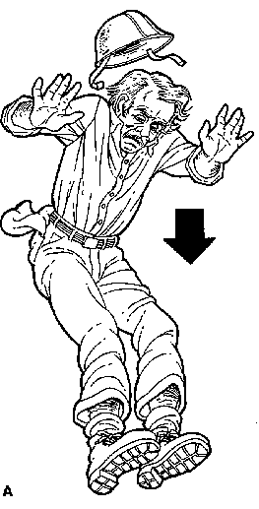
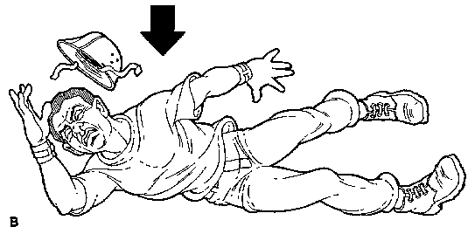
Mechanism
Most subtrochanteric fractures are caused by
  -Direct lateral trauma
  -Axial loading (with failure in subtrochanteric
  region).

Slide 6
Low energy
High energy
Minimal comminution
Spiral pattern more common
Osteoporotic bone
High comminution involving much of the proximal femur
Significant soft tissue damage

Slide 7
Natural History
High-energy trauma
The other life-threatening conditions must be adequately handled before managing the definitive treatment of the subtrochanteric fracture.
The concept of damage control in acute management

Slide 8
Diagnosis
History
Elicit mechanism (low versus high energy)
Preinjury status: preexisting hip pain and constitutional symptoms to rule out pathologic fracture
Ambulatory status/pre-injury functional status/occupation
Chest pain, shortness of breathe, light headedness, dizzyness, palpitations, headache

Slide 9
Physical Exam
ABC’s in high energy injuries
Pain and apprehension
Swollen thigh, bruising
Shortened extremity, externally rotated
Inability to actively flex/extend hip and pain with passive range of motion
Neurovascular compromise is very rare
Secondary Survey!

Slide 10
Radiographic Exam
Full-length femur views in AP and lateral planes
Note inner and outer diameter of medullary canal
Curvature of femoral shaft
Preexisting deformities or implant devices
AP Pelvis
Neck shaft angle of unaffected side

Slide 11
AP and Lateral of the hip
Determine if fracture line extends into piriformis fossa, medial cortex, etc.
Bone scan/MRI for occult fractures

Slide 12
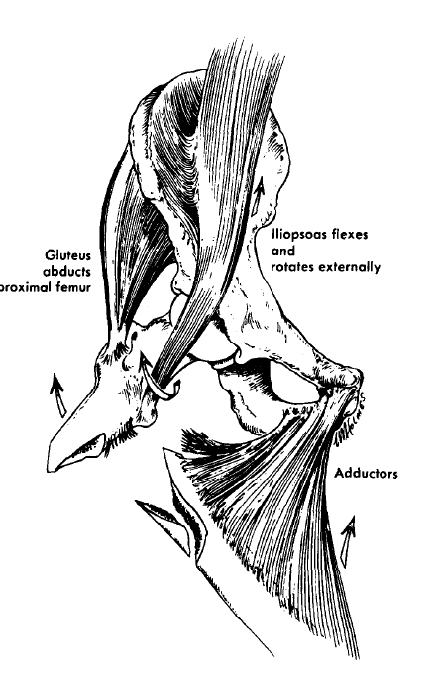
Deformity
Iliopsoas
short abductors of the hip
adductor magnus

Slide 13
Biomechanical Considerations
The fractures occur typically at the junction between trabecular bone and cortical bone where the mechanical stress across the junction is highest in the femur
frequent fracture comminution in this region, due to changes in the structure and the mechanical environment.

Slide 14
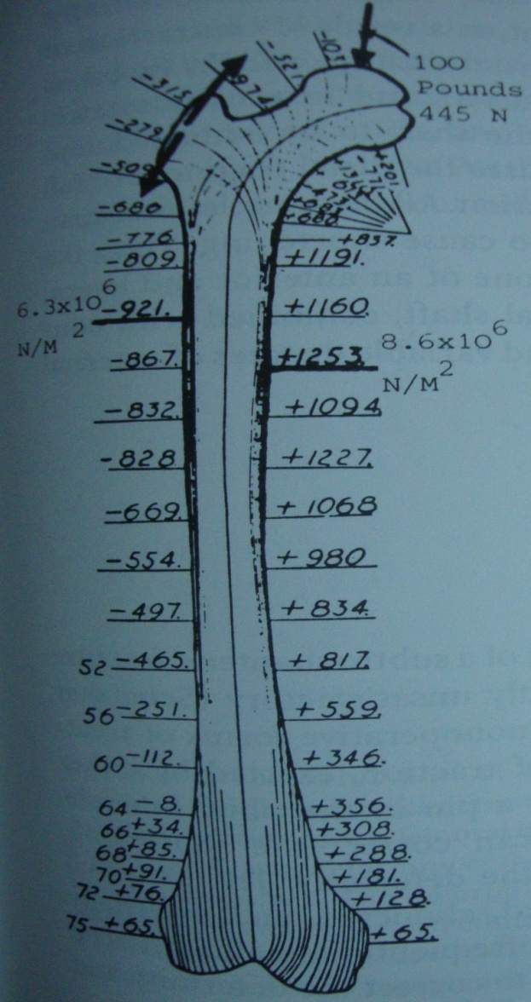
Mechanical Forces
Eccentric load application to the femoral head.
Koch has calculated the tremendous compression stress on the medial side and tension stress on the lateral cortex in the subtrochanteric region.

Slide 15
Biomechanical Considerations
The healing of the fracture is also special, as the high-energy trauma induces more vascular insults to the bone.
Marked displacement of the fracture fragments proximally and distally due to muscular forces.

Slide 16
Classification of subtrochanteric femoral fractures
C.L. Loizou *, I. McNamara, K. Ahmed, G.A. Pryor, M.J. Parker
Department of Orthopaedics, Peterborough District Hospital, Thorpe Road, Peterborough, PE3 6DA, UK
Classification
A review of the literature identified 15 different classification methods for subtrochanteric femoral fractures.
There was no agreement between the different classifications regarding the proximal and distal border or for those fractures, which traverse anatomical boundaries

Slide 17
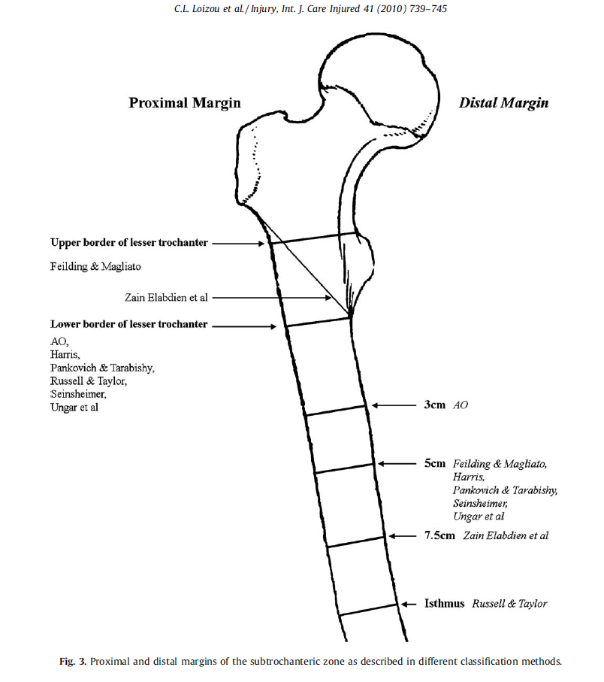

Slide 18
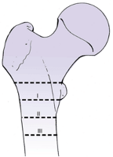
Classification
Fielding Classification (1966)
  Based on location of the primary fracture line in relation to the lesser trochanter

Slide 19
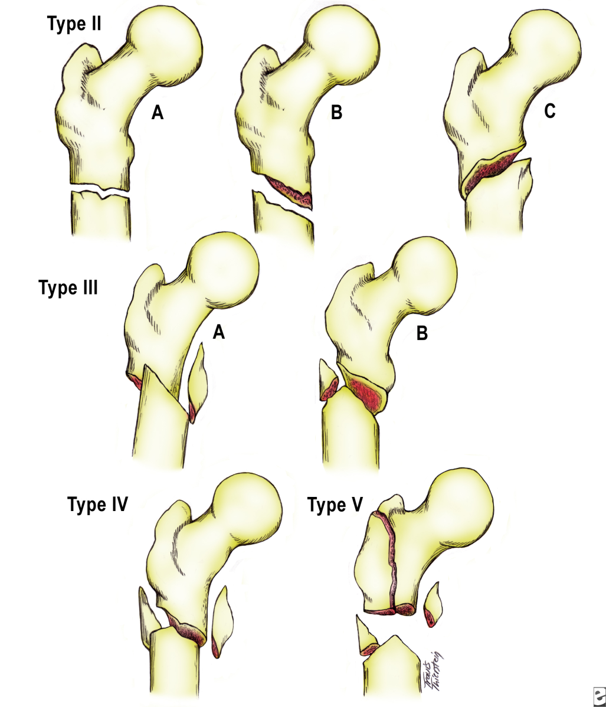
Classification
Seinsheimer Classification
  Based on number of major bone fragments and the location and shape of fracture lines

Slide 20
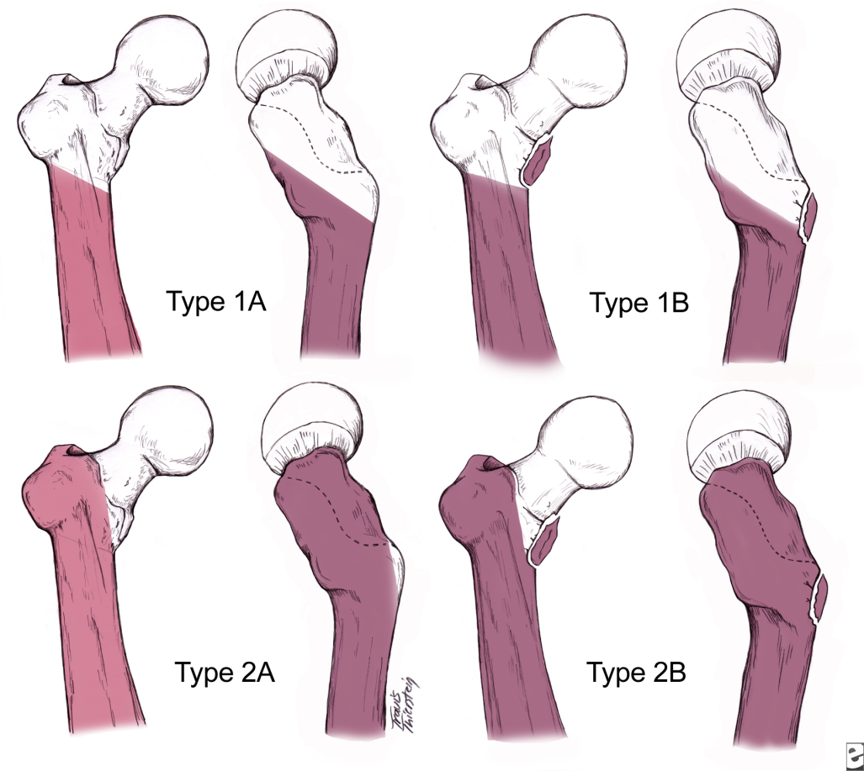
Classification
Russell-Taylor
  Advocated by Browner, et al in Skeletal Trauma

Slide 21
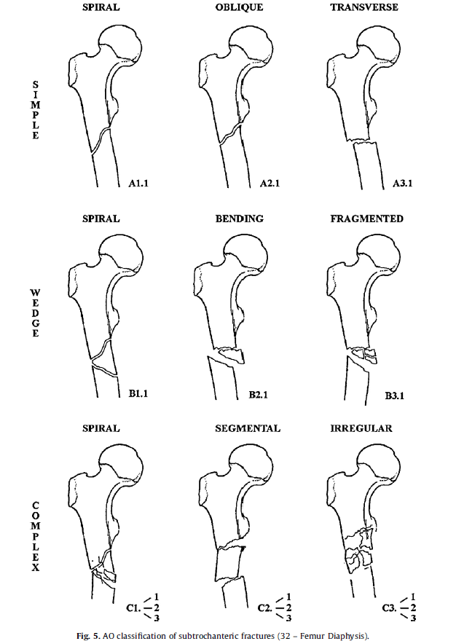
AO classification

Slide 22
So what does Classification matter?
Key factors to look for:
Is the medial cortex intact?
Is the greater troch/piriformis fossa involved?
Is it a reverse obliquity type pattern?

Slide 23
Treatment
Subtrochanteric fractures result in:
Shortening of involved limb
Varus positioning of the femoral head and neck
This creates a functionally weakened abductor group.
May cause abductor lurch.

Slide 24
The goals of management are:
Restoration of normal length
Restoration of normal rotation
Correction of femoral head and neck angulation
The most common error is reduction in varus
Leads to increased stress on implant
Diminished effectiveness of the abductors

Slide 25
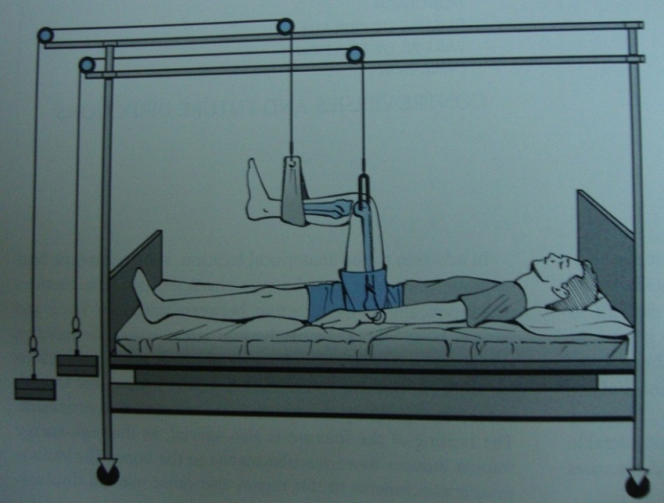
Nonoperative
In 3-4 weeks, leg gradually lowered to less flexion
Cast bracing when consolidation is achieved
Callus formation on x-ray
Evidence of mechanical continuity
Traction
90-90 positioning is required
Initially 30-40lbs of traction
Frequent radiographs
Less than 5° varus/valgus angulation
At least 25% fracture fragment apposition

Slide 26
Complications
DVT, PE, pressure sores, pneumonia, pin tract infections
Shortening, varus/valgus deformity, peroneal nerve palsy
Velasco and Comfort reported that 11/22 patients had unsatisfactory results with traction

Slide 27
Operative
Avoids complications of prolonged bed rest and hospitalization
Accurate reduction, anatomic reduction, or anatomical alignment
Early surgery reduces blood loss and pain
Early mobilization

Slide 28
Open
Anatomical reduction and rigid fixation with interfragmentary compression
Excessive dissection
Bone grafting posteromedially to enhance fracture healing and posteromedial stability
mechanical failure due to the long lever arm and nonunion are relatively common.
Banan H, Al-Sabti A, Jimulia T, et al. The treatment of
unstable, extracapsular hip fractures with the AO/ASIF proximal
femoral nail (PFN)—our first 60 cases. Injury 2002

Slide 29
Closed
Anatomical realignment: length and rotation must be corrected
Closed reduction and internal fixation
Load sharing device

Slide 30
Comparison of Open and Closed Techniques
Open Technique Closed Technique
Surgical trauma ++++ +
Fracture hematoma Disturbed Preserved
Reduction Anatomical reduction Anatomical alignment
Fixation Rigid Stable
Radiation Minimal Intraoperative screening
Biomechanical Medial support Intramedullary fixation important
Fracture healing Higher rates of delayed Excellent and nonunion
Complications Implant failure Fixation failure,defomities

Slide 31
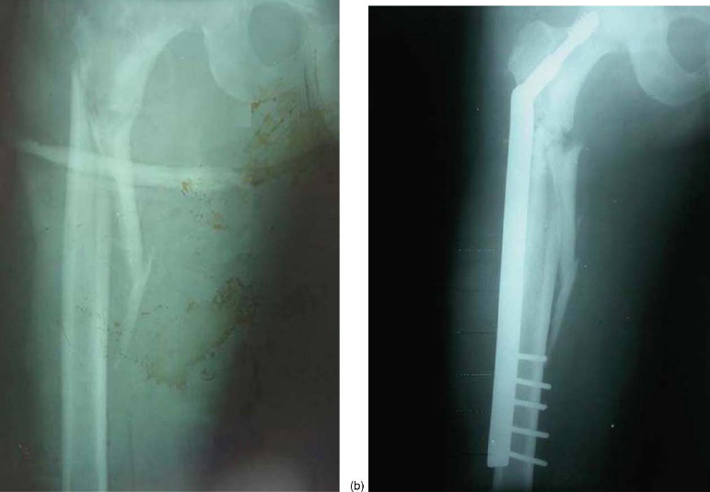
Indirect reduction and biological internal fixation of comminuted subtrochanteric fractures of the femur with DHS

Slide 32
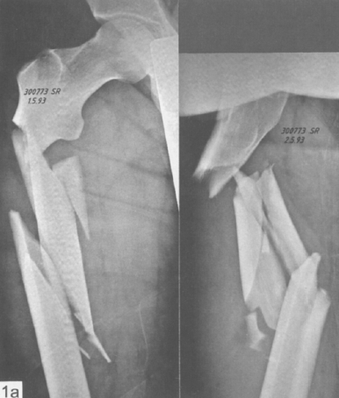
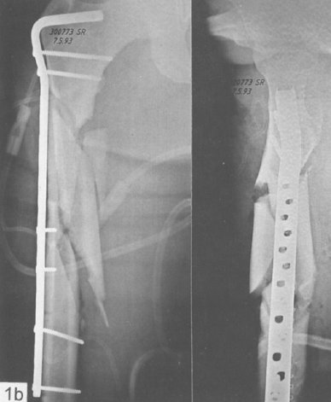
Indirect reduction with a condylar blade plate for osteosynthesis of subtrochanteric femoral fractures

Slide 33
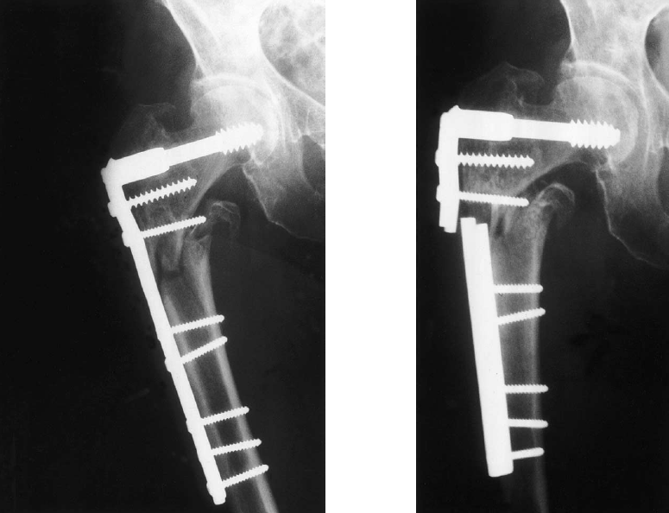
Fracture fixed biologically with a DCS, collapsed into varus

Slide 34
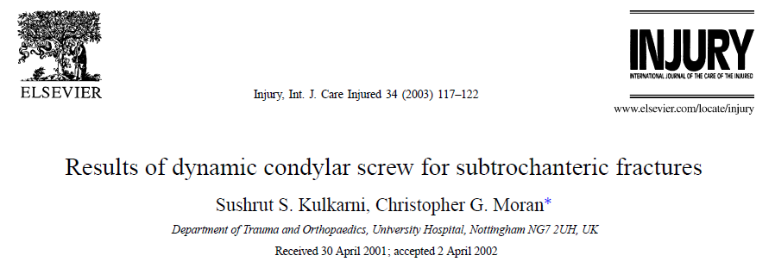
Using the DCS, the results were good in the young patients with high-energy injuries. However, the implant failure rate is high in elderly patients who suffer low-energy fractures. The DCS should not be used if weight bearing cannot be minimized in this group

Slide 35
Sanders R, Regazzoni P. Treatment of subtrochanteric femur fractures using the dynamic condylar screw. J Orthop Trauma
1989
Extramedullary fixation depends on screw fixation of a plate to the lateral cortex, so the mechanical stability of fixation would be problematic.
Moreover, due to the risk of varus collapse and a low union rate, extramedullary fixation is not recommended for complex fractures

Slide 36
Borens O,Wettstein M, Kombot C, et al. Long gamma nail in the treatment of subtrochanteric fractures. Arch Orthop Trauma Surg 2004; 124(7):443-447.
Cheng MT, Chiu FY, Chuang TY, et al. Treatment of complex subtrochanteric fracture with the long gamma AP locking nail: a prospective evaluation of 64 cases. J Trauma 2005;
The advantages of intramedullary devices
less extensive exposure
fewer biomechanical stresses with medial movement of the lever arm and earlier weight-bearing.

Slide 37
Types of Intra Medullary nails
Centromedullary (standard ILN)
Contained within the medullary canal
Condylocephalic nail (Enders)
Inserted into the femoral condyle and extended in retrograde fashion into the femoral head/neck
Cephalomedullary (Recon Nail)
Contained within the medullary canal .
Also screw or nail devices that can be inserted into the femoral head and neck

Slide 38
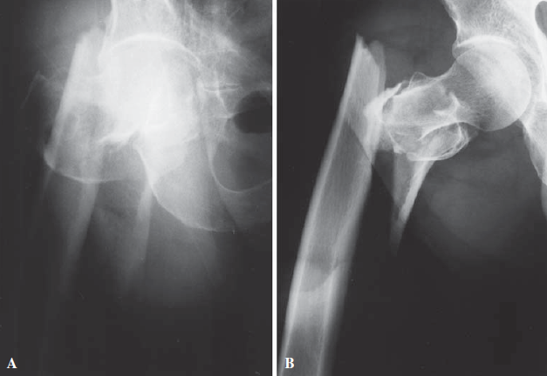
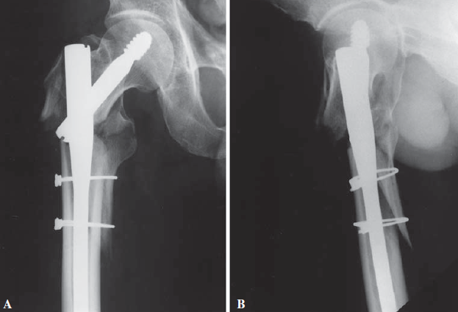
GAMMA NAIL

Slide 39
Leung KS, So WS, Shen WY, et al. Gamma nails and dynamic hip screws for pertrochanteric fractures: a randomised prospective study in elderly patients. J Bone Joint Surg Br 1992
failures with the Gamma nail
due to a lack of rotational stability of the proximal fragment and/or malpositioning of the neck screw.
The major complications associated with Gamma nail fixation, in fracture of the femoral shaft, have been reported to occur in 2% to 11% of cases

Slide 40
21.Ramakrishnan M, Prasad SS, Parkinson RW, et al. Management of subtrochanteric femoral fractures and metastases using long proximal femoral nail. Injury 2004
PFN overcomes the limitations associated with the Gamma nail.
provides rotational stability to the proximal fragment with two proximal locking hip screws and reduces the incidence of cut-out.

Slide 41
The clinical results of PFNA-long in the treatment of Subtrochanteric femoral fractures have been encouraging, with no mechanical failures of the implant
although technical difficulties are encountered with the insertion of proximal locking screws

Slide 42
PFNA improves the biomechanical properties and yields better purchase of the helical blade in the femoral head.
The blade has been biomechanically proved to provide increased rotational stability with compaction of cancellous bone around the blade, and better resistance to varus collapse

Slide 43
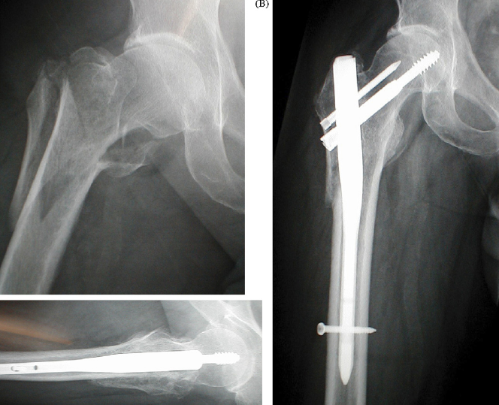
PFN-A

Slide 44
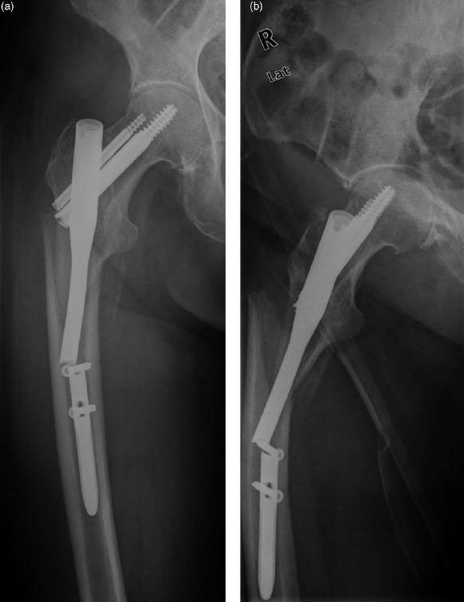
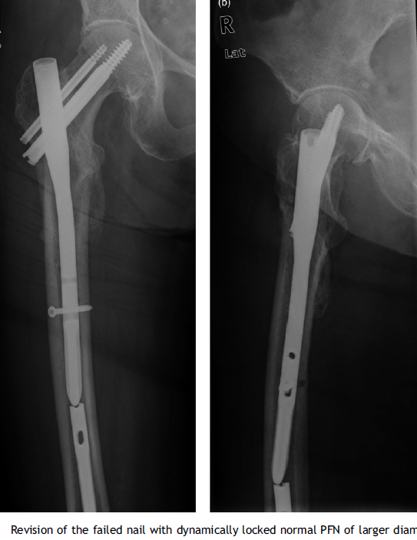
Proximal femoral nail failure in a subtrochanteric fracture: The importance of fracture to distal locking screw distance B.F. Ongkiehong a,*, R. Leemans
distance from distal locking screw hole to fracture is one of the determinants of suitability.

Slide 45
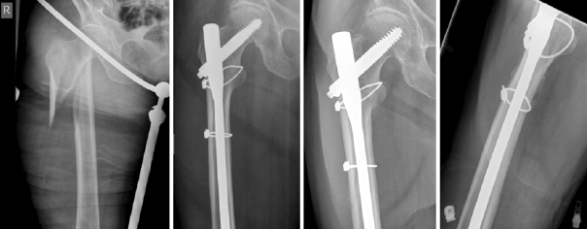
Encirclage…judicious use

Slide 46
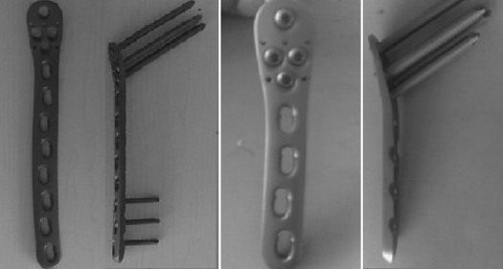
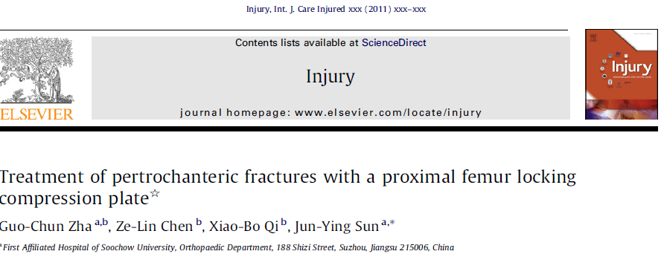
Newer trends

Slide 47
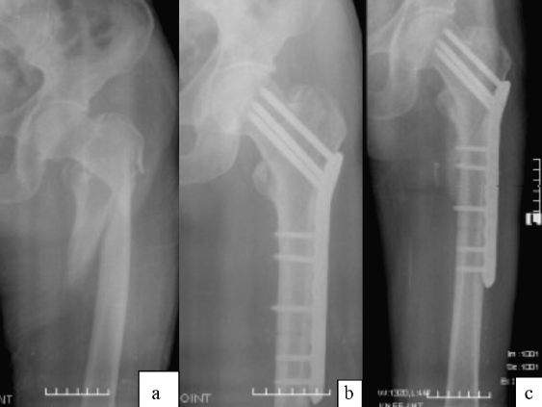
The PFLCP can be a feasible alternative to the treatment of pertrochanteric fractures. Treatment with a PFLCP can provide good-to-excellent healing for pertrochanteric fractures, with a limited occurrence of complications.
PFLCP

Slide 48
CASE 1
21 YR OLD MALE
RTA
COMUNITED SUBTROCH. EXTENDING TO PY.FOSSA.
NO OTHER INJURY.

Slide 49
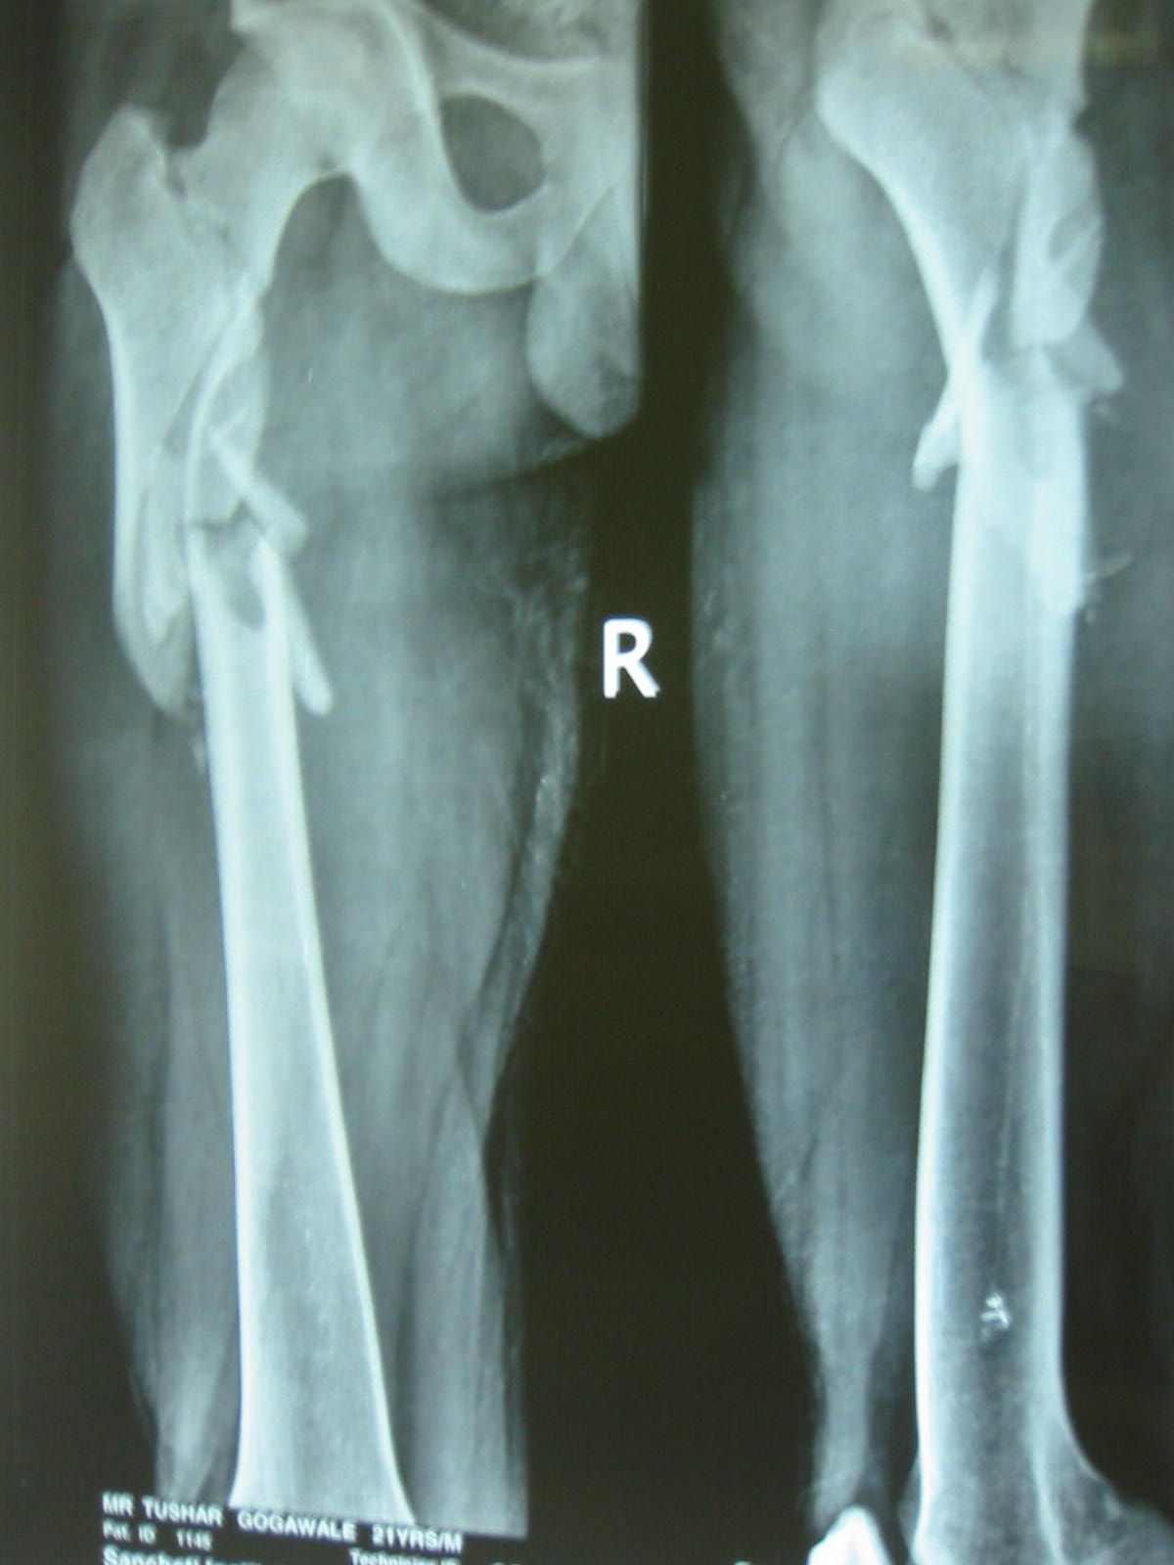
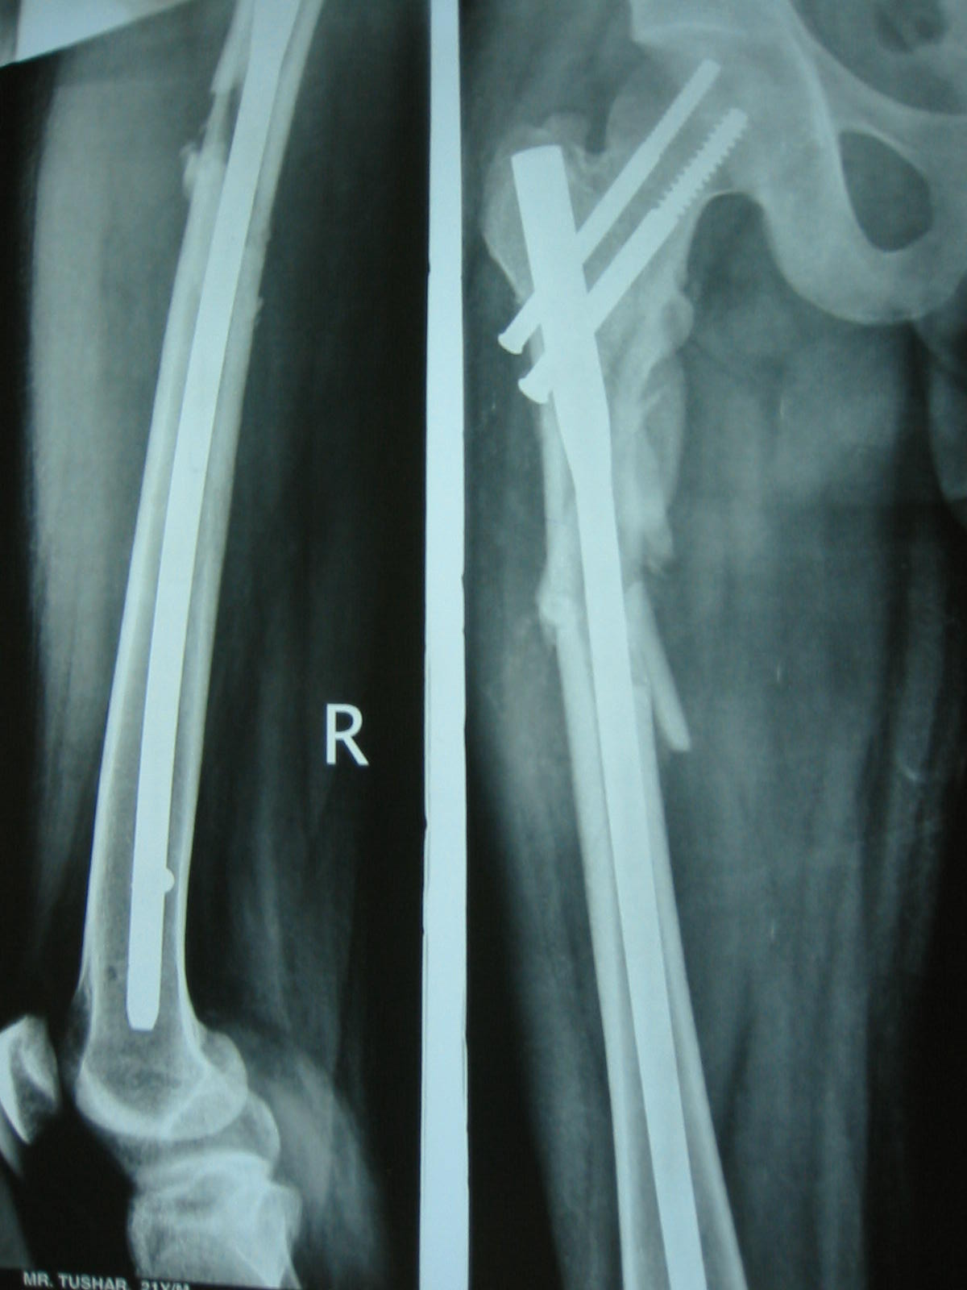

Slide 50
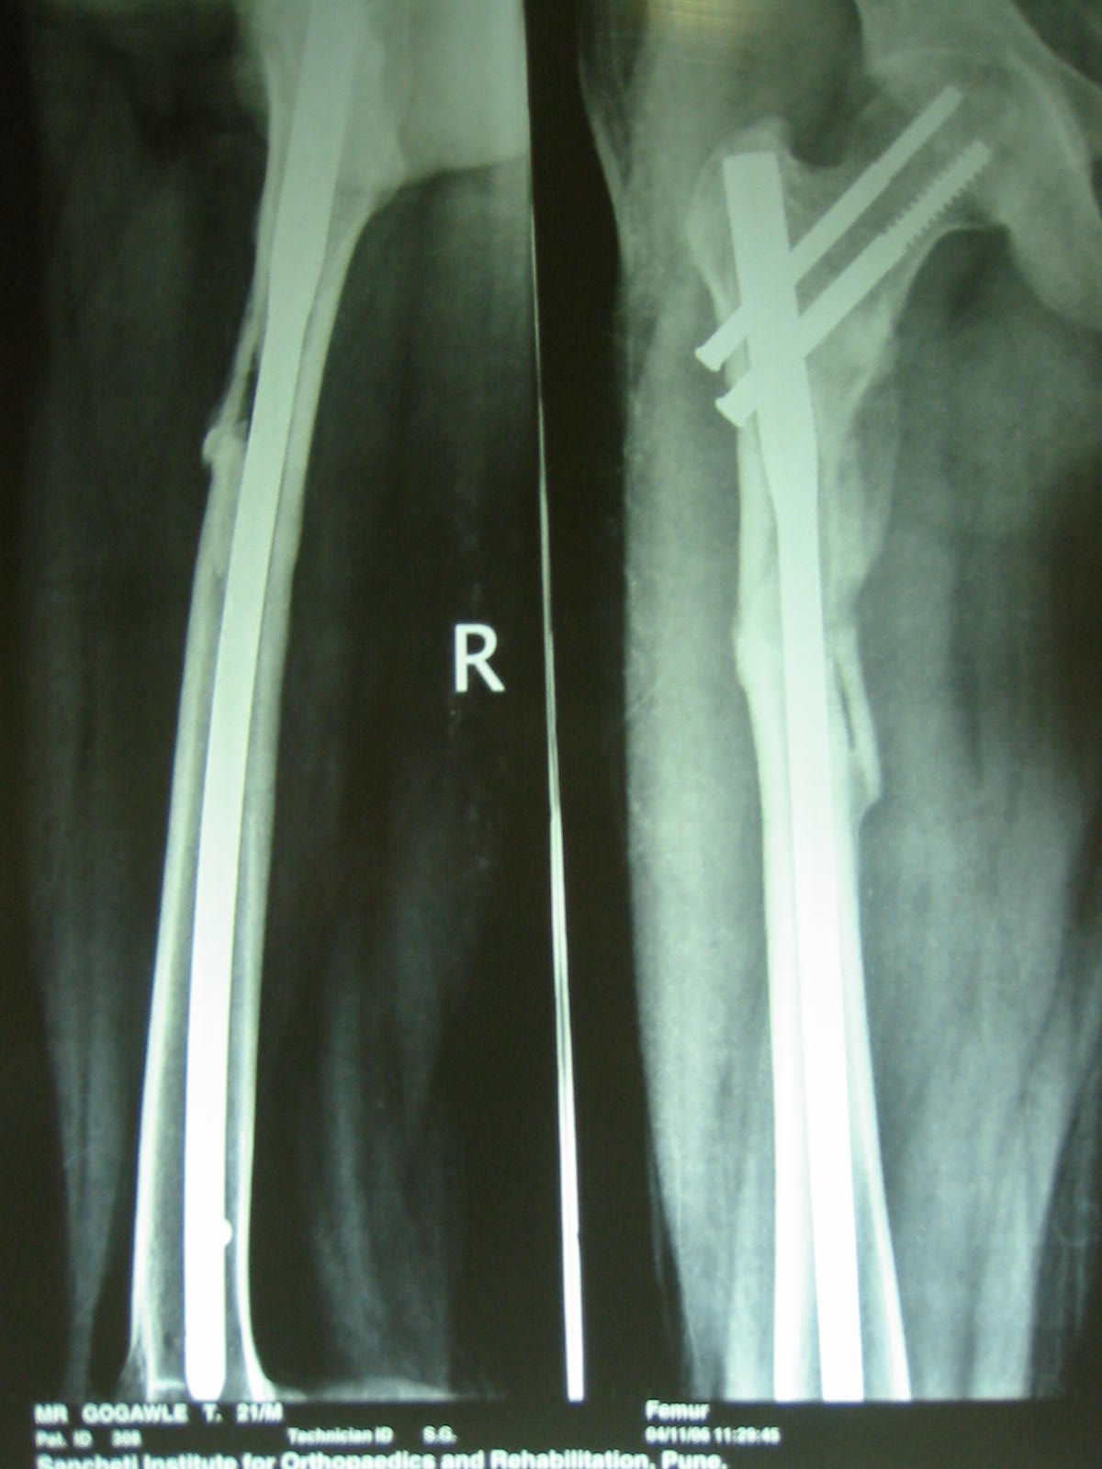
6 M

Slide 51
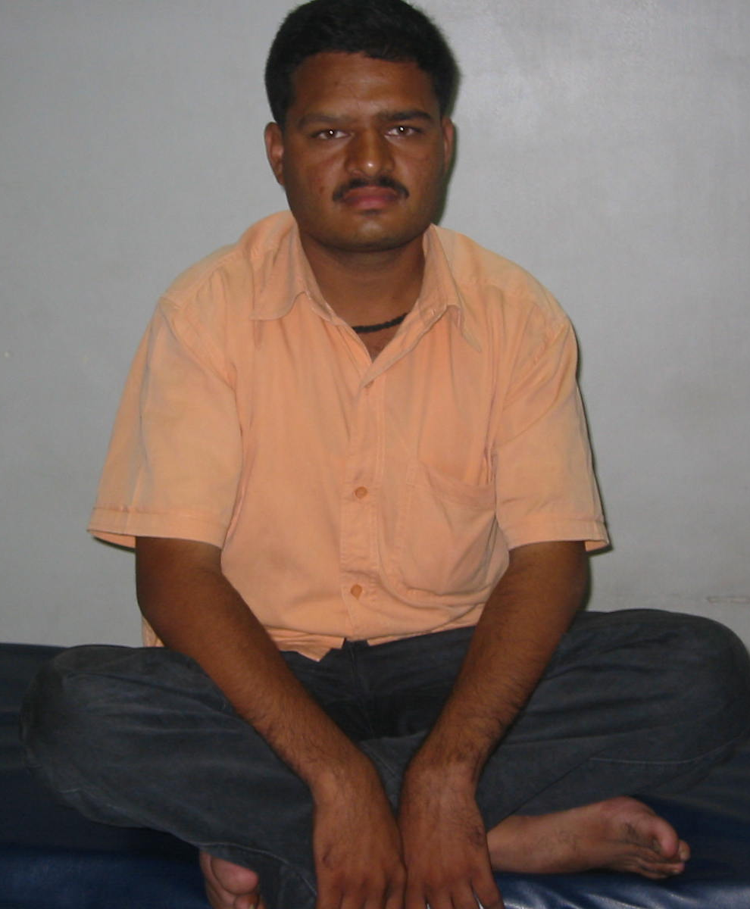
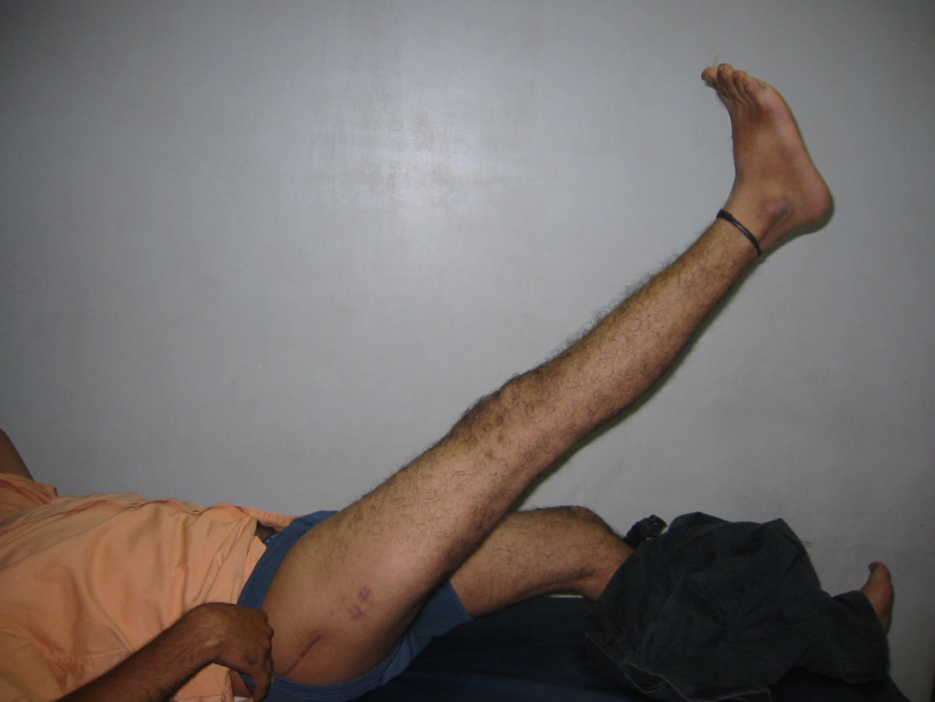
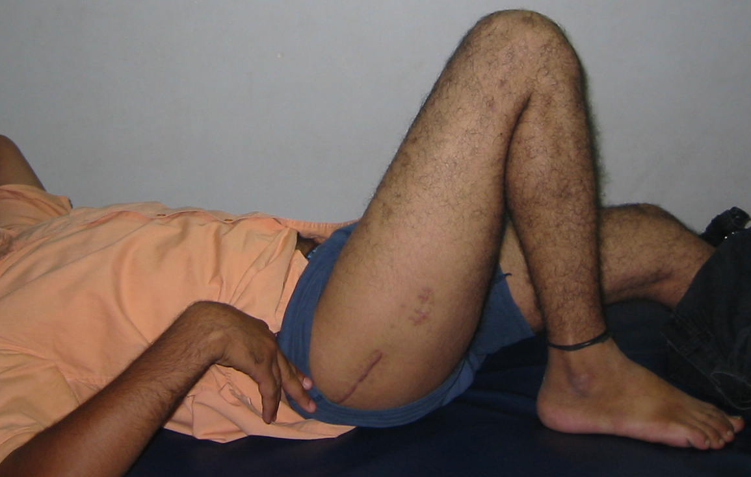

6 m
post-op

Slide 52
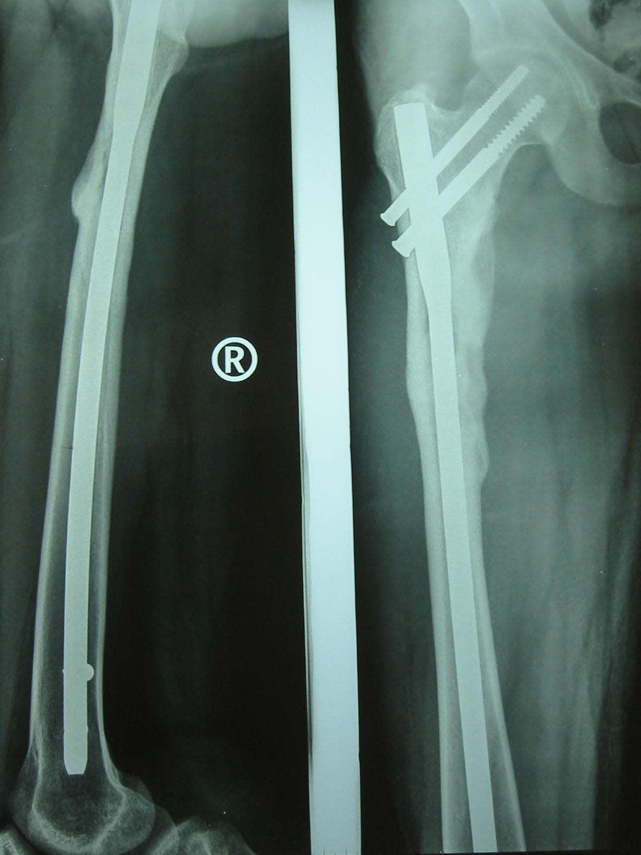
1 year followup

Slide 53
CASE 2
40 yr old female lecturer.
Fall from height.
Communited subtroch.
Fragment facing out.
Closed or open reduction?

Slide 54
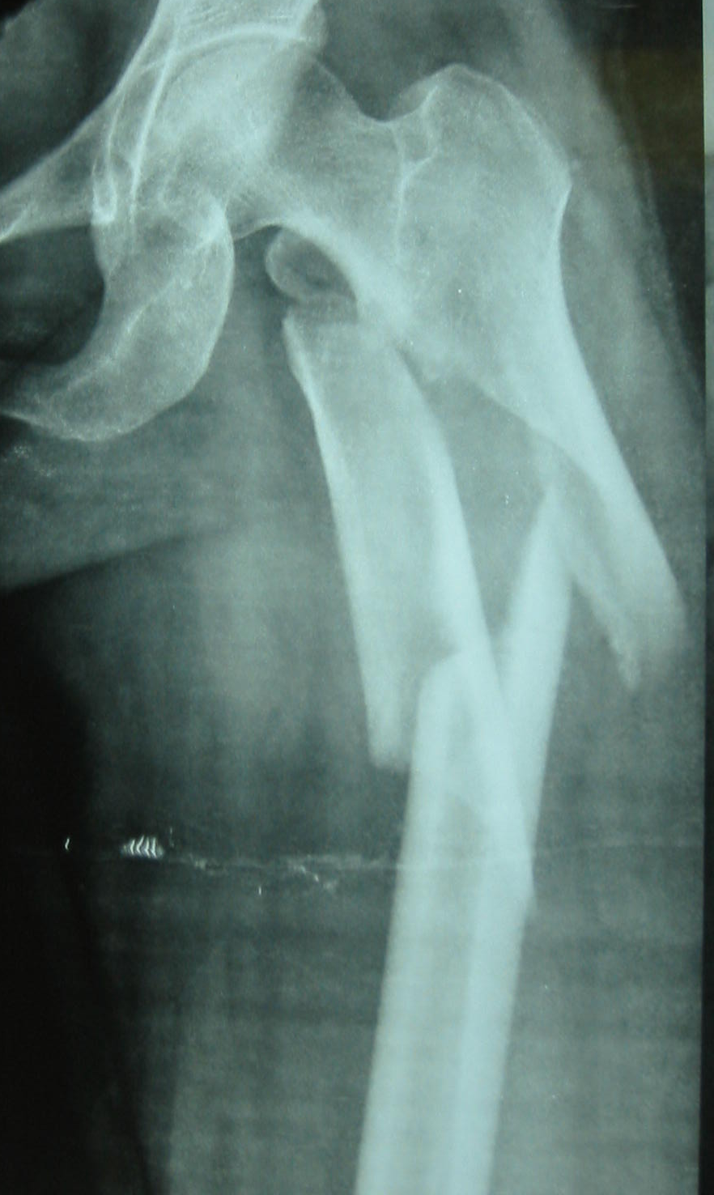
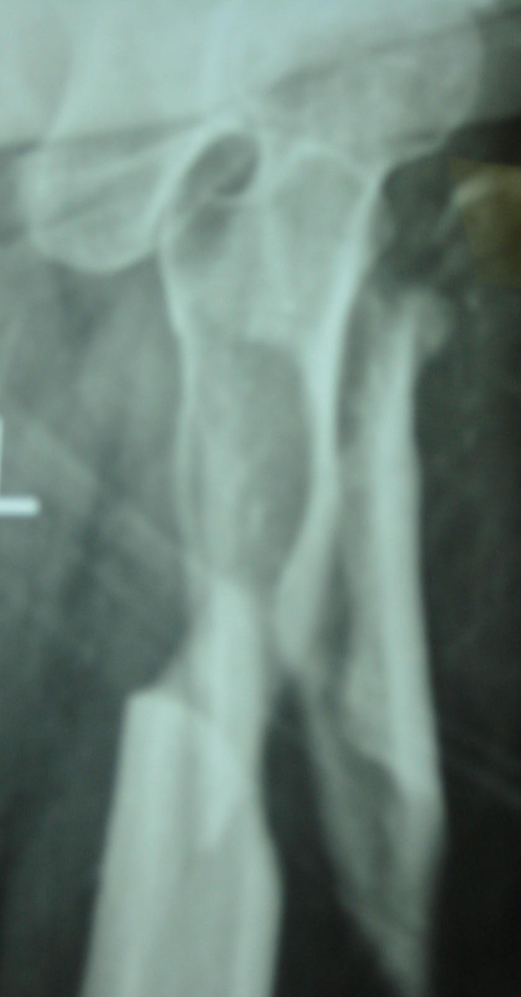

Slide 55
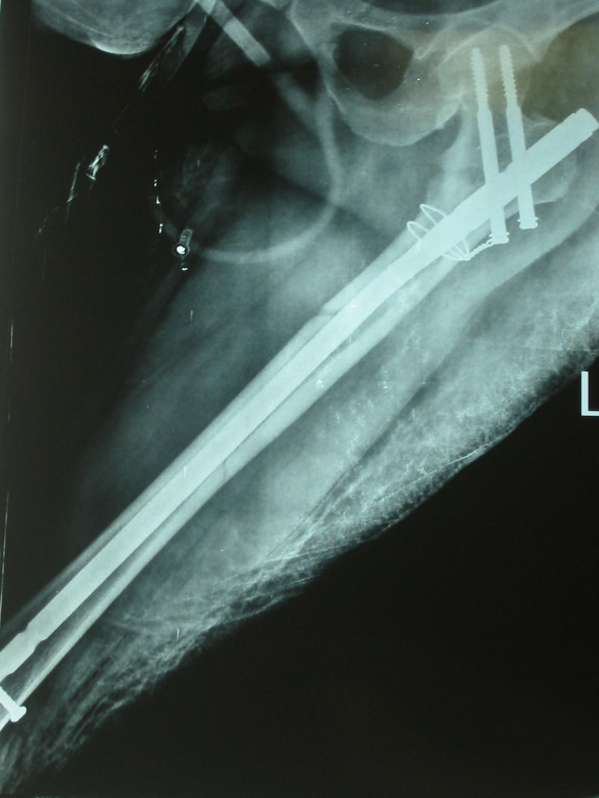
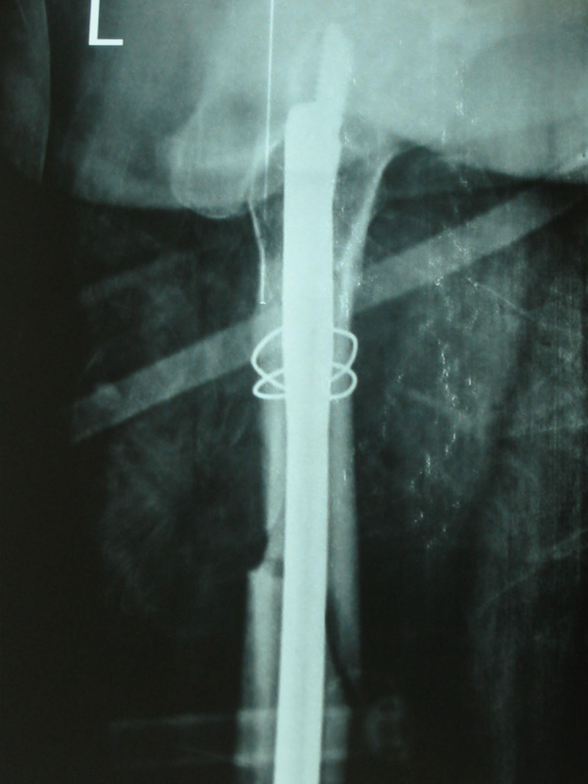

Slide 56
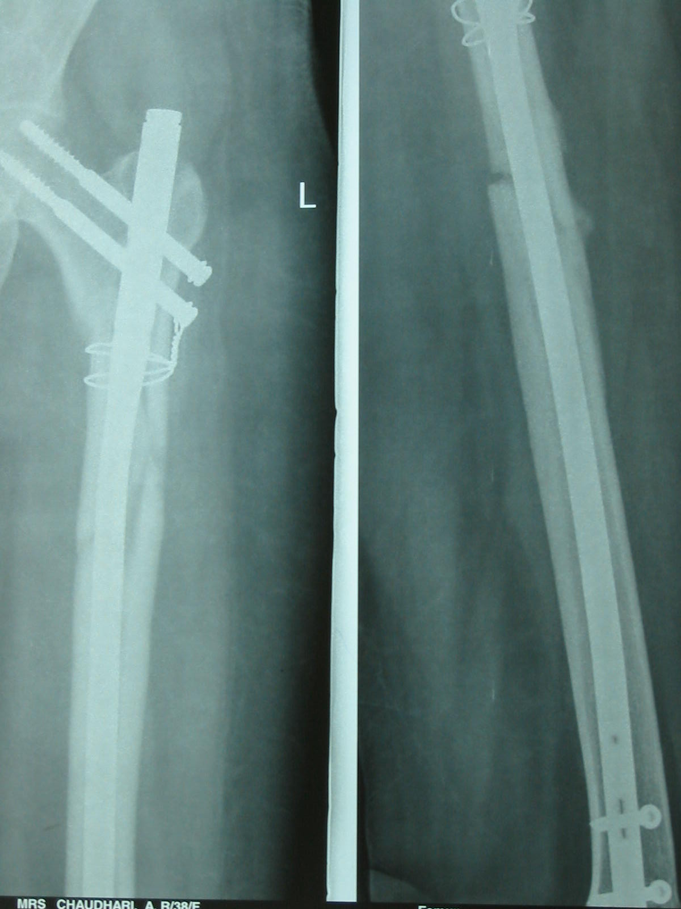
3 month xray
Pt full wt bearing
With stick

Slide 57
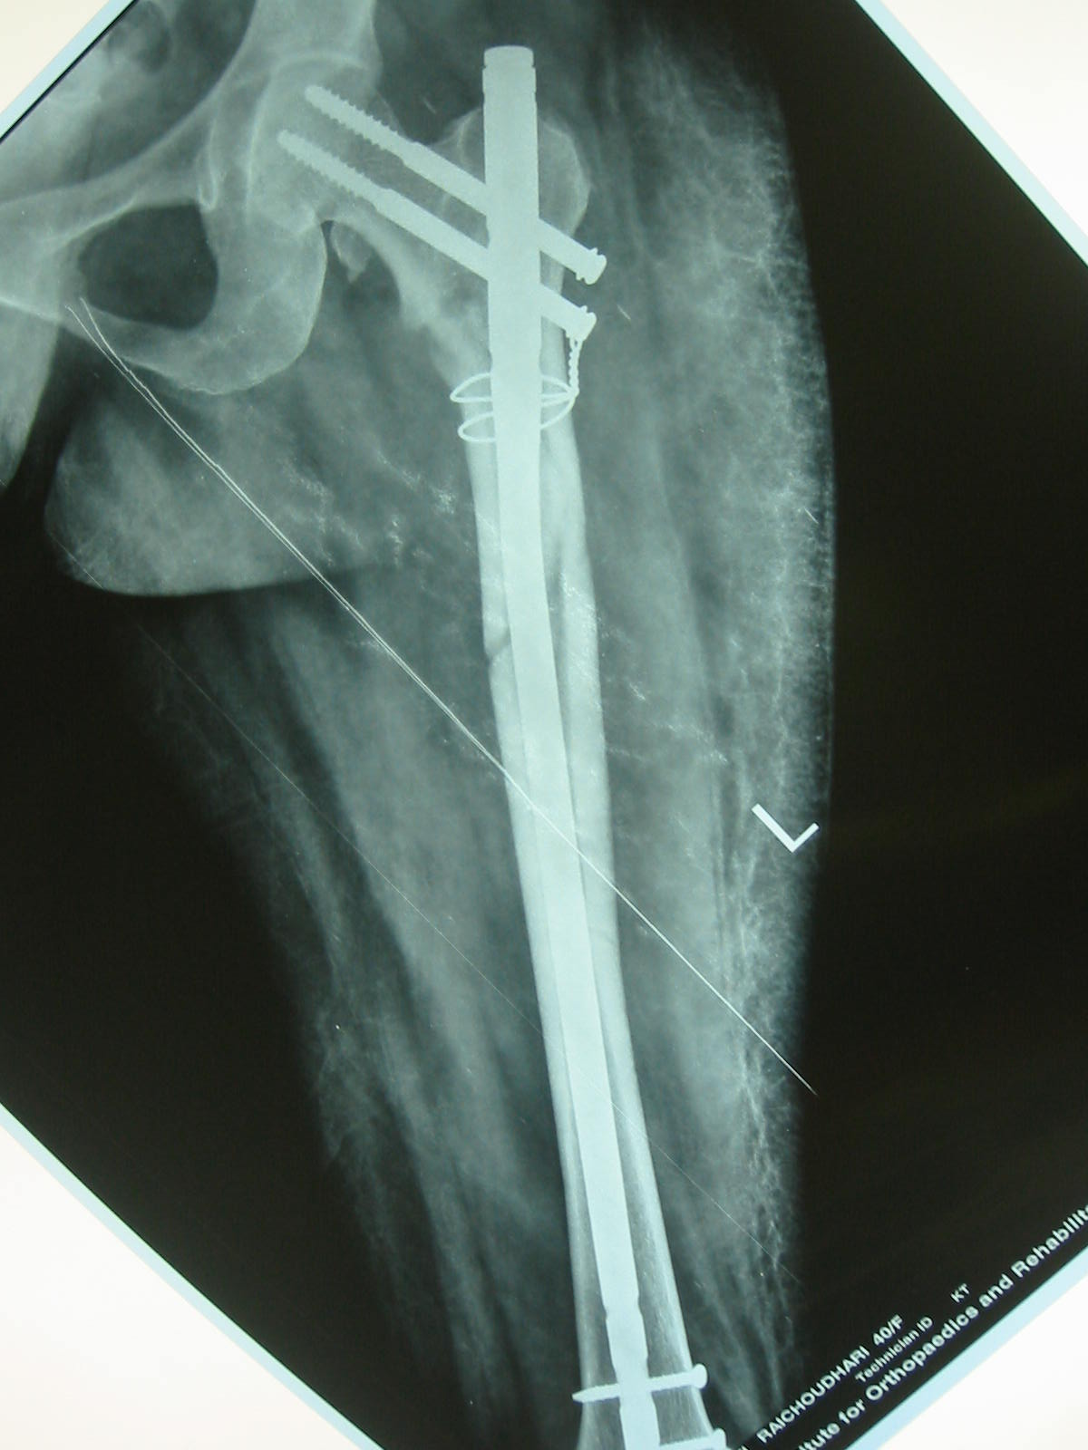
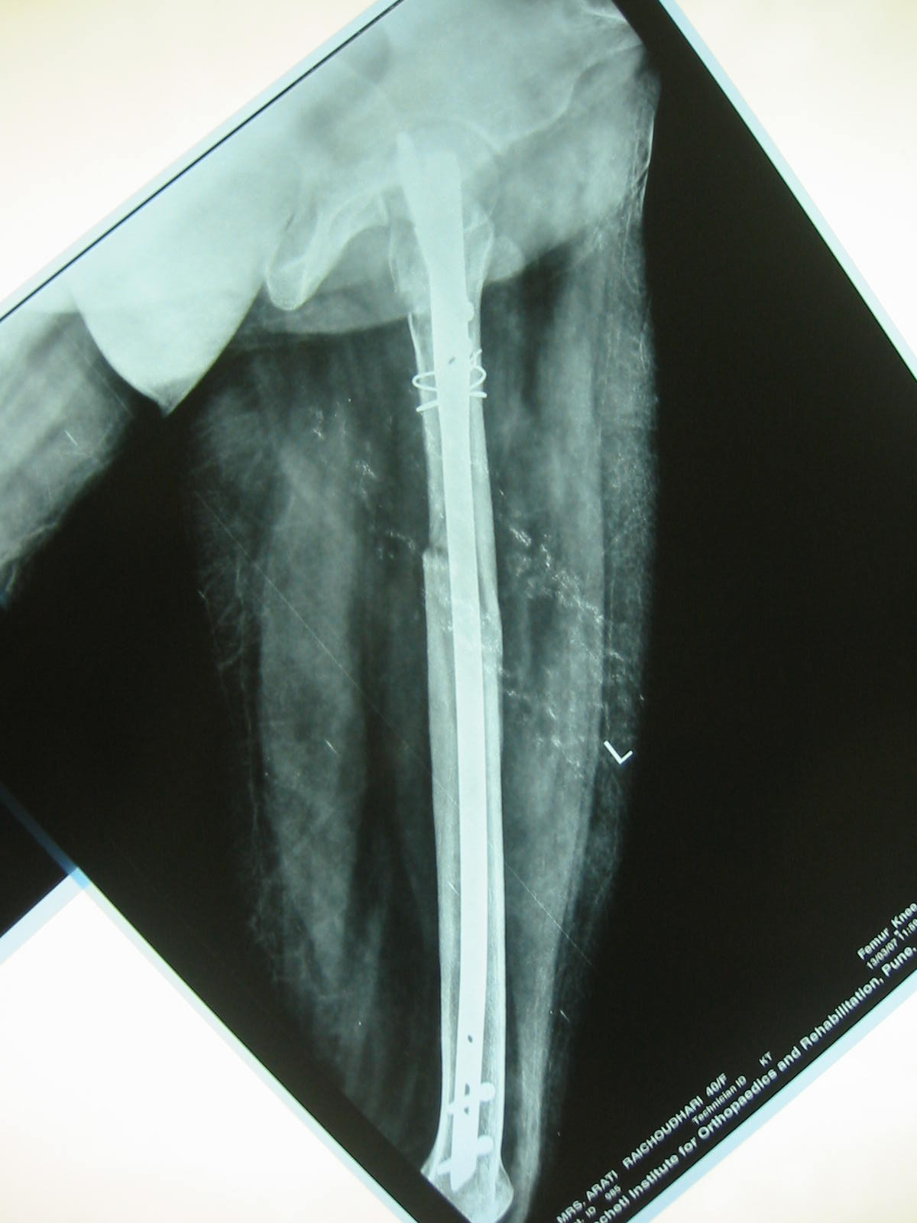
6 month xrays . Full wt bearing
without support

Slide 58
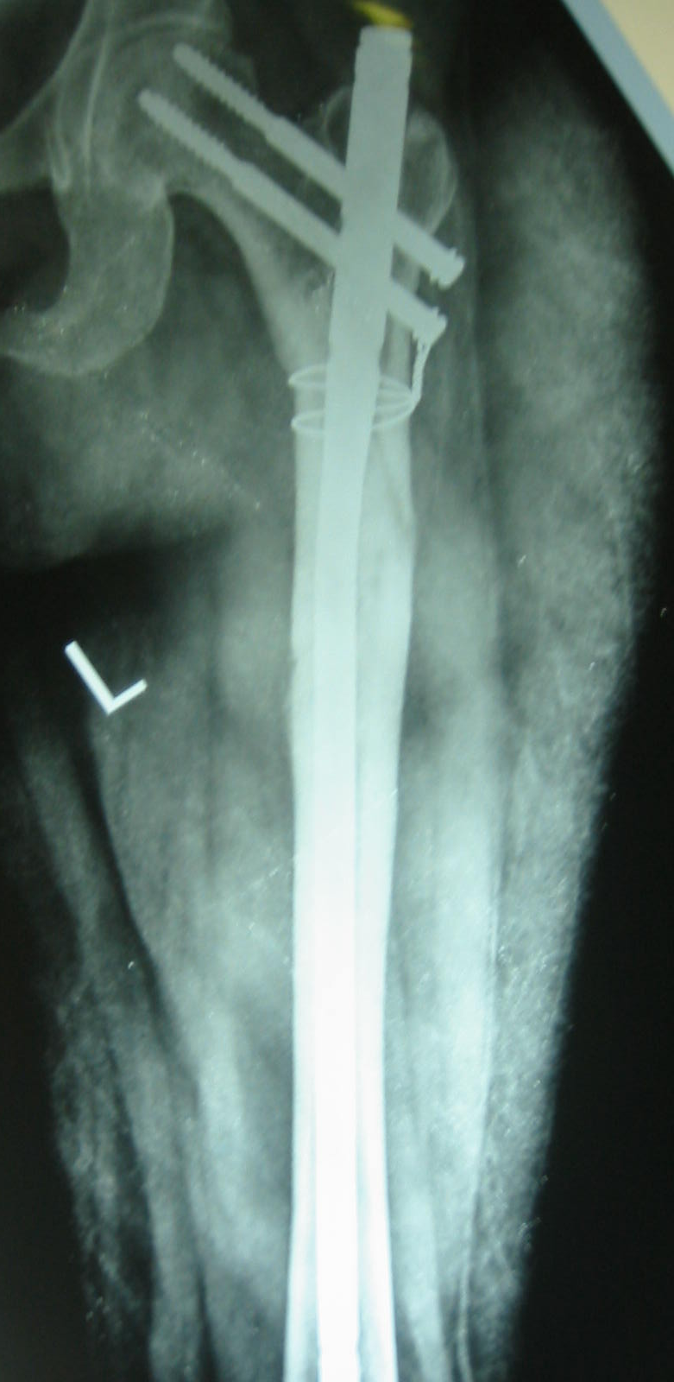
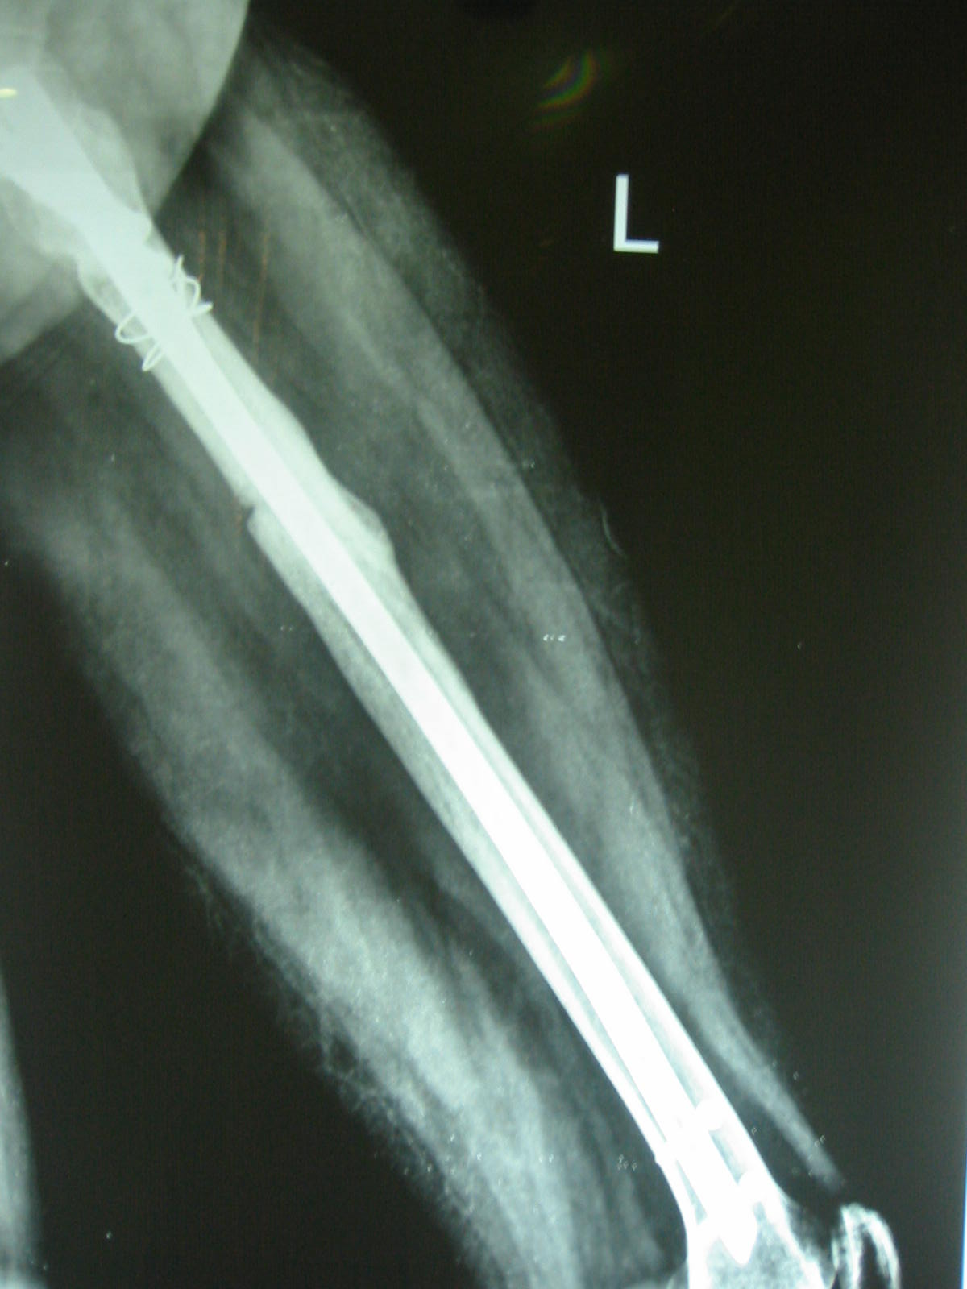
9 month xrays

Slide 59
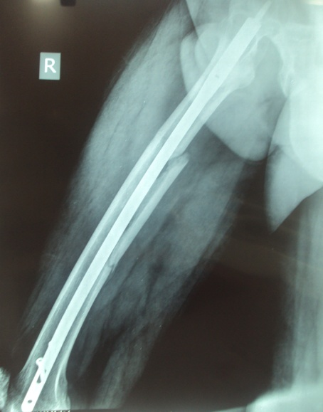
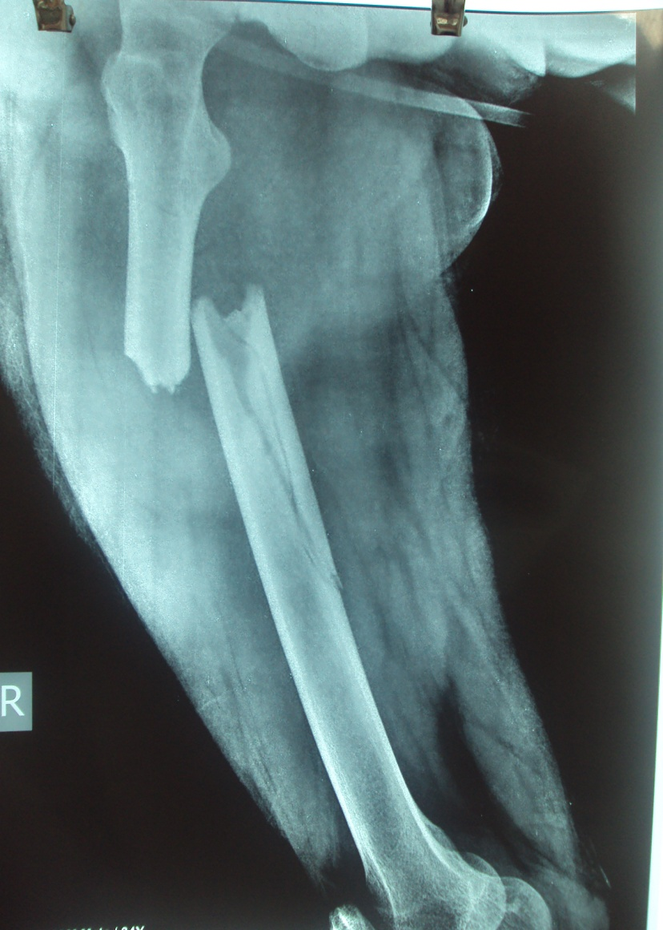
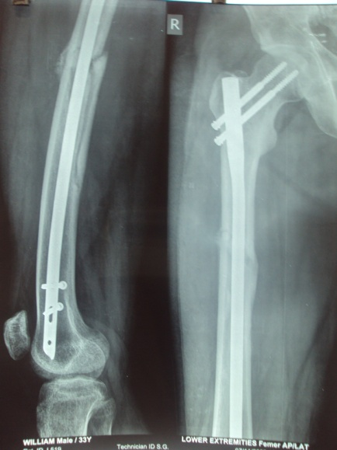
POST OP
CASE 3 PRE OP

Slide 60
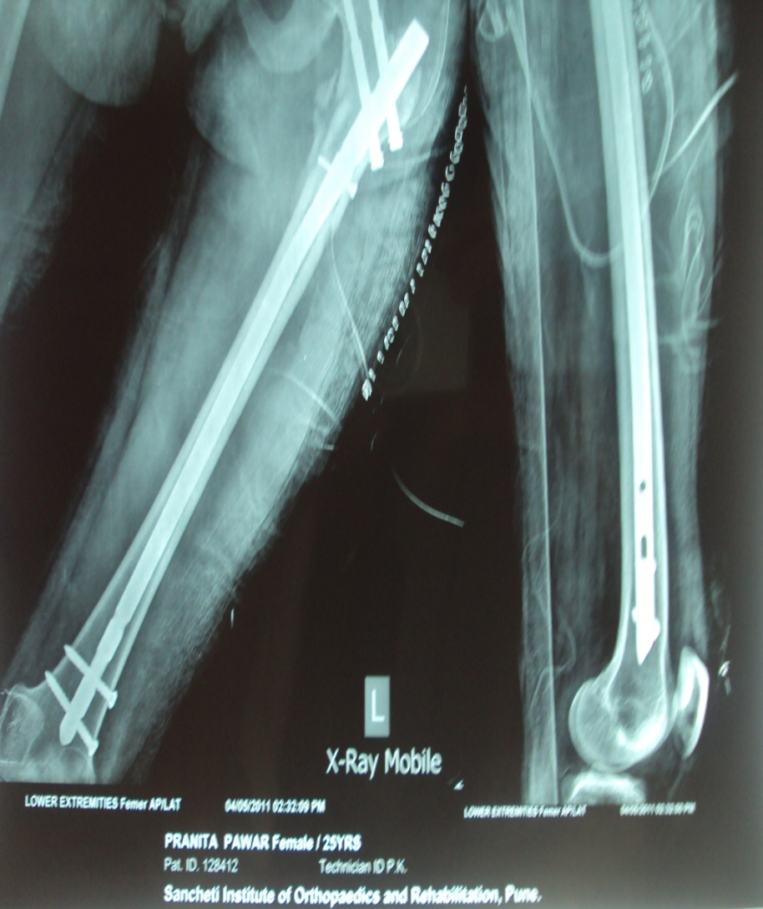
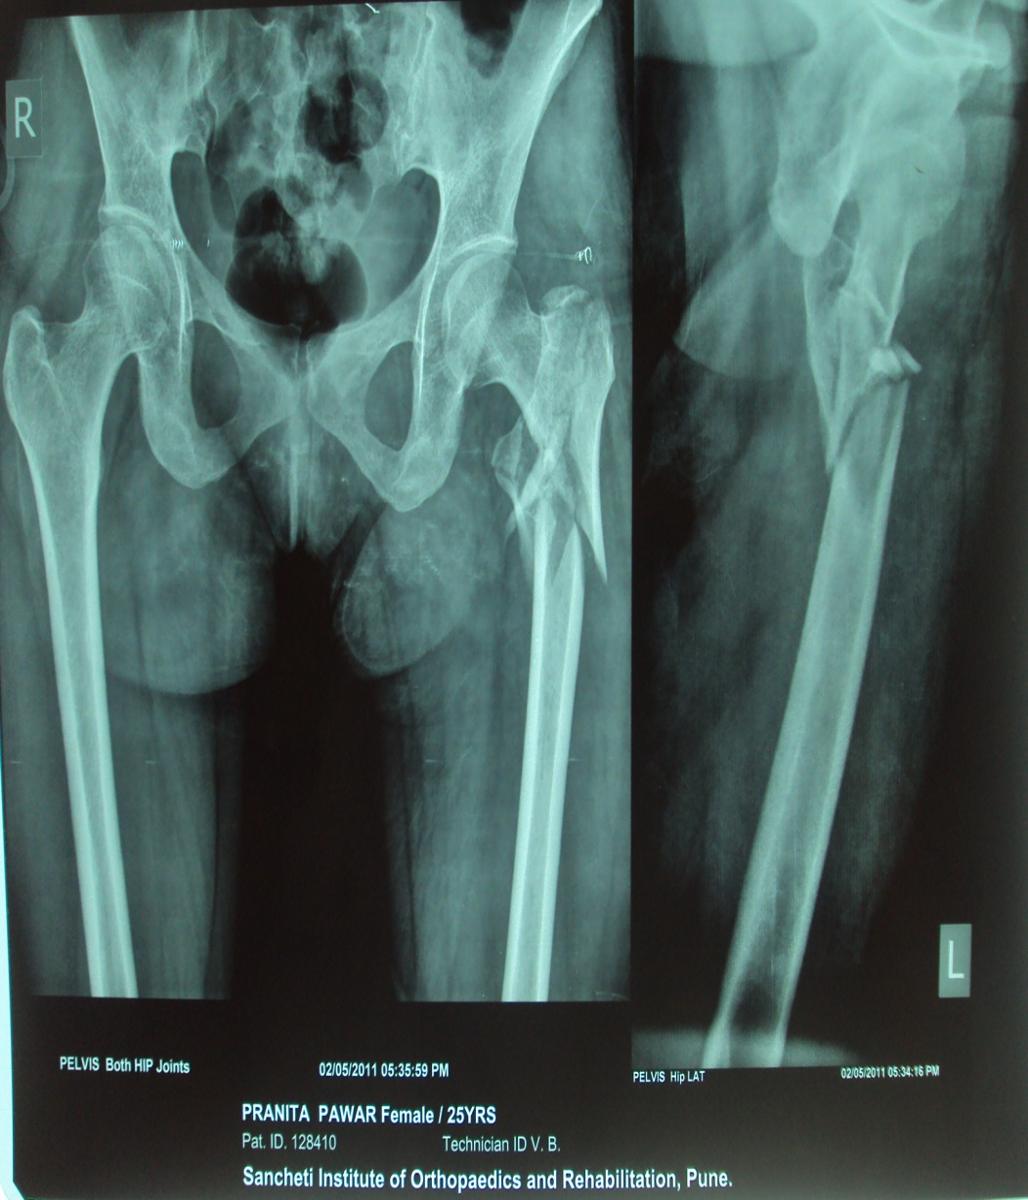
Case 4
Preop 1st day post - op

Slide 61
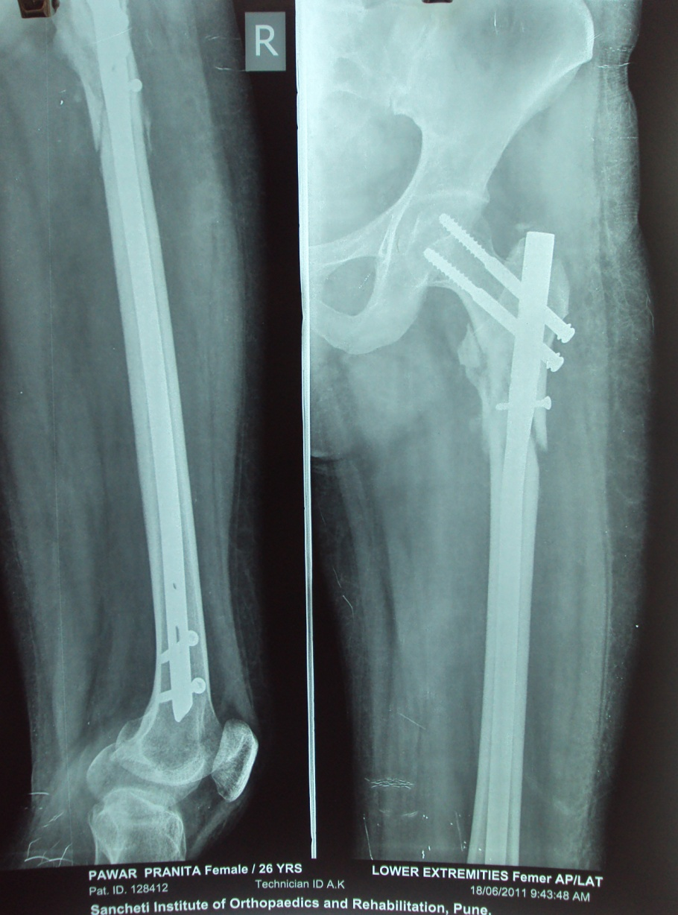
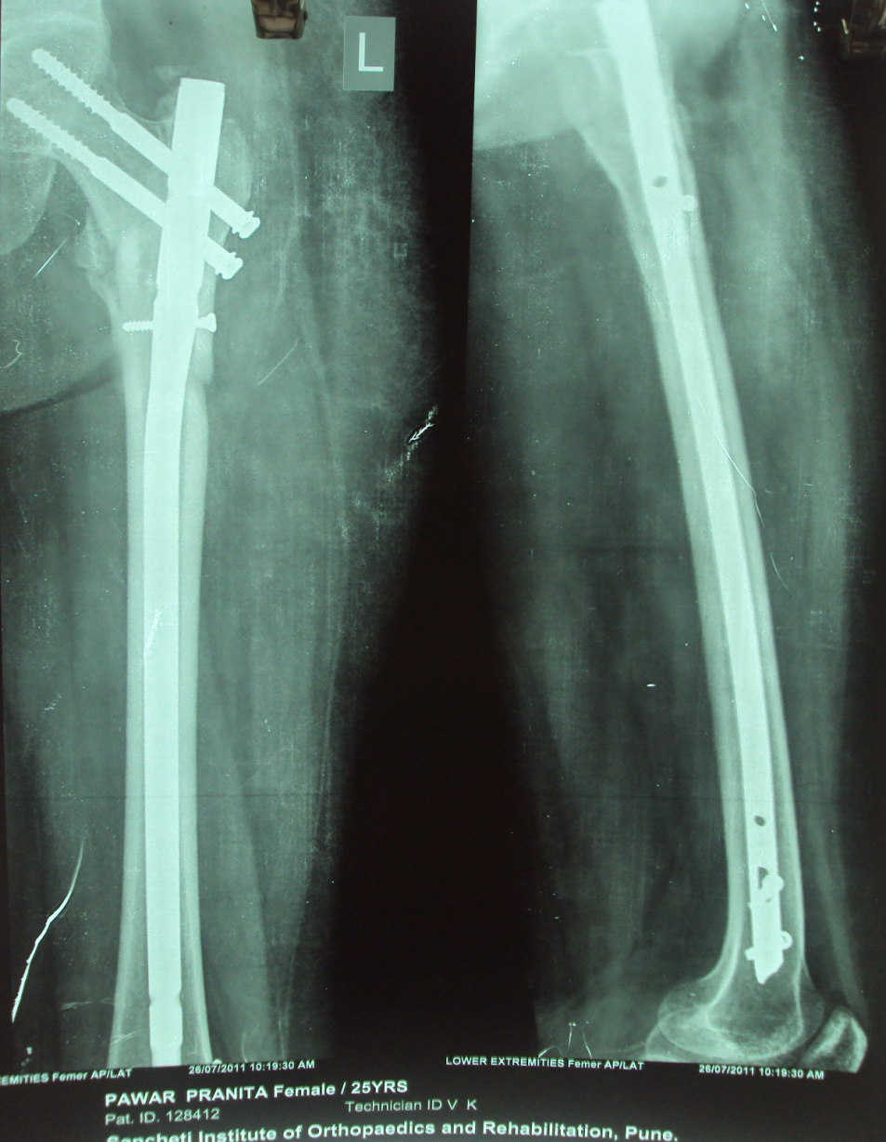
1 m post op 2 m post op

Slide 62
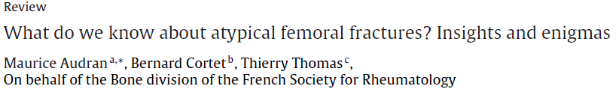
Reports of atypical femoral fractures in patients on bisphosphonate therapy has generated both considerable interest and major anxiety as a possible clinical manifestation of the old and unproven “frozen bone” concept, in which treatment-induced suppression of bone turnover is believed to decrease bone strength

Slide 63
Conclusion
Subtrochanteric femur fractures can be challenging to treat in Orthopaedic practice.
Current literature supports intramedullary fixation over surface implants.
Technical problems with instrumentations may be encountered.
Intramedullary implants are biomechanically superior.

Slide 64
THANK YOU……

Slide 66
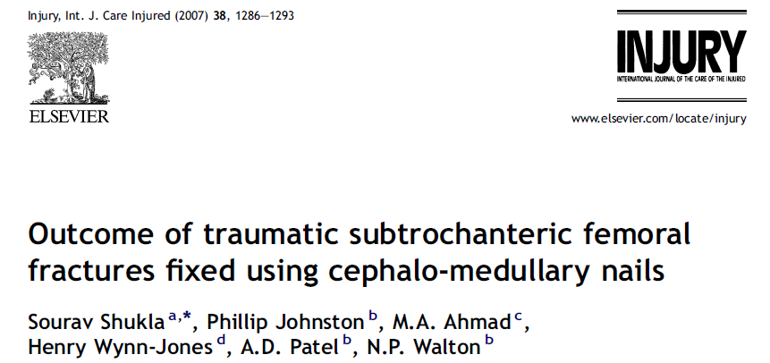
use of open reduction where necessary to avoid varus malreduction to avoid such complications, particularly as open reduction was not associated with a higher complication rate in this series.
The study supports the use of cephalo-medullary nailing for subtrochanteric fractures with a union rate of 95%.

Slide 67
Banan H, Al-Sabti A, Jimulia T, et al. The treatment of unstable, extracapsular hip fractures with the AO/ASIF proximal femoral nail (PFN)—our first 60 cases. Injury 2002
Extramedullary fixation –disadvantages
extensive surgical dissection,
longer operative time,
more intraoperative blood loss, and
insertion difficulty.
mechanical failure due to the long lever arm and nonunion are relatively common.

Slide 68
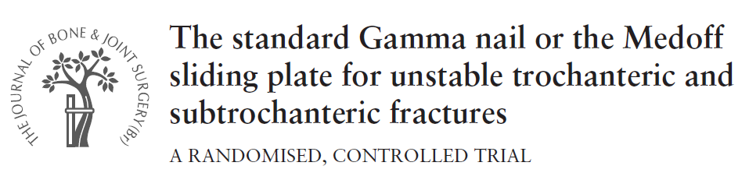
The MSP in the biaxial dynamisation mode had a low rate of failure in trochanteric fractures but an unacceptably high rate when used in the biaxial dynamisation mode in subtrochanteric fractures

Slide 69
Proximal femoral nail failure in a subtrochanteric fracture: The importance of fracture to distal locking screw distance B.F. Ongkiehong a,*, R. Leemans
distance from distal locking screw hole to fracture is one of the determinants of suitability.

