Slide 1
UVEA II
BY DR. KUNTAL SHAH

Slide 2
At the end of the session you will be able to
Understand the basics of Uveitis
Know various types of uveitis
How to manage a case of uveitis
Know the causes of defective vision in uveitis

Slide 3
Uvea
Middle, pigmented, structures of the eye includes the iris, ciliary body, and choroid Highly vascular layer
Various functions
  Regulation of entry of light
  Accommodation
  Production of aqueous
  Nutrition to outer layers of retina

Slide 4
Clinical Approach to Uveitis
Uveitis inflammation (ie, -itis) of the uvea
broadly categorized
Infectious and non-infectious
Frequently associated with systemic disease,

Slide 5
Classification of Uveitis
Based on anatomy(the portion of the uvea involved),
Clinical course (acute, chronic, or recurrent),
Etiology(infectious or noninfectious),
Pathological(granulomatous ,nongranulomatous)

Slide 6
The SUN Working Group
Etiologic categories (infectious or noninfectious)
Anatomical classification into 4 groups
anterior uveitis
intermediate uveitis
posterior uveitis
panuveitis

Slide 7
The SUN Working Group Anatomical Classification of Uveitis
Type Primary Site of Inflammation Includes
Iritis Iridocyclitis Anterior cyclitis
Anterior uveitis Anterior chamber
Intermediate uveitis
Vitreous
Pars planitis Posterior cyclitis Hyalitis
Posterior uveitis
Retina or choroid
Focal, multifocal, or diffuse Choroiditis Chorioretinitis Retinochoroiditis Retinitis Neuroretinitis
Panuveitis
Anterior chamber, vitreous, and retina or choroid

Slide 8
Descriptors in Uveitis
Category
Onset
Descriptor
Sudden
Insidious limited Persistent
Acute
Comment
Duration
< 3 months' duration
>3 months' duration
sudden onset limited duration
•
Course
Recurrent
Repeated episodes separated by periods of inactivity without treatment >3 months' duration Persistent uveitis with relapse
<3 months after discontinuing
treatment
Chronic

Slide 9
Granulomatous
Non Granulomatous
Mutton fat KPs
Dense PS
Iris nodules
Invasion by live organism/hypersensi tivity
Insidious onset, chronic course
Fine KPs
Filiform PS
No nodules
Allergic/exudative
Acute onset, short duration

Slide 10
Non-granulomatous inflammation typically has a lymphocytic and plasma cell infiltrate
granulomatous reactions also include epithelioid and giant cells

Slide 11
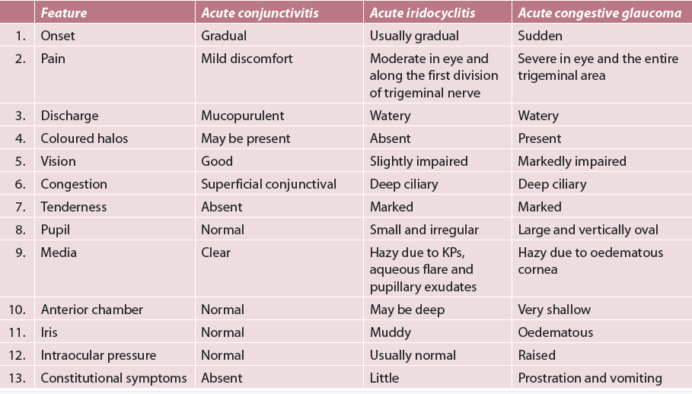

Slide 12
Anterior Uveitis
The anterior chamber is the primary site of inflammation.
iritis -Inflammation confined to the anterior chamber
iridocyclitis -If it spills over into the retrolental space
keratouveitis -if it involves the cornea
sclerouveitis -if the inflammatory reaction involves the sclera and uveal tract

Slide 13
Intermediate Uveitis
Major site of inflammation is the vitreous.
Inflammation of the middle portion (posterior ciliary body, pars plana) of the uvea.
Manifests primarily as floaters-affecting vision;
The eye frequently appears quiet externally.
Visual loss is primarily a result of chronic cystoid macular edema (CME) or cataract

Slide 14
Posterior Uveitis
intraocular inflammation primarily involving the retina and/or choroid.
Inflammatory cells may be observed diffusely throughout the vitreous cavity, overlying foci of active inflammation, or on the posterior vitreous face.
Ocular examination reveals
focal, multifocal, or diffuse areas of retinitis or choroiditis, with
varying degrees of vitreous cellular activity

Slide 15
Pan uveitis
primary sites of inflammation in panuveitis (diffuse uveitis) are the anterior chamber, vitreous, and retina or choroid.
Associated with many systemic infectious and non-infectious diseases

Slide 16
Symptoms of Uveitis
Depend on which part of the uveal tract is inflamed,
the rapidity of onset (sudden or insidious),
the duration of the disease (limited or persistent).
course of the disease (acute. chronic. or recurrent)

Slide 17
Acute-onset anterior uveitis (iridocyclitis)
Pain, photophobia, redness and blurred vision
Pain -acute onset of inflammation in the region of the iris as in acute iritis or from secondary glaucoma.
Referred pain that seems to radiate over the larger area served by cranial nerve V (the trigeminal nerve).
Epiphora, redness and photophobia are usually present when inflammation involves the iris, cornea, or ciliary body.

Slide 18
Chronic iridocyclitis (juvenile idiopathic arthritis)
May not be associated with any symptoms at all
Blurred vision may develop as a result of calcific band keratopathy, cataract, or CME
Intermediate uveitis
Symptoms of floaters and blurred vision.
Floaters result from the shadows cast by vitreous cells and snowballs on the retina.
Blurred vision may be caused by CME or vitreous opacities in the visual axis

Slide 19
Posterior uveitis
painless decreased visual acuity, floaters, photopsia, metamorphopsia, scotomata, nyctalopia, or a combination of these.
Blurred vision may be caused by the retinitis or choroiditis
CME, epiretinal membrane, retinal ischemia, and choroidal neovascularization.
from refractive error such as a myopic or hyperopic shift associated with macular edema
Blurred vision include opacities in the visual axis from inflammatory cells, fibrin, or protein in the anterior chamber; keratic precipitates (KPs); secondary cataract; vitreous debris; macular edema; and retinal atrophy

Slide 20
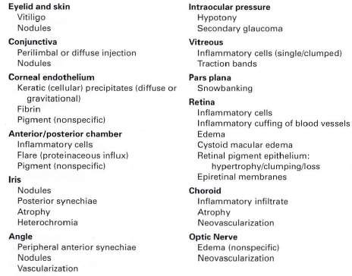
Signs of Uveitis

Slide 21
Signs of Uveitis
Anterior Segment
keratic precipitates
Inflammatory cells
Flare
Hypopyon
pigment dispersion
pupillary miosis
Iris nodules synechiae, both anterior and posterior
Band keratopathy (seen with long-standing uveitis)

Slide 22
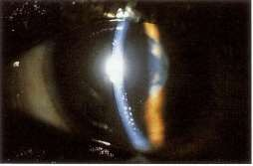
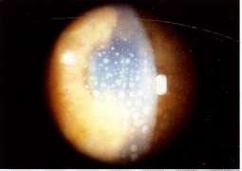
Keratic precipitates
Collections of inflammatory cells on the corneal endothelium.
When newly formed, they tend to be white and smoothly rounded, but they then become crenated ( shrunken),pigmented, or glassy. Large, yellowish K Ps are described as
mutton-fat K Ps; usually associated with granulomatous types of inflammation

Slide 23
Keratic precipitates (KPs)
Are proteinaceous cellular deposits occurring at the back of cornea
Mostly, these are arranged in a triangular fashion
occupying the centre and inferior part of cornea
due to convection currents in the aqueous humour.
The composition and morphology of KPs varies with the severity, duration and type of uveitis.

Slide 24
Following types of KPs may be seen:
i. Mutton fat KPs: These typically occur in
granulomatous iridocyclitis and are composed
of epithelioid cells and macrophages. They are
large, thick, fluffy, lardaceous KPs, having a greasy or waxy appearance.
ii. Small and medium KPs (granular KPs). These are
pathognomic of nongranulomatous uveitis and are
composed of lymphocytes. These small, discrete,
dirty white KPs are arranged irregularly at the back of cornea. Small KPs may be numerous.

Slide 25
iii. Fine KPs, also called as ‘stellate’ KPs, typically cover entire corneal endothelium and form the so called endothelial dusting. These are seen in
Fuch’s heterochromic iridocyclitis, herpetic iritis
and CMV retinitis.
iv. Old KPs. These are sign of healed uveitis. Either of the above described KPs with healing process shrink, fade, become pigmented and irregular
in shape (crenated margins). Old mutton fat KPs
usually have a ground glass appearance due to
hyalinization.

Slide 26
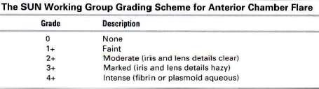
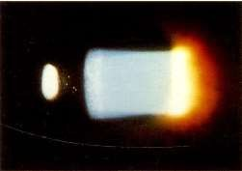

Slide 27
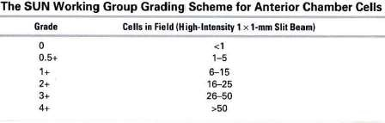
Number of inflammatory cells seen in a I-mm x 1mm high powered beam at full intensity at a 45°_60° angle

Slide 28
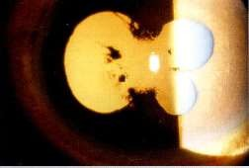
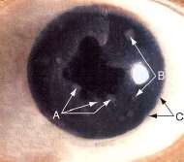
Iris involvement :
anterior or posterior synechiae,
iris nodules (Koeppe nodules at the pupillary border, Busacca nodules within the iris stroma, and Berlin nodules in the angle)
iris granulomas,
heterochromia (eg, Fuchs heterochromic iridocyclitis), or stromal atrophy (eg, herpetic uveitis)

Slide 29
Intraocular pressure (lOP) -often low secondary to decreased aqueous production or increased alternative outflow
lOP may increase - if the meshwork becomes clogged by inflammatory cells or debris or trabeculitis
Pupillary block with iris bombe and secondary angle closure - acute rise in lOP

Slide 30
Signs in Intermediate uveitis
vitreous inflamatory cells , vitreous haze
snowball opacities, which are common with sarcoidosis or intermediate uveitis
Exudates over the pars plana (snowbanking). Active snowbanks have a fluffy or shaggy appearance
vitreal strands
Chronic uveitis may be associated with cyclitic membrane formation, secondary ciliary body detachment, and hypotony

Slide 31
Signs of Posterior uveitis
Retinal and choroidal signs may be unifocal, multifocal, or diffuse
Retinal or choroidal inflammatory infiltrates
Inflammatory sheathing of arteries or veins
Exudative, tractional, or rhegmatogenous retinal detachment
Retinal pigment epithelial hypertrophy or atrophy'
atrophy or swelling of the retina, choroid, or optic nerve head‘
preretinal or sub retinal fibrosis
Retinal or choroidal neovascularization

Slide 32
Laboratory and Medical Evaluation
Medical history, review of systems , thorough ophthalmologic and general physical examination
There is no one standardized battery of tests that needs to be ordered for all patients with uveitis
When the history and physical examination do not clearly indicate the cause rule out the most common causes. which include syphilis,sarcoidosis and tuberculosis
Purified protein derivative (PPD) skin test
serum angiotensin-converting enzyme (ACE)
syphilis serologies
chest radiograph or chest computed tomography

Slide 33
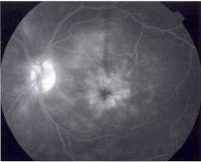
Ancillary testing
Fluorescein angiography(FA)-
for evaluating eyes with chorioretinal disease and structural complications caused by posterior uveitis
CME (Flower petal pattern of Leakage)
retinal vasculitis
secondary choroidal or retinal neovascularization
areas of optic nerve, retinal, and choroidal inflammation

Slide 34
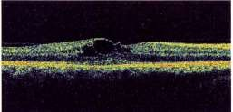
Optical coherence tomography (OCT)
OCT has become a standard of care for the objective measurement of
Uveitic CME ,
Retinal thickening,
subretinal fluid associated with choroidal neovascularization,
serous retinal detachments
limited by media opacities

Slide 35
Fundus autofluorescence imaging - emerging noninvasive modality
Utilizes the fluorescent properties of lipofuscin to assess the viability of the retinal pigment epithelium (RPE)- photoreceptor complex in inflammatory chorioretinopathies
lndocyanine green angiography-
patterns of hypofluorescence in the presence of inflammatory choroidal vasculopathies

Slide 36
Ultrasonography - useful in demonstrating
vitreous opacities,
choroidal thickening,
retinal detachment,
cyclitic membrane formation, particularly if media opacities preclude a view of the posterior segment
Anterior chamber paracentesis Vitreous biopsy
Chorioretinal biopsy

Slide 37
Medical Management of Uveitis
Goal
effectively control inflammation
eliminate or reduce the risk of vision loss from structural and functional complications that result from uncontrolled inflammation
Includes
topical cycloplegics,
topical or systemic nonsteroidal anti-inflammatory drugs
topical or systemic corticosteroids

Slide 38
Mydriatic and Cycloplegic Agents
Beneficial for breaking or preventing the formation of posterior synechiae
For relieving photophobia secondary to ciliary spasm.
Cycloplegics commnly used.
Cyclopentolate hydrochloride 1%
Atropine 1%
Homatropine 2%
Tropicamide 0.5%

Slide 39
Nonsteroidal Anti-Inflammatory Drugs
work by inhibiting cyclooxygenase (COX) isoforms l and 2 or 2 alone
Reduce the synthesis of prostaglandins that mediate inflammation
Ketorolac and 2 newer agents bromfenac and nepafenac - used for the treatment of CME.

Slide 40
Corticosteroids
Mainstay of uveitis therapy
Treatment of active inflammation in the eye
Prevention or treatment of complications such as CME
Reduction of inflammatory infiltration of the retina, choroid, or optic nerve
Topical administration
Effective primarily for anterior uveitis

Slide 41
Routes of Administration
Topical
Oral
Sub tenon
Intra vitreal

Slide 42
Systemic administration
Supplement or replace other routes of administration
Used for vision-threatening chronic uveitis when topical corticosteroids are insufficient or when systemic disease also requires therapy
The dosing and taper should be individualized to the patient
If corticosteroid therapy is required for longer than 3 months. Immuno-modulatory therapy (IMT) is indicated

Slide 43
1- 2 mg/kg/day of oral prednisolone
Gradually tapered every 1 to 2 weeks until the disease is quiescent.

Slide 44
H2 blockers or Proton pump inhibitors to prevent gastric and peptic ulcers
Long-term corticosteroid therapy - supplement the diet with calcium and vitamin D to lessen the chances of osteoporosis.

Slide 45
lmmunomodulatory Medications
antimetabolites.
inhibitors of T-cell signaling
alkylating agents
biologic response modifiers

Slide 46
Indications :
vision-threatening intraocular inflammation
Reversibility of the disease process
Inadequate response to corticosteroid treatment
Failure of therapy
corticosteroids contraindicated because of systemic problems
unacceptable corticosteroid side effects
chronic corticosteroid dependence

Slide 47
Adverse effects
Renal and hepatic toxicity,
Bone marrow suppression, and increased susceptibility to infection
Therefore blood monitoring including complete blood count and liver and renal function tests

