Slide 1
LECTURE 5
COMPLICATIONS OF CONSERVATIVE TREATMENT IN FRACTURE
DR ARVIND
ASSOCIATE PROFESSOR
DEPT OF ORTHOPAEDICS
DHIRAJ HOSPITAL, SBKS MIRC
SUMANDEEP VIDYAPEETH VADODARA

Slide 2
CLOSED REDUCTION

Slide 3
“A fracture in plaster of Paris will not displace more than its previous maximal displacement”
Sarmiento,York 1998

Slide 4
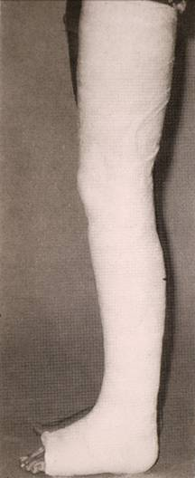
Nonoperative treatment
Children
Undisplaced fractures
“Stable” reduced fractures
Contraindication for surgery:
  patient
  health care team

Slide 5
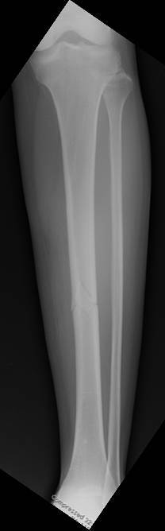
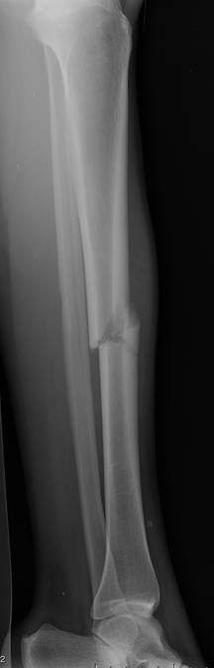
RS 5/26/04
41 y/o F

Slide 6
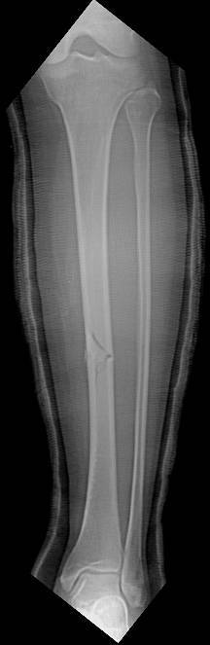
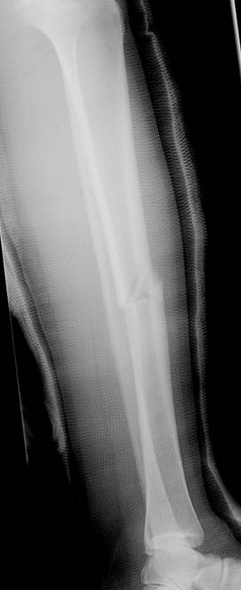
RS 5/26/04

Slide 7
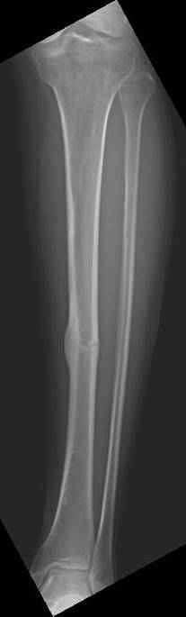
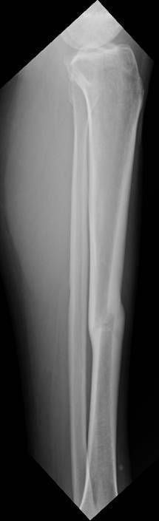
RS 9 months

Slide 8
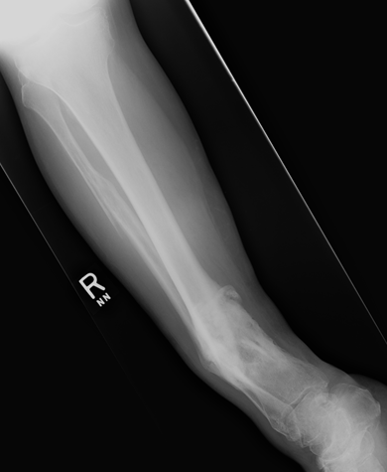
What is acceptable ?

Slide 9
Malunion Criteria
5-10 degrees valgus
5 -10 degrees varus
5-10 degrees recurvatum
5-10 degrees procurvatum
10-15 degrees rotation
1-1.5 cm shortening

Slide 10
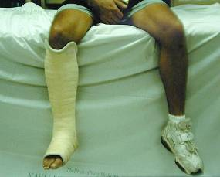
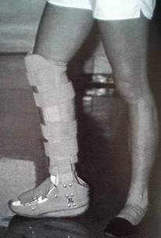
Closed Functional Treatment
Sarmiento
1000 fractures
  98.5% union
  <12mm shortening: 95%
  <8 degrees angulation: 95%
  60% lost to follow-up
No functional outcomes, ROM

Slide 11
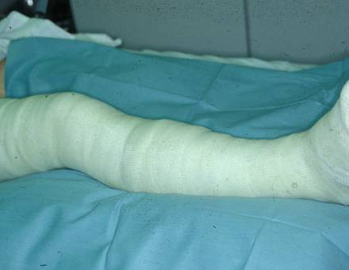
Tibial fractures
Cast management-The issues
Hindfoot stiffness
Non-union
Mal-union
Compartment syndrome
Quality of life
End function
SKIN ISSUES

Slide 12
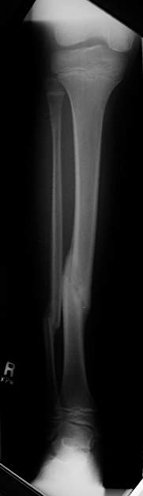
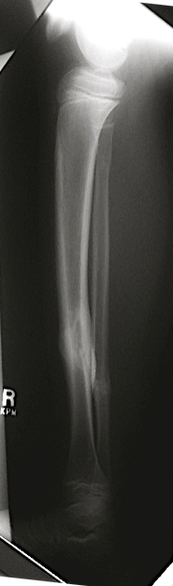
Closed Treatment
Indications
  Low energy, closed
  Stable
  Minimal Displacement
  Pediatric
Challenges
  Loss of reduction
  Malunion
  ‘Fracture disease’
  Intact fibula

Slide 13
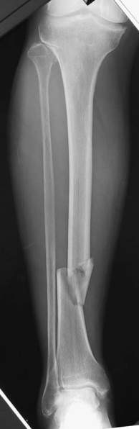
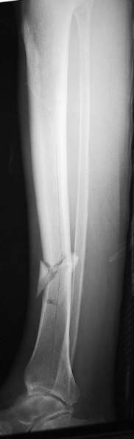
Intact Fibula
  Difficult reduction
  Late varus
  Relative indication for operative rx

Slide 14
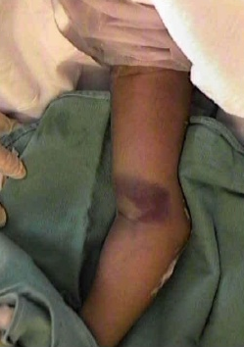
RECOGNIZING THE PATHOLOGY
Type of the fracture/dislocation(Classification)
Deformities (including the deforming forces)
SIGNS AND SYMPTOMS OF FRACTURE/DISLOCATION
Pain
Swelling
Tenderness
Deformities
Limit ROM
Stepping
Crepitus

Slide 15
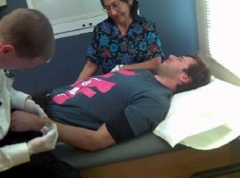
ANESTHESIA
LOCAL
Hematoma block
REGIONAL BLOCK
GENERAL
General anaesthesia
sedation using morphine,benzodiazepine

Slide 16
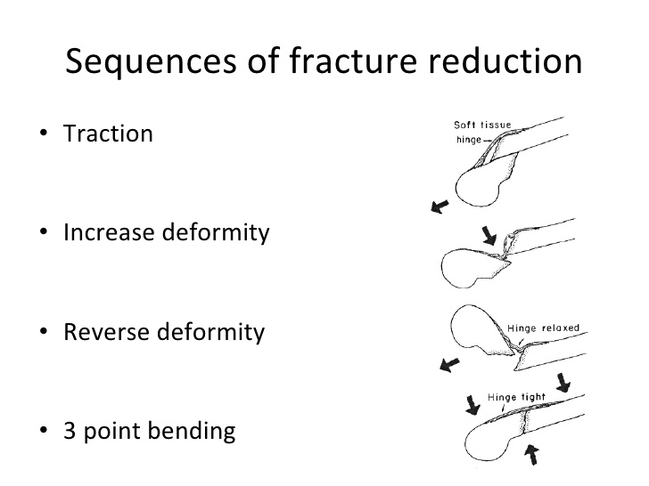
SEQUENCES OF REDUCTION
TRACTION
INCREASE DEFORMITY
REVERSE DEFORMITY
3 POINT BENDING

Slide 17
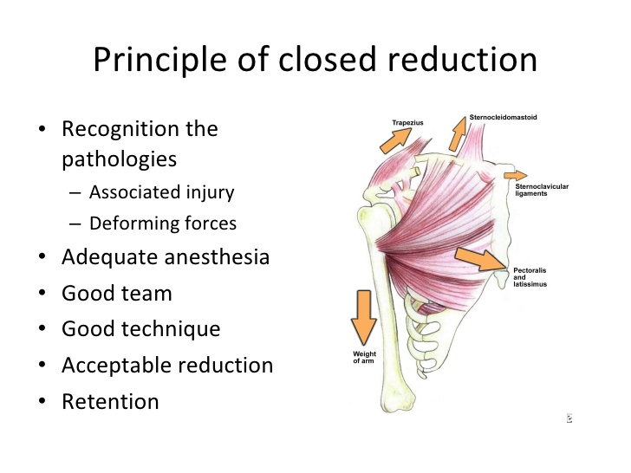

Slide 18
Closed Reduction Principles
All displaced fractures should be reduced to minimize soft tissue complications, including those that require ORIF
Use splints initially
  Allow for swelling to settle down
  Adequately pad all bony prominences

Slide 19
Closed Reduction Principles
Adequate analgesia and muscle relaxation are critical for success
Reduction maneuver may be specific for fracture location and pattern
Correct/restore length, rotation, and angulation
Immobilize joint above and below

Slide 20
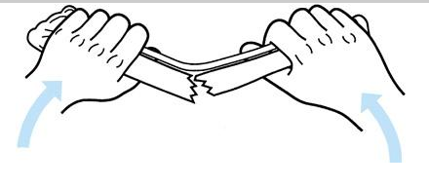
Closed Reduction Principles
Reduction may require reversal of mechanism of injury, especially in children with intact periosteum
When the bone breaks because of bending, the soft tissues disrupt on the convex side and remain intact on the concave side

Slide 21
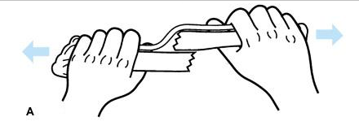
Closed Reduction Principles
Longitudinal traction may not allow the fragments to be disimpacted and brought out to length
if there is an intact soft-tissue hinge (typically seen in children who have strong perisoteum that is intact on one side)

Slide 22
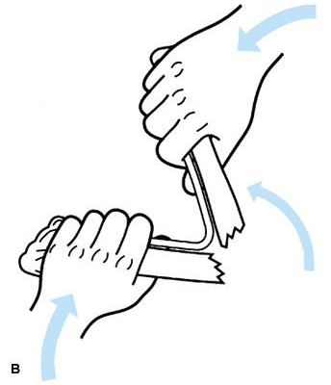
Closed Reduction Principles
Reproduction of the mechanism of fracture to hook on the ends of the fracture
Angulation beyond 90° is usually required

Slide 23
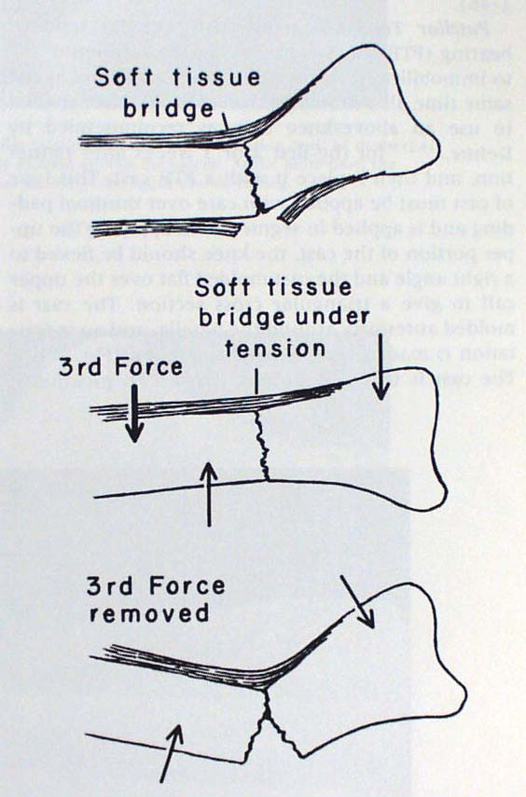
Closed Reduction Principles
Three point contact (mold) is necessary to maintain closed reduction
Removal of any of the three
forces results in loss of reduction
Figure from: Rockwood and Green: Fractures in Adults, 4th ed, Lippincott, 1996.
Notes:
Figure from: Rockwood and Green: Fractures in Adults, 4th ed, Lippincott, 1996.

Slide 24
Closed Reduction Principles
Cast must be molded to resist deforming forces
“Straight casts lead to crooked bones”
“Crooked casts lead to straight bones”

Slide 25
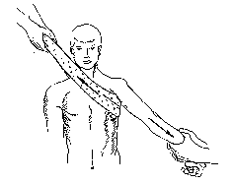
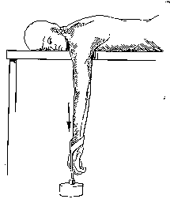
Shoulder Dislocation –
Usually no need of any anaesthesia
Supine position
Gentle longitudinal traction and external rotation
Gradual abduction
Usually reduce around 120 deg of abduction
Notes:
Figures from Rockwood and Green, 5th ed..

Slide 26
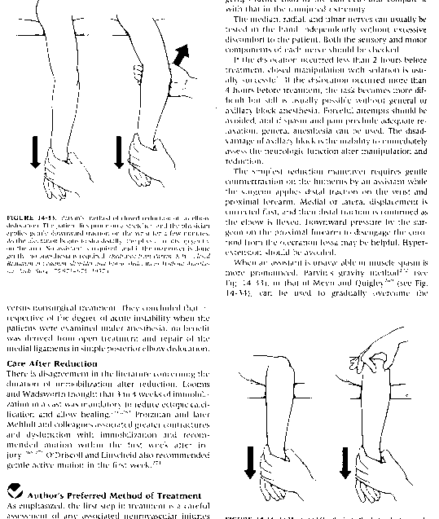
Common Joint Reductions
Elbow Dislocation - traction, flexion, and direct manual push
Notes:
Figures from Rockwood and Green, 5th ed

Slide 27
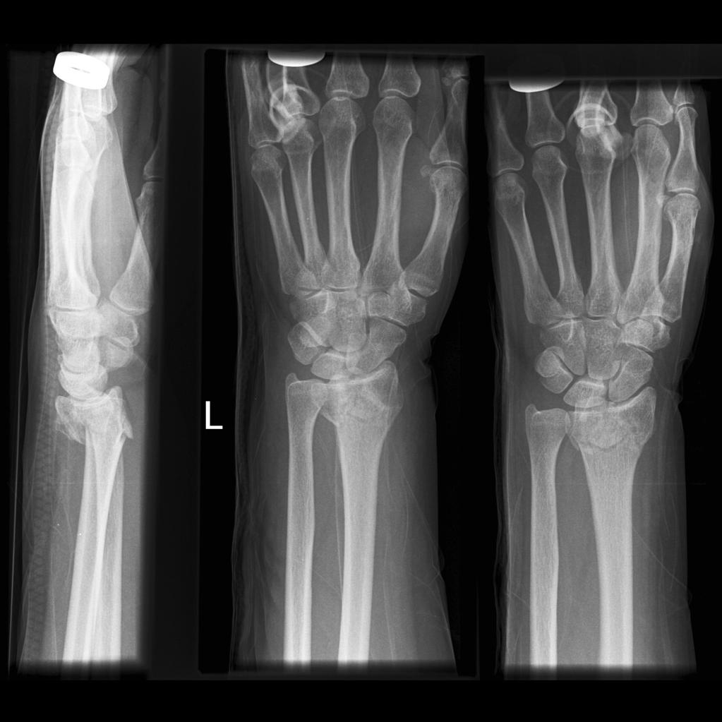
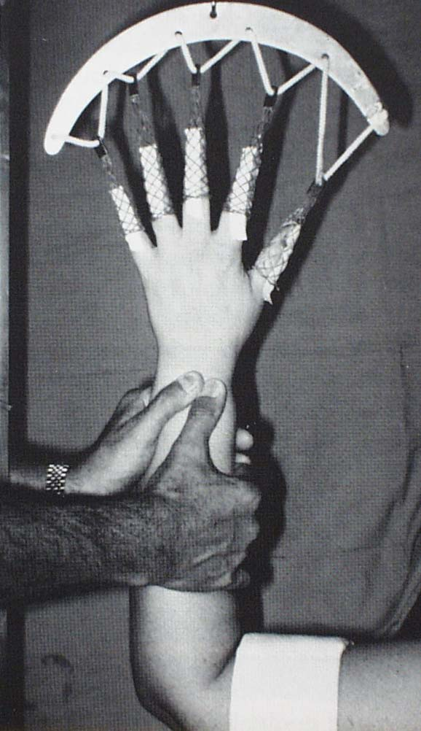
Distal Radius
Traction and counter traction
Disimpaction in the reverse as in mode of injury
Palmar flexion
Ulnar deviation
Notes:
Figure from: Rockwood and Green: Fractures in Adults, 4th ed, Lippincott, 1996.

Slide 28
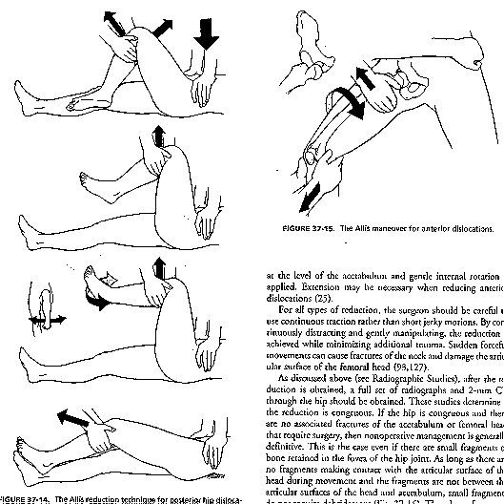
Common Joint Reductions
Hip Dislocation
Relaxation, flexion, traction, adduction and internal rotation
Gentle and atraumatic
Relocation should be palpable and permit significantly
improved ROM. This often requires very deep sedation.
Notes:
Figures from Rockwood and Green, 5th ed.

Slide 29
ACCEPTABLE REDUCTION
Functional concern
Mechanics
Shortening
Apposition
Sagital,coronal plan malalignment
Axial malalignment is not accepted(rotation)

Slide 30
HIGH FAILURE RATE OF REDUCTION IN:
Avulsion Fractures
Unstable Fractures
Fracture that wont heal

Slide 31
MCQ 1
Non-operative treatment of the factures can be done in:
Children
Open fractures
Stable fractures
Undisplaced fractures

Slide 32
MCQ 2
Non operative treatment of the fractures can be done by:
Plaster of Paris
Splints
Tractions
All of the above

Slide 33
MCQ 3
Complications of non operative fracture management includes all except:
Plaster sores
Malunion
Non union
Stable reduction

Slide 34
MCQ 4
Distal radius fractures are reduced by which of the following manoeuvres:
Traction
Counter traction
Disimpaction
All of the above

Slide 35
MCQ 5
Who was the scientist to advocate plaster management of fractures
Sarmiento
Ponsetti
Hugh Owen Thomas
Bohler Braun

Slide 36
THANK YOU

