Slide 1
INFECTIVE ENDOCARDITIS

Slide 2
INTRODUCTION
The prototypic lesion of infective endocarditis,
THE VEGETATION , is a mass of platelets, fibrin, microcolonies of microorganisms, and scant inflammatory cells.

Slide 3
Infection most commonly involves heart valves but may also occur on the low-pressure side of a ventricular septal defect (VSD), on mural endocardium damaged by aberrant jets of blood or foreign bodies, or on intracardiac devices themselves.

Slide 4
Endocarditis can be classified according to the - temporal evolution of disease,
- the site of infection,
- the cause of infection,
( the predisposing risk factor e.g., injection drug use)

Slide 5
Like → Right - left sided
→ Mitral - Aortic - Tricuspid valve IE
→ CIED endocarditis
→ Native ( NVE ) - Prosthetic ( PVE )
→ Intravenous drug user IE
→ Acute - Subacute IE

Slide 6
Acute endocarditis is a
-Hectically febrile illness
-Structurally normal endocardium
-Rapidly damages cardiac structures
-Seeds extracardiac sites,
-If untreated, progresses to death within weeks.

Slide 7
Subacute endocarditis
  follows an indolent course
  causes structural cardiac damage only slowly
  Rarely metastasizes
  Is gradually progressive unless complicated by a major embolic event or a ruptured mycotic aneurysm.

Slide 8
INCIDENCE
In developed countries, incidence of IE- 4 to 7 cases per 100,000 population per year.
In India , 21000 cases per yr. ( Medicine Update 2016)
In developed countries,
- 25-30% cases are Health care associated NVE
- 16–30% of all cases of endocarditis involve PV
Harrison (19th )

Slide 9
Incidence of IV Drug user IE is less commonly reported in india , may be because of lack of self reporting as IVDU is not uncommon in INDIA.
Mitral valve is common than AV in India, while AV is common in western countries.
Acc to ICE-PCS Study, MV = AV.
Tricuspid valve is common in india because of CHD than due to IVDU.
Medicine update 2016

Slide 10
The risk of prosthesis infection is greatest during
- first 6–12 months after valve replacement;
- gradually declines to a low
- stable rate thereafter is similar for mechanical and bioprosthetic devices.
The incidence of endocarditis involving cardiovascular implantable electronic devices (CIED),
- Implantable cardioverter-defibrillators (ICD),
- permanent pacemaker
Ranges from 0.5 to 1.14 cases per 1000 device recipients
is higher among patients with an ICD than PP.

Slide 11
PREDISPOSITION
Congenital heart diseases remain a constant predisposition
Chronic RHD is still a common predisposition in developing countries.
While in developed countries,
- Illicit IV drug use
- Degenerative valve disease
- Intracardiac devices

Slide 12
ETIOLOGY
Oral cavity - portals for viridans streptococci
Skin – portal for staphylococci,
Upper respiratory tract - HACEK organisms
(Haemophilus species, Aggregatibacter aphrophilus, A.actinomycetemcomitans, Cardiobacterium species,Eikenella species, and Kingella species).

Slide 13
Streptococcus gallolyticus subspecies gallolyticus (formerly S. bovis biotype 1) originates from the GIT, where it is associated with polyps and colonic tumors.
Enterococci enter the bloodstream from the genitourinary tract.
In India , streptococci & staphylococci are commonest organisms .(medicine update 2016)

Slide 14
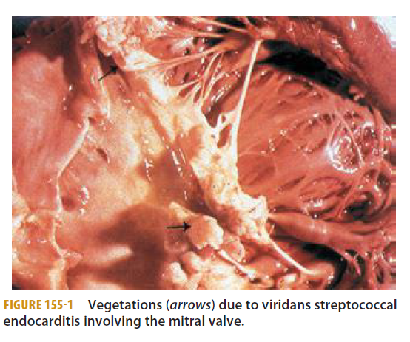
Vegetations due to viridans streptococcal endocarditis involving the mitral valve

Slide 15
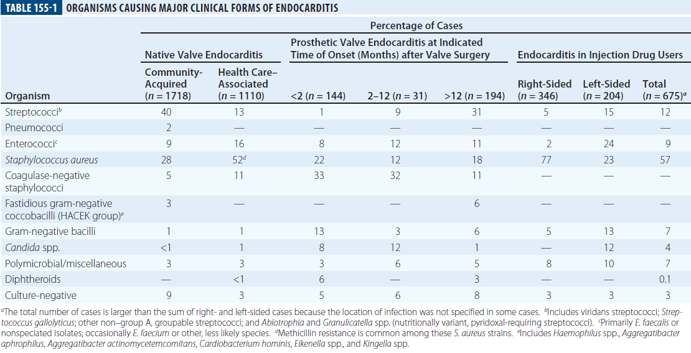
ORGANISM CAUSING MAJOR CLINICAL FORMS OF INFECTIVE ENDOCARDITIS

Slide 16
PATHOGENESIS
The undamaged endothelium is resistant to infection by most bacteria and to thrombus formation.
Endothelial injury (e.g., at the site of impact of high-velocity blood jets or on the low-pressure side of a cardiac structural lesion) allows either direct infection by virulent organisms or the development of a platelet-fibrin thrombus—a condition called ‘nonbacterial thrombotic endocarditis’ (NBTE).
This thrombus serves as a site of bacterial attachment during transient bacteremia.

Slide 17
CARDIAC CONDITIONS
Resulting in NBTE are
- Mitral regurgitation,
- Aortic stenosis
- Aortic regurgitation
- Ventricular septal defects
- Complex congenital heart disease.

Slide 18
NBTE also arises as a result of a Hypercoagulable state; this gives rise to marantic endocarditis (uninfected vegetations seen in patients with malignancy and chronic diseases)
To bland vegetations complicating SLE and the APLA.

Slide 19
Organisms that cause endocarditis enter the bloodstream from mucosal surfaces, the skin, or sites of focal infection.
Microorganisms in the blood adhere at sites of NBTE,
Except for more virulent bacteria (e.g., S. aureus) that can adhere directly to intact endothelium or exposed subendothelial tissue.

Slide 20
The organisms that commonly cause endocarditis have surface adhesin molecules, collectively called microbial surface components recognizing adhesin matrix molecules (MSCRAMMs), that mediate adherence to NBTE sites or injured endothelium.

Slide 21
Fibronectin-binding proteins are required for S. aureus invasion of intact endothelium; thus these surface proteins may facilitate infection of previously normal valves.

Slide 22
Microorganisms also induce platelet deposition and a localized procoagulant state by eliciting tissue factor from the endothelium or, in the case of S. aureus, from monocytes as well.
Fibrin deposition combines with platelet aggregation and microorganism proliferation to generate an infected vegetation.

Slide 23
Organisms deep in vegetations are metabolically inactive (nongrowing) and relatively resistant to killing by antimicrobial agents.
Proliferating surface organisms are shed into the bloodstream continuously.

Slide 24
CLINICAL MENIFESTATION
The clinical manifestations of endocarditis—other than constitutional symptoms, which probably result from cytokine production—arise from
- Damage to intracardiac structures
- Embolization of vegetation fragments, leading to infection/infarction of remote tissues.

Slide 25
- Hematogenous infection of sites during bacteremia
- Tissue injury due to the deposition of circulating immune complexes or immune responses to deposited bacterial antigens.

Slide 26
NVE, PVE, and endocarditis due to injection drug use share clinical and laboratory menifestations.
In patients with Subacute presentations,
fever is typically low-grade and
rarely exceeds 39.4°C (103°F)
Acute presentations ,
fever is high grade (103 -104°F)
Fever may be blunted in patients who are elderly, are severely debilitated, or have renal failure.

Slide 27
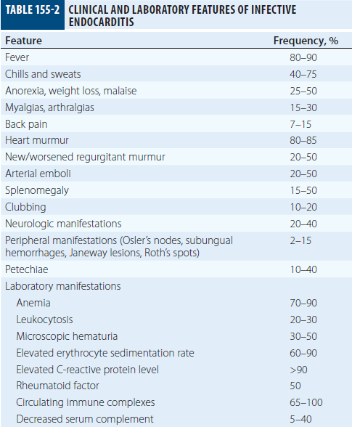
CLINICAL AND LABORATORY FEATURES OF INFECTIVE ENDOCARDITIS

Slide 28
CARDIAC MENIFESTATIONS
Although heart murmurs are usually indicative of the predisposing cardiac pathology rather than of endocarditis, valvular damage and ruptured chordae may result in new regurgitant murmurs.

Slide 29
In acute endocarditis (NVE)
Murmurs may be absent initially but ultimately are detected in 85% of cases.
Congestive heart failure (CHF) develops in 30–40% of patients as a consequence of valvular dysfunction.
Occasionally, CHF is due to endocarditis-associated myocarditis or an intracardiac fistula.
Heart failure due to AV dysfunction progresses more rapidly than MV.

Slide 30
Extension of infection beyond valve leaflets into adjacent tissue results in perivalvular abscesses, which in turn may cause intracardiac fistulae with new murmurs.
Abscesses extension
- AV annulus to epicardium → Pericarditis
- Upper ventricular septum → interrupt the conduction system, leading to varying degrees of HB.

Slide 31
Emboli to a coronary artery occur in 2% of patients and may result in MI.

Slide 32
NON-CARDIAC MENIFESTATIONS
Janeway lesions - The classic non-suppurative peripheral manifestations of subacute endocarditis are related to prolonged infection; with early diagnosis and treatment, these have become infrequent.
Osler’s nodes : septic embolization mimicking lesions (subungual hemorrhage) is common in patients with acute S. aureus endocarditis

Slide 33
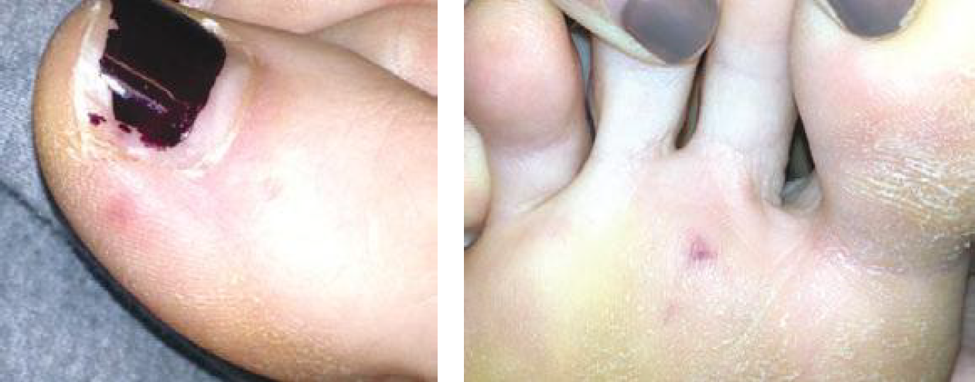

Slide 34
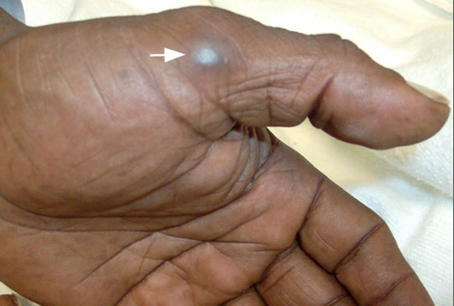
Osler nodes, Another finding related to subacute infective endocarditis, are smallish, tender, subcutaneous nodules that range from red to purple and are found primarily in the pulp spaces of the terminal phalanges of the fingers and toes, soles of the feet, and the thenar and hypothenar eminences of the hands. Their appearance is often preceded by neuropathic pain. They last from hours to several days. The underlying mechanism is probably the circulating immunocomplexes of subacute infective endocarditis.

Slide 35
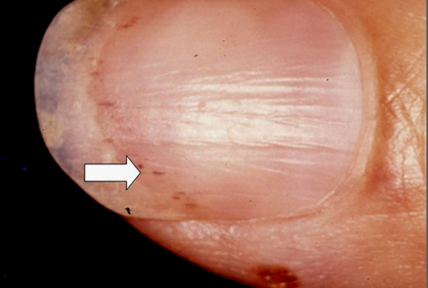

Slide 36
Hematogenously seeded focal infection occurs most often in the skin, spleen, kidneys, skeletal system, and meninges.
Arterial emboli, onehalf of which precede the diagnosis, are clinically apparent in up to 50% of patients.

Slide 37
Risk of embolisation increases when
- Endocarditis caused by S. aureus,
- Vegetations >10 mm in diameter
- Infection involving the mitral valve, especially the AML

Slide 38
Symptoms, pain, or ischemia-induced dysfunction relate to the organ or area suffering embolic arterial occlusion
e.g., kidney, spleen, bowel, extremity

Slide 39
Cerebrovascular emboli presenting as strokes or occasionally as encephalopathy complicate 15–35% of cases of endocarditis.
The frequency of stroke is
- 8/1000 pt-days a wk prior to diagnosis
- 4.8/1000 pt-days during the first
- 1.7 /1000 pt days second weeks of effective antimicrobial therapy.
Only 3% of strokes occur after 1 week of effective therapy.

Slide 40
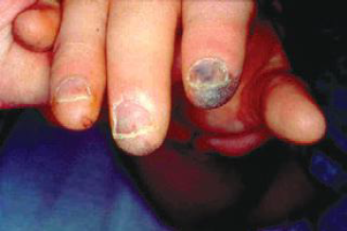

Slide 41
Other neurologic complications
-Aseptic or purulent meningitis,
- ICH d/t hemorrhagic infarcts or ruptured mycotic aneurysms
- Seizures.
- Microabscesses in brain and meninges occur commonly in S. aureus endocarditis;

Slide 42
Immune complex deposition on the glomerular basement membrane causes diffuse hypocomplementemic glomerulonephritis and renal dysfunction, which typically improve with effective antimicrobial therapy.
Embolic renal infarcts cause flank pain and hematuria but rarely cause renal dysfunction

Slide 43
Tricuspid valve is involved in 50% of pt of endocarditis associated with injection drug use. ( In India , common because of CHD )
Presents with
- fever
- but with faint or no murmur
- No peripheral manifestations.
Septic pulmonary emboli, which are common with tricuspid endocarditis
- cough
- pleuritic chest pain
- nodular pulmonary infiltrates, or
- occasionally pyopneumothorax.

Slide 44
Infection of the AV/ MV presents with the typical clinical features of endocarditis, including peripheral manifestations.

Slide 45
CIED endocarditis may be associated with generator pocket infection
- fever
- minimal murmur
- pulmonary symptoms due to septic emboli.

Slide 46
In PVE,
Early onset IE (arising within 60 days of valve surgery , typical symptoms may be obscured by comorbidity associated with recent surgery.
In both early-onset and more delayed presentations, paravalvular infection is common and often results in partial valve dehiscence, regurgitant murmurs, CHF, or disruption of the conduction system.

Slide 47
DIAGNOSIS
When a pt comes with complaints of FEVER with predisposing conditions of IE , cardiac or non-cardiac features , microbiological evidence of organisms causing IE, then
- careful clinical examination
- echocardiography
- microbiologicical evaluation
Should be done to avoid missed or delay in diagnosis .

Slide 48
Definitive diagnosis of IE can only be made when vegetations are examined HISTOLOGICALLY and MICROBIOLOGICALLY
Neverthless , there is highly sensitive and specific criteria called ‘ MODIFIED DUKES CRITERIA’.

Slide 49
MODIFIED DUKES CRITERIA
It is based on clinical , laboratory and echocardiographical findings which are commonly encountered in pts with IE.
Diagnosis is made according to presence of criteria as follows :

Slide 50
DEFINITIVE :
TWO Major criteria
OR
One major & Three minor
OR
FIVE minor

Slide 51
2) PROBABLE :
ONE major
OR
ONE major & ONE minor
OR
THREE minor

Slide 52
3) REJECTED :
- If even above criterias are not fulfilled
- if an alternative diagnosis is established,
- if symptoms resolve and do not recur with ≤4 days of antibiotic therapy,
- if autopsy after ≤4 days of antimicrobial therapy yields no histologic evidence of endocarditis.

Slide 53
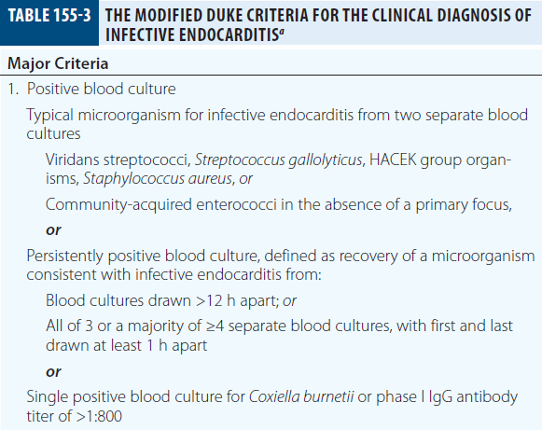
THE MODIFIED DUKE CRITERIA FOR THE CLINICAL DIAGNOSIS OF INFECTIVE ENDOCARDITIS

Slide 54
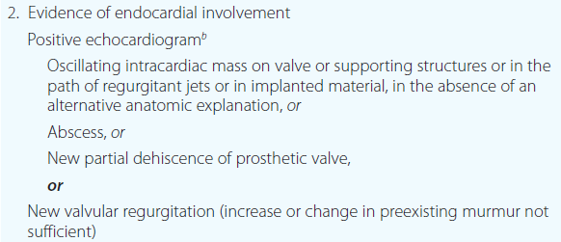

Slide 55
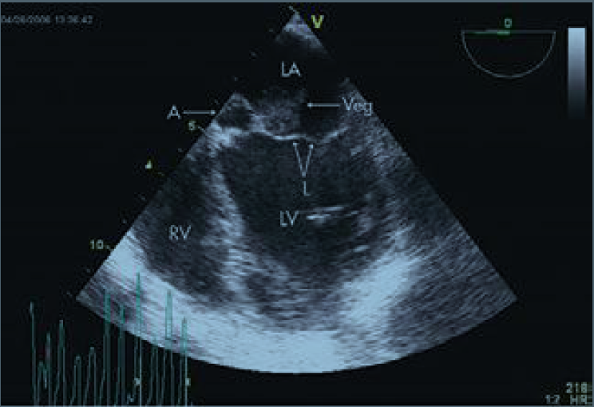

Slide 56
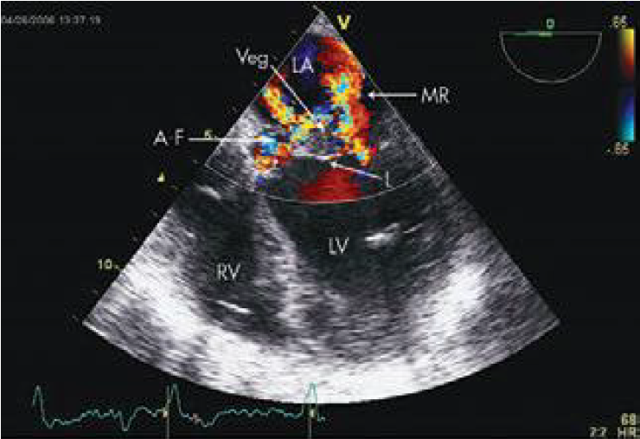

Slide 57
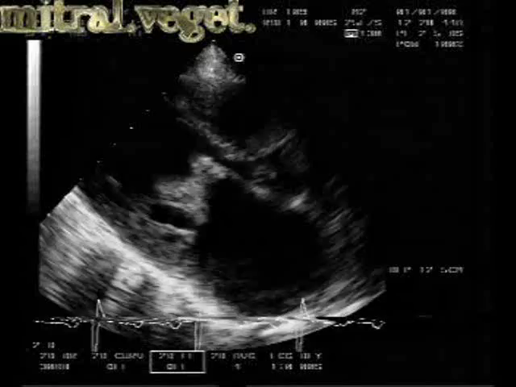

Slide 58
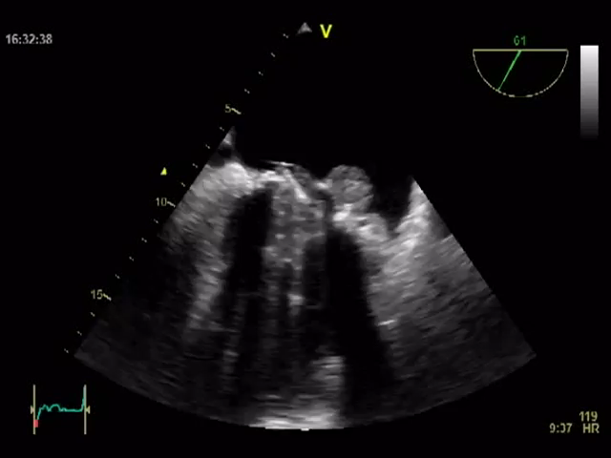

Slide 59
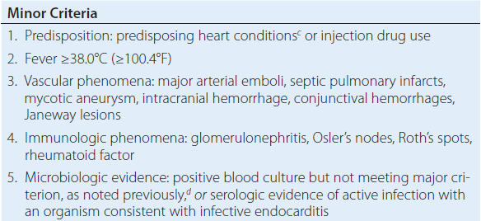

Slide 60
In western settings
St. Thomas Modification , have increased sensitivity in both NVE and PVE both, without decreasing specificity.
Few additions in minor criteria are ESR , CRP , spleenomegaly , clubbing , microscopic hematuria.

Slide 61
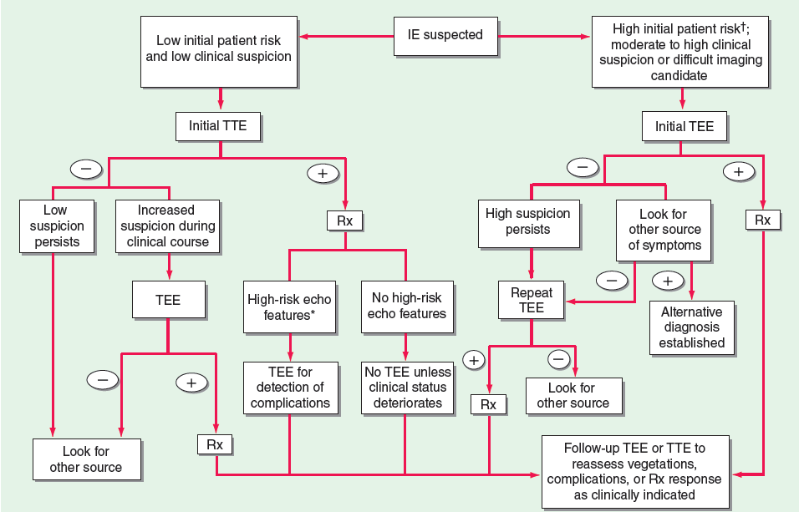

Slide 63
TREATMENT
To cure endocarditis, all bacteria in the vegetation must be killed.
However, it is difficult to eradicate these bacteria because
- local host defenses are deficient
- the bacteria are largely nongrowing
- metabolically inactive
- are less easily killed by antibiotics

Slide 64
BASIC REQUIREMENTS
Thorough knowledge of susciptibility of organisms
Decision of starting antibiotic must balance the need of specific microbiological diagnosis
Concomittent infection at other sites
Potential progression of disease

Slide 65
Selecting proper antibiotic ( effectiveness , allergies, interaction with other drugs, risks and adverse events, end organ dysfunction)
Antibiotics need to be given for longer time and parenterally & organism specific
Need for surgery.

Slide 66
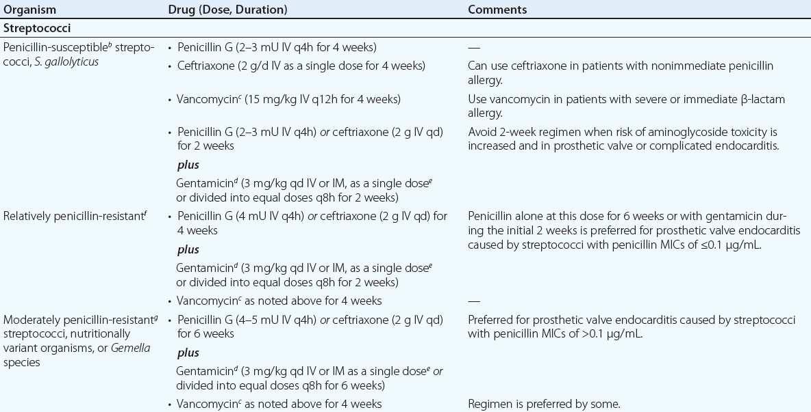
4 + 2

Slide 67
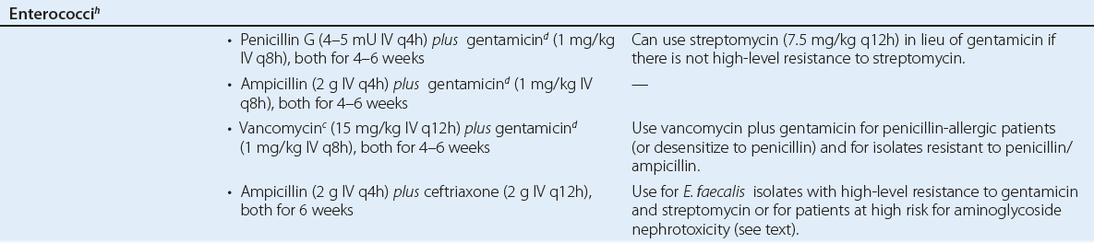
4–6 wks
4 wks

Slide 68
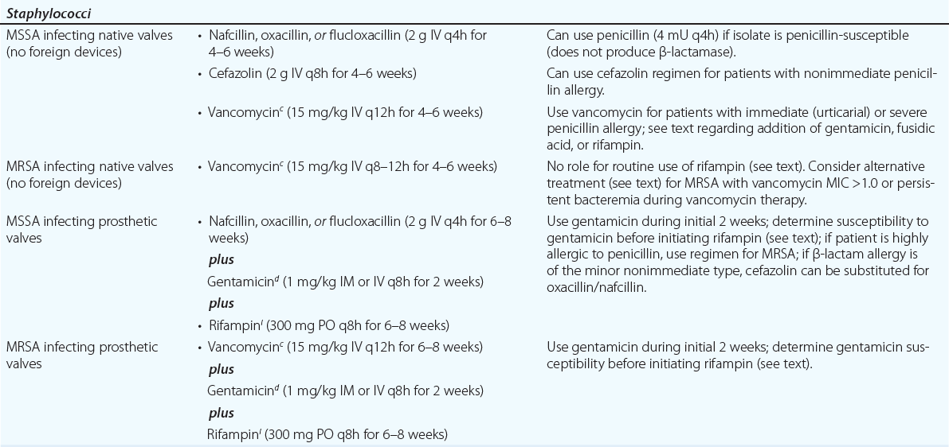
4-6 wks
6-8 + 2 wks

Slide 69
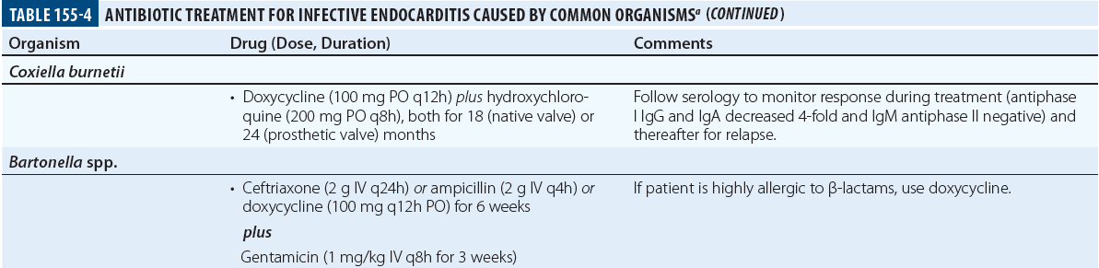
ANTIBIOTIC TREATMENT FOR INFECTIVE ENDOCARDITIS CAUSED BY COMMON ORGANISMS
18-24 months
6 + 3 wks

Slide 70
OTHER ORGANISMS
With NO meningitis ,
if isolates are Streptococcus pneumoniae,
Penicillin ( 4 MU IV every 4 hr ) or
Ceftriaxone ( 2 gm IV OD )
If MIC > 2 , then VANCOMYCIN can be used .
With Meningitis , standard treatment doses of VANCOMYCIN & CEFTRIAXONE are used .

Slide 71
In c/o Pseudomonal isolates ,
Antipseudomonal antibiotics are used
( Piperacillin ) & Tobramycin is used.
With CANDIDA Albicans ,
Amphotericin B & flucytocin

Slide 72
EMPIRICAL THERAPY
Empirical therapy for acute endocarditis in an injection drug user should cover MRSA and gram-negative bacilli. Treatment with vancomycin plus gentamicin, initiated immediately after blood samples are obtained for culture, covers these organisms as well as many other that are likely to be inhibited by the specific prior therapy

Slide 73
Similarly, treatment of health care–associated endocarditis must cover MRSA. In the treatment of culture-negative episodes, marantic endocarditis must be excluded and fastidious organisms sought by serologic testing.

Slide 74
In the absence of prior antibiotic therapy, it is unlikely that S. aureus, CoNS, or enterococcal infection will present with negative blood cultures; thus, in this situation, recommended empirical therapy targets not these organisms but rather nutritionally variant organisms, the HACEK group, and Bartonella species.

Slide 75
Pending the availability of diagnostic data, blood culture–negative subacute NVE is treated with gentamicin plus ampicillin-sulbactam (12 g every 24 h) or ceftriaxone; doxycycline (100 mg twice daily) is added for enhanced Bartonella coverage.

Slide 76
For culture-negative PVE, vancomycin, gentamicin, cefepime, and rifampin should be used if the prosthetic valve has been in place for ≤1 year.
Empirical therapy for infected prosthetic valves in place for >1 year is similar to that for culture-negative NVE

Slide 77
If cultures may be negative because of confounding by prior antibiotic administration, broader empirical therapy may be indicated, with particular attention to pathogens

Slide 78
CIED ENDOCARDITIS
Antimicrobial therapy for CIED endocarditis is adjunctive to complete device removal.
Bacteremic CIED infection may be complicated by coincident NVE or remote-site infection (e.g., osteomyelitis).

Slide 79
A 4- to 6-week course of endocarditis-targeted therapy is recommended for patients with CIED endocarditis and for those with bacteremia that continues during ongoing antimicrobial therapy after device removal

Slide 80
Not all bloodstream infections in CIED patients indicate endocarditis. If evidence suggesting endocarditis is lacking, bloodstream infection due to gram-negative bacilli, streptococci, enterococci, and Candida species may not indicate device infection.

Slide 81
However, in the absence of another source, relapse after antimicrobial therapy increases the likelihood of CIED endocarditis and warrants treatment as such.

Slide 82
CULTURE NEGATIVE ENDOCARDITIS
More common in INDIA => 40-60 %
Factors : Prior antibiotic therapy
: fastidius organisms or atypical
organisms not growing in usual culture media.( HACEK , Brucellosis )
: Intracellular bacteria ( C. burnetti , bartonella )

Slide 83
In General
NVE , therapy should target streptococcus , staphylococcus , HACEK organisms .
Early PVE , should cover MRSA , Gram negative organisms .
Late PVE , should cover same as NVE.

Slide 84
THERAPY AS OUT PATIENT
Fully compliant, clinically stable
patients who are no longer bacteremic
not febrile
have no clinical or echocardiographic findings that suggest an impending complication may complete therapy as outpatients

Slide 85
MONITORING THERAPY
Measurement of BCT ( BACTERICIDAL TITRE ) is not recommended.
Serum conc of Aminoglycosides and Vancomycin is recommended to address toxicity.
Blood tests for assessment of Renal functions , liver functions , hematological function , to be performed periodically.

Slide 86
BLOOD CULTURES
Blood cultures should be repeated daily until sterile in patients with endocarditis due to S. aureus or difficult-to-treat organisms,
Rechecked if there is recrudescent fever, and performed again 4–6 weeks after therapy to document cure.

Slide 87
Blood cultures become sterile within 2 days after the start of appropriate therapy when infection is caused by viridans streptococci, enterococci, or HACEK organisms.
In S. aureus endocarditis, It takes 3-5 days
whereas in MRSA endocarditis, positive cultures may persist for 7–9 days with vancomycin or daptomycin treatment.

Slide 88
MRSA bacteremia → despite an adequate dosage of vancomycin → indicates reduced vancomycin susceptibility → alternative therapy.
When fever persists for 7 days despite appropriate antibiotic therapy→ evaluated for paravalvular abscess, extracardiac abscesses (spleen, kidney), or complications (embolic events).
Vegetations become smaller with effective therapy
However, 3 months after cure, 50% are unchanged and 25% are slightly larger.

Slide 89
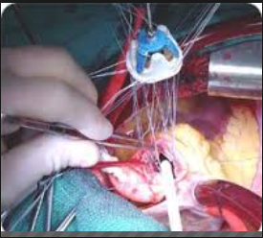
SURGICAL TREATMENT

Slide 90
Surgical intervention has increased in recent decade , upto 50 % cases in western countries.
Endocarditis due to
Candida infections ,
Large vegetations ,
Refractory to antimicrobial therapy
Acute severe AR
Refractory heart failure.

Slide 91

PROPHYLAXIS OF I.E.
ORAL DRUGS :
Tab . Amox 2 gm ( 1 hr before )
( If allergic to penicillin ,
then Tab . AZITHRO )
Intravenous :
Inj. Ampicillin 2 gm (1 hr before procedure)
( If allergic to penicillin , then Inj. Ceftriaxone )

Slide 92

THANK YOU

