Slide 1
Isoniazid resistance and death in patients with tuberculous meningitis: retrospective cohort study

Slide 2
ISONIAZID
Known as Isonicotinylhydrazine (INH)
First-line ANTITUBERCULOSIS medication
Only bactericidal agent that easily crosses the blood-brain barrier, achieving concentrations in cerebrospinal fluid similar to those in serum.
Bacteriostatic for "resting" bacilli,
Bactericidal for rapidly dividing microorganisms

Slide 3
MECHANISM OF ACTION
Isoniazid – prodrug
Mycobacterial catalase-peroxidase
Inhibit the bioSynthesis of mycolic acids
Mycolic acids are unique to mycobacteria, high degree of selectivity of ISONIAZID
Isoniazid penetrates well into caseous material
FAST & SLOW ACETYLATORS

Slide 4
UNTOWARD EFFECTS
peripheral neuritis-- most common
prevented by supplemental pyridoxine
Hepatotoxicity
Rash
Fever
Precipitate convulsion
Arthritic symptoms etc..

Slide 5
RESISTENCE
most common mechanism of isoniazid resistance is mutations in catalase-peroxidase (katg) that decrease its activity, preventing conversion of the prodrug to its active metabolite
Another mechanism of resistance is related to a mutation in the mycobacterial inhA and KasA genes involved in mycolic acid biosynthesis
Mutations in NADH dehydrogenase (ndh) also confer isoniazid resistance

Slide 6
Tuberculous Meningitis
Most often in young children but also develops in adults, especially those infected with HIV.
Hematogenous spread or from the rupture of a subependymal tubercle into the subarachnoid space
Rare in developed BUT common in developing countries

Slide 7
CLINICAL FEATURES
Headache
Vomiting
Low-grade fever
Lassitude
Depression
Confusion
Behaviour changes
Neck rigidity
Oculomotor palsies
Papilloedema
Focal hemisphere signs
Depression of conscious level
MENINGISM

Slide 8
DIAGNOSIS
CSF EXAMINATION
-high leukocyte count (up to 1000/L)
-a protein content of 1–8 g/L (100–800 mg/dL)
-a low glucose concentration
Culture of CSF is diagnostic in up to 80%
PCR sensitivity of up to 80%
ADA sensitive BUT low specificity
CT and MRI show hydrocephalus and abnormal enhancement of basal cisterns or ependyma.

Slide 9
OBJECTIVE
To determine whether initial isoniazid resistance is associated with death during the treatment of tuberculous meningitis
DESIGN
Retrospective cohort study.

Slide 10
INTRODUCTION
Tuberculous meningitis is the most devastating manifestation of tuberculosis
HIV and tuberculosis epidemics, tuberculosis has become the most common cause OF meningitis.
We tested the hypothesis that initial isoniazid resistance would be associated with adverse outcomes in patients being treated for an initial episode of tuberculous meningitis.

Slide 11
METHODS
SETTING;
Analysed data from the National Tuberculosis Surveillance System at the Centers for Disease Control,Atlanta, GA,USA
PARTICIPANTS;
  INCLUSION CRITERIA; analysis to patients with a diagnosis of tuberculous meningitis, a positive culture for Mycobacterium tuberculosis from any site, and initial isoniazid susceptibility data
  EXCLUSION patients with initial resistance to both isoniazid and rifampicin(multi-drug resistance).

Slide 12
STATISTICAL METHODS:
Determined the unadjusted association betweeninitial isoniazid resistance and subsequent death by using the χ2 test
Calculated an odds ratio and a 95% confidence interval to evaluate the strength of the association and the precision of the effect
Association of initial isoniazid resistance and subsequent death according to whether the patient was infected with HIV and whether the patient had a positive cerebrospinal fluid culture
Used STATA v10.0 for all statistical calculations.

Slide 13
RETROSPECTIVE COHORT STUDY:
---Historic cohort study,
---Latin retr, "look back“
---generally means to take a look back at events that already have taken place.
ODD’S RATIO:
---Measure of effect size describing the strength of association or non-independence between two binary data values
---Event occurring in one group to the odds of it occurring in another group
REGRESSION:
---logistic regression is used for prediction of the probability of occurrence of an event by fitting data to a logit function logistic curve

Slide 14
RESULTS
Unadjusted analysis::
1896 patients after exclusion
1614 (85%) had a positive culture from cerebrospinal fluid
282 (15%) had positive cultures only from other sites.
541 (29%) patients died during treatment.
Of the remaining 1355 patients, 1177 (87%) completed treatment and 178 (13%) were lost to follow-up.

Slide 15
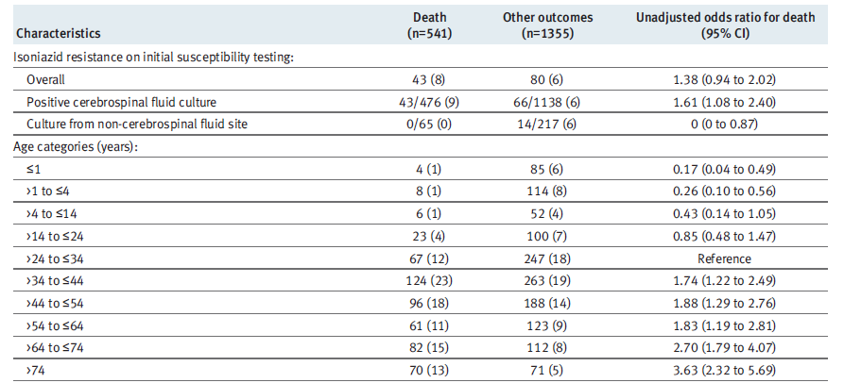

Slide 16
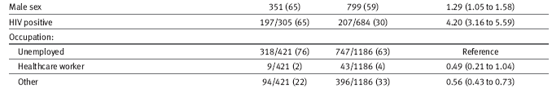
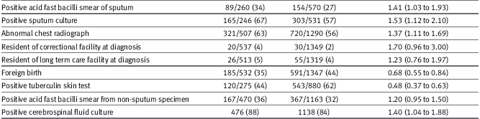

Slide 17
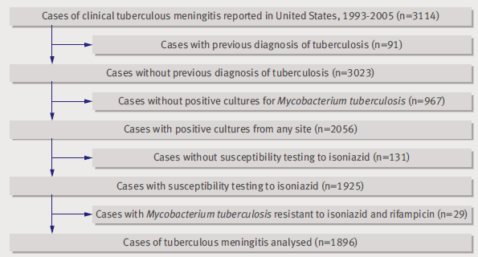
Adjusted analyses::

Slide 18
Secondary analyses
1050 adults(older than 14 years) with positive cerebrospinal fluid cultures treated initially with isoniazide,rifampicin,ethambutol, and pyrazinamide
AIDS
Intravenous drug use, non-intravenous drug use and alcohol

Slide 20
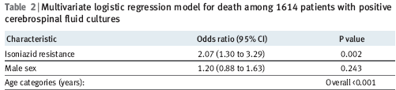
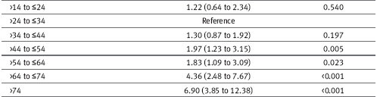

Slide 21
DISSCUSSION
Tuberculous meningitis, isoniazid resistance on initial susceptibility testing was associated with subsequent death among those with a positive cerebrospinal fluid culture for M.tuberculosis.
Association independent of age and HIV status and remained robust in a secondary analysis limited to adults treated initially with isoniazid,rifampicin (or rifabutin), ethambutol, and pyrazinamide and in sensitivity analyses that considered loss to follow-up.

Slide 22
Contd…
delayed cerebrospinal fluid sterilisation in cases of tuberculous meningitis that are resistant to either isoniazid or streptomycin.
isoniazid resistance is a threat to the successful treatment of tuberculosis when meningeal involvement is present

Slide 23
WHAT THIS STUDY ADDS
Initial isoniazid resistance was associated with death during anti-tuberculous treatment in patients with tuberculous meningitis
In areas with a high prevalence of isoniazid resistance among newly diagnosed cases of tuberculosis, treatment strategies other than the standard four drug regimen should be evaluated

Slide 24
CONCLUSION
Mortality from tuberculous meningitis attributable to isoniazid resistance will be greater when isoniazid resistance among newly diagnosed cases is more common
Use of an empirically expanded regimen for seriously ill patients when drug resistance is suspected
Identification of risk factors for isoniazid resistance
RCT --evaluate the optimal empirical regimen for patients with tuberculous meningitis who are at high risk for both initial isoniazid resistance and poor clinical outcomes.

Slide 25
TAKE HOME MESSAGE
Second line anti-tuberculous drugs with demonstrated activity in the central nervous system such as cycloserine or the fluoroquinolones SHOULD be used & trials regard it’s effect to reduce mortality..

