Slide 1
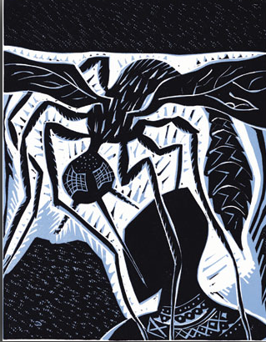
MALARIA

Slide 2
Introduction
Protozoal disease. Transmitted by bite of infected Anopheles mosquito.
In the Susruta, a Sanskrit medical treatise, the symptoms of malarial fever were described and attributed to the bites of certain insects.
Alphonse Laveran, a French army surgeon, was the first to notice parasites in the blood of a patient suffering from malaria in Nov, 1880.
In 1897, Ronald Ross, a British officer in the Indian Medical Service, was the first to demonstrate that malaria parasites could be transmitted from infected patients to mosquitoes and vice versa.
Till date, 4 Nobel prizes have awarded for work on Malaria.

Slide 3
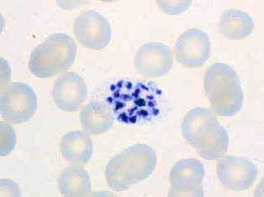
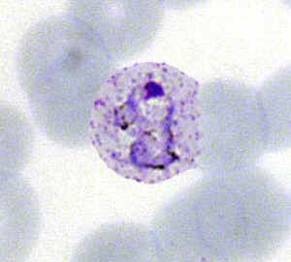
Types of Malaria
Out of various species of Plasmodium, following
Cause disease in human -
Plasmodium Vivax
P. Vivax trophozoite
P. Vivax schizonts

Slide 4
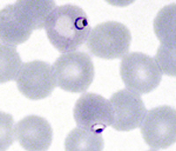
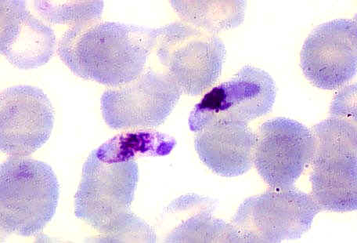
Plasmodium falciparum
P. Falciparum trophozoite ring
P. Falciparum gametocytes

Slide 5
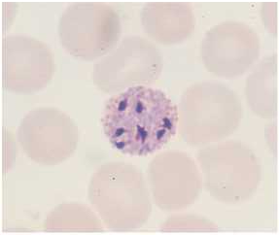
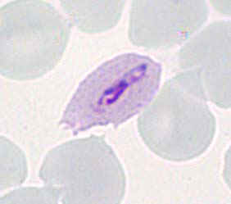
Plasmodium ovale
P. Ovale trophozoite
P. Ovale schizonts

Slide 6
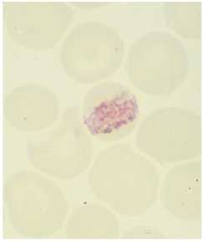
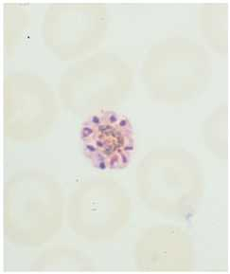
Plasmodium malariae
P. Malariae trophozoite
P. Malariae schizonts

Slide 7
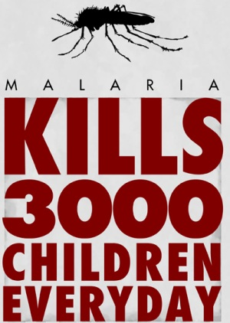

Slide 8
Epidemiology
Transmission occurs in 107 countries. Half of world population at risk. Responsible for 1 – 3 million deaths/yr.
Serious problem in Africa, where one in every five (20%) childhood deaths is due to the effects of the disease. An African child has on average between 1.6 and 5.4 episodes of malaria fever each year. Every 30 seconds one child dies from malaria.

Slide 9
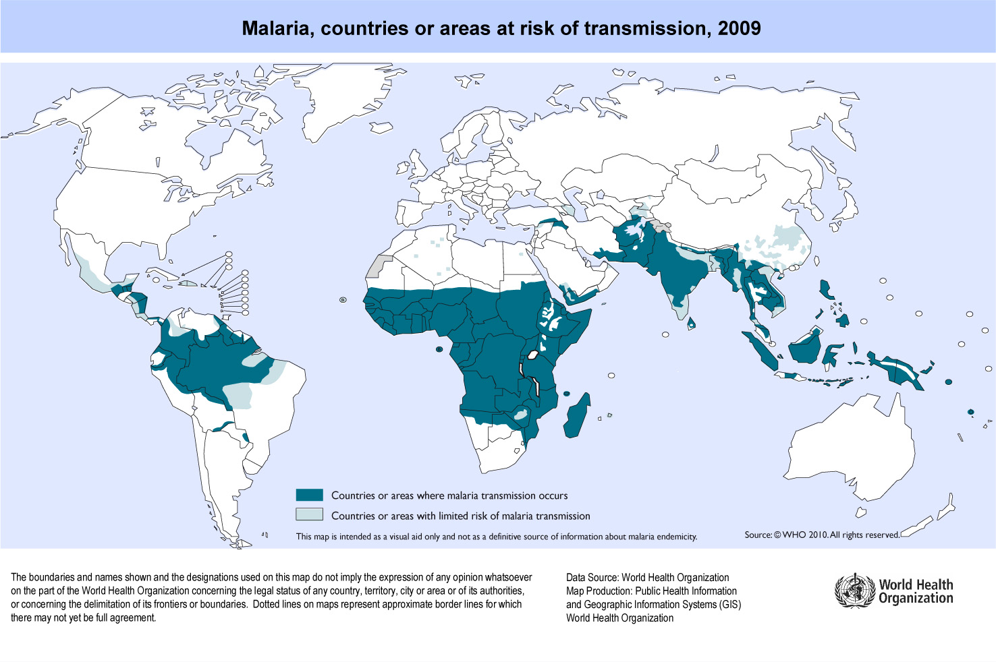

Slide 10
Malaria occurs throughout most of the tropical regions of the world.
P. falciparum -Africa, New Guinea, and Haiti.
P. vivax is - Central America.
The prevalence of these two species is approximately equal in the Indian subcontinent, Eastern Asia, South America, and Oceania.
P. malariae is found especially throughout sub-Saharan Africa, but is much less common.
P. ovale is rare outside Africa.

Slide 11
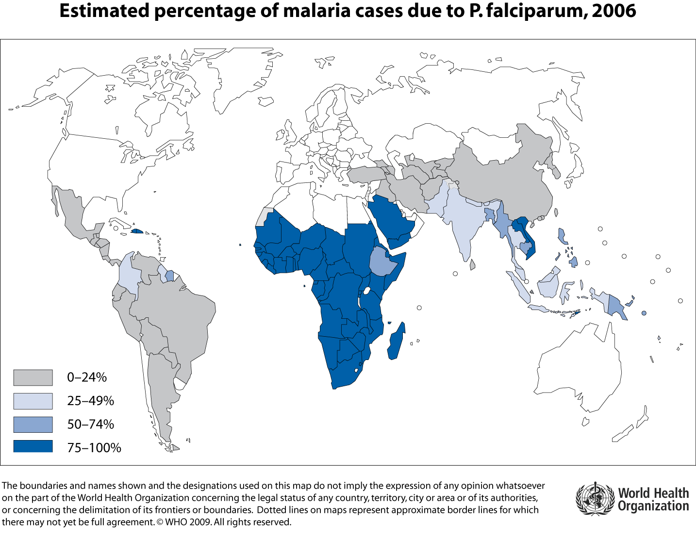
Malaria cases due to P. falciperum

Slide 12
Stable malaria - Transmission throughout the year.
  Mainly affects young children, immunity by adulthood.
  Difficult to control.
  E.g. Papua New Guinea as well as rural West and East African regions, etc.
Unstable malaria - Transmission is seasonal with variable intensity.
  Endemic population immunity is low .
  Affects all age groups. It is easier to control than stable malaria.
  North West India, Plateau's of Madagascar and Ethiopia, etc.

Slide 13
The principal determinants of the epidemiology of malaria are
  the number (density),
  the human-biting habits, and
  the longevity of the Anopheline mosquito vectors.
In-mosquito lifecycle of parasite (sprogony) lasts for 8 – 30 days; thus, to transmit malaria, the mosquito must survive for >7 days.
At temp below 16-18 deg C, sporogony cant be completed and transmission does not occur.

Slide 14
INDIA
About half of confirmed malaria cases in india are due to P. falciperum.
Reported as Chloroquine resistant region by WHO.
Mainly prevalent in north east border states of India.

Slide 15
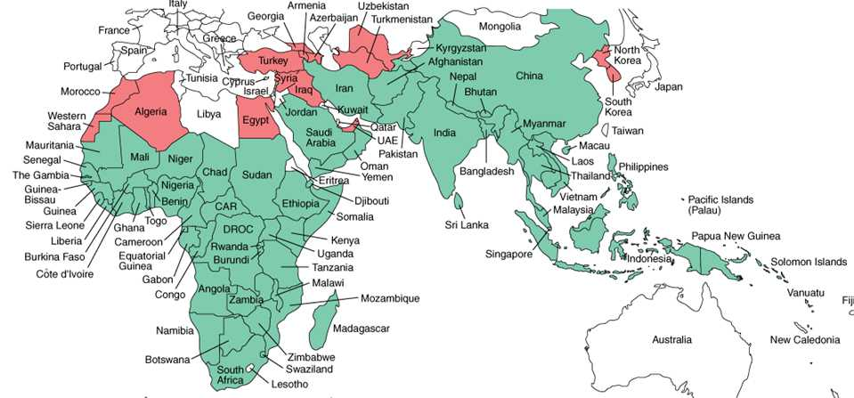
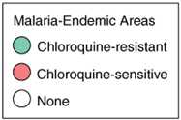
Chlorquine resistance pattern

Slide 16
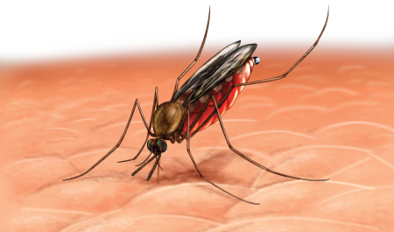
Etiopathogenesis
Human Infection begins when a female Anopheline mosquito innoculates plasmodium sporotzoits from its salivary glands during blood meal.

Slide 17
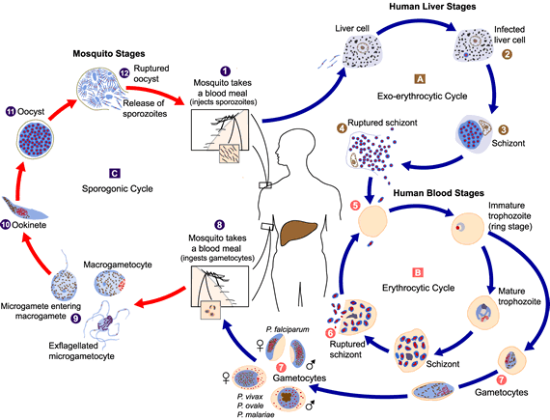
Lifecycle of Malarial Parasite
Notes:
The malaria parasite life cycle involves two hosts. During a blood meal, a malaria-infected femaleAnopheles mosquito inoculates sporozoites into the human host . Sporozoites infect liver cells and mature into schizonts , which rupture and release merozoites . (Of note, in P. vivax and P. ovale a dormant stage [hypnozoites] can persist in the liver and cause relapses by invading the bloodstream weeks, or even years later.) After this initial replication in the liver (exo-erythrocytic schizogony ), the parasites undergo asexual multiplication in the erythrocytes (erythrocytic schizogony ). Merozoites infect red blood cells . The ring stage trophozoites mature into schizonts, which rupture releasing merozoites . Some parasites differentiate into sexual erythrocytic stages (gametocytes) . Blood stage parasites are responsible for the clinical manifestations of the disease.
The gametocytes, male (microgametocytes) and female (macrogametocytes), are ingested by anAnopheles mosquito during a blood meal . The parasites’ multiplication in the mosquito is known as the sporogonic cycle . While in the mosquito's stomach, the microgametes penetrate the macrogametes generating zygotes . The zygotes in turn become motile and elongated (ookinetes) which invade the midgut wall of the mosquito where they develop into oocysts . The oocysts grow, rupture, and release sporozoites , which make their way to the mosquito's salivary glands. Inoculation of the sporozoites into a new human host perpetuates the malaria life cycle.

Slide 18
Characteristic | P. Falciparum | P. Vivax | P. Ovale | P. Malariae
Duration of intrahepatic phase (days) | 5.5 | 8 | 9 | 15
No of merozoites releases per infected hepatocyte | 30,000 | 10,000 | 15,000 | 15,000
Duration of erythrocytic cycle (hours) | 48 | 48 | 50 | 72
In P. Vivax and P. ovale malaria, some of the sporozoites (Intrahepatic form) develop into hypnozoite and remain dormant in liver to cause relapse.

Slide 19
Erythrocyte changes in Malaria
Parasite consumes and degrades intracellular proteins, mainly hemoglobin. Toxic heme is detoxified to Hemozoin – Malarial pigment.
RBC becomes more irregular in shape, more antigenic and less deformable.
In P. Falciparum infections, the antigenic ‘knobs’ on the erythrocyte surface extrude Erythrocyte membrane adhesive proteing (PfEMP1), which mediate “cytoadherence” to venular or capillary endothelium.
Infected RBCs may also adhere to uninfected ones (to form Rosettes) and to other parasitized erythrocytes (agglutination).

Slide 20
The processes of cytoadherence, rosetting, and agglutination are central to the pathogenesis of falciparum malaria.
They result in the sequestration of RBCs containing mature forms of the parasite in vital organs (particularly the brain), where they interfere with microcirculatory flow and metabolism.
Sequestered parasites continue to develop out of reach of the principal host defense mechanism: splenic processing and filtration.
As a consequence, only the younger ring forms are seen circulating in the peripheral blood in falciparum malaria, and the level of peripheral parasitemia underestimates the true number of parasites within the body.

Slide 21
In the other three ("benign") malarias, sequestration does not occur, and all stages of the parasite's development are evident on peripheral blood smears.
P. vivax and P. ovale show predilection for young RBCs and P. malariae for old cells.
P. falciparum can invade RBCs of all ages and thus produce high level of parasitemia.

Slide 22
Host Responce
Initially nonspecific defense mechanisms are activated. Splenic immunologic and filtrative clearance functions are augmented.
The material released on rupture of a schizont induces activation of macrophages and the release of cytokines, which cause fever. Temperature >40ºC damage mature parasite.
sickle cell disease, ovalocytosis, thalassemia, and glucose-6-phosphate dehydrogenase (G6PD) deficiency all confer some amount of protection of against malaria. Probably due to impaired parasite growth at low oxygen tensions.

Slide 23
exposure to sufficient strains confers protection from high-level parasitemia and disease but not from infection.
As a result of this state of infection without illness (premunition), asymptomatic parasitemia is common among adults and older children living in regions with stable and intense transmission

Slide 24
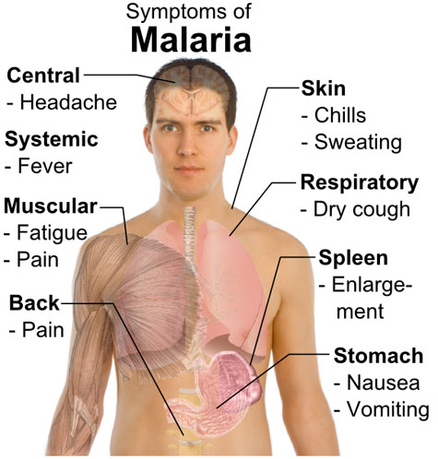
Clinical Presentation:
Acute Uncomplicated Malaria

Slide 25
Symptoms
Commonest cause of fever in tropical countries
Lack of sense of well being
Headache
Fatigue, abdominal discomfort
Muscle aches
Nausea vomiting
Orthostatic hypotension

Slide 26
Fever of Malaria
Paroxysms of fever
Cold phase: 20-60 min abrupt onset of chills and uncontrollable shivering(rigors).
Hot phase: temp often upto 40º - 41.7º C , associated with headache, flushing, tachycardia.
Wet phase: fever remits with in 3-8 hours even in absence of R_{x}, with profuse sweating.

Slide 27
Such paroxysms keep repeating every 48 to 72 hours.
Tertian Fever: On first and third day e.g. Pl. Vivax, Ovale,
Quartan Fever: On first and fourth day e.g. Pl. Malariae
Aperiodic Quotidian: Irregular spikes of fever, touches baseline e.g. Pl. Falciperum
Uncommon features: dry cough, diarrhoea, herpes labialis.

Slide 28
Physical findings
Fever,
Malaise
Mild anemia
Palpable spleen ( in some cases)
Mild jaundice and hepatomegaly may also be present.

Slide 29
Severe complicated Malaria
About 1% of patient with P. falciperum infection may develop more severe manifestations culminating in failure of various organ systems.
This does not occur in P. vivax malaria.

Slide 30
WHO Criteria for Severe Malaria
Clinical manifestations:
  Prostration.
  Impaired consciousness.
  Respiratory distress.
  Multiple convulsions.
  Circulatory collapse.
  Pulmonary oedema.
  Abnormal bleeding.
  Jaundice.
  Haemoglobinuria.
Laboratory tests:
  Severe Anemia
  Hypoglycemia
  Acidosis
  Renal impairment
  Hyperlactatemia
  Hyperparasitemia

Slide 31
Manifestations of Severe Falciparum malaria
Cerebral Malaria
Hypoglycemia
Acidosis
Renal Impairment
Pulmonary edema
Hematological Impairment
Liver dysfunction
Septicemia

Slide 32
Cerebral Malaria
Diffuse symmetrical encephalopathy
Sequestration of Parasite in cerebral end vessels causes disturbance in microcirculatory flow and metabolism.
Divergent eyes, pouting reflex, preserved corneal reflexes. Variable planters, DTRs. Absent Abdominal reflex.
Retinal hemorrhage, opacities, papillaedema, cotton wool spots may be present
Convulsions-GTCs or more covert seizure activity.
~15% surviving children have some residual neuro deficit.

Slide 33
Hypoglycemia
Results from –
  Failure of hepatic gluconeogenesis,
  Increased consumption of glucose by host and parasite
  Antimalarial drugs.
Difficult to interpret in unconscious patient.

Slide 34
Acidosis
Lactic acidosis - usually coexists with hypoglycemia. Caused by –
  Anaerobic glycolysis in infested tissues
  Lactate production by parasites
  Defective lactate clearance by hepatic and renal systems.

Slide 35
Pulmonary Edema
Noncardiogenic Pulmonary edema
ARDS
Pathogenesis unclear.
Could be aggravated by overly vigorous administration IV fluids.

Slide 36
Renal Impairment
Common among adults with severe falciperum malaria
Related to RBC sequestration interfering with renal microcirculatory flow and metabolism.

Slide 37
Hematological Abnormality
Anemia due to-
  Accelerated RBC removal by spleen
  Obligatory RBC destruction by parasite
  Ineffective erythropoiesis
Coagulation abnormality
  Mild thrombocytopenia is common
  < 5% develop DIC.

Slide 38
Liver Dysfunction
Jaundice is common. Due to –
  Hemolysis,
  Hepatocyte injury
  Cholestatsis
Contributes to hypoglycemia, lactic acidosis and impaired drug metabolism.

Slide 39
Septicemia
May complicate malaria, especially in endemic areas Salmonella has been associated with P. falciperum malaria
Unconscious patients may develop UTI and Chest infections
Patients with convulsions may develop aspiration pneumonia.

Slide 40
Malaria in Pregnancy
In hyper and holoendemic areas, falciperum malaria in primi- and second gravida is associated with low birth wt. (avg. reduction ~170g)
In areas with unstable transmission, pregnant women are prone to severe infections and fetal distress, premature labour and still birth.
P. vivax also causes Low Birth Wt (~110g), but effects are pronounced in multigravidae patients.

Slide 41
Malaria in Children
Convulsions, coma, hypoglycemia, acidosis and severe anemia are relatively common in children with severe malaria. Jaundice, renal failure and pulm edema are uncommon.
Severe malaria can result in longterm neurocognitive and developmental deficits.

Slide 42
Complications of Malaria
Major acute complications of Severe Malaria
  Unarousable come/cerebral malaria
  Acidemia / acidosis
  Severe normochromic, normocytic anemia
  Renal failure
  Pulm Edema / ARDS
  Hypotensive shock
  DIC / Bleeding
  Convulsions

Slide 43
Major Chronic complication of Severe Malaria
  Hyperreactive Malarial Splenomegaly
  Quartan Malarial Nephropathy
  Burkitt’s lymphoma and Epstein-barr virus infection

Slide 44
Chronic complications of Malaria
Tropical Spleenomegaly
AKA Hyperreactive Malarial Spleenomegaly (HMS)
In endemic areas, due to repeated infections, there is marked elevation in serum IgM and malarial antibody. Associated with elevated cytotoxic IgM antibodies leading to uninhibited B cell production of IgM and formation of cryoglobulins. This stimulated Reticulo-endothelial hyperplasia.

Slide 45
Quartan Malarial Nephropathy
Common with chronic and repeated P. malariae infections causes soluble immune complex mediated injury to renal glomeruli resulting in Nephrotic syndrome.
Pathologically, focal segmental glomerulonephritis.
Immunofluorescence reveals deposits of compliments and immunoglobulins.

Slide 46
Burkitt’s lymphoma and Epstein-Barr virus infection
Malaria related immunosuppression provokes infection with lymphoma viruses.
Burkitt’s lymphoma is strongly associated with Epstein-Barr virus.

Slide 47
Diagnosis
In low transmission areas, clinical diagnosis of uncomplicated malaria should be based on degree of exposure and history of fever in the previous 3 days with no features of other diseases.
In high transmission areas, clinical diagnosis should be bases of history of fever in previous 24 hours and/or presence of anemia in young children.

Slide 48
Thick blood smear
Blood should be uneven in thickness, dried thoroughly and stained with giemsa without fixing.
Advantage of concentrating parasites 40 to 100 folds. Thus increasing the sensitivity.
Highly sensitive. Picks up 0.001% parasitemia.
Both parasites and WBCs are counted. No of parasites per unit volume is calculated from the TLC.
Minimum of 200 WBCs are counted under oil immersion.

Slide 49
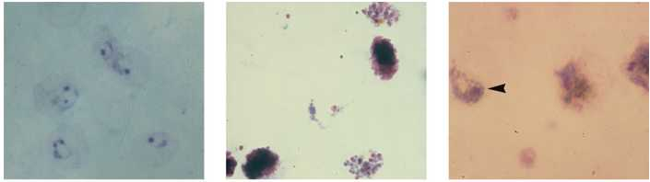
Thick smear – P. vivax
Trophozoite Schizont Gametocyte

Slide 50
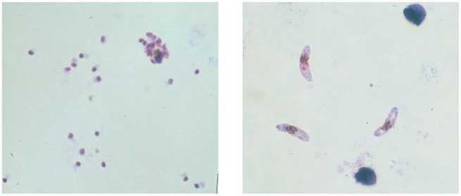
Thick Smear – P. falciparum
Trophozoits Gametocytes

Slide 51
Thin Blood smear
Sufficiently thin so that hands of a watch can be seen thru it.
Rapidly air dried and fixed in anhydrous methanol and stained with Romanowsky stain. RBCs in the tail of smear is examined with oil-immersion lens.
Insensitive (<0.05% parasitemia)
Rapid, species specific and inexpensive.

Slide 52
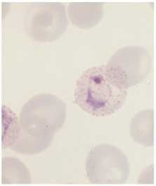
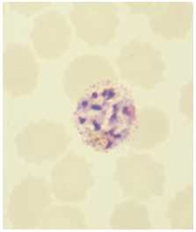
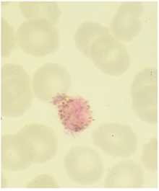
Thin Smear – P. vivax
Trophozoite Schizont Gametocyte

Slide 53
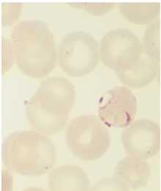
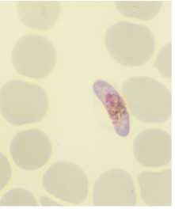
Thin Smear – P. falciparum
Trophozoite Gametocyte

Slide 54
Rapid Diagnostic Tests
PfHRP2 base dipstick or Card test:
-The malarial antigen ( P. falciparum specific Histidin Rich Protein2) is caught by the monoclonal antibody and it is reflected as colored band.
-Detects only P.falciparum. Remains positive for weeks after infection.
-Specificity – 80% Sensitivity – 98%
-Does not quantitate the parasitemia.

Slide 55
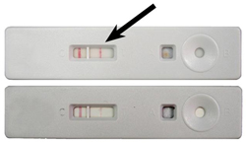
PfHRP2 base kit for P.falciparum
Positive
Negative

Slide 56
2. Plasmodium LDH dipstick or Card test
- This test uses two monoclonal antibodies directed against parasite LDH.
- The first is pan-specific LDH, which reacts with all P. LDH. Second reacts specifically with falciparum LDH.
- May miss low level parasitemia with p.vivax, ovale and p. malariae. Does not speciate between theses organism. Does not quantitate.
- Specificity ~ 100%. Sensitivity ~ 88 – 94%.

Slide 57

Plasmodium LDH base kit
Negative
Positive for
Plasmodia
Positive for
P. falciparum

Slide 58
Fluorescence Microscopy
- Fluorescent dyes like acridine orange, benzothiocarboxy purine and rhodamine 123 attach to nucleic acids in the parasite nucleus.
- When examined under fluorescence microscope illuminated with UV light, the parasite nuclei strongly fluoresce. E.g. Quantitative Buffy-Coat (QBC) test
- Main advantage is that it requires less experience and expertise than conventional microscopy
- Expensive.

Slide 59
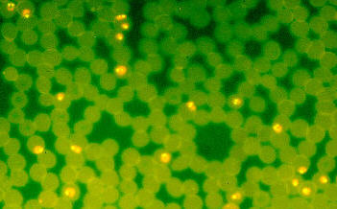
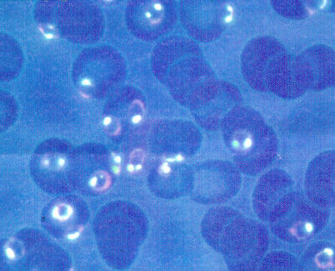
Fluorescence Microscopy
Acridine Orange stain showing
Plasmodium Trophozoites
DAPI stain

Slide 60
Polymerase chain reaction
It used to identify parasite r-RNA and DNA in peripheral blood
It is the most sensitive test for diagnosis of malaria and can detect parasitemia as low as 5 parasite per microL of blood.
100% sensitive and specific.
Becomes negative after 3 days of successful treatment.
Expensive. Result available only after 24 hours.

Slide 61
Treatment - Anti-Malarial Drugs
Quinine, Qunidine:
-It acts by inhibiting hemozoin biocrystallization, thus facilitating aggrgation of cytotoxic heme.
-Anti malarial activity : main action on bloodstage trophozoites.
-kills gametocytes of P.vivax, ovale and malariae. (Not that of falciparum.)
-No action of liver stage.
S/E: Major: Hypoglycemia.
Minor: Prolonged QTc, Postural Hypo- tension, Cinchonism (Tinnitus, vertigo, rash, vertigo, nausea, abdo pain).

Slide 62
Chloroquin
- least expensive, safest and best tested.
- emergence of resistance a great concern. Still the first line of drug in Sub-Saharan Africa.
- Action same as Quinine, plus an unclear mechanism of forming of CHQ-haem or CHQ-DNA complex may also be there.
- Most significant activity against schizonts of all strains (except CHQ resistant), safe during Pregnancy.
- S/E: Major: Hypotension, Shock, cardiac arrythmia when given IV
Minor: Nausea, hypoglycemia,

Slide 63
Amodiaquin
- Antimalarial activity same as CHQ.
- thought to be more effective in clearing parasites in uncomplicated malarial than Chloroquine, thus leading to a faster rate of recovery.
- S/E: Major: Agranulocytosis, hepatitis (mainly with) prophylactic use.
Minor: Nausea.

Slide 64
Mefloquin:
- action on blood trophozoites and gametocytes.
- Unsafe in first trimester of pregnancy.
- It is now used solely for the prevention of resistant strains of P. falciparum despite being effective against P. vivax, P. ovale and P. marlariae.
- S/E: Major: Neuropsychiatric reactions, convulsions, encephalopathy.
Minor: Nausea, giddiness, nightmares.

Slide 65
Primaquin:
- used for radical cure.
- irradicates hynozoites of P.vivax and P. ovale
- kills all stages of gametocytes.
- mechanism of action is not fully understood but it is thought to mediate some effect through creating oxygen free radicals that interfere with the plasmodial electron transport chain.
- S/E: Major: Hemolysis in subjects with Severe G6PD deficiency,
Minor: Vomiting, diarrhoea, abdo pain.

Slide 66
Artimisinin and derivatives:
- most commonly used one is Artesunate
- Broader stage specificity and more rapid action than other drugs. No action of liver stage. Kills all but fully mature gametocytes of falciparum.
- The active compound is artemsinin. It is a sesquiterpene lactone with a chemically rare peroxide bridge linkage. It is this that is thought to be responsible for its antimalarial action.
- S/E: Major: Anaphylaxis, urticaria, fever
Minor: Reduction in Retic count.

Slide 67
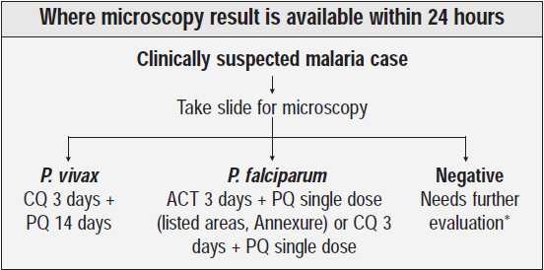
WHO & GOI guidelines for Rx:

Slide 68
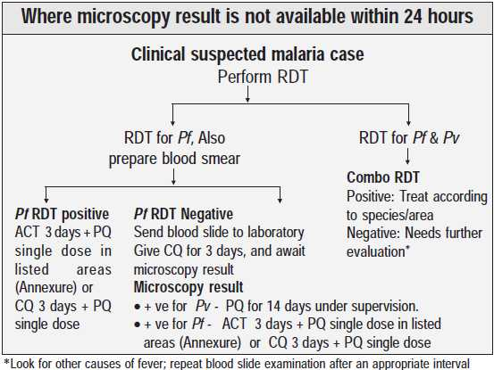

Slide 69
R_{x} of CHQ sensitive P. Vivax, P. Ovale &
P. malariae.
- Chloroquin 10 mg base/kg stat at followed by
5 mg /kg at 12, 24 and 36 hours.
OR
- Chloroquin 10 mg/ kg stat followed by
10 mg/kg at 24 hours
5 mg/kg at 48 hours
OR
- Amodiaquine 10 – 12 mg base /kg OD for 3 days

Slide 70
Radical treatment R_{x} of P.vivax & ovale
- Primaquin 0.25 mg base/kg OD for 14 days
- In SEAR and Oceania- 0.375 – 0.5 mg base/kg
OD for 14 days.
- In Mild G6PD deficiency- 0.75 mg base/kg once a week for 6 wks

Slide 71
R_{x} of CHQ sensitive P. falciparum:
- Chloroquin 10 mg base/kg stat at followed by
5 mg /kg at 12, 24 and 36 hours.
OR
- Chloroquin 10 mg/ kg stat followed by
10 mg/kg at 24 hours
5 mg/kg at 48 hours
OR
- Amodiaquine 10 – 12 mg base /kg OD for 3 days

Slide 72
R_{x} Uncomplicated P. falciparum malaria:
- Artesunate 4 mg/kg OD for 3 days
+
Sulfadoxine 25 mg/kg /
Pyrimethamine 1.25 mg/kg as single dose
OR
- Artesunate 4 mg/kg OD for 3 days
+
Amodiaquine 10 mg base/kg OD for 3 days

Slide 73
R_{x} Multi-drug Resistant P. falciparum malaria
- Artemether – Lumefantrine (1.5/9) mg/kg BD for 3 days
OR
- Artesunate 4 mg/kg OD for 3 days +
Mefloquine 25 mg base/kg total dose.
( 8 mg/kg OD for 3 days OR
15 mg/kg on Day 2 &
10 mg/kg on Day 3)

Slide 74
R_{x} of severe P. falciparum malaria
- Artesunate 2.4mg/kg IV stat f/b
2.4mg/kg IV at 12 and 24 hours
2.4mg/kg IV daily if necessary.
- Artemether 3.2 mg/kg IM stat f/b
1.6 mg/kg IM daily for 2 – 5 days.

Slide 75
R_{x} of severe P. falciparum malaria (cont.)
- Quinine Dihydrochloride
20 mg of salt/kg infused over 4 hours f/b 10 mg of salt/kg infused over 2-8 hours every 8 hrly for 2-7 days
- Quinidine
10 mg of base/kg infused over 1-2 hours f/b
1.2 mg of base/kg/hour with ECG monitoring.

Slide 76
Second line R_{x} for Imported malaria:
- Artesunate 2mg/kg OD for 7 days
Or
- Quinine 10 mg salt/kg TDS for 7 days.
+
either Tetracycline 4mg/kg Qid for 7 days
or Doxycycline 3mg/kg OD for 7 days
or Clindamycin 10mg/kg BD for 7 days
or Atovaquone-Proguanil (20/8)mg/kg OD for 3 days

Slide 77
Prophylaxis of Malaria:
Chloroquine
- CHQ 300 mg base total dose - only in areas with CHQ sensitive falciparum and vivax
- Begin 1-2 wks before travel to malarious area, take weekly on the same day of the week while in the malarious area and for 4 weeks after leaving such area.

Slide 78
Hydroxychloroquine – only in areas with CHQ sensitive falciparum malaria.
- Dose 310 mg base.
- Begin 1-2 wks before travel to malarious area, take weekly on the same day of the week while in the malarious area and for 4 weeks after leaving such area.

Slide 79
Mefloquine
- In areas with CHQ resistant falciparum
- Dose 228 mg of base total
- Begin 1-2 wks before travel to malarious area, take weekly on the same day of the week while in the malarious area and for 4 weeks after leaving such area.

Slide 80
Atovaquone / Proguanil
- In areas with CHQ and Mefloquine resistant falciparum
- 1 adult tablet begin 1-2 days before travel to malarious area, take daily at the same time while in the malariuos area, continue for 7 days after leaving such area.

Slide 81
Doxycycline
- In areas with CHQ and Mefloquine resistant falciparum malaria
- 100 mg PO OD. begin 1-2 days before travel to malarious area, take daily at the same time while in the malariuos area, continue for 4 weeks after leaving such area.

Slide 82
Primaquin
- Used for presumptive anti-relapse therapy.
- in persons who are intolerant to other recommended drugs. begin 1-2 days before travel to malarious area, take daily at the same time while in the malariuos area, continue for 7 days after leaving such area.

Slide 83
Prevention
Vaccines for malaria are under development, with no completely effective vaccine yet available.
Vaccines that have undergone field trial without encouraging results are
  SPf66
  CSP-R32LR
  RTS,S/AS02A (undergoing trials)

Slide 84
THANK YOU

