Slide 1
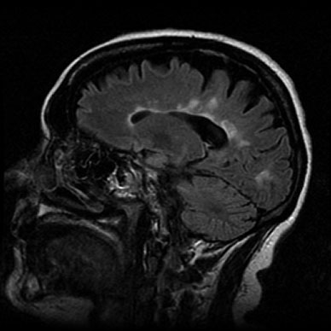
Multiple Sclerosis

Slide 2
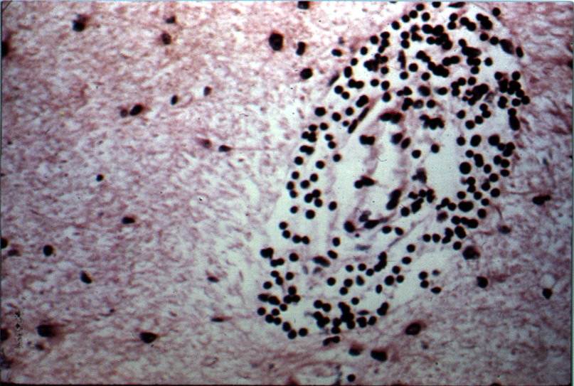
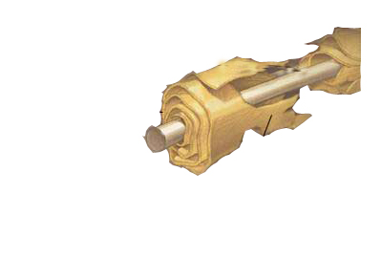
Definition
Triad of-
    Inflammation
    Demyelination
    Gliosis (scarring)
Pathology
-Acute MS lesion (Plaque): Perivenular cuffing with inflam mononucleare cells, predominantly T cells and macrophages.
-BBB is disrupted at site of inflammation, but vessel wall is preserved.

Slide 3
Diagnostic Criteria
1. Objective clinical abnormality of CNS.
2. involvement must reflect predominantly disease of the whitematter long tracts, namely,
            Pyramidal tracts,
            Cerebellar pathways,
            Medial longitudinal fasciculus,
            Optic nerve
            Posterio column

Slide 4
3. Examination or history must implicate 2 or more areas of CNS,
  a. MRI may be used to document second lesion when only one site of clinical abn detected. A confirmatory MRI must have
  Either 4 lesions involving white matter or 3 lesions if one of them is Periventricular in location.
  Acceptable lesion must be >3mm in D.
  When pt > 50 yrs, 2 of the following must b met,
  (i) Lesion > 5mm, (ii) lesion adjacent to bodies of lat ventricles and (iii) lesion present in post fossa.
  b. Evoked resp may be used to document a second lesion.

Slide 5
4. Clinical pattern must be
A. Two of more separate episodes of worsening involving diff sites of CNS, each lasting at least 24h and occuring at least 1 month apart, or
B. gradual or stepwise progession over at least 6 months if accompanied by increased IgG synthesis or two or more oligoclonal bands.
5. Neurological cond could not be attributed to an other disease.

Slide 6
Definite MS: All five criteria fulfilled
Probable MS: All five criteria fulfilled except
a. only one objective abnormality despite two syptomatic episode
b. only one symptomatic episode despite or more objective findings.
At risk of MS: Criteria 1,2,3 and 5 fulfilled; pt has only one symptomatic episode and one objective abnormality.

Slide 7
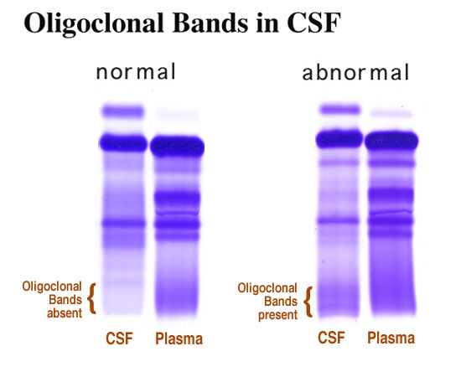
CSF Picture:

Slide 8
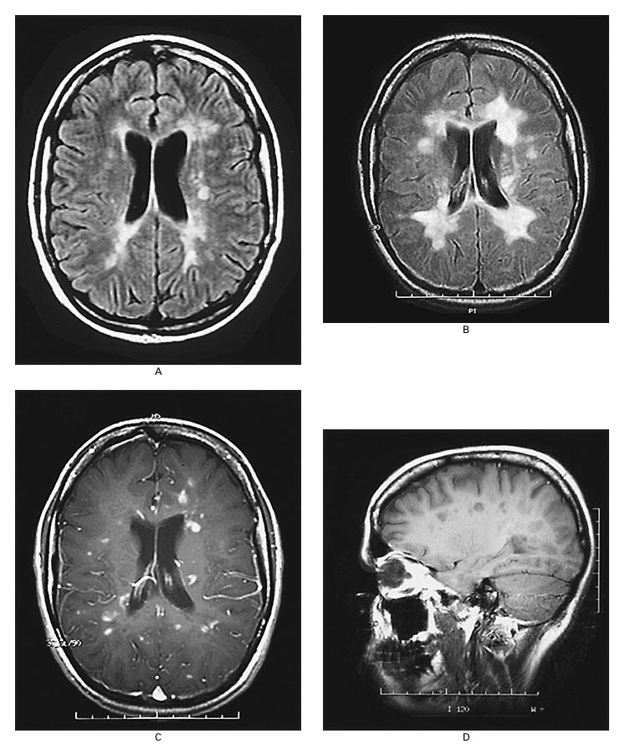
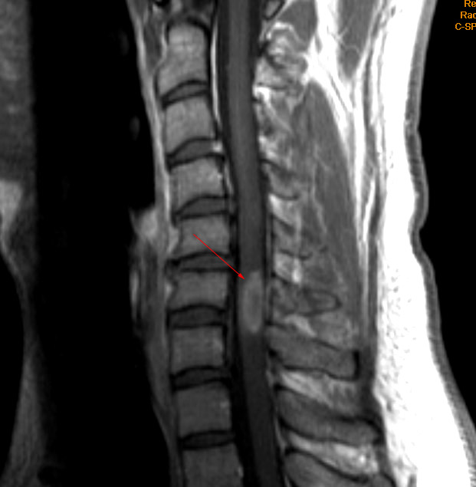
MRI findings:

