Slide 1
Pulmonary Hypertension in
Sickle Cell Anemia

Slide 2
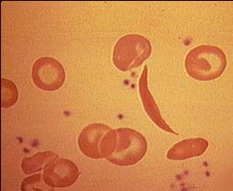
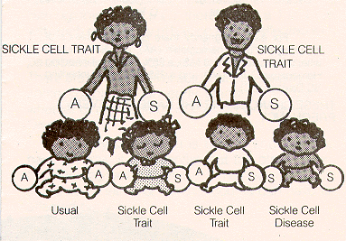
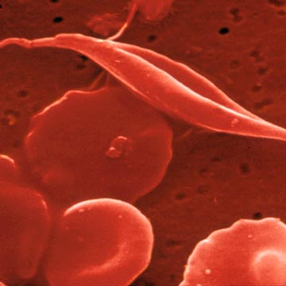
What is Sickle Cell Anemia (SCA)?
  It is a structural Hemoglobin variant. Autosomal recessive transmission.
  Normal Hb has 2 alpha and 2 beta subunits (α₂β₂)
  In Sickle cell anemia – there is substitution of valine for glutamic acid at position 6 in β chain.
  The resultant mutant Hb S has unusual solubility characteristics and undergoes liquid crystal (tactoid) formation as it becomes deoxygenated.

Slide 3
Normal Hemoglobin (Hb A)
There are 4 protein subunits of Hemoglobin A
There will be different forms of Hemoglobin when there is a mutation in the beta subunit.
Hb A
α
β
α
β

Slide 4
Sickle cell Anemia
Mutation in one copy of the hemoglobin beta gene. Half of beta subunits are replaced with Beta S.
This results when both copies of beta gene have S mutation.
Hb S
α
β
α
β^{s}
Hb S
α
β^{s}
α
β^{s}

Slide 5
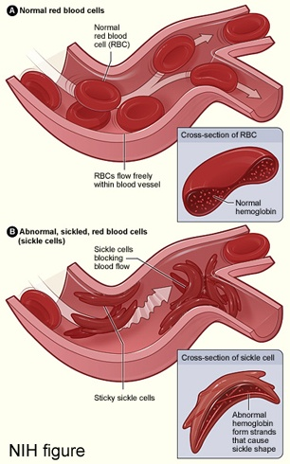
Pathogenesis
Normal RBCs passing thru the small blood vessels with elsticity
Due to repeated sickling, sickled RBC loses elasticity and shortened survival – chronic hemolytic anemia
Sickled RBCs also adhere to vessel wall and block circulation, causing statsis and tissue damage.

Slide 6
Medical Complications
Recurrent bone pains
Pulmonary complications
Infections
C V Stroke
Leg ulcers
Osteomyelitis/ Avascular Necrosis
Renal Papillary Necrosis
Jaundice
Splenic sequestration

Slide 7
Pulmonary Complications
Pulmonary manifestations of Sickle cell disease are leading cause of morbidity and mortality.
They are –
Acute Chest Syndrome (ACS)
Airway hyperreactivity
Sickle cell chronic lung disease (SCCLD)
  - Pulmonary hypertension
  - Sleep disordered breathing

Slide 8
The Acute Chest Syndrome (ACS)
Common form of lung injury in SCD
When severe analogous to acute respiratory distress syndrome.
Defined by development of new pulmonary infiltrates consistent with alveolar consolidation but not atelectasis involving at least one segment.
Radiographic abnormality accompanied by chest pain, fever, tachypnoea, wheezing or cough.

Slide 9
Causes of Acute Chest Syndrome
3 major causes proposed:
1. pulmonary infection
2. embolisation of bone marrow fat – ffg vaso-occlusive crisis
3. intravascular pulmonary sequestration of sickled erythrocytes ➔lung injury & infarction

Slide 10
Risk factors for ACS
Younger age.
Homozygous haemoglobin SS.
Low haemoglobin F concentration.
High steady state leucocyte counts.
High haemoglobin levels.
Previous history of acute chest syndrome.
Avascular necrosis of bone.

Slide 11
Clinical aspects of ACS
Associated with marked systemic inflammation, fever, leukocytosis , abrupt drop in Hb and thrombocytopaenia.
May require ventilatory support
Rapid simple or exchange blood transfusion, removes sickled erythrocytes → rapid recovery.

Slide 12
Airway Hyperreactivity
Significant comorbidity in children with SCD
Chronic lung dx can also occur – probably result of recurrent episodes of ACS
High incidence of airway hyperreactivity in several studies
However, low prevelance of asthma – may be underdiagnosed.

Slide 13
Asthma and SCD
Children with SCD and asthma have nearly twice as many episodes of ACS.
Several theories: VQ mismatch→ local tissue hypoxia and increased sickling of RBC, increase release of inflammatory markers may cause increase airway hyperreactivity.
Further studies warranted to determine if aggressive Rx of asthma reduces risk of ACS and possibly morbidity & mortality of ACS in SCD

Slide 14
Pulmonary Artery Hypertension (PAH)
Def^{n} : Pulmonary artery hypertension (PAH) is defined as mean pulmonary artery pressure > 25 mm Hg at rest or > 30 mm Hg during exercise, with normal pressure being 15 mm Hg.
Primary – Rare – idiopathic
Secondary – as a complication of many pulmonary, cardiac or extrathoracic conditions that impedes the flow of blood through the lungs or that causes sustained periods of low oxygen in the blood.

Slide 15
Pathology of PAH
Most prevalant lesions thickening of the media and intima of small pulm vessels, along with concentric nonlaminar intimal hyperplasia and fibrosis occurs.

Slide 16
Mechanism of development of PAH in SCD patients
Several Mechanism have been proposed –
NO deficiency
Progressive interstitial fibrosis 2º to ACS
Vasculopathy 2o to platelet activation and intimal thickening.
Hypoperfusion of pulm vascular bed
? Recurrent thromboembolism.

Slide 17
Role of NO in Hemolysis associated PAH
NO produced by NOS (NO Synthases) – convert arginine to citrulline producing NO in process
NO diffuses from endothelial cell into myocytes, trigger cGMP there, relaxes myocytes and causes vasodilatation.
In SCD, intravascular hemolysis releases RBC hemoglobin and arginases in plasma.
Plasma Hb scavanges NO, while arginases interferes with further NO production.
NO deficiency – Vasoconstriction.

Slide 18
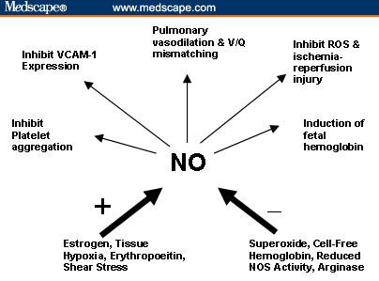
Factors in the inhibition and release of NO

Slide 20
Research
Several studies corroborate a role for NO in ACS. Morris and coworkers reported in 2000 that steady-state L - arginine levels, normal in children with SCD, dropped during VOC and went even lower in those who went on to develop ACS.
In contrast, NO levels were normal at the onset of VOC and decreased during hospitalization for both patients with VOC and those with ACS.
These data suggest that low arginine levels during VOC reflect a state of acute substrate depletion that results in a decrease in NO production.

Slide 21
Hemodynamics of Pulm Hypertension
SCD patients have an anemia-induced increase in cardiac output.
This high output state requires that the pre-capillary pulmonary microcirculation vasodilate in order to accommodate the increased flow of deoxygenated blood and sickled erythrocytes. In this high-output state, any interference with vasodilation by the high-viscosity sickled blood cells will increase pulmonary pressure.
The Six-Minute Walk Distance Test, which evaluates the distance that a participant
can walk in 6 minutes, is a good surrogate of cardio-pulmonary dynamics and functional lung impairment in patients with SCD suspected of having PAH.

Slide 22
Research
The first reference in the literature documenting pulmonary hypertension in SCD was in 1982 when Collins and colleagues[4] described the clinical history, cardiac catheterization results, and autopsy findings in 3 patients with PAH.
SCD patients with pulmonary hypertension have a significantly increased mortality rate compared with SCD patients without pulmonary hypertension.
Sutton and colleagues reported a 40% mortality rate in SCD patients with pulmonary hypertension at 22 months post diagnosis (odds ratio 7.86; 95% confidence interval = 2.63-23.4), compared with SCD patients without pulmonary hypertension.

Slide 23
Evaluation of PAH
Doppler echocardiographic assessment (ECHO) of the tricuspid valve regurgitant jet velocity (TRV) has become a less invasive way to detect PAH and a valuable screening modality.
Investigators at the NIH-Howard employed this protocol to detect PAH in 195 unselected adults with SCD in a prospective trial.
This was a landmark study because it validated this noninvasive method for detecting PAH in SCD patients, quantified the age-related prevalence, and examined predisposing factors for PAH in this population.

Slide 24
PAH on ECHO was defined as a TRV of 2.5 m/sec or greater. Using these criteria, the investigators found that 32% of patients had PAH, with 25% of cases being mild (TRV = 2.5-2.9 m/sec) and 5% to 10 % being severe (TRV > 2.9 m/sec)

Slide 25
Clinical signs and symptoms
Clinically there are sever clues to detecting the presence of PAH. Mild disease does not produce much symptoms. With increasing disease.
  Chronic dyspnea - Hypoxemia
  Increases P2 or TR - Cor P
  Arrhythmias - Syncope
  Sudden death

Slide 26
Investigations
Routine plus work up for Anemia.
Hb Electrophoresis
ECG
2D – ECHO DOPPLER
Right heart catheterization.

Slide 27
Treatment Options
Hydroxyurea – Induces HbF prduction. Role for Rx of PAH under study
L – arginine replacement therapy – in reserch.
Sildenafil – Under study.

Slide 28

Thank You!!!

