Slide 1
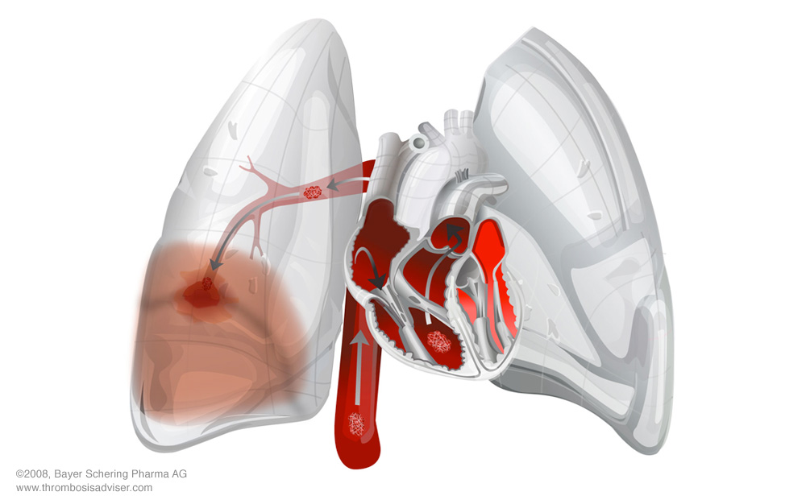
Approach to
Pulmonary Embolism

Slide 2
Content
Introduction
Epidemiology
Risk factors
Clinical findings
Investigations
Treatment
Approach
References

Slide 3
Introduction
It is Obstruction of pulmonary artery or one of its branches by material
Thrombus
Tumor
Air
Amniotic fluid
Fat
Infacted material
That originated elsewhere in body

Slide 4
Epidemilogy
The incidence of pulmonary embolism in the United States is estimated to be 1 case per 1000 persons per year.¹
An autopsy study on patients at the Postgraduate Institute of Medical Education and Research (PGIMER), Chandigarh revealed that PE was present in 159 (16%) of 1000 patients who died in the hospital. clinical (pre-mortem) suspicion of PE was recorded in 30% of patients and a diagnosis of PE could be made in <10%.²
http://www.ncbi.nlm.nih.gov/pubmed/12885687 (from pub med)
http://www.ncbi.nlm.nih.gov/pubmed/18160596 (from pub med)

Slide 5
Risk Factors
The PIOPED II (Prospective Investigation of Pulmonary Embolism Diagnosis) study listed the following risk factors :
Immobilization
Surgery and trauma
Pregnancy
Oral contraceptives and estrogen replacement
Malignancy
Hereditary factors resulting in a hypercoagulable state
Drug abuse (intravenous [IV] drugs)
Hyperlipidemias
Thrombocytosis
Varicose veins

Slide 6
Clinical Evaluation
The most common symptom is unexplained breathlessness.
Diagnosis is difficult because symptoms and signs are nonspecific.
Whenever unexplained sudden onset breathlessness with Tachypnea & Tachycardia in bed ridden patient suspect Pulmonary Embolism

Slide 7
Various Clinical Findings (PIOPED – 2)
Symptoms & Sign | Women | Men
Dyspnoea | 80% | 78%
Pleuritic Chest Pain | 60% | 57%
Cough | 41% | 40%
Haemoptysis | 10% | 21%
Leg Pain | 23% | 30%
Leg Swelling | 24% | 36%
Pleural Rub | 2% | 7%
Crackles | 60% | 57%
Mean Heart Rate (beats/min) | 98 ±19 | 93± 18
Mean Resp Rate (rate/min) | 24± 8 | 23± 7
PIOPED – 2 Stein PD, Beemath A et al. Am J Med. 2007;120(10):871

Slide 8
Well’s Criteria for Pulmonary embolism
Clinical Variable | PE Score
Signs and symptoms of DVT | 3
Alternative diagnosis less likely than PE | 3
Heart rate >100/min | 1.5
Immobilization >3 days; surgery within 4 weeks | 1.5
Prior PE or DVT | 1.5
Haemoptysis | 1
Cancer | 1
Risk | Score
Low | <2
Intermediate | 2-6
High | >6
http://emedicine.medscape.com/article/1918940-overview#a2

Slide 9
Simplified Geneva Score
Content | Score
Previous DVT or PE | 1
Heart Rate 75 to 94/ min | 1
Heart rate > 95/min | 2
Surgery or Fracture < 1 month | 1
Haemoptysis | 1
Malignancy | 1
Unilateral Lower Limb Pain | 1
Unilateral Lower Limb Oedema | 1
Age >65 years | 1
Clinical Variability | Score
Unlikely | <2
Likely | >2
http://www.ncbi.nlm.nih.gov/pubmed/23591793

Slide 10
PERC (Pulmonary Embolism Rule-out Criteria)
Age <50 years
Heart Rate <100 bpm
Oxygen Saturation >94%
No unilateral Leg Swelling
No Haemoptysis
No surgery or Trauma within 4 weeks
No prior DVT or PE
No hormone use
PE is rule out if all criteria negative for pre test suspicious if any positive then further evaluation required
Kline (2004) J Thromb Haemost 2(8): 1247-55 [PubMed]

Slide 11
Investigations
Nonimaging modalities
  Plasma D-Dimer
  Cardiac biomarkers
  ECG
Noninvasive imaging modalities
  Venous ultrasonography
  Chest X-ray
  CT scan
  MRI
  Echocardiography
Invasive modalities
  Pulmonary angiography

Slide 12
Plasma D-Dimer
It is degradation product of fibrin produced by plasmin-mediated proteases enzyme
Normal value:- <500 µg/L or ng/mL [age × 10 ng/mL ]
Sensitivity > 95% but poor specificity (No specific data)
Also increase in MI, Pneumonia, Sepsis, Postoperative state, carcinoma and many times in 2nd & 3rd trimester of Pregnancy

Slide 13
Serum Troponin
It is increased due to RV microinfarction
Serum troponin levels can be elevated in up to 50% of patients with a moderate to large pulmonary embolism.⁴

Slide 14
Electrocardiogram
Sinus tachycardia
S wave in lead I, Q wave in lead III and inverted T wave in lead III (S1Q3T3 Sign)
Cor P, Right axis deviation with RBBB (due to RV strain)
T wave inversion in V1 – V4 (due to RV ischemia)
20% of patients with proven pulmonary embolism have any of these classic ECG changes. If ECG abnormalities are present, they may be suggestive of pulmonary embolism.⁵

Slide 15
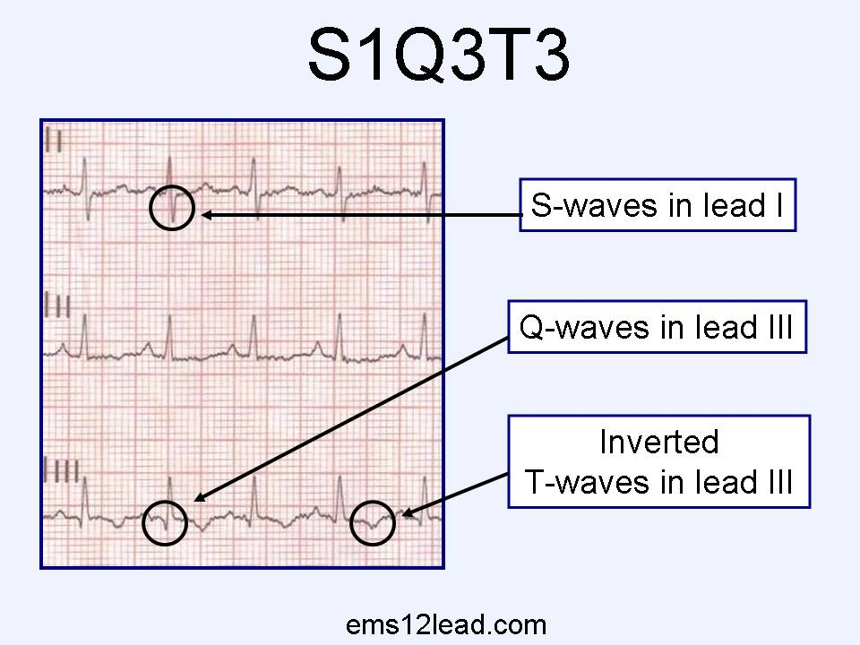

Slide 16
Venous Ultrasonography
Ultrasonography of the deep venous system relies on loss of vein compressibility (because of passive distention by thrombus)
Thrombus is may directly visualized. It appears homogeneous and has low echogenicity.
The vein itself often appears mildly dilated, and collateral channels may be absent.
With the advent of noninvasive imaging, it has become less common in practice.

Slide 17
Chest X Ray
Chest radiographs are abnormal in most cases
The classic findings of pulmonary infarction include a wedge-shaped, pleura-based triangular opacity with an apex pointing toward the hilus (Hampton hump) or decreased vascularity (Westermark sign).

Slide 18
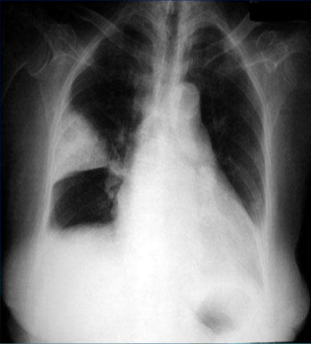
Triangular opacity with an apex pointing toward the hilus (Hampton hump)

Slide 19
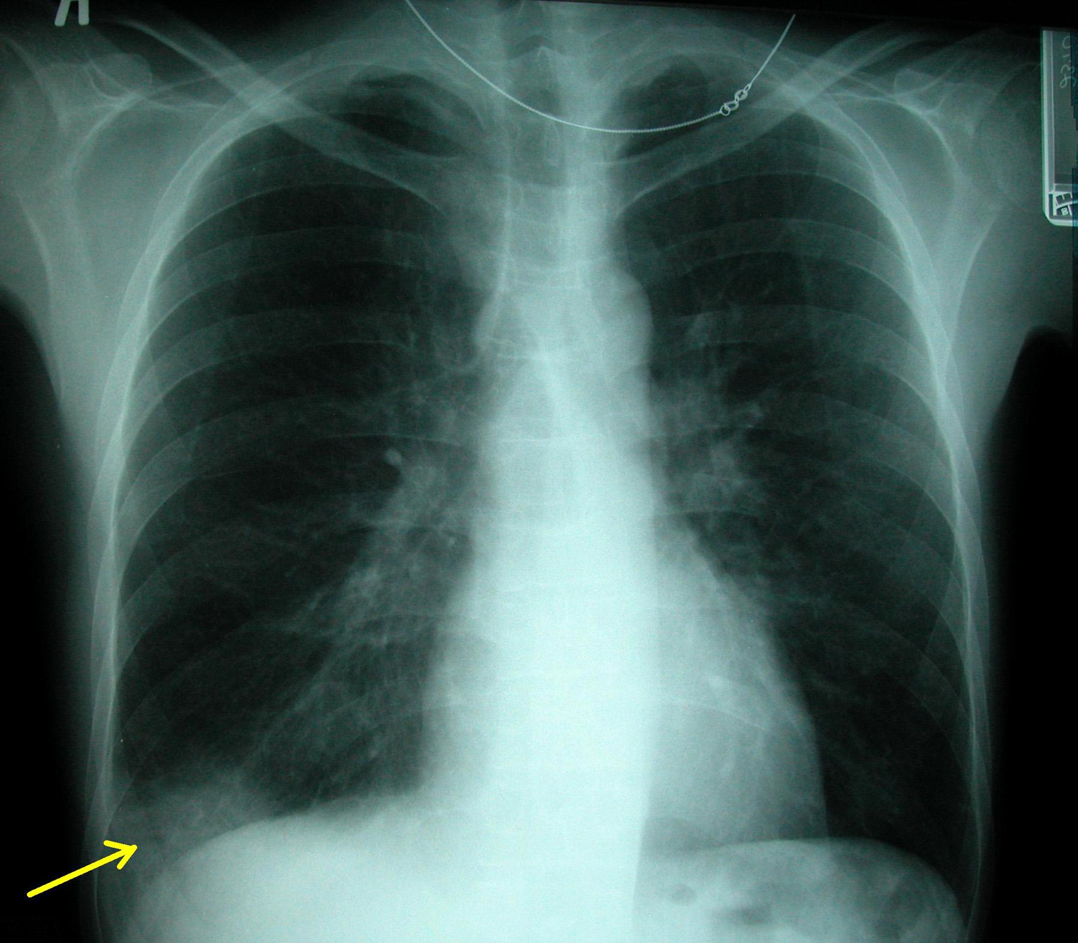
peripheral wedge-shaped infiltrate
(westermark’s sign)

Slide 20
Chest CT Scan
Important diagnostic technique in suspected pulmonary embolism.
It is non invasive, cheaper than pulmonary angiography, and widely available.
CT scan can provide significant additional information related to alternate diagnoses.
CT angiography is the initial imaging modality of choice for stable patients with suspected pulmonary embolism.⁶

Slide 21
Ventilation – Perfusion Scan
Albumin labeled with a gamma-emitting radionuclide are injected i.v. and are trapped in the pulmonary capillary bed
Ventilation scans, obtained with a radiolabeled inhaled gas such as xenon or krypton, improve the specificity of the perfusion scan.
Abnormal ventilation scans indicate abnormal nonventilated lung, thereby providing possible explanations for perfusion defects other than acute PE, such as asthma and COPD.
May be used when CT scanning is not available or if the patient has a contraindication to i.v. contrast material.

Slide 22
Echocardiography
It is a very useful for detecting conditions that may mimic PE, such as acute MI, pericardial tamponade, and aortic dissection.
Findings =
  McConnell’s sign: hypokinesis of the RV free wall with normal or hyperkinetic motion of the RV apex
  right ventricular dysfunction including right ventricular enlargement and evidence of pulmonary hypertension

Slide 23
Pulmonary Angiography
Positive results consist of a filling defect or sharp cutoff of the affected artery.
Patients who have long-standing pulmonary arterial hypertension and right ventricular failure are considered high-risk patients for the procedure.

Slide 24
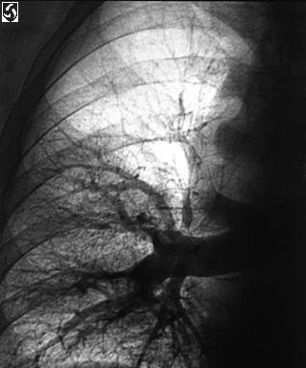
Filling defect

Slide 25
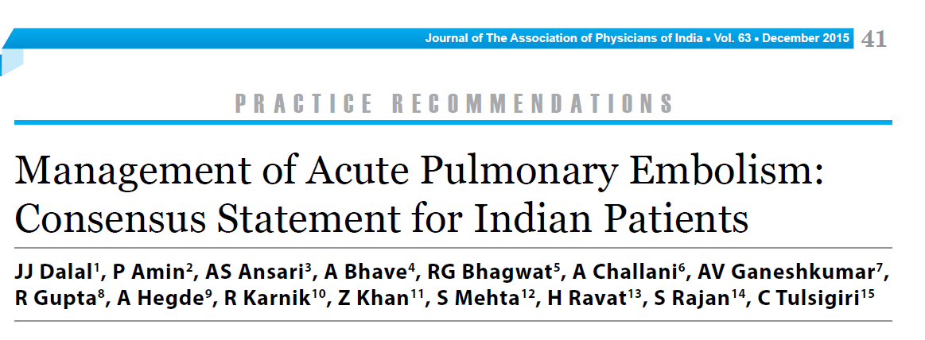
Approach Chart

Slide 26
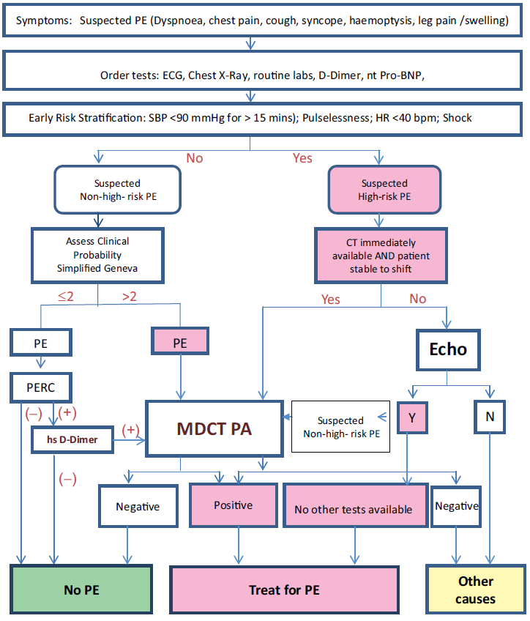

Slide 27
Treatment
Anticoagulation
Thrombolysis
Embolectomy
Vana cava Filters
Supportive care

Slide 28
Anticoagulation
There are three options
The conventional strategy of parenteral therapy “bridged” to warfarin,
Parenteral therapy “bridged” to a novel oral anticoagulant such as dabigatran
oral anticoagulation with rivaroxaban or apixaban with a loading dose followed by a maintenance dose as monotherapy without parenteral anticoagulation

Slide 29
Heparin based parenteral Anticoagulants are:
  Unfractionated Heparin
  Low molecular weight Heparin (LMWH)
  Fondaparinux

Slide 30
Unfractionated Heparin (UFH)
UFH anticoagulates by binding and accelerating the activity of antithrombin, thus preventing additional thrombus formation.
UFH is dosed to achieve a target activated partial thromboplastin time (aPTT) of 60–80 s.
The initial bolus of 80 U/kg or 5000 IU, followed by an initial infusion rate of 18 U/kg per hour or 1300 IU/ hour.
T ½= 1-2 hrs

Slide 31
Low Molecular Weight Heparin (LMWH)
Current guidelines for patients with acute PE recommend LMWH over UFH.
Have a greater bioavailability and have a longer duration of anticoagulant effect.
A fixed dose of LMWH can be used, and laboratory monitoring of aPTT is not necessary
Not used in patient of renal dysfunction
Dose:- 1 mg/kg sc 12 hourly
T ½ = 5 to 7hr

Slide 32
Fondaparinux
Fondaparinux, an anti-Xa is administered as a weight-based once-daily subcutaneous injection in a prefilled syringe.
It is synthesized in a laboratory and, unlike LMWH or UFH, is not derived from animal products.
No laboratory monitoring is required.
It does not cause heparin-induced thrombocytopenia.
The dose must be adjusted downward for patients with renal dysfunction.
Dose :- 5 mg sc once daily ( >50 kg)
7.5 mg sc once daily ( 50-100 kg)
10 mg sc once daily (>100kg)
T ½= 17-21 hrs

Slide 33
Warfarin
It is Vitamin K antagonist
Requires 5–10 days of administration to achieve effectiveness as monotherapy (UFH ,LMWH , and fondaparinux are the “bridging agents” used when initiating warfarin)
Usual start dose is 5 mg
Titrate to INR, target 2.0–3.0
Food interact with warfarin are spinach, green peas, soyabean, green tea, alcohol etc.
T ½= 68-90 hrs

Slide 34
Novel Oral Anticoagulant
Novel oral anticoagulants are administered in a fixed dose, establish effective anticoagulation within hours of ingestion, require no coagulation monitoring, and have few of the drug-drug or drug-food interactions.
Rivaroxaban (factor Xa inhibitor) = 15 mg bd
Apixaban ( factor Xa inhibitor) = 5 mg bd
Dabigatran (direct thrombin inhibitor) = 150 mg bd

Slide 35
Thrombolysis
Thrombolytic agents and dose in PE are:
Urokinase = 4400 IU/Kg bolus follwed by 4400 IU/kg/hr for 12- 24 hr
Streptokinase = 2.5 lakh IU i.v. bolus follwed by 1 lakh IU/hr infusion for 12-24 hrs
Alteplase = 10 mg bolus, 90 mg IV infusion over 2 hrs
Reteplase = 10 U I.V. bolus over 30 min
Tenecteplase = 30 to 50 mg I.V. bolus over 5 sec

Slide 36
Thrombolytic therapy should be used in patients with acute PE associated with hypotension (systolic BP< 90 mm HG) who do not have a high bleeding risk.
Contraindication are intracranial bleed recent or past, recent trauma etc.
In a meta-analysis of 16 randomized studies comparing thrombolytic therapy with anticoagulation therapy in patients with pulmonary embolism reduced mortality by 47% but was associated with a 2.7-fold increase in major bleeding.⁷

Slide 37
Embolectomy
It is one of the treatment where risk of major haemorrhage is there
Guidelines from the American Heart Association (AHA) advise that either catheter embolectomy and fragmentation or surgical embolectomy is reasonable for patients with massive pulmonary embolism who have contraindications to fibrinolysis or who remain unstable after receiving fibrinolysis.⁸

Slide 38
Vena Cava Filters
These are the Inferior Vana Caval filter placed using a percutaneous technique, biocompatible and mechanically stable, and able to trap emboli without causing occlusion of the vena cava.⁹
Indication:-
  Patients with acute venous thromboembolism who have an absolute contraindication to anticoagulant therapy (eg, recent surgery, hemorrhagic stroke, significant active or recent bleeding)
  Patients with massive PE who survived but in whom recurrent embolism invariably will be fatal

Slide 39
Supportive Management
For patients with hypotension, replete volume with 500 mL of normal saline.
Additional fluid should be infused with extreme caution because excessive fluid administration exacerbates RV wall stress,
Dopamine and dobutamine are first-line inotropic agents for treatment of PE-related shock.
Other agents that may be effective include norepinephrine, vasopressin, or phenylephrine.

Slide 40
The initial approach to Assess hemodynamic stability —
Hemodynamically unstable (“massive” PE) is that which presents with hypotension; hypotension is defined as a systolic blood pressure (BP) <90 mmHg for a period >15 minutes, hypotension requiring vasopressors.
Hemodynamically stable:- These patients are a heterogeneous group ranging from patients with small PE and stable BP (“low risk”) to patients with larger PE who have right ventricular dysfunction and borderline BP (ie, “submassive” PE/intermediate risk).

Slide 41
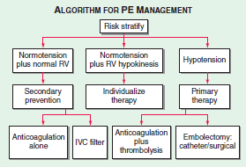

Slide 42
Hemodynamically stable — The initial approach should focus upon general supportive measures while the diagnostic evaluation is ongoing;
supportive measures include the following:
Peripheral intravenous access
Oxygen supplementation
Empiric anticoagulation depending upon the clinical suspicion for PE & risk of bleeding

Slide 43
Hemodynamically unstable —
initial support should focus upon restoring perfusion with intravenous fluid resuscitation and inotropic support
Respiratory support — Supplemental oxygen should be administered to target an oxygen saturation ≥90 percent. Severe hypoxemia, hemodynamic collapse, or respiratory failure should prompt consideration of intubation and mechanical ventilation.

Slide 44
For most patients who become hemodynamically stable following resuscitation and in whom the clinical suspicion for PE is high, we should prefer immediate anticoagulation with unfractionated heparin.
For patients with a high clinical suspicion for PE who are hemodynamically unstable and in whom transfer to radiology is considered unsafe, a portable perfusion scan can be done at some centers.

Slide 45
When portable perfusion scanning or CTPA is not available or is unsafe, we should prefer bedside echocardiography to obtain a presumptive diagnosis of PE prior to the empiric administration of thrombolytic therapy.
If bedside echocardiography is delayed or unavailable, the use of thrombolytic therapy as a life-saving measure should be individualized; if not used, the patient should receive empiric anticoagulation.

Slide 46
The decision to administer thrombolysis is strongly influenced by additional clinical factors. For example, while a patient with proven PE-induced shock who is unconscious requiring very high doses of inotrops is a candidate for immediate intravenous thrombolytic therapy, a patient who has low blood pressure for 20 minutes but who is awake, alert, and comfortable, with low oxygenation requirement might be considered for anticoagulation alone, or an interventional procedure.

Slide 47
Some Recommendations
According to American College of Chest Physicians (ACCP) guidelines¹⁰ ( 27th feb,2012)
Immediate therapeutic anticoagulation should be initiated for patients in whom PE is suspected; it reduce 20% mortality.
Starting low–molecular weight heparin (LMWH) or fondaparinux, preferred over unfractionated heparin (UFH)
If patients are to be treated with LMWH, once daily treatment is preferred to twice daily treatment

Slide 48
Patients who are considered to be low risk should be discharged early from hospital.
Warfarin initiated at the time of diagnosis, and they should have UFH, LMWH, or fondaparinux discontinued only after the international normalized ratio (INR) is 2.0 for at least 24 hours but no sooner than 5 days after warfarin therapy has been started

Slide 49
Refrences
Horlander KT, Mannino DM, Leeper KV. Pulmonary embolism mortality in the United States, 1979-1998: an analysis using multiple-cause mortality data. Arch Intern Med. 2003 Jul 28. 163(14):1711-7
Kakkar N, Vasishta RK. Pulmonary embolism in medical patients: An autopsy-based study.Clin Appl Thromb Hemost2008;14:159–67.
Reference Values During Pregnancy at perinatology.com. Retrieved October 2014
Konstantinides S. Clinical practice. Acute pulmonary embolism. N Engl J Med. 2008 Dec 25. 359(26):2804-13.
emedicine.medscape.com/article/300901-workup#c20
Remy-Jardin M, Pistolesi M, Goodman LR, Gefter WB, Gottschalk A, Mayo JR, et al. Management of suspected acute pulmonary embolism in the era of CT angiography: a statement from the Fleischner Society. Radiology. 2007 Nov. 245(2):315-29
Chatterjee S, Chakraborty A, Weinberg I, Kadakia M, Wilensky RL, Sardar P, et al. Thrombolysis for pulmonary embolism and risk of all-cause mortality, major bleeding, and intracranial hemorrhage: a meta-analysis. JAMA. 2014 Jun 18. 311(23):2414-21
Jaff MR, McMurtry MS, Archer SL, Cushman M, Goldenberg N, Goldhaber SZ, et al. Management of Massive and Submassive Pulmonary Embolism, Iliofemoral Deep Vein Thrombosis, and Chronic Thromboembolic Pulmonary Hypertension: A Scientific Statement From the American Heart Association. Circulation. 2011 Apr 26. 123(16):1788-1830.
Ballew KA, Philbrick JT, Becker DM. Vena cava filter devices. Clin Chest Med. 1995 Jun. 16(2):295-305.
Guyatt GH, Akl EA, Crowther M, Gutterman DD, Schunemann HJ for the American College of Chest Physicians Antithrombotic Therapy and Prevention of Thrombosis Panel. Executive Summary: Antithrombotic therapy and prevention of thrombosis, 9th ed: American College of Chest Physicians evidence-based clinical practice guidelines. Chest. 2012 Feb. 141(2 Suppl):7S-47S

Slide 50
Thank you

