Slide 1
Typhoid Fever
( Enteric Fever )
Investigations, Treatment, Complications

Slide 2
INVESTIGATIONS

Slide 3
NO Investigation is Diagnostic other than Positive CULTURE

Slide 4
DIFFERENT SITES
Blood culture
Stool culture
Urine culture
Bile culture
Bone marrow aspirate culture(most sensitive)
Clot culture

Slide 5
Blood cultures
In Adults 5- 10 ml of Blood is collected by venepuncture inoculated into 50 – 100 ml of Bile broth ( 0.5 % )
Several other media are available used as per the availability of medium to suit their laboratory conditions.
The yield of blood culture is quite variable

Slide 6

Blood Culture
Blood Cultures are positive in
1st week in 90%
2nd week in 75%
3rd week in 60%
4th week & later in 25%

Slide 7
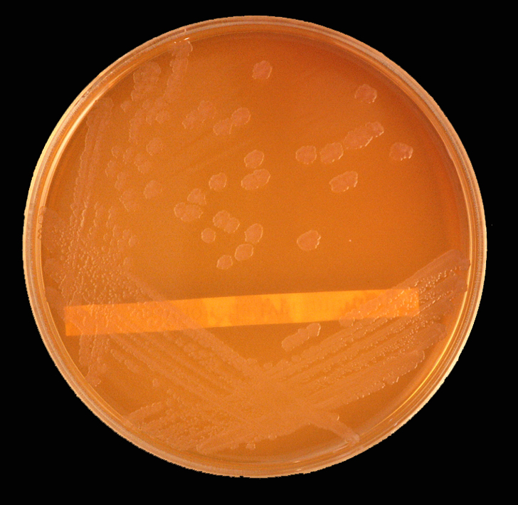
Salmonella on Mac Conkey's agar

Slide 8
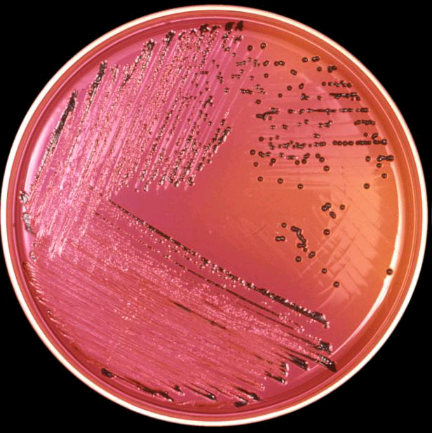
Salmonella on XLD agar

Slide 9
Bone Marrow & Other Cultures
Unlike blood culture, bone marrow culture remains highly (90%) sensitive despite 5 days of antibiotic therapy.
Culture of intestinal secretions (best obtained by a noninvasive duodenal string test) can be positive despite a negative bone marrow culture.
If blood, bone marrow, and intestinal secretions are all cultured, the yield is >90%.
Stool cultures, while negative in 60–70% of cases during the first week, can become positive during the third week of infection in untreated patients.

Slide 10
Clot culture
Clot cultures are more productive in yielding better results in isolation.
A blood after clotting, the clot is lysed with Streptokinase, but expensive to perform in developing countries.

Slide 11
HISTORY OF SERO DIAGNOSIS
In 1896, it was demonstrated that the serum from an animal immunized with the typhoid bacillus agglutinated (clumped) the typhoid bacterial cells, and it was shown that the serum of patients afflicted with typhoid likewise agglutinated the typhoid bacillus. Serodiagnosis of typhoid was thus made possible by 1896.

Slide 12

Widal Test
In 1896 Widal A professor of pathology and internal medicine at the University of Paris (1911–29), he developed a procedure for diagnosing typhoid fever based on the fact that antibodies in the blood of an infected individual cause the bacteria to bind together into clumps (the Widal reaction).

Slide 13
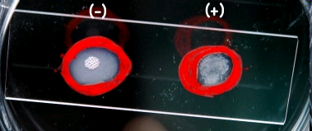
Slide agglutination tests
In slide agglutination tests a known serum and unknown culture isolate is mixed, clumping occurs within few minutes
Commercial sera are available for detection of specific O-antigen serogroups, designated A, B,C_{1,}C_{2,}D, and E.
Strains in these six serogroups cause ~99% of Salmonella infections in humans and warm-blooded animals.

Slide 14
Widal test
Serum agglutinins es abruptly during the 2nd or 3rd week
The widal test detects antibodies against O-somatic and H-flagellar antigens
Two serum specimens obtained at intervals of 7 – 10 days to read the raise of antibodies.
Serial dilutions on unknown sera are tested against the antigens for respective Salmonella
False +Ve & False -Ve limits the utility of the test
The interpretative criteria when single serum specimens are tested vary
Cross reactions limits the specificity

Slide 15

Significant Titers helps in Diagnosis
Following Titers of antibodies against the antigens are significant when single sample is tested
O > 1 in 160
H > 1 in 320
Testing a paired sample for Rising of titers carries a greater significance

Slide 16
Limitations of Widal test
Classically, a four-fold rise of antibody in paired sera Widal test is considered diagnostic of typhoid fever. However, paired sera are often difficult to obtain and specific chemotherapy has to be instituted on the basis of a single Widal test. Furthermore, in areas where fever due to infectious causes is a common occurrence the possibility exists that false positive reactions may occur as a result of non-typhoid

Slide 17
Widal test – Still a popular test
The Widal test (Widal’s agglutination reaction) is routinely practised for the serodiagnosis of typhoid fever by most of the laboratories. Several workers have expressed doubt regarding the reliability of the test.
Several factors have contributed to this uncertainty. These include poorly standardised antigens, the sharing of antigenic determinants with other Salmonellae and the effects of immunisation with TAB vaccine.
Another major problem relates to the difficulty of interpreting Widal test results in areas where Salmonella typhi is endemic and where the antibody titres of the normal population are often not known.

Slide 18
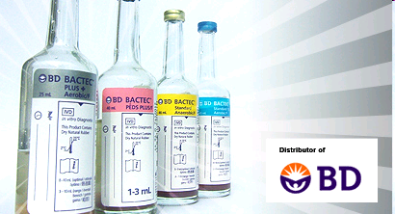
Bactek and Radiometric based methods are in recent use
Bactek methods in isolation of Salmonella is a rapid and sensitive method in early diagnosis of Enteric fever.
Many Microbiology Diagnostic Laboratories are upgrading to Bactek methods

Slide 19
In 15–25% of cases, leukopenia and neutropenia are detectable. Leukocytosis is more common among children, during the first 10 days of illness, and in cases complicated by intestinal perforation or secondary infection. Other nonspecific laboratory findings include moderately elevated liver function tests and muscle enzyme levels.

Slide 20
Diagnosis of Carriers
Useful in public health purpose.
Useful in screening food handlers, cooks, to detect carrier state
Typhoid bacilli can be isolated from feces or from bile aspirates
Detection of Vi agglutinins in the Blood can be determinant of carrier state.

Slide 21
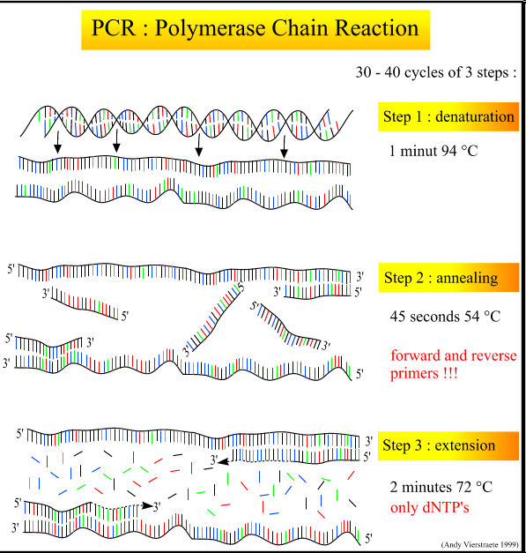
Emerging Methods in Diagnosis of Enteric fever
Detection of circulating antigen by Co - agglutination methods with use of Cowan’s strain Staphylococcus coated with antibodies
PCR. The advent of PCR technology has provided unparalleled sensitivity and specificity for the diagnosis of typhoid

Slide 22
Molecular typing methods, including pulsed-field gel electrophoresis, are used in epidemiologic investigations to differentiate Salmonella strains of a common serotype.
Polymerase chain reaction (PCR) and DNA probe assays to detect S. Typhi in blood are being developed.

Slide 23
Treatment

Slide 24
Antibiotic Therapy for Enteric Fever
Indication | Agent | Dosage (Route) | Duration, Days
Empirical Treatment
 | Ceftriaxoneª | 1–2 g/d (IV) | 7–14
 | Azithromycin | 1 g/d (PO) | 5
Fully Susceptible
 | Ciprofloxacin^{b} (first line) | 500 mg bid (PO) or 400 mg q12h (IV) | 5–7
 | Amoxicillin (second line) | 1 g tid (PO) or 2 g q6h (IV) | 14
 | Chloramphenicol | 25 mg/kg tid (PO or IV) | 14–21
 | Trimethoprim-sulfamethoxazole | 160/800 mg bid (PO) | 14
Multidrug-Resistant
 | Ciprofloxacin | 500 mg bid (PO) or 400 mg q12h (IV) | 5–7
 | Ceftriaxone | 2–3 g/d (IV) | 7–14
 | Azithromycin | 1 g/d (PO)^{c} | 5
Nalidixic Acid–Resistant
 | Ceftriaxone | 1–2 g/d (IV) | 7–14
 | Azithromycin | 1 g/d (PO) | 5
 | High-dose ciprofloxacin | 750 mg bid (PO) or 400 mg q8h (IV) | 10–14
ªOr another third-generation cephalosporin [e.g., cefotaxime, 2 g q8h (IV), or cefixime, 400 mg bid (PO)].
^{b}Or ofloxacin, 400 mg bid (PO) for 2–5 days.
^{c}Or 1 g on day 1 followed by 500 mg/d PO for 6 days.

Slide 25
Antimicrobial Therapy in Typhoid
For treatment of drug-susceptible typhoid fever, fluoroquinolones are the most effective class of agents, with cure rates of ~98% and relapse & fecal carriage rates of <2%.
With prompt antibiotic therapy, >99% of the people with typhoid fever are cured, although convalescence may last several months.
Patients with persistent vomiting, diarrhea, and/or abdominal distension should be hospitalized and given supportive therapy as well as a parenteral 3rd-generation cephalosporin or fluoroquinolone, depending on the susceptibility profile.
Therapy should be administered for at least 10 days or for 5 days after fever resolution

Slide 26
Drug resitance an Emerging concern
Previously Choramphenicol was the drug of choice for the treatment of typhoid fever. However, with the development more safer and more effective drugs the use of Choramphenicol has declined these days.
3rd generation cephalosporins, like Ceftriaxone, and Flouroquinolones, like ciprofloxacin and levofloxacin are the drugs of choice for treatment of typhoid fever .
Once again many strains are sensitive to Choramphenicol

Slide 27
Treatement of carriers
The 1–5% of patients who develop chronic carriage of Salmonella can be treated for 4–6 weeks with an appropriate oral antibiotic. Treatment with oral amoxicillin, trimethoprim-sulfamethoxazole (TMP-SMX), ciprofloxacin, or norfloxacin is ~80% effective in eradicating chronic carriage of susceptible organisms.
However, in cases of anatomic abnormality (e.g., biliary or kidney stones), eradication often requires both antibiotic therapy and surgical correction.

Slide 28
Vaccines for Typhoid Prevention
Two types of vaccines are available
Oral and Injectable
Oral – A live oral vaccine ( typhoral ) is a stable mutant of S.typhi strain Ty 21a lacking the enzyme UDP Galactose -4-epimerase.
One capsule given orally taken before food, with glass of water or milk, on 1, 3, 5 days ( three doses )
No antibiotics should be taken during the period of administration of vaccine

Slide 29
Vaccine - injectable
The injectable vaccine, ( typhim –vi) contains purified Vi polysaccharide antigen derived from S.typhi strain ty21
Given as single subcutaneous or intramuscular injection
Single dose is adequate.
Booster dose to be take after 3 years.

Slide 30
Vaccines for Typhoid
Both vaccines are given to only > 5 years of age.
Immunity lasts for 3 years
Need a booster

Slide 31

Simple hand hygiene and washing can reduce several cases of Typhoid

Slide 32
Complications

Slide 33
Complication in Typhoid
Severe Gastrointestinal bleeding (10–20%) and intestinal perforation (1–3%) - most common in the third and fourth weeks of illness and result from hyperplasia, ulceration, and necrosis of the ileocecal Peyer's patches at the initial site of Salmonella infiltration.
If not diagnosed can lead to fatal complications.
Neurologic manifestations occur in 2–40% of patients and include meningitis, Guillain-Barré syndrome, neuritis, and neuropsychiatric symptoms (described as "muttering delirium" or "coma vigil"), with picking at bedclothes or imaginary objects.

Slide 34
Rare Complication in Typhoid
Incidences are reduced by prompt antibiotic treatment
Pericarditis,
Myocarditis,
Orchitis,
Hepatitis,
Glomerulonephritis,
Pyelonephritis and
Hemolytic uremic syndrome,
Severe Pneumonia, Arthritis,
Osteomyelitis, and Parotitis.
Disseminated Intravascular Coagulation,
Hematophagocytic syndrome,
Pancreatitis,
Hepatic And Splenic abscesses
Granulomas,
Endocarditis,

Slide 35
Relapse
Apparent recovery can be followed by relapse in 5 – 10 % of untreated patients within 2–3 weeks of fever resolution and in association with the same strain type and susceptibility profile.
On few occasions relapses can be severe and may be fatal.

Slide 36
Typhoid carriers
One in thirty of the survivors, however, become carriers.
In carriers the bacteria remain hidden inside the gall bladder, causing new infections as they are shed from an apparently healthy host.

Slide 37
Academic progress on carrier state in Typhoid
The factors that enable the bacteria to establish chronic infection were unclear. However, in a paper published this week in the Proceedings of the National Academy of Science, researchers at the Institute of Food Research in Norwich and the Karolinska Institute in Sweden found that the change of a single base pair in one Salmonella gene can determine whether the bacteria cause short-term illness or a long-term carrier state.

Slide 38
FAMOUS VICTIMS
Dr. Hashimoto Hakaru M.D., discoverer Of Autoimmune Thyroiditis Hashimoto's thyroiditis. Died on January 9th, 1934 of Typhoid fever.
Mary Mallon, more commonly known as Typhoid Mary, survived/carrier
Abigail Adams, second First Lady of the United States, wife of John Adams, died of typhoid fever on October 28th, 1818.
Charles Darwin, naturalist, during his visit to Chile with HMS Beagle in 1835
Leland Stanford Jr. died of typhoid in 1884; his parents founded Stanford University in his memory.
William Wallace Lincoln, third son of Abraham Lincoln, the 16th President of the United States, died February 20th, 1862 of typhoid fever.
Mary Todd Lincoln, wife of Abraham Lincoln.
Wilbur Wright, one of the famous Wright Brothers. Died May 30, 1912 of typhoid fever.
Stephen Douglas, politician and 1860 Presidential Runner-Up
Dr HJH 'Tup' Scott, captain of the 1886 Australian cricket team that toured England, died of typhoid in 1910.^{[25]}

Slide 39
Thank You

