Slide 1
DEMENTIA
Skill development for identifying problems
and their management
By: Dr NISHEET PATEL
DEPARTMENT OF PSYCHIATRY

Slide 2
NEUROCOGNITIVE DISORDERS
Definition: Disorders in which impaired cognition has not been present since birth or very early life.
Underlying pathology, and frequently the etiology as well, can potentially be deter­mined.
Appeared in DSM-5 for the first time.
Major & minor neurocognitive dis­orders
"Dementia,Delirium, Amnestic, and Other Cognitive Disorders“ in DSM-IV.

Slide 3
Memory Loss
Memory loss :Part of the normal aging process and usually involves a decreased ability to retrieve information.
Does not impact activities of daily living.

Slide 4
Mild Cognitive Impairment
Mild Cognitive Impairment: syndrome of cognitive decline greater than expected for an individual’s age and education level that does not interfere notably with activities of daily living.
Puts people at higher risk to progress to dementia.

Slide 5
Dementia
Dementia is a disorder characterized
problems with memory and at least one other cognitive function (learning, reasoning, language, spatial ability and orientation, and handling complex tasks) that are severe enough to interfere with activities of daily living.
Dementia may have different etiologies

Slide 6
Why Dementia?
Prevalence: 3-11% in age ≤ 65 yrs ; 25-40% in age ≥ 85 yrs.
High financial cost of care
High burden of care on community.
Many remain undiagnosed and untreated.

Slide 7
Advantage : early diagnosis
Which diagnosis is preferred?
Definite diagnosis
Probable diagnosis
Possible diagnosis
Dementia remains underdiagnosed; an estimated 50% of primary care patients aged older than 65 years remain undiagnosed .

Slide 8
Advantage : early diagnosis
Disease stabilization and delayed progression of cognitive , functional and behavioral symptoms.
Many etiological factors are reversible.
Allows both the patient and family to participate in their care plan and to prepare better for future challenges
Early treatment provides economic beneﬁts both to the patient and caregiver as well as society as a whole.

Slide 9


Slide 10
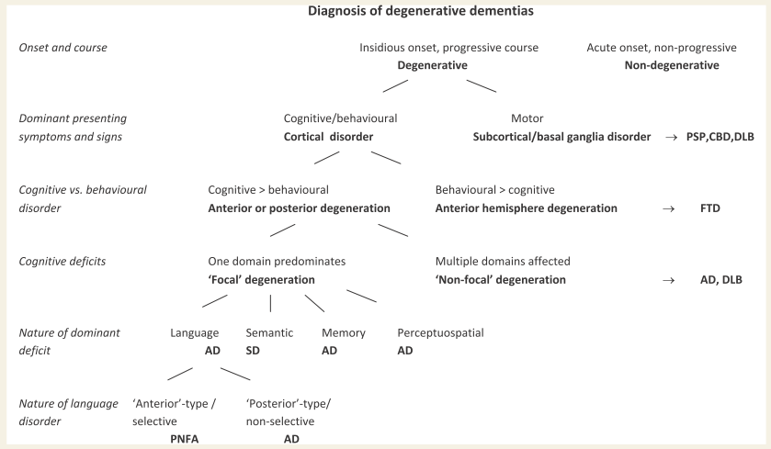
Snowden et al, Brain 2011; doi:10.1093/brain/awr189

Slide 11
Clinical approach to diagnosis
Prediagnostic evaluation
A careful history for each differential diagnosis
Enlist risk factors
Look for reversible causes and comorbid illnesses

Slide 12
Cognitive assessment
For screening and monitoring purpose.
MMSE
Mini-Cog
MoCA
ADS

Slide 13
Functional assessment
Independence /disability
Assessment of ADL and IADL

Slide 14
BPSD Symptom Clusters
Aggression
Agitation
Physical aggression
Verbal Aggression
Aggressive resistance
to care
Pacing
Repetitive actions
Dressing/undressing
Restless/anxious
Apathy
Withdrawn
Lacks interest
Amotivation
Euphoria
Pressured speech
Irritable
Hallucinations
Delusions
Misidentification
Suspicious
Sad
Tearful
Hopeless
Guilty
Anxious
Irritable/screaming
Suicidal
Mania
Psychosis
Depression
Cummings,1998

Slide 15
Role of caregiveres
Identify the primary caregiver
Assess adequacy of family and other support system
Cultural language and literacy considerations

Slide 16
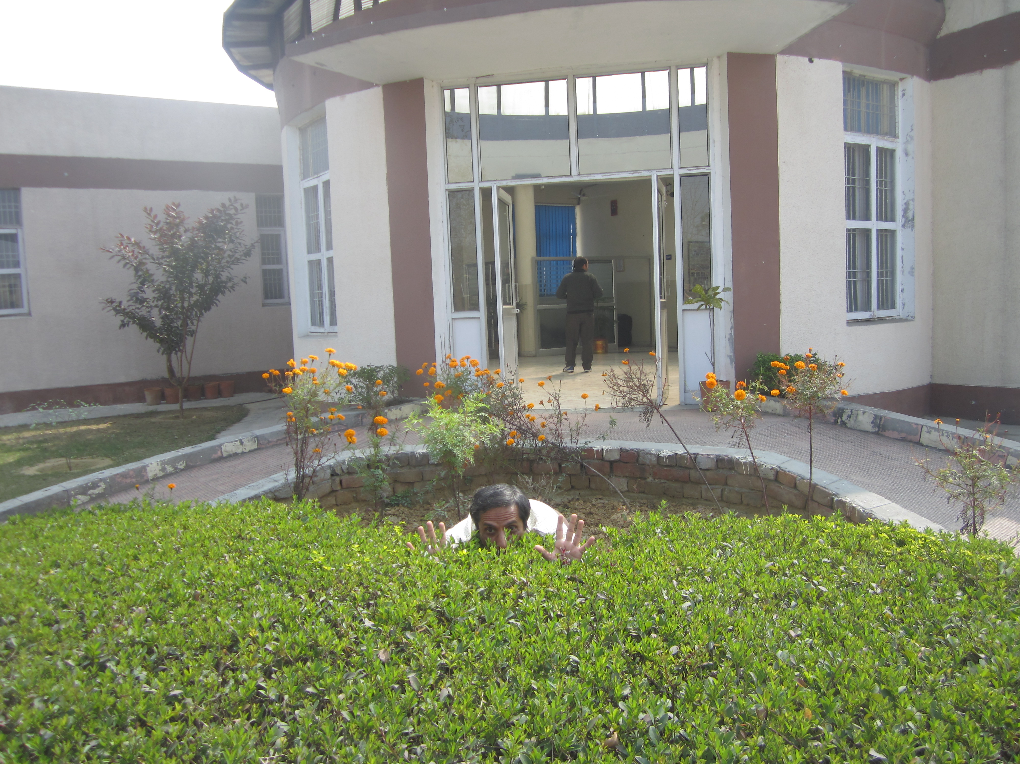

Slide 17
Commonly asked questions-1
What it is due to ? Is it hereditary…..

Slide 18
Commonly asked questions-2
Is this condition reversible?

Slide 19
Commonly asked questions-3
How medicines can help? Can the patient recover?

Slide 20
Commonly asked questions-4
Do I need to consult any other specialist? How would they help?

Slide 21
Commonly asked questions-5
What tests /X-rays are needed?How would these help?

Slide 22
Commonly asked questions-6
Is there any long term care facility available?

Slide 23


Slide 24
Warning Signs for Alzheimer’s Disease
● Memory loss
● Difﬁculty performing familiar tasks
● Problems with language
● Disorientation to time and place
● Poor or decreased judgment
● Problems with abstract thought
● Misplacing things
● Changes in mood or behavior
● Changes in personality
● Loss of initiative

Slide 25
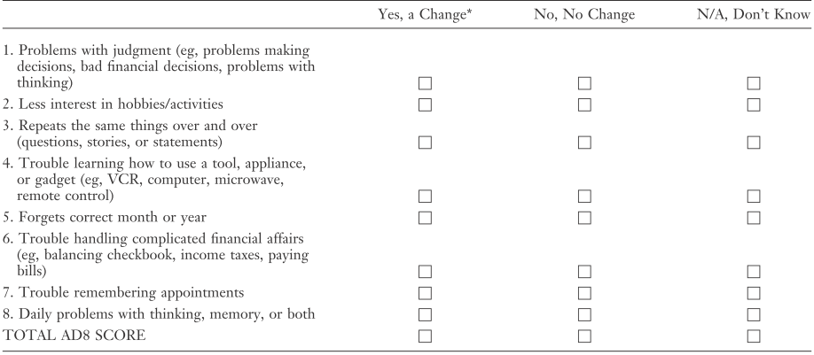
AD8 Dementia Screening Interview

