Slide 1
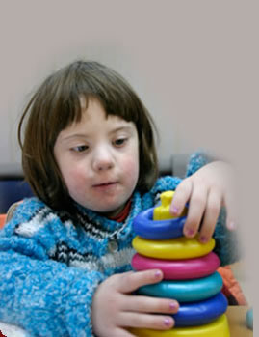
Intellectual Disability
By: Dr Nisheet Patel
Department of Psychiatry

Slide 2
Formerly known as mental retardation
The American Association on Intellectual and Developmental Disability (AAIDD) defines intellectual disability as a disability characterized by significant limitations in both intellectual functioning (reasoning, learning, and problem solving) and in adaptive behavior (conceptual, social, and practical skills) that emerges before the age of 18 years.

Slide 3
DSM-5 Criteria
Significant sub average general intellectual functioning.
Concurrent impairment in adaptive behavior.
Manifested before age of 18.
Diagnosis is made independent of coexisting physical or mental disorders.

Slide 4
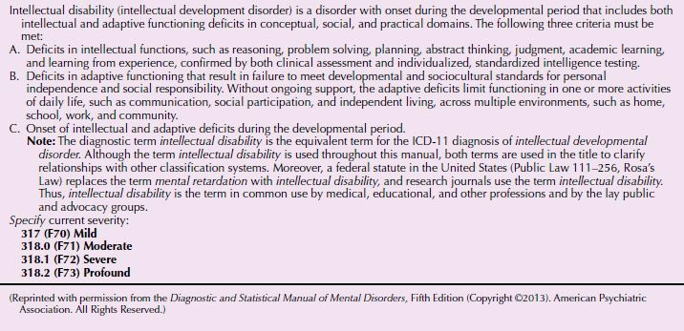
DSM-5 Diagnostic Criteria for Intellectual Disability

Slide 5
Classification
Based on Intelligence assessment:
IQ below 70 or 2 SD below mean for particular standardized test like:
SFB
Bhatia’s Battery
Draw a man Test

Slide 6
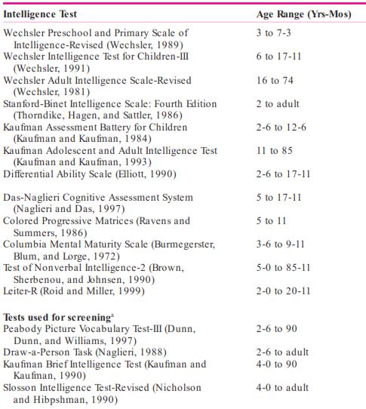

Slide 7
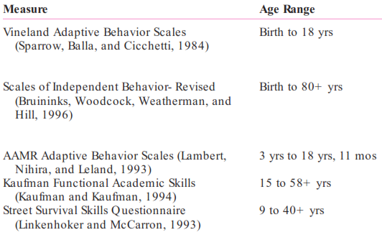
Common Adaptive Behavior Measures

Slide 8
Degrees of Severity
Mild:
85% of ID persons. IQ from 50 to 70.
Late identification in school.
Academics up to 6th std or high school.
Achieve social and vocational skills for self support.
Need guidance under unusual social/economic stress.
No specific cause identified generally.

Slide 9
Moderate:
10% of persons with ID.
IQ from 35 to 50.
Can learn to communicate adequately, poor social awareness.
Fair motor development
Academics up to 2nd or 3rd std.
Unskilled or semiskilled work under supervision.

Slide 10
Severe:
4% of individuals with ID.
IQ from 20 to 35.
Poor motor development, minimal speech.
Can learn to count and recognize words.
Cause is more likely to be identified.
Contribute partially to self maintenance.

Slide 11
Profound:
1 to 2% of individuals with ID.
IQ below 20.
Specific cause known in most individuals.
Gross disability, need nursing care.
Can learn to communicate their needs.
May achieve very limited self care.

Slide 12
Unspecified Intellectual Disability
Over age 5
Difficult to evaluate but are strongly suspected to have ID.
Sensory or physical impairment viz blindness, deafness or mental disorder,
that makes administration of tests difficult.

Slide 13
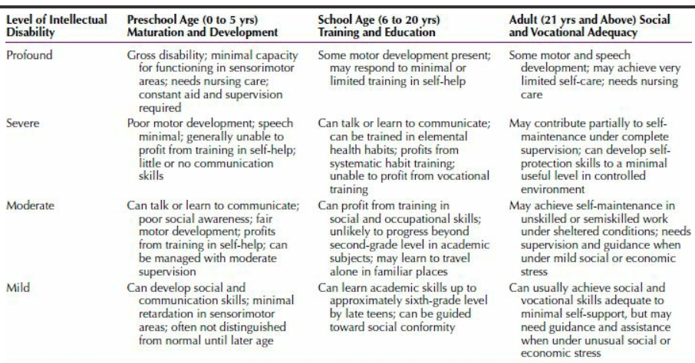
Developmental Characteristics

Slide 14
Epidemiology
Prevalence- 1% to 3%.
Highest incidence: school-age children with the peak at the ages 10 to 14 years.
1.5 times more common among men than among women.

Slide 15
COMORBIDITY
40.7 percent of intellectually disabled children between 4 and 18 years of age met criteria for at least one psychiatric disorder.
The severity of disability affected the type of psychiatric disorder.
Disruptive and conduct disorder more prevalent in mild ID.
Autism spectrum, self mutilation more frequent in severe ID.

Slide 16
2-3 % meet diagnostic criteria for schizophrenia.
50 % meet criteria for mood disorders when standard instruments are used.
But these are not standardized for ID population.
Psychiatric symptoms not amounting to a full psychiatric disorder include hyperactivity, short attention span, self injurious behaviors (head banging, biting) repetitive stereotypical behaviors.
Negative self image, low self esteem, poor frustration tolerance, dependence, rigid problem solving styles, more common in mild ID.

Slide 17
Seizure disorders occur more frequently.
Prevalence rates increase proportionally to severity level of ID.
1/3rd of children and adolescent with coexisting ID and epilepsy had autism spectrum disorder.
0.07 % of general population is estimated to have combination of intellectual disability; epilepsy and autism spectrum disorder.

Slide 18
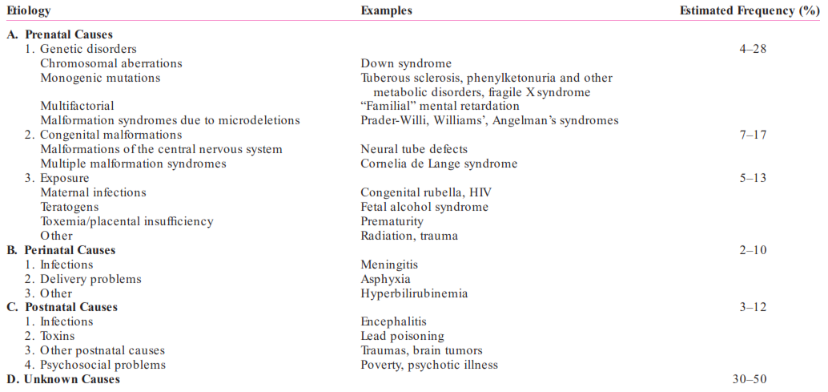
Etiology

Slide 19
Overall, in up to two thirds of all ID persons, the probable cause can be identified.
Among chromosomal and metabolic disorders, Down syndrome, fragile X syndrome, and phenylketonuria (PKU) are the most common disorders that usually produce at least moderate ID.
Those with mild ID sometimes have a familial pattern apparent in parents and siblings.
Deprivation of nutrition, nurturance, and social stimulation can contribute to the development of ID.
Genetic, environmental, biological, and psychosocial factors work additively.

Slide 20
Down Syndrome (trisomy 21)
Down syndrome has been the most investigated, and most discussed syndrome in ID.
Children with this syndrome were originally called mongoloid because of their physical characteristics of slanted eyes, epicanthal folds, and flat nose.
Despite a plethora of theories and hypotheses advanced in the past 100 years, the cause of Down syndrome is still unknown.

Slide 21
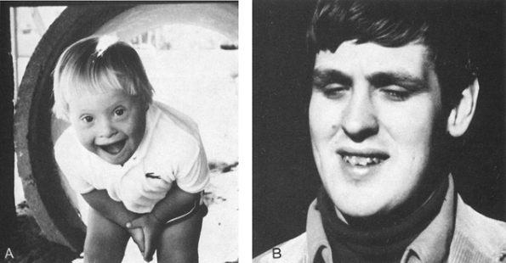
A. Young child with Down syndrome.
B. Young adult with fragile X syndrome.

Slide 22
Fragile X Syndrome
Fragile X syndrome is the second most common single cause of ID.
The syndrome results from a mutation on the X chromosome at what is known as the fragile site (Xq27.3).
The typical phenotype includes a large, long head and ears, short stature, hyperextensible joints, and postpubertal macroorchidism.
Intellectual disability ranges from mild to severe.

Slide 23
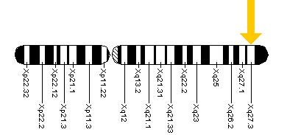
_{Martin-Bell syndrome}
Fragile X syndrome occurs in about 1 of every 1,000 males and 1 of every 2,000 females.

Slide 24
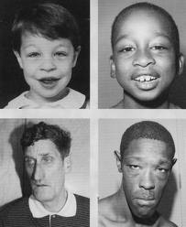
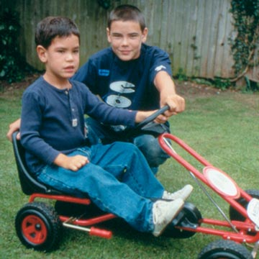
Fragile X Syndrome

Slide 25
Prader-Willi Syndrome
Result from a small deletion involving chromosome 15, occurring sporadically.
Prevalence is less than 1 of 10,000.
Pt. Exhibit compulsive eating behavior and often obesity, Intellectual Disability, hypogonadism, small stature, hypotonia, and small hands and feet.
Children with PWS often have oppositional and defiant behavior.

Slide 26
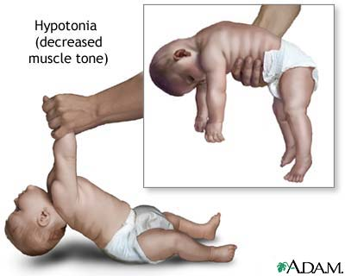
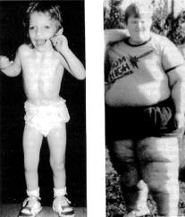
Prader-Willi Syndrome

Slide 27
Cat's Cry (Cri-du-Chat) Syndrome
Children with cat's cry syndrome lack part of chromosome 5.
They are severely disabled and show microcephaly, low-set ears, oblique palpebral fissures, hypertelorism.
The characteristic cat-like cry is caused by laryngeal abnormalities, gradually changes and disappears with increasing age.

Slide 28
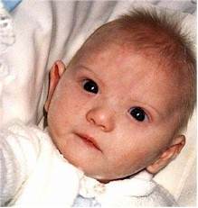
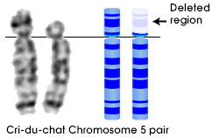
Cri-du-Chat Syndrome

Slide 29

Cri-du-Chat Syndrome

Slide 30
Phenylketonuria
PKU was first described by Ivar Asbjörn Fölling in 1934 as the paradigmatic inborn error of metabolism. PKU is transmitted as a simple recessive autosomal mendelian trait and occurs in about 1 of every 10,000 to 15,000 live births.
The basic metabolic defect in PKU is an inability to convert phenylalanine, an essential amino acid, to paratyrosine because of the absence or inactivity of the liver enzyme phenylalanine hydroxylase, which catalyzes the conversion.

Slide 31
Phenylketonuria
Most patients with PKU are severely disabled, but some are reported to have borderline or normal intelligence. Eczema, vomiting, and convulsions occur in about a third of all patients.
They frequently have temper tantrums and often display bizarre movements of their bodies and upper extremities, including twisting hand mannerisms; their behavior sometimes resembles that of children with autism or schizophrenia.

Slide 32
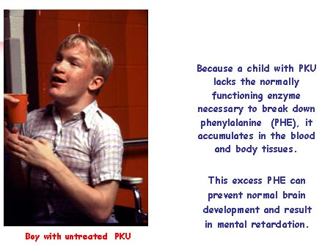

Slide 33
Rett's Disorder
Rett's disorder is hypothesized to be an X-linked dominant syndrome that is degenerative and affects only females.
Now diagnosed as form of autism spectrum disorder.
Deterioration in communications skills, motor behavior, and social functioning starts at about 1 year of age. Autistic-like symptoms are common, as are ataxia, facial grimacing, teeth-grinding, and loss of speech.

Slide 34
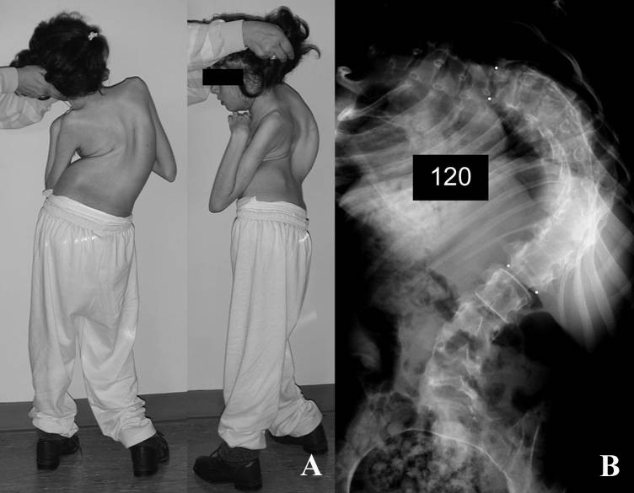
Rett's Disorder

Slide 35
Neurofibromatosis
Also called von Recklinghausen's disease.
Caused by a single dominant gene, which may be inherited or be a new mutation.
Occurs in about 1 of 5,000 births.
Characterized by cafe au lait spots on the skin and by neurofibromas, including optic gliomas and acoustic neuromas, caused by abnormal cell migration.
Mild intellectual disability occurs in up to one third of those with the disease.

Slide 36
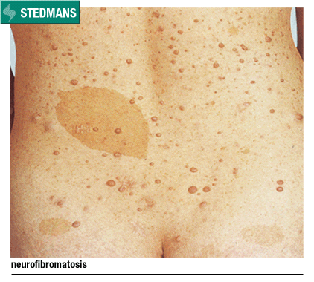

Slide 37
Tuberous Sclerosis
Tuberous sclerosis is the second most common of the neurocutaneous syndromes; a progressive intellectual disability occurs in up to 2/3rd of all affected persons.
It occurs in about 1 of 15,000 persons and is inherited by autosomal dominant transmission.
Seizures occur in all those with ID.

Slide 38
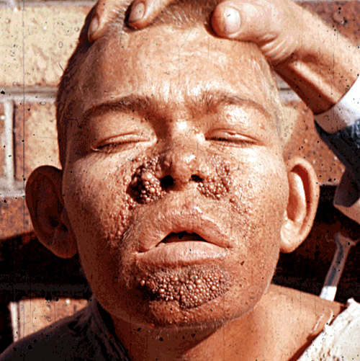
Tuberous Sclerosis

Slide 39
Lesch-Nyhan Syndrome
Lesch-Nyhan syndrome is a rare disorder caused by a deficiency of an enzyme involved in purine metabolism.
The disorder is X-linked; patients have Intellectual Disability, microcephaly, seizures, choreoathetosis, and spasticity.
Compulsive self mutilation by biting the mouth and tongue.

Slide 40
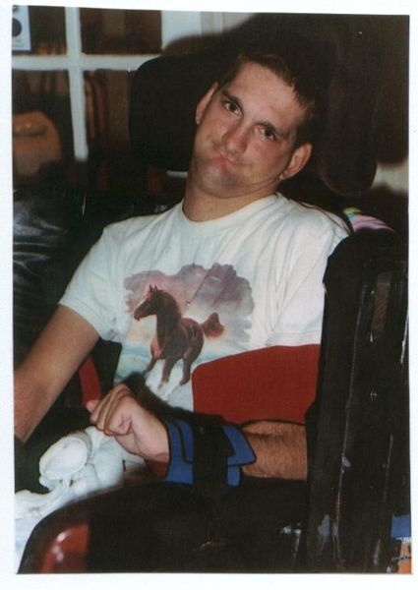
Lesch-Nyhan Syndrome

Slide 41
Adrenoleukodystrophy
Characterized by diffuse demyelination of the cerebral white matter resulting in visual and intellectual impairment, seizures, spasticity, and progression to death.
The disorder is transmitted by a sex-linked gene located on the distal end of the long arm of the X chromosome.
The clinical onset is generally between 5 and 8 years of age, with early seizures, disturbances in gait, and mild intellectual impairment.

Slide 42
Maple Syrup Urine Disease
An inborn error of metabolism caused by defective oxidative decarboxylation of )-keto acids of leucine, isoleucine, and valine.
These branched-chain amino acids are present in the blood and urine in high concentrations.
Manifestations of disease include feeding difficulties, physical and intellectual disability (severe), and a urine odor similar to that of maple syrup; neonatal death is common.

Slide 43
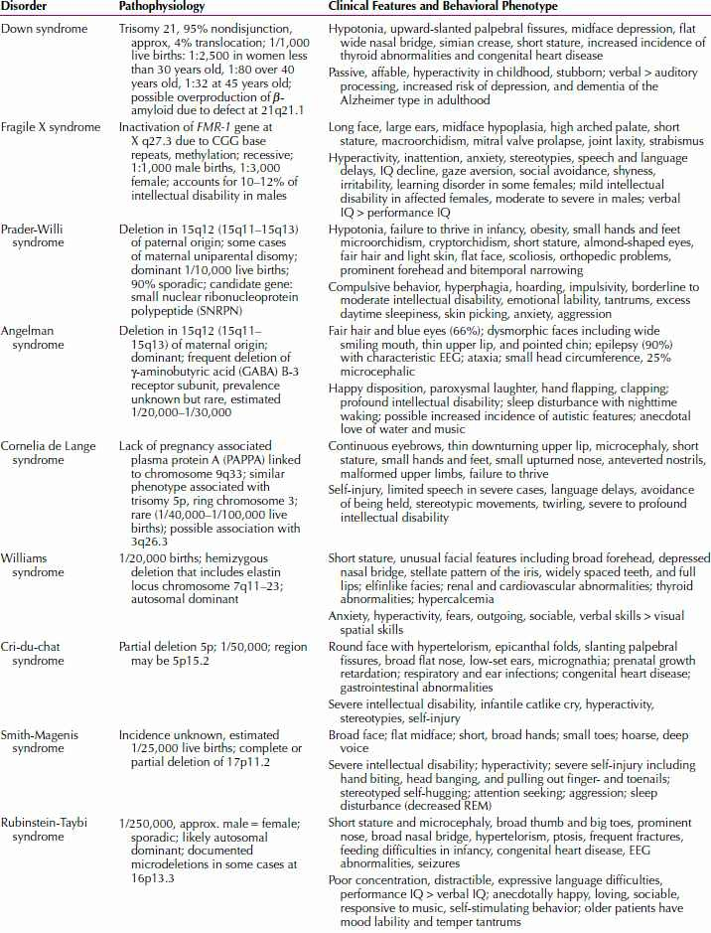

Slide 44
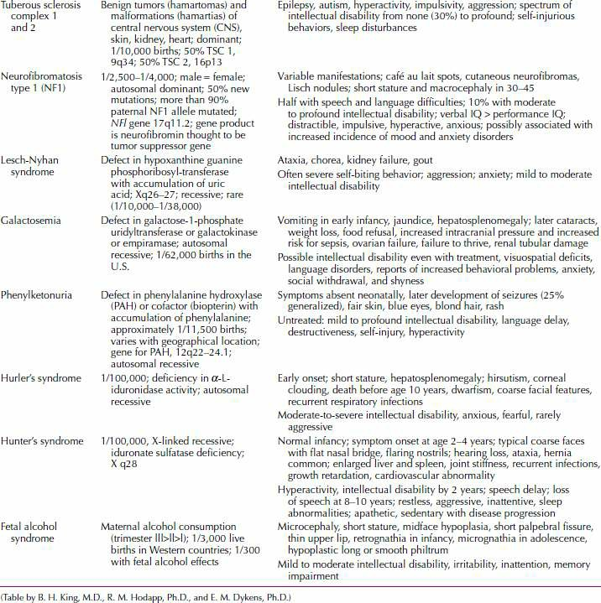

Slide 45
Diagnosis
History
Structured Assessment
Physical Examination
Neurological Examination
Laboratory Investigation

Slide 46
History
Obtained from parents or caretaker.
Attention to mother’s pregnancy, labor, delivery.
Family History of ID.
Consanguinity.
Known familial hereditary disorders.

Slide 47
Psychiatric Interview
Two factors are of importance:
1) the interviewer's attitude.
2) manner of communicating.
A mildly retarded adult with a mental age of 10 is not a 10-year-old child.
When addressed as if they were children, some retarded persons become justifiably insulted, angry, and uncooperative.

Slide 48
Emphasis on:
How patient coped with stages of development.
Frustration tolerance, impulse control over aggressive or sexual behavior.
Co-morbidities viz. Seizure, Behavior disturbances, ADHD, Depression, adjustment issues.

Slide 49
Physical Examination
Configuration and size of the head offer clues to a variety of conditions, such as microcephaly, hydrocephalus, or Down syndrome.
Patient's face may have some signs of particular syndromes that greatly facilitate the diagnosis, such as hypertelorism, a flat nasal bridge, prominent eyebrows, epicanthal folds, corneal opacities, retinal changes.

Slide 50
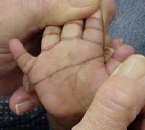
Dermatoglyphics
Occur in chromosomal disorders, prenatal rubella infection.
Shows uncommon ridge patterns and flexion creases.

Slide 51
Neurological Examination
Sensory Impairment
Hearing impairment occur in 10% cases. (4 times higher than normal population)
Visual disturbances
Seizures
Abnormal muscle tone, involuntary movements.
Clumsiness or poor coordination common in Mild ID.

Slide 52
Laboratory Examination
Chromosomal Studies:
Amniocentesis- 15weeks.
Chorionic Villi Sampling (CVS) – 8 to 10 weeks.
MaterniT21 (21,18,13,X & Y)

Slide 53
Urine and Blood Analysis for Lesch-Nyhan, PKU, galactosemia, Hurler’s and Hunter’s.
EEG for seizure disorder.
  Nonspecific changes characterized by slow frequencies with burst of spikes and sharp or blunt wave complexes.
  Do not elucidate specific diagnosis.

Slide 54
Neuroimaging :
Biological mechanisms contributing to intellectual disability.
MRI can show abnormalities in the brain such as myelination patterns.
Baseline for potentially degenerative process.

Slide 55
Hearing and Speech Evaluation
More common in ID.
Hearing impairments can simulate ID.
Difficult to assess as co-operation is required.
Unreliable in in severely disabled persons.

Slide 56
Treatment
Primary Prevention
  Screening for PKU
  Socio-economic improvement to reduce malnutrition, prematurity and perinatal factors.
  Education to lay public, avoid alcohol,.
  Good perinatal medical care and reduce diseases of pregnancy.
  Immunization
  Genetic counseling in at-risk parents (PKU, Down’s)

Slide 57
Secondary and Tertiary Prevention:
  should be treated to shorten the course of the illness.
  to minimize the sequelae or consequent disabilities.
  Hereditary metabolic and endocrine disorders, such as PKU and hypothyroidism, can be treated effectively in an early stage.

Slide 58
Education for the Child.
  Academics and adaptive training, social and vocational skills
Behavioral, Cognitive, and Psychodynamic Therapies.
  Enhance social behavior
  Control and minimize aggressive and destructive behavior.
  Dispel false beliefs.
  Decrease conflict.

Slide 59
Family Education.
  Manage expectations, Special training, self-help groups.
Social Intervention.
  Enhance social interactions, friendships and general self esteem.
  Special Olympics since 1968.

Slide 60
Psycho-pharmacological Interventions
Aggression and self injurious behavior
  Antipsychotics
  Greater risk for tardive dyskinesia
  Risperidone and clozapine found to be safer and well tolerated.
  Improvement in cognitive ability is also reported with risperidone.

Slide 61
ADHD
  Psychostimulants: ID more prone to side effects so close monitoring is required.
  Methylphenidate: improved ability to maintain attention and stay focused on task.
  Risperidone: Also efficacious but may increase prolactin levels.
  Amphitamines, clonidine, Atomoxetine also used in ID for ADHD

Slide 62
Depressive Disorders
  May be overlooked due to prominent behavioral problems.
  Relative safety of SSRIs (fluoxetine, paroxetine, sertraline) trial is advocated.
  Disinhibition in response to SSRIs in ID with ASD is reported.

Slide 63
Stereotypical Motor Movements:
  Antipsychotics are used.
  Obsessive-compulsive symptoms often overlap in ID especially with co-morbid ASD.
  SSRIs are also shown to be efficacious.

Slide 64
Explosive Rage Behavior:
  Antipsychotics particularly Risperidone have shown to be efficacious.
  Beta- blockers like propranolol have also been tried with little success.

Slide 65
Thank You

