Slide 1
HIATAL HERNIA

Slide 2
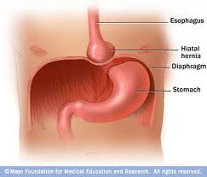
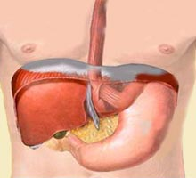
DEFINATION
Hiatal hernia is the protrusion of the stomach upward into the mediastinal cavity through the esophageal hiatus of the diaphragm.
Normally, a portion of the esophagus and all or part of the stomach are situated in the abdominal cavity.
Normal Anatomy Hiatal Hernia

Slide 3
Risk factors for Sliding Hiatal Hernia
Age
Increased intra-abdominal pressure (e.g. Obesity, pregnancy, coughing, heavy lifting).
Smoking
Notes:
Worse when patient supine/leaning
Lump or feeling that food is stuck beneath the xiphoid
Late symptoms of dysphagia and vomitting may suggest stricture

Slide 4
Pathpysiology
Normally, the esophagus passes down through the chest, crosses the diaphragm, and enters the abdomen through a hole in the diaphragm called the esophageal hiatus. Just below the diaphragm, the esophagus joins the stomach.
In individuals with hiatal hernias, the opening of the esophageal hiatus (hiatal opening) is larger than normal, and a portion of the upper stomach slips up or passes through the hiatus and enter into the chest.

Slide 5
PATHOPHYSIOLOGY
Tear of Phrenoesophageal ligament :
is a fibrous layer of connective tissue and maintains the LES within the abdominal cavity
A hiatal hernia compromises reflux barrier
  Reduced LES pressure
  Reduced esophageal acid clearance
  Transient LES relaxation episodes particularly at night time
Notes:
The phrenoesophageal ligament is formed by fusion by endothoracic and endoabdominal fascia at the esophageal hiatus

Slide 6
Types of Hiatal Hernia
1. Sliding hiatal hernia:
Herniation of both the stomach and the gastroesophageal(GE) junction into the thorax.
90% of esophageal hernias
2. Paraesophageal hiatal hernia:
Herniation of all or part of the stomach through the esophageal hiatus into the thorax with an undisplaced GE junction
Least common esophageal hernia (<10%)
3: combines sliding and para esophageal…very rare

Slide 7
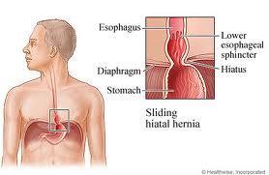
Sliding hiatal hernia:
The sliding type, as its name implies, occurs when the junction between the stomach and esophagus slides up through the esophageal hiatus during moments of increased pressure in the abdominal cavity.
When the pressure is relieved, the stomach falls back down with gravity to its normal position.
Approximately 90% of all hiatal hernias are the sliding type.

Slide 8
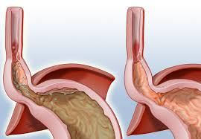
Sliding hernia

Slide 9
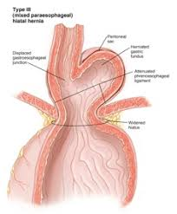
Combined sliding and paraesophageal

Slide 10
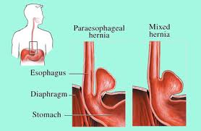
Paraesophageal hiatal hernia
  Paraesophageal hiatal hernia:
  In paraesophageal hiatal there is no sliding up and down. A portion of the stomach remains stuck in the chest cavity.
  These hernias remain in the chest at all times.
  This type is less common.

Slide 11
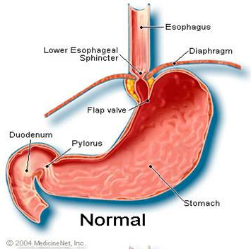
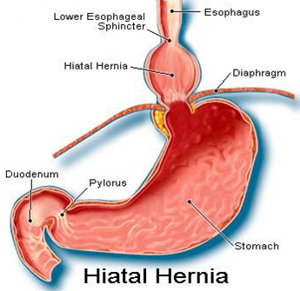

Slide 12
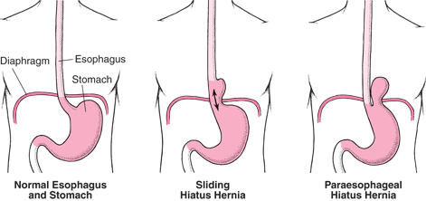

Slide 13
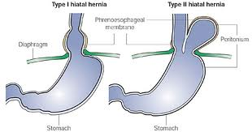

Slide 14
Clinical Manifestation
The patient with sliding hernia may have,
Heart burn
Regurgitation of contents of stomach and
Dysphagia but at least 50% are Asymptomatic.
The patient with paraoesophageal hernia usually feels a sense of fullness after eating or may be asymptomatic.

Slide 15
Complications of Sliding Hiatal Hernia
Most common complication is GERD.
Other complications are rare and are related to reflux
  Esophagitis (dysphagia, heartburn)
  Consequences of esophagitis ( peptic stricture, Barrett’s esophagus, esophageal carcinoma)
  Extra-esophageal complications ( pneumonitis/ pneumonia, asthma, cough, laryngitis)
  bleeding

Slide 16
Investigations for Sliding Hiatal Hernia
Chest X-ray
Barium swallow
Endoscopy
Esophageal manometry (to measure the pressure of LES)
24-48h esophageal pH monitoring to quantify reflux
Gastroscopy with biopsy to rule out cancer and esophagitis

Slide 17
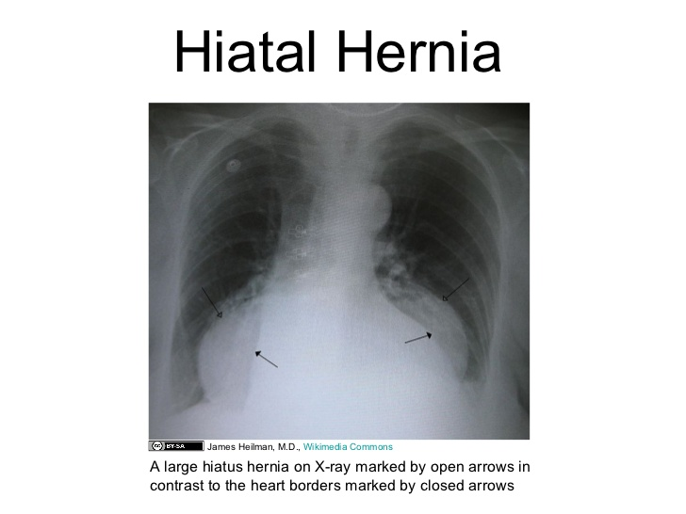

Slide 18
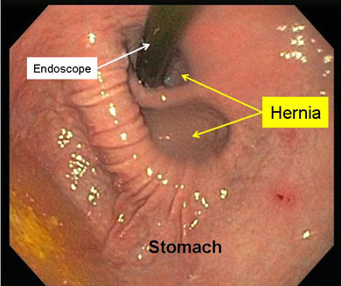
Endoscopic view:

Slide 19
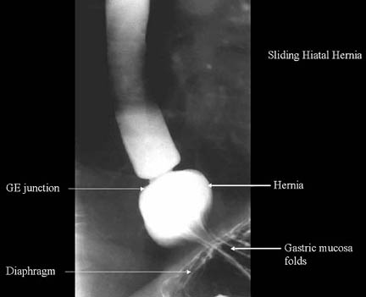
Barium swallow demonstrates hiatal hernia:

Slide 20
Treatment of Sliding Hiatal Hernia
LIFESTYLE MODIFICATION
  Stop smoking,
  weight loss,
  elevate head of bed,
  no meals <3h prior to sleeping,
  smaller and more frequent meals,
  avoid too much alcohol, coffee, mint and fat.

Slide 21
MEDICAL THERAPY
  Antacids
  H2 receptor blockers like ranitidine
  Proton pump inhibitors e.g. Omeprazole
  Pro kinetic agents e.g. Metoclopramide

Slide 22
SURGICAL THERAPY
Indications:
  Failure of medical therapy or complications loke…..
  Esophageal stricture
  Severe nocturnal aspiration
  Barrett’s esophagus

Slide 23
Anti-reflux procedure e.g Fundoplication
  A laparoscopic procedure in which the fundus of the stomach is wrapped around lower end of esophagus. The types of fundoplication include:
  The Nissen fundoplication is total (360°),
  Partial fundoplication known as Thal (270° anterior),
  Belsey (270° anterior transthoracic)
  Dor (anterior 180-200°)
  Lind (300° posterior)
  Toupet fundoplication (posterior 270°) are alternative procedures with somewhat different indications and outcomes.

Slide 24
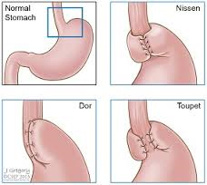

Slide 25
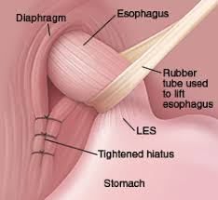
Narrowing of the oesophageal hiatus

Slide 26
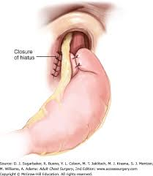
Narrowing the oesophageal opening and Nissan fundoplication

Slide 27
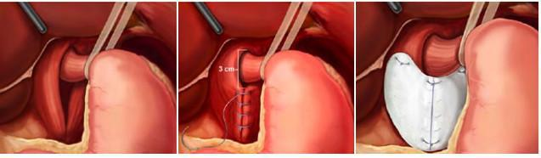
Narrowing G.E. Jn. With mesh plasty

Slide 28
Risk factors for Paraesophageal Hiatal Hernia
Age
Increased intra-abdominal pressure
Women > Men
Fiber-depleted diet
Chronic esophagitis
Notes:
Muscle weakening and loss of elasticity as people age is thought to predispose to hiatus hernia,
Conditions such as chronic esophagitis may cause shortening of the esophagus by causing fibrosis of the longitudinal muscles and, therefore, predispose to hiatal hernia. However, which comes first, the hiatal hernia worsening the reflux or the reflux-induced shortening of the esophagus, remains unknown.

Slide 29
Clinical features of paraesophageal hiatal hernia
Usually asymptomatic due to normal GE junction
Pressure sensation in lower chest, dysphagia
Nausea and vomiting

Slide 30
Complications of paraesophageal hiatal hernia
Hemorrhage
Strangulation ( Gastric volvulus)
Obstruction
Gastric stasis ulcer ( Cameron lesions- causes iron deficiency anemia)

Slide 31
Investigation of Paraesophageal Hiatal Hernia
Upper Gastrointestinal Series
Contrast solution is swallowed and X-rays
are used to identify the presence of a hiatal hernia.
Upper Endoscopy
A gastroscope is used to evaluate the esophagus and stomach
CT Scan
Useful especially for evaluation of a paraesophageal hernias to identify the size of the hernia and other organs which may be involved.

Slide 32
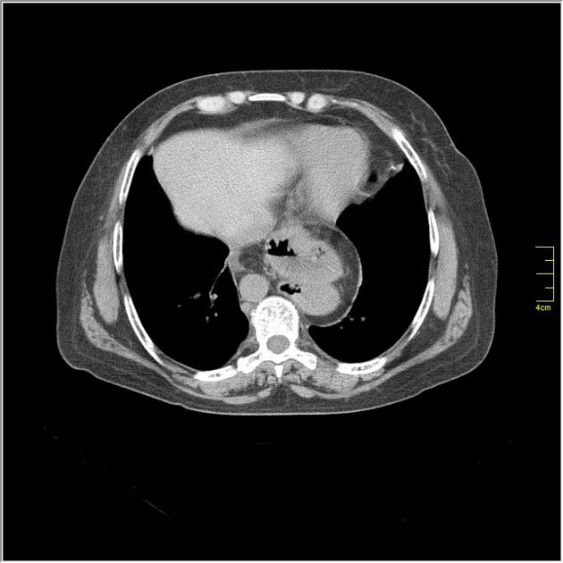
CT Scan

Slide 33
Treatment Of Paraesophageal Hiatal Hernia
Paraesophageal hiatal hernia is treated surgically.
Indications for surgery
Nausea/ Vomiting
No bowel movement
Gastric volvulus/ Strangulation
Severely incompetent LES
Paraesophageal hernia
Notes:
However, young patients with severe or recurrent complications of GERD, such as strictures, ulcers, and bleeding, who cannot afford lifelong PPI treatment or would prefer to avoid taking medications long term, may be surgical candidates.

Slide 34
Surgical procedures for P.H.H
Hiatal Hernia repair
The Surgeon will;
Reduce the stomach and other content of the hernia into the abdominal cavity
Excise the hernia sac
Repair the defect on the diaphragm
Fundoplication- nissen

Slide 35
Anti-reflux procedure e.g Fundoplication
Gastropexy: Suturing the stomach to anterior abdominal wall
PEG (Percutaneous endoscopic gastrostomy): Usually in elderly patients at high surgical risk.

Slide 36
Complications Of Surgical treatment
Intra abdominal infection
Esophageal perforation
Dysphagia
Belching difficulty
Bloating (gas bloat syndrome)
  Self limiting within 2-4 wks, but may persist

Slide 37


Slide 38
M.C.Q. 1
Hiatal hernia means protrusion of ………. In to the mediastinum
A : liver
B : stomach
C : spleen
D : small intestine

Slide 39
M.C.Q. 2
In sliding oesophageal hiatal hernia the G.E. Junction……….
A: remains same place
B: moves upwards
C : moves downwards
D : none of above

Slide 40
M.C.Q. 3
SURGICAL MANAGEMENT OF HIATAL HERNIA IS CALLED………
A; : Nissen fundoplication
B: Lords plication
C : Partial gastrectomy
D: subtotal gastrectomy

Slide 41
M.C.Q. 4
Conservative treatment of sliding hiatal hernia includes followings EXCEPT……..
A : raise the head end of bed
B : aceclophenac
C : antacids
D : proton pump inhibitor

Slide 42
M.C.Q. 5
In NISSEN fundo plicatin the stomach is wrapped around the lower end of stomach to…….degree
A : 270
B : 200
C : 360
D : 180

Slide 43
KEY
MCQ ANSWER
1……….B
2……….B
3……….A
4……… B
5……….C

