Slide 1
Meckel’s diverticulum
Dr.ohang chaudhari

Slide 2
Meckel’s diverticulum
Congenital diverticulum
Arising from terminal ileum
Remnant of unobliterated proximal portion of vitelo intestinal duct
Most common congenital anomaly of small intestine

Slide 3
Vitelo intestinal duct
In developing fetus
It is long narrow tube
That joins yolk sac to the midgut lumen
Appears at the end of 4th week
Obliterate at 9th week of gestational age

Slide 4
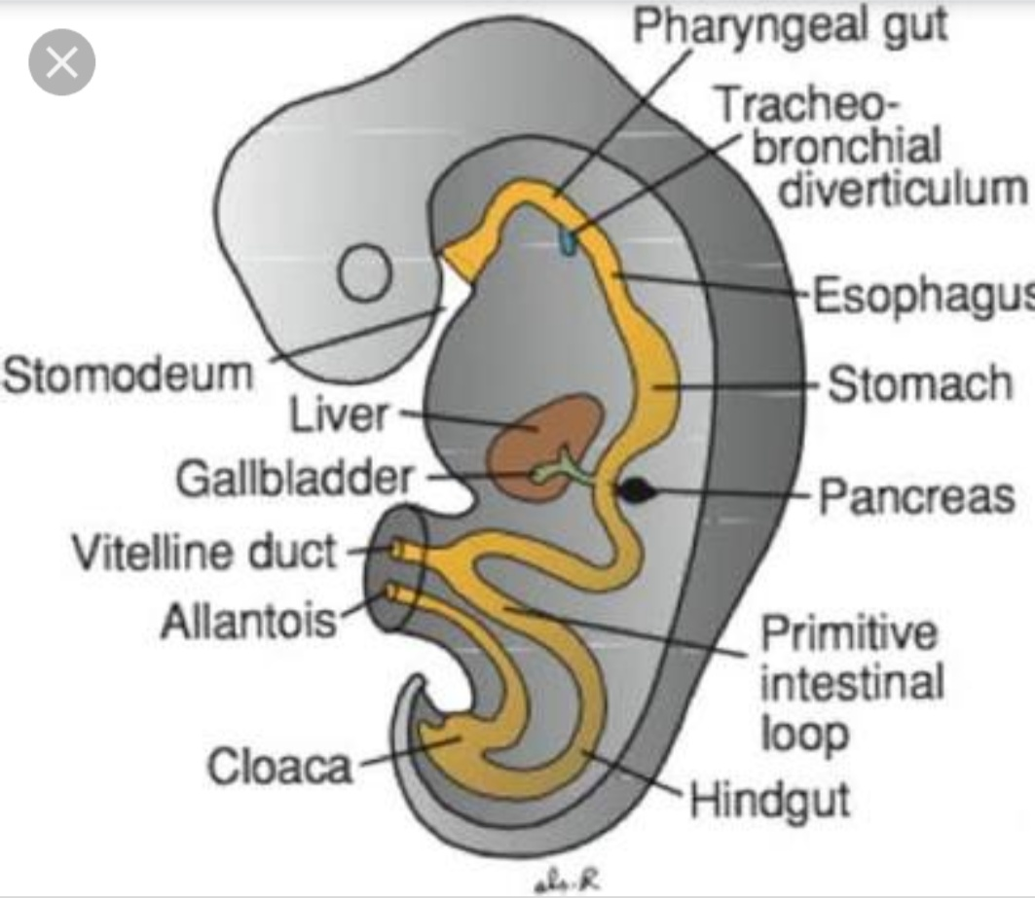
.

Slide 5
Rule of 2
2% common
2 feet away from ileocaecal valve
2 inch in length
2% of meckel”s diverticulum are symptomatic
50% of symptomatic are below 2 years of age

Slide 6
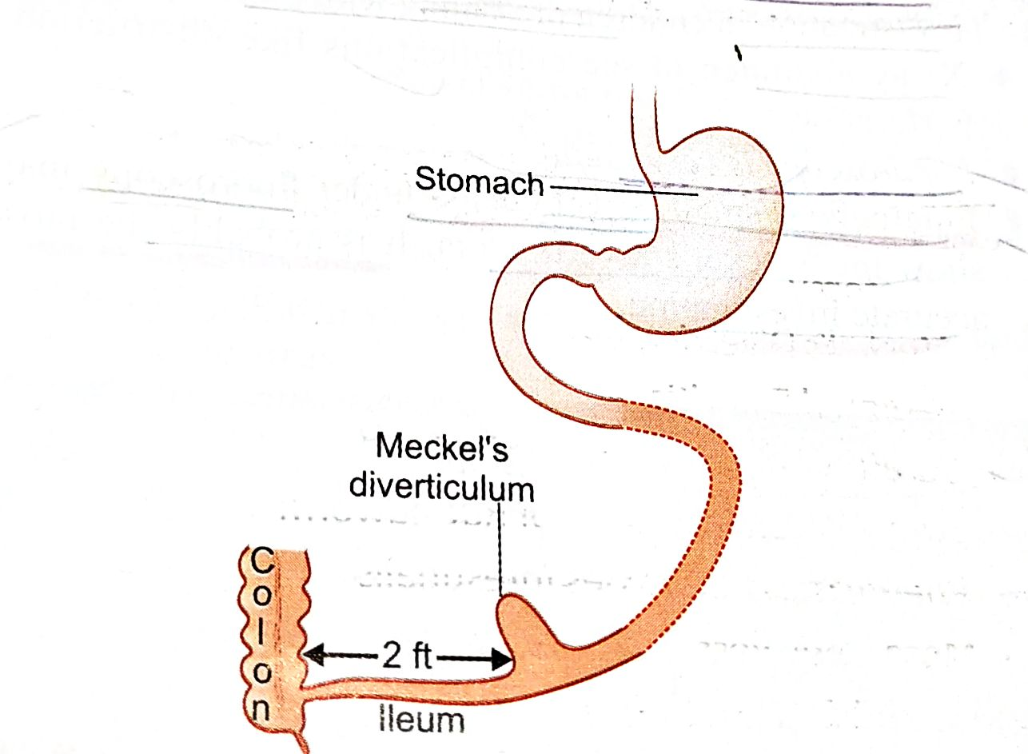
.

Slide 7
pathology
Arise from antimesenteric border of ileum
Contains all 3 layers of intestine
With independent blood supply
in 20% cases mucosa contains epithelium like gastric mucosa……colon and pancreas

Slide 8
pathology
May be connected with umbilicus through band or fistula
May be associated with esophageal atresia, anorectal malformations

Slide 9
presentations
Asymptomatic most of time
Severe hemorrhage most common
Intestinal obstruction due to band/adhesion/ intussusception
Perforation
Diverticulitis
Litter's hernia —present as hernia content

Slide 10
presentations
Silent meckel”s diverticulum —found during laparotomy, laparoscopy

Slide 11
diagnosis
Technetium radioisotope scan
X ray abdomen standing
Laparoscopy
Small bowel enema under fluoroscopy

Slide 12
treatment
Asymptomatic– can be left alone
Symptomatic– resection of small segment of ileum containing meckel”s diverticulum and end to end anastomosis
meckel’s diverticulectomy & closure of enterotomy but chances of retaining heterotopic tissue and stenosis is high

Slide 13
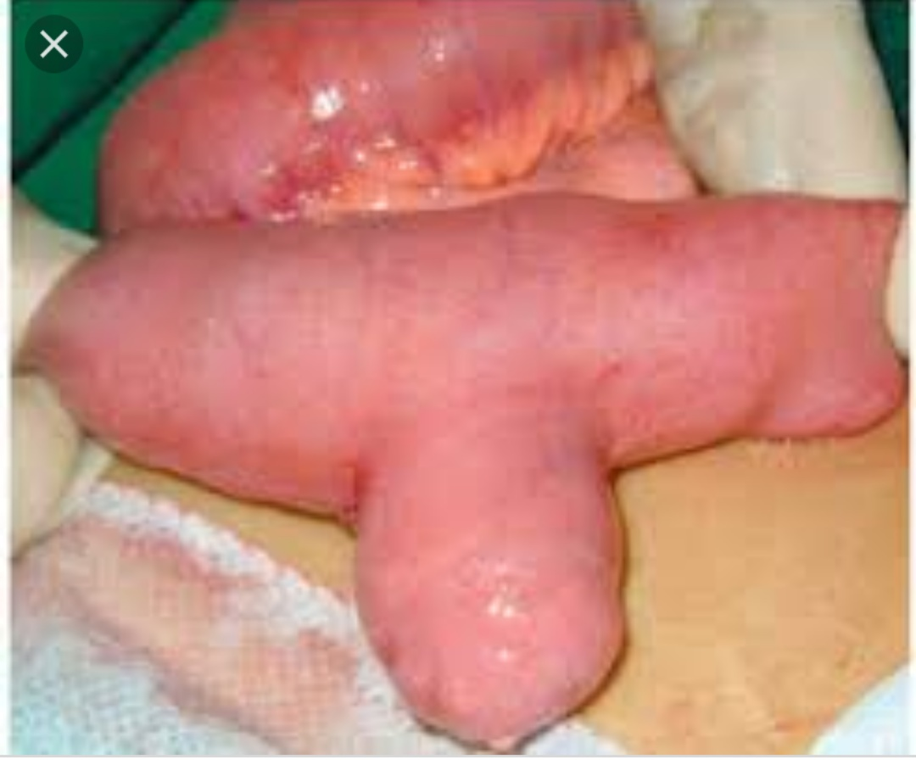
.

Slide 14
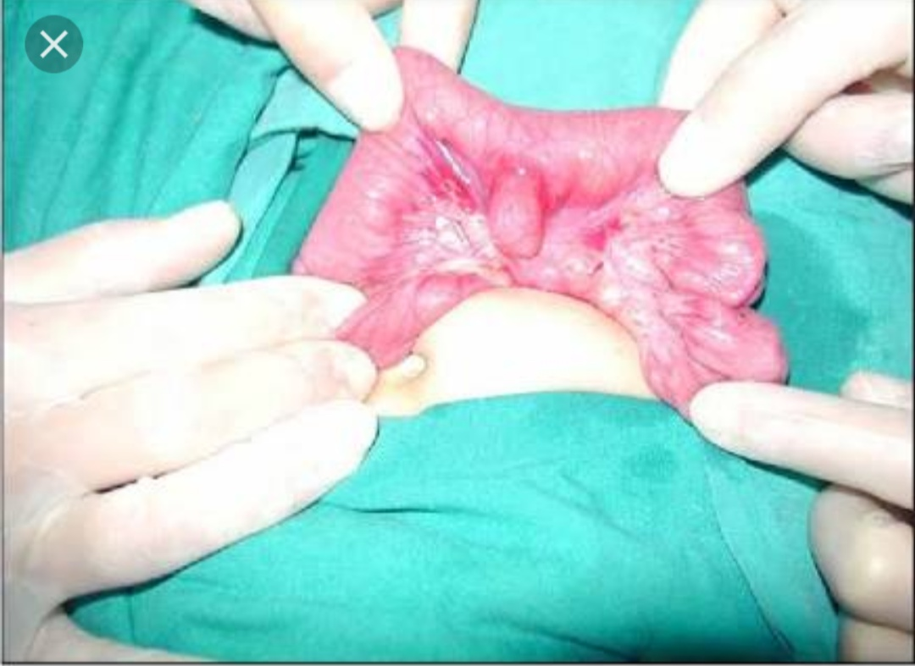
.

Slide 15
Indications for surgery
Narrow base and length is more
When there is band, adhesions, obstruction , intussusception
If found in children below 2 years of age

Slide 16
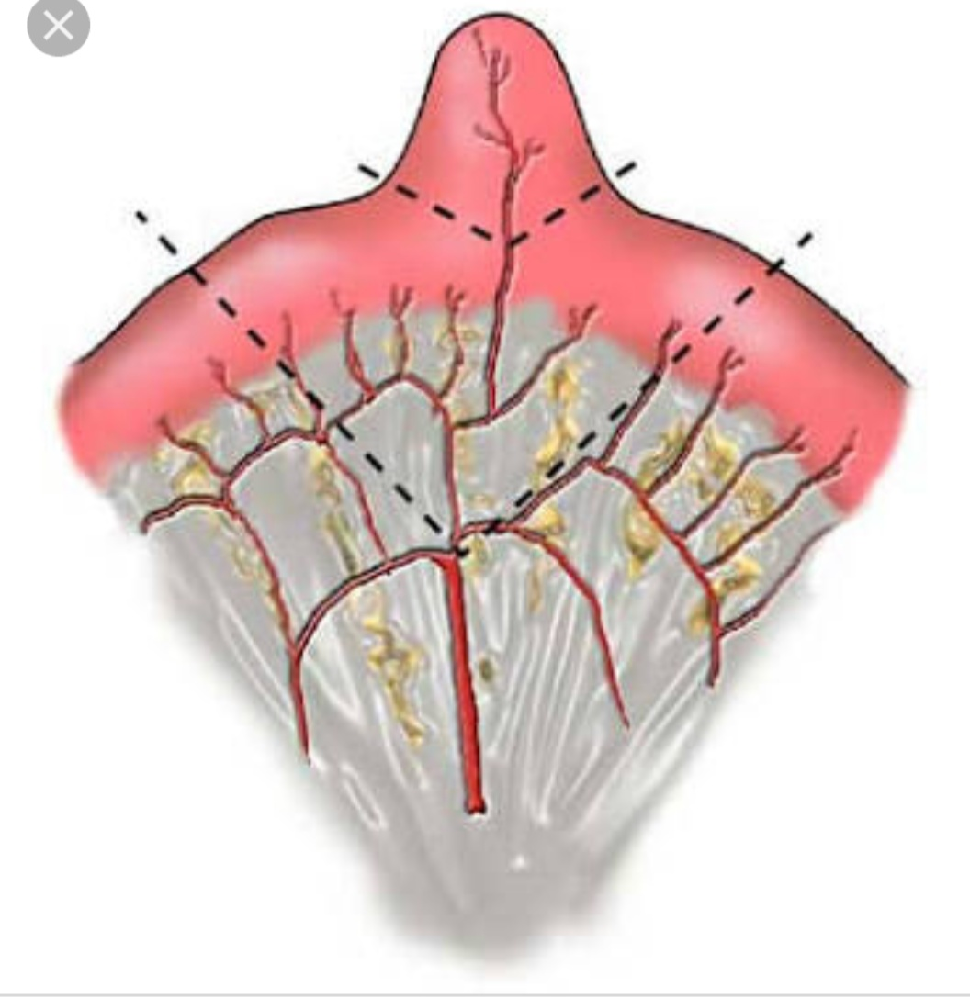
.

Slide 17
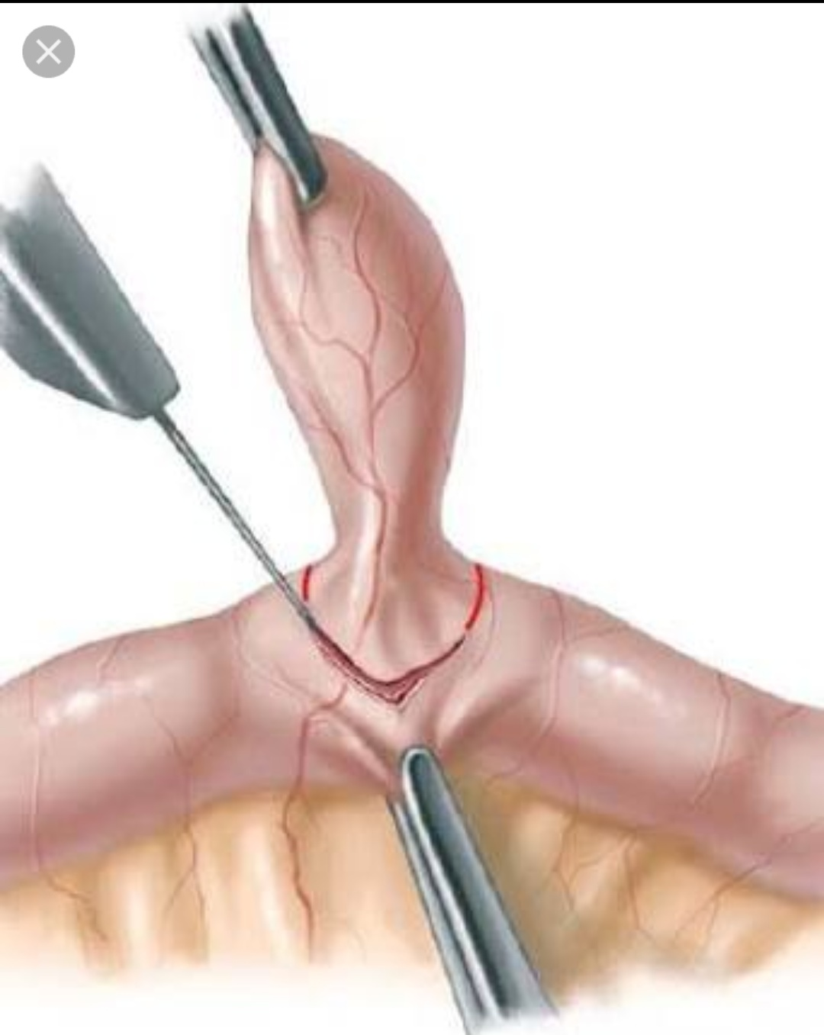
.

Slide 18
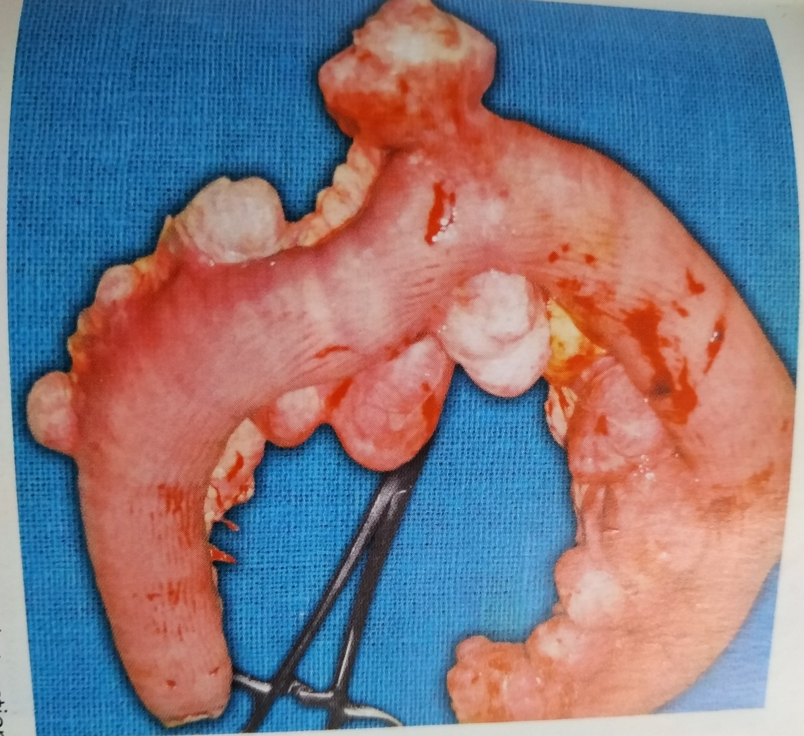
Resected parts

Slide 19
MCQ 1
Vitelo intestinal duct appears at which intrauterine age? 1. 2 week 2. 3 week 3. 4 week 4. 5 week

Slide 20
MCQ 2
Yolk sac via vitelo intestinal duct connected to 1. foregut 2.midgut 3. hindgut 4. rectum

Slide 21
MCQ 3
All are true about meckle’s diverticulum EXCEPT 1. Arise from antimesenteric border of ileum
2.Contains only 2 layers of intestine
3.With independent blood supply 4. in 20% cases mucosa contains epithelium like gastric mucosa……colon and pancreas

Slide 22
MCQ 4
Rule of 2 in meckle’s diverticulum contains all EXCEPT 1. 2% common
2.2 feet away from ileocaecal valve 3.2 inch in length
4.2% of meckel”s diverticulum are Asymptomatic

Slide 23
MCQ 5
Litter's hernia contains 1. appendix 2. meckle’s diverticulum 3. urinary bladder 4. rectum

Slide 24
.
THANK YOU

