Slide 1
…..PERCEPTION…..
By:
Dr. Lakhan Kataria
Department of Psychiatry

Slide 2
What is PERCEPTION
The conscious awareness of the elements in the environment by the mental processing of the sensory stimuli.

Slide 3
Why is it IMPORTANT ?
Because people’ s behavior is based on their perception of what really is , not on reality itself.

Slide 4

Perception
You can see a white vase as figure against a black background, or two black faces in profile on a white background

Slide 5
WHY DO WE STUDY PERCEPTION
To better understand how people make attribution about events.
We don’t see reality. We INTERPRET what we see and call it reality.

Slide 6
Normal perception
Concrete reality
External objective space
Clearly delineated
Sensory elements full and fresh
Constant
Independent of our will

Slide 7
DISORDERS OF PERCEPTION
SENSORY DISTORTIONS
constant real perceptual object perceived in a distorted way
1 CHANGES IN INTENSITY
2CHANGES IN QUALITY
3CHANGES IN SPATIAL FORM
4CHANGES IN EXPERIENCE OF TIME
SENSORY DECEPTIONS
new perception may or may not be in response to external stimulus
1ILLUSIONS
2HALLUCINATIONS

Slide 8
CHANGES IN INTENSITY
HYPERAESTHESIA
DEC PHYSIOLOGICAL THRESHOLD
IN…..
HYPOAESTHESIA
INC PHYSIOLOGICAL THRESHOLD
IN….

Slide 9
CHANGES IN QUALITY
1 ACHROMATOPSIA
2 DYSCHROMATOPSIA
Xanthopsia
Chloropsia
Erythropsia
LITHIUM – metallic taste and not a hallucination but a true change in gustation

Slide 10
DYSMEGALOPSIA
Change in perceived shape
In….
MICROPSIA
MACROPSIA
METAMORPHOSIA
PARAPROSOPIA

Slide 11
SPATIAL LOCATION
1 TELOPSIA OBJECT FAR AWAY
2 PELOPSIA OBJECT NEAR
3 ALLOAESTHESIA DIFFERENT POSITION FROM WHAT EXPECTED
4 AKINETOPSIA IMPAIRMENT OF VISUAL PERCEPTION OF MOTION

Slide 12
ILLUSION
Definition:
Perceptual misinterpretation of a real external stimulus
MULLER LYER ILLUSION
TYPES OF ILLUSION
AFFECT
COMPLETION
PAREIDOLIA

Slide 13
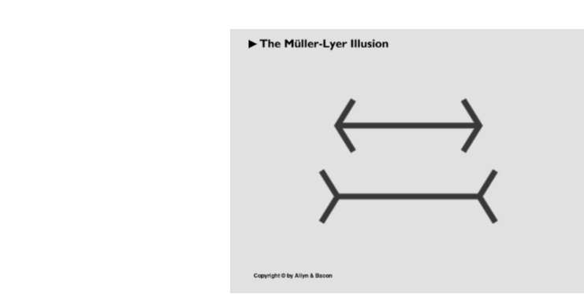
  Müller-Lyer Illusion
    The two lines above are the same length, but the diagonals extending outward from both ends of the lower line make it look longer than the upper line

Slide 14
HALLUCINATIONS
Definition:
A FALSE SENSE OF PERCEPTION OCCURING IN ABSENCE OF ANY RELEVANT EXTERNAL STIMULATION OF SENSORY MODALITY INVOLVED.
From internal sources of information
Appraised incorrectly as if from external sources of information

Slide 15
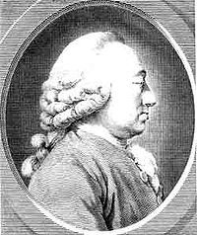
Causes of hallucinations
1 EMOTIONS
2 SUGGESTION
3 PERIPHERAL SENSE ORGAN
charles bonnet syndrome
4 SENSORY DEPRIVATION
5 DISEASES OF CNS

Slide 16
TYPES OF HALLUCINATIONS
AUDITORY
1 PERSON
2PERSON
3PERSON
In schizophenia, alcoholic hallucinosis,organic state
Imperative hallucination

Slide 17
Visual hallucinations
In organic states
Varied : flashes of light, partly organized, completely organized
LILIPUTIAN hallucinations
Coherent visual and auditory hallucinations
in late onset schizophrenia
in temporal lobe epilepsy

Slide 18
OlFACTORY HALLUCINATIONS
Padre pio phenomena
In schizophrenia , organic state
GUSTATORY HALLUCINATIONS
In schizophrenia, organic state
TACTILE HALLUCINATIONS
A hallucination involving the perception of being touched or of something being under ones skin
In alcohol intoxication, benzodiazepine withdrawal
1superficial thermic
haptic
hygric
paraesthetic
2kinaesthetic
3visceral

Slide 19
Hallucinatory syndromes
Alcoholic hallucinosis
Organic hallucinosis

Slide 20
PSEUDO HALLUCINATIONS
Clear
Vivid
Full consciousness
Inner subjective space
Involuntary
NOT REAL PERCEPTION

Slide 21
FUNCTIONAL HALLUCINATIONS the stimulus causing the hallucination is heard in addition to the hallucination
EXTRACAMPINE HALLUCINATIONS hallucinations that occur outside the limits of sensory field
REFLEX HALLUCINATIONS synaesthesia it is the experience of stimulus in one sensory modality producing sensory experience in the other
AUTOSCOPY/PHANTON MIRROR IMAGE it is the experience of seeing oneself and knowing that it is oneself
NEGATIVE AUTOSCOPY patient looks in the mirror and sees no image

Slide 22
THANK YOU…….
HAVE A GOOD DAY…….

