Slide 1
Psychology of memory
By: Dr Nisheet Patel
Department of Psychiatry

Slide 2
Definition of memory
It is the process whereby what is experienced or learned is established as a record in CNS(registration),where it persists with variable degree of permanence(retention) and can be recollected or retrieved from storage at will(recall).

Slide 3
Cognition-process through which information coming from the senses is transformed,reduced,elaborated,recovered and used.
Information-sensory input from the environmentbthat informs us about something that is happening there.
Cognitive process-process involved in knowing about the world.
(cognitive process can operate in the absence of any immediate stimuli,as in dreams)

Slide 4
Processes in memory
Encoding-process of receiving sensory input and transforming it into a form or code which can be stored.
Storage-process of putting coded information into memory.
Retreival-process of gaining access to the stored,coded information when needed.

Slide 5
Information – processing theory
By Richard Atkinson and Richard shiffrin
States that memory starts with a sensory input from environment
This input is held for a very brief time(several seconds) in sensory register associated with sensory channels.
Sensory register
visual-1 sec(can hold upto 11-16 items)
auditory-4-5sec

Slide 6
Information that is registered in sensory register may pass on to short term memory(STM),where it is held upto perhaps 20-30 sec
Some of the information reaching STM is processed by being rehearsed that is by having attention focused on it,perhaps by repeating over and over or by linking with other already stored information.
Information that is rehearsed may pass on to long term memory(LTM),where it may stay for days,months,years,lifetime.
Information not so processed may be lost.
When we remember something – its representation is retrieved from LTM

Slide 7
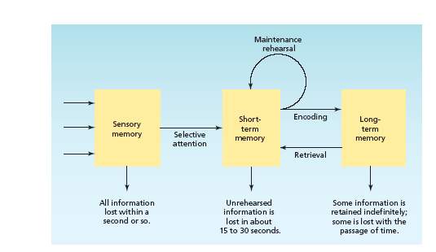

Slide 8
Sensory Memory
Sensory memory - the very first stage of memory, the point at which information enters the nervous system through the sensory systems.
  Iconic memory - visual sensory memory, lasting only a fraction of a second.
    Capacity – everything that can be seen at one time.
    Duration - information that has just entered iconic memory will be pushed out very quickly by new information, a process called masking.
    Eidetic imagery - the rare ability to access a visual memory for 30 seconds or more.

Slide 9
  Echoic memory - the brief memory of something a person has just heard.
    Capacity - limited to what can be heard at any one moment and is smaller than the capacity of iconic memory
    Duration – lasts longer that iconic — about 2 to 4 seconds

Slide 10
Short-Term Memory
Short-term memory (STM) (working memory) - the memory system in which information is held for brief periods of time while being used.
  Selective attention – the ability to focus on only one stimulus from among all sensory input.
Chunking – bits of information are combined into meaningful units, or chunks, so more information can be held in STM

Slide 11
Short-Term Memory
Maintenance rehearsal - practice of saying some information to be remembered over and over in one’s head in order to maintain it in short-term memory (STMs tend to be encoded in auditory form).
Elaborative rehearsal - a method of transferring information from
STM into LTM by making that information meaningful in some way by tying
or integerating with existing memories.
Duration of STM - lasts from about 12 to 30 seconds without rehearsal.
STM is susceptible to interference
(e.g., if counting is interrupted,
have to start over).

Slide 12
Long term memory
When we think about memory,it is usually LTM that we have in mind.
Is the ability to store more information for long periods of time (life times) like phone numbers, names and address’ from when we were kids.
long-term memory can store much larger quantities of information for potentially unlimited duration (sometimes a whole life span). Its capacity is immeasurably large.
Long-term memory is often divided into two further main types: explicit (or declarative) memory and implicit (or procedural) memory.

Slide 13
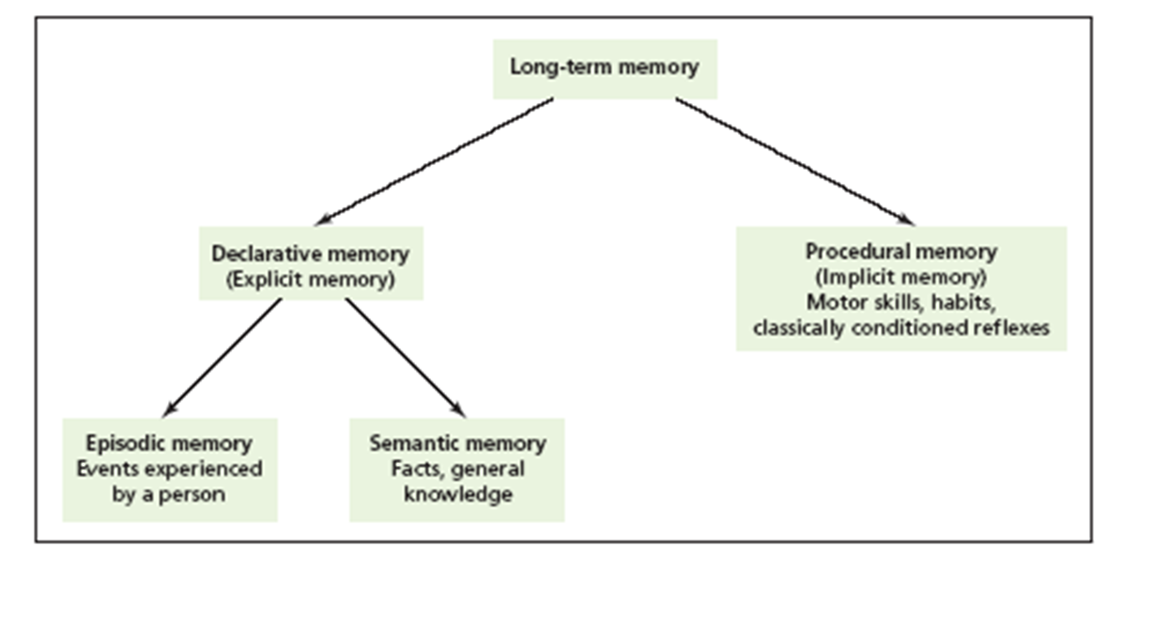

Slide 14
Types of LTM
Procedural (nondeclarative) memory - type of long-term memory including memory for skills, procedures, habits, and conditioned responses. These memories are not conscious but are implied to exist because they affect conscious behavior.
Declarative memory – type of long-term memory containing information that is conscious and known (memory for facts).

Slide 15

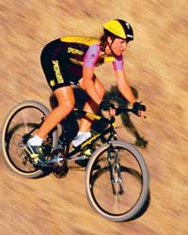
Procedural (Nondeclarative) LTM
Skills that people know how to do.
Also include emotional associations, habits, and simple conditioned reflexes that may or may not be in conscious awareness.
Anterograde amnesia - loss of memory from the point of injury or trauma forward, or the inability to form new long-term memories. Usually does NOT affect procedural LTM.
Procedural memory often called implicit memory - memory that is not easily brought into conscious awareness.

Slide 16
Declarative LTM
All the things that people know.
Semantic memory - type of declarative memory containing general knowledge, such as knowledge of language and information learned in formal education with a meaning
Episodic memory - type of declarative memory containing personal information not readily available to others, such as daily activities and events.
Semantic and episodic memories are forms of explicit memory - memory that is consciously known.

Slide 17
Tip of the tongue phenomenon(TOT)
It shows what happens when we search through our library of experiences to retrieve a memory.
Suppose if we are trying to recall someone’s name but we can not quit remember it,the name is on our tip of tongue but can’t recall it.
We may come up with names similar to the name we want to recall.
This indicates that information is organized in LTM.
TOT is a retrieval failure.(recall has failed,atleast temporarily)

Slide 18
Memory recall/retrieval
Retrieval, recall or recollection (calling back the stored information in response to some cue for use in a process or activity)
refers to the subsequent re-accessing of events or information from the past, which have been previously encoded and stored in the brain.
During recall, the brain "replays" a pattern of neural activity that was originally generated in response to a particular event, echoing the brain's perception of the real event.

Slide 19
Retrieval cues and reconstructive processes are important factors in the “read out” or retrieval from memory.
Retrieval cues
helps in finding stored information in LTM
By retrieval cues or reminders which direct the search to the appropriate part of LTM memory.
Reconstructive processes
It is modification of already stored input.
Sometimes called confabulation in cases of people with memory disorders who have very little stored in memory and try to fill in the gaps during retrieval.

Slide 20
Forgetting
It is apparent loss of information already encoded and stored in LTM
Types of forgetting:
Encoding failure
Decay or disuse
Retroactive interference
Proactive interference

Slide 21
Encoding failure- the information is not attended and fails to be encoded in memory.
Decay or disuse- the information that is not accessed decays from the storage system over the time.
Proactive interference- older informations already in the memory interferes in the retrieval of newer information.
Retroactive interference- newer information interferes in retrieval of older information.

Slide 22
Motivated forgetting
Given by Sigmund freud in his book “psychopathology of everyday life”.
Done by repression.
People generally remember pleasant events more often than unpleasant ones

Slide 23
Amnesia- loss of memory
Amnesia is profound memory deficit due to either loss of what was stored or inability to form new memories.
Types:
Retrograde amnesia - loss of memory from the point of some injury or trauma backwards, or loss of memory for the past.
Anterograde amnesia - loss of memory from the point of injury or trauma forward, or the inability to form new long-term memories (“senile dementia”).
Infantile amnesia - the inability to retrieve memories from much before age 3.
  Autobiographical memory - the memory for events and facts related to one’s personal life story (usually after age 3).

Slide 24
Thank you

