Slide 1
ANATOMY AND PHYSIOLOGY OF LACRIMAL SYSTEM

Slide 2
Levels of Evidence
Grade A – Systemic reviews, Meta analyses, RCT
Grade B – Non-randomised studies
Grade C – Observational studies
Grade D – Case Series, Expert opinion

Slide 3
Levels of Evidence
**** ~ Systematic reviews, meta analysis of randomized control studies
*** ~ Non randomised studies
** ~ Observational or non experimental studies
* ~ Expert opinion

Slide 4
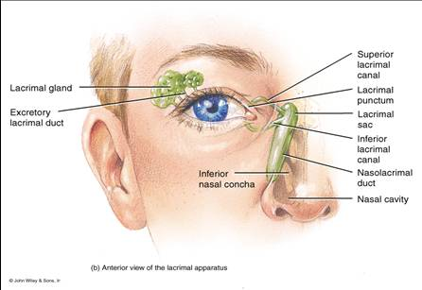

Slide 5
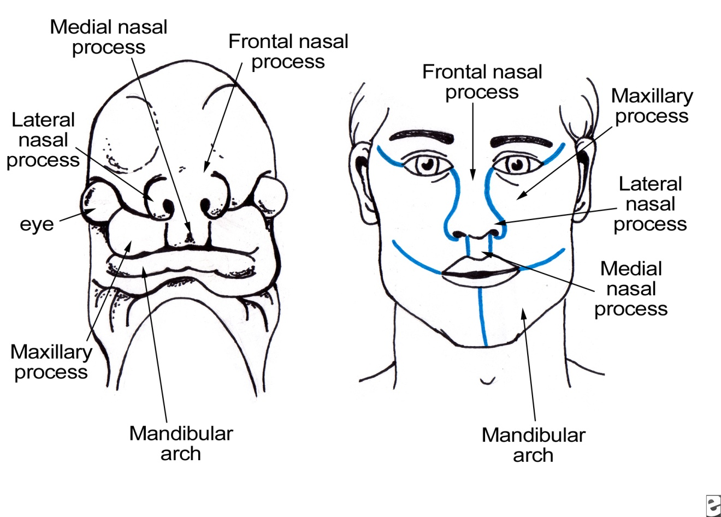
EMBRYOLOGY

Slide 6
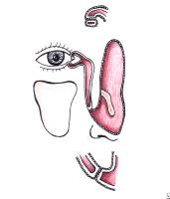

Slide 7
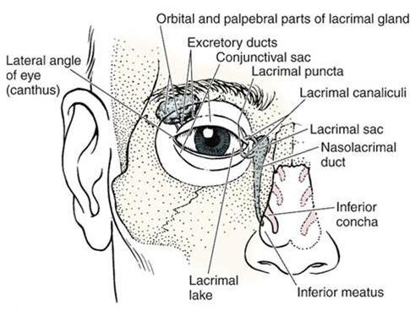
LACRIMAL GLAND

Slide 8
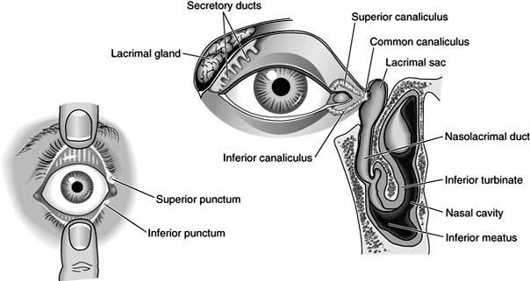
LACRIMAL PUNCTA

Slide 9
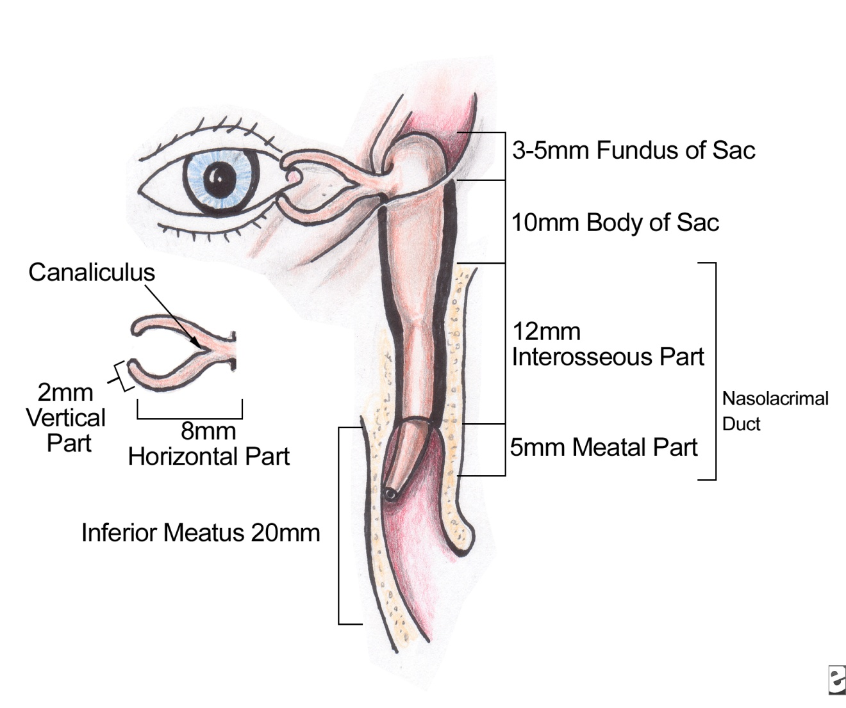
CANALICULI

Slide 10
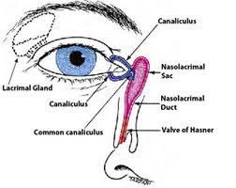
LACRIMAL SAC

Slide 11
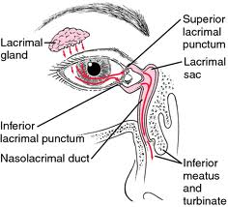
NASOLACRIMAL DUCT

Slide 12
NERVE SUPPLY
The Lacrimal Sac is supplied by:
- Parasympathetic fibres originates from the lacrimal nucleus of the facial nerve in the pons
- Sympathetic post ganglionic fibres originate from the superior cervical ganglion

Slide 13
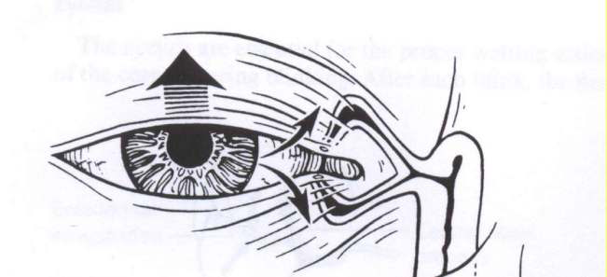
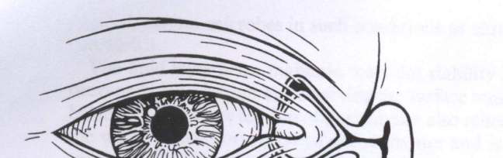
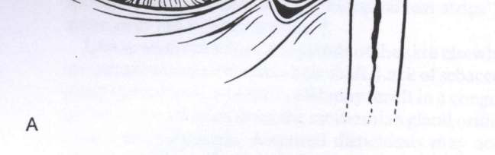
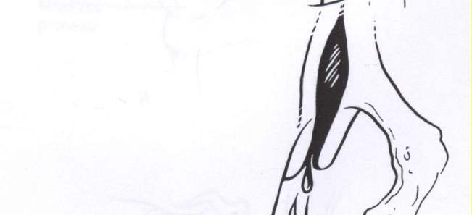
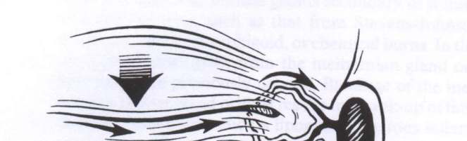
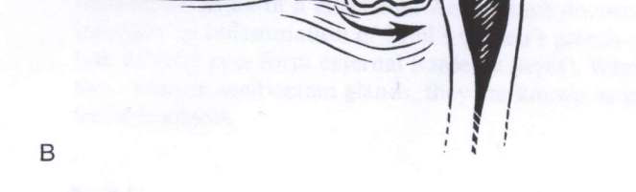
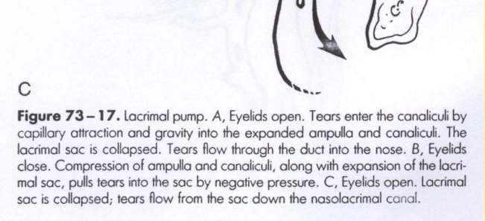
PHYSIOLOGY

Slide 14
PATHOLOGICAL CONDITIONS
DRY EYE
WATERING EYE
MUCOCOELE
PYOCOELE
DACROCYSTITIS

Slide 15
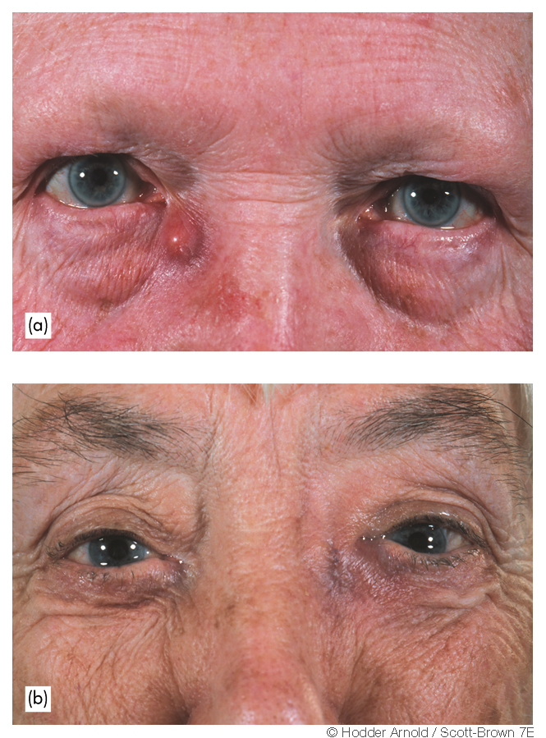

Slide 16
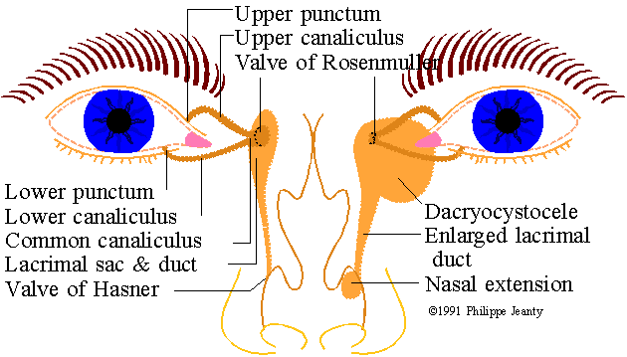

Slide 17
NAME OF STUDY | AUTHOR | REFERENCE | SAMPLE SIZE | RESULT | P value | CONCLUSION
Trauma of the lacrimal drainage system: retrospective study | Drnovsek-Olup B¹, Beltram M. | Croat Med J. 2004 Jun;45(3):292-4.. | 32 | Patent lacrimal drainage system was achieved in all 25 patients with primary reconstruction of the injury. Restenosis of the canaliculus occurred in 4 out of 7 patients after secondary reconstruction. | Not more than 0.05 | Early repair of the lacrimal drainage system eliminates complications in comparison with secondary repair. Repair of the lacrimal drainage system may be delayed for up to 48 h, if an experienced operating team is available.

Slide 18
1. …lacrimal gland is type of..
Mucinous gland
Serous gland
Mixed gland
Endocrine gland

Slide 19
2. Opening of the nasolacrimal duct into the inferior nasal meatus is partially covered by
Valve of hasner
Plica lacrimalis
Valve of rosenmuller
Limen nasi

Slide 20
3.The maxillary and fronto nasal prominences in an embryo develop at what age
62 days
52 days
32 days
90 days

Slide 21
4. Lacrimal gland is situated in lacrimal fossa formed by
Temporal bone
Frontal bone
Zygomatic bone
Nasal bone

Slide 22
5. Lacrimal artery is a direct branch of
Facial artery
Ophthalmic artery
Middle temporal artery
External carotid artery

Slide 23
THANK YOU

