Slide 1
Anatomy and Physiology of Olfactory nerve

Slide 2
Levels of Evidence
Grade A – Systemic reviews, Meta analyses, RCT
Grade B – Non-randomised studies
Grade C – Observational studies
Grade D – Case Series, Expert opinion

Slide 3
Levels of Evidence
**** ~ Systematic reviews, meta analysis of randomized control studies
*** ~ Non randomised studies
** ~ Observational or non experimental studies
* ~ Expert opinion

Slide 4
INTRODUCTION
The olfactory nerve is actually a collection of sensory nerve rootlets that extend down from the olfactory bulb and pass through the many openings of the cribriform plate in the ethmoid bone.

Slide 5
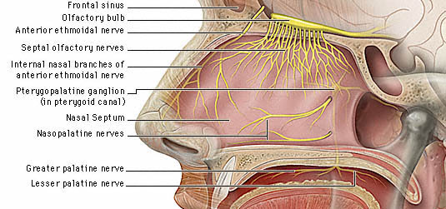

Slide 6
Olfactory bulb: Situated over the olfactory sulcus on the orbital surface of the frontal lobe
Olfactory tract: It leaves the posterior pole of the olfactory bulb to run on the inferior surface of the frontal lobe along the olfactory sulcus.

Slide 7
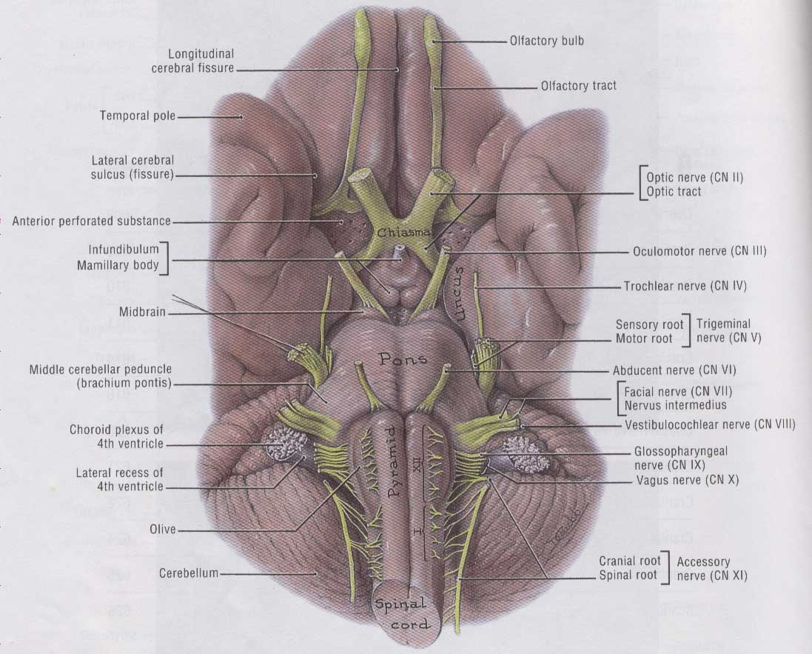

Slide 8
NEURAL SYSTEMS
Main olfactory system
Accesory olfactory system
Trigeminal somatosensory system
Nervus terminalis (1,2)

Slide 9
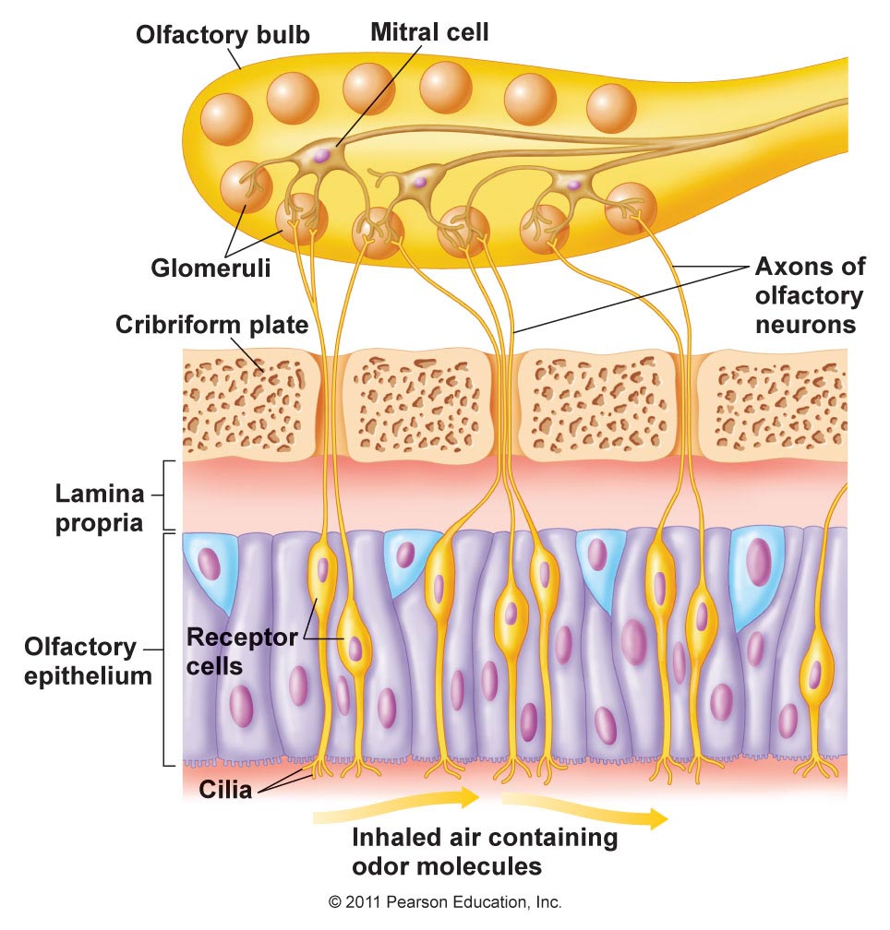
OLFACTORY NEUROEPITHELIUM

Slide 10
Cell types:
Bipolar sensory receptor neurons
Microvillar cells
Supporting cells
Cells lining Bowman’s gland
Horizontal basal cells (dark)
Globose basal cells (light)

Slide 11
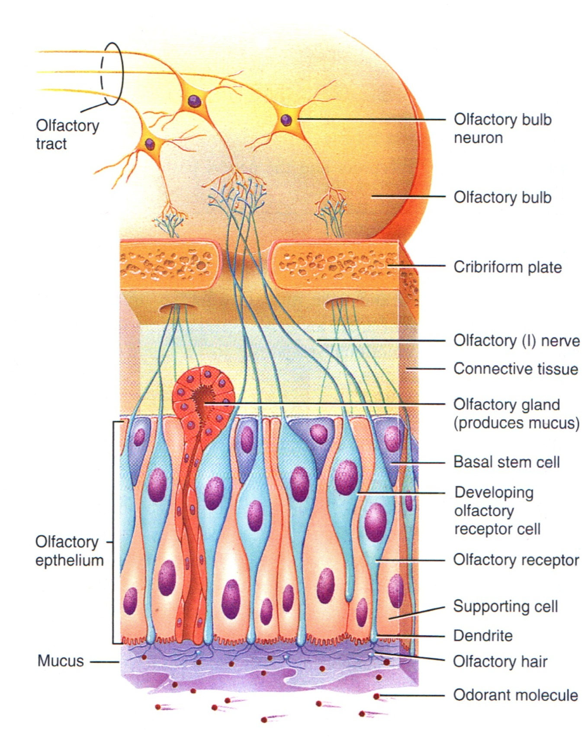

Slide 12
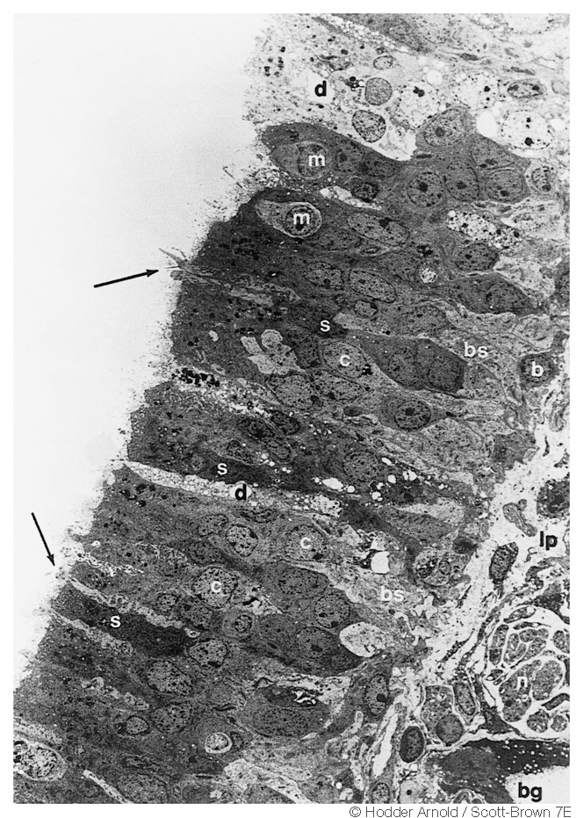
Electron microscope picture

Slide 13
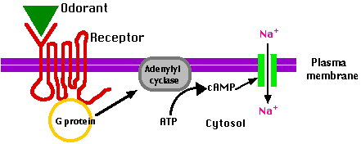
GENERATION OF IMPULSE

Slide 14
MECHANISM OF OLFACTORY CELL STIMULATION
Odorant + receptor protein
↓
Activation of G protein (3,4)
↓
Activation of adenylyl cyclase
↓
ATP → cAMP
↓
Opening of Na⁺ channels
↓
Na⁺ influx
↓
depolarization

Slide 15
OLFACTORY PATHWAY

Slide 16
OLFACTORY PATHWAY
First order neurons: Bipolar sensory receptor neurons and Glomeruli
Second order neurons: Mitral and tufted cells
Third order neurons:
Mediodorsal nuclei of Thalamus, Medial and posterior Hypothalamus, Hippocampus, Orbitofrontal cortex

Slide 17
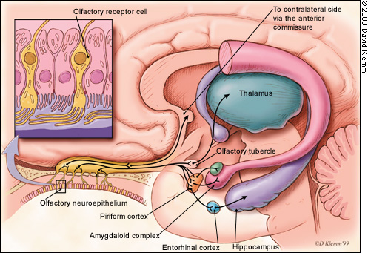

Slide 18
APPLIED
Clinical testing
Olfactory disorders

Slide 19
OLFACTORY DISORDERS
Anosmia
Partial anosmia
Hyposmia
Hyperosmia
Dysosmia
Heterosmia
Presbyosmia

Slide 20
References
1.. Wiedenbecher M, Hosemann W, Buhr W. Endoscopic
endonasal dacryocystorhinostomy: results in 56 patients.
Annals of Otology, Rhinology and Laryngology. 1994; 103:
363-7.
2. Whittet HB, Shun-Shin GA, Awdry P. Functional
endoscopic transnasal dacryocystorhinostomy. Eye. 1993;
7: 545-9.
3. Kong YT, Kim TI, Kong BW. A report of 131 cases of
endoscopic laser lacrimal surgery. Ophthalmology. 1994;
101: 1793-800.
4. Metson R, Woog JJ, Puliafito CA. Endoscopic laser
dacryocystorh inostomy. Laryngoscope. 1994; 104:
269-74.

Slide 21
NAME OF STUDY | NAME OF AUTHOR | REFERENCE DETAILS | SAMPLE SIZE | RESULT | P VALUE | CONCLUSION
Characteristics of olfactory disorders in relation to major causes of olfactory loss | Temmel AF, Quint C, Schickinger-Fischer B, Klimek L, Stoller E, Hummel T. | Arch Otolaryngol Head Neck Surg. 2002 Jun;128(6):635-41. | 278 | Causes of olfactory loss were categorized as follows: trauma (17%), upper respiratory tract infection (URI) (39%), sinonasal disease (21%), congenital anosmia (3%), idiopathic causes (18%), or other causes (3%). | - | Among many complaints of olfactory loss, the predominant ones were food related. This loss in Quality of Life seemed to be of greater importance in younger than in older people, and women seem to be affected more strongly than men.

Slide 22
Q-1 which is the only cranial nerve to have regenerative ability?
C N I
C N II
C N VII
None of the above

Slide 23
Q-2 which of the following cell type is not found is olfactory nerve?
Globose basal cells
Microvillar cells
Purkinje cells
Supporting cells

Slide 24
Q-3 Mitral and Tufted cells constitutes
First order neurons
Second order neurons
Third order neurons
Fourth order neurons

Slide 25
Q-4 full form of UPSIT is:
Universal preliminary smell identification test
University of Pennsylvania Smell Identification Test
University of Paris Smell Identification Test
none of the above

Slide 26
Q-5 aetiology of Anosmia
URTI
Head trauma
Nasal sinus diseases
All of the above

Slide 27
Thank you

