Slide 1
ANATOMY AND PHYSIOLOGY OF
OPTIC NERVE

Slide 2
Levels of Evidence
Grade A – Systemic reviews, Meta analyses, RCT
Grade B – Non-randomised studies
Grade C – Observational studies
Grade D – Case Series, Expert opinion

Slide 3
Levels of Evidence
**** ~ Systematic reviews, meta analysis of randomized control studies
*** ~ Non randomised studies
** ~ Observational or non experimental studies
* ~ Expert opinion

Slide 4
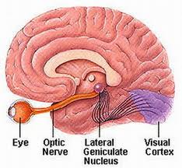
INTRODUCTION

Slide 5
STRUCTURE OF NERVE
1.2 million myelinated fibers
Diameter of optic nerve : 2-10 micrometer
Not a nerve in true sense- direct extension of brain
Lacks neurilemma so unable to regenerate.
Length : 47-50 mm
Optic nerve head : 1.8 mm

Slide 6
PARTS OF OPTIC NERVE
Intraocular part : 1 mm
Intraorbital part : 30 mm
Intracanalicular part : 6-9 mm
Intracranial part : 10 mm

Slide 7
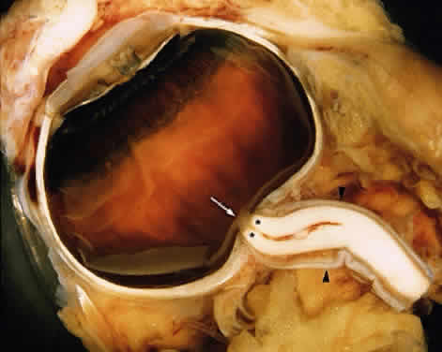
INTRAOCULAR PART

Slide 8
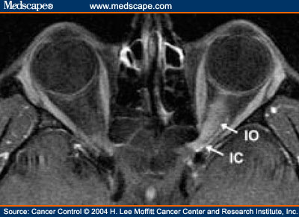
INTRAORBITAL PART

Slide 9
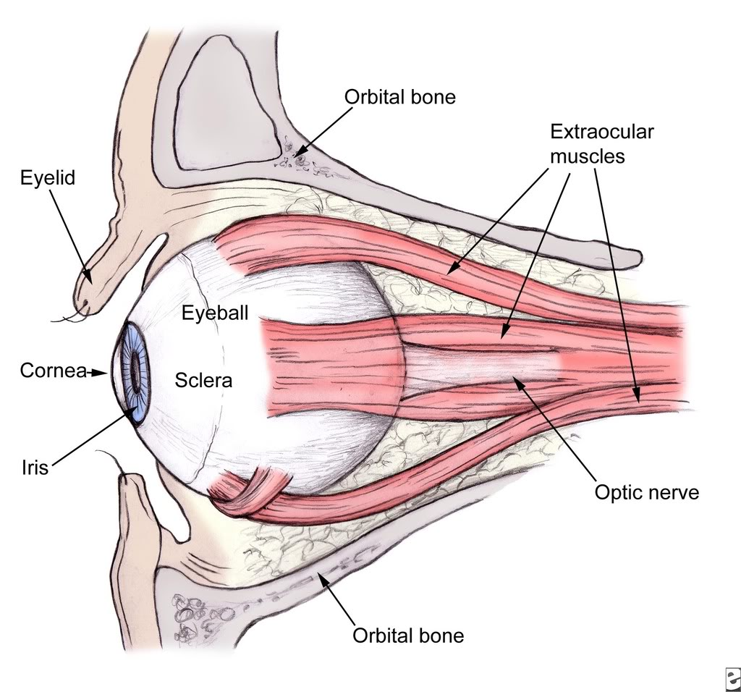

Slide 10
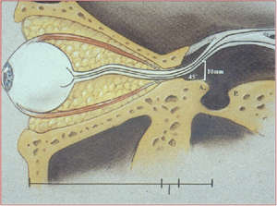
INTRACANALICULAR PART

Slide 11
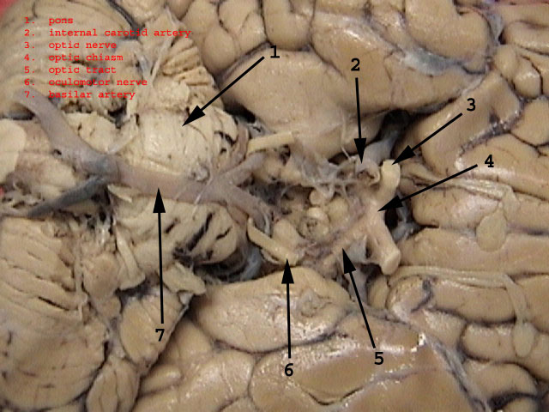
INTRACRANIAL PART

Slide 12
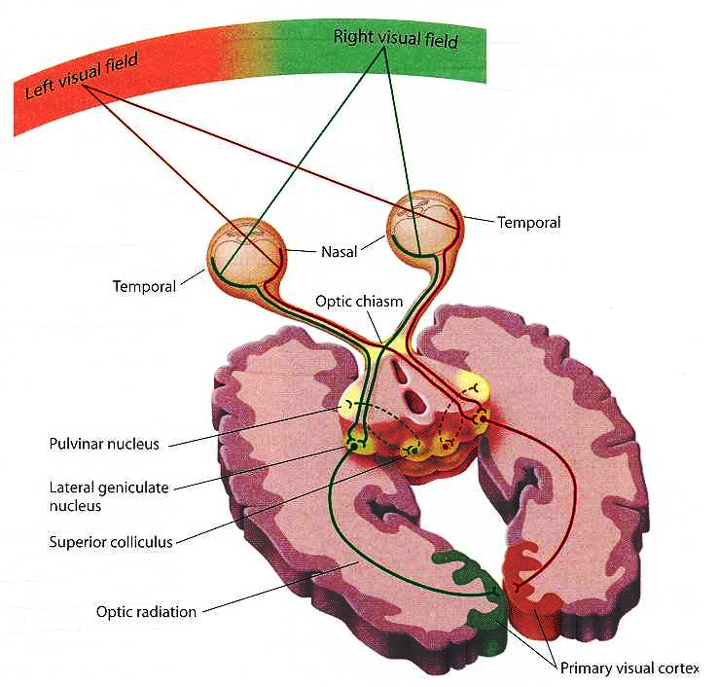
VISUAL PATHWAY

Slide 13
Optic chiasma
Optic tracts
Lateral geniculate bodies
Optic radiations
Visual cortex

Slide 14
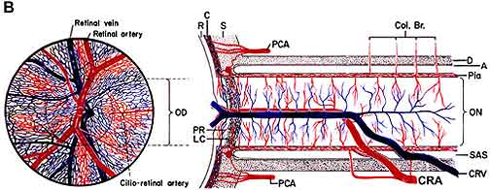
VASCULAR SUPPLY

Slide 15
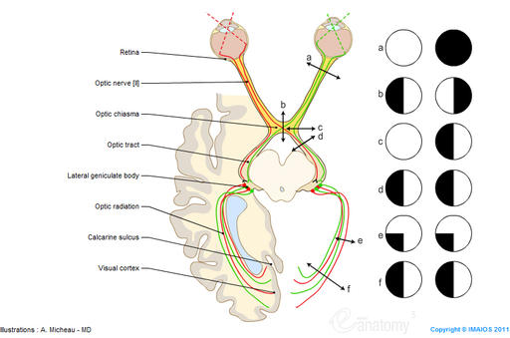
LESIONS OF VISUAL PATHWAY

Slide 16
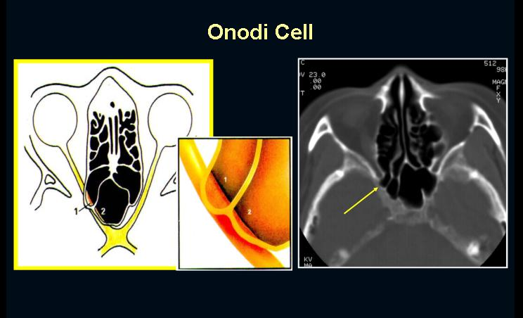
APPLIED ANATOMY

Slide 17
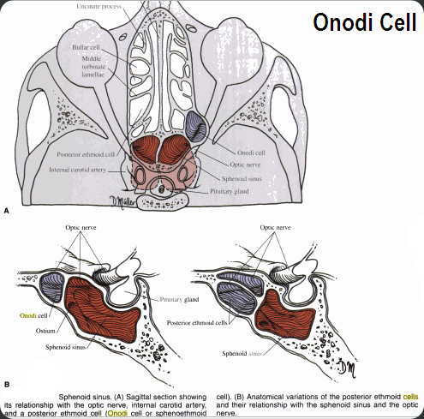

Slide 18
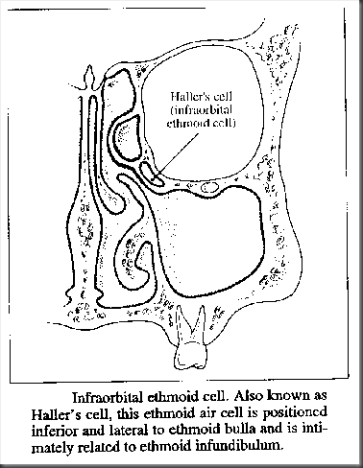

Slide 19
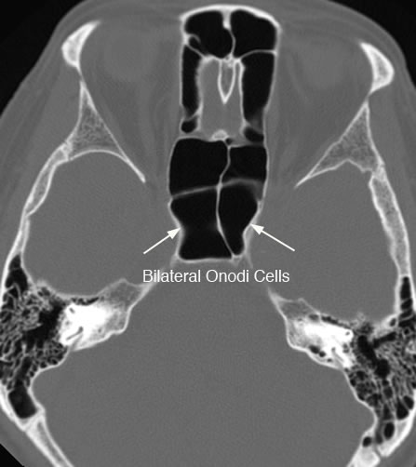

Slide 20
NAME OF STUDY | AUTHOR | REFERENCE | SAMPLE SIZE | RESULT | P value | CONCLUSION
The treatment of traumatic optic neuropathy: the International Optic Nerve Trauma Study | Levin LA, BECK RW, JOSEPH MP, SEIFF’S KRALEER | OPHTHALMOLOGY999 Jul;106(7):1268-77. | 133 | Visual acuity increased by > or = 3 lines in 32% of the surgery group, 57% of the untreated group, and 52% of the steroid group (P = 0.22). The surgery group had more patients whose initial vision was no light perception. | 0.22 | No clear benefit was found for either corticosteroid therapy or optic canal decompression surgery. The number of patients studied was sufficient to rule out major effects in the treatment groups, although clinically relevant effects in specific subgroups could have been missed.

Slide 21
REFERENCE
OPHTHALMOLOGY999 Jul;106(7):1268-77
Levin LA, BECK RW,
JOSEPH MP,
SEIFF’S KRALEER

Slide 22
1. What is not true about optic nerve
a)It is made up of about 1.2 million nerve fibres
b)It is a direct extention of brain
c)It is a nerve in true sense
d)It lacks neurilemma

Slide 23
2. Intraorbital part of the optic nerve is about
a)60 mm long
b)30 mm long
c)10 mm long
d)5 mm long

Slide 24
3. Onodi cells are basically
a)Anterior sphenoid cells
b)Posterior sphenoid cells
c)Anterior ethmoid cells
d)Posterior ethmoid cells

Slide 25
4. Optic chiasma is in close relation with
a)Cavernous sinus
b)Sella tursica/pituitary
c)Lateral sinus
d)Lateral geniculate body

Slide 26
5. Lesions at the level of optic chiasma lead to
a)Bilateral anopia
b)Unilateral anopia
c)Bilateral hemianopia
d)none

Slide 27
THANK YOU

