Slide 1
ANATOMY OF SUBMANDIBULAR GLAND

Slide 2
Levels of Evidence
Grade A – Systemic reviews, Meta analyses, RCT
Grade B – Non-randomized studies
Grade C – Observational studies
Grade D – Case Series, Expert opinion

Slide 3
Levels of Evidence
**** ~ Systematic reviews, meta analysis of randomized control studies
*** ~ Non randomised studies
** ~ Observational or non experimental studies
* ~ Expert opinion

Slide 4
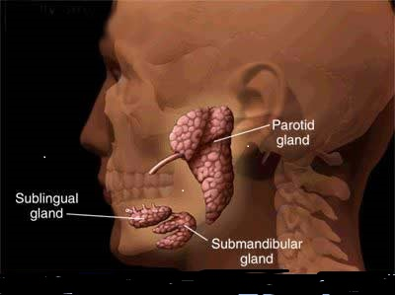
Large salivary gland.
Situated in the anterior part of the digastric triangle.
Roughly J shaped.

Slide 5
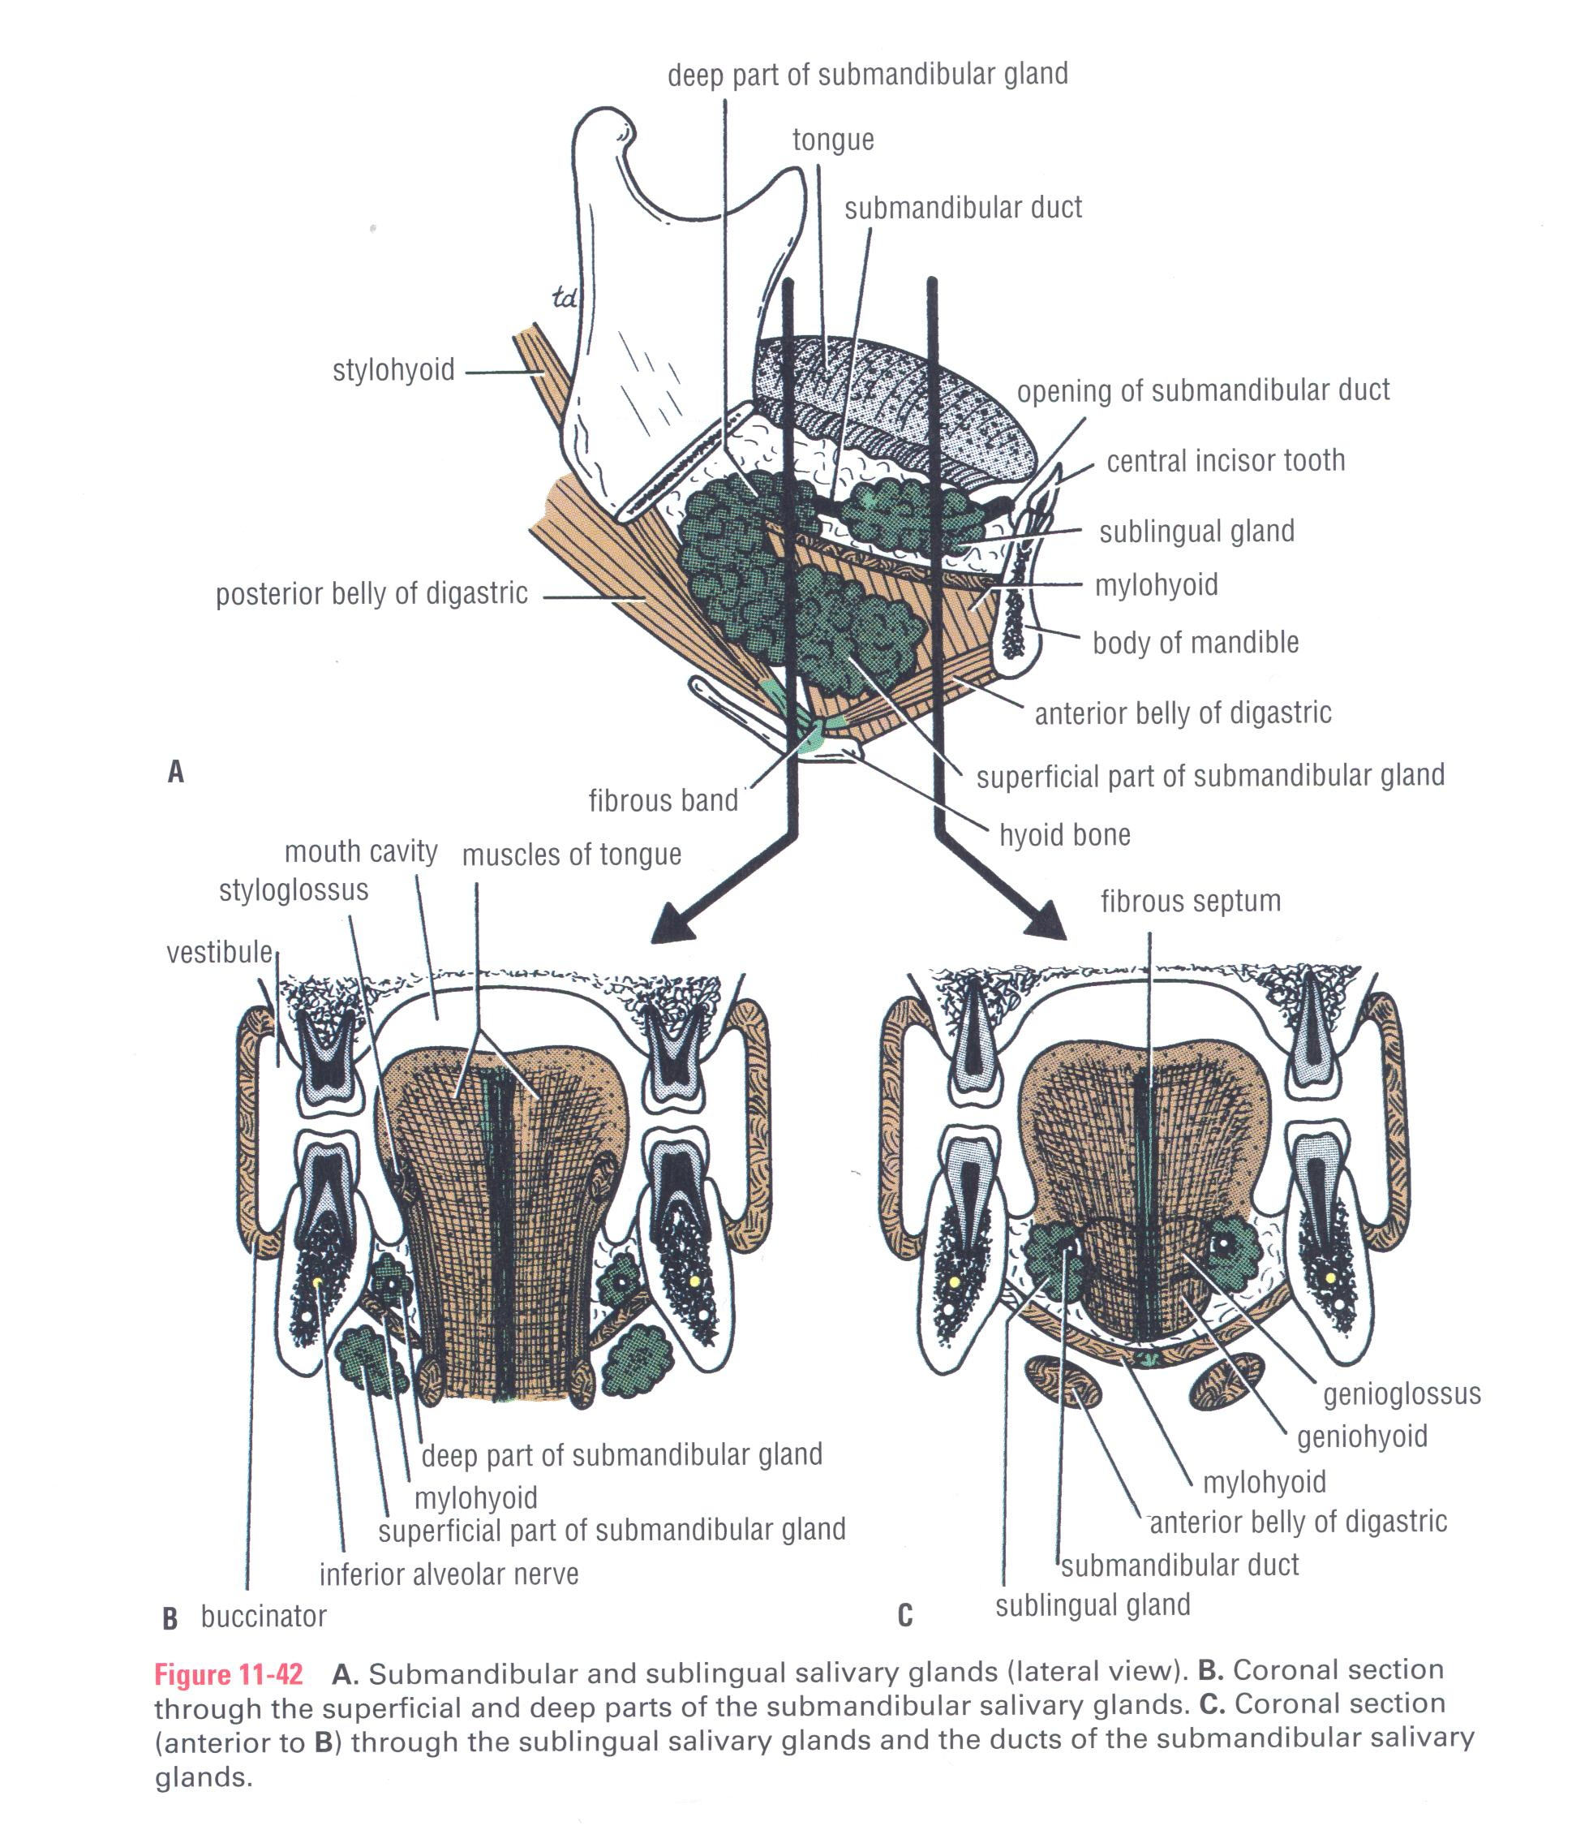
It is a lobulated mass, composed of serous & mucous acini.
It has a large superficial part & a small deep part.
Its deep part is continuous with superficial part around posterior border of mylohyoid muscle.
Its superficial part lies in digastric triangle between mylohyoid & body of mandible (superficial to mylohyoid).
Its small deep part lies deep to mylohyoid and superficial to hyoglossus

Slide 6
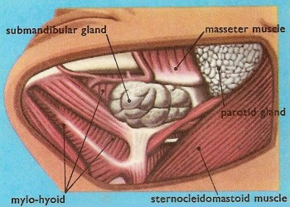
Anteriorly : anterior belly of digastric
Posteriorly : posterior belly of digastric + stylohyoid muscle.
Medially (deep) : -mylohyoid

Slide 7
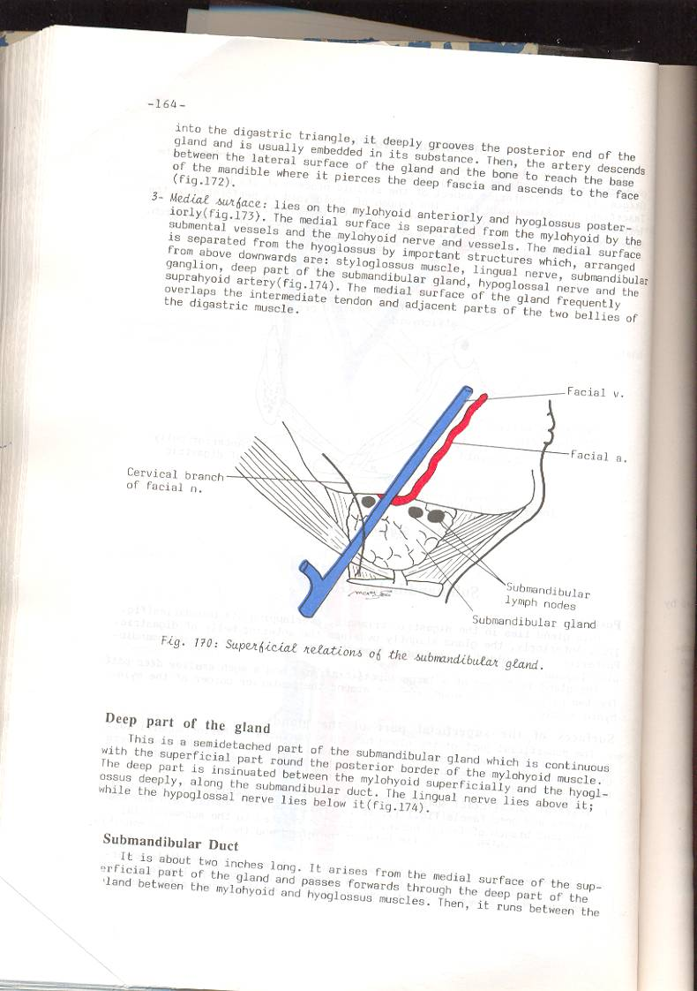
SUPERFICIAL PART
Laterally : -it lies in contact with submandibular fossa on medial surface of mandible.
Inferolaterally (superficial) : -skin, superficial fascia, platysma & investing layer of deep cervical fascia + submandibular L.Ns. -it is crossed by facial vein & cervical branch of facial nerve. -facial artery ascends into digastric triangle, it deeply grooves posterior end of the gland, then passes between lateral surface of gland & the bone to reach base of mandible where it pierces deep fascia to ascend to face.

Slide 8
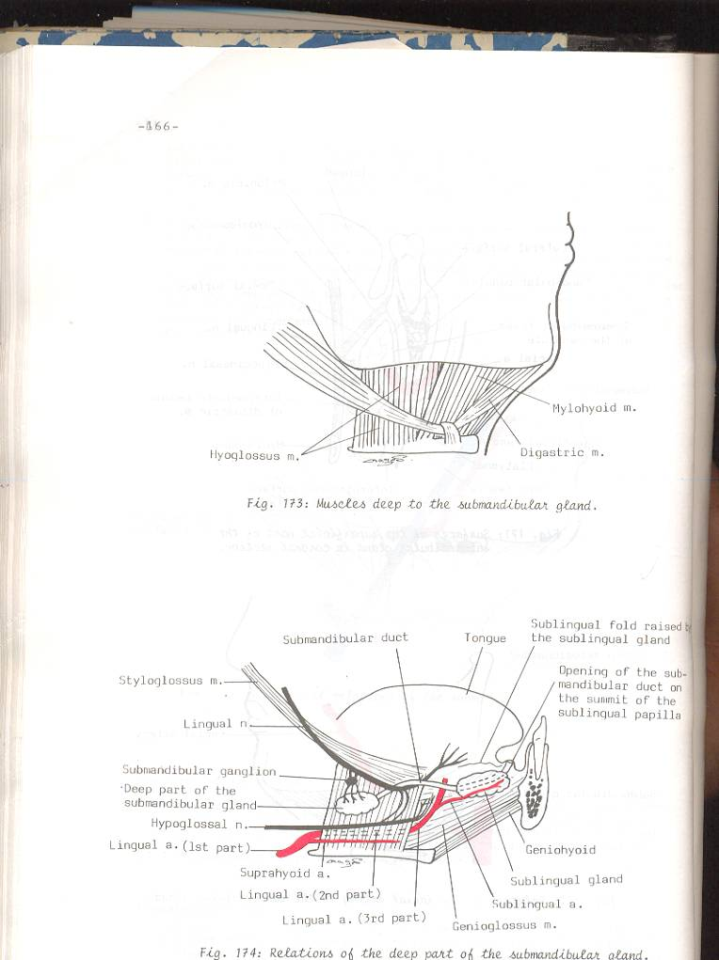
DEEP PART
Medially (deep) : hyoglossus & styloglossus.
Laterally (superficial) : mylohyoid & superficial part of gland.
Superiorly : lingual N. & submandibular ganglion.
Inferiorly : hypoglossal N.

Slide 9
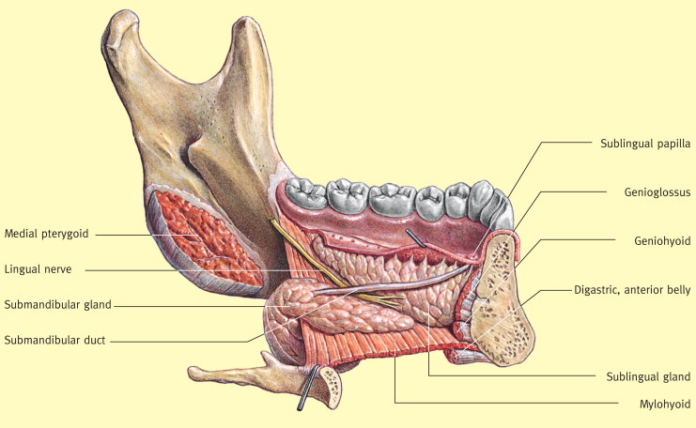
DUCT
It emerges from anterior end of its deep part.
It is crossed by lingual N. ,then lies between sublingual gland & genioglossus muscle.
It opens into floor of mouth at the side of frenulum of tongue.

Slide 10
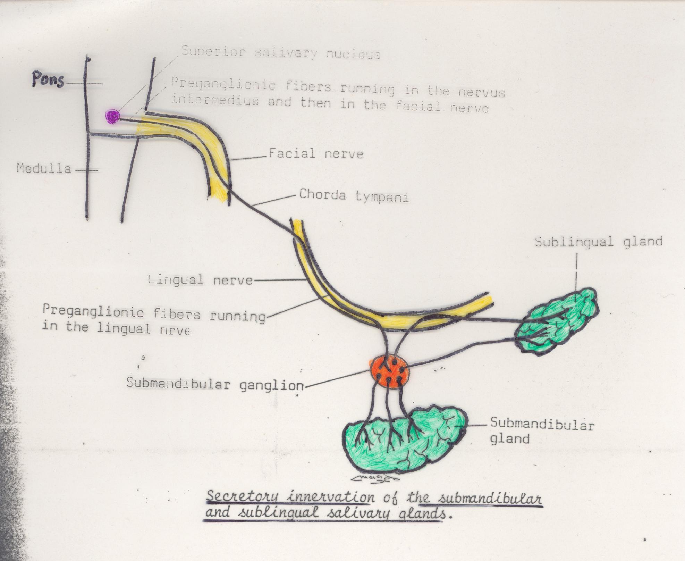
Bl. Supply : branches of Facial & lingual arteries.
Lymph drainage : submandibular + deep cervical L.N.
Nerve supply : 1-Parasym.secretomotor Fs. :. from sup.salivary.N.of 7th C.N. (Facial N.) via chorda tympani N. to join lingual N. and pass into submandibular ganglion, then postganglionic parasymp. secretory Fs. From ganglion via lingual N. into gland. 2-Symp.Fs. : from plexus of nerves around Facial +Lingual arteries.
3-Sensory : lingual N

Slide 11
SIALOLITHIASIS
Calculus formation : its commmon site is the submandibular gland : tense swelling below the body of the mandible,which is greatest during a meal and is reduced in size or absent between meals (diagnostic of the case).
Clinically: by examination of floor of mouth, reveals absence of ejection of saliva from the orifice of duct. stone can be palpated in the duct.

Slide 12
NAME OF STUDY | NAME OF AUTHOR | REFERENCE DETAILS | SAMPLE SIZE | RESULT | CONCLUSION
Primary Tuberculosis of Submandibular Salivary Gland | Leo Francis Tauro, Celine George, Aroon Kamath, GK Swethadri,² and Rohan Gatty | J Glob Infect Dis. 2011 Jan-Mar; 3(1): 82–85. doi: 10.4103/0974-777X.77301 | 2 | . Direct extension to the salivary gland parenchyma by the bacillus may occur through the duct system. Primary tuberculosis of salivary gland may occur in two forms as an acute inflammatory lesion (mimicking acute suppurative sialadinitis) or as a chronic mass (tumor) lesion that may be asymptomatic for many years. | The source of infection in these cases was uncertain. However, it was probably from tooth or tonsils or elsewhere in the oral cavity. Since our patients had no evidence of concomitant tuberculosis elsewhere in the body and tuberculosis of submandibular gland is a rare disease, we did not consider it in our provisional diagnosis.

Slide 13
MCQ

Slide 14
1. Submandibular gland lies in which triangle of neck?:
diagastric triangle
Posterior triangle
All of the above
None of the above

Slide 15
2.How many parts does Submandibular gland has:
2
3
4
1

Slide 16
3.Where does submandibular gland duct opens :
In ear
In Nose
In Mouth
A and B

Slide 17
4.What is the blood supply of the submandibular gland?
Facial artery
Lingual artery
Maxillary artery
A and B

Slide 18
5.What is the lymphatic drainage of the gland?
Submandibular
Deep cervical
All of the above
None of the above

Slide 19
THANK YOU

