Slide 1
Cranial nerve III , IV and VI

Slide 2
Levels of Evidence
Grade A – Systemic reviews, Meta analyses, RCT
Grade B – Non-randomised studies
Grade C – Observational studies
Grade D – Case Series, Expert opinion

Slide 3
Levels of Evidence
**** ~ Systematic reviews, meta analysis of randomized control studies
*** ~ Non randomised studies
** ~ Observational or non experimental studies
* ~ Expert opinion

Slide 4
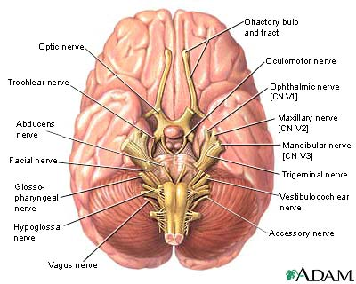

Slide 5
Cranial nerve III

Slide 6
Two motor nuclei:
Oculomotor nucleus
Edinger – westphal
Both the nuclei lie in the midbrain at the level of superior colliculi.

Slide 7
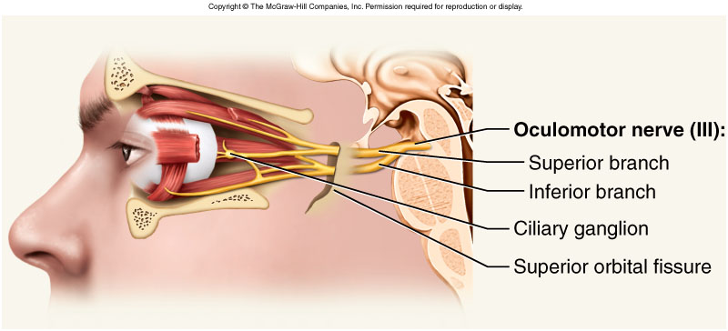

Slide 8
Pathway :
The nerve is attached to the medial surface of the crura of midbrain.
Enters the cavernous sinus.
At the anterior pole of cavernous sinus the nerve divides into superior and inferior divisions.
Both the division pass through the middle part of the superior orbital fissure.
Reaches the orbital cavity.

Slide 9
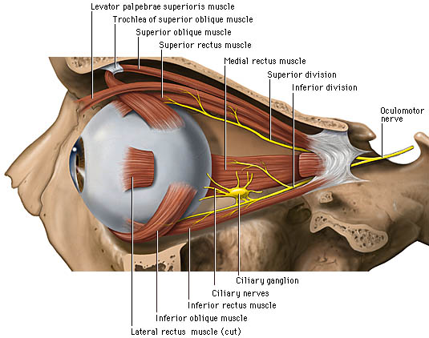

Slide 10
Functions.
Lifting the upper eyelid.
Turning the eye upward downwards and medially.
Constricting the pupil.
Accommodating the eye.

Slide 11
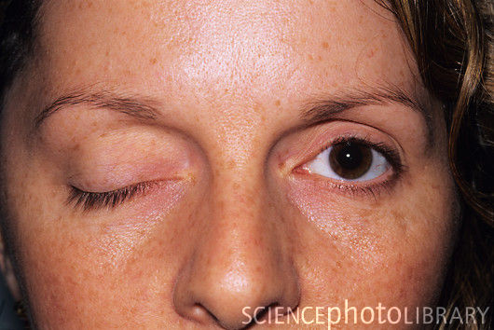
Oculomotor nerve palsy.

Slide 12
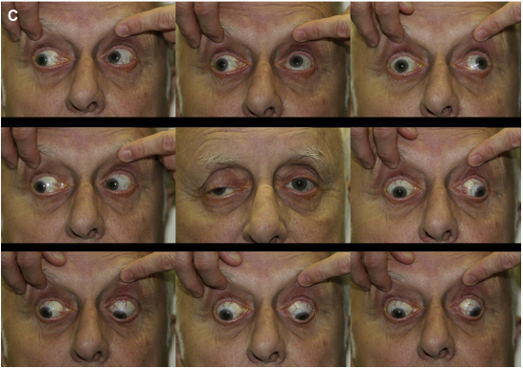

Slide 13
Cranial nerve IV

Slide 14
The nerve has one motor nucleus .
Nucleus lies at the level of inferior colliculi nucleus.
The nerve is unique in three aspects:

Slide 15
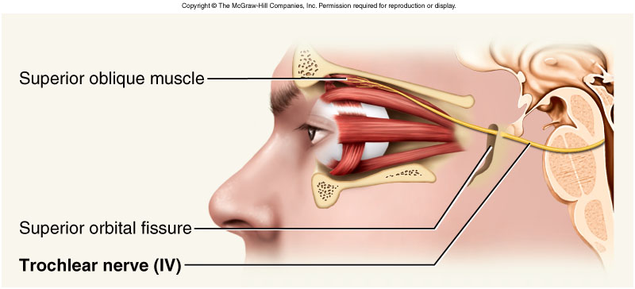

Slide 16
Pathway:
Emerges from the posterior surface of midbrain beneath the inferior colliculi.
Curves around the lateral surface of cerebral peduncles.
Enters the cavernous sinus.
Passes through the lateral part of the superior orbital fissure.
Reaches the orbital cavity.
Supplies superior oblique muscle.

Slide 17
Functions.
Supplies the superior oblique muscles.
Turns the eyeball downwards and laterally.

Slide 18
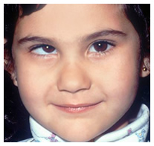
Trochlear nerve palsy

Slide 19
Cranial nerve VI

Slide 20
Abducent nerve has one motor nucleus .
The abducent nucleus is located in the lower pons.

Slide 21
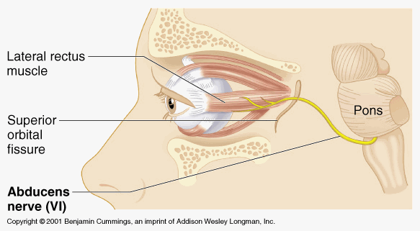

Slide 22
Pathway:
The nerve emerges b/w pons and the pyramid of the medulla .
Enters the inferior petrosal sinus at the apex of the petrous temporal bone.
Passes through the middle part of the superior orbital fissure .
Reaches the orbital cavity.
Supplies lateral rectus muscle.

Slide 23
Functions.
Innervates the lateral rectus muscle of the ipsilateral orbit.
Lateral rectus is responsible for lateral gaze.

Slide 24
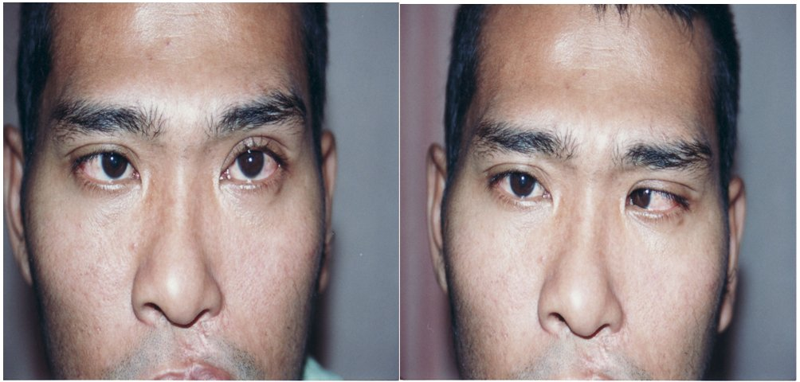
Abducent nerve palsy

Slide 25
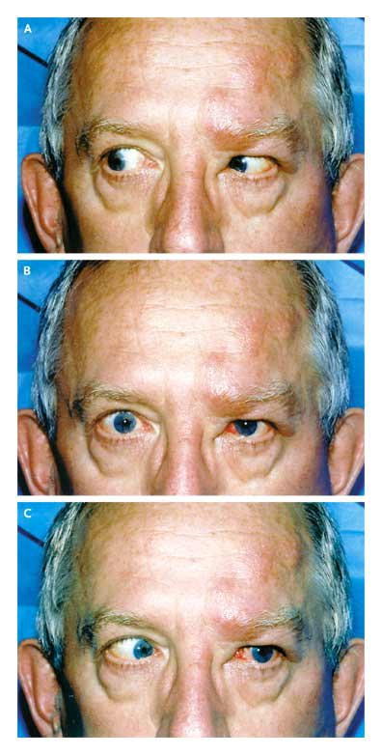

Slide 26
Name | Authors | Ref Page nos. | Sample Size | Results | P value | Conclusions
Microsurgical anatomy of the ocular motor nerves. | Yi Zhang, Hao Liu, En-Zhong Liu, You-Zhi Lin | 623-8 | 50 | The abducens nerve ended on the posterior one-third of the lateral rectus muscle in 86 specimens. If the belly of the lateral rectus muscle was divided into three superior-inferior parts, the nerve commonly entered into the middle one-third in 74 specimens. |  | Based on the observed data, microanatomical relationships of the orbital contents were revised.
Name of study | Author | Reference Page no. | Sample Size | Result | P value | Conclusion
Microsurgical anatomy of the ocular motor nerves. | Yi Zhang, Hao Liu, En-Zhong Liu | 623-8 | 50 | The superior division of the oculomotor nerve coursed between the optic nerve and the superior rectus muscle , a its branches entered into the superior rectus muscle and levator muscle. A mean of five fibers innervated the superior rectus muscle. The inferior division of the oculomotor nerve branched into the medial rectus, inferior rectus and inferior oblique muscles. |  | Based on the observed data, microanatomical relationships of the orbital contents were revised.

Slide 27
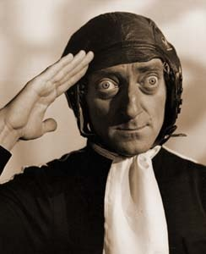
THANK YOU

Slide 28
MCQ

Slide 29
1. What are the functions of oculomotor nerve:
A. Lifting the upper eyelid.
B. Turning the eye upward downwards and medially.
C .Constricting the pupil.
D. Accommodating the eye.
E.All of the above

Slide 30
2. What are the functions of trochlear nerve:
A. Supplies the superior oblique muscles.
B. Turns the eyeball downwards and laterally.
C. All of the above
D. None of the above

Slide 31
3. Abducent nerve has how many motor nuclei:
1
2
3
4

Slide 32
4. What are the functions of abducent nerve
A. Innervates the lateral rectus muscle of the ipsilateral orbit.
B. Lateral rectus is responsible for lateral gaze.
C. All of the above
D. None of the above

Slide 33
Nuclei of Abducent nerve is located in :
Mid brain
Inferior calliculi
Lower pons
None of the above

