Slide 1
ALOPECIA
HAIR LOSS

Slide 2
Alopecia
None Scaring
(Reversible)
Scaring
(Irreversible)
.
X

Slide 3
Introduction & definition
How many hairs in the body?
5 millions hairs; 100,000 in the scalp
Growth rate?
0.3mm/day for scalp hair

Slide 4
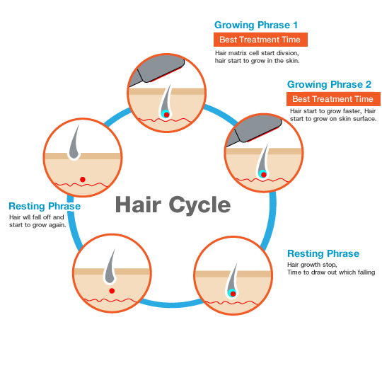

Slide 5
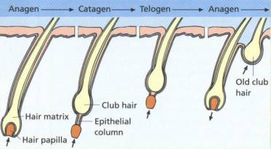

Slide 6
Androgenetic Alopecia
(Male and Female Pattern Hair Loss)

Slide 7
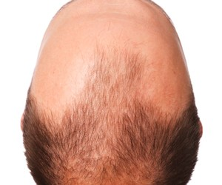

Slide 8
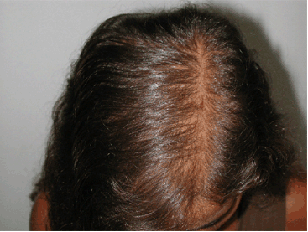

Slide 9
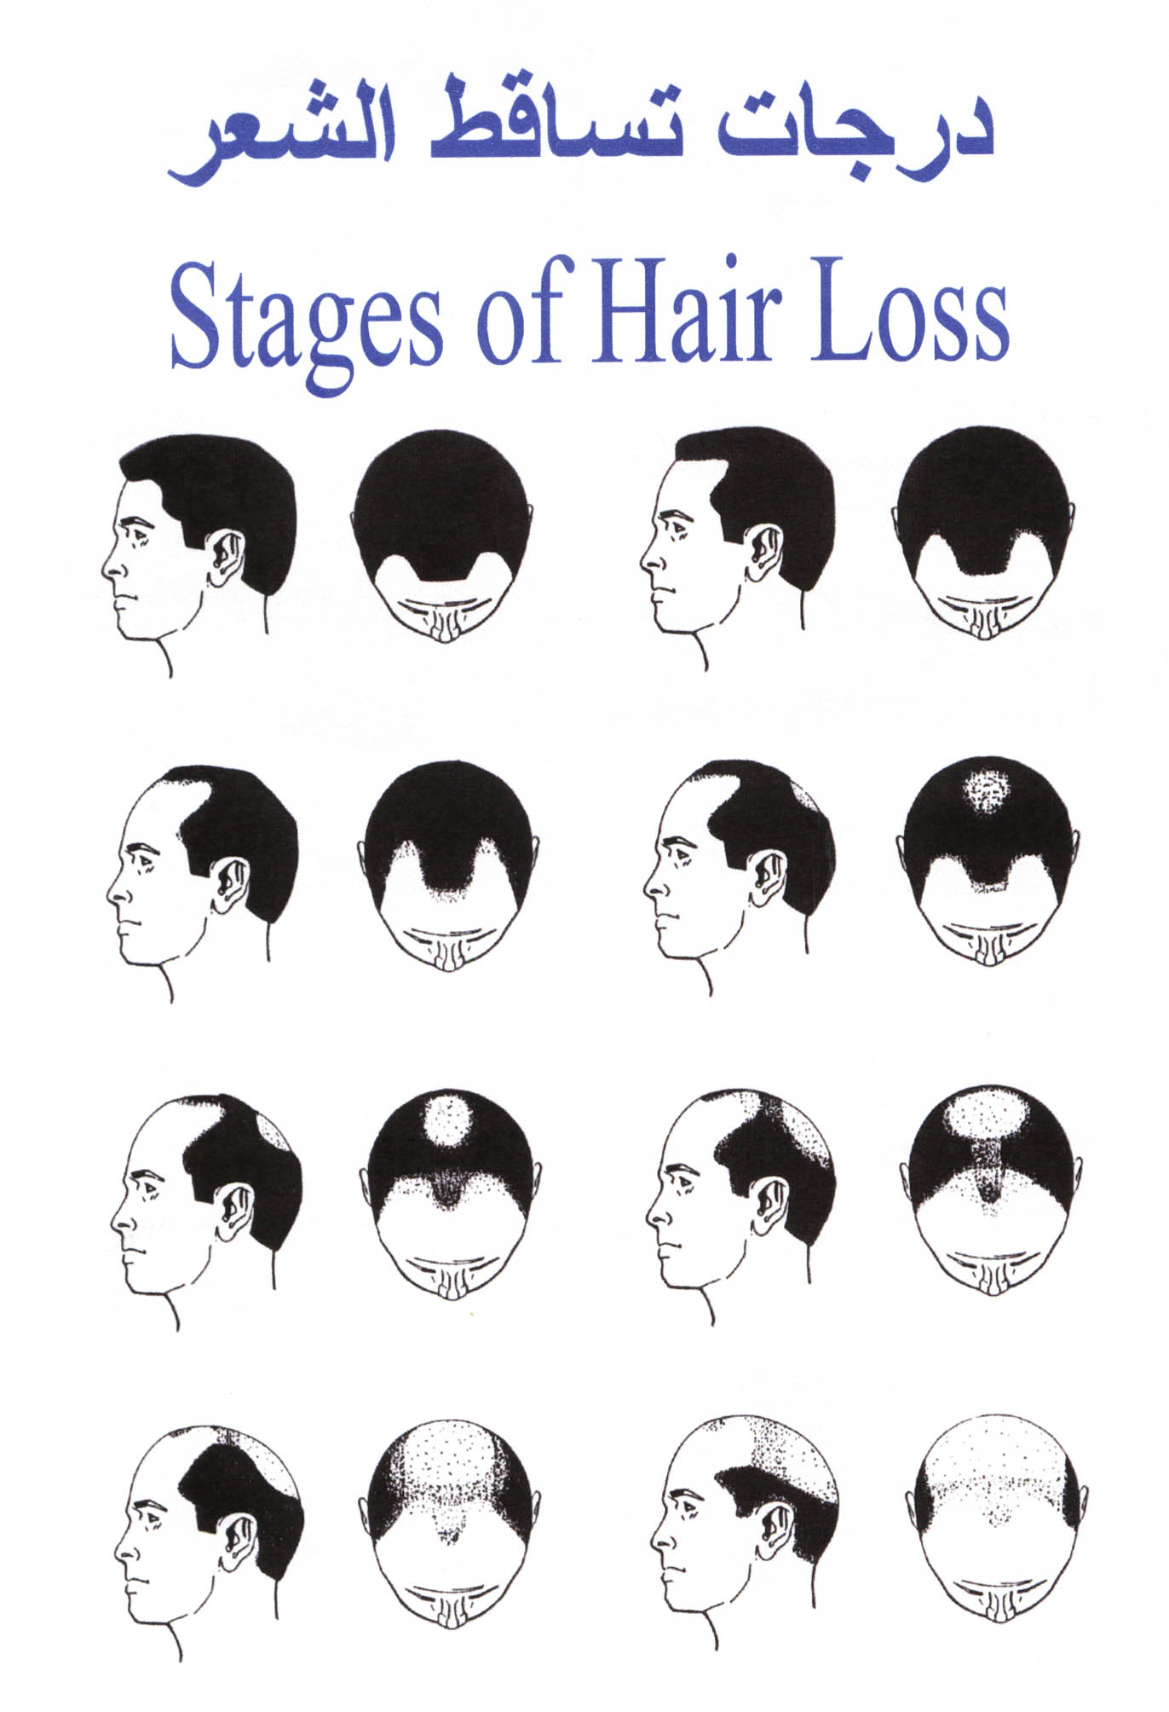
Male Pattern Hair Loss

Slide 10
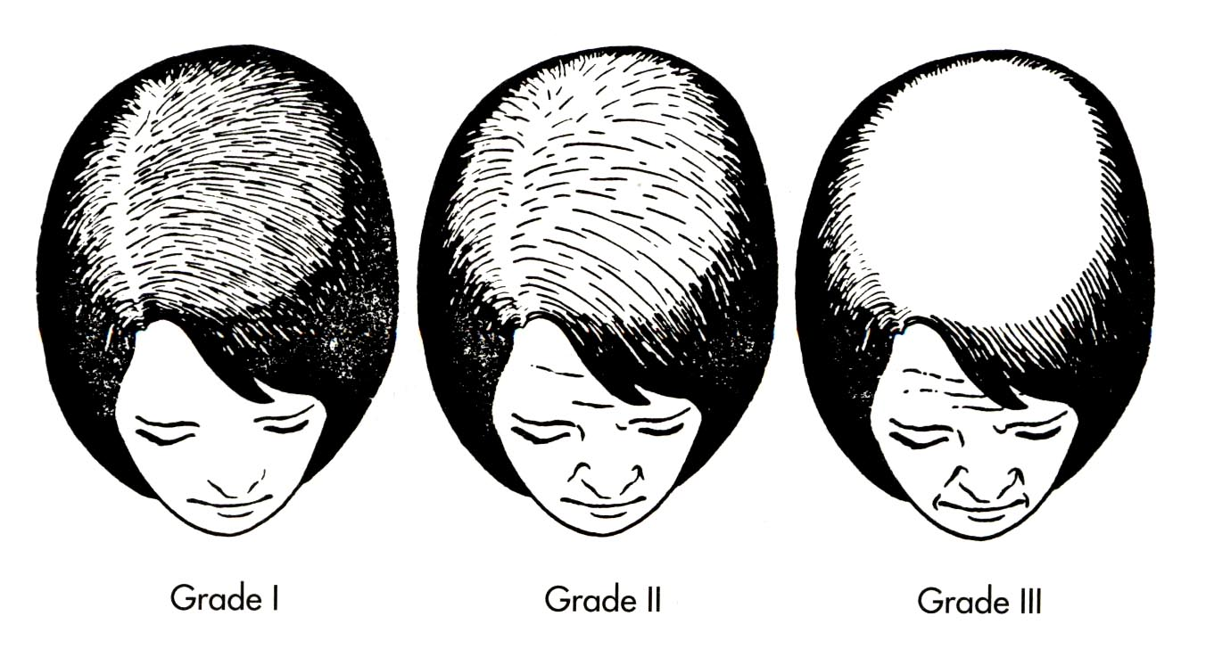
Female Pattern Hair Loss

Slide 11
Androgenetic Alopecia
Androgenetic Alopecia affects up to 50% of males and 40% of females
Autosomal dominant with variable penetrance
85% : +ve family history
Role of androgens in the pathogenesis:

Slide 12
Topical Treatment
Minoxidil 2% and 5% Solution
m/a K+ channel opener
Systemic treatment
Finestride (5 ALPHA Reductase enzyme inhibtion)

Slide 13
Alopecia Areata
Alopecia Areata affects up to 2%
30%: +ve Family history
75% : Self recovery
Role of immune system in the pathogenesis
Types of alopecia areata:
- localized partial
- localized extensive
- alopecia totalis
- alopecia universalis

Slide 14
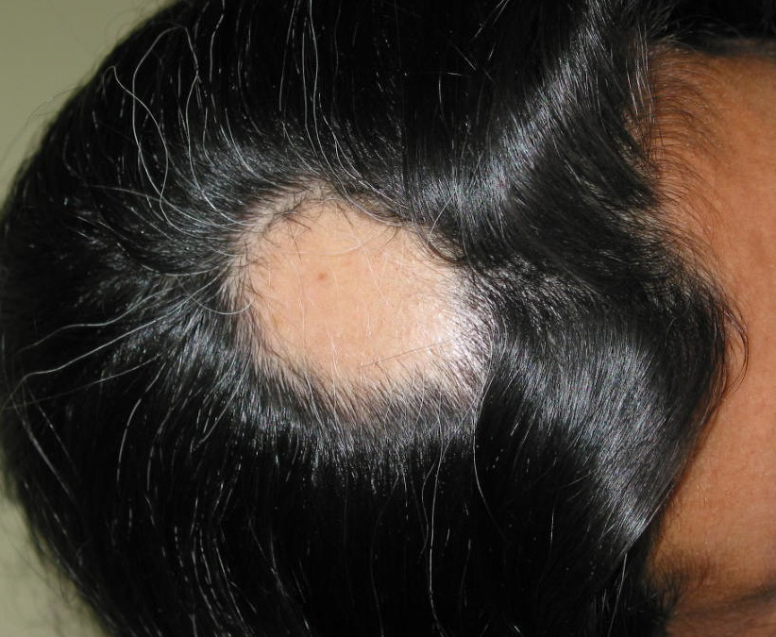

Slide 15
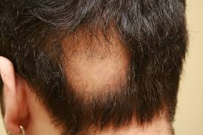

Slide 16
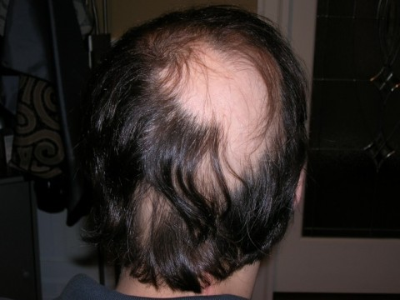

Slide 17
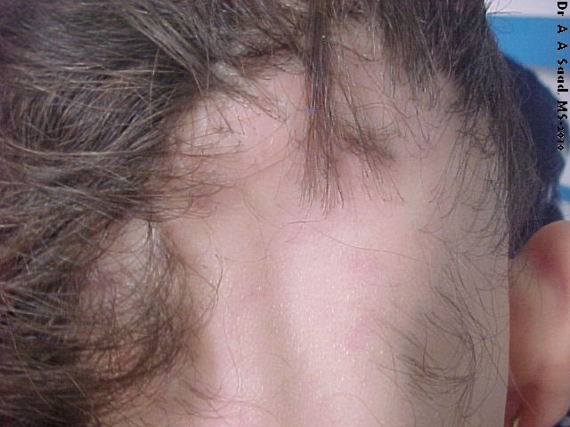

Slide 18
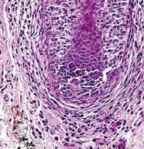
Histopathology of alopecia areata:

Slide 19
Treatment
…

Slide 20
Treatment
1. Intralesional Corticosteroids
2. Topical corticosteroids
Topical salicylic acid
Cryotherapy (liquid nitrogen)

Slide 21
Skin Sensitizers
(Immune modulating Rx)
Diphencyclopropenone (DPCP)
Anthraline
others

Slide 22
Other Rx
Topical steroids
Systemic Steroids
Cytotoxic Rx
Phototherapy
Minoxidil
Hair Transplant
X

Slide 23
Evidence
based
Studies
Journal | Title Level of evidence | Methods | Results | Conclusion
Arch Dermatol. 2009; 145(11):1262-1266. | Alefacept for Severe Alopecia AreataA Randomized, Double-blind, Placebo-Controlled Study Level III | Forty-five individuals with chronic and severe AA affecting 50% to 95% of the scalp hair and resistant to previous therapies. Eligible individuals were randomized to receive either weekly IM administration of placebo or alefacept,15 mg, for 12 weeks, followed by a 12-week, posttreatment observation period. Safety and efficacy were assessed throughout the 24-week study period. Randomization lists detailing the person's identification (ID) number and medication allocation were provided by a coordinating monitor. | Participants receiving alefacept for 12 consecutive weeks demonstrated no statistically significant improvement in AA when compared with a well-matched placebo-receiving group (P = .70). | Alefacept is ineffective for the treatment of severe AA.

Slide 24
JAMA Dermatol. 2014; 150(1):47-50. | Clobetasol Propionate, 0.05%, vs Hydrocortisone, 1%, for Alopecia Areata in ChildrenA Randomized Clinical Trial Level II | This single-center, randomized, blind, 2-arm, parallel-group, superiority trial was carried out over a 24-week period at a tertiary referral academic dermatology clinic at The Hospital for Sick Children in Toronto, Ontario, Canada. Forty-two children attending the outpatients clinic, 2 to 16 years of age with alopecia areata affecting at least 10% of scalp surface area, were eligible; 1 declined to participate. There were no withdrawals from the study. Patients were randomly assigned to receive clobetasol propionate, 0.05% cream, or hydrocortisone, 1%, cream. Patients applied a thin layer of the assigned cream twice daily to the areas of hair loss for 2 cycles of 6 weeks on, 6 weeks off, for a total of 24 weeks. | All participants were assessed at 6, 12, 18, and 24 weeks (except 1 participant who missed the 6-week visit). After adjusting for baseline hair loss, the clobetasol group had a statistically significant (P < .001) greater decrease in the surface area with hair loss, compared with the hydrocortisone group at all time points except at 6 weeks. One patient with extensive alopecia areata experienced skin atrophy that resolved spontaneously in 6 weeks. There was no difference observed in the number of patients with abnormal urinary cortisol at the beginning and the end of the study. | Topical clobetasol propionate, 0.05%, cream is efficacious and safe as a first-line agent for limited patchy childhood alopecia areata.

Slide 25
Multiple choice questions
1.Hairfall following chronic illness is called
a)Anagen effluvium
b)Telogen effluvium
c)Hair shaft deformities
d)Catagen phase
2.Treatment for alopecia areata is
a)Topical steroid
b)Topicaltacrolimus 0.1 %
c)Intralesional steroids
d)All of the above
3.Treatment modality for androgenetic alopecia
a)Topicalminoxidil
b)Oralfinasteride
c)Follicular hair transplant
d)All of the above

Slide 26
4.Normal hair growth is
a)3 mm/week
b)3 mm/month
c)3 mm/day
d)1 mm/day
5.Common hair shaft deformities are
a)monilethrix
b)Trichorrhexisinvaginata
c)Trichorrhexisnodosa
d)All of the above

Slide 27
Thank you

