Slide 1
Acrodermatitis enteropathica and an overview of zinc metabolism
Julie leishangthem

Slide 2
Zinc metabolism
Trace element
<0.01% of the body weight
Total body content in a 70 kg adult : 2.5 g
30% - bones
60% - muscle
Highest conc. : eyes,hair,male reproductive organs,bone
Intermediate levels : liver,kidney,muscle
blood : 80% in RBC carbonic anhydrase
Plasma level :70 – 110 ug/DL(10% more in serum)

Slide 3
Normal range of plasma zinc conc. : variable
Plasma zinc : 50% freely exchangeable(loosely bound to albumin)
7% amino acid bound
Remaining bound to alpha 2-macroglobulin,other serum proteins

Slide 4
3 functions of zinc
Catalytic
Structural
Regulatory

Slide 5
Catalytic
Component of catalytic site of metalloenzymes
Carbonic anhydrase
Alkaline phosphatase
Alcohol dehydrogenase
Carboxypeptidase A and B
Superoxidase dismutase

Slide 6
Structural
Component of gene regulatory proteins
Facilitates appropriate protein folding
Zinc finger proteins – key role in formation and maintenance of all tissues includ. Skin
Eg. ZAC highly expressed in basal keratinocytes has tumour suppressor activity,in bcc expression of ZAC is lost
Intracellular binding of tyrosine kinase to T – cell receptors and CD4 & CD8 coreceptors

Slide 7
Regulatory
Ionic signal in cells moving through gated membrane channels
Inside the cells, it modifies cellular function by binding to and detaching from zinc dependant proteins
Important role in nucleic acid metabolism and protein synthesis
Incorporation of thymidine into DNA
Function of thymidine kinase and DNA dependant RNA polymerase
Inhibits ribonuclease activity

Slide 8
Metabolism
Absorption of zinc :
Duodenum and proximal Small intestine

Slide 9
Mechanism of absorption
Active transport, facilitated by LMW ligands of pancreatic origin.
Ligands bind zinc and transport it to luminal surfaces of intestinal epithelial cell
From there, zinc is transferred to a binding site on the basolateral membrane
Available for attachment to albumin and transferrin proteins in the portal circulation

Slide 10
Metabolism
Percentage of dietary zinc absorbed - 20%-80%
Absorption depends on existing nutritional status & on level of intake.
Preexisting deficiency enhances absorption,
physical & chemical properties of the diet.
Sources
Animal > plant
Phytate
Calcium
Fiber
Metals – Cu,Pb,Fe

Slide 11
Functions of zinc in humans
Growth
Sexual maturation and function
Appetite
Senses of taste and smell
Maintainence of epithelial structures
Wound healing
Cognitive and psychological function
Maintenance of normal immunocompetence

Slide 13
Etiological Factors in Zinc Deficiency
Inadequate dietary intake : low-income diets,old age,protein – calorie malnutrition
Increased zinc requirement : rapid growth,pregnancy,lactation,tissue anabolism
Decreased availability : phytate,fibre
Decreased absorption : malabsorption syndrome,steatorrhoea
Excessive losses : hyperzincuria,surgery,burns,

Slide 14
Iatrogenic : chelating drugs (penicillamine ), parenteral nutrition
Genetic defects : acrodermatitis enteropathica

Slide 15
Acrodermatitis enteropathica
Autosomal recessive disorder of zinc deficiency
Genetic defect has been mapped to 8q24
Defective gene : SLC39A4 (encodes zinc transporter Zip4)
Incidence : 1 in 5 lakh children
Described first by Danbolt & Closs

Slide 16
Pathogenesis
Zn deficiency
Defect in Zip4
A tissue specific Zn regulated Zn transporter abundantly expressed in enterocytes which functions to absorb dietary Zn from SI
Defect in early stages of zinc absorption from duodenum & jejunum
Bioavailability of chemical form & structure in which dietary zinc is presented to intestinal mucosal brush border is reduced thereby causing malabsorption

Slide 17
Clinical features
Onset occurs during infancy
Time of onset depends on the presence and duration of breast – feeding
Not breast fed - 1st 4 : 10 weeks of life
Breast fed infants : 1 – 2 weeks after weaning
Begins within few weeks after birth in bottle fed infants with bovine milk and soon after weaning
Similar to deficiency dermatitis caused by low dietary zinc

Slide 18
Clinical features
Acral and periorificial dermatitis
Alopecia
Diarrhea

Slide 19
Acral dermatitis
Eczematous pink scaly plaques – hands,feet,face,anogenital region
Vesicular,bullous,pustular or desquamative
Erosions
Angular cheilitis(perleche)
Paronychia
Secondary infection with bacteria/candida albicans
Zebra – striped light and dark banding of hair (polarised light microscopy)

Slide 20
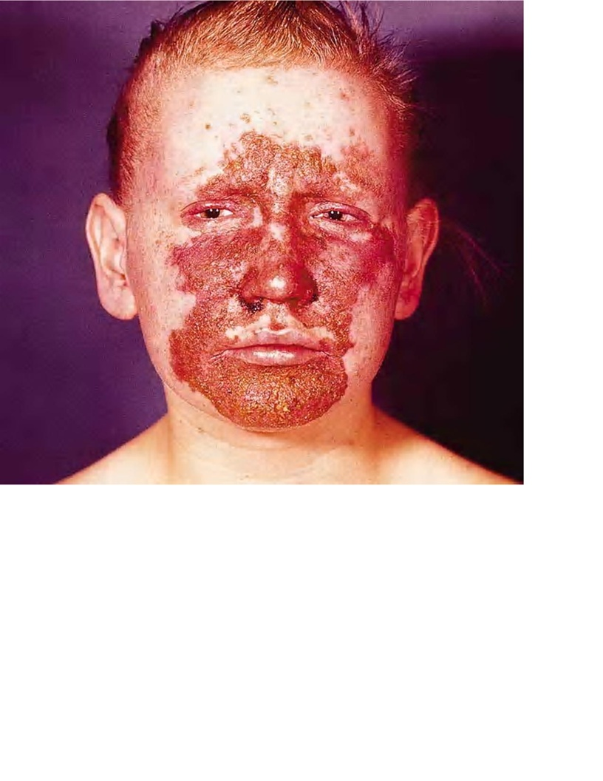
Typical periorificial chronic skin lesions with necrotic areas around the nose. The vermilion area is always spared. The hair growth is poor.

Slide 21
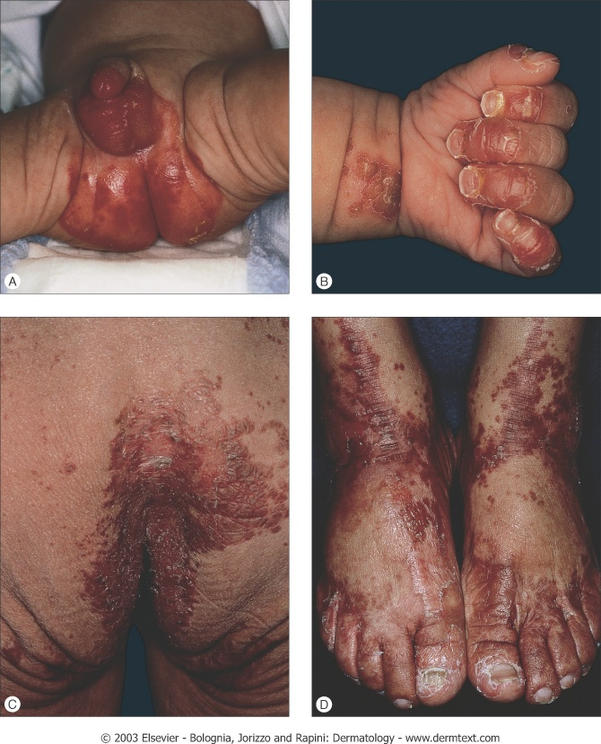

Slide 22
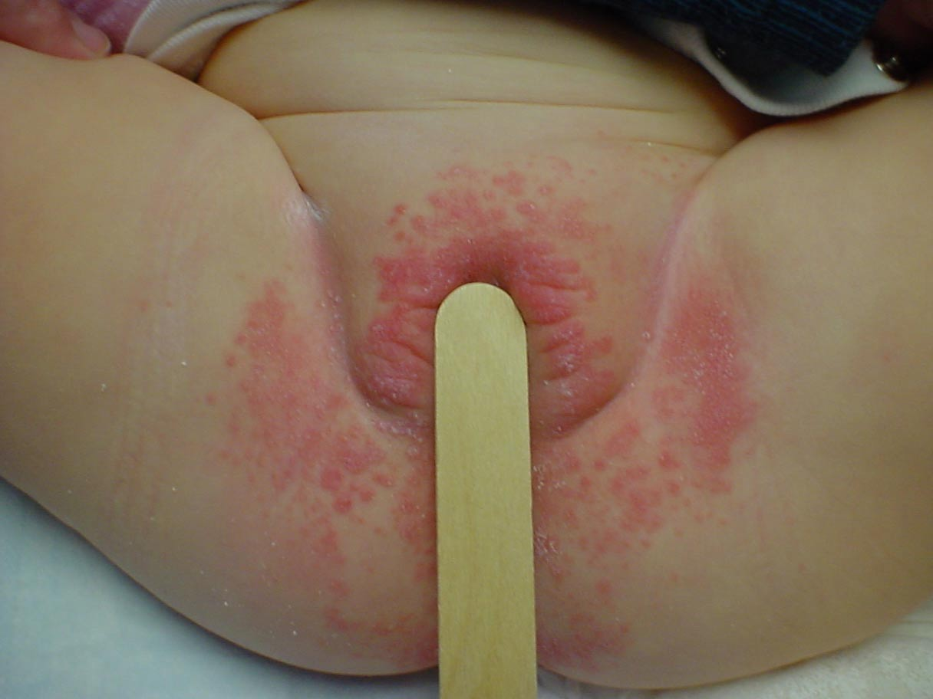

Slide 23
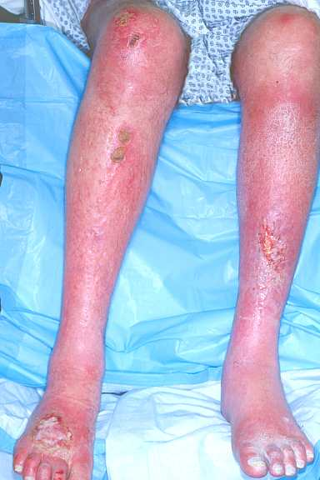
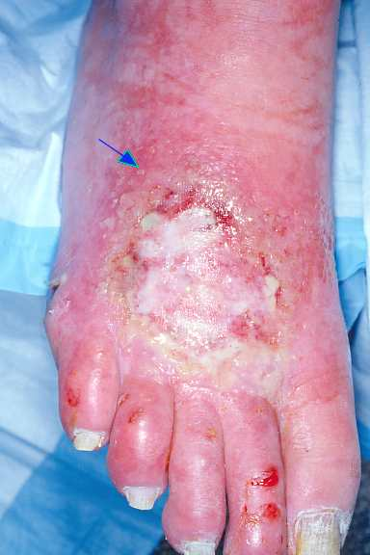
Bilateral erythematous areas with vesicles pustules &ulcers

Slide 24
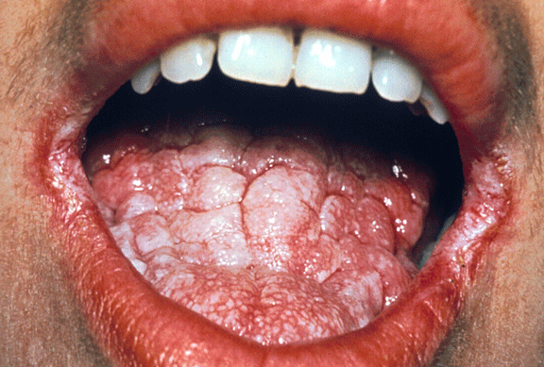
Angular cheilitis

Slide 25
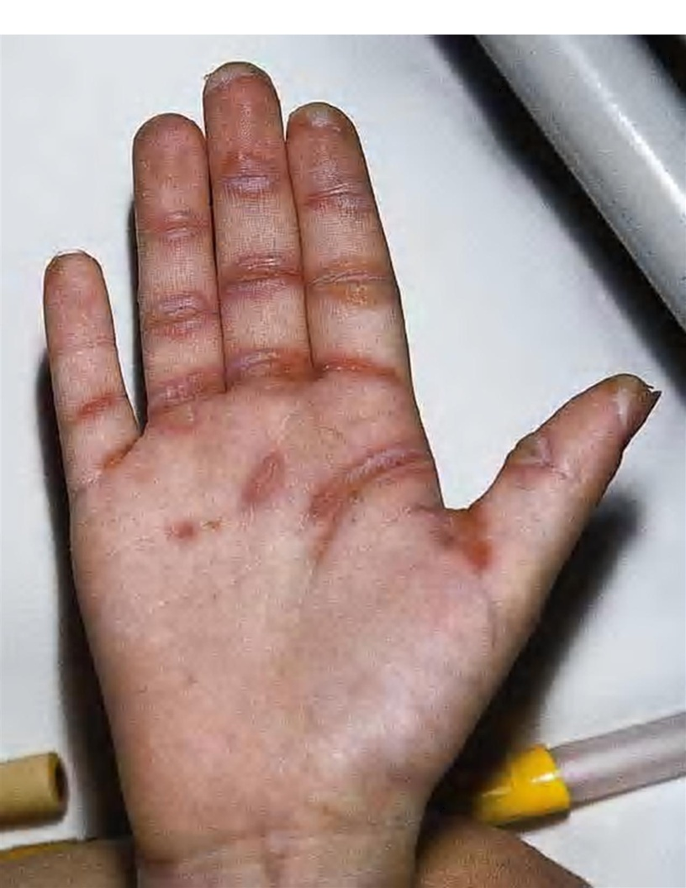
Flat bullae on flexural skin creases

Slide 26
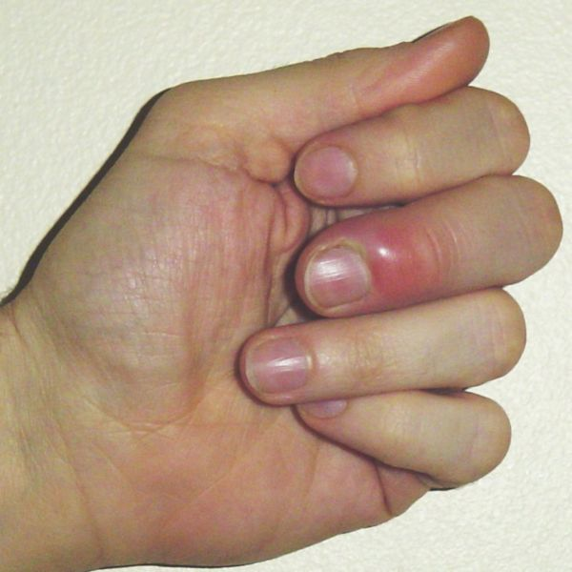
Paronychia

Slide 27
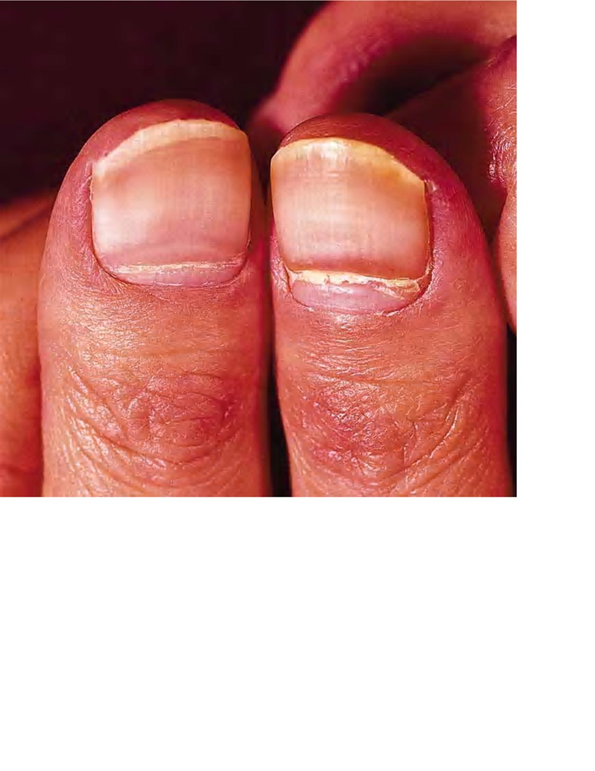
Beau's lines on thumb nails

Slide 28
Alopecia
Worsens with time

Slide 29
Diarrhoea
Most variable manifestation
Other vague GI complaints

Slide 30
Other C/Fs
Growth retardation
Mental slowing
Poor wound healing
Anemia
Photophobia
Delayed puberty
Hypogonadism
Hypogeusia/hyposmia/anorexia
Congenital malformations – neural tube defects
Ocular symptoms – blepharitis,conjunctivitis,corneal opacities
Emotional lability

Slide 31
Non – hereditary zinc deficiency
Acral dermatitis – hallmark
Chronic wasting
GI involvement
Groups at risk
Alcoholics
Vegetarians
Malnourished
Premature infants

Slide 32
Delayed wound healing
Impaired free radical scavenging
Abnormal lymphocyte function
Increased susceptibility to infections
Aggravation of dermatological conditions

Slide 33
Acute zinc deficiency with total parenteral nutrition
Increased urinary zinc excretion during parenteral nutrition , caused by an excess amount of amino acid bound zinc being presented for tubular reabsorption
Periorificial rashes, depression, alopecia, diarrhoea

Slide 34
Histopathology
Pathognomonic of dermatitis
Fully developed “necrolysis” (cytoplasmic pallor, vacuolization, ballooning degeneration, confluent necrosis of keratinocytes in granulosum & spinosum of epidermis)
Keratinocytes have pyknotic nuclei
Confluent parakeratosis assoc.with hypogranulosis
Psoriasiform hyperplasia in resolving AE lesions

Slide 35
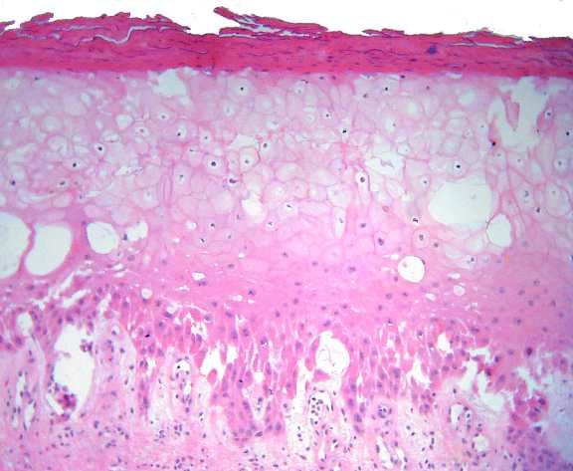

Slide 36
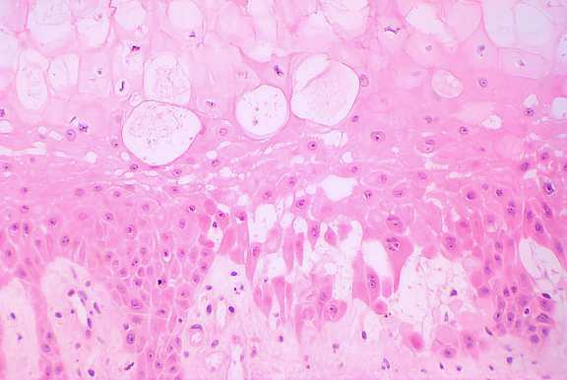
Huge basal keratinocytes as if to explode and small defects in DEJ (high power)

Slide 37
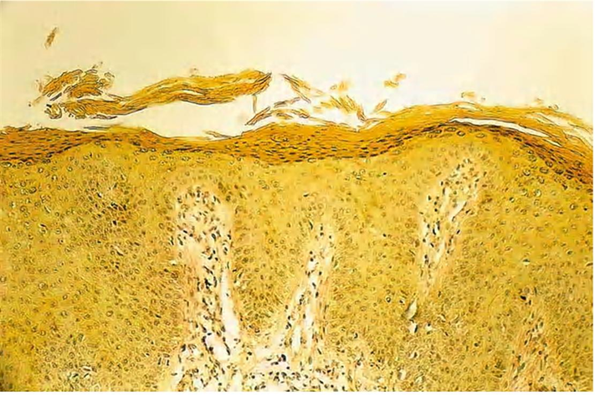
Chronic zinc deficiency with parakeratosis, acanthosis and slight spongiosis.

Slide 38
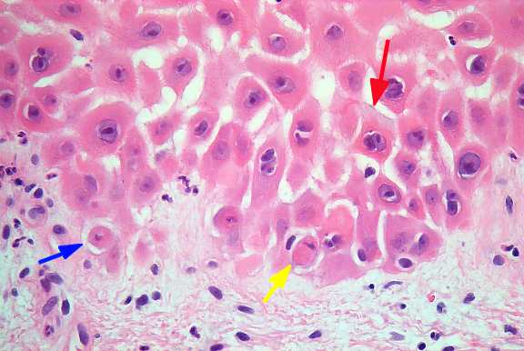
Spongiosis

Slide 39
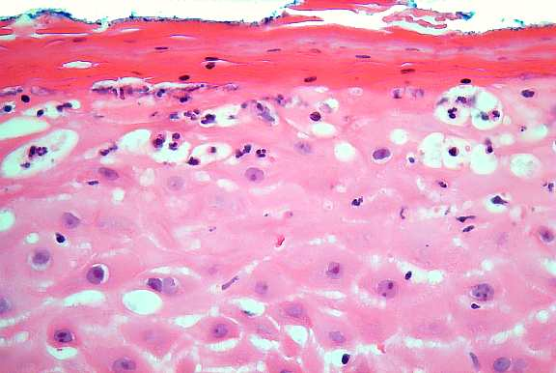
PMN in upper epidermis

Slide 40
Dietary zinc
Average Zn requirement for 0-6 months – 2mg/d
Human milk ideal source of zinc in the first few months of infancy
After 6 months, Zn requirement
7months-3years - 3mg/d
4-8 years – 5mg/d
9-13 years – 8 mg/d
>13 years (boys) & men – 11mg/d
14-18 years (girls) – 9 mg/d , if preg – 12mg/d
>18 years (women) – 8 mg/d, if preg 11mg/d

Slide 41
Investigations
Same for both hereditary & nonhereditary AE
Normal plasma levels (Zn) – 70-110 ug/dl
Normal serum levels (Zn) – 80-120 ug/dl
1. Serum/plasma Zinc levels
Easiest
Most accurate
Most commonly used
2. RBC & leukocyte zinc levels
Difficult
Expensive
More error

Slide 42
Investigations
3. Hair zinc
Commonly measured
Long term zinc levels indicated
4. Serum alkaline phosphatase
Indicator of zinc levels

Slide 43
Treatment
Zinc replacement therapy
Dietary or intravenous supplementation
Started at 3mg/kg/d of elemental zinc (50mg elemental zinc in 220 mg zinc sulphate) in AE
Zn plasma levels & Zn dependent enzymes monitored every 3-6 months
In deficiency dermatitis due to low zinc levels – 0.5-1mg/kg/d of elemental zinc initiated

Slide 44
Treatment response
Clinical improvement seen rapidly(days-weeks) before even a significant change in zinc levels
Severely infected erosive skin lesion improve in 1-2 weeks
Diarrhea improves within 24 hours
Mental improvement in 24-48 hours
In children, surge of total body & hair growth within 3-4 weeks

Slide 45
Types of zinc given
Zinc sulphate (recommended for oral)
Zinc gluconate
Zinc chloride (recommended for iv)

Slide 46
Side effects of Zinc therapy
Gastric irritation with nausea, vomiting, gastric hemorrhage
Large accidental zinc intake can cause fatal multiorgan failure

Slide 47
Journal | Title Level of Evidence | Methods | Results | Conclusion
The New England Journal of Medicine Year : 1975 Volume : 292 Issue : 17 Page : 879-882 | Zinc Therapy of Acrodermatitis Enteropathica Level 4 | The therapeutic effect of orally administered zinc was evaluated in an adult woman with acrodermatitis enteropathica. When she was off therapy and in clinical relapse the plasma zinc concentration (10μg per 100 ml), serum alkaline phosphatase(3 IU per liter) and urine zinc excretion rate (39 μg per 24 hours) were extremely low. | Di-iodohydroxyquin therapy was accompanied by a modest increase in plasmazinc concentrations. Oral zinc sulfate (220 mg three times a day or 50 mg twice a day) resulted in rapid and complete clinical remission, and in a return of plasmazinc, serum alkaline phosphatase and urinary zinc excretion to normal | These data are compatible with a severe zinc deficiency state and indicate that the inherited defect in this disease is either in or closely related to zinc metabolism. The beneficial effects of zinc therapy in this patient provide further confirmation of the efficacy of oral zinc in the treatment of acrodermatitis enteropathica.

