Slide 1
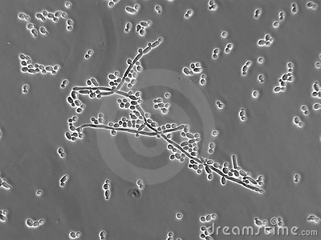
CANDIDIASIS

Slide 2
Candidiasis is an infection caused by the yeasts, of family candida, most commonly(80%) Candida Albicans
It majorly causes superficial infections, however, systemic infections by it are also known

Slide 3
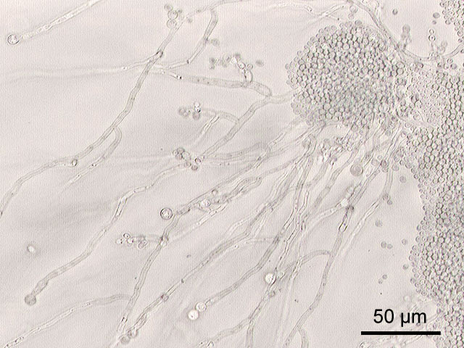
CANDIDA ALBICANS
Oval yeast
2-6 x 3-9 micro m
Produces budding cells, pseudohyphae and hyphae

Slide 4
Carriage Sites
GIT-
  colonization with candida M/C occurs during birth from birth canal
  Of normal subjects, 26% carry yeast in oral cavity while 47% had rectal carriage
Cutaneous
  Not a normal commensal
  Present in the Skin adjacent to body orifices and fingers

Slide 5
Continued..
Vaginal-
  Colonised by candida in 12.7% women
  m/c by C.Albicans,
  sometimes C.Glabrata

Slide 6
Clinical Presentation
Oral candidiasis
Cutaneous cadidiasis
Genital candidiasis

Slide 7
Oral candidiasis
Oral thrush
Acute erythematous candidiasis
Chronic pseudomembranous candidiasis
Chronic erythematous candidiasis
Chronic plaque –like candidiasis
Angular cheilitis
Chronic nodular candidiasis

Slide 8
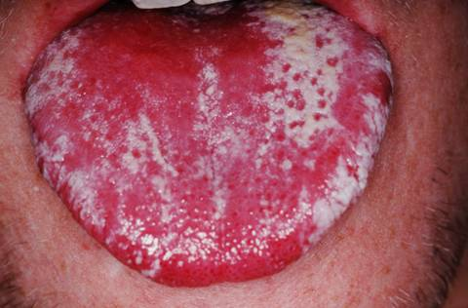
ACUTE PSEUDOMEMBRANOUS CANDIDIASIS
(ORAL THRUSH)
Well defined,
curdy white patches
of pseudomembrane
When removed leaves behind an eryhtematous base
Sites: buccal mucosa, gums, palate, toungue
Seen in : neonates in 1st weeks of life
elderly, debilitated, immunosuppresed pts

Slide 9
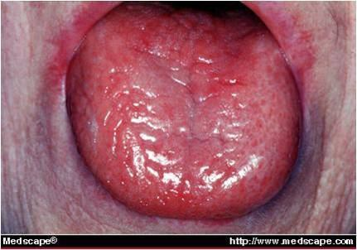
ACUTE ERYTHEMATOUS
CANDIDIASIS
( Acute Atrophic Candidiasis)
Marked soreness
Denuded, atrophic,
erythematous, inflamed mucous membrane
M/C site : tongue
Cause: use of antibiotics(M/C) or corticosteroids

Slide 10
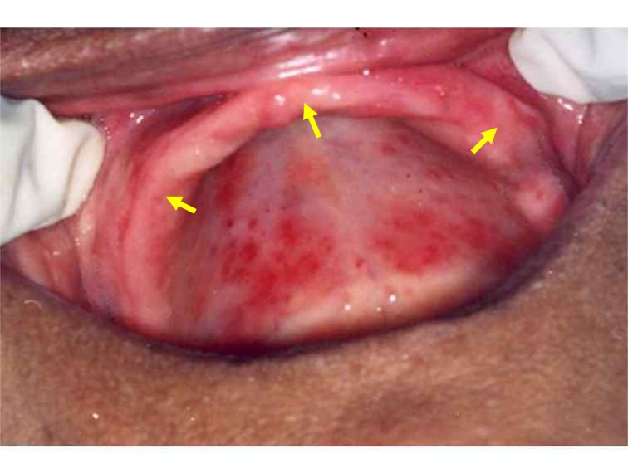
CHRONIC ERYTHEMATOUS CANDIDIASIS
( CHRONIC ATROPHIC C./
DENTURE SORE MOUTH)
Bright red, sharply defined,
shiny atrophic epithelium
Associated with angular cheilitis
Cause: dentures and orthodontic appliances
m/c site: upper denture area ie palate, gums

Slide 11
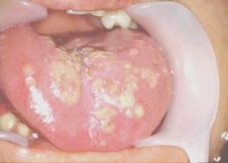
CHRONIC PLAQUE LIKE CANDIDIASIS
(CANDIDAL LEUKOPLAKIA)
Persistent ,firm ,irregular, white plaques
Surrounded by erythematous margin
Not easily removed
M/C site: tongue and cheeks
Seen M/C in men

Slide 12
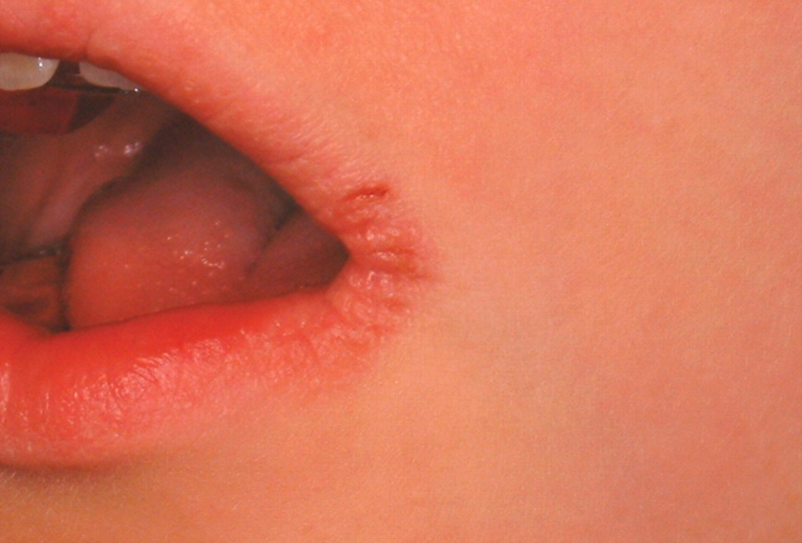
Angular cheilitis
Soreness, erythema, maceration,
fissuring at the angles of the mouth
Predisposing factors: habitual lip licking, nutritional status , deep folds

Slide 13
Cutaneous candidiasis
Flexural (intertrigo)
Napkin candidosis
Perianal and scrotal candidosis
Granuloma gluteale infantum
Candidal paronychia
Onychomycosis

Slide 14
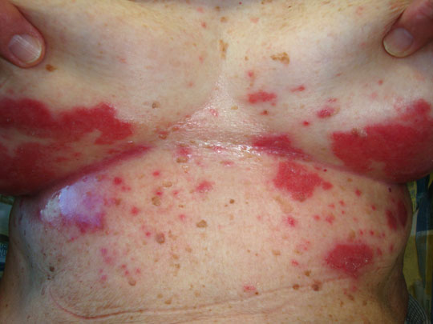
Flexural candidiasis
(Intertrigo)
Effects the skin folds
Retention of moisture, inc temp
maceration favour candida growth
Initially there is erythema and
moist exudation
Fringed, irregular edges, subcorneal pustules which rupture to from erosions
Characteristic - presence satellite pustular lesions
Soreness and itching

Slide 15
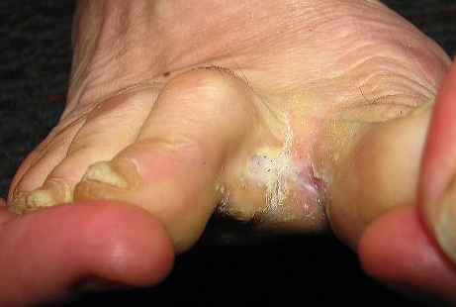
Erosio-interdigitalis blastomycetia
candida infection of the web spaces
There is marked maceration, with a prominent thick, white horny layer
Macerated Skin under the rings and dressings can also be affected

Slide 16
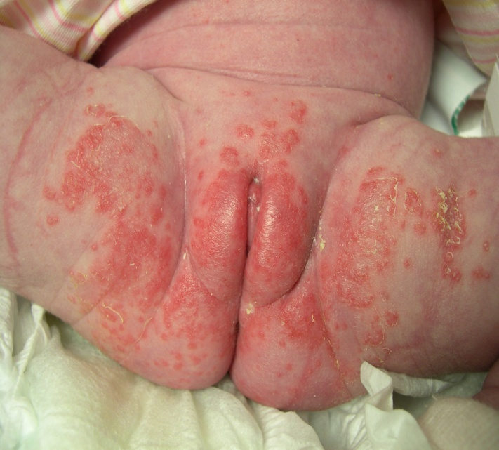
Napkin Candidosis
Candida though is commonly
Present, it is more prevelant
Where the skin is infected with napkin rash
Subcorneal pustules, fringed irregular border and sattelite lesions are seen
Application of steroid creams modify the clinical features and even enhance growth of candida

Slide 17
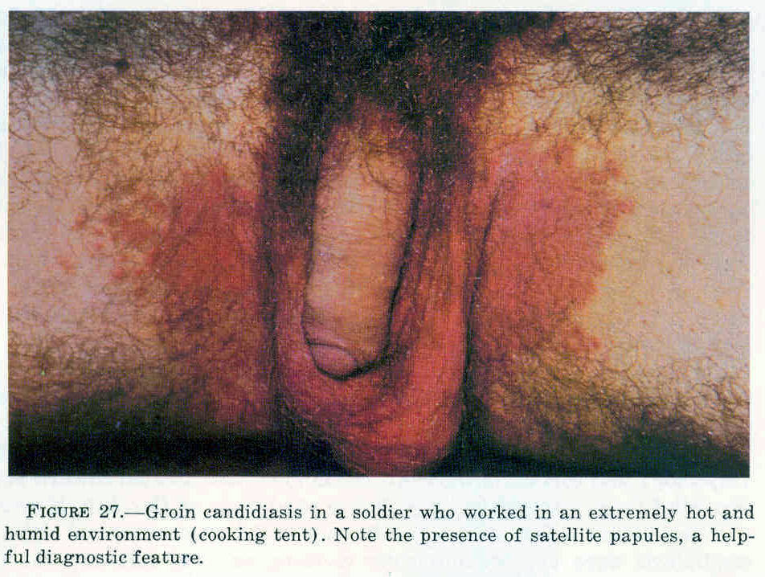
Perianal and scrotal candidosis
Usually seen in men working
in hot and humid Climate
Begins initially as soreness,
erythema and itching in the perianal area
Latter spreads along the natal cleft and also involves the scrotum
erythema and soreness are usual features, however Subcorneal pustules are not often seen

Slide 18
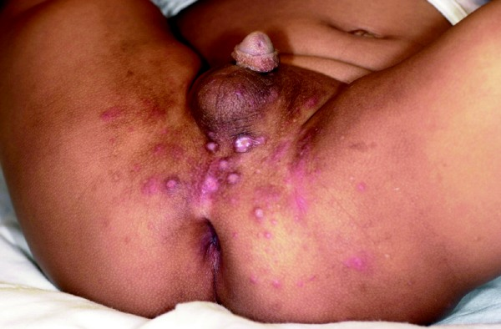
Granuloma gluteale infantum
Rare condition
Sites: buttocks, genitalia,
upper thigh and pubis
Features:bluish brown nodules develop
primary rash may clear leaving behind the nodules
Marked scaling and hyperkeratosis may also be present

Slide 19
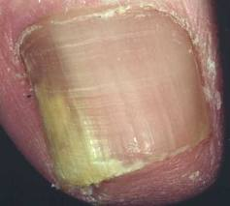
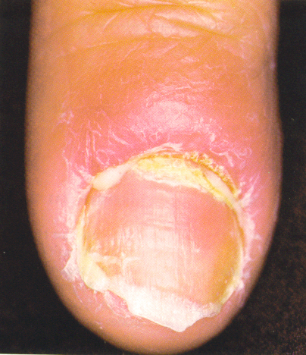
Candidal paronychia & onychomycosis
Characteristic feature is distal and sunungual onychomycosis
Seen more in people who are chronically exposed to organic debris
It can lead to complete destruction of nail plate
Paronychia : nail fold is red and tender, loss of cuticle, pus discharge may be present

Slide 20
Genital candidiasis
Vulvovaginal candidiasis
Candidal balanitis

Slide 21
Vulvovaginal candidiasis
Seen in 75% women
More common in pregnancy
Itching, soreness and thick creamy white discharge
O/E- dusky erythema of vaginal mucosa
In chronic cases the mucosa becomes glazed and atrphic
The rash can extend to involve the pernieum and groins

Slide 22
Candidal balanitis
More common in diabetic and in those whose partner is suffering from vulvovaginitis
Mild cases- small papular lesion on glans which rupture leaving peeling edges
chronic and severe cases- inflammatory changes become persistent- soreness, irritation, erythema and even erosions can develop

Slide 23
Lab diagnosis
Direct examination:
Oval thin walled yeast cells
Pseudohyphae

Slide 24
Culture:
Colony – appear in 48- 72 hrs
creamy white, smooth

Slide 25
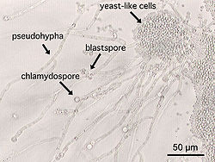
Microscopy:
budding yeast cells
Pseudohypae
Germtubes- rudimentery ture hypae
Chlamydospore- refractile vesicles produced on ends of filaments

Slide 26
Other test:
Physiological tests-
  sugar and nitrogen source assimilation
  Presence /absence of urease
Serology and immunology
  ELISA -For cell wall component mannan

Slide 27
Treatment
The rule in the therapy of is to eliminate the predisposing factors
To control some factors;
  the administration of antibiotics, steroids, and immunosuppressants
  humidity,
  local maceration
  vaginal pH
  fitting dental prostheses.
Topical antifungal
Systemic antifungal agents

Slide 28
Cutaneous candidosis
If the affected area is erythematous,
only topical antifungal agents are applied
imidazoles (eg, bifonazole,clotrimazole, fenticonazole, isoconazole, ketoconazole,miconazole, omoconazole, oxiconazole, terconazole)
These topical antifungals are applied twice daily until the patient is cured.

Slide 29
If the lesions persist, and In severe cases,
systemic triazoles,-
fluconazole (150 to 300 mg weekly for 4 weeks)
itraconazole (200 mg every 12 hours for 4 weeks)
A new triazole, posaconazole, in oral suspension (800 mg daily for 3 weeks) is effective for most Candida spp.

Slide 30
Oral candidosis
One of the most commonly used drugs is nystatin as a solution, administered as a rinse 2 to 3 times a day.
It is recommended that the rinse be swallowed.
In serious and very extensive cases of oral candidosis,
the oral triazoles as mentioned earlier should be administered

Slide 31
Vulvovaginal candidosis
Topical azoles in the form of vaginal creams or suppositories are commonly used.
These include butoconazole,clotrimazole, econazole lipogel, fenticonazole, ketoconazole,miconazole, omoconazole, oxiconazole, and terconazole.
Oral triazoles, such as fluconazole as a single dose of 150 to 300 mg, can also be given.

Slide 32
Paronychia and onychomycosis
Systemic treatments are used.
These include
itraconazole at 200 mg daily for 3 months,
or 200 mg every 12 hours for one week each month for 3 months
Fluconazole at 1 to 2 mg/kg daily in children aged older than 1 year until cured and
150 to 300 mg weekly for 4 to 6 weeks in adults
voriconazole intravenously at a dose of 4 mg/kg every 12 hours or orally at 100 to 200 mg every 12 hours

Slide 33
Topical treatments can be used for lactating mothers and preschool children when less than 50% of the fingernails are affected or when the patient is intolerant to oral antifungal drugs.

Slide 34
Thank you

