Slide 1
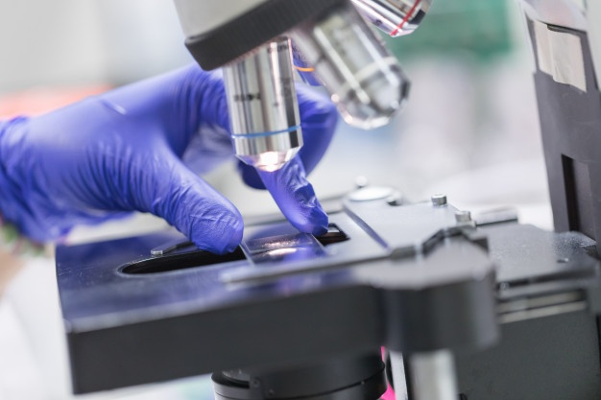
PATTERNS OF INFLAMMATION

Slide 2
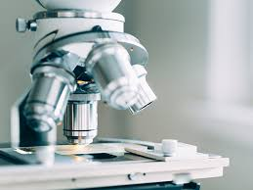
CELLS

Slide 3
LYMPHOCYTES
large round cells + large dark nucleus filling the entire cell leaving a rim of cytoplasm in periphery
“ a blue cell is a lymphocyte “
MACROPHAGE
Cell with large pale and clear nucleus with abundant cytoplasm.
Derived from monocyte.
Hallmark is its motility and phagocytic function.
HISTIOCYTE
In granuloma these macrophages are fixed to the tissue

Slide 4
EPITHELOID CELLS
These macrophages – influence of lymphokines – transformed into epitheloid cells .
Greater phagocytic activity and less motility.

Slide 5
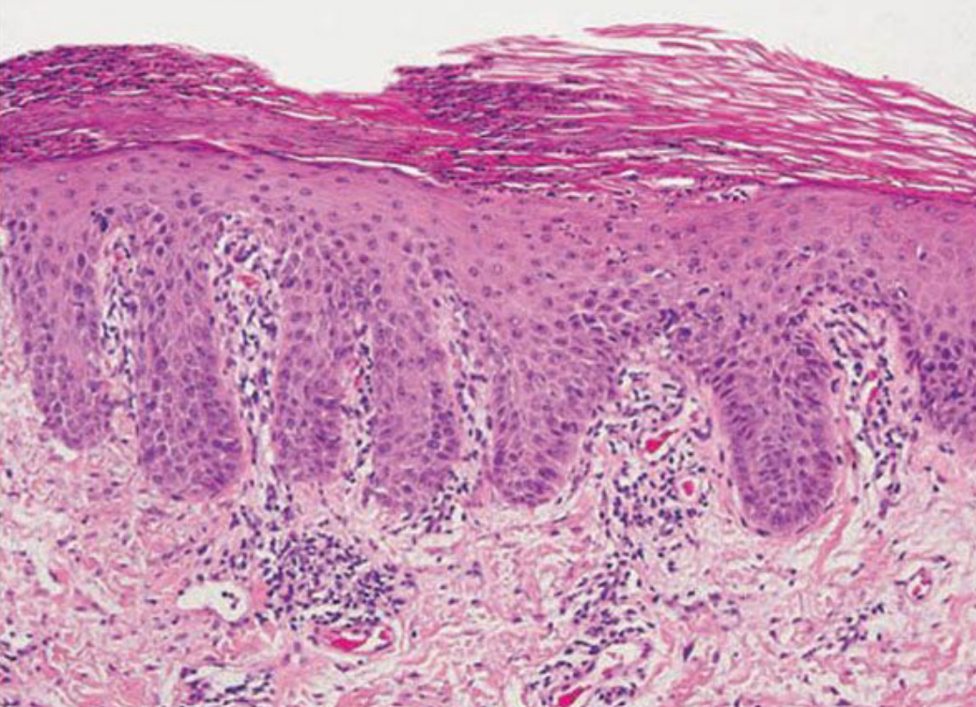
DEFINITIONS
PARAKERATOSIS :
refers to retention of nuclei by the cells of the stratum corneum.
associated with absence of granular layer
due to delayed maturation process and altered process of keratinization

Slide 6
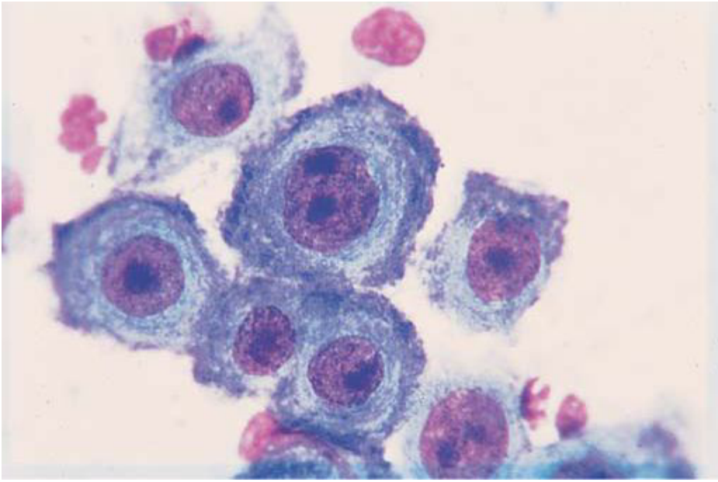
ACANTHOSIS : thickening of the stratum malpighii layer
(str. spinosum + str. Basale)
ACANTHOLYSIS : loss of cohesion of keratinocytes due to breakdown of intercellular bridges (clefts, vesicles and bullae)

Slide 7

INTRODUCTION
The concept of reaction patterns in dermatopathology helps in formulation of algorithms for diagnosis.
Pinkus – first to suggest an approach based on tissue reactions.
Finally it was perfected by Ackerman.

Slide 8
Weedon’s scheme - major patterns
- minor patterns
- cellular patterns
Ackerman’s scheme – divided into nine types of reaction patterns
By Maize et al - another scheme - based on anatomical levels

Slide 9
Combining al the schemes ..following sceme is proposed
A] EPIDERMAL REACTIONS
major minor
- psoriasiform - epidermolytic hyperkeratosis
- spongiotic - acantholytic dyskeratosis
- vesiculobullous - cornoid lamella
- papillomatosis
- atrophy
B] DERMOEPIDERMAL JUNCTION (INTERFACE DERMATITIS) - lichenoid
- vacuolar

Slide 10
C] DERMAL - granulomas
- vasculitis
- fibrosing reactions
- subepidermal bullous diseases
- superficial perivascular inflammations
- superficial and deep perivascular inflammations
D] SUBCUTIS - septal panniculitis
- lobular panniculitis
E] APPENDAGEAL - folliculitis
- perifolliculitis

Slide 11
PSORIASIFORM
Parakeratosis
Acanthosis
Regular and club shaped elongation of rete ridges
Suprapapillary thinning of stratum malpighii
Dilated and tortuous blood vessels in dermal papilla
- Auspitz sign

Slide 12
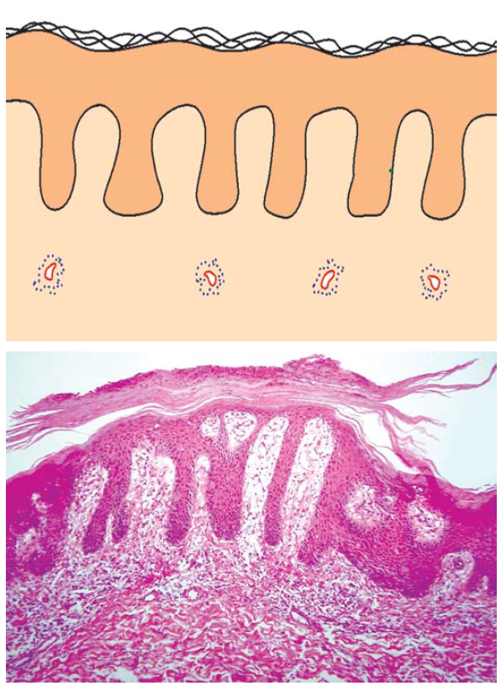
The prototype disease of this pattern is psoriasis..
Psoriasis: Regular hyperplasia of the epidermis with suprapapillary thinning and dilated tortuous vessels in the papillary dermis.
Neutrophilic collections are seen in the foci of parakeratosis.

Slide 13
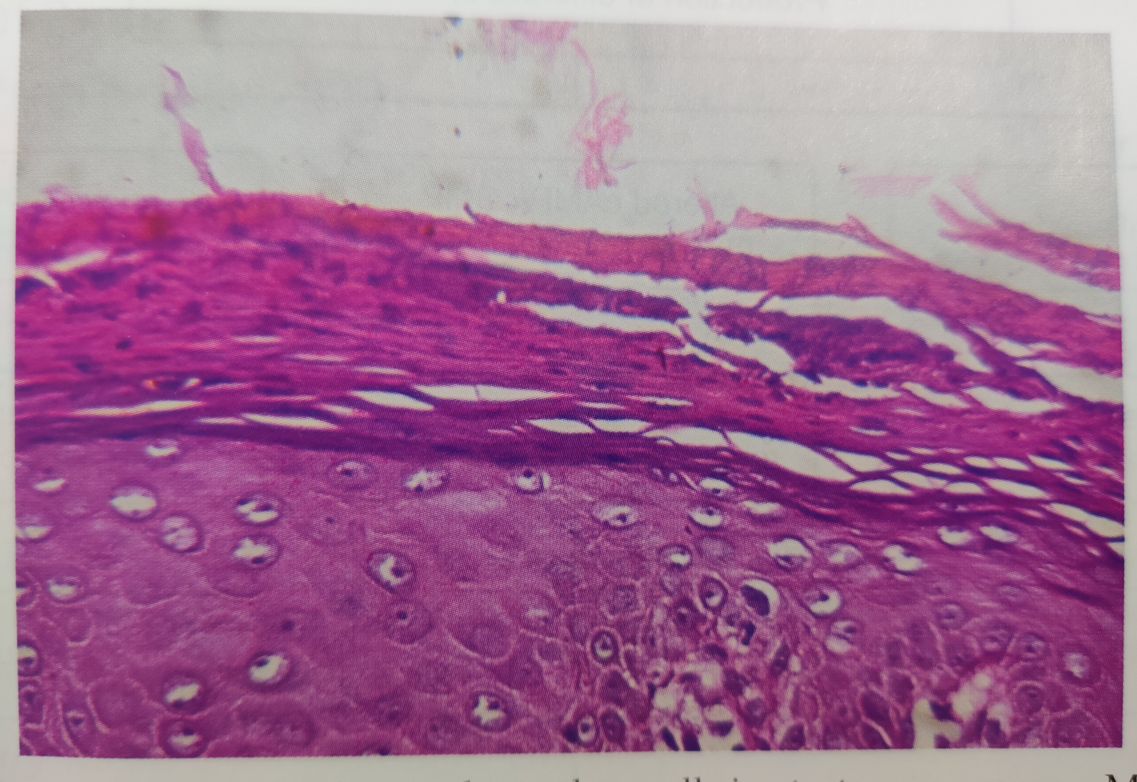
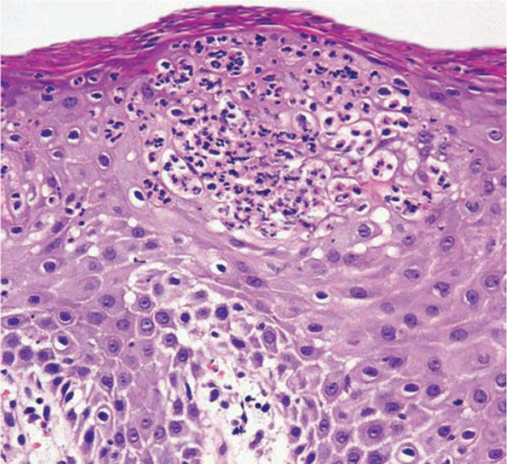
Munro’s microabscess :
Accumulation of polymorphonuclear cells in stratum corneum.
Kogoj’s pustules :
Accumulation of polymorphonuclear cells in a sponge like network of degenerated keratinocytes in stratum granulosum.

Slide 14
This pattern is also seen in
Lichen simplex chronicus
Prurigo nodularis
Chronic dermatitis
Secondary syphilis
Sarcoidosis
Pityriasis rubra pilaris
Erythroderma
Seborrheic dermatitis

Slide 15
SPONGIOTIC
This eczematous tissue reaction is characterized by :
- Intercellular edema between keratinocytes of the spinous layer leading to stretching of their intercellular bridges
- Spongiotic vesicles
- Exocytosis of inflammatory cells
- Parakeratosis
- Dilated blood vessels in upper dermis (erythema )

Slide 16
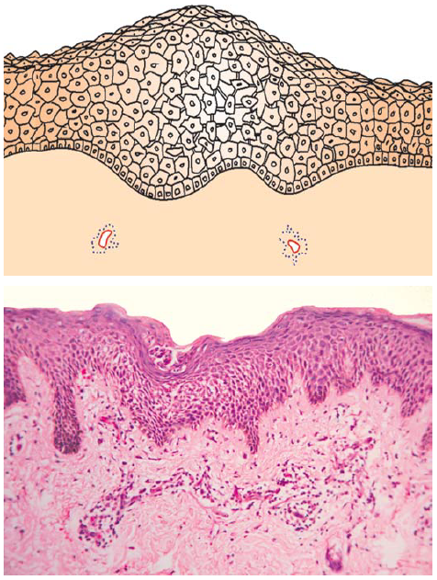
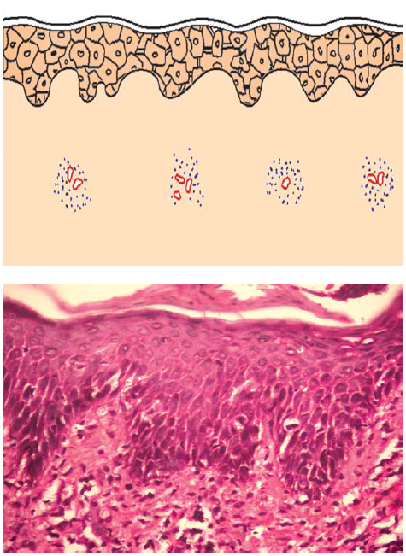
Subacute spongiotic dermatitis: Separation of keratinocytes from each other due to intercellular edema
Nummular eczema Epidermis shows hyperplasia and intercellular edema

Slide 17
Classification as per the cell type associated with spongiosis
1. Lymphocytic spongiosis
- all forms of dermatitis
- pityriasis rosea
- pleva
- insect bit reactions
2. Eosinophilic spongiosis
- pemphigus
- insect bite reaction
- pemphigoid

Slide 18
3. Spongiform pustules : spongiosis with polymorphs
- Psoriasis
- candidiasis
4. Miliarial spongiosis : spongiosis in acrosyringium
- Miliaria rubra
5 . Follicular spongiosis : spongiosis in hair follicle
- eosinophilic pustular folliculitis
- seborrheic dermatitis
- follicular eczema

Slide 19
VESICULOBULLOUS
Depending on the level of bulla
1.Intraepidermal bullous disease
- Suprabasal (above basal layer) : Pemphigus vulgaris
- Subcorneal (below stratum corneum) : Pemphigus foliaceous
: Subcorneal pustular dermatoses
2. Subepidermal bullous disease :
- Bullous pemphigoid
- Herpes gestationis
- Dermatitis herpetiformis

Slide 20
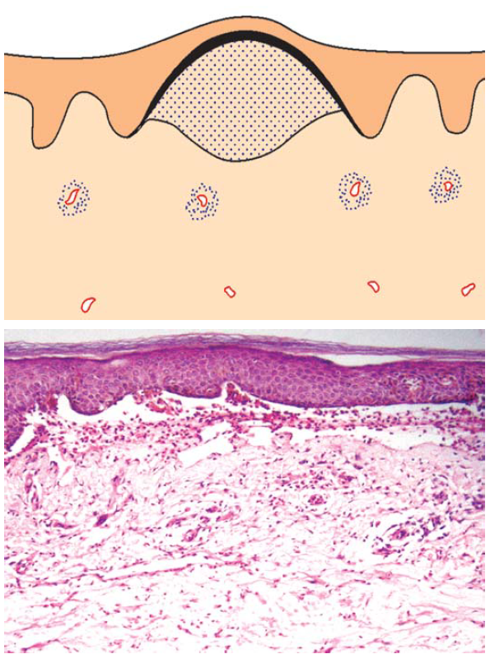
SUBEPIDERMAL VESICULAR
DEMATITIS
Bullous pemphigoid: Subepidermal blister containing multiple eosinophils

Slide 21
Differential diagnosis
No infiltrate :
Toxic epidermal necrolysis and Stevens–Johnson syndrome
Epidermolysis bullosa
Blister due to physical causes, e.g. suction, pressure, burns
Lymphocytes prominent:
Erythema multiforme
Epidermolysis bullosa acquisita
Eosinophils prominent:
Bullous pemphigoid, herpes gestationis
Insect bite reaction
Neutrophils prominent:
Dermatitis herpetiformis, linear IgA disease
Cicatricial pemphigoid

Slide 22
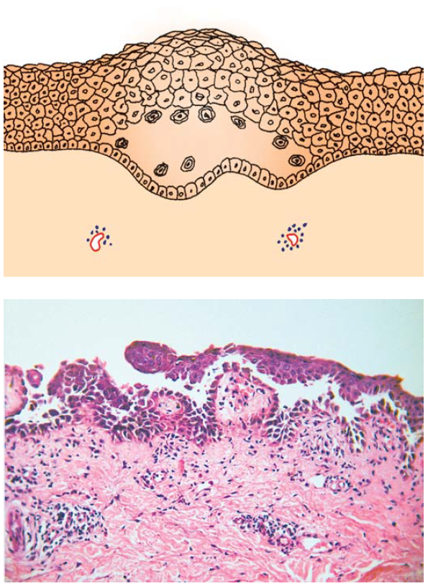
INTRAEPIDERMAL VESICULAR AND PUSTULAR DERMATITIS (ACANTHOLYTIC = TZANCK CELLS)
Blister within the epidermis containing acantholytic cells with or without inflammatory cells
Periphery of blister shows spongiosis or acantholytic dyskeratosis
Pemphigus vulgaris :
Suprabasal cleft with acantholytic cells. Tombstone appearance of basal cells .

Slide 23
Differential diagnosis
Upper epidermal Suprabasal
- Pemphigus foliaceus - Pemphigus vulgaris
Impetigo - Pemphigus vegetans
Bullous impetigo - Hailey–Hailey disease
Staphylococcal scalded skin syndrome - Darier’s disease

Slide 24
INTRAEPIDERMAL VESICULAR AND PUSTULAR DERMATITIS (BALLOONING)
Superficial perivascular and intraepidermal infiltration of inflammatory cells
Intracellular edema of keratinocytes of the spinous layer leading to swollen and pale spinous cells (ballooning)
Rupture of the ballooned keratinocytes forming large spaces lined by their walls or later leading to intraepidermal vesicle or pustule containing inflammatory cells

Slide 25
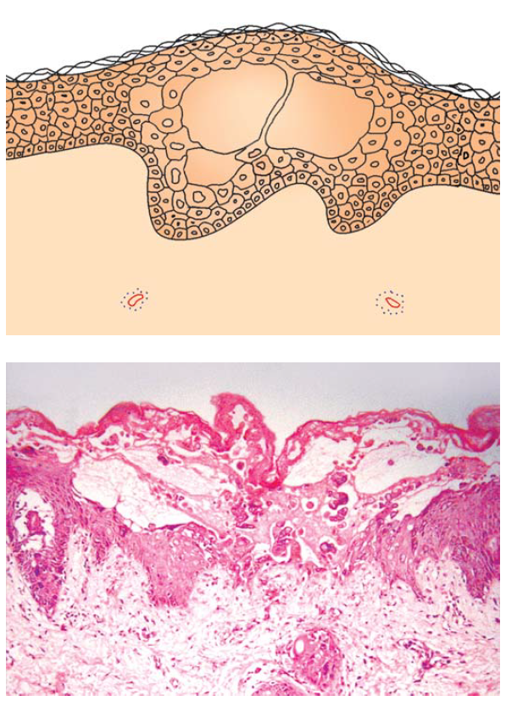
Herpes virus infection: Intraepidermal vesicle containing ballooned keratinocytes and a few multinucleated epithelial giant cells

Slide 26
Differential diagnosis
Herpes virus infections
Irritant contact dermatitis
Phototoxic dermatitis
Pityriasis lichenoides et varioliformis acuta

Slide 27
INTERFACE DERMATITIS
It is a term used to denote cellular and tissue changes at the dermoepidermal junction. Primary changes of which include :
Basal cell vacuolation
Apoptosis of cells resulting in colloid bodies and necrotic keratinocytes
Infiltrate at dermoepidermal junction which often obscures it.

Slide 28
Interface dermatitis is classified into two types
Lichenoid type :
Band like infiltrate is predominant. Eg lichen planus
2. Vacuolar type :
vacuolation of keratinocytes is predominant .
Eg erythema multiforme , PLEVA

Slide 29
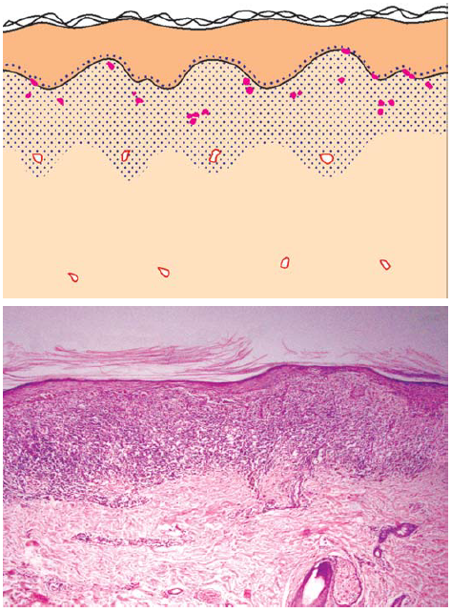
LICHENOID
Dense band-like collection of inflammatory cells hugging the interface
Dermoepidermal junction may be obscured .

Slide 30
Differential diagnosis
Lichen planus
Drug induced lichenoid eruptions
Lichen striatus
Lichen nitidus
Dermatomyositis
Graft versus host disease

Slide 31
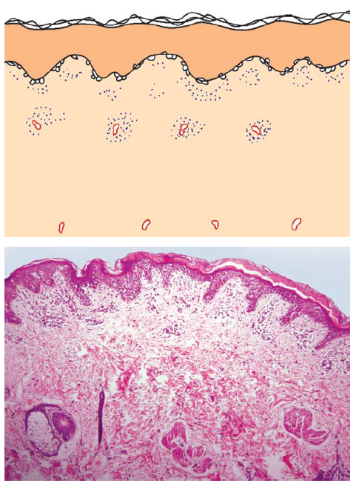
VACUOLAR
Vacuolization of basal cell layer, colloid bodies
Pigment incontinence
Pityriasis lichenoides chronica: Superficial perivascular lymphocytic infiltrate. Vacuolar interface is seen at dermoepidermal junction.

Slide 32
Differential diagnosis
Erythema multiforme
Stevens–Johnson syndrome
Toxic epidermal necrolysis
Pityriasis lichenoides acuta and chronica
Drug eruption
Viral exanthem

Slide 33
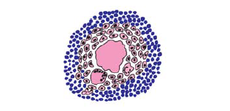
GRANULOMA
Granuloma is a biological response of the mononuclear phagocytic system to partially soluble antigen (micro organism , foreign body).
Morphologically, it is seen as
a focal accumulation of macrophages (or its derivative – epitheloid cell , giant cell , foam cell)
with other inflammatory cells (lymphocytes, eosinophils , plasma cells , polymorphs) and
connective tissue elements (blood vessels , connective tissue changes)

Slide 34
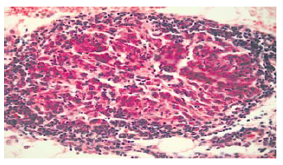
Classification of granuloma
EPITHELOID CELL GRANULOMA
1] Tuberculoid granuloma
Leprosy (TT and BT)
Tuberculosis (lupus vulgaris, tuberculosis verrucosa cutis, and scrofuloderma)
Syphilis (late secondary and tertiary)

Slide 35
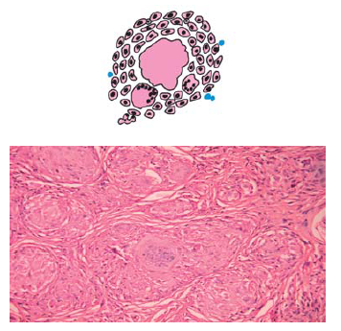
2] Sarcoid granuloma
Sarcoidosis
Foreign body granuloma (late)
Tuberculoid leprosy
Syphilis (secondary)
Sarcoidosis: Nodular collections of epithelioid cells without a mantle of lymphocytes

Slide 36
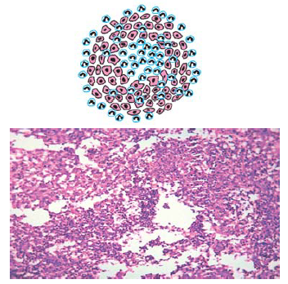
B.MACROPHAGE GRANULOMA
1] Diffuse macrophage infiltration
- cutaneous leshmaniasis
- lepromatous leprosy
2] Suppurative granuloma : consisting of lymphocytes, epithelioid histiocytes mixed with neutrophils

Slide 37
- Infections:
Bacterial: Scrofuloderma
Atypical mycobacteriosis
Actinomycetoma
Fungal: Chromoblastomycosis
Sporotrichosis
Rhinosporidiosis Foreign body granuloma (early)
3] Xanthogranulomas
- Infective : lepromatous leprosy
- Non infective : Juvenile xanthogranuloma
Necrobiotic xanthogranuloma

Slide 38
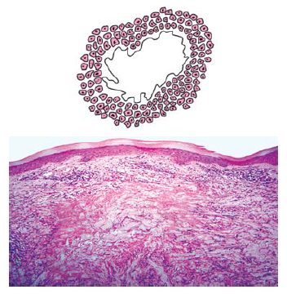
C. PALISADING (NECROBIOTIC) GRANULOMA
Nodular collection of histiocytes forming a ring around some extracellular material
1.Granuloma annulare
2.Necrobiosis lipoidica
3.Rheumatoid nodule
4.Syphilis
5.Foreign body

Slide 39
VASCULITIS
Damage to vessel wall leading to hyalinization of vessel wall
Focal infiltration of vessel wall by inflammatory cells
Deposition of fibrinoid (fibrin , complements and immunoglobulins) in and around vessel
Extravasation of RBCs
Presence of nuclear dust (remnants of nuclei seen as bluish particles scattered in dermis)

Slide 40
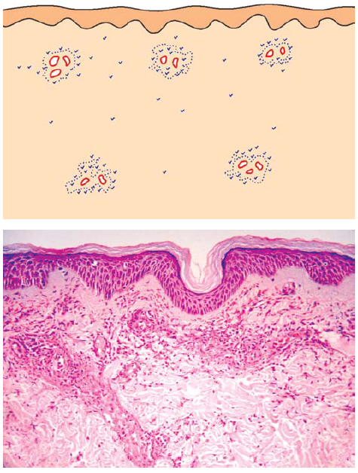
Small vessel vasculitis
Leukocytoclastic vasculitis: Perivascular and
interstitial neutrophilic infiltrate along with fibrin deposition and extravasation of RBC’s

Slide 41
Differential diagnosis
- Erythema nodosum leprosum
- Hypersensitivity vasculitis
- Septic vasculitis
- Urticarial vasculitis
- Erythema elevatum diutinum

Slide 42
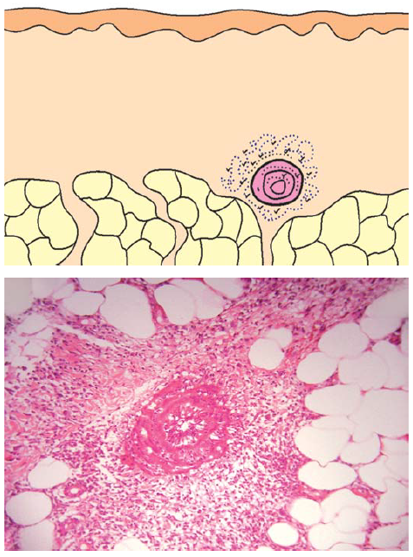
Medium-sized vessel vasculitis
Erythema induratum: A medium sized vessel in the subcutaneous tissue infiltrated by neutrophils with fibrin deposition in the wall

Slide 43
Differential diagnosis
Erythema induratum
Erythema nodosum leprosum
Thrombophlebitis
Polyarteritis nodosa
Wegener’s granulomatosis

Slide 44
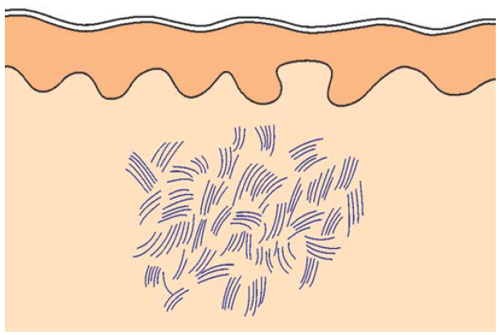
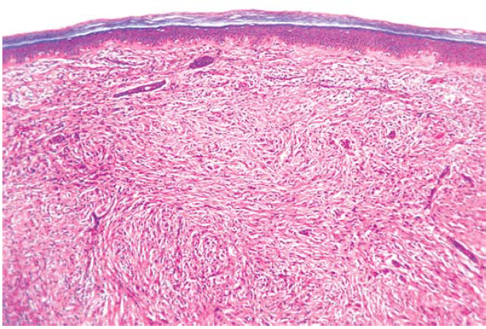
FIBROSING DERMATITIS
Hallmark features are changes in connective tissue
- collagen fibres
- elastic fibres
- fibroblast.
Scar: Dense diffuse infiltrate of fibrocytes throughout the dermis

Slide 45
FIBROSIS SCLEROSIS
Proliferation of fibroblasts Proliferation of collagen fibres
+ collagen fibres + decrease in number of fibro
+ loss of elastic fibres blasts .
Eg : scar eg : striae
hypertrophic scar systemic sclerosis /
keloid morphea
dermatofibroma lichen sclerosus et atrophicus

Slide 46
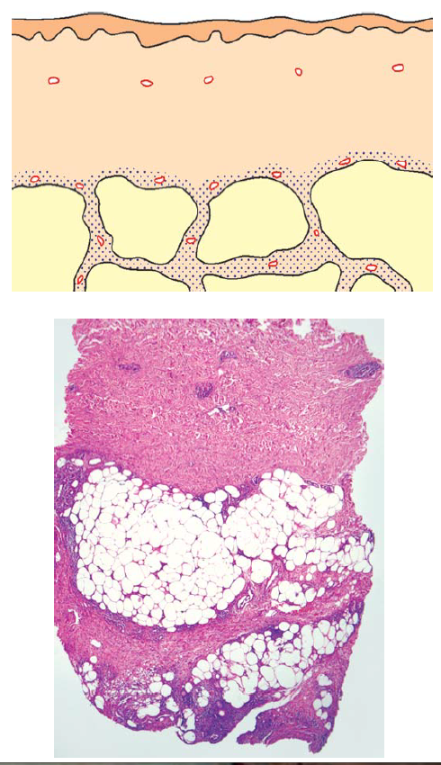
PANNICULITIS (SEPTAL)
Inflammatory infiltrate involving the septae which may get thickened
Erythema nodosum : Inflammatory infiltrate in the septae of subcutaneous fat and thickening of the septa

Slide 47
Differential diagnosis
Without vasculitis with vasculitis
- Erythema nodosum - Erythema nodosum
- Scleroderma leprosum
Necrobiosis lipoidica - Periarteritis nodosa
- Thrombophlebitis

Slide 48
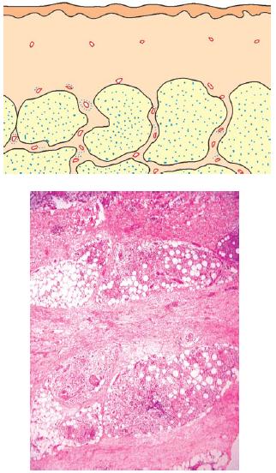
PANNICULITIS (LOBULAR)
Inflammatory infiltrates involve the fat lobules with or without fat necrosis
Erythema induratum: Inflammatory infiltrate predominantly in the fat lobules, though there is sparse infiltrate in the septae and septal thickening

Slide 49
Differential diagnosis
Without vasculitis With vasculitis
- Pancreatic panniculitis, factitial panniculitis - Erythema nodosum
- Lupus panniculitis, lupus profundus leprosum
- Tuberculous gumma, syphilitic gumma - Erythema induratum
- Traumatic panniculitis - Nodular vasculitis
- Cold panniculitis
- Abscesses
- Sarcoidosis (subcutaneous nodules)

Slide 50
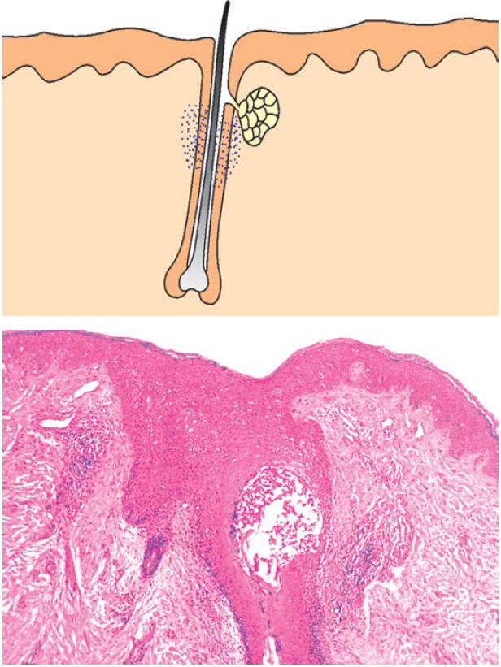
SUPPURATIVE FOLLICULITIS
Collection of neutrophils or eosinophils in and/or around the follicular infundibulum
Spongiosis of the infundibular wall
Folliculitis: Collection of neutrophils in the follicular infundibulum

Slide 51
Differential diagnosis
Superficial Deep
- Bacterial folliculitis - Furuncle
- Dermatophytic folliculitis - Dermatophytic folliculitis
- Eosinophilic pustular folliculitis - Nodulocystic acne
- Acne vulgaris - Hidradenitis suppurativa
- Rosacea
- Eosinophilic pustular folliculitis

Slide 52
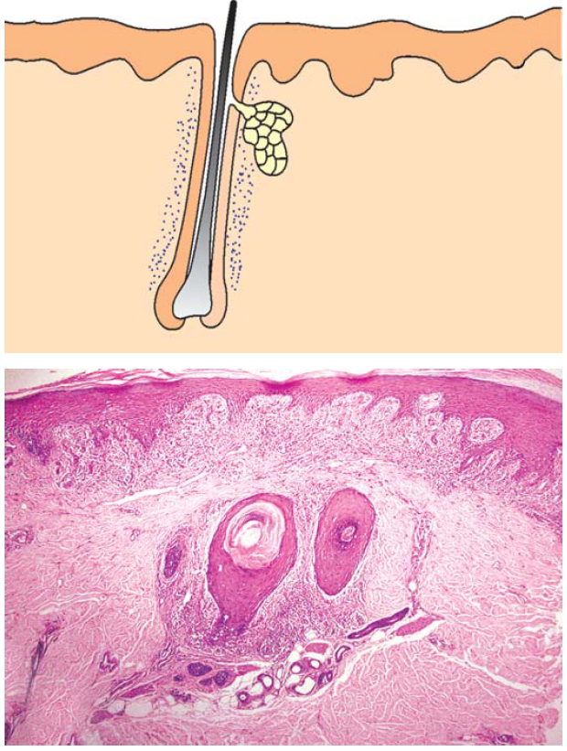
PERIFOLLICULITIS
Inflammatory infiltrate is present around the follicular infundibulum
Lichen plano pilaris:
Dense lymphocytic infiltrate around hair follicles

Slide 53
Differential diagnosis
Lymphocytes predominate : Keratosis pilaris
Phrynoderma
Follicular lichen planus
Discoid lupus erythematosus
Histiocytes predominate : Rosacea
Secondary syphilis (acneiform)
Fibrocytes predominate : Follicular lichen planus
Keratosis pilaris atrophicans

Slide 54
ALOPECIA
Reduction in the number or absence of the hair follicles
Fibrotic tracts which indicate earlier presence of the hair follicle
Arrector pilori muscles are more in number than the number of the hair follicle
Reduced number of sebaceous units

Slide 55
Differential diagnosis
Non inflammatory Inflammatory
Androgenetic alopecia
Telogen effluvium Lymphocytes Neutrophils
Trichotillomania predominant predominate
Traction alopecia - alopecia areata - Tinea capitis
- Follicular lichen planus - Folliculitis
- DLE decalvans

Slide 56
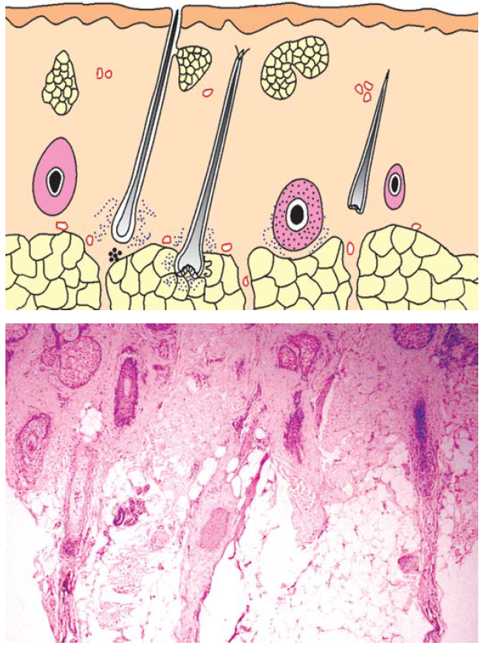
Alopecia areata : Several follicles in catagen and
sparse lymphocytic infiltrate within their fibrous tracts

Slide 57

THANK YOU

