Slide 1
PHOTOTHERAPY

Slide 2
What is phototherapy?
‘Phototherapy’ is the therapeutic use of ultraviolet radiation without exogenous photosensitiser
‘Photochemotherapy’ is the combined use of drug psoralen and UVA radiation to achieve an effect not achieved by individual components alone

Slide 3
HISTORY

Slide 4
HISTORY
Indians and Egyptians in 2000 BC used the pigment stimulating properties of Bayachee (Psorilia corylifolia) and Ammi majus respectively for the treatment of vitiligo
In 1895 modern phototherapy began when Niel Finsen used carbon arc source to treat lupus vulgaris

Slide 5
In 1923, Goeckerman and in 1953, Ingram introduced their regimes of phototherapy using Broad band UVB and coal tar and dithranol respectively.
In 1947, Fahmy , an Egyptian pharmacologist isolated psoralen from seeds of Ammi majus
Parish, in 1970’s used psoralens plus artificial source of UVA light in treatment skin conditions

Slide 6
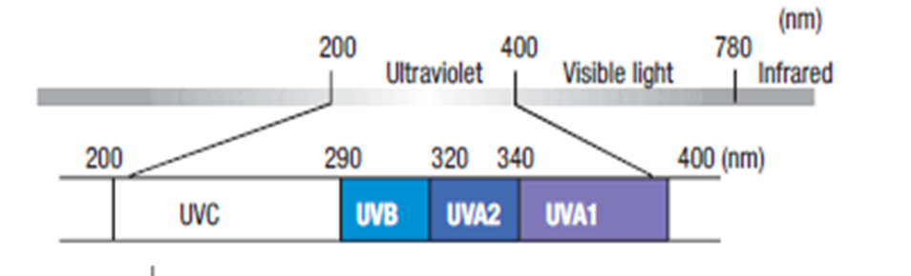
Spectrum of electromagnetic radiation

Slide 7
Various Phototherapeutic Modalities
Narrow band UV B
Broad band UV B
PUVA
UV A-1 Phototherapy
Targeted Phototherapy
Photodynamic therapy

Slide 8
NBUVB THERAPY

Slide 9
Erythemal Response
This red line represents our skin’s erythemal response (sun burning response) to Ultraviolet light.
9

Slide 10
UVB Broadband (Conventional UVB)
The blue line is the typical broadband UVB spectra. Notice that a lot of the BB UVB spectrum overlaps our erythemal response curve and hence causes significant undesired burning.
10

Slide 11
UVB Narrow Band
The green line is UVB Narrow Band. Note that very little of it’s output overlaps with our erythemal response curve and therefore cause very little burning.
11

Slide 12
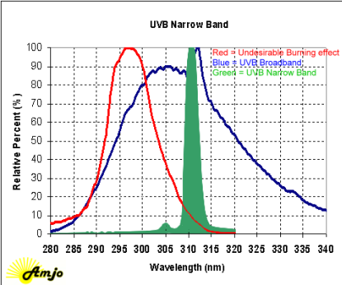

Slide 13
THERAPEUTIC SPECTRUM
Philips model TL-01 fluorescent bulbs are used which emit UVB in the range of 310 to 315 nm with a peak at 312nm
Reduction in the erythmogenic wavelenghts (290-305nm)
5-6 folds increased emission of longer UVB wavelength

Slide 14
MECHANISM OF ACTION
NBUVB radiation is absorbed by DNA and urocanic acid in the skin and lowers antigen presenting cell activity.
In psoriasis it lowers peripheral natiral killer cell activity, lymphocyte proliferation and immune regulatory cytokine production by Th1 ( IL-2, IFN-g) and Th2 (IL-10) cells

Slide 15
In vitiligo
Stabilization of the depigmenting process.
Stimulation of residual follicular melanocytes

Slide 16
Stimulates dopa-negative, amelanotic melanocytes in the outer hair root sheath to proliferate, produce melanin and migrate outward to adjacent depigmented skin resulting in perifollicular repigmentation.

Slide 17
NBUVB UNIT
Whole body chambers
  TL-01 tubes
  Tl-o1 tubes in combination with UVA tubes
Small area treatment equipment
  Hand and foot unit
  NBUVB comb

Slide 18
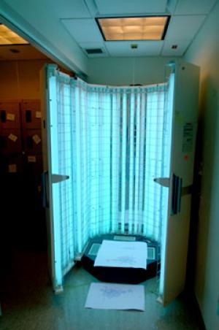
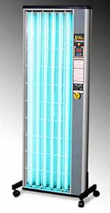

Slide 19
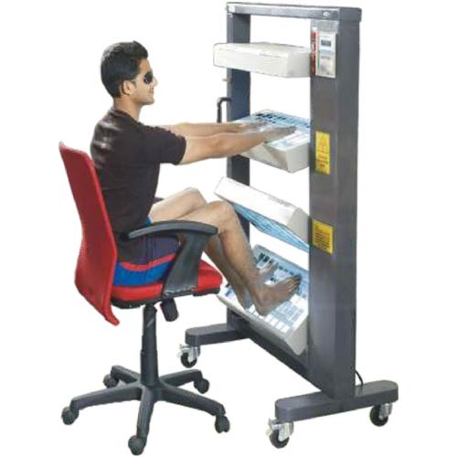

Slide 20
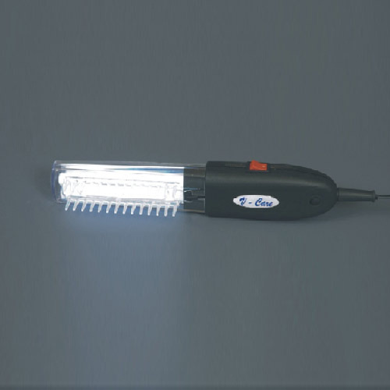

Slide 21
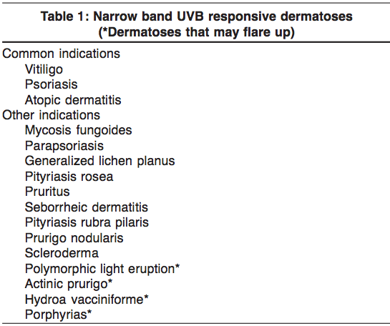
INDICATIONS

Slide 22
VITILIGO
Westerhorf and Krobotova in 1997 first reported the use of nbuvb in the treatment of vitiligo.
In their study, 67% of pts undergoing nbuvb showed repigmentation compared with 46% of pts receiving topical PUVA aftre 4 months of therapy.

Slide 23
In an open trial conducted in 2000, 51 children with generalized vitiligo were treated twice weekly with nbuvb for a maximum period of 1 year
In 53% of pts, there was more than 75% overall repigmentation and stabilization of the disease in 80% of pts

Slide 24
In a meta-analysis of non surgical therapies in generalized vitiligo by Njoo et al, higher success rates were observed with nbuvb (63%) as compared to oral PUVA (51%).

Slide 25
Advantages over PUVA
  Lack of psoralen related side effects
  No need fo day long eye protection
  Cosmetically better colour match
  Safe in children

Slide 26
However, the relative stability of nbuvb over PUVA , maximum safe duration and cumulative dose remain to be determined.

Slide 27
PSORIASIS
Nbuvb has a higher ratio of therapeutic to erythmogenic activity

Slide 28
Benefits of narrowband UVB treatment when compared to broadband UVB
Faster clinical response
More complete clinical response of psoriatic plaques
Shorter period of exposure
needed
Longer periods of remission from symptoms
Lower cumulative dose
of UVB
Minimises potential side effects like redness and itching

Slide 29
Nbuvb is equivalent or nearly equivalent to Puva without the inconvenience and toxicity of psoralens

Slide 30
Advantages of NBUVB compared to PUVA therapy
NO OR MINIMAL RISK OF CARCINOGENESIS
SAFETY IN CHILDREN AND PREGNANCY AND LACTATION
DEVOID OF DRUG RELATED SIDE EFFECTS
DOES NOT REQUIRE PHOTOPROTECTIVE SPECTACLE USE POST-TREATMENT

Slide 31
DOSING SCHEDULE
Goal of the therapy is to achieve persistent asymptomatic erythema

Slide 32
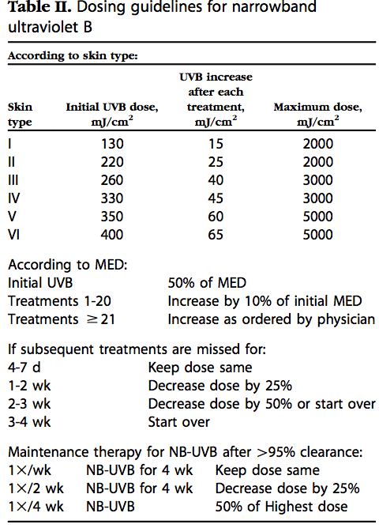

Slide 33
MED
Expose six 1 cm2 areas of skin on the inner aspect of forearm or lower back to gradually increasing amounts of UV radiation
24 hrs later, these areas are examined and the smallest UV dose that results in uniform erythema is considered as the MED

Slide 34
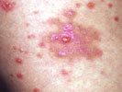
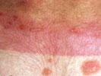
Complications of treatment
Acute complications include:
Acute sunburn effect: tender erythema & /or pruritus
Ocular toxicity: photokeratitis causing grittiness, pain, photophobia, tearing & blepharospasm
Polymorphous light eruption
Blisters: NB-UVB may rarely cause lesional bullae
Herpes simplex (treat with aciclovir and cover affected area)
Lesional blisters
Localised burn

Slide 35
Worsening skin disease
  Koebnerisation from erythema is treated with more UVB
  If due to photo-aggravation, UVB may have to be discontinued
Long-term complications include:
  Photo-ageing:
    Wrinkling, freckling, xerosis, telangiectasia, elastosis & atrophy
  Skin cancer:
    Solar keratoses, squamous cell carcinoma, basal cell carcinoma & melanoma

Slide 36
Combination regimens with NBUVB
Topical corticosteroids
Calcipotriol
Tazarotene
Psoralens
Methotrexate
Acitretin
Emollients

Slide 37
PUVA THERAPY
ORAL
TOPICAL

Slide 38
PUVA Phototherapy
Psoralen plus UVA photo chemotherapy is the photochemical interaction between a psoralen medication and UVA radiation
The drug psoralen has no therapeutic effect by itself and produces an effect only when the patient is exposed to UVA radiation
Beneficial therapeutic effect is seen in Psoriasis, vitiligo and many other dermatoses

Slide 39
Mechanism of Action
(in Psoriasis)
. In the normal skin or in the skin of psoriatic patients, psoralen induced skin photosensitization involves two distinct types of reactions occurring independently of each other and concurrently when psoralen treated skin is exposed to 320 - 400nm radiation.

Slide 40
Mechanism of action
Two types of reactions
Type 2
(Minor)
The formation of O2 reactive species which bring about oxidation of cellular lipoproteins and membrane lipids
Type 1
(Major )
-Anoxic reaction
-damages DNA by formation of photoadducts with pyrmidine basesand cross linking of adjacent strands

Slide 41
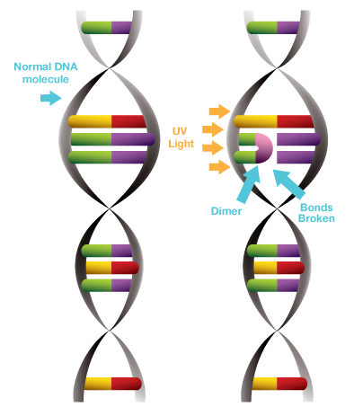
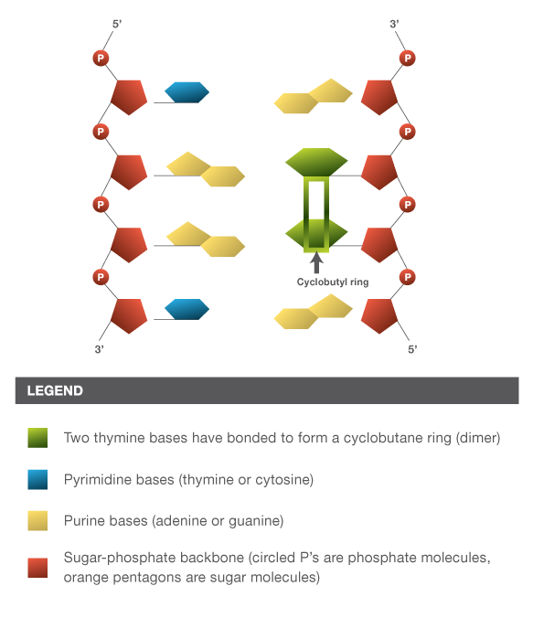

Slide 42
Sites of reaction
a) Cell nuclei (DNA and chromatin)
b) Cell membrane of the epidermal, dermal and endothelial cells
c) Cytoplasmic constituents (enzymes, RNA, lysosomes etc.)
d) Membrane lipids involving a photodynamic reaction and the production of reactive oxygen species.

Slide 43
Also , PUVA Photochemotherapy causes immunosuppression by
Decreasing the langerhans cells in the skin
Decreasing the natural killer cells
Decreased activated T lymphocytes and the cytokines produced by Th1 and Th2 cells

Slide 44
Mechanism of action
(in vititligo)
Increases the number of functional melanocytes by activating the dormant melanocytes
Causes hypertrophy of the existing melanocytes and increases their arborization
Augments the development of melanosomes and increases their transfer to melanocytes
Stimulates of tyrosinase activity
Enhances migration of activated melanocytes fro skin appendages

Slide 45
ORAL PUVA

Slide 46
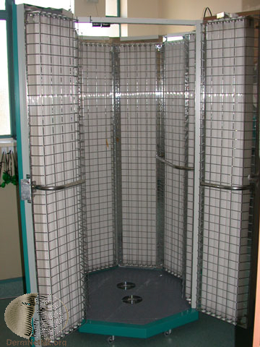
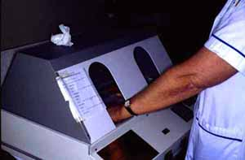
Oral PUVA
The source of UVA are fluorescent lamps or high pressure halide metal lamps
UVA doses are given in J/sqcm
8 MOP in dose of 0.6 mg/kg given followed by UVA exposure after 2 hours

Slide 47
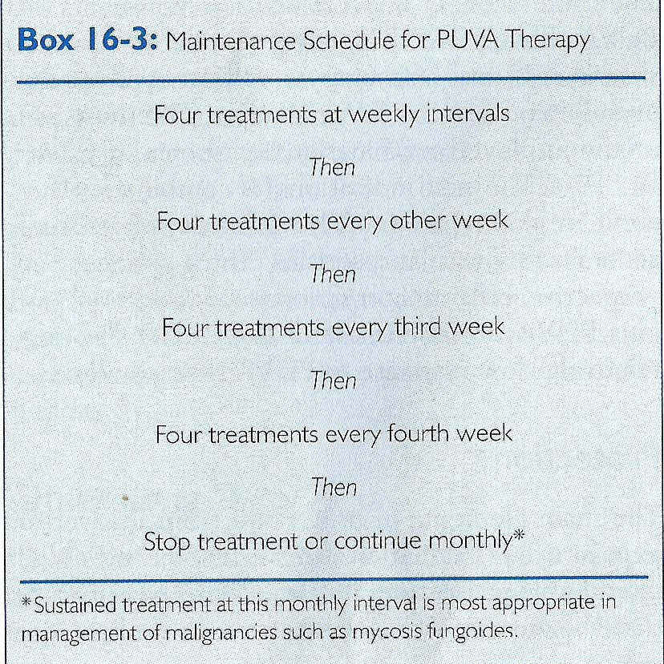
Clearance Schedule
Maintenance Schedule
Treatments are given 2-3 times weekly at least 48 hours apart
If erythema is present and is widespread , treatment should be stopped until it clears
When 95% or more of the original area of psoriasis has cleared the the patient is changed to a maintenance schedule

Slide 48
Recommendations regarding
PUVA Therapy
Treatment is given for 2-3 times/week for 12-24 months
Maximum number of sittings : 150-200
Maximum safe cummulative dose proposed : 1000-1500 J/sq.cm
Beyond 200 treatment sessions, there is approximately 10 fold increase in risk of squamous cell carcinoma

Slide 49
SIDE EFFECTS

Slide 50
Short term side effects of PUVA
Phototoxic reactions
  Symptomatic erythema
  Pruritus
  Subacute phototoxicity
  Photoonycholysis
  Koebner phenomenon
  Friction blisters on hands and feet
  Ankle edema
  Hypertrichosis

Slide 51
Due to Methoxsalen alone
  Gastrointestinal disturbances
  CNS disturbances
  Bronchoconstriction
  Hepatic toxicity
  Drug fever
  Exanthems
Others
  Cardiovascular stress
  Herpes simplex recurrence
  Photosensitive eruptions

Slide 52
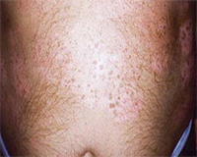

Long term side effects of PUVA
Photoageing :Wrinkling, freckling, xerosis,
Skin cancer: Solar keratoses, squamous cell carcinoma, basal cell carcinoma & melanoma

Slide 53
Generalised erythema should result in changes to the schedule.
No erythema: dose according to schedule
Asymptomatic erythema (pink): hold at previous dose
Symptomatic but subsided erythema (red): reduce by 10%
Erythema and tenderness still present: withhold treatment and then reduce by 10%
Marked pain or blistering: withhold, and then reduce by 25%

Slide 54
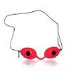
Risk to Eye with PUVA therapy
Eye protection with UVA-blocking solar shields is recommended on the day of PUVA treatment (1)
A recent study suggests :
  Psoralen plus ultraviolet A does not increase the risk of cataracts.
  There is no significant increase in risk of either visual impairment or cataract with exposure to increasing numbers of PUVA therapy sessions.(2)
(1) INT J DERMATOL 1995 NOV
(2)J AM ACAD DERMATOL ,AUGUST 2007

Slide 55
Topical PUVA
Application of 8 MOP cream or lotion for half an hour followed by UV rays for 2-5 minutes
Indication:BSA <10%
Mechanism :- psoralens penetrate into the skin and form photoadducts with DNA and inhibit epidermal DNA synthesis

Slide 56
Advantages:
  Side effects of oral intake of drugs avoided
  Eye protection not required
Disadvantages:
  Irregular patches of unacceptable hyperpigmentation
  Tedious application if patches are many in number
  Phototoxic reactions like erythema and blistering are more

Slide 57
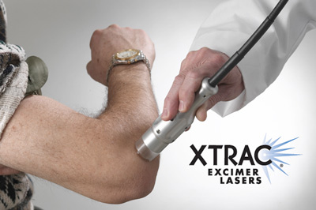
Targeted Phototherapy
Targeted UV therapy results in
less toxicity, fewer treatments,
and a lower cumulative UV dose
when compared with whole-body phototherapy
The Excimer laser is an example of a targeted phototherapy unit available for psoriasis treatment
Particularly useful in:
  Localized lesions involving less than 10% of body surface area
  Small children
  Non-exposed sites (scalp, ears, axillae, groin, intergluteal cleft)
  Resistant sites (elbows and knees, lower legs and ankles, chronic lesions induced by trauma known as koebner lesions, palms with thin lesions)
  Situations in which more accurate dosimetry is important
J Am Acad Dermatol 2011

Slide 58
Advantages
Exposure of involved area only hence less phototoxic side effects
Quick delivery of energy and shortened duration of treatment
Maeuverable hand piece allows treatment of difficult areas
Limits unsightly tanning of normal skin
Induced rates of repigmentation seem to be higher than NBUVB
Machine occupies less space

Slide 59
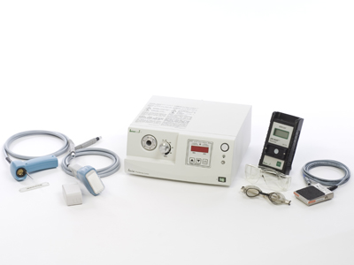
Disadvantages
Higher cost of machine
Large areas cannot be treated

Slide 60
THANK YOU!!!

