Slide 1
PSYCHOCUTANEOUS DISORDERS

Slide 2
CLASSIFICATION

Slide 3
Psychiatric disorders without significant dermatological disease
1.1. Delusional syndromes
Parasitosis
Smell
Impregnation and contamination
1.2 Disorders of awareness of the body
Phobias and obsessive compulsive disorders
Disorders of body image: body dysmorphic disorder (BDD)
Disturbance of body size and eating, e.g. anorexia nervosa, bulimia
Phobias, e.g. mole phobia, venereophobia, wart phobia, and steroid phobia.
Obsessive – compulsive behaviours, e.g. hand washing, hair plucking
Atypical pain disorders, e.g. glossodynia, vulvodynia and scrotodynia
Other dermatologic hypochondriases: botoxophilia, tanorexia, cyberchondria.

Slide 4
2. Mental disorders and dermatological disorders
2.1 Classical psychosomatic disorders
Dermatoses in which emotional precipitating or perpetuating factors may be important
Vesicular eczema of the palms and soles
Atopic dermatitis
Seborrhoeic dermatitis
Psoriasis
Some cases of localized or generalized pruritus
Alopecia areata
Aphthosis
Flushing reactions and rosacea
Hyperhidrosis
Urticarias

Slide 5
2.2. Dermatoses primarily factitious in origin
Dermatitis factitia
Artefact by proxy
Witchcraft syndrome
Dermatological pathomimicry
Dermatitis simulata
Malingering
Compensation neurosis
Munchausen’s syndrome
Fabricated and induced illness (Munchausen’s syndrome by proxy)
Deliberate self-cutting
Self-mutilation

Slide 6
2.3 Dermatosis in association with harmful habits and compulsions
Lichen simplex
Neurotic excoriations
Prurigo nodularis
Acne excoriee
Hair plucking
Trichotillomania
Trichophagia
Nail destruction
Onychotillomania
Lip-licking cheilitis
Knuckle biting

Slide 7
2.4 The psychogenic purpura syndromes
Autoerythrocyte sensitization (Gardner-Diamond syndrome)
Autosensitivity to DNA
Psychogenic purpura (idiopathic)
Stigmata
2.5 Disorders of neglect of self-care (synonym Diogenes syndrome)
2.6 Drug-dependence syndromes
Alcohol-related syndromes
Substance abuse
2.7 Mental disorders due to dermatological treatment
Cortisone psychosis
Interferon depression
2.8 Dermatological disorders due to psychopharmcological treatment
Lithium-induced psoriasis
Tranquillizer hyperpigmentation
Anti-depressant hyperhidrosis

Slide 8
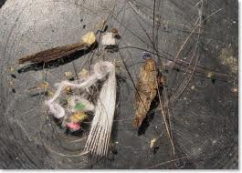
Delusion of parasitosis
Belief of being infested with parasites
Middle aged to elderly females

Slide 9
Delusions of parasitosis
The patient with delusions of parasitosis has an unshakeable conviction that his or her skin is infested by parasites
Neurological
Cerebrovascular disease
Dementia and neurodegenerative diseases
Parkinson’s disease
Huntingdon’s disease
CNS tumours
Head injury
Encephalitis
Meningitis
Multiple sclerosis
Learning disability

Slide 10
Cardiovascular disorders
Arrhythmias
Heart failure
Coronary artery bypass
Renal disease
Chronic renal failure
Dialysis
Liver disease
Hepatitis
Endocrine disease
Diabetes mellitus
Hypothyroidism
Panhypopituitarism
Hypoparathyroidism
Acromegaly
Nutritional disorders
Pellagra
Folate deficiency
Vitamin B₁₂ deficiency
Anorexia nervosa
Infectious diseases
Syphilis
AIDS
Tuberculosis (pulmonary)
Leprosy
Malignancy
Breast cancer
Colon cancer
Lung cancer
Lymphoma
Chronic lymphatic leukaemia

Slide 11
Substance abuse
Amphetamines
Cannabis
Cocaine
Ecstasy
Opiates
Medicines
Corticosteroids
Ciprofloxacin
Mefloquine
Pemoline
Phenelzine
Pargyline

Slide 12
Clinical findings
Patients present in an anxious ruminative, overwhelmed state, with history of visits to multiple physicians without satisfaction
A long and detailed history that includes visual or tactile hallucinations of the organisms
Provides evidence of the parasitic infection in the form of clothing lint, skin crusts, or other debries, the so called “matchbox sign”, which is delusionally misinterpreted as entire organisms, body parts, larvae, or ova.
Lesions ranging from mild excoriations to large ulcers may reflect patients unsuccessful attempts at treating the perceived infestation.

Slide 13
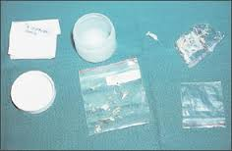
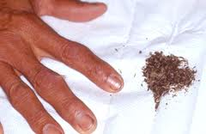

Slide 14
Differential diagnosis of delusions of parasitosis
Dermatologic | Systemic | Psychiatric
Chronic folliculitis | Dementia | Cocaine use
Insect bite reactions | Malignancy (brain) | Amphetamine use
Dermatitis artefacta | Cerebrovascular disease | Psychotic-spectrum illness
Dermatitis para-artefacta | Vitamin B12 deficiency | Affective disorder

Slide 15
Treatment
The critical tenet of treatment is to keep the patient engaged.
Pimozide has been used historically as the drug of choice, although it is now being replaced by atypical antipsychotics, which are associated with a more favorable side effect profile.
The clinician needs to be aware of the need for monitoring for metabolic syndrome characterized by abdominal obesity, insulin resistance and impaired glucose tolerance, disturbance in lipid metabolism, hypertension and weight gain.

Slide 16
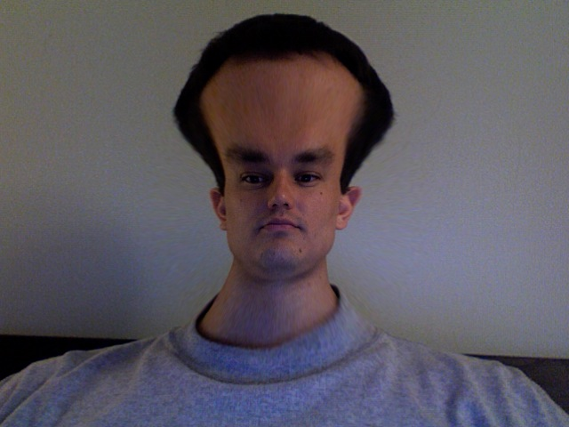
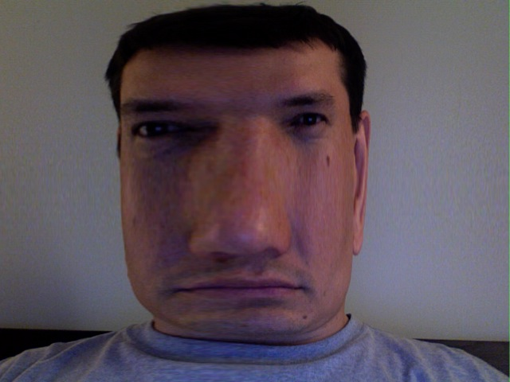
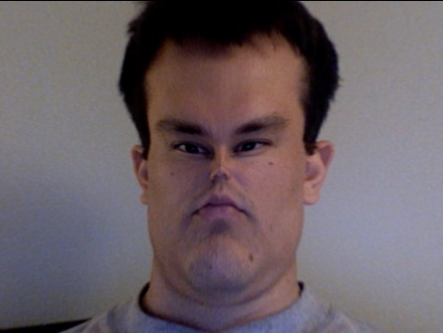
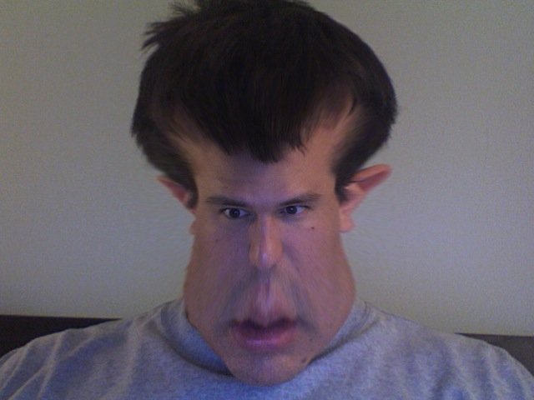

Body Dysmorphic Disorder

Slide 17
DSM-IV-TR
Diagnostic Criteria
Preoccupation with an imagined defect in appearance.
If a slight physical anomaly is present, the person’s concern is markedly excessive.
The preoccupation causes clinically significant distress or impairment in social, occupational, or other important areas of functioning.
The preoccupation is not better accounted for by another mental disorder (e.g., anorexia nervosa).
Body Dysmorphic Disorder is classified as a somatoform disorder

Slide 18
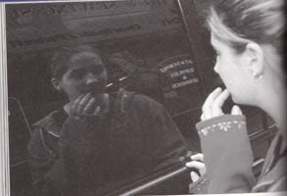
Associated Features
These behaviors may consume many hours a day:
Frequent checking | Checking in mirrors or windows (or avoiding them) | Using a magnifying glass to scrutinize the defect | Constant requests for reassurance
Excessive grooming | Hair combing or Hair removing | Skin picking | Ritualized makeup application
Behaviors aimed at improving the defect | Excessive exercise | Dieting | Frequent changing of clothes

Slide 19
Co-morbid Disorders
Body dysmorphic disorder is related to other psychiatric disorders, but because of the lack of studies preformed, it is not clear whether the following disorders predispose, cause, or coexist with BDD.
Major depressive disorder
Obsessive-compulsive disorder
Anxiety disorders, especially social phobia
Eating disorders

Slide 20
Treatment
The most common forms of treatment are:
Cognitive-Behavioral Therapy
  Individuals identify their negative thoughts and replace them with alternative beliefs
  Exposure and response prevention
Selective Serotonin-Reuptake Inhibitors:
  Selective Serotonin-Reuptake Inhibitors (SSRI’s) or antidepressant medications reduce the obsessive dysmorphic thoughts, the emotional distress, and the associated ritualistic behavior.
Treatment with only medicine proves to be ineffective, because nearly all patients who quit the medicine relapse.

Slide 21
PSYCHOGENIC PRURITUS
Represents those with intractable and persistant itch for which no pruritic physical illness or dermatological illness can be found.The psychological parameters of itch should be considered as ;
Predominant psychological pruritus classified as a somatoform or dissociative disorder.
Pruritus in dermatological illness for which psychological factors play a role in the development or course.

Slide 22
(3) Problems in coping with chronic pruritus in the sense of an adjustment disorder,so called helpless/hopelessness reactions.
(4) Co-morbidity with other psychiatric conditions ,particularly substance abuse,anxiety reactions and depression.

Slide 23
Pruritus is a multifactorial symptom. Dermatological, neurological, iatrogenic illness and internal disease are well recognised causes.
Diagnostic criteria for psychological pruritus
Localised or generalised pruritus
Chronic pruritus (>6weeks)
The absence of a somatic cause.

Slide 24
Three additional criteria from the following seven;
. A chronological relationship of pruritus with one or several life events that could have psychological repercussions.
. Variations of intensity associated with stress.
. Nocturnal variations.
. Predominance during rest of inactions.

Slide 25
. Pruritus that is improved by psychogenic drugs.
. Pruritus that is improved by psychotherapy.
Treatment :-
- Antihistamines .
- Doxepin – upto 125 mg/day
combined effect of both antipruritic and antidepressants actions.
- SSRI’s – paroxetine (20-40mg/day)
fluvoximine (100-200mg/day)
citalopram (20-40mg/day)

Slide 26

Trichotillomania
- morbid craving to pull out hair.
- Diagnostic criteria :-
A) Recurrent pulling out of ones own hair resulting in hair loss.
B) An increasing sense of tension immediately before pulling out the hair or when attempting to resist the behaviour .

Slide 27

C) Pleasure ,gratification or relief when pulling out the hair.
D) The disturbance is not better accounted for by another mental disorder.
E) The disturbance provokes clinically marked distress and impairment in occupations,social or other areas of functioning.
- Associated with –depression in 14%
anxiety disorder in 15%

Slide 28
- Commonest from scalp mostly from vertex.
- Typically the hairs are short ,irregular,broken and disorted.
- Patients use wigs,semipermanent use of hats and scarves to disguise the defects.
- Chronic folliculitis of neck, chin, chest, pubic areas or thighs may be the presenting complaints.
- Trichorhizophagia –hair root alone is eaten.
- Trichophagia –whole hair is eaten.

Slide 29
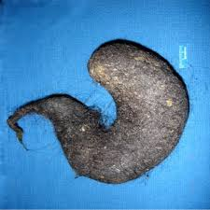
TRICHOBEZOAR
Bezoars -ball like aggregations of vegetable or fibre like materials in stomach and small intestine.
Almost exclusively seen in gills and young women.
Swallowed hair is retained within folds of gastric mucosa.

Slide 30
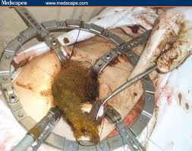
Leads to nausea, vomiting, abdominal pain, anorexia, weight loss, foul breath.
Complications –
1. intestinal bleeding.
2. pancreatitis
3. obstructive symptoms

Slide 31
Rapunzel syndrome
1.those with tricobezoar with a tail that extends atleast to the jejunum.
2.gastrointestinal obstructive symptoms more likely.
INVESTIGATIONS
Scalp biopsy-most useful
Normal growing hair amongest empty hair follicles .

Slide 32
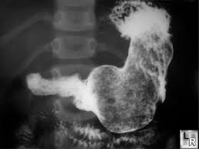
3)Hair shafts are often broken or reduced to little dark bodies.
4)Clinically ,GI bezoars –palpated as nontender, mobile mass in upper abdomen.
5)Barium contrast –filling defect in a lace-like, mottled pattern.
6)CT Scan – most accurate.
7)Gastric endoscopy-used for removal.

Slide 33

- TREATMENT
Behavioural therapy.
pharmacotherapy-Tricyclic antidepressants
SSRI

Slide 34
ONYCHOTILLOMANIA & ONYCHOPHAGIA
Compulsive habits of nail picking & nail biting.
Nail biting -usually confined to finger nails.
Nail picking -may involve all digits.
Damage to cuticle causes paronychia,nail dystrophy& longitudinal melanonychia.
In chronic cases-associated with trichotillomania.
TREATMENT
Clomipramine
Pimozide

Slide 35
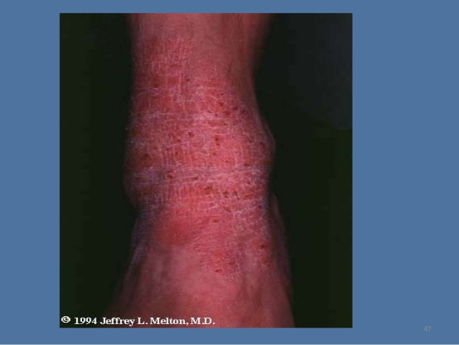
Lichen simplex and neurodermatitis
Response of the predisposed skin to repeated rubbing
Minor initiating event, such as trauma, infection or insect bite, precipitates episodic insistent scratching and rubbing. Irritability itching is the major complaint.
Prolonged spasms of uncontrollable self-damage which proceeds with increasing rapidity until the pruritus is relieved to be replaced by soreness and pain. The change from itch to pain is quite sudden and this abrupt cessation has been described as orgasm cutanee.
Characteristic thickened, coarsely grained papules and nodules with hyperpigmentation.

Slide 36
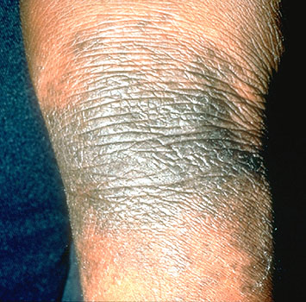
Classic sites of involvement are within easy reach, particularly on the nape and sides of the neck, elbows, thighs, knees and ankles.
Early small violaceous papules with surface excoriations to chronic areas that present as hyperkeratotic plaques with pigment changes.
Dermatological worry beads.
Treatment
Antihistamines is helpful, but antidepressants particularly tricyclic compounds such as doxepin in doses as low as 25-50 mg/day may be more effective.
Non psychotropic medication is also sometimes effectives using thalidomide 50-100 mg daily for up to 2 months at a time.

Slide 37
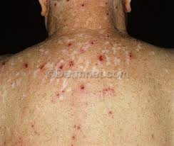
Pathological skin picking
Recurrent picking accompanied by visible tissue damage and functional impairment.
Clinical features
Lesions can be seen in all stages of development.
Clinically, the lesions are polymorphic, the newer lesions are angular excoriated erosions with a serosanguinous crust found predominantly on the face, hair margins, sides of the neck, chin, upper chest, shoulders, upper arms and thighs.
The healing lesions are erythematous, eventually becoming white and atrophic centrally and commonly hypertrophic and hyper pigmented at the periphery.
They may be quite deep, extending into dermis, and are distributed symmetrically within reach of the hands.

Slide 38
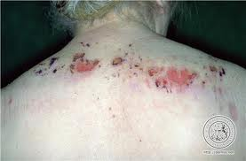
Significant bouts of cellulitis and ulceration are common, leading to hospitalization.
Older lesions show pink or red scars, some of which may be hypertrophic. Chronic lesions may also show atrophic scars, which merge and are eventually seen as linear, coalescent areas.
Lesions appear at all stages of development and may number from a few to several hundred.
Characteristically, these lesions appear as discrete islands in a seas of normal skin.

Slide 39
Differential diagnosis
It is important to exclude excoriations caused by
Generalized pruritus
Bullous diorders
Excoriated lesions
  Lichen planus
  Lupus erythematous

Slide 40
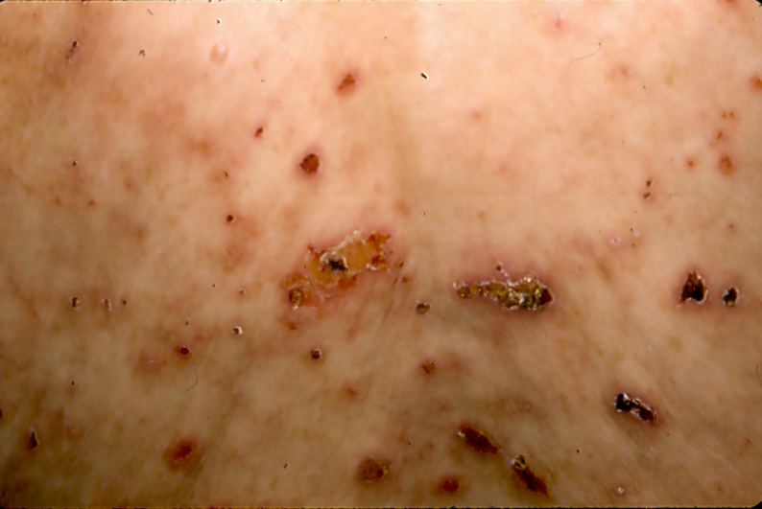
Treatment
Cognitive behavioural therapy alone has improved some patients, although the management of underlying personality difficulties may require the specific skills of a psychotherapist. Habit reversal programmes may also help.
The compulsive nature of this disorder responds well to antidepressants and in particular to serotonin re-uptake inhibitor drugs, such as fluoxetine, fuvoxamine and citalopram.
Clomipramine and dexepin have been reported to work well.

Slide 41
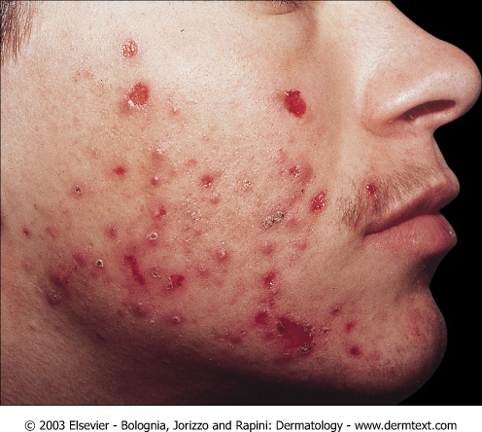
Acne excoriee
Particularly in adolescent girls under emotional stress who picked and squeezed acne lesions.
Although some patients develop these lesions after picking acne, most had no acne at all.
The condition should be considered a variant of psychogenic (neurotic) excoriation, with the lesions largely confined to the face.
.

Slide 42
Clinical lesions resemble those of chronic excoriations. They are found predominantly around the hairline, forehead, preauricular cheek and chin areas.
Extension to the neck and occipital hairline is common.
Chronic lesions characteristically show white, atrophic scarring with peripheral hyperpigmentation.
Lesions are picked as a ritual, apparently as a response to itch or throbbing. The lesions are excoriated until emptied

Slide 43
Although patients with acne excoriee sometimes respond to simple acne therapy, most require systemic antibiotics and isotretinoin.
The tetracyclines, in particular doxycycline, are better than the other antibiotics and topically the patients prefer antibiotic roll-on preparations to the benzoyl peroxide creams, which are too irritant.
Habit-reversal therapy and hypnosis has worked well but combined laser resurfacing and cognitive psychotherapy had prolonged success.

Slide 44
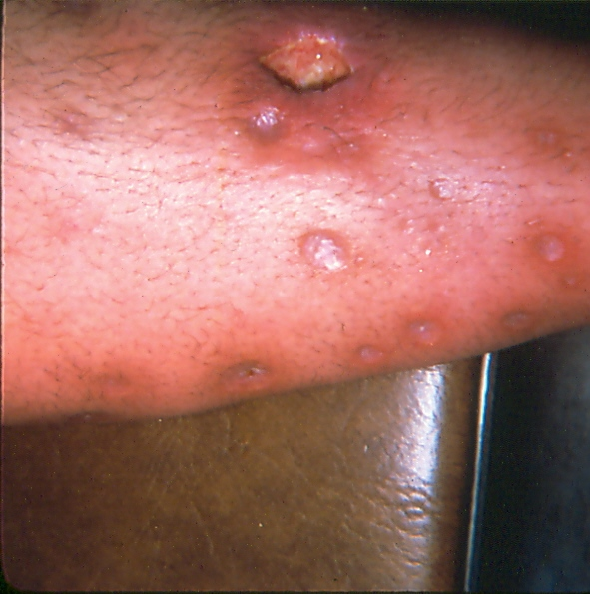
Dermatitis factitia
Caused entirely by the actions of the fully aware (i.e. not consciously impaired) patient on the skin, hair, nails or mucosae.
Female to male ratio varying from 20:1 to 4:1.
The psychopathology underlying the production of factitious lesions suggested that the patient wants the sickness role as the essential pathology since the primary gain of being a patient is usually to be suspected of all illness.
Bleaches, soaps and household cleaners are most commonly employed by women; industrial acids and automotive fluids by men.

Slide 45
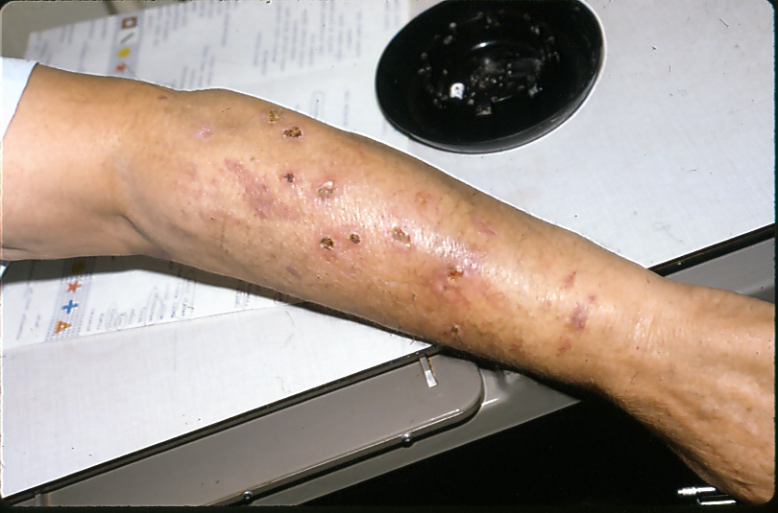
Children produce purpura on the chin by sucking on cups and on limbs by direct mouth suction or with the use of a toy or tool.
Shearing stress also produces purpura, tending to present as linear limb lesions.
Careful examination of an acute lesion may reveal the presence of a needle track where milk, air, faeces, urine, cooking oil, silicone, grease or engine oil has been injected. .
May present with a non-healing, post surgical wound.
Makeup, skin painting and application of glue have been skillfully used to simulate port-wine stains, other naevi, scaly dermatoses.

Slide 46
Differential diagnosis
Blistering, crusty lesions may simulate ecthyma, herpes simplex and bullous disorders.
Facial blisters may simulate porphyria cutanea tarda.
The collagen-vascular diseases included vasculitis and pyoderma gangrenosum must be excluded in non-healing wounds as must atypical mycobacterial infections and imported tropical infections..
Diverse hereditary sensory neuropathies can show chronic non-healing ulcers and be mistaken for factitious wounds as can the coetaneous changes of reflex sympathetic dystrophy.
Drug addicts develop extensive ulceration and scarring at injection sites after extravasation of drug ‘cocktails’ into the skin.

Slide 47
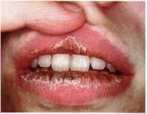
Factitious cheilitis
Commonest in girls and young women.
Simulation of cheilitis by applying a crust of paper, glue and colorant.
Role of factitious behaviour in the pathogenesis of exfoliative cheilitis
Reactions of the lips are limited and appear particularly as persistent inflammation with crusting and variable haemorrahge.
The crusts may be very thick with a succession of layers of congealed haemorrhagic exudates resembling a carapace or oyster shell.
The haemorrhage can also be impressive with coagulated blood and serum extruding over the lips. This is caused by picking, biting, rubbing and licking.

Slide 48
Differential diagnosis
Includes contact dermatitis actinic damage, chronic lip-licking habit and causes of granulomatous cheilitis.
Secondary candidiasis is common and treatment containing an antifungal

Slide 49
Factitious nail disease
Traumatic and chemical damage to both the nail and nail fold have been seen in children and adults.
Children show chronic paronychia caused by the insertion of nails, pins or splinters.
Soldiers avoiding duty have habitually used caustics to damage their fingers.
The characteristic lesions show purpura and haemorrhage around the nail fold but also subungual haemorrhage and pustules.

Slide 50
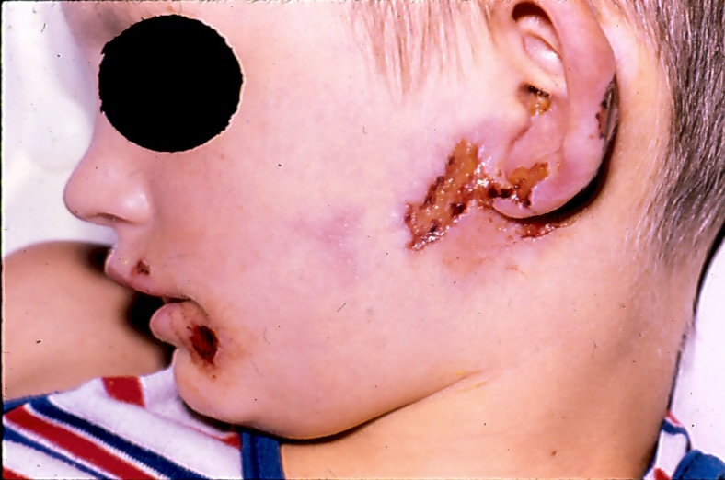
Investigations of factitious dermatitis
The primary suspicion of factitious dermatitis is clinical.
Clinical evidence is based on the physical appearance, distribution and evolution of lesions. Other clinical diagnostic clues may be seen such as the sparing of decorative marks and the areas of skin on the back.
Suspicions are aroused by the presence of physiologically impossible symptoms, observably incompatible lesions, contradictory objective evidence and non-response to reasonable treatment.
A skin biopsy will provide essential supportive information but may not be necessary in all cases such as suction purpura on the skin.

Slide 51
Lesions produced by injection into subcutaneous tissues produce deeper lesions which show as vasculitis or an odd panniculitis.
Careful examination may show injection tracts and foreign material.
Ink shows as pigment with limited inflammation, and talc excites a macrophage reaction with giant cells. Injected oils and greases produce deep continuing panniculitis.
Examination under polarized light can identify foreign material and further refinement can be found with energy dispersive X-ray analysis and infrared spectrometry.
The histopathology of factitious disease may vary with time and serial biopsy may be diagnostically helpful in sophisticated artefact because differing patterns of change may be present on each occasion.

Slide 52
Comorbidity
Twenty per cent of patients have a somatization disorder and hypochondriasis.
These are co-morbid with anxiety, depression and substance abuse.

Slide 53
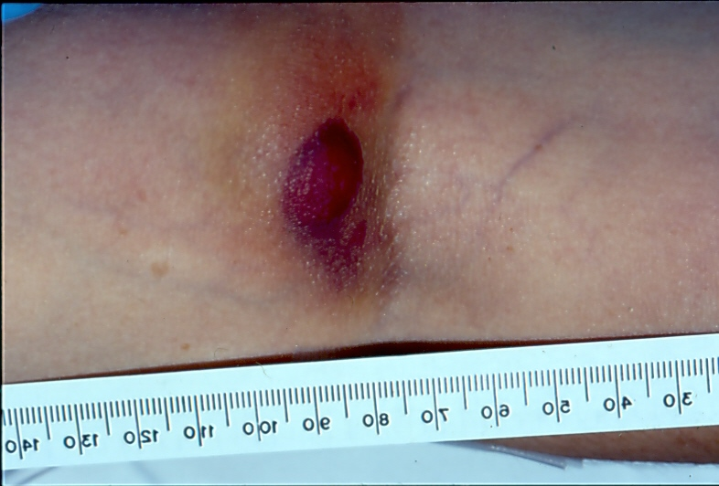
Treatment
Three therapeutic aims
First, the skin damage may be extensive, disfiguring and infected. There is always significant skin damage which will be both inflamed and infected with the potential for scarring and residual pigmentation.
Topical and systemic antibiotics, analgesics and anti inflammatories establish the doctor-patient relationship and underline to the patient that the physician has a helpful, non aggressive, sympathetic approach.

Slide 54
Secondly, time should be taken to identify the nature and extent of the psychological problem.
The psychological problems should be approached in a non intrusive manner, allowing the patient freedom to express their difficulties in a passive, confidential environment.
Thirdly, it is important to follow up the patient to establish that psychological and social factors were intrinsic to the remission.

Slide 55
The management and prognosis in adults is that of the primary psychological disorder.
Depression responds well to tricyclics, or SSRI antidepressants.

Slide 56

Dermatitis passivata
The cessation of normal skin cleansing will produce an accumulation of keratinous crusts.
Commonly seen in geriatric or demented patients.
The lesions are the result of self neglect and comprise cumulative accretions of keratin and dirty debris which forms a thick carapace with time.
Lesions are usually found on the upper central chest, over the back and accumulated as coagulated debries in the groins.
These elderly patients may be paranoid, have mood disorders or have temporofrontal dementia.
Alcohol abuse is co-factor.

Slide 57

Significant psychopathology was schizoid thought disorder and social withdrawal.
Occasionally, patients with a dissociative hysterical limb palsy will present with mild but significant hyperkeratosis on the affected limb.
Specialist psychological therapy was usually necessary either as day care or community psychiatric support.

Slide 58
Malingering
The intentional production of false or grossly exaggerated physical or psychological symptoms, motivated by external incentives such as avoiding military duty, avoiding work, seeking financial compensation, evading criminal prosecution or obtaining drugs.
Short term and opportunistic
Chronic, non-healing, post-operative scars are manipulated with instruments, or even faecal injection to maintain sepsis.
Hand dermatitis, both irritant and allergic contact may be perpetuated to seek higher compensation.

Slide 59

Cutaneous diseases and alcohol misuse
Alcohol dependence and alcohol abuse are on the increase. They rank among the three commonest psychiatric disorders in the community.
Discoid dermatitis appears to be more frequent in alcohol abusers.
Atopic dermatitis appears to be unaffected by alcohol to the same degree.
Seborrhoeic dermatitis is twice as common with alcohol abuse.
Alcohol abstinence help to induce remission of psoriasis and relapse was induced by re-consumption.

Slide 60
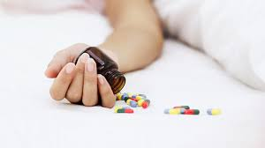
Suicide in dermatological patients
Suicide refers to a range of self-destructive behaviors ranging from a non lethal acts, which have been called suicidal gestures, attempted suicide, parasuicide and more recently self-injury, to a lethal action in which a patient dies, defined as a completed suicide.
Facial acne associated with significant risk (5.6%) of suicidal ideation.
Suicidal ideation also found in patients with Darier’s disease related to the disfigurement the intractability, social exclusion and smell of the dermatosis.

Slide 61
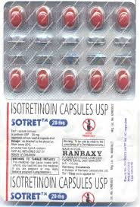
Isotretinoin and mood changes
Psychological effects include aggression, personality changes, poor concentration, tearfulness, depression, ruminations of guilt and psychosis.
Increase in frequency and/or severity with increased dosage, simulating a dose-response relationship.
Should routinely ask about mood change at each clinic visit and if indicated use a depression inventory, for example Beck Depression Inventory (BDI) or Hospital Anxiety and Depression Scale (HAD). Positive scores (BDI > 0) should prompt withdrawal of the drug and referral to the psychiatry team.

Slide 62
Drugs treatments
Antidepressants
When starting an antidepressant, it is necessary, due to the delay in therapeutic action, to counsel the patient that side effects may appear before response.
Antidepressants do need to be withdrawn gradually, but are not associated with tolerance or craving.
Antidepressants be continued for at least 6 months pas the remission of symptoms, as this helps reduce the risk of relapse.
Serotonin reputake inhibitors (SRIs, SSRIs) are now recommended as first-choice due to their relatively low side-effect profile and lower toxicity in over-dosage.
Nausea, dyspepsia and gastrointestinal upset, headache, agitation and anxiety, sweating and rashes, insomnia, and sexual dysfunction.

Slide 63
Tricyclic antidepressants
No longer recommended for first line use in depression.
Side-effects include dry mouth, blurred vision, constipation, sedation, urinary retention and postural hypotension.

Slide 64
Atypical antipsychotics
The agents of choice are the ‘atypical antipsychotics’, the more recently developed agents, which have a lower incidence of extra-pyramidal side-effects.
Other side-effects are frequent with antipsychotics, such as drowsiness and weight gain, hyperpro-lactinaemia and QT interval prolongation.
There is an association with impaired glucose tolerance with antipsychotics, especially the typical

Slide 65
Typical antipsychotics
Haloperidol has a wide range of uses, not only in psychoses, but also in tic disorders, hiccup and nausea.
Many dermatologists may have used it in the early part of their medical career to treat in the elderly in-patient.

Slide 66
Anxiolytics
The benzodiazepine anxiolytics can appear initially very effective in alleviating anxiety symptoms and states, but problems with tolerance and dependence rapidly develop, and they are frequently misused.

Slide 67
Mood stabilizers
Lithium – effective in acute mania, prophylaxis of bipolar disorder and augmentation of treatment in refractory depression. It has a narrow therapeutic index and a wide array of side effects, especially on the kidneys and thyroid, and requires careful monitoring through blood tests.It is also known for causing exacerbations of psoriasis.
Valproate
Carbamazepine

Slide 68


